Slide 1
DRTM-AD84
General 16-bit (8 Channel ADC, 4 Channel DAC Board)
Robert Meyer
Advanced Techniques in LLRF control for XFEL
Otwock-Swierk, 20.02.2013

Slide 2
Specification
RTM-Board Interface D1.0 / D1.1
8 Channel 16-bit ADC
Selectable 50Ω or 1kΩ Input impedance
Selectable 2MHz LPF for antialiasing
10MSPS Data rate
Inputbandwidth of 90MHz or 2 MHz
4 Channel 16-bit DAC
High Gain Output ±3V@50r
Low Gain Output ±1V@50r
1 MSPS direct Data rate / 16MSPS with interpolation
Independent Timing on each Channel

Slide 3
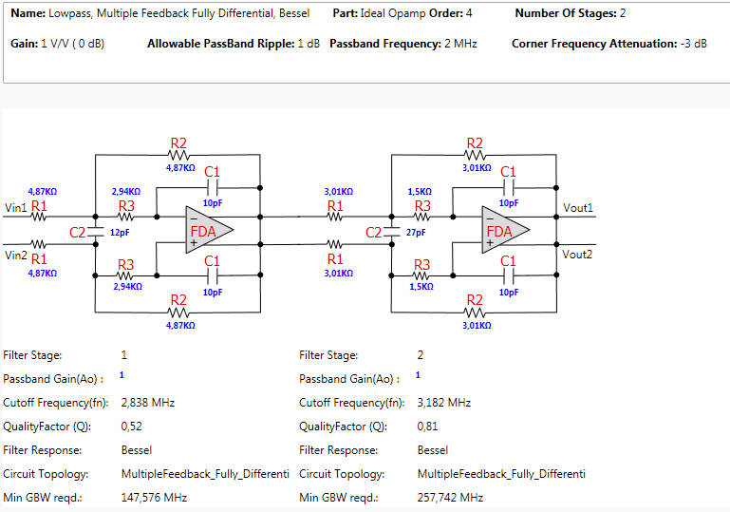
Filterstage

Slide 4
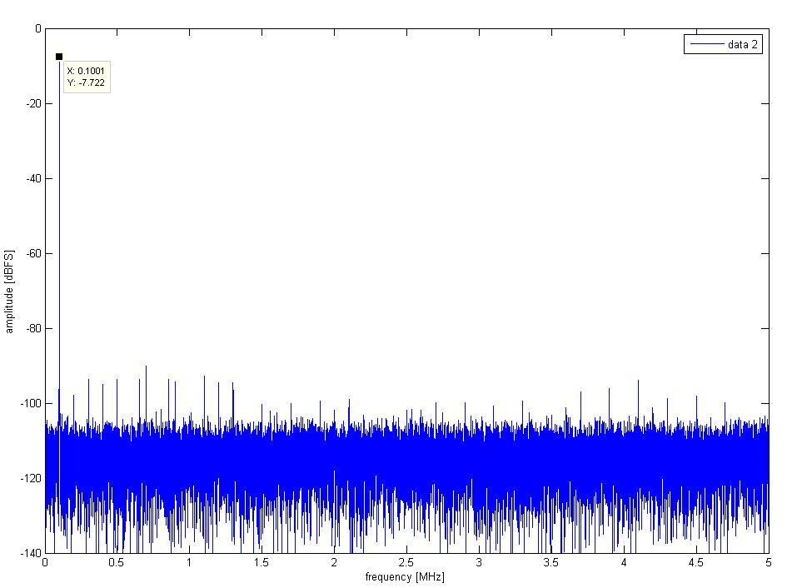
FFT on RAW-Data

Slide 5
Next Steps
Change RTM-Interface to D1.1
Change DAC-Outputfilter from Passive to Active
Improve Voltagegenaration
See how it works in “real life”

