Slide 1
Interferometer for RF synchronization Status and Plans
Dominik Sikora

Slide 2
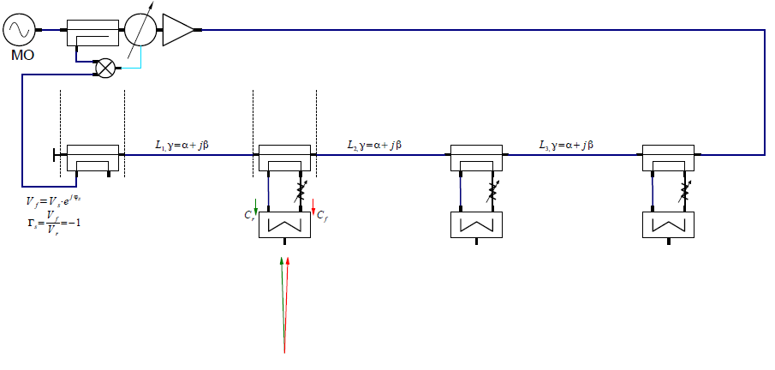
Interferometer basics

Slide 3
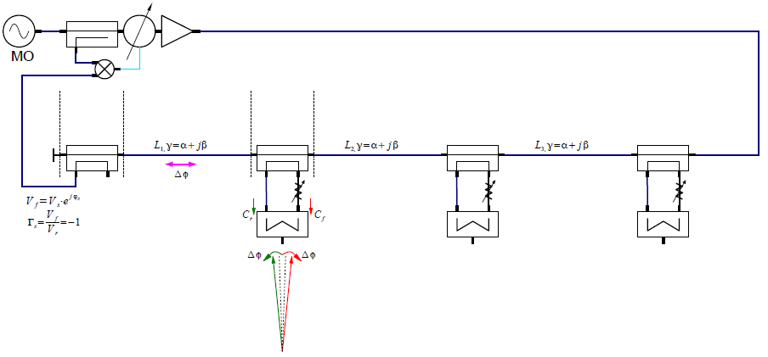
Interferometer basics

Slide 4
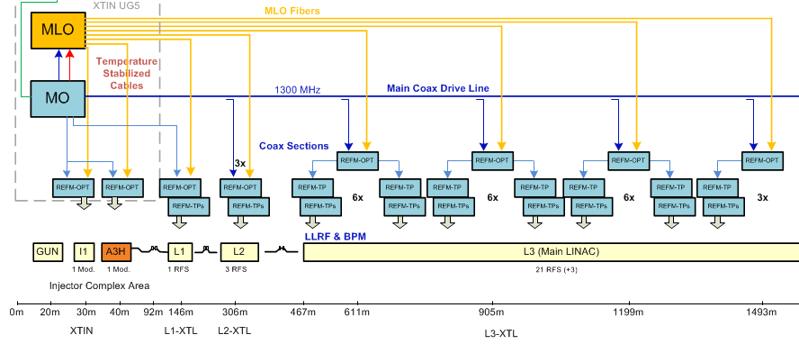
Interferometer links

Slide 5
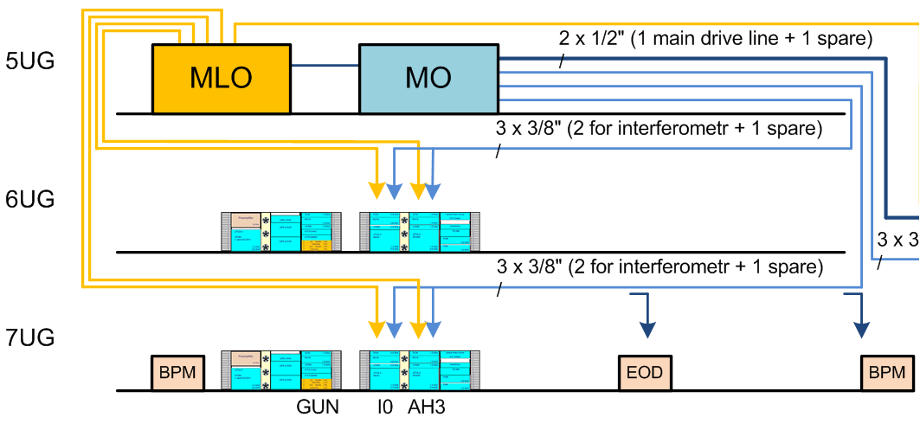
Injector links
Interferometer Tap Points:
I0 system
3rd harmonic system
Interferometer link for 7UG till GUN tests

Slide 6
Injector link – power budget
72dBm
-0.1dB
100m, -13.1dB
57.7dBm
-0.1dB
57.8dBm
-1dB
58.8dBm
-0.1dB
58.9dBm
31.4dBm
31.3dBm
30.3dBm
-20dB
-20dB
-20dB
-20dB
11.4dBm
10.3dBm
-0.3dB
-0.3dB
14.1dBm
13dBm
To L2RF
I0
To L2RF
A3H

Slide 7
Injector link – different couplers
62.1dBm
-0.1dB
100m, -13.1dB
45dBm
-1.5dB
46.5dBm
-1dB
47.5dBm
-1.5dB
49dBm
18.8dBm
17.3dBm
16.3dBm
-8dB
-20dB
-6dB
-20dB
10.8dBm
10.3dBm
-0.3dB
-0.3dB
13.5dBm
13dBm
To L2RF
I0
To L2RF
A3H

Slide 8
Injector link – cable ½"
57.7dBm
-0.1dB
100m, -8.3dB
48.2dBm
-0.1dB
48.3dBm
-1dB
49.3dBm
-0.1dB
49.4dBm
31.4dBm
31.3dBm
30.3dBm
-20dB
-20dB
-20dB
-20dB
11.4dBm
10.3dBm
-0.3dB
-0.3dB
14.1dBm
13dBm
To L2RF
I0
To L2RF
A3H

Slide 9
Injector link – cable 7/8"
46.2dBm
-0.1dB
100m, -4.6dB
40.4dBm
-0.1dB
40.5dBm
-1dB
41.5dBm
-0.1dB
41.6dBm
31.4dBm
31.3dBm
30.3dBm
-20dB
-20dB
-20dB
-20dB
11.4dBm
10.3dBm
-0.3dB
-0.3dB
14.1dBm
13dBm
To L2RF
I0
To L2RF
A3H

Slide 10
Injector link – couplers and 7/8"
36.8dBm
-0.1dB
100m, -4.6dB
28.2dBm
-1.5dB
29.7dBm
-1dB
30.7dBm
-1.5dB
32.2dBm
18.8dBm
17.3dBm
16.3dBm
-8dB
-20dB
-6dB
-20dB
10.8dBm
10.3dBm
-0.3dB
-0.3dB
13.5dBm
13dBm
To L2RF
I0
To L2RF
A3H
Can we provide less power for L2RF? What range of power is acceptable?
Can we use thicker cable instead of 3/8"?

Slide 11
L1 link
How important is spare LLRF system in L1? Do we need local interferometer link with Tap Ponits in each rack?

Slide 12
L1 link – power budget
69.9dBm
-0.1dB
100m, -13.1dB
56.7dBm
-0.1dB
56.8dBm
30.3dBm
-20dB
-20dB
10.3dBm
-0.3dB
13dBm
To L2RF
L1

Slide 13
L1 link – power budget
57.1dBm
-0.1dB
100m, -13.1dB
42.7dBm
-1.5dB
44.2dBm
16.3dBm
-6dB
-20dB
10.3dBm
-0.3dB
13dBm
To L2RF
L1
Coupler with bigger coupling factor
Thicker cable? Less power to L2RF

Slide 14
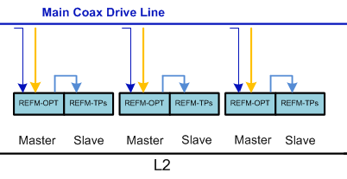
L2 link
Direct connection from L2RF to DCM – no critical power link

Slide 15
L3 link – from L2RF to DCM
Four identical sections
Two symmetric interferometer links at each section

Slide 16
L3 link – from L2RF to DCM
63.0dBm
-0.1dB
30m
-1.4dB
52.1dBm
-0.1dB
52.2dBm
50m
-2.3dB
54.5dBm
-0.1dB
54.6dBm
50m
-2.3dB
56.9dBm
-0.1dB
57.0dBm
49.1dBm
49.0dBm
46.7dBm
46.6dBm
44.3dBm
-20dB
-20dB
-20dB
-20dB
-20dB
-20dB
29.1dBm
26.7dBm
24.3dBm
-0.3dB
-0.3dB
-0.3dB
31.8dBm
29.4dBm
27dBm
To DCM
To DCM
To DCM

Slide 17
L3 link – from L2RF to DCM
54.9dBm
-0.1dB
30m
-1.4dB
40.4dBm
-1dB
41.4dBm
50m
-2.3dB
43.7dBm
-1.5dB
45.1dBm
50m
-2.3dB
47.5dBm
-1.5dB
48.9dBm
37.4dBm
36.4dBm
34.1dBm
32.6dBm
30.3dBm
-10dB
-20dB
-8dB
-20dB
-6dB
-20dB
27.4dBm
26.1dBm
24.3dBm
-0.3dB
-0.3dB
-0.3dB
30.1dBm
28.8dBm
27dBm
To DCM
To DCM
To DCM
It’s needed even more power:
Loss of interconnections
slave LLRF system
BPMs
10MHz for diagnostics

Slide 18
REFMs naming
Interferometer Tap Points with L2RF electronics (generally REFM-OPT):
REFM-OPT-A0 (GUN and I0)
REFM-OPT-A3H (3rd harmonic)
REFM-OPT-L1 (L1 station)
REFM-OPT-L2 (L2 stations)
REFM-OPT-L3 (L3 stations)
Interferometer Tap Points without L2RF:
REFM-TP (master LLRF system)
REFM-TPs (slave LLRF system)

Slide 19
REFMs space issue
L2RF electronics – 3U height
Interferometer electronics – 2U height
Crucial place – 2x REFM-OPT modules in injector racks
3rd harmonic system: Interferometer Tap Point + additional 3.9GHz PLL + L2RF
I0 system
Can we use just one 1.3GHz L2RF and then generate 3.9GHz?

Slide 20
Tap Point configuration
Conventional method – length between Tap Points tuning
Cable length adjusting (thin interconnection cables inside the box)
Phase shifter / phase trimmer in the main line
New method – attenuation value calculation for any cable length (plans)

Slide 21
Summary
Power issue:
Thicker cables
Couplers with bigger coupling factor
Space issue:
Biggest problem in injector racks
In tunnel racks space can be extend in place of LOGMs

Slide 22
Thank you for your attention ☺

