Slide 1
DAMC-DS800 Status
Samer Bou Habib
Notes:
How to edit the title slide
Upper area: Title of your talk, max. 2 rows of the defined size (55 pt)
Lower area (subtitle): Conference/meeting/workshop, location, date, your name and affiliation, max. 4 rows of the defined size (32 pt)
Change the partner logos or add others in the last row.

Slide 2
Agenda
Introduction
Main issues
Status and Timeline
2013.02.20 Otwock, Poland
Samer Bou Habib, ISE-WUT

Slide 3
Introduction – Main Requirements
AMC Fast Digitizer Card
8 analog channels (AC or DC) up to 2.7GHz @ 800 MSPS ADCs
4 „VM-like” DACs
SRAMs for all ADC channels

Slide 4
Main Issues – what took so long…
Requirements – long time but resolved (I hope)
Z3 Classes - resolved
MMC standarization – pending !
Design complication
Space
Altium ☹

Slide 5
Timeline
Till End of February
Routing
March & April
Production + Assembly
Firmware !!! Maybe WJ?
June (July)
Testing
Firmware !!!
August++
V2.0
Celebrate
→☺
More Firmware ☺ (Applications)

Slide 6
Timeline
Routing
Production + Assembly
Testing
V2.0
Celebrate
→☺
Firmware !!! Maybe WJ?
Firmware !!!
More Firmware ☺ (Applications)
August++
June (July)
March & April
Till End of February

Slide 7
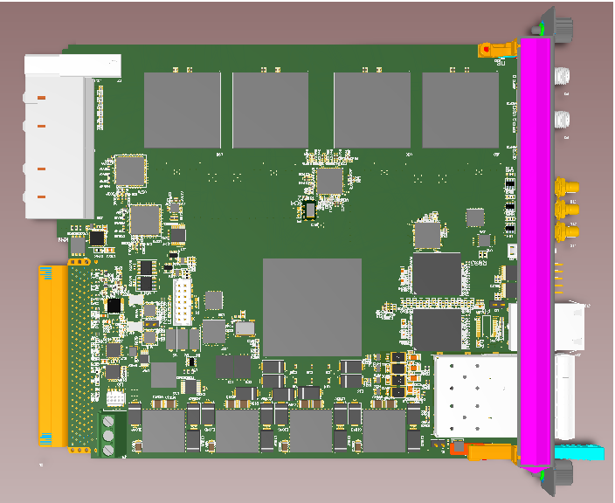
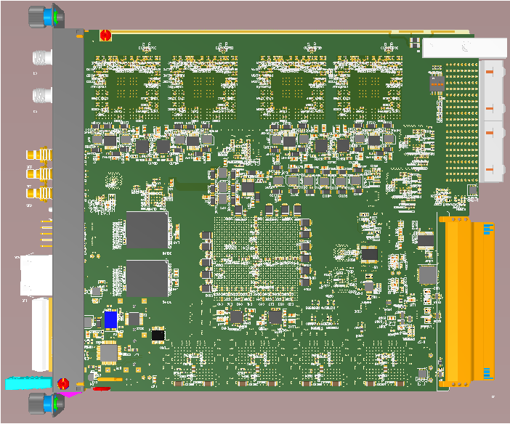
Altium 3D View

Slide 8
Altium

Slide 9
Altium

Slide 10
Thank you for your attention
S.BouHabib@stud.elka.pw.edu.pl

