Slide 1
Firmware Framework and Development Overview
Lukasz Butkowski

Slide 2
Firmware Structure
Application part: algorithms, user logics
Board Part : provides interfaces to all devices on board and configures devises
Intermediate layer: mapping of board resources with application interface

Slide 3
current
Board 1
FPGA
CONFIG
PERIPHERALS
BOARD_1
APPLICATION 1
BOARD_1 interface
Under preparation
FPGA
Board 2
CONFIG
CONFIG
BOARD_2
MAP
LAYER
APPLICATION 1
BOARD_2 interface
APP_1
interf
PERIPHERALS

Slide 4
ENT_TOP - top entity
PKG_BOARD
Board configuration
ENT_APPLICATION_INTG
PKG_APPLICATION
Application configuration
ENT_BOARD_TOP
Interfaces:
Logic,
ADC,DAC,
DDR,
PCIe,
LLL,
SPI, I2C etc…
ENT_APPLICATION_TOP
User logic
IO
Application interface
Board interface
adapter

Slide 5
Project generator
GUI tool:
Choose board;
Choose available board configuration or create new based on default
Choose application;
Choose available application configuration or create new based on default
Assign signals from board to the application,
Generate project;
Outputs:
ISE project ( *.xise, *.tcl files) - for development
Makefile – for automation
Alfa version of tool already prepared by Jarek Szewinski.
(still need some upgrades and development)

Slide 6
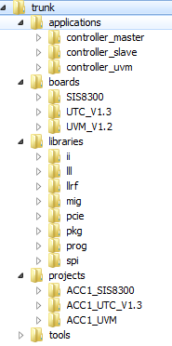
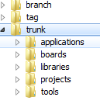
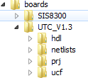
Source structure, repository structure
branch – development done in branches, each branch have the same structure as trunk
tag – tagged versions of framework
trunk – main framwork files, most stable and current version
hdl – vhdl, verilog source files
netlists – generated netlist files
prj – files for synthesis of board part
ucf – default constraints file

Slide 7
Automation
Code documentation generation using doxygen:
Commit of code into repository triggers generation of documentation,
VHDL code need to be commented properly by developers,
Done, need some adjustments for VHDL codes
Build server:
Automated compilation of project on a dedicated server,
Compilation triggered by commit to the repository trunk or triggered manually,
Result of build visible through web browser,
Automatic version set in VHDL code before compilation ,
Database of compiled firmware's with information about compilation and status,
Under preparation, fully operational in end of summer or sooner,

Slide 8
Build version control
WORD_FIRMWARE
Address 0 of every bar, board or application version, version of configuration used for board or for application, nomenclatures under preparation
WORD_COMPILATON
Address 1 of every bar,
Stamp of compilation, points database entry of build server with information:
- Repository link from which it was compiled
- Revision of this repository
- Software used in compilation,
- Date of compilation,
- State of firmware: under tests, not ok, ok

Slide 9
REDMINE
Bug track and project management tool,
Integrated wiki and documentation of projects,
Integrated with source code repository,
Links issues with repository revisions,
FREE – open source with good community support

Slide 10
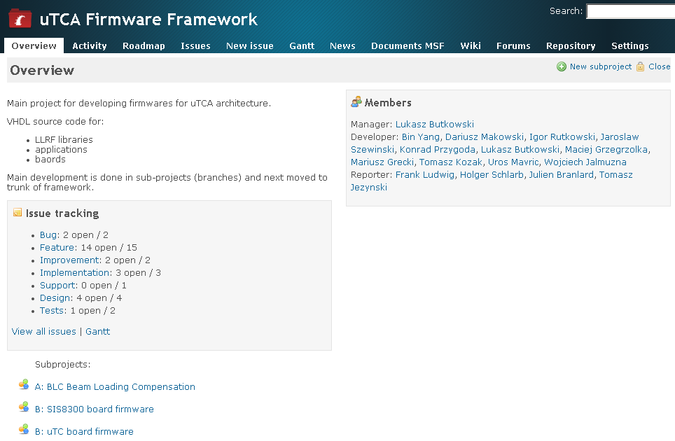

Slide 11
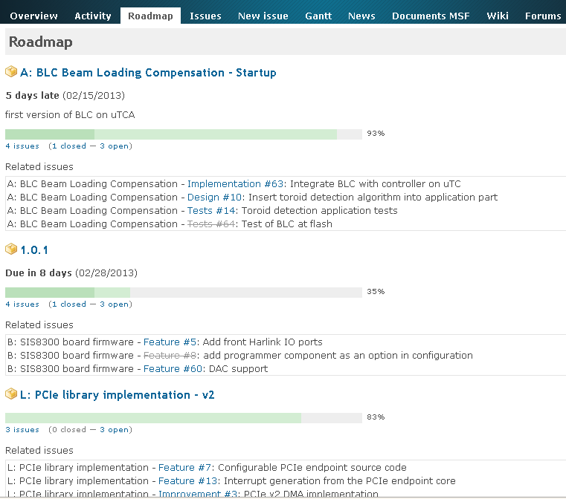

Slide 12
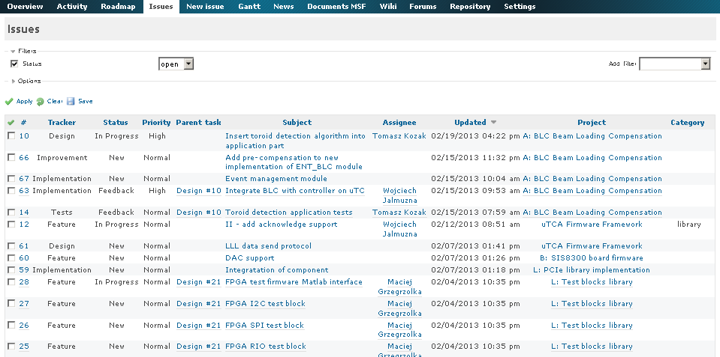

Slide 13
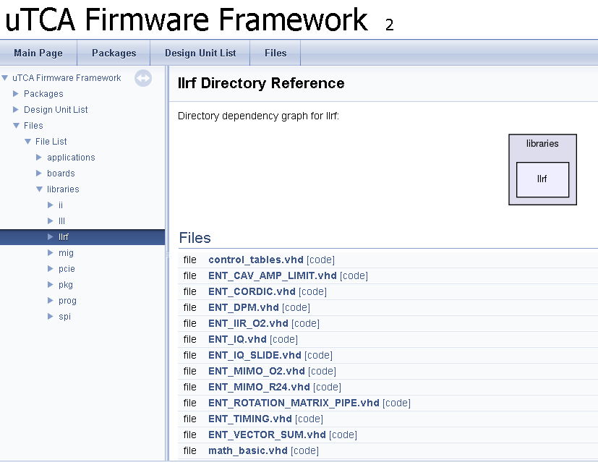

Slide 14
Redmine link:
https://mskllrfredminesrv/projects/utca_firmware_framework
SVN repository link of trunk:
https://mskllrfredminesrv/svn/utca_firmware_framework/trunk
or
https://mskllrfredminesrv:8080/viewvc/utca_firmware_framework/trunk
Doxygen (test version):
https://mskllrfredminesrv/doxygen/utca_firmware_framework/docs/html/files.html

Slide 15
Thank you for your attention

