Slide 1
uDWC
Dominik Sikora

Slide 2
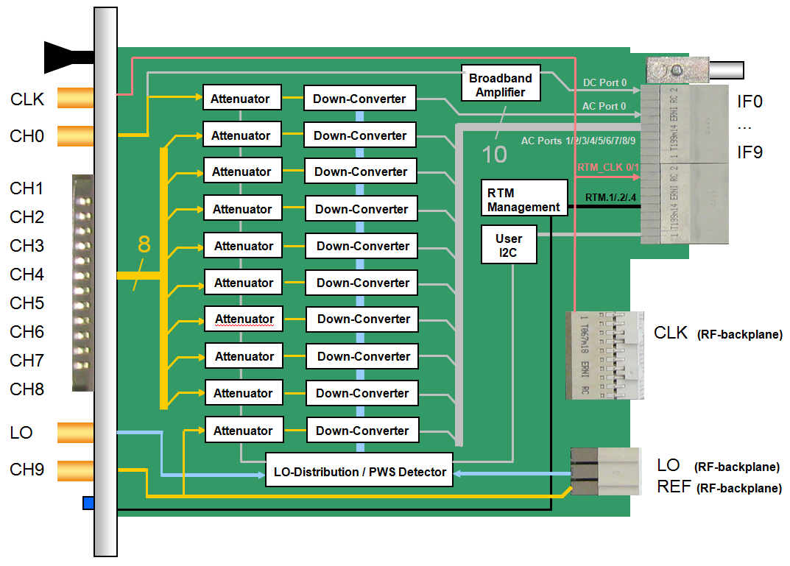
Block diagram

Slide 3
uDWC versions
uDWC8300 v1.0 (J. Piekarski)
uDWC8300 v1.1 (M. Hoffman)
uDWC8300FR v1.0 – with RJ45 connector for digital link
uDWC8300 v2.1 – without digital link
uDWC8300 v2.2 (latest 8 boards)
uDWC8300 v2.3 (DRTM-DWC10 for licensing, just before production)

Slide 4
Main delays during whole design
Digital link (SIS8300 - TMCB)
RF inputs matching and crosstalks issue
Rogers laminate during uDWC8300 v2.1 production
Zone3 Class
MMC standardization

Slide 5
Last changes – for v2.3
RF backplane power pin assignment
Capacitors for lifetime improvement
MMC for basic version (additional temperature sensor, dual DAC for digital lines supplying)
DAC pins grounded in Zone 3
Resignation of ITR services (production delays and board bending)

Slide 6
Licensing
Production files for DRTM-DWC10 (v2.3) are ready
Production stopped by unexpected errors during tests (AM spurious distortions – can be PS adapter board cause)
Attenuators configuration firmware for v2.2 didn’t tested yet
Production by Struck (30 boards of 1.3GHz variant in near future)

Slide 7
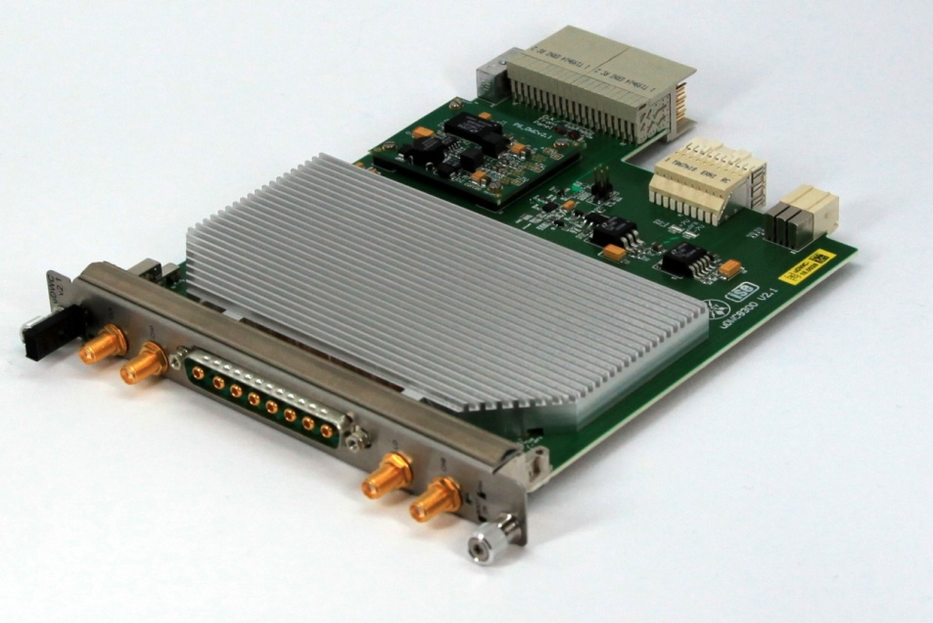
Thank you for your attention ☺

