Slide 1
DFMC-MD22
2 channel stepper motor driver
Robert Meyer
Advanced Techniques in LLRF control for XFEL
Otwock-Swierk, 20.02.2013

Slide 2
Specification
FMC-Board with 2 channel
2A Coil Current per Channel
256 µSteps per Full step
Reference switch Readout
Heidenhain (EnDat 2.2) or Incremental Encoder Readout
Operating Temperature 0 to 70°C
Endurance 10 Years

Slide 3
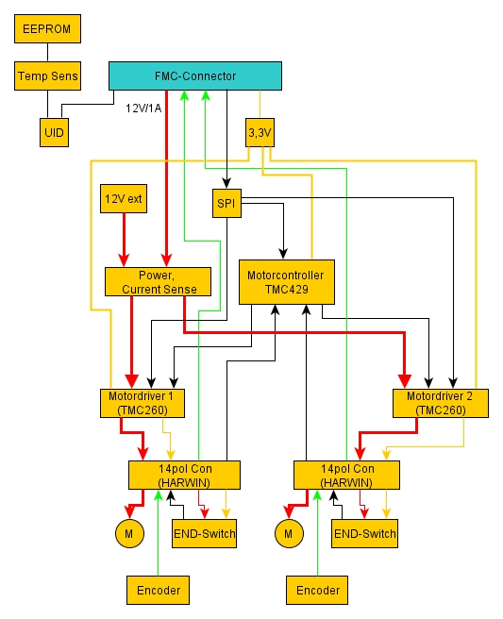
Blockdiagramm

Slide 4
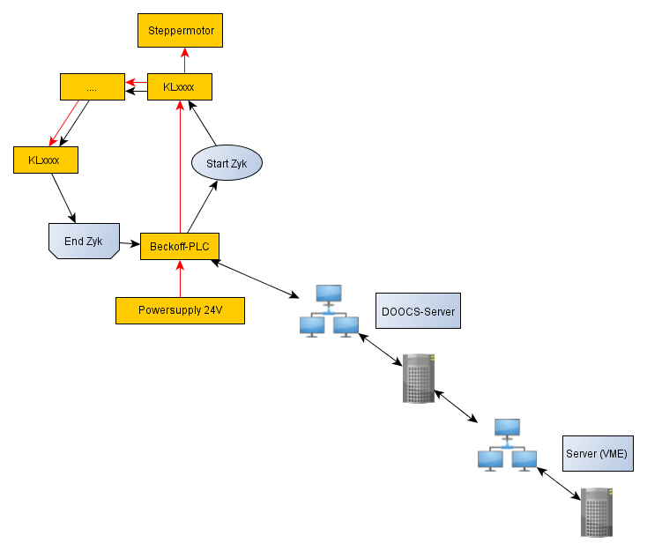
Present System

Slide 5
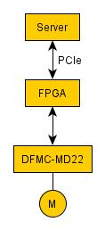
System with DFMC-MD22

Slide 6
Next Steps
Improving 5V Generation
Searching new Connector for Frontpanel?
Measure interference to Neighbor Boards (for example on Struck ADC Board)
DOOCS-Server has to be made

Slide 7
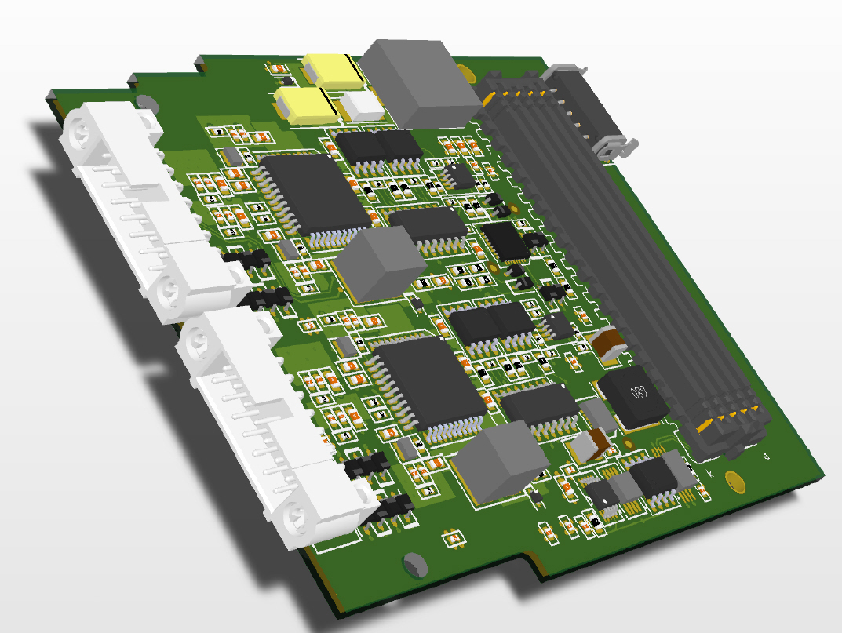
3D-Modell of Board

Slide 8
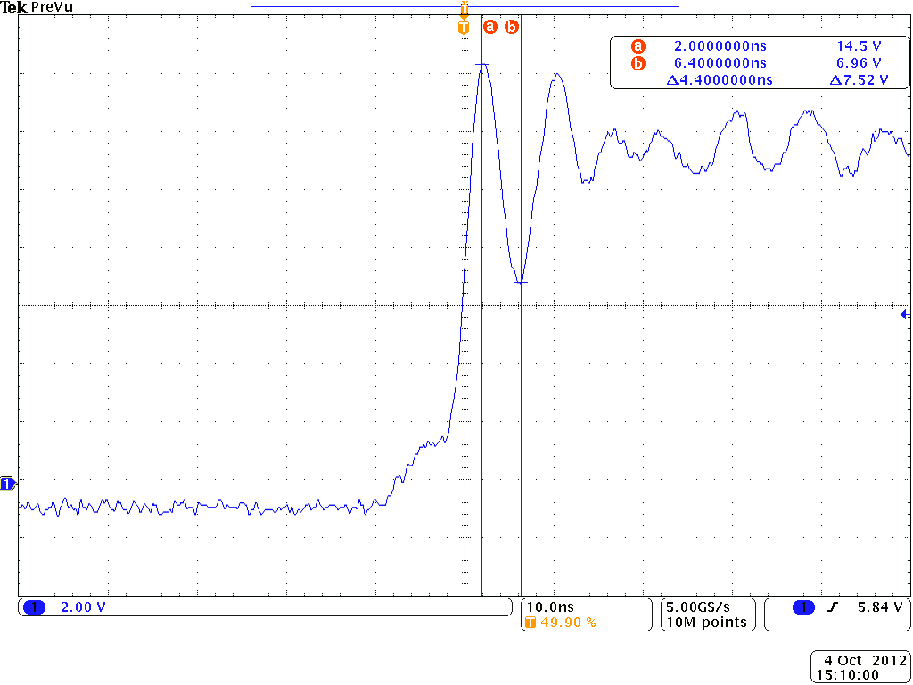
Ringing on Output

