Slide 1
KDS in MSK LLRF group
Maciek Kudla
LLRF Collaboration Workshop
Swierk, 2013, February, 19-21

Slide 2
KDS – what it is?
KDS is a DESY abbreviation (Kabel Dokumentations System) for Command package for device and cable documentation and control built by FNT GmBH. It is based on Oracle DB
Web interface under Adobe Flash Player technology, VPN needed to access
Command package is used in car industry
Desy support: Long-IT (2 persons)
Desy Project Management: MDI (Kay Wittenburg)
Password protected access (Read, Write, Admin modes, but some actions are allowed only for DESY support team)

Slide 3
Motivations for KDS usage
Inventory of LLRF devices
Installations and device usage control
Storing place for essential devices data
In Basic Object Data: Device characteristic, settings
in Attachments
Photos, Manuals, Specifications (Device Type related)
Test reports, Failure reports (individual Devices related)
History events for individual Devices
changes of individual settings,
defects, etc
Device searches

Slide 4
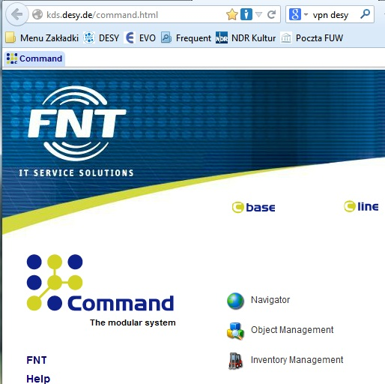
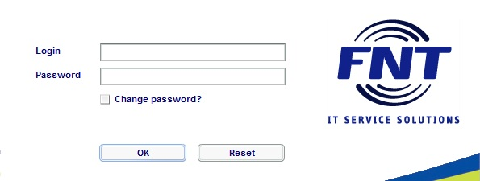
Command Login and Main Entry Window
http://kds.desy.de/command.html
password delivered by DESY support

Slide 5
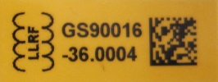
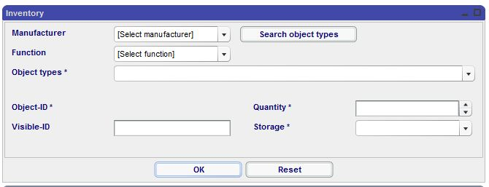
Inventory
All devices coming to MSK LRRF group are registered and labeled (yellow LLRF label with 2D Data Matrix code).
For new type of device new KDS type is created (MK, DESY KDS support or FNT). KDS type contains essential device type data, port definitions, graphics etc.
During the inventory individual setting of device are introduced.
Automatic insertion of data to the KDS is under discussion.
Inventory in KDS is made by KSG (Kudla, Szczepanski, Galant)
Inventory can be done manually, by an Excel file import.

Slide 6
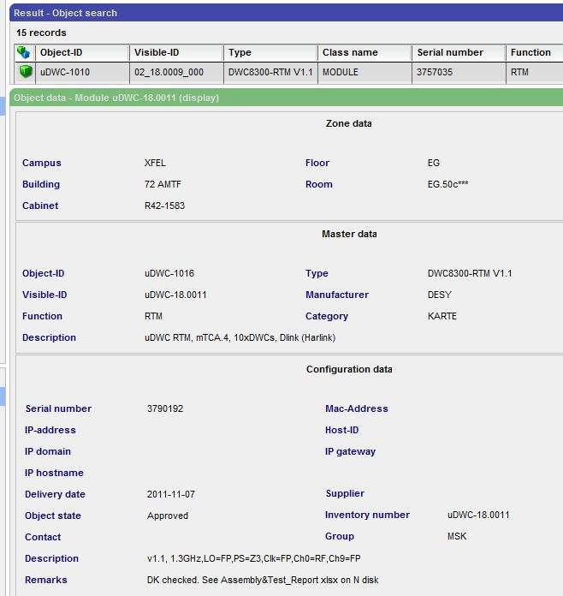
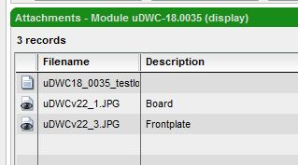
Device data
Attachments:
Object data:
uDWC settings

Slide 7
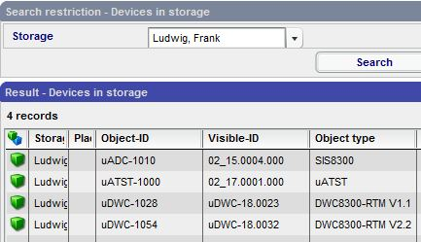
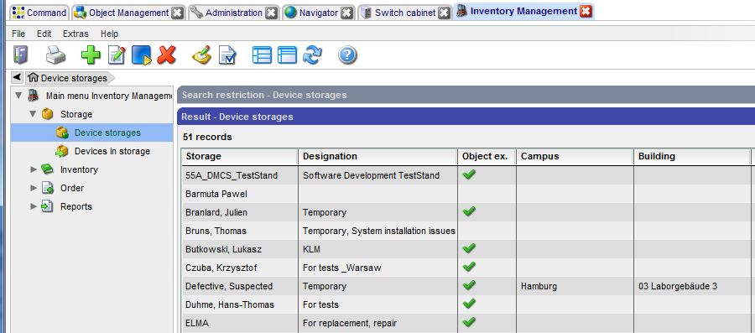
Usage control -> Inventory Management -> Devices in storage
The purpose: to keep track of special device usages: short tests, repairs, exhibitions, etc. We have 51 Storages related to LLRF devices users.
Is important that Storage owner return the device after usage to KSG or/and inform them on device status or location change

Slide 8
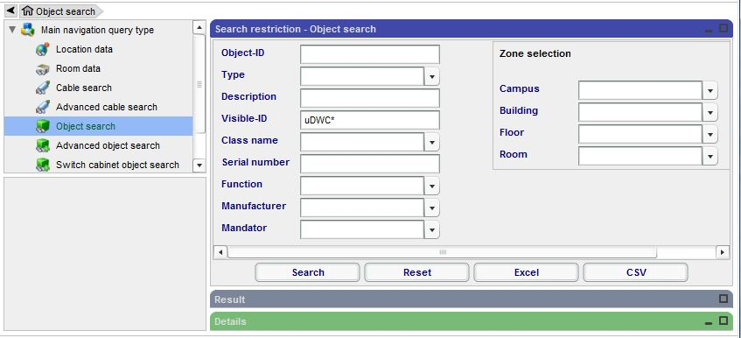
Device search -> Object Management -> Object search (1)
Several methods available for device search (Object search, Advanced Object search, Special searches
Hint:
Is recommended to use Visible-ID field where generic device abrreviations can be used (EG.: uCPU for all ADlink, Concurrent CPUs)
Wild characters are valid – Asterisk, etc

Slide 9
Device search -> Object Management -> Object search (2)
Search Result
Hint: Advanced object search gives wider device information

Slide 10
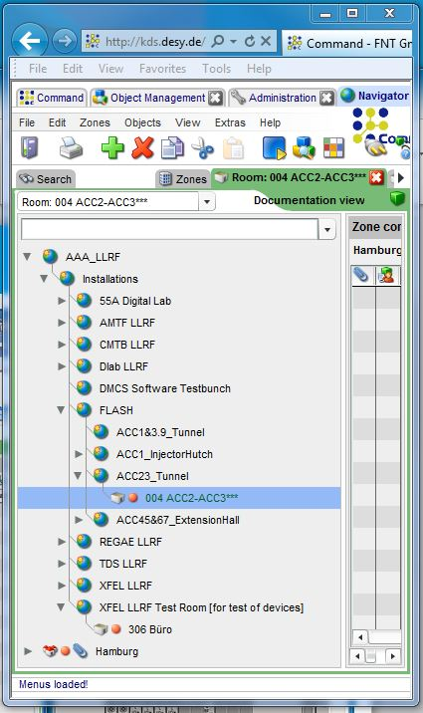
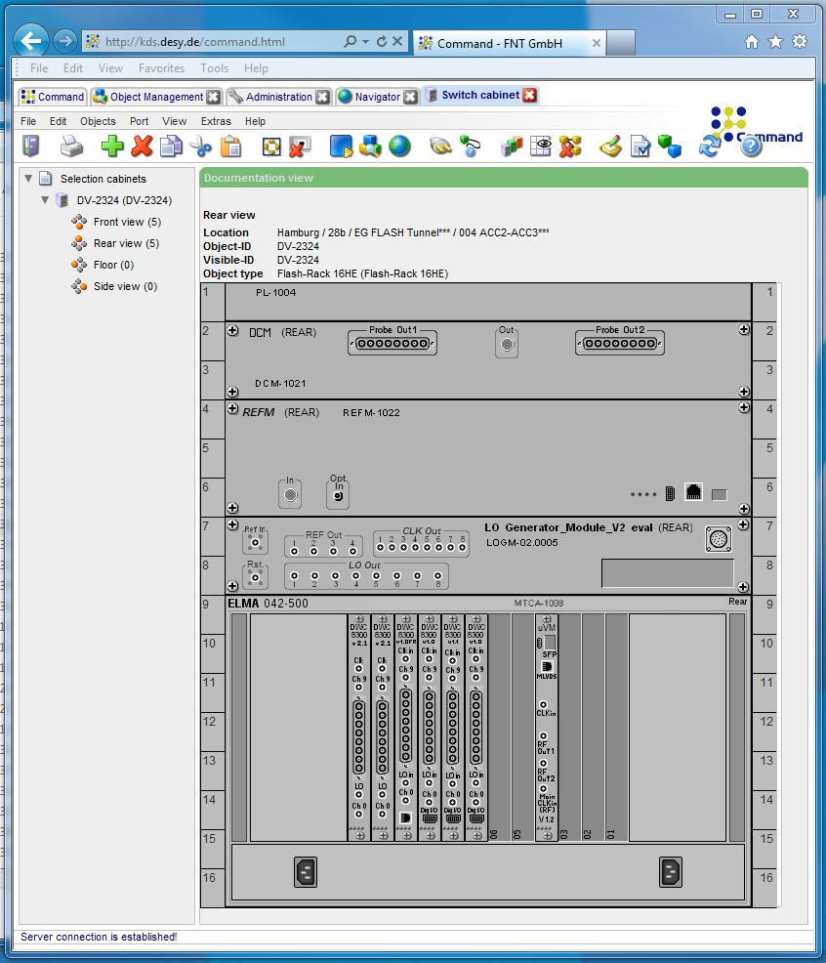
Installation overviews -> Navigator -> Topzones
Device LLRF code
available also on click
Device version

Slide 11
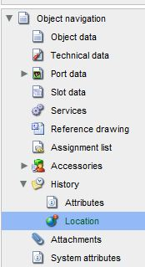
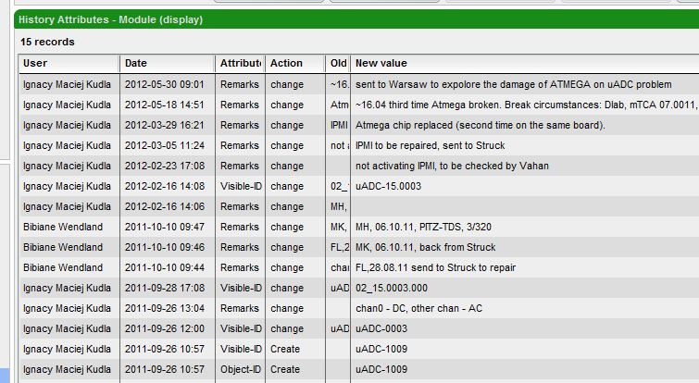
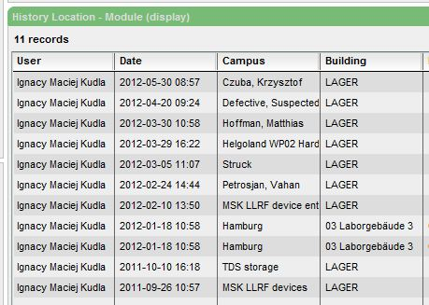
Device Histories -> Attributes, Locations
Attributes (in MSK KDS usage Remarks goes to the History Attributes). Here History of uADC-15.0003:
Locations:

Slide 12
MSK KDS users
Read Only users (Device search, Device and Installations overview, etc)
Write users (Editing of Device Fields, Storages and Installations editing, etc)
No | Benutzername | Name
1 | branlard | Julien Branlard
2 | chris | Christian Schmidt
3 | dmakow | Dariusz Makowski
4 | dsikora | Dominik Sikora
5 | fludwig | Frank Ludwig
6 | irutkow | Igor Rutkowski
7 | jpiekars | Jan Piekarski
8 | kczuba | Krzysztof Czuba
9 | kprzygod | Konrad Przygoda
10 | mavric | Uros Mavric
11 | mzukocin | Mateusz Zukocinski
12 | pbarmuta | Pawel Barmuta
13 | tjezynsk | Tomasz Jezynski
14 | wjalmuzn | Wojciech Jalmuzna
No | User Name | Name
1 | christo | Christopher Gerth
2 | kuehndan | Daniel Kuehn
3 | maschrad | Matthias Hoffmann
4 | mfelber | Matthias Felber
5 | oliwa | Krzysztof Oliwa
6 | szczepan | Bartlomiej Szczepanski
7 | wierba | Woyciech Wierba
Admin users (Device types editing, etc)
No | User Name | Name
1 | agalant | Adam Galant
2 | mkudla | Ignacy Maciej Kudla

Slide 13
Final remarks
~300 devices in LLRF KDS system together with a lot of information
Automatic interface to access data in KDS under discussion with DESY support team
I will send e-mail to all the storage keepers to check – please check devices in your possession!
Critics, comments very welcome, necessary!

