Slide 1
BAM-FMC
Samer Bou Habib
Notes:
How to edit the title slide
Upper area: Title of your talk, max. 2 rows of the defined size (55 pt)
Lower area (subtitle): Conference/meeting/workshop, location, date, your name and affiliation, max. 4 rows of the defined size (32 pt)
Change the partner logos or add others in the last row.

Slide 2
Agenda
Introduction
Main Issues
Status and Timeline
2013.02.20 Otwock, Poland
Samer Bou Habib, ISE-WUT

Slide 3
Introduction*
FMC standard
Double width
Mainly prepared to be used with DAMC-FMC25
216 MSPS (no pulse skipping)
*Details

Slide 4
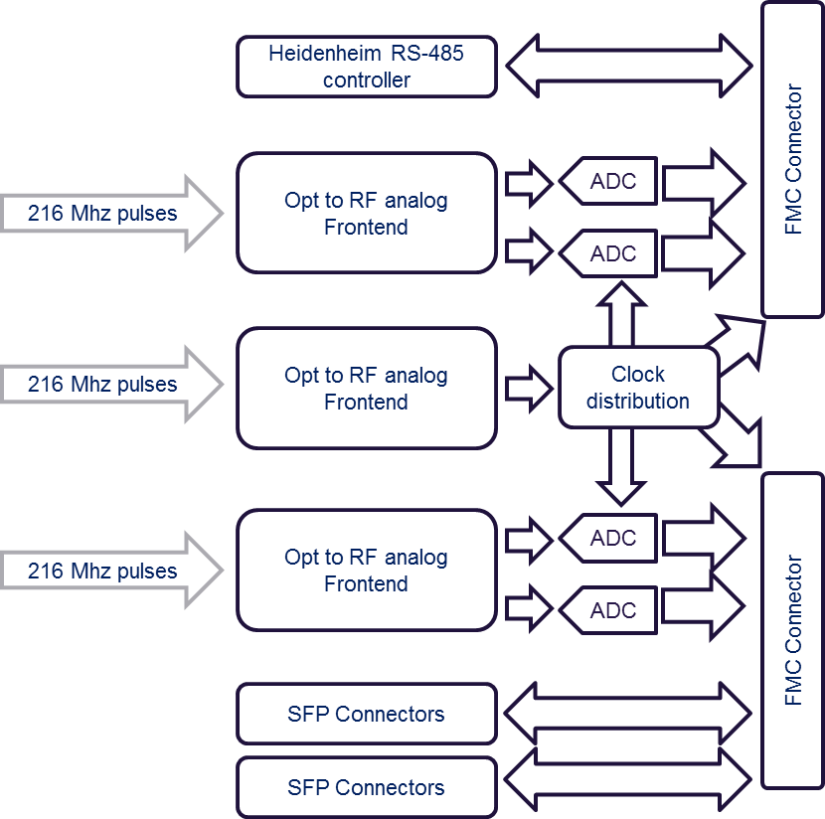
Block Diagram
Modulated
MLO
Modulated

Slide 5
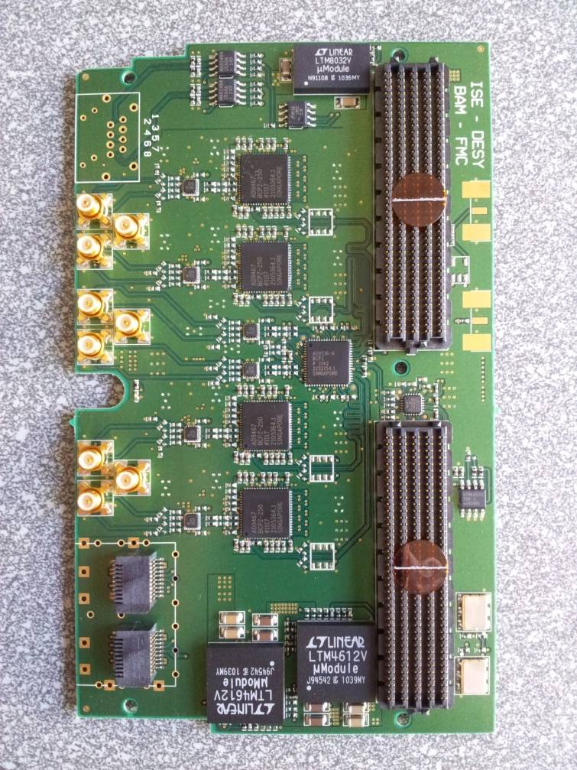
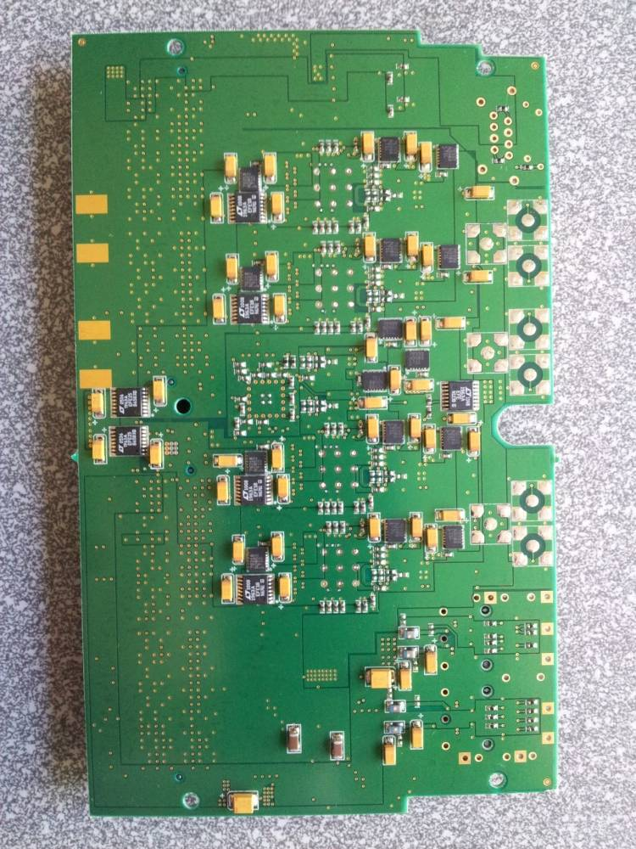
BAM-FMC

Slide 6
Main Issues – what took so long…
Optical-to-RF circuits not fit for new PD ⇒ ”old” will be used
PD performance very delicate and dependant on used laminate
Lack of manpower! – partially resolved

Slide 7
Timeline
Till End of February
BAM tests precise plan
Additional PD boards (min. 2)
March
FMC-evaluation: JS+SBH+JD
„Integrated” board design: SBH+ JD ; Laminate !
April
System:preparation: JS
„Integrated” board design
May
System:preparation: JS
Production and Assembly
June(July)
Final tests and Installation

Slide 8
Timeline
BAM tests precise plan + PD boards
FMC-evaluation: JS+SBH+JD
System:preparation: JS
May
April
March
Till End of February
„Integrated” board design: Laminate !
„Integrated” board design
Production and Assembly
Final tests and Installation
June-July
System:preparation: JS
Final tests and Installation

Slide 9
What is to be done (fast)
2-3 PD boards assembly and tests: JD
Laminate for integrated FMC
CLK circuits evaluation: JS + SBH
ADC circuits evaluation: JS + SBH
Integration of FMC with PD
Power levels: SBH + JD
CLK/Time shifting : JS + SBH

Slide 10
Thank you for your attention
S.BouHabib@stud.elka.pw.edu.pl

