Slide 1
REFM
Dominik Sikora

Slide 2
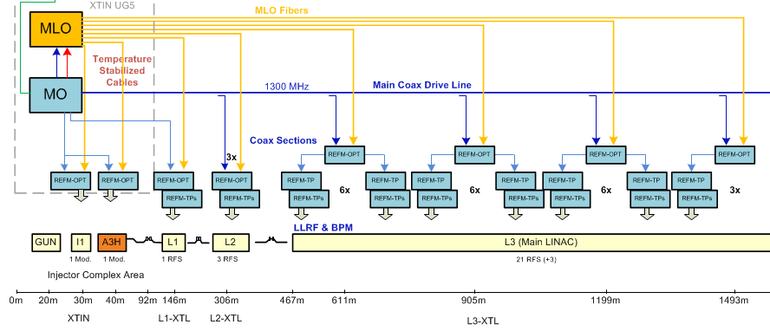
Interferometer links

Slide 3
REFMs naming
Interferometer Tap Points with L2RF electronics (generally REFM-OPT):
  REFM-OPT-A0 (GUN and I0)
  REFM-OPT-A3H (3rd harmonic)
  REFM-OPT-L1 (L1 station)
  REFM-OPT-L2 (L2 stations)
  REFM-OPT-L3 (L3 stations)
Interferometer Tap Points without L2RF:
  REFM-TP (master LLRF system)
  REFM-TPs (slave LLRF system)

Slide 4
REFM components
Laser to RF
Laser to RF
Interferometer
  2x directional couplers
  Phase detector
  Phase shifter (VM)
Tap Point
  2x directional couplers
  Attenuator
  Phase shifter
  Power combiner
  Eventually high power amplifier
Frequency divider, power divider
3.9GHz generator
Interferometer
Tap Point
3.9GHz PLL

Slide 5
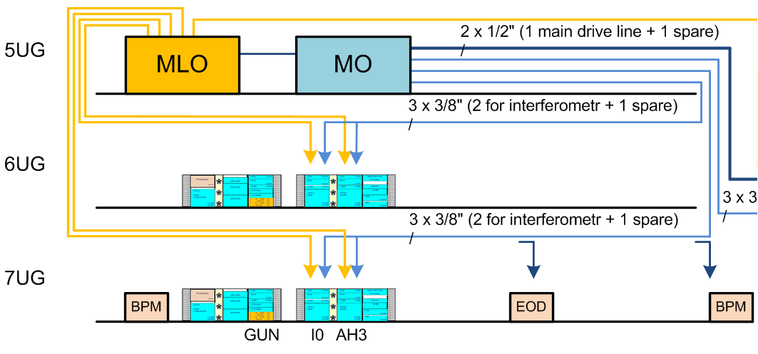
Injector links

Slide 6
Injector links
Tap Point
3.9GHz PLL
Laser to RF
Laser to RF
Frequency
divider
DCM 1.3GHz
10MHz
DCM 3.9GHz

Slide 7
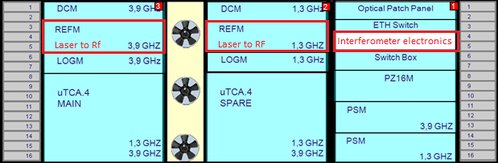
Injector links
Tap Point
3.9GHz PLL
Laser to RF
Laser to RF
Frequency
divider
DCM 1.3GHz
10MHz
DCM 3.9GHz
Space issue for REFMs in injector area – separate Laser to RF boxes from interferometer electronics

Slide 8
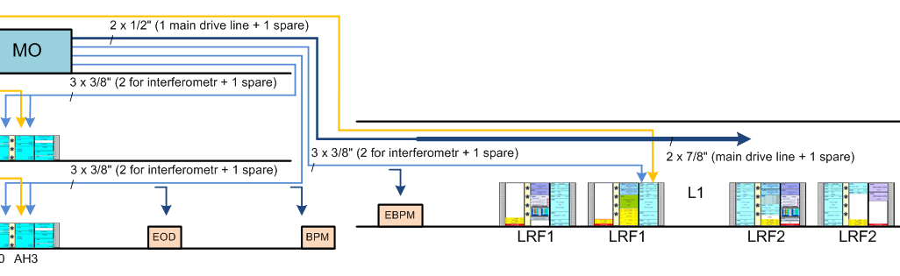
L1 REFMs

Slide 9
L1 REFMs
Tap Point
Laser to RF
Frequency
divider
Interferometer
10MHz
REFM-OPT-L1 users (3):
  DCM in Master LLRF (27dBm)
  Interferometer for signal distribution to Slave nad spare LLRF racks
  Frequency divider 1300MHz -> 10MHz
Main output
for DCM

Slide 10
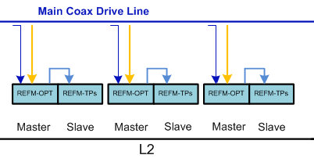
L2 REFMs

Slide 11
L2 REFMs
Laser to RF
Frequency
divider
Interferometer
10MHz
REFM-OPT-L2 users (3):
  DCM in Master LLRF (27dBm)
  Interferometer for signal distribution to Slave LLRF rack
  Frequency divider 1300MHz -> 10MHz
Main output
for DCM

Slide 12
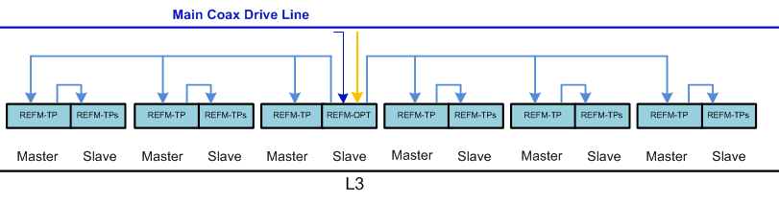
L3 link – from L2RF to DCM

Slide 13
L3 link – from L2RF to DCM
Laser to RF
Interferometer
Interferometer
REFM-OPT-L3 users (4):
  DCM in Master LLRF (27dBm)
  2x Interferometer for signal distribution to rest of the LLRF racks
  Frequency divider 1300MHz -> 10MHz
Main output
for DCM

Slide 14
L3 link – from L2RF to DCM
Laser to RF
Interferometer
Interferometer
REFM-OPT-L3 users (4):
  DCM in Master LLRF (27dBm)
  2x Interferometer for signal distribution to rest of the LLRF racks
  Frequency divider 1300MHz -> 10MHz
Main output
for DCM

Slide 15
Summary
Space issue in injector area
No space issue in L1, L2 and L3 sections – 2U height in place of LOGM boxes (uLOG)
Power input for Laser to RF (from yesterday talk)

Slide 16
Thank you for your attention ☺

