Slide 1

BSM Physics in Herwig++
K. Arnold, L. d'Errico, S. Gieseke, D. Grellscheid, K. Hamilton, A. Papaefstathiou, S. Platzer, PR, C. Rohr, A. Schofield, A. Siodmok, M. Stoll, D. Winn
Peter Richardson
IPPP, Durham University

Slide 2
Outline
Introduction
Philosophy
Current Status
Future Improvements
Using Herwig++
Conclusions

Slide 3
Introduction
Herwig++ is an on going project to provide a replacement for the FORTRAN HERWIG program.
Based on the same physics philosophy but with improved physics simulation based on the theoretical developments of the last 10 years, not just a rewrite.
There are many improvements to the simulation for both Standard Model and BSM physics.
In this talk I will concentrate on BSM physics.

Slide 4
History
FORTRAN HERWIG was highly developed for the simulation of SUSY:
  2g2 production matrix elements;
  1g2 and 1g3 decays including matrix elements and spin correlations;
  option of R-parity violation, including both lepton and baryon number violating terms.
  interface to TAUOLA for longitudinal correlations of taus.
A lot of effort to produce detailed a simulation of one model. Adding additional models, e.g. UED, would have been as much work again.

Slide 5
Philosophy
So for Herwig++ we wanted the following features:
  retain the good features of FORTRAN HERWIG, e.g. the spin correlations;
  make adding new models much easier;
  simulate perturbative and non-perturbative decays in the same way so all correlations can be generated for taus;
  generate QCD radiation from coloured BSM particles.

Slide 6
Philosophy
The simulation of both Standard Model and Beyond the Standard Model hard processes and decays in Herwig++ is:
  based on a reimplementation of the HELAS library in C++.;
  all interactions are coded as vertex classes;
  the Standard Model hard processes and decays are implemented using hard-coded matrix elements using these classes;
  for BSM models the matrix elements for 2g2 scattering processes and 1g2 and 1g3 decays are automatically generated based on the spin structure of the process.

Slide 7
Vertex Classes
The Feynman rules are coded as Vertex classes inheriting from one of the already implemented spin structures, e.g. for a new vector coupling need to supply, c ,g_{L}, g_{R}
The interactions in new physics models can then be implemented by supplying the couplings in the model.

Slide 8
New Physics
Implementing a new model in Herwig++ is then simply a matter of:
  implementing a new model class which inherits from the Herwig++ Standard Model class and stores or calculates any parameters needed in the model;
  implementing the Vertex classes, specifying the interactions in the model;
  specifying the particle content of the model.
Still requires some coding for each model.

Slide 9
Current Status
A seventh hadron-hadron version (2.6) of Herwig++ was released on 23 May 2012 with major improvements with respect to the previous version.
Major changes:
  a new structure for the implementation of next-to-leading order matrix elements;
  an improved treatment of wide-angle gluon radiation;
  new hard-coded next-to-leading order matrix elements for deep inelastic scattering and VBF;
  additional BSM models;
  statistical colour reconnection model
  automated energy scaling of underlying-event tunes.
Described in detail in arXiv:1205.4902 and the manual arXiv:0803.0883.

Slide 10
Status
The current release includes:
  full spin correlations;
  simulation of off-shell effects;
  simulation of 2g2 process;
  simulation of two and three-body decays;
  some 2g3 processes for BSM Higgs physics;
  Small Δm weak decays using tau hadronic currents;
  allows different vertex Lorentz structures to be easily handled;
  Wide range of models MSSM, NMSSM, RS, ADD, Sextet, Little Higgs (with or w/o T-parity), Leptoquarks, UED, …

Slide 11
Correlations in e⁺e⁻
Unpolarised
HERWIG
+ Hw++

Slide 12
UED
e⁻ near
e⁻ far
Look at the decay
q
e⁻ near
q*_{L}
Z*
e⁺ far
e⁺ near
e⁺ far
e*_{R}
γ*

Slide 13
Correlations in Tau Decays
Left Handed stau
Right Handed stau
HERWIG+TAUOLA
+ Hw++
Fraction of visible energy carried by the charged pion

Slide 14
Correlations in Tau Decays
Based on hep-ph/0612237 Choi et al.

Slide 15
Finite Width Effects
In the past finite width effects were handled in HERWIG using a variety of approaches:
  W and Z bosons were produced using matrix elements including the decay products to get the correlations correct;
  a sophisticated treatment of the Higgs lineshape was used.
  the masses of the top and BSM particles were smeared using a Breit-Wigner distribution.
In Herwig++ wanted to use a more sophisticated approach.

Slide 16
Finite Width Effects
As with the rest of the simulation use the same machinery for both perturbative and hadronic decays.
Include a weight factor
For outgoing particles in hard production matrix elements and decays and generate the off-shell mass q.

Slide 17

Off-Shell effects in Decays

Slide 18
Finite Width effects in Production
Tevatron
LHC
Need to be careful with gauge invariance.
Rescale mass used in the matrix element calculation to either the same value or the on-shell mass.

Slide 19
Different Spin Structures
With the exception of the code implementing the vertex the rest of the simulation doesn’t care what the Lorentz structure of the vertex is, e.g. for a fermion-fermion-vector coupling
only the code calculating Γ needs to know what it is.
Introduce a new level of abstract classes to allow any Lorentz structure to be implemented.

Slide 20
Example: VBF Higgs Production
To explore the CP structure of the Higgs can implement a new vertex class with the CP-even and CP-odd operators.
Then from the input files replace the Standard Model HWW vertex and get the result using the Standard Model matrix elements.
Based on hep-ph/0105325 Plehn et. al

Slide 21
Z’ with Anomalous γZZ’ coupling
Another example is the model of with a Z’ coupling to both the SM fermions and γZ via an anomalous coupling hep-ph/0501154 Kozlov .
The vertex for the Z’ coupling to the Standard Model fermions can b essentially copied from the Z vertex.
Need a new Lorentz structure for the anomalous vertex but then the generation of the hard matrix elements and decays proceeds using the general code.

Slide 22
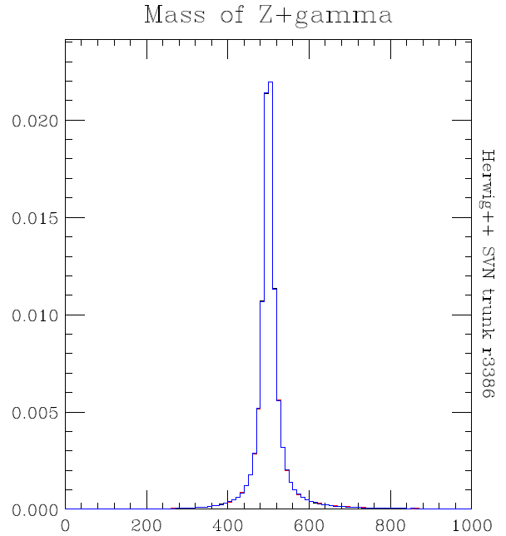
Z’ with Anomalous γZZ’ coupling

Slide 23
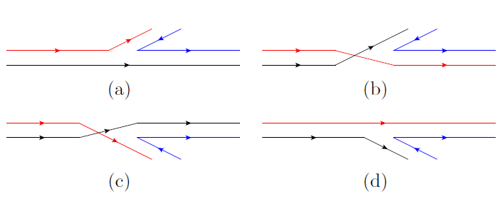
Colour Sextet Particles
The simulation of particles in the sextet representation of SU(3) needs changes in the shower to handle particles with more than one (anti) colour line.
For example for gluon radiation from a sextet particle.
PR and Winn Eur.Phys.J. C72 (2012) 1862

Slide 24
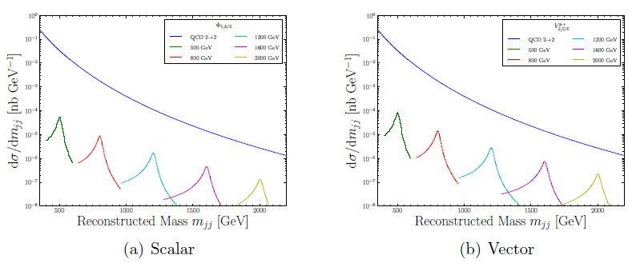
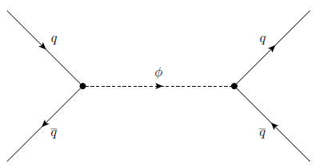
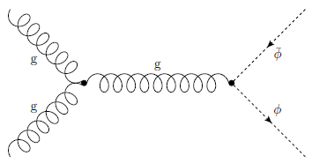
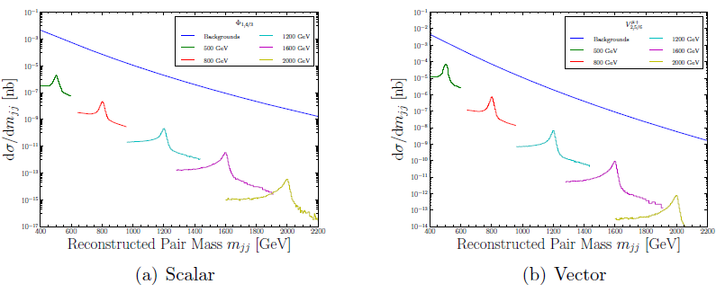
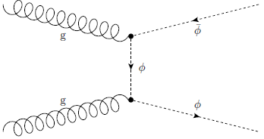
Colour Sextet Particles

Slide 25
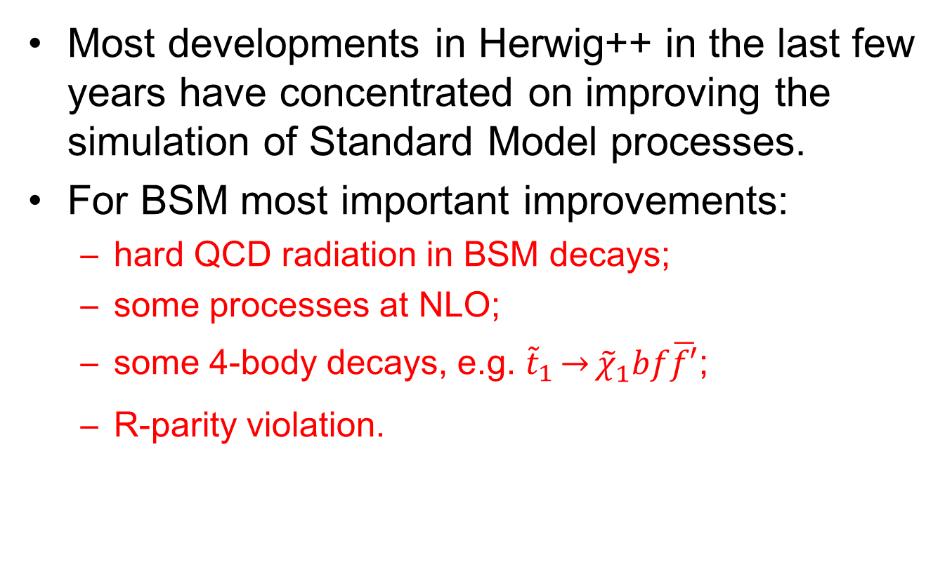
Future Developments
Most developments in Herwig++ in the last few years have concentrated on improving the simulation of Standard Model processes.
For BSM most important improvements:
  hard QCD radiation in BSM decays;
  some processes at NLO;
  some 4-body decays, e.g. ${\tilde{t}}_{1}\overset{→}{}{\tilde{χ}}_{1}^{}bf\overline{f′}$;
  R-parity violation.

Slide 26
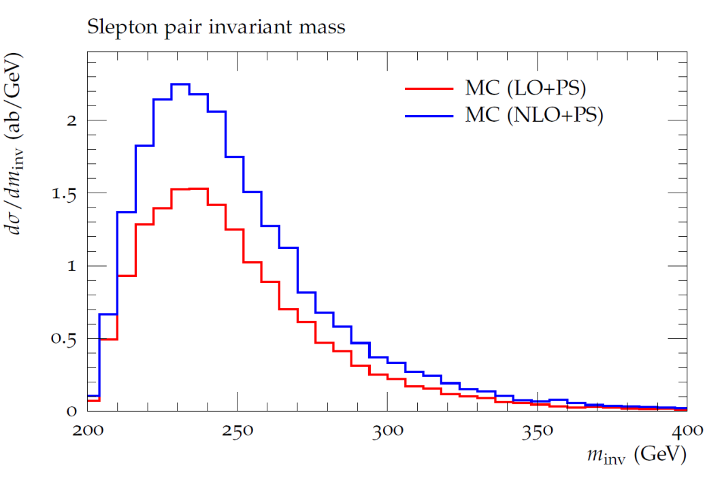
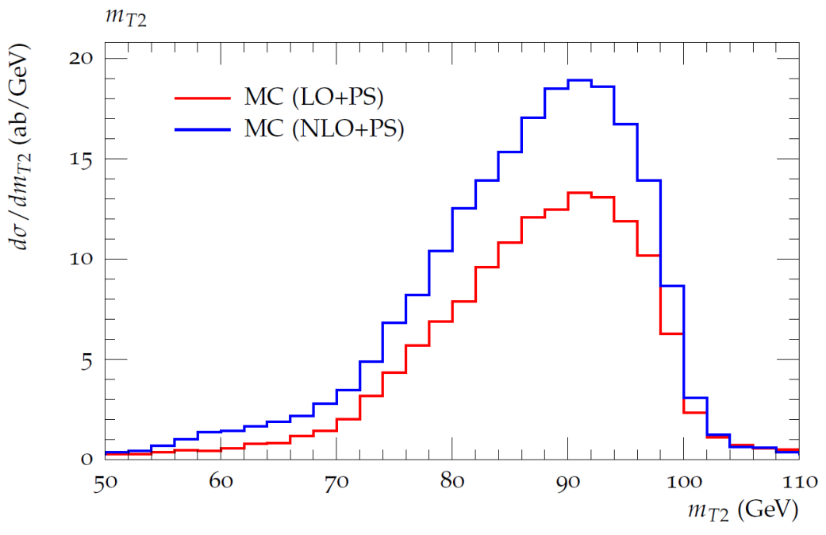
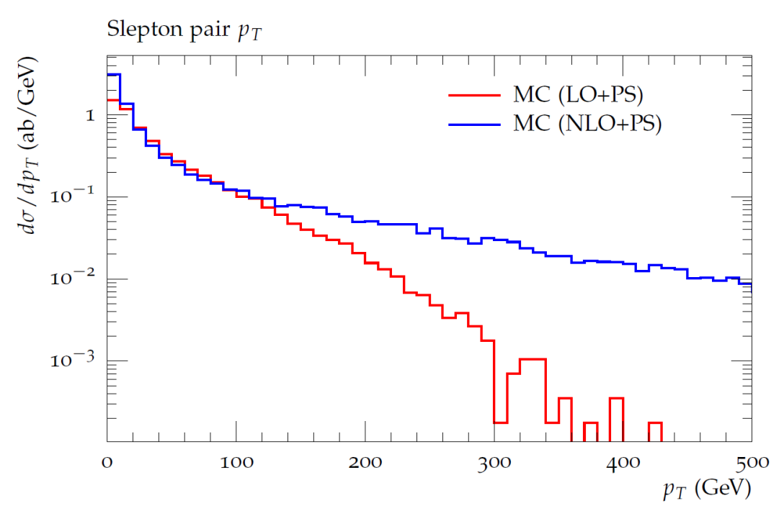
NLO SUSY Processes
A limited number of colour singlet NLO SUSY processes.
I. Fridman-Rojas PR arXiv:1208.0279

Slide 27
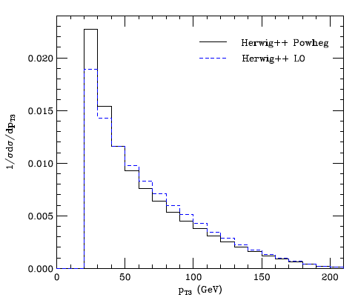
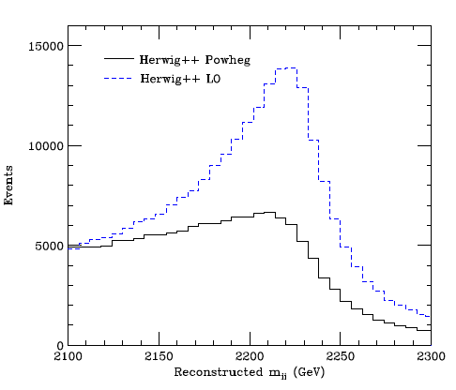

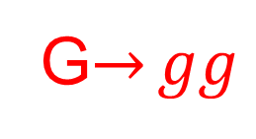
Hard Radiation in BSM Decays
First step in improving the simulation of hard radiation in BSM processes.
Apply a POWHEG style correction for real radiation in decays.
Will be available in the next release.
PR and A. Wilcock arXiv:1303.4563
$${\tilde{u}}_{L}\overset{→}{}\tilde{ug}$$
G$\overset{→}{}gg$

Slide 28
R-parity Violation
Long standing interest in R-parity violating models in Herwig.
Current version supports the showering and hadronization of externally supplied baryon number (and sextet) processes.
Work in progress on the internal implementation of R-parity via SLHA2.

Slide 29
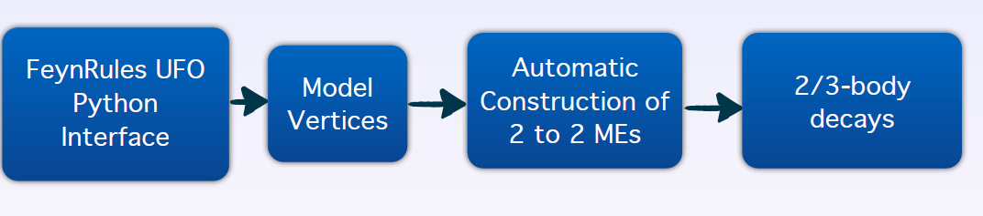
FeynRules UFO Python interface
Automatically convert a model in UFO file format into a Herwig++ model.
The rest of the machinery remains unchanged.
Implementation almost complete, some testing required. Soon in a public release!
D. Grellscheid and A. Papaefstathiou

Slide 30
Using Herwig++
The source code is available from
http://projects.hepforge.org/herwig/
together with wiki and bug tracker.
In order to improve user support in the first instance all requests for support to herwig@projects.hepforge.org.
We will open a ticket for all issues and use this for all interactions to improve support and keep a record.

Slide 31
Using Herwig++
Need to download and install ThePEG and Herwig++ as explained on
http://projects.hepforge.org/herwig/versions.html
Has been tested on a wide variety of Linux systems (32 and 64 bit) and Intel based Macs.
We use autotools, configure and make for installation.
Detailed instructions at
http://projects.hepforge.org/herwig/trac/wiki/HerwigInstallation
For the tutorial for this workshop we have supplied either a virtual machine or a script to install Herwig++ and all the dependencies. See https://herwig.hepforge.org/trac/wiki/MC4BSM-2013

Slide 32
Using Herwig++
A number of examples are installed in the share directory.
We have simplified the structure of the input files so that the majority of users should only need to edit one file.
If you try the LHC example LHC.in
  herwig-location/bin/Herwig++ read LHC.in
Creates the event generator LHC.run
  herwig-location/bin/Herwig++ run LHC.run –N#of-events
Runs the event generator.

Slide 33
Using Herwig++
The hard process can be changed by adding new matrix elements
# Drell-Yan Z/gamma
insert SimpleQCD:MatrixElements[0] MEqq2gZ2ff
# Drell-Yan W
# insert SimpleQCD:MatrixElements[0] MEqq2W2ff
# gamma-gamma
# insert SimpleQCD:MatrixElements[0] MEGammaGamma
# gamma+jet
# insert SimpleQCD:MatrixElements[0] MEGammaJet
# gg/qqbar -> Higgs
# insert SimpleQCD:MatrixElements[0] MEHiggs
# higgs+jet
# insert SimpleQCD:MatrixElements[0] MEHiggsJet
# QCD 2-2 scattering
# insert SimpleQCD:MatrixElements[0] MEQCD2to2
# top-antitop production
# insert SimpleQCD:MatrixElements[0] MEHeavyQuark

Slide 34
Using Herwig++
Simple analysis of the events, producing output in topdraw format can be switched on
##################################################
# Useful analysis handlers for hadron-hadron physics
##################################################
# analysis of W/Z events
# insert LHCGenerator:AnalysisHandlers 0 /Herwig/Analysis/DrellYan
# analysis of top-antitop events
# insert LHCGenerator:AnalysisHandlers 0 /Herwig/Analysis/TTbar
# analysis of gamma+jet events
# insert LHCGenerator:AnalysisHandlers 0 /Herwig/Analysis/GammaJet
# analysis of gamma-gamma events
# insert LHCGenerator:AnalysisHandlers 0 /Herwig/Analysis/GammaGamma
# analysis of higgs-jet events
# insert LHCGenerator:AnalysisHandlers 0 /Herwig/Analysis/HiggsJet

Slide 35
Using Herwig++
Cuts on the particles produced in the hard process can be changed, e.g. p_{T} and η of photons
set PhotonKtCut:MinKT 20.0*GeV
set PhotonKtCut:MinEta -3.
set PhotonKtCut:MaxEta 3.
Switch off parts of the event generation
Hadron Decays
Multiple scattering
set /Herwig/EventHandlers/LHCHandler:DecayHandler NULL
set /Herwig/Shower/ShowerHandler:MPI No

Slide 36
Using Herwig++
A number of examples of BSM models, SUSY, RS and UED are included with the release and can be used in the same way.
If you try the LHC MUED example LHC-MUED.in
  herwig-location/bin/Herwig++ read LHC-MUED.in
Creates the event generator LHC-MUED.run
  herwig-location/bin/Herwig++ run LHC-MUED.run –N#of-events
Generates events and provides the widths and branching ratios.

Slide 37
Conclusions
Herwig++ is a fully functional event generator for LHC physics and has been used to do the BSM simulation for many LHC analyses.
It provides detailed simulation of a wide range of models.
Future improvements will enable the simulation of a wider range of models.

