Slide 1
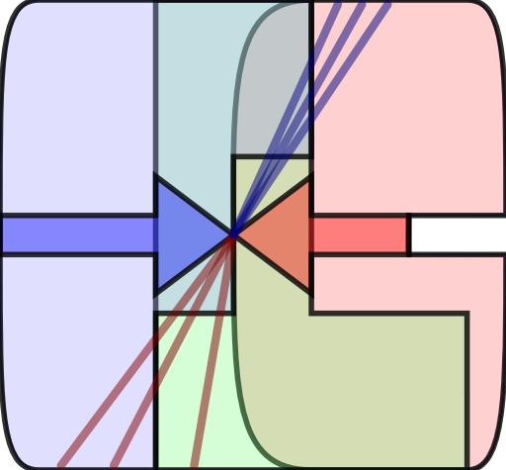
S-Electrons properties at the ILC
Sabato Stefano Caiazza
06 May 2013

Slide 2
ILC For SUSY
LHC SUSY searches
ILC SUSY searches
Can explore a wide phase space within the colored s-particle spectrum
Much less sensitive to s-leptons and s-top
Democratic EW production (especially sensitive to light particles)
Good definition of the center of mass energy
Beam polarization under control
Smaller phase space available for a search
Notes:
ILC 4 SUSY
Up to now we discussed the different strategies to search for SUSY signals at the LHC. In that environment the searches can explore a wide phase space in terms of the colored s-particles but the LHC experiments are less sensitive to s-leptons and s-top
On the other hand a lepton collider is more democratic in the production processes and is especially sensitive to light particles but doesn’t have access to such a wide phase space. On the other hand in this limited phase space, due to the knowledge of the center of mass energy and the possibility to modulate the beam polarization is possible to access much more information about the underlying physics

Slide 3
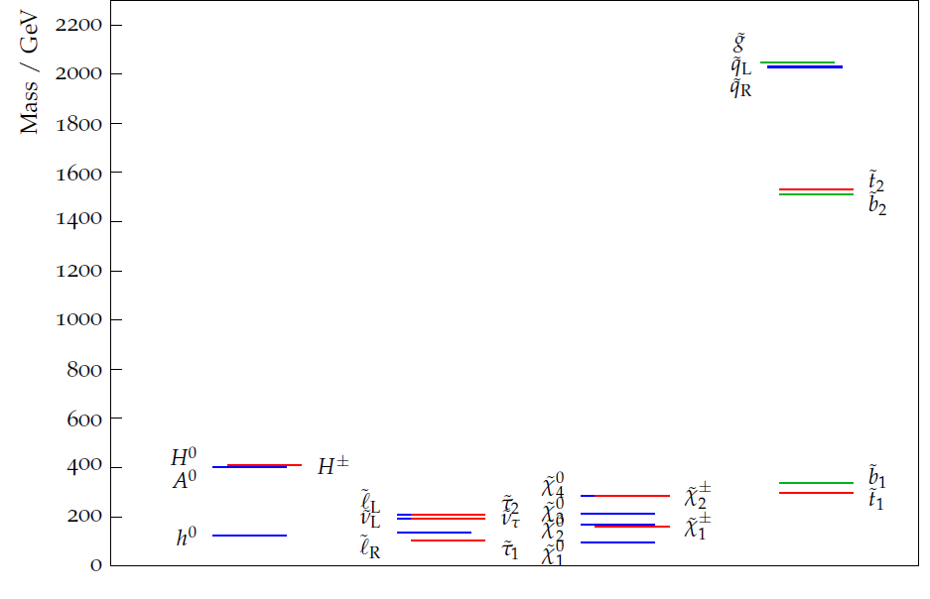
ILC friendly SUSY spectrum
Rich light spectrum
Heavy colored s-particles
Constrained by the LHC exclusions
Long decay chains
Mass degeneracies
Decoupled regions, limited parameter space
Notes:
TDR4 Benchmark
So an ILC friendly SUSY spectrum will feature a very rich light spectrum populated by all the particles that the LHC has not excluded yet. Such a model allows a lot of different physics processes both simple and complex. We can have long decay chains, configurations with particle almost mass degenerate and regions where a small set of the particle spectrum can actually be decoupled from the rest and described by a very limited number of parameters.
Don’t pay to much attention at the mass scale at this moment

Slide 4
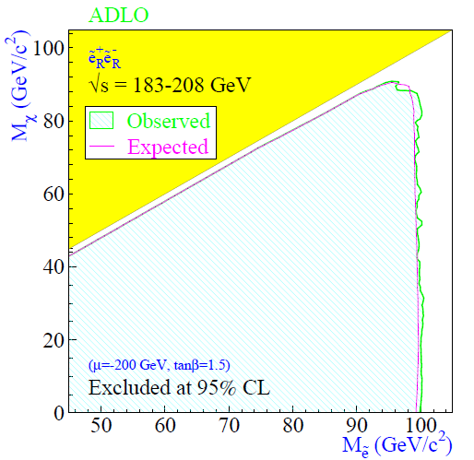
Sleptons / LSP decoupled region
S-leptons can only decay to LSP
Described in a 2 parameter space (the two masses)
LEP constraints
Each s-lepton is decoupled from the other
Neutralino heavier than 45 GeV
S-Electron / S-muon heavier than 95 GeV
Notes:
One of this configuration is that which describes the lightest sleptons and the LSP when the first can only decay to the latter. A very interesting situation appears when the one or more of the sleptons are lighter than the gauginos but the LSP. In this situation each of these decays 100% to the LSP creating a self contained two parameter system that can be explored quite thoroughly.
Among the different s-leptons the s-electrons have very interesting features that makes it particularly interesting
LEP already searches already put quite some constraint on this system and ILC can extend it further
SIMPLIFIED DIAGRAM
The situation I’m going to analyze is that of a SUSY spectrum where the lightest sleptons can only decay to the LSP. This configuration can be studied in a 2 parameter space for either the smuons or the selectrons (for the stau there might be some difference due to mixing of the different chiralities).
For this type of configuration there are quite stringent LEP constraints

Slide 5
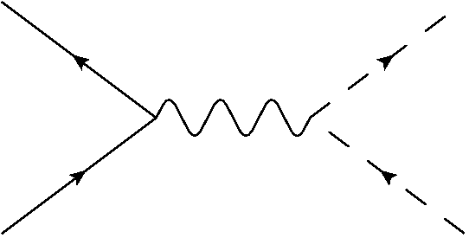
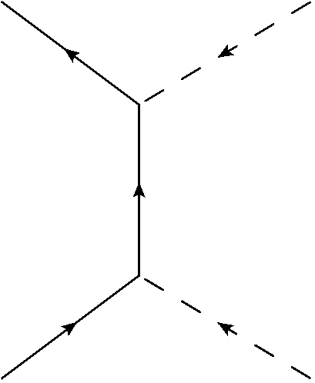
S-Electron Production @ ILC
S-Channel production
Massive T-Channel exchange
S-Electron chirality
Common to all s-fermions
Only possible for
Same branching ratio for and (if mass degenerate)
Strongly enhance the production (from 116,7 fb to 641,9 fb in TDR4)
and not mass degenerate
Right handed s-fermions lighter
A polarized beam can selectively produce (mostly) one type
Forward peaking angular distribution
Isotropic angular distribution
Notes:
Let’s start from the production of s-electrons in a lepton collider. The s-channel production of the s-electron is due to the exchange of a an EW neutral particle and is common to all the sfermions.
Because s-e and s-mu are degenerate or almost degenerate in mass in these scenarios, the branching ratio for this two processes is the same.
Additionally the s-e can be produced via a neutralino exchange in the t-channel. Because no other (visible) sfermion couple directly to electrons
There is one more feature to discuss. Contrary to the fermionic partners, the two chiral state of the sfermions are not mass degenerate and in most of the cases the right handed sfermions is lighter than the left handed one.
A polarized beam can be used to selectively produce mostly one particle type compared to the other

Slide 6
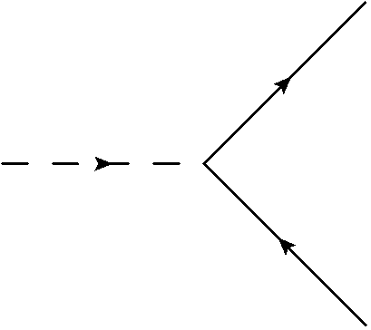
S-Electron decays
Special case
LSP is the only lighter neutralino
General case
Electron + Neutralino
Neutrino + Chargino
Only one available decay channel
Two body decay of a boosted scalar particle
Start of a potentially long decay chain
Physical parameters
Neutralino Mass
S-Electron mass
Center of mass energy
Notes:
Now let’s dicuss the decay modes.
In general the s-electron decays to an electron and a neutralino or the matching neutrino with a chargino with a branching ratio depending on the gaugino mixing from which then a possibly long decay chain can start.
In the special case when only the LSP is lighter than the selectron we are considering we have a single decay mode available. In this configuration we have a simple two-body decay of a scalar particle which can be described by 3 parameters: Neutralino mass, selectron mass and the center of mass energy

Slide 7
Two body decay of a scalar particle
2-Body decay in the parent rest frame
Boosting the parent rest frame
Scalar parent
Daughters’ momentum fixed
Daughters’ momentum depend on the angle between the decay and the boost direction.
The particle decay isotropically
The momentum is distributed uniformly
Experimental parameters
Width and mean of the momentum distribution
Position of the edges of the distribution
Distribution smearing due to instability of E_{CM} and other uncertainties
$$γ={E_{CM}}/{2M_{\tilde{e}}}$$
Notes:
If we start in the rest fram of the s-electron we know that the daughter’s momentum must be fixed by simple kinematics.
Once we boost the parent rest frame the actual particle momentum we can detect on the experiment depends on the angle between the decay and the boost direction
Because the decaying particle is a scalar the decay is isotropic which means that the momentum of the electron will be uniformly distributed between a minimum and a maximum.
Now we need to get two experimental parameters to correlate to the physical ones and these are the width and the mean of the momentum distribution or alternatively the position of the edges. One of the problems is that the distribution itself might be smeared by the limited stability of the center of mass energy due to beamstrahlung

Slide 8
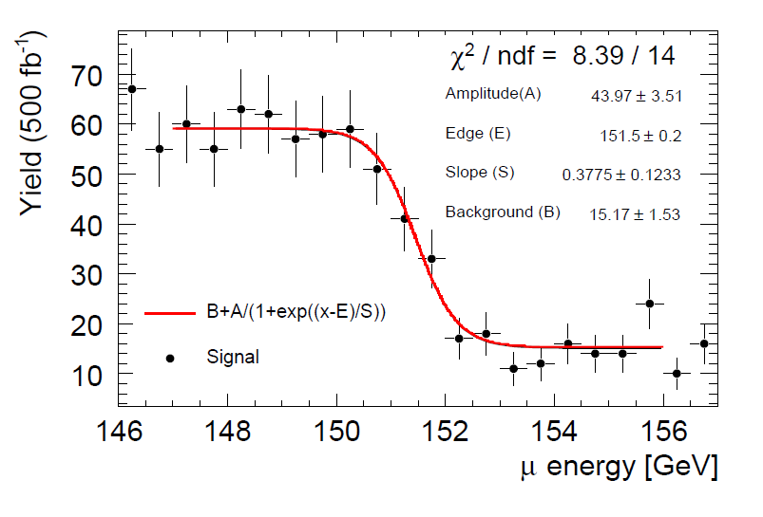
Fitting the edge
Fitting the edge
Traditional method used in other analysis.
Requires a preliminary assumption about the shape of the edge.
Uses a limited number of bin around the edge
From D’Ascenzo – DESY Thesis 2009-004
Notes:
So now let’s assume we have such a distribution I, wanted to introduce a few methods that can be used to find the relevant parameters of this distribution.
The traditional way that is used to find the edges of such a distribution is to fit some approximation of a step function to the data in those few bins around the edge position and define the edge position as a function of one of the parameters of this function.
This technique has two issues: one is that it only uses a very limited amount of data that are those in the few bins around the edge and the second one is that requires a preliminary assumption about the actual shape of the edge.

Slide 9
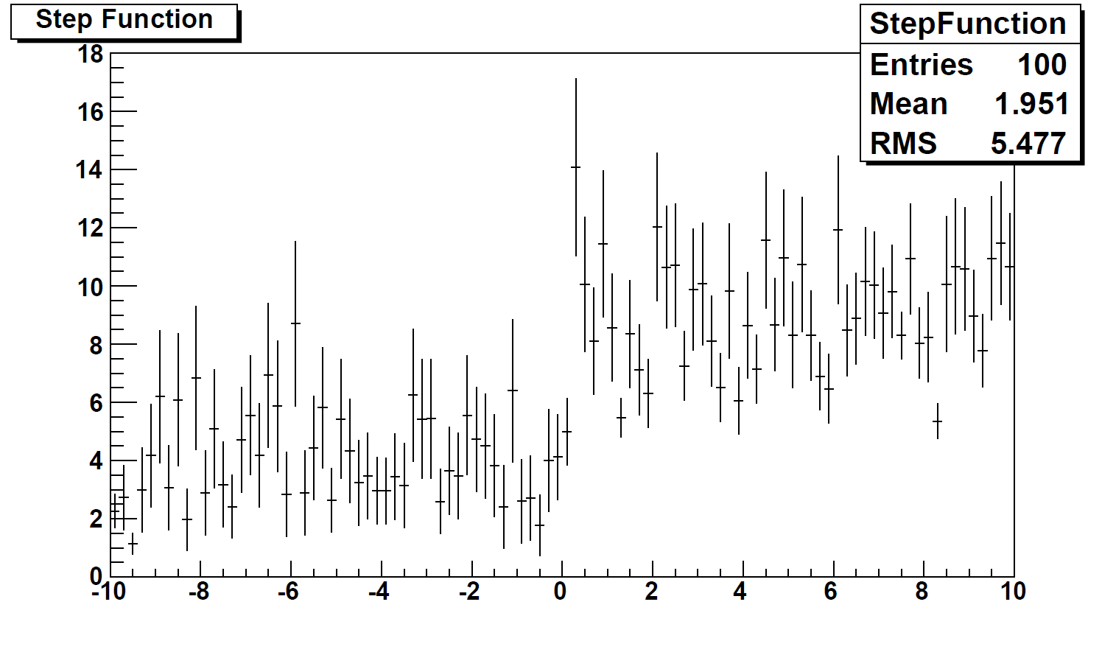
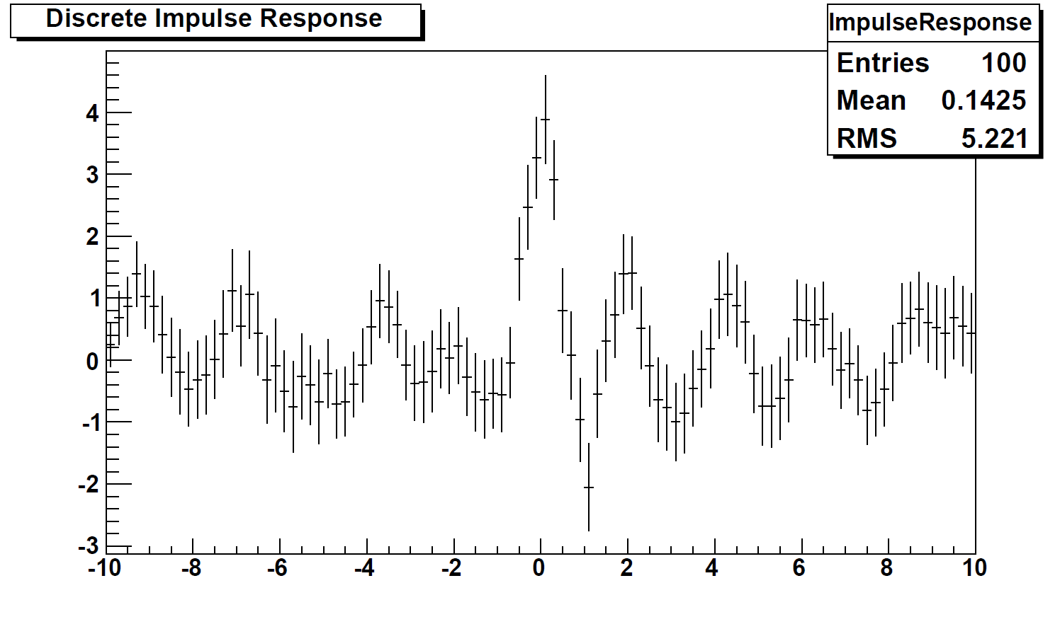
Edge Detection
Computational edge detection
How does it work
Test example
Based on image processing techniques (Canny Filter)
No prior assumption required
It can give information about the edge shape
Convoluting the function to analyze with a special weighting function
Weighting function is optimized for the feature to detect (Steps, ridges, Roofs)
First derivative of a gaussian is almost optimal for edges
See: John Canny – A Computational approach to edge Detection (1986)
Step function at 0
Gaussian smearing
Poisson random noise
Notes:
What I tried to do then was to introduce a technique, based on common image processing algorithms that would detect the edge position without any prior assumption about the edge shape and could actually provide some information about that shape.
Technically it is a
In this plot I wanted to show this technique applied to a test distribution. The edge position is at 0 and it is smeared with a gaussian function. On top of this I applied a Poisson distributed white noise.
If you look by eye you would probably fix the edge at 0,5 due to this bin having a particularly high fluctuation, but applying this technique you can actually detect the real position of the edge which is actually at zero

Slide 10
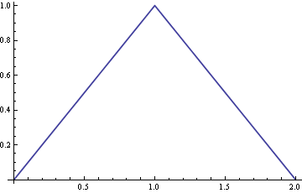
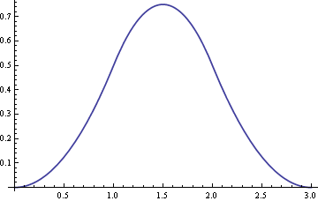
Alternative characterization
Using all data available
Central Limit Theorem
Edge detection techniques only use a limited amount of data near the feature
The mean of a sufficiently large number of independent random variables, each with a well-defined mean and well-defined variance, will be approximately normally distributed
Parameter determination
Average a random sample of electron momenta and fit the results with a gaussian
The momentum of each selected electron is an independent random variable sampled from a box like distribution
Derive the mean and the width of the initial distribution
Quite effective with large amounts of data
Notes:
This techniques I described is quite efficient but still only uses a very limited amount of data around the actual position of the edge while completely ignoring the whole bulk of the distribution.
As I said we need two parameters to describe our distribution and from which we can derive the physical parameters. These can be the mean and the width of the distribution. To try and use all the data of the distribution I introduced another technique based on the basic central limit theorem.
If we assume that each electron that we select is actually an independent sample taken out of the distribution we want to study we can apply the central limit theorem and plot the average of a fixed number of these samples. For a good behavior distribution the distribution of the mean of n samples would be a gaussian with the same mean of the distribution and a sigma that is correlated to the width of the initial distribution. If we assume that the initial distribution was a box distribution we can get the width of the box from the sigma of the gaussian distribution we obtain.

Slide 11
Model independent Constraints
LEP Limits
S-Electron mass > 95 GeV
ILC Parameters
CM energy 500 GeV
Neutralino mass > 45 GeV
Max electron polarization 80%
Max positron polarization 30%
Model Independent signature
Missing energy > 90 GeV
1 electron and 1 positron only in the final state
Each e/p momentum < 200 GeV
Low activity around the beam pipe
Notes:
Now we can try to apply these concepts to some actual data and I will need to introduce some specific model point on which to work but what I’ll show is actually quite independent from the actual model point. The constraint from which I started are just the LEP limit of the neutralino mass and the nominal center of mass energy of the machine.
The LEP limits the neutralino mass to 45 GeV (Check better) and the nominal center of mass energy of ILC that I used is 500 GeV. This will constraint the experimental signature to 1 isolated electron and 1 isolated positron, each of which with less than 200 GeV/c momentum, and a maximum visible energy of 400 GeV/c. I don’t expect any other activity and I also expect that most of the activity is far from the beam line.
It is also important to notice that this is done with polarized beams

Slide 12
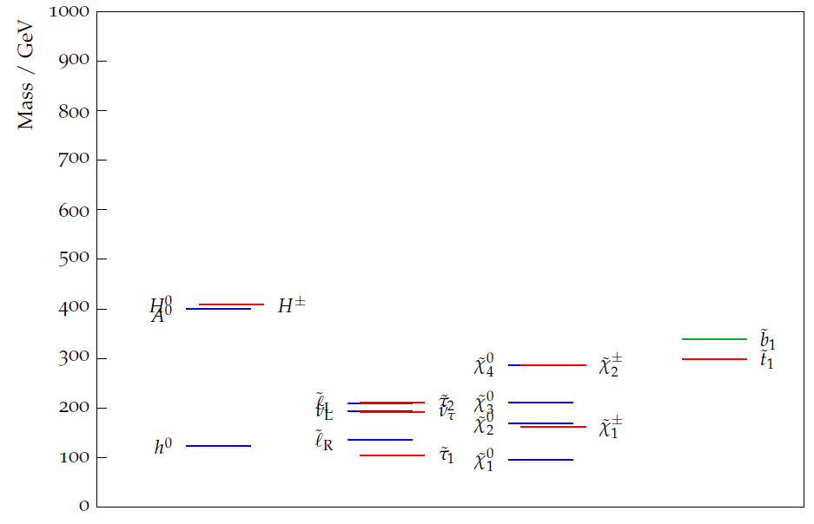
S-leptons spectrum in TDR4
Neutralino Mass: 94.4 GeV/c²
S-Electron Mass: 135.0 GeV/c²
Theoretical Dist. Center: 63.88 GeV/c
Theoretical Dist. Width: 107.53 GeV/c
Notes:
Now we can try to apply these methods to some model point. I already showed you at the beginning the whole spectrum of this model point, thi is a zoom below and what we focus on is this section below 150 GeV. In this model the Neutralino has a mass of 94.4 GeV and the Selectron of 135.0 GeV

Slide 13
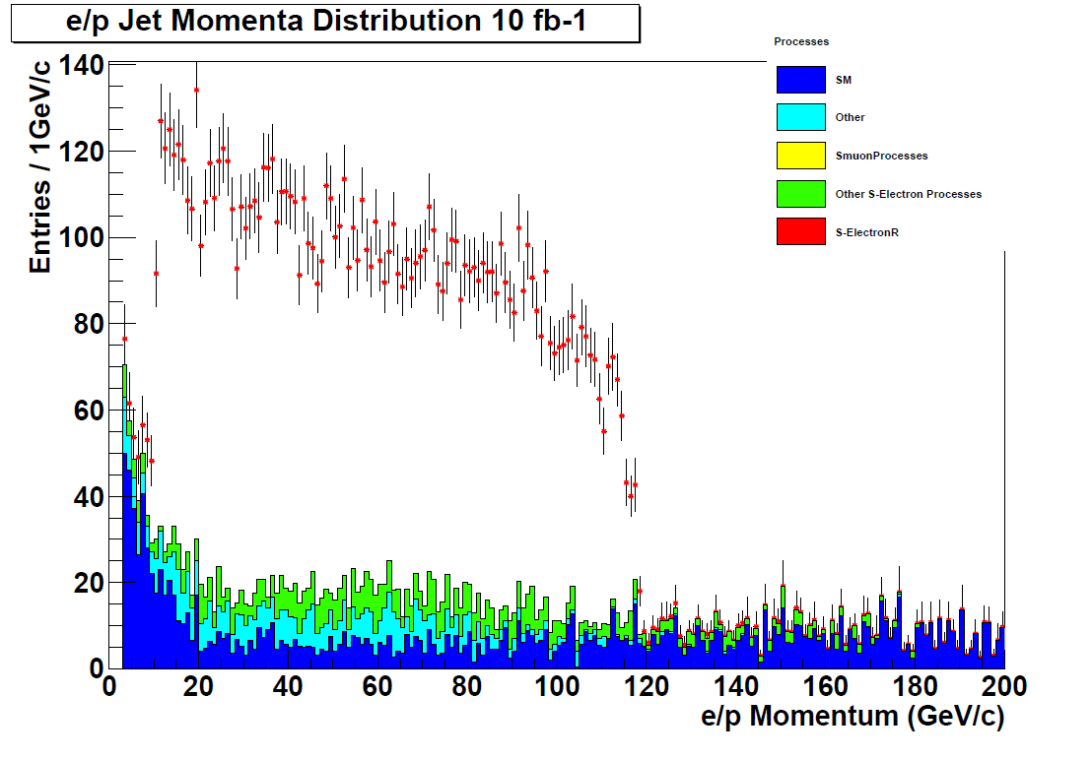
Constraining in 1 week
10 fb⁻¹ ILC Data
Equivalent to 1 week of full luminosity
Notes:
After about 1 week of data taking at its nominal luminosity this is what ILC would be able to produce, subject to the cuts I mentioned.
When I apply the algorithms I mentioned I get this number for the selectron and neutralino mass. As I said this was obtained without any more constraint than those that you can find in the PDG, assuming our simplified model

Slide 14
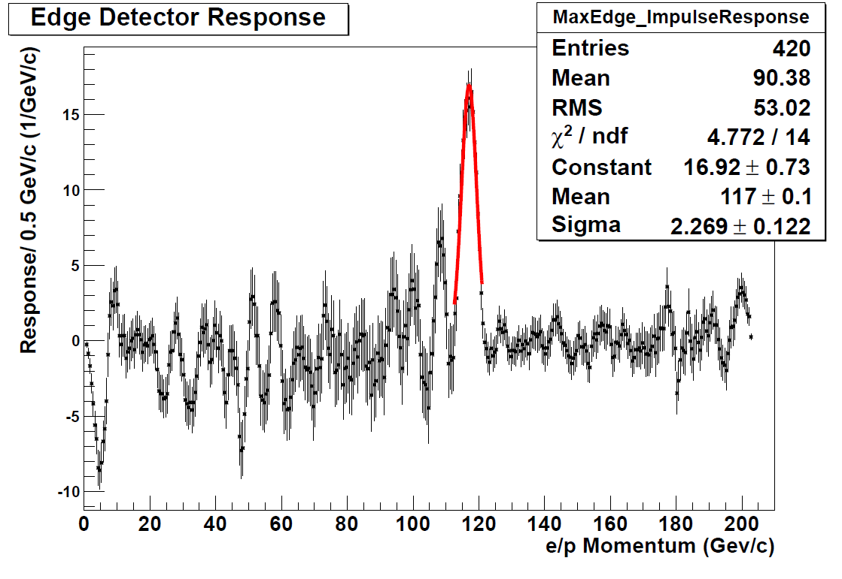
Edge Detector Response
High Edge Position:
Low Edge Position:
Expected: 117.64 GeV/c
Measured 117 ± 0.1 GeV/c
Expected: 10.11 GeV/c
Measured: 10.67 ± 0.07 GeV/c
Notes:
Now I can apply the edge detection algorithm and this is a sample of the result applied to the data to detect the edge at high momentum.
On this plot I show the response of the algorithm to detect the edge position for the high edge of the distribution.
To evaluate the peak position I fitted a gaussian around the highest peak using the error on the mean as the error on my measurement

Slide 15
Edge Detector Errors
High Edge Position
Low Edge Position
Expected: 117.64 GeV/c
Measured 117 ± 0.1 GeV/c
Expected: 10.11 GeV/c
Measured: 10.67 ± 0.07 GeV/c
Symmetric offset
Distribution center
The technique measures the center of the edge, not the endpoint
It can be calibrated
It can be corrected analytically using the amplitude and width of the response
Expected: 63.88 GeV/c
Measured: 63.83 ± 0.12 GeV/c
Notes:
Now you will probably notice that there is a systematic offset of about 500 MeV, symmetric on the two edges, the low edge is slight higher, the high edge slightly lower.
It’s not a chance, it is actually due to the fact that the technique measures the center of the edge, not the endpoint.
Nonetheless I think the issue is not very important because this error can be calibrated away or, even better, can be corrected analytically using the amplitude and width of the response. But I still have to work on it a bit.
The best demonstration of the efficiency of the method is the determination of the distribution center

Slide 16
Mass Measurement
Using 1 week of data
Model independent and not optimized cuts
Without calibration/corrections
Distribution center
Expected: 63.88 GeV/c
Measured: 63.83 ± 0.12 GeV/c
Distribution Width
Expected: 107.53 GeV/c
Measured: 106.44 ± 0.12 GeV/c
Neutralino Mass
Expected: 94.4 GeV/c²
Calculated: 96.6 ± 0.9 GeV/c²
S-Electron Mass
Expected: 135.0 GeV/c²
Calculated: 138.8 ± 0.8 GeV/c²
Notes:
Now I can just try to apply this values to the measurement of the selectron and neutralino mass.
Bearing in mind that the analysis only make use of a limited amount of data, very loose and model independent cuts and without calibration and correction it is possible to calculate the following values for the selectron and neutralino mass. They are a bit higher that the true value but it’s expected due to the lack of calibration and correction, still these are already close to the target

Slide 17
Backup

Slide 18
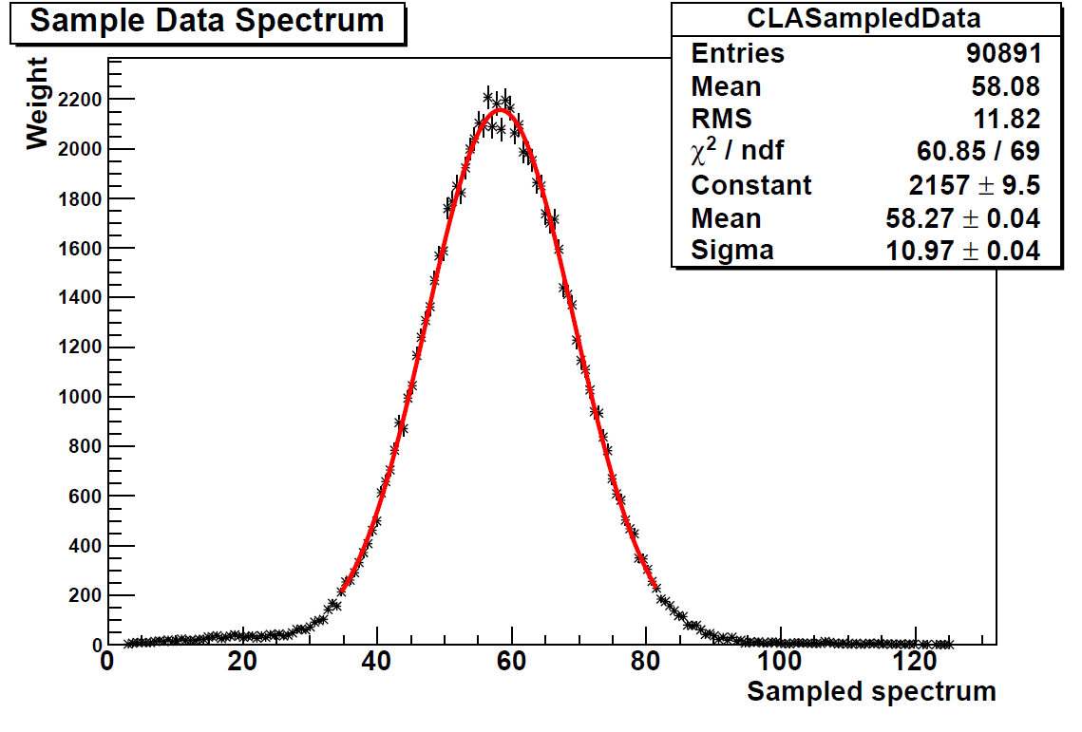
250 fb-1 Central Limit
Distribution Width
Expected: 107.53 GeV/c
Measured: 107 ± 0.4 GeV/c

Slide 19
Conclusion
Constraining a simplified model in 1 week at ILC
Computational method for edge detection
Light s-electron decay to the LSP
No assumption on the edge shape
Preliminary results allow to constrain the physical parameters within few GeV
Very consistent edge determination
Needs some refinement to obtain the end point position
Notes:
What I wanted to show was how, in a simplified SUSY model where the LSP is the only neutralino/chargino lighter than the light sleptons a machine like ILC can quickly detect and measure the properties of the model without any further preliminary assumption using the powerful signal provided by the selectron production in a e/p collider.
I also introduced a new method that can be used to calculate the position of the edges of a distribution using a computational technique that doesn’t require any prior knowledge of the shape of such an edge. This technique can be very efficiently used to calculate the position of the center of the edge. Using this very simple tools I obtained a first determination of the selectron and neutralino mass in this scenario that is already very close to the actual value.
In the ext week I plan to optimize the system and calibrate it and I’m optimistic that I can obtain a mass resolution within 1GeV with this limited amount of data.
I also apply the same technique to the full 250 fb-1 data of the 5 year ILC plan.

