Slide 1
FERMI@Elettra
E. Allaria, R. Appio, L. Badano, W.A. Barletta, S. Bassanese, A. Battistoni, F. Bencivenga, S.G. Biedron, A. Borga, R. Borghes, M. Bossi, E. Busetto, C. Callegari, F. Capotondi, D. Castronovo, P. Cinquegrana, S. Cleva, D. Cocco, M. Coreno, M. Cornacchia, P. Craievich, R. Cucini, I. Cudin, F. D'Amico, M.B. Danailov, M. Dal Forno, G. D'Auria, A. Demidovich, R. De Monte, P. Delgiusto, G. De Ninno, S. Di Fonzo, M. Di Fraia, S. Di Mitri, B. Diviacco, A. Fabris, R. Fabris, W. Fawley, M. Ferianis, E. Ferrari, S. Ferry, L. Fröhlich, P. Furlan, G. Gaio, F. Gelmetti, A. Gessini, E. Giangrisostomi, D. Giuressi, L. Giannessi, M. Giannini, R. Gobessi, C. Grazioli, R. Ivanov, E. Karantzoulis, M. Lonza, A. Lutman, B. Mahieu, N. Mahne, C. Masciovecchio, M. Milloch, S.V. Milton, M. Musardo, I.P. Nikolov, S. Noe, F. Parmigiani, G. Passos, E. Pedersoli, G. Penco, M. Petronio, L. Pivetta, M. Predonzani, E. Principi, L. Raimondi, F. Rossi, L. Rumiz, A. Salom, C. Scafuri, R. Sergo, C. Serpico, P. Sigalotti, S. Spampinati, C. Spezzani, M. Svandrlik, C. Svetina, S. Tazzari, M. Trovò, R. Umer, A. Vascotto, M. Veronese, R. Visintini, M. Zaccaria, D. Zangrando, M. Zangrando and many others
Beschleunigerbetriebsseminar Grömitz, 18.–21.3.2012
Lars Fröhlich, Elettra–Sincrotrone Trieste

Slide 2
Overview
FERMI@Elettra
Machine layout
Parameters
Timeline
FERMI FELs
High Gain Harmonics Generation
FEL1 – 1-stage HGHG
FEL2 – 2-stage HGHG
Diagnostics + Feedbacks
Map:
Wikimedia Commons

Slide 3
Elettra & FERMI
FERMI@Elettra Project
80–4 nm HGHG Free-Electron Laser
Sponsors:
Ministero dell'Istruzione, dell'Università e della Ricerca (MIUR)
Regione Autonoma Friuli Venezia Giulia
European Investment Bank (EIB)
European Research Council (ERC)
European Commission (EC)
Collaborations:
DESY, ENEA, INFN, LBL Berkeley, MAX-lab, MIT, ...
Linac
Undulator Hall
Experimental Hall
Notes:
Elettra: 2.0 GeV/2.4 GeV, up to 350 mA
1 GeV linac in use until 2007
2010: Top up

Slide 4
FERMI@Elettra
100 MeV
270 MeV
~650 MeV
1.2 GeV
 | Energy | Bunch Charge | Repetition Rate | Beam Power
Typical | 1.2 GeV | 500 pC | 10 Hz | 6 W
Future | 1.5 GeV | <1 nC | 50 Hz | <75 W
Notes:
gun: 1.6 cell
S0: SLAC type, forward traveling wave, 2/3pi mode
C: CERN type, forward traveling wave, 2/3pi mode
S: ELETTRA type, backward traveling wave, 3/4pi mode, SLED rf pulse compression
X: X-band

Slide 5
FERMI@Elettra
FEL1: 1-stage HGHG
FEL2: 2-stage HGHG
 | Seed Wavelength | Modulators | Radiators | Output Wavelength
FEL1 | 210–280 nm | 1 (planar) | 6 (APPLE-II) | 80–20 nm
FEL2 | 210–280 nm | 2 (planar) | 2 + 6 (APPLE-II) | 20–4 nm
Notes:
gun: 1.6 cell
S0: SLAC type, forward traveling wave, 2/3pi mode
C: CERN type, forward traveling wave, 2/3pi mode
S: ELETTRA type, backward traveling wave, 3/4pi mode, SLED rf pulse compression
X: X-band

Slide 6
Injector

Slide 7
CERN Structures

Slide 8
SLED Structures

Slide 9
Spreader

Slide 10
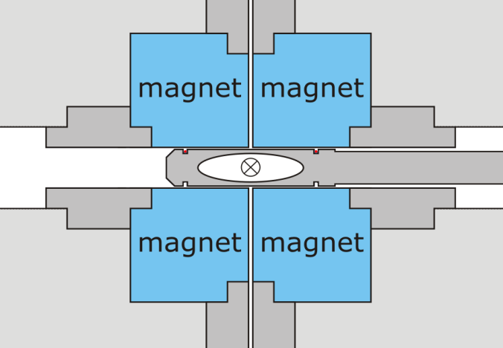
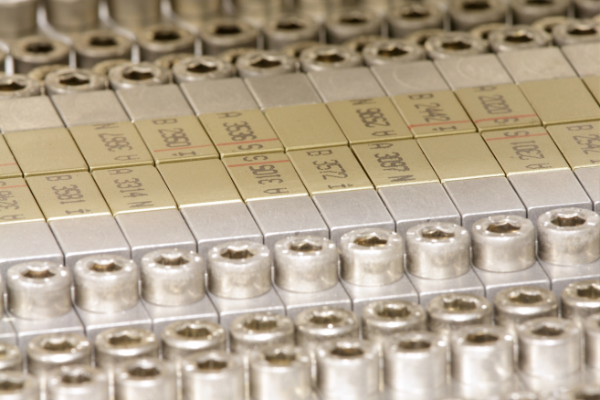
FEL-1 Radiators

Slide 11
Dump Line

Slide 12
Experimental Hall

Slide 13
Beamlines & Scientific Programs
TIMEX – Elastic and inelastic scattering
Transient grating spectroscopy (transform-limited bandwidth)
Pump & probe spectroscopy, ultra-fast magnetization dynamics (brightness, wavelength tunability)
DIPROI – (Coherent) diffraction and projection imaging
Single shot (bio and solid state structures)
Resonant (chemical and magnetic imaging)
Time-resolved (morphology and internal structure at the nm scale)
(brightness, wavelength tunability, circular polarization)
delay lines
LDM – Low density matter
Structure of nano-clusters (brightness)
High resolution spectroscopy (narrow bandwidth, wavelength tunability)
Ionization dynamics (circular polarization)
Catalysis in nano-materials (fs pulse and stability)

Slide 14
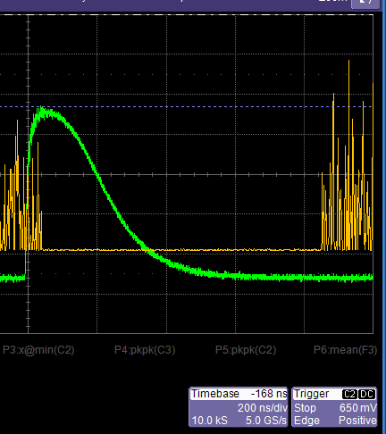
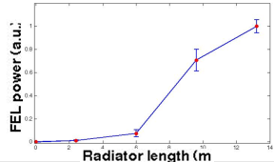
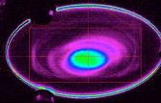
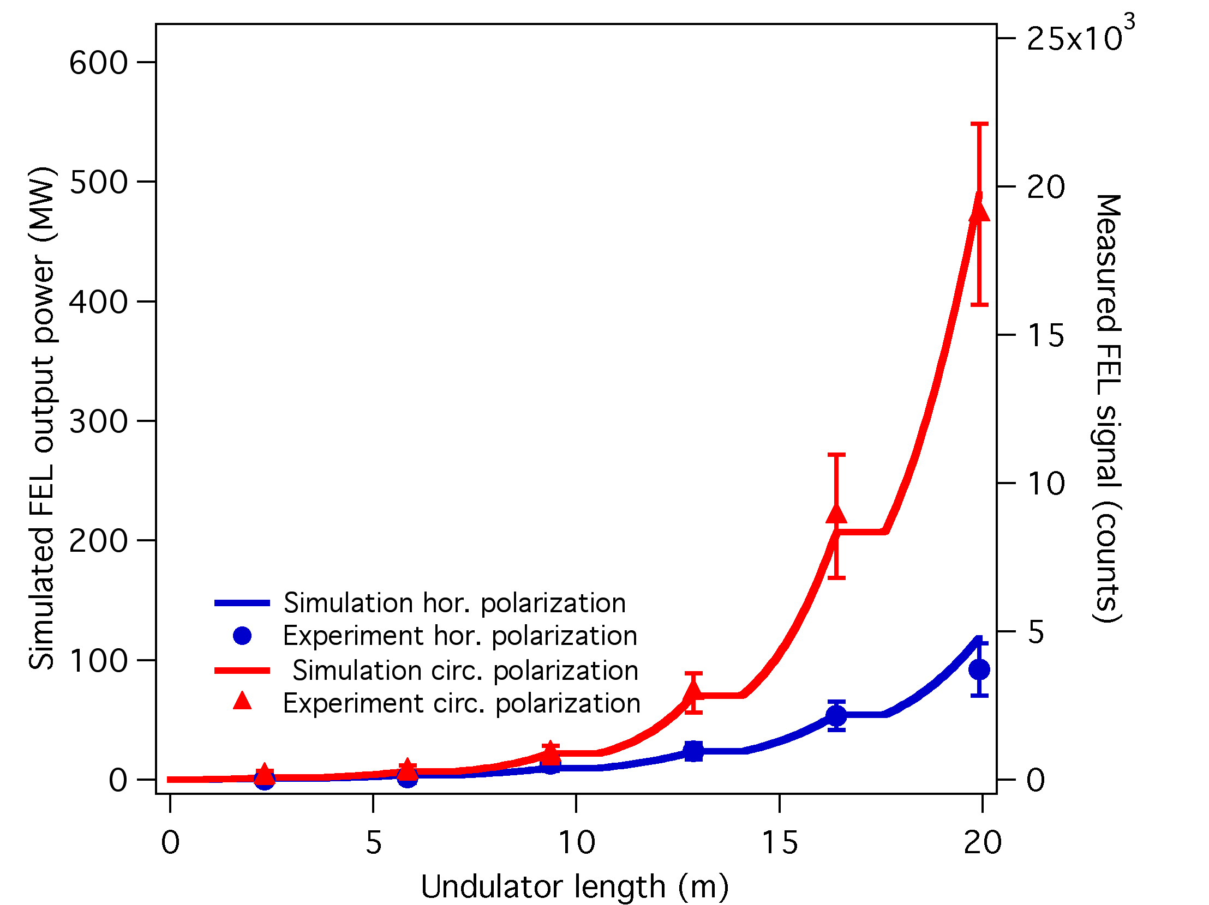
Timeline
2009
05 – Linac building ready
08 – Start of photoinjector commissioning
2010
06 – Undulator hall ready
07 – BC1 commissioning
09 – Full beam energy reached
10 – FEL1 undulators installed
10 – Experimental hall ready
12 – First coherent emission from FEL1 (43 nm)
2011
02 – First evidence of FEL gain
04 – First light to beamlines, initial photon experiments
07 – First observation of “Gaussian” spot
07 – Measured exponential gain curve

Slide 15
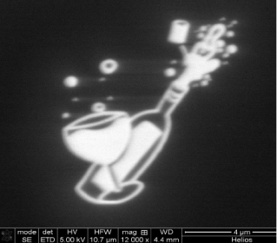
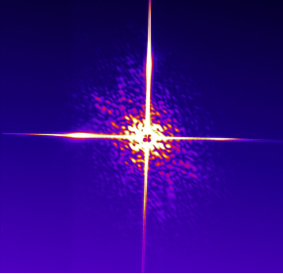
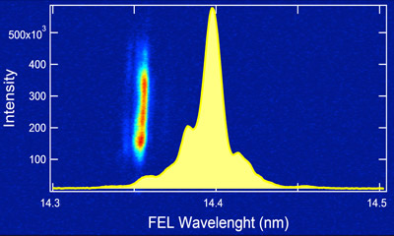
Timeline
2012
02 – First electrons through FEL2 line
03 – First single shot diffraction image
04 – FEL2 undulators installed
05 – Laser heater commissioned
05 – X-band cavity commissioned
05 – First photons from first stage of FEL2
10 – First lasing of full FEL2 setup
12 – Dual-color operation with two seed pulses
2013
02 – First pump-probe experiments with IR laser
03 – FEL2 commissioning

Slide 16
FEL1

Slide 17
FEL1: Single-stage HGHG
energy
energy
Simulations: E. Allaria
non-sinusoidal density modulation
→
harmonic content
current

Slide 18
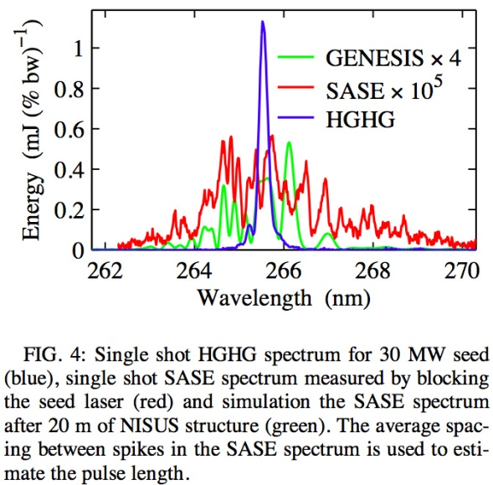
FEL1: Single-stage HGHG
Differences to SASE:
Hard to reach short photon wavelengths
Added complication of spatial/temporal overlap
Temporal coherence (no single spikes)
More control over lasing process (e.g. pulse length, energy chirp)
Clean spectrum (small bandwidth)
L.H. Yu et al., PRL 91, 074801 (2003).

Slide 19
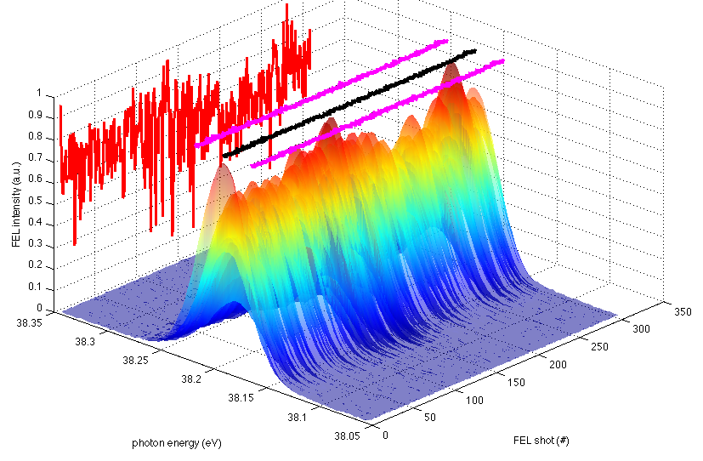
FEL1: Wavelength Stability
In addition to a very narrow spectrum FERMI delivers excellent spectral stability.
Short and long term measurements show that the spectral peak jitters by less than 1 part in 10⁴.
Photon energy 38.19 eV
Abs. fluctuation (rms) 1.1 meV
Rel. fluctuation (rms) 3·10⁻⁵
Abs. rms bandwidth 22.5 meV
Rel. rms bandwidth 6·10⁻⁴
Electron bunch: 350 pC, 1.24 GeV, CF~3
Resonant wavelength: 32.5 nm
E. Allaria

Slide 20
Optical Parametric Amplifier
Operation with OPA
Tunable seed → tunable FEL wavelength
Drawbacks:
Minor pulse energy
Lower transverse beam quality
M. Danailov et al., Proc. FEL2011, pp. 183–186.

Slide 21
FEL1: Two Colors
Images: E. Allaria, W. Fawley
0.2 nm
Operation with two seed pulses
DIPROI pump–probe experiment
(December 2012)
Pulse separation: ~0.6 ps
wavelength
delay seed–electrons (ps)
Notes:
Image: 7th harmonic of ~262 nm

Slide 22
FEL2

Slide 23
FEL2: Two-stage HGHG
260 nm seed
→
43.3 nm radiation
(6th harmonic)
43.3 nm seed
→
14.4 nm radiation
(3rd harmonic)

Slide 24
FEL2: Two-stage HGHG

Slide 25
FEL2: Two-stage HGHG
energy modulation 260 nm

Slide 26
FEL2: Two-stage HGHG
density modulation 260 nm + harmonics

Slide 27
FEL2: Two-stage HGHG
radiation emission
43.3 nm
(6th harmonic)

Slide 28
FEL2: Two-stage HGHG
“Fresh bunch injection” Delay electron bunch so that the photon pulse overlaps with a fresh part.

Slide 29
FEL2: Two-stage HGHG
energy modulation 43.3 nm

Slide 30
FEL2: Two-stage HGHG
density modulation 43.3 nm + harmonics

Slide 31
FEL2: Two-stage HGHG
radiation emission
14.4 nm
(3rd harmonic)

Slide 32
FEL2: Two-stage HGHG

Slide 33
14.4 nm without Fresh Bunch
11.10.2012 Morning
Allaria/Giannessi
The FEL was turned on in the morning almost in the same conditions as it was left yesterday, with about 20 uJ at 43nm. During optimization we found an unexpected behavior of the FEL intensity vs the phase shifter between the two radiators of the first stage. A software problem related to the e-beam energy was fixed by B. Diviacco. Now the phase shifters operate as expected. A signal at 14.4 was obtained with the modulator of the second stage tuned at 14.4nm as all the following radiators. This signal was used to optimize the emission at this wavelength. The Zr filter is doing what expected, with a negligible transmission at 43nm and few percent transmission at 14.3 nm. With the filter in it is possible to observe the spot at the short wavelength on the yag screen.
Notes:
0.99 GeV

Slide 34
14.4 nm with Fresh Bunch
11.10.2012 Afternoon
Diviacco/Fawley
… LG then optimized quad settings to peak emission with all 6 radiators closed and we found a fairly good and tight mode pattern. Then we turned on the delay section; initially could only get a sporadic signal with about 160 fs of delay in last hour of shift we tried to optimize orbit and timing, often getting a strong signal (>500 pC on the FEL-2 photodiode, comparable to best seen in "whole bunch" operation earlier) but the trajectory feedback in the iUFEL region was unable to keep a steady trajectory as it seems the delay chicane produces a kick which cause the FLE02.02 H corrector to max out in current.
We are reasonably sure given the delay time that this is true fresh bunch, 2 stage HGHG emission -- if true, more prosecco will be needed by the end of next week (or possibly this weekend).
Several setups were tried:
14.4 nm (6x3),
10.8 nm (12x2/8x3/6x4/4x6),
08.7 nm (6x5)

Slide 35
FEL2: Lasing at 10.8 nm
unpublished data
Notes:
Pulse energy up to 100 uJ
~120 fs pulse length

Slide 36
Diagnostics + Feedbacks

Slide 37
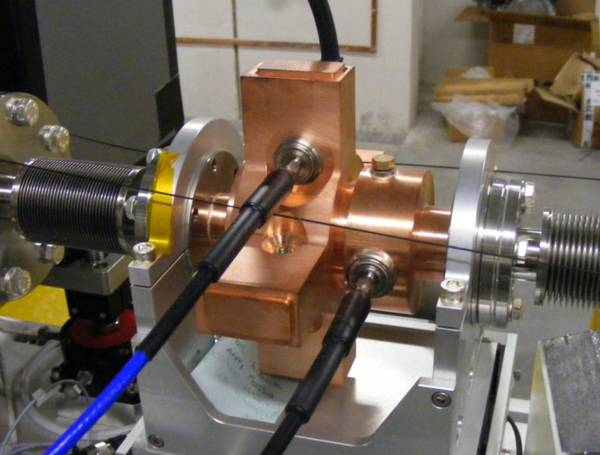
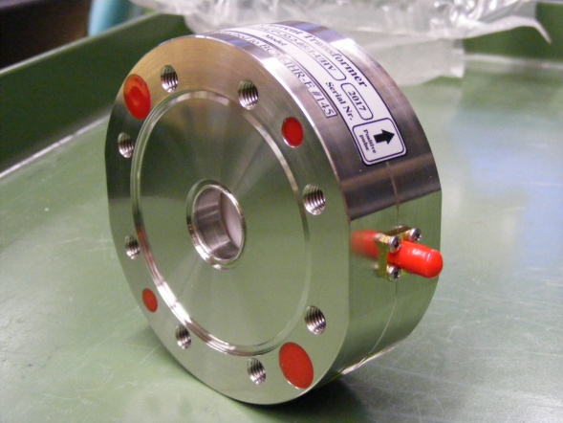
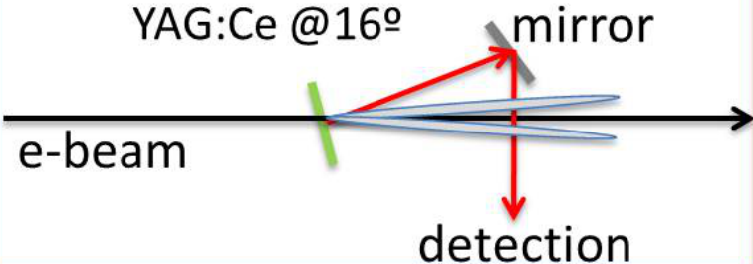
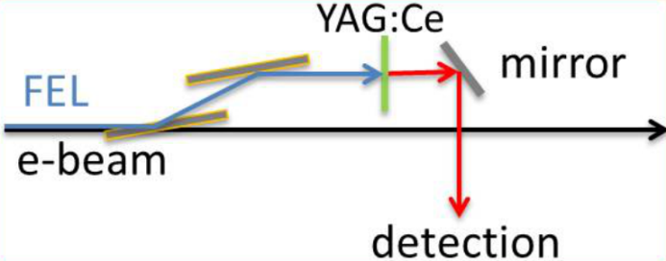
Standard Diagnostics
Beam position monitors (S. Bassanese, R. De Monte)
Stripline BPMs + Libera
Undulators: Cavity BPMs (range ±1.5 mm, res. 1.2 µm)
Charge monitors (S. Bassanese)
Bergoz in-flange, ~1% resolution
Screens
(L. Badano, M. Bossi, M. Veronese)
Standard multiscreens: YAG/OTR at 45°
Undulator screens:
Electron beam — YAG
Photon beam — Mirrors + Al-coated YAG
Notes:
gun: 1.6 cell
S0: SLAC type, forward traveling wave, 2/3pi mode
C: CERN type, forward traveling wave, 2/3pi mode
S: ELETTRA type, backward traveling wave, 3/4pi mode, SLED rf pulse compression
X: X-band

Slide 38
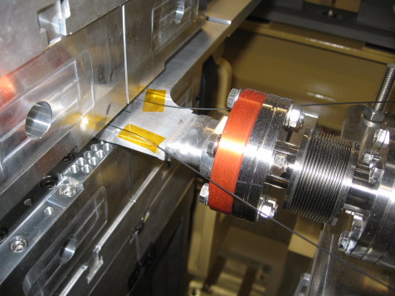
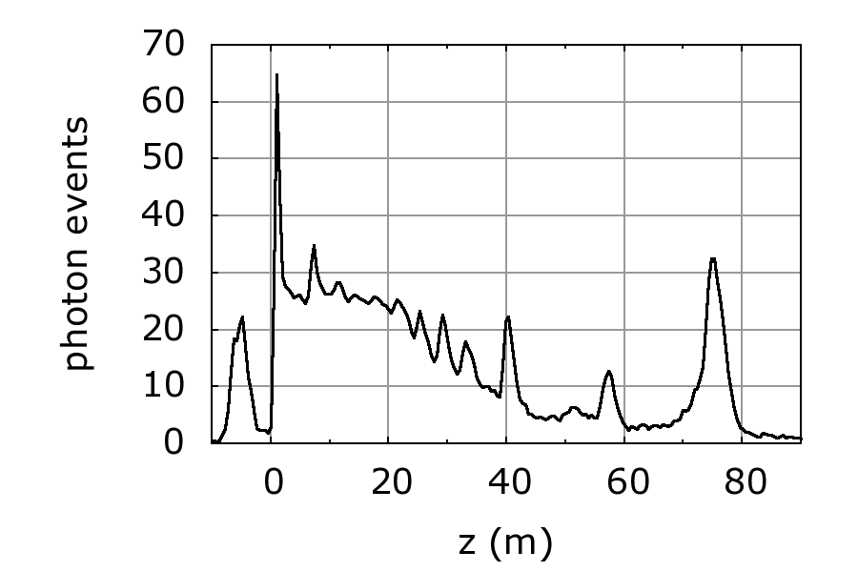
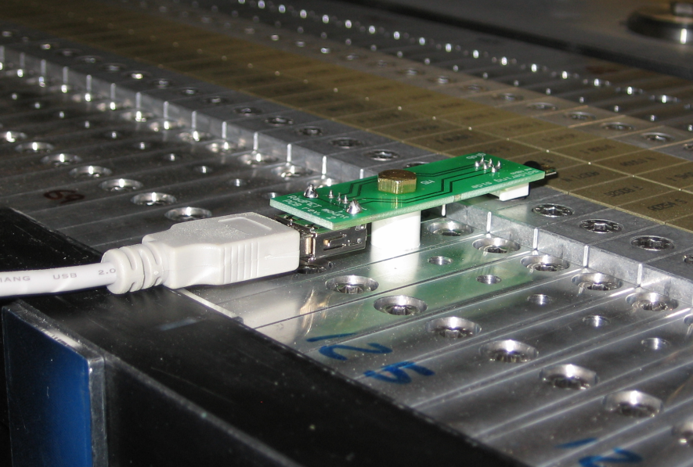
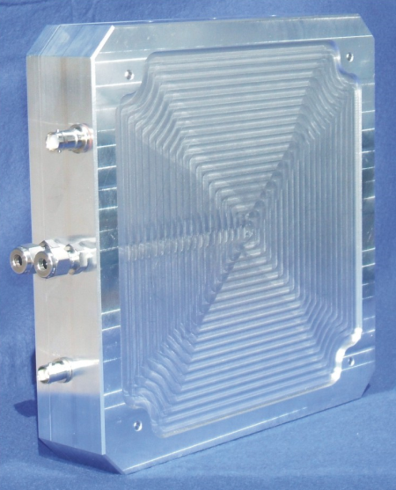
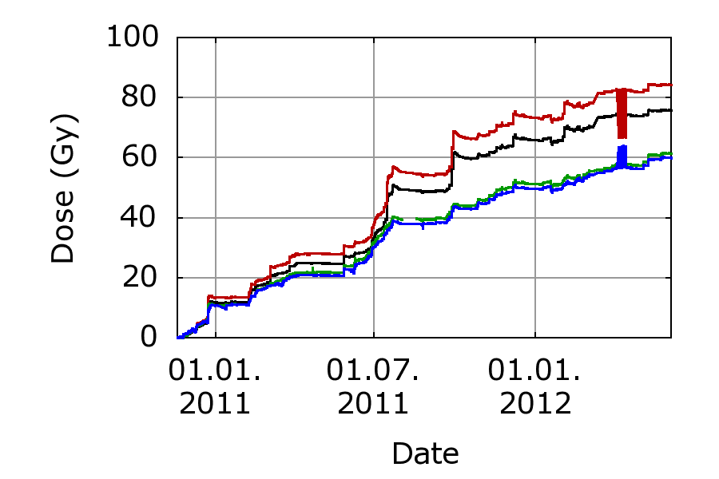
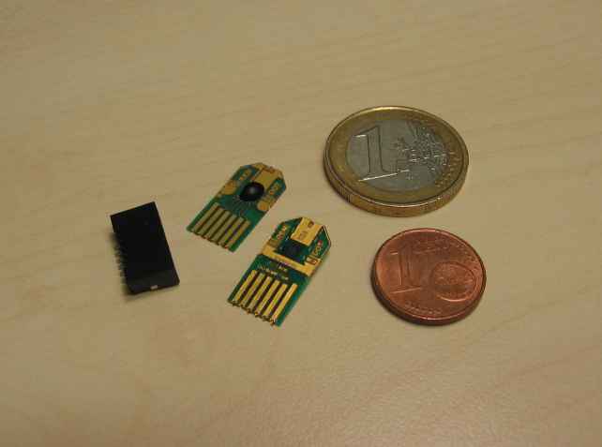
Beam Loss Diagnostics
PIN diodes
(A. Vascotto)
~120 installed
Cherenkov fiber beam loss position monitor
Resolution:
50 cm
RADFET online dosimetry
Integrating dosimeters, readout every minute
Ionization chambers
Voltage: 1000 V
Noise: <0.4 µGy/h rms

Slide 39
Longitudinal Diagnostics
Low energy RF deflector
Pyroelectric detector
Diodes 30/100 GHz
Bunch Arrival Monitor
Pyro
Diodes 30/100/300 GHz
BAM
Electro-optical sampling
High energy RF deflector

Slide 40
Beam-based Feedback Loops
Amplitude L1
Energy BC1
Phase L1
Compression BC1
Amplitude L3
Energy BC2
Phase L3
Compression BC2
RF Amplitude L0
Energy LH
RF Amplitude L4
Energy Spreader
Other feedback loops:
Charge
Seed laser pointing
Beam position/LINAC
Beam position/FEL
And the X-band cavity?

Slide 41
Thanks for your interest.
Thanks for slides, images+input to:
E. Allaria, B. Diviacco, L. Giannessi, S. Di Mitri, M. Svandrlik

