Slide 1


European XFEL
Winfried Decking (DESY)
DESY Beschleunigerbetriebsseminar
Grömitz, 18.03.2013
Notes:
How to edit the title slide
Upper area: Title of your talk, max. 2 rows of the defined size (55 pt)
Lower area (subtitle): Conference/meeting/workshop, location, date, your name and affiliation, max. 4 rows of the defined size (32 pt)
Change the partner logos or add others in the last row.

Slide 2
Zeitplan & Herausforderungen

Slide 3
Organisatorisches
European XFEL GmbH ist für den Betrieb des XFEL verantwortlich
DESY betreibt im Auftrag und in eigener Verantwortung den Beschleuniger
De facto ähnlich wie bei allen unseren Anlagen, die ja nie zum Selbstzweck betreiben werden

Slide 4
Team
Koordinationsgruppe (Koordination, Planung, Nutzerkontakt, ….)
Beschleunigerphysiker (Berechnungen, Messschichten, Schichtbetrieb)
Operateure (Schichtbetrieb, Panel- und Prozedurentwicklung)
Systemverantwortliche (aus den M- und XFEL-Gruppen)
Rufbereitschaften
Evtl. Vollschicht zumindest einiger Gruppen (LLRF, Diagnose, Photonensysteme) in der heißen Phase
Mess-/Entwicklungsschichten
Photonensysteme Wissenschaftler/Operateure
Im Kontrollraum
F,S,N Operateur, Beschleunigerphysiker
F,S Spezialisten/Systemverantwortliche aus der Koordinations- bzw. den technischen Gruppen

Slide 5
Team
Beschleuniger-physik
System- spezialisten
DESY &
XFEL.EU
Betriebs-gruppen
Koordination
Operateure
Maschinenkoordinator XFEL: Winni Decking

Slide 6
Parameter
Quantity | Value
electron energy | 10.5/14/17.5 GeV
macro pulse repetition rate | 10 Hz
RF pulse length (flat top) | 600 μs
bunch repetition frequency within pulse | 4.5 MHz
bunch charge | 0.02 – 1 nC
electron bunch length after compression (FWHM) | 2 – 180 fs
Slice emittance | 0.4 - 1.0 mm mrad
beam power | 500 kW
# of modules (containing eight 9-cell superconducting 1.3 GHz cavities) | 101
accelerating gradient for 17.5 GeV | 23.6 MV/m
# of 10 MW multi-beam klystrons | 27
average klystron power (for 0.03 mA beam current at 17.5 GeV) | 5.2 MW

Slide 7

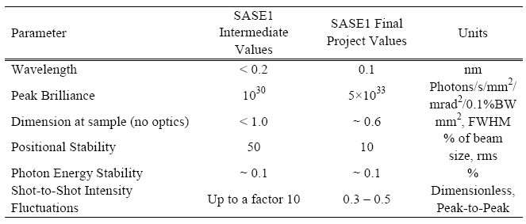

‘Start of Operation’ ist definiert in der European XFEL Convention

Slide 8
XFEL Inbetriebnahme und Betrieb - Zeitplan
T0: Start des Linac Cool-downs
Beginn der Injektor Inbetriebnahme mit Strahl
T0 - 12 Monate (Mitte 2014)
Beginn der Gesamtinbetriebnahme mit Strahl
T0 (Mitte 2015)
Erster Nutzerbetrieb
T0+9 Monate (Frühjahr 2016)
Weiterentwicklung des XFEL parallel zum Nutzerbetrieb
T0+30 Monate (bis Ende 2017)
Nutzerbetrieb (Ca. 4000-5000 Stunden Nutzerbetrieb, ca. 1000-2000 Stunden für Weiterentwicklung)

Slide 9
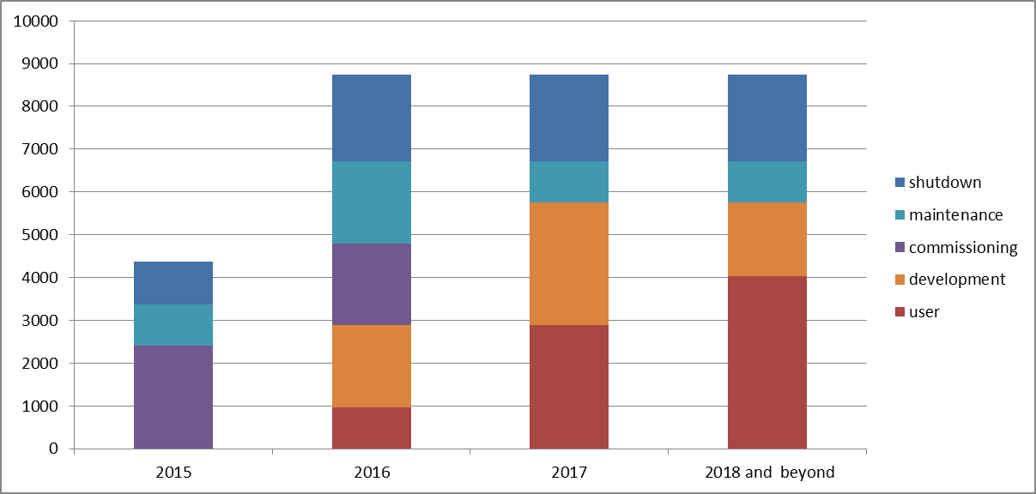
Machine Time Distribution

Slide 10
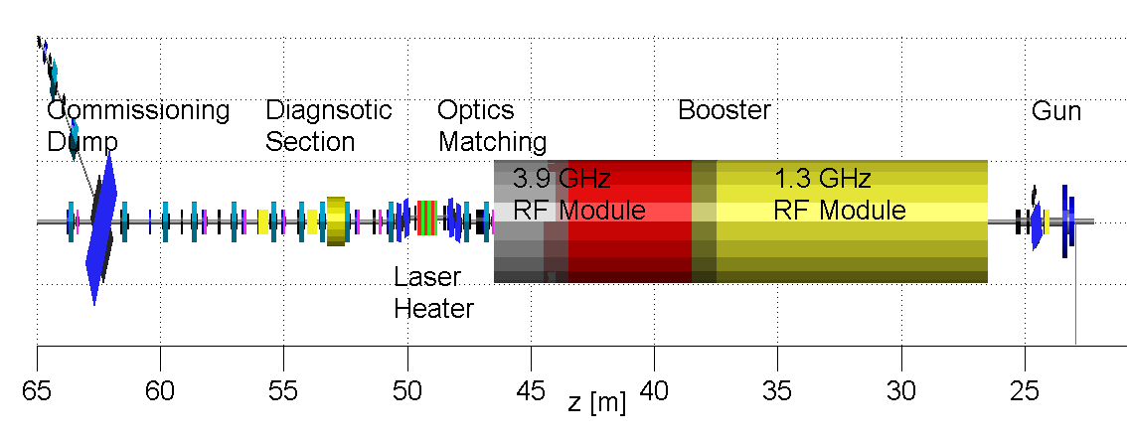
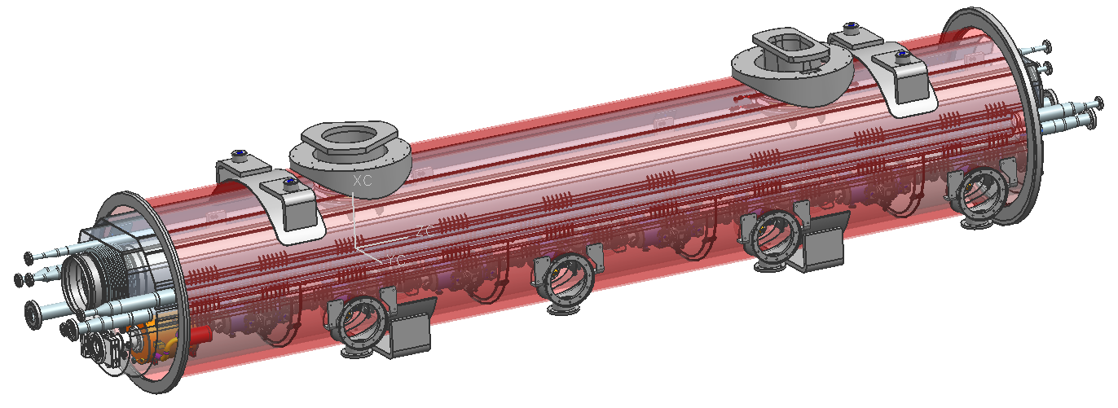
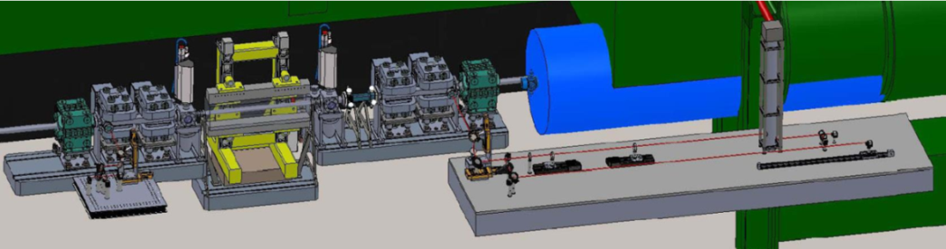
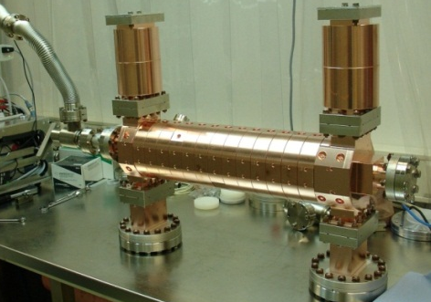
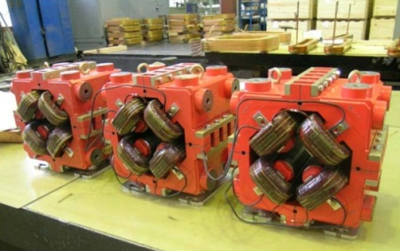
Injector

Slide 11
Injektor Inbetriebnahme
,Vorarbeiten‘:
Konditionierung und wenn möglich Charakterisierung der Gun bei PITZ
1 monatiger high-power RF Test im XTIN im Herbst 2013 !!!
Bis dahin Infrastruktur, Medien, Kontrollen, Personeninterlock, … installiert im XTIN

Slide 12
Injektor Inbetriebnahme
Erreichen aller XFEL Betriebsparameter
Inbetriebnahme von Unterkomponenten
Laser Heater, 3.9 GHz System, Diagnostik, Kontrollen, Feedbacks, Automatisierungen, …
Quantity | Value
macro pulse repetition rate | 10 Hz
RF pulse length (flat top) | 600 μs
bunch repetition frequency within pulse | 4.5 MHz
bunch charge | 0.02 – 1 nC
Slice emittance | 0.4 - 1.0 mm mrad

Slide 13
Injektor Inbetriebnahme
Etablierung des Injektor Routinebetriebes
‘Teambuilding’
1 Jahr erscheint genug Zeit
Möglichkeit für Tests, ‚Trial and Error‘, …

Slide 14
XFEL Gesamtinbetriebnahme
,Vorarbeiten‘:
Installation der RF und warmes Koppler konditionieren
Technische Inbetriebnahme aller Subsysteme soweit ohne Strahl und bei geöffnetem Tunnel möglich
LLRF:
Nach Cool-Down cavity tuning und high-power Tests ohne Strahl
Strahl bis zum ersten Dump, Inbetriebnahme einer RF Station
T0+2 Monate: Strahltransport durch Linac möglich

Slide 15
Working Group on Commissioning
(Core) Participants in 2012:
J. Pflüger Undulators (WP 71)
J. Grünert X-ray Photon Diagnostic (WP-74)
H. Sinn X-ray Optics & Beam Transport (WP-73)
R. Treusch FLASH Photon Coordination
Th. Tschentscher Photon Experiments
W. Decking, T. Limberg Machine Layout Coordination
E. Shneydmiller, M. Yurkov FEL Concepts (WP-21), FLASH SASE Tuning
H. Schlarb LLRF (WP-02)
S. Schreiber FLASH Coordination
Ab 2013:
‚Steeringgruppe
Commissioning‘: W. Decking, T. Limberg, H. Sinn, T. Tschentscher

Slide 16
E-beam parameters
A first set of e-beam parameters:
Beam energy will be 17.5 GeV
Linac will be operated with several tens of bunches (not single bunch) as fast as possible
single bunch operation is useless for LLRF diagnostics and studies
beam charge around 0.5 to 1 nC
General Diagnostics and LLRF

Slide 17
XFEL Gesamtinbetriebnahme – Meilenstein 1
First Beam through Linac
A 17.5 GeV beam is transported through the linac to the TLD dump
Pattern: 10-100 Hz, single bunch, 0.5nC, compression =100
Control: Charge, peak current, energy and trajectory are controlled by slow feedbacks.

Slide 18
XFEL Gesamtinbetriebnahme – Meilenstein 2
First Beam through ‘Alster’ Beamline
A 17.5 GeV beam is transported through the linac to the T4D dump.
Pattern: 10-100 Hz, single bunch, 0.5nC, C=100
Control: Charge, peak current, energy and trajectory are controlled by slow feedbacks.
Electron beam based trajectory alignment in undulator

Slide 19
Undulator Sequence and SASE Wavelength
Commissioning should start with SASE1 and continue with SASE3:
eases initial e-beam operation
allows parallel commissioning of SA1 and SA3 photon beam lines
if no SASE is reached in SASE1, SASE3 could be put into operation with much looser tolerances to diagnose e-beam parameters
it is recommended from FLASH experience to focus activities on one beam line and commission this fully to benefit from the lessons learned and not double errors
SASE search should be performed with fully closed gaps (i.e., 0.16 nm wavelength at SASE1)

Slide 20
XFEL Gesamtinbetriebnahme – Meilenstein 3 ,4,5
First Lasing observable in SASE1 (T0 + 6 month)
First lasing is observed at 0.16 nm
Commissioning of photon diagnostics & beam line with spontaneous radiation
Photon based alignment of undulator gap and phase shifter setting
SASE search
First Lasing observable in SASE3 (T0 + 7.5 month)
First Lasing observable in SASE2 (T0 + 12 month)

Slide 21
Erster Nutzerbetrieb
Eine Ladung, eine Energie
Einige 10 – 100 Bunche
Möglichst schnell SASE-Photonen für die Inbetriebnahme von Photonenstrahlwegen und Experimenten
Ca. 1000 Nutzerstunden in 2016, dabei wird immer nur ein Experiment zur Zeit bedient
“Conditions for 'First User Experiments'
experiments can use x-ray beam at TDR performance, but with limited flexibility in terms of pulse pattern, pulse length and photon wavelength”

Slide 22
Weiterentwicklung
Multi-bunch operation
Pattern: 10 Hz, 2700 bunches, 0.5nC, C=100
Control: Charge, peak current, energy, trajectory and arrival time are controlled by slow and fast feedbacks.
Quasi-simultaneous operation of SASE1 and SASE2 beam line
Pattern: 10 Hz, 2700 bunches, 0.5nC, C=100
Control: Charge, peak current, energy, trajectory and arrival time are controlled by slow and fast feedbacks.
Tasks:
Bunch pattern control by fast switching elements

Slide 23
Weiterentwicklung
Flexibility in wavelength and bunch length
Pattern: 10 Hz, 2700 bunches, 0.02-1nC, C=2000-50
Control: Charge, peak current, energy, trajectory and arrival time are controlled by slow and fast feedbacks.
Tasks:
establish procedures to change bunch length/bunch charges
establish procedures to change photon wavelength by changing energy/undulator gap
Seeding
…..

Slide 24
Lessons learned (Jim Welch / LCLS)
Thorough Pre-beam Checkout: Detailed pre-beam checkout conducted from the actual controls panels and verified in the tunnel with Hall probes, clip-on ammeters, simple tape measures, etc, ensures that the hardware and software is functioning at a fundamental level prior to beam.
Software Ready for Commissioning: Process automation and data analysis software fully prepared ahead of time to support commissioning activities
Friendly Control System: A control system that makes it easy for physicists to develop scripts. Imagine running without phase scans, correlation plots, matching, etc, etc, etc

Slide 25
Lessons learned (Jim Welch / LCLS)
Sequential Commissioning: Beam-based feedback loops implemented as the commissioning moves downstream so that upstream systems are locked in while the downstream systems are brought on line.
Basics First: A 'layered' approach to commissioning whereby fundamentals are verified first (BPM scaling, linear optics, magnet operation, etc), before plunging into the more exciting phase of beam characterization.
Disciplined Planning: A uniform plan focused on getting the machine up and running reasonably well and quickly, rather than a more academic approach where many various machine and system studies are executed sequentially, leaving the machine in an unknown and constantly changing state.

Slide 26
Lessons learned (Jim Welch / LCLS)
Reliable Diagnostics: Having reliable diagnostics for all (or almost all) electron beam parameters throughout the machine and particularly in the undulator available.
Working Feedbacks: Having feedback systems for all major machine components and having a stable machine configuration. Then any lengthy machine study or tuning or optimization can be done with one dedicated parameter changed while everything else doesn't drift away.

Slide 27
Lessons learned (Jim Welch / LCLS)
Good Conventional Alignment: A well carried-out conventional alignment program positioned the components very close to their target locations.
Fix the Problems: Leaving as few mysteries as possible - not leaving a system until we understand what it is doing
Adequate Commissioning Time: plenty of time was available for commissioning the electron beam in stages
Good Theoretical Work
Dedicated Team: all these points worked because of the dedicated people who made them work...

Slide 28
Zusammenfassung
Inbetriebnahme des XFEL wird unter großem Erfolgs- und Zeitdruck stehen
Gute Vorbereitung und Planung ist wichtig
Gerüst und Strategie für die Inbetriebnahme steht
Mittelfristig: Detailplanung mit den einzelnen WPs
Aufbau des ‚Commissiong-Teams‘ beginnt

