Slide 1
High-Level Anwendungen (Controls) bei XFEL/FLASH
T. Limberg

Slide 2
Gliederung
Organisatorisches
Werkzeuge und Konzepte
Beispiele

Slide 3
Orga…
MCS-1
J. Wilgen
MCS-4
R. Kammering
MLC verantwortlich
für HLC: WD, TL
MPY
S. Meykopff

Slide 4
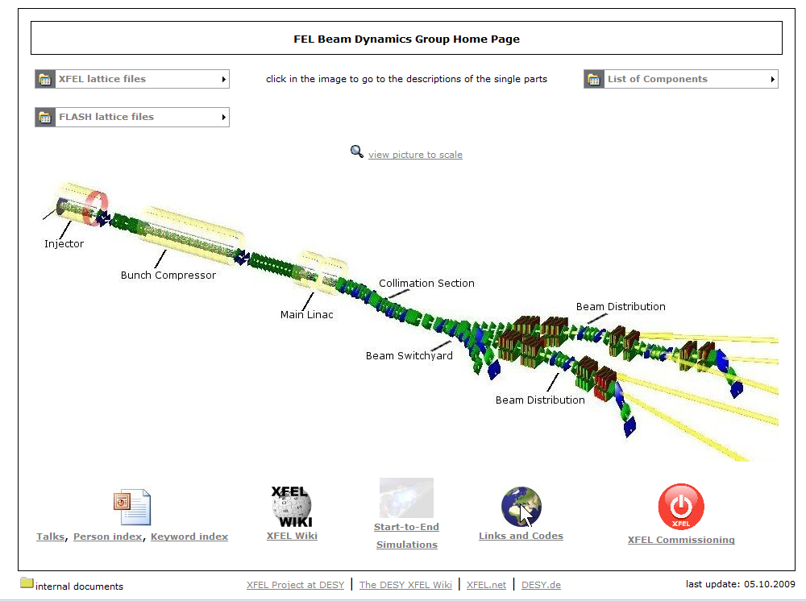
FEL Beam Dynamics Homepage

Slide 5
Aufgaben
Oberflächen und Server zur Steuerung von Multikomponenten-Prozessen (z.B. Automatisierte Emittanzmessung)
Unterstützung automatisierter Maschienenexperimente
Hi-Level Post-Mortem Analyse

Slide 6
Was haben wir an Werkzeugen?
Matlab Server
(Duval)
DAQ
DOOCS server lib
Java server lib (Duval)
C server lib (Duval)
‘Shell’ server
J. Wilgen’s
Server builder
server wizard
helpers
S
erver
Tine
examples
Optic server
tbd
Magnet server
Beam Profile
Middle Layer
Server
ttfr
ttfw
Orbit Server
New Optic Server
jdoocs_call
Most of the
DAQread
Energy Server
PETRA and linac
servers
Wrappers for
Kicker server
middle layer
Lots of FLASH
Fat Clients
servers
Camera server

Slide 7
Kontrollsystem Ebenen

Slide 8
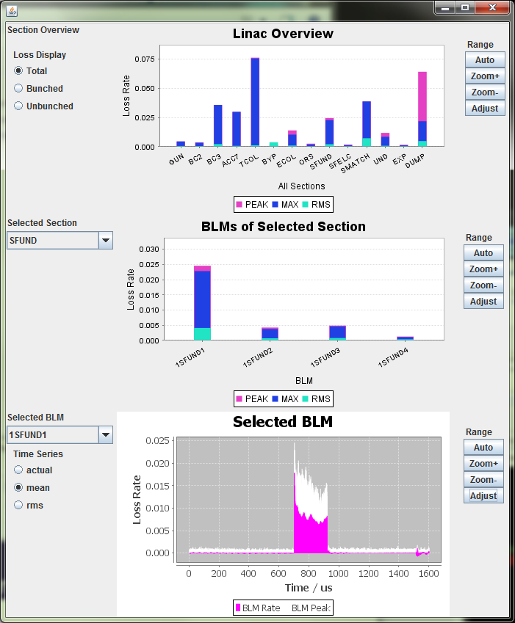
Beam Loss Monitor Middle Layer Server für FLASH
Produced output data
For each BLM and each event, a time series which contains
The current data
A bunch-wise average, RMS, and a peak-hold value over the last N events
For each BLM, a summary of the current time series
Average, RMS, maximum and peak-hold of loss rates of bunch current, dark current, and total.
For each accelerator section a summary over all contained BLMs
Average, RMS, maximum and peak-hold of loss rates of bunch current, dark current, and total.

Slide 9
Matlab Middle Layer

Slide 10
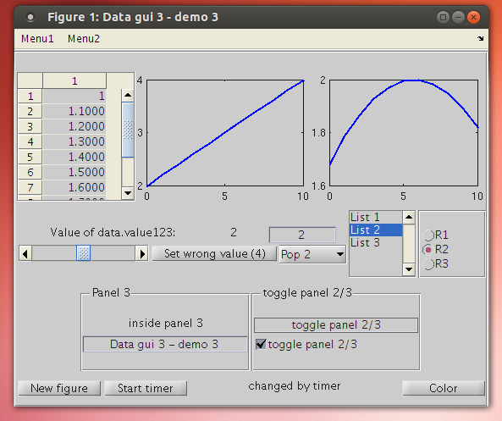
Matlab GUI Bibliothek
axes
checkbox
edittext
figure
listbox
menuitem
panel
popupbox
pushbutton
radiogroup
slider
statictext
table
togglebutton

Slide 11
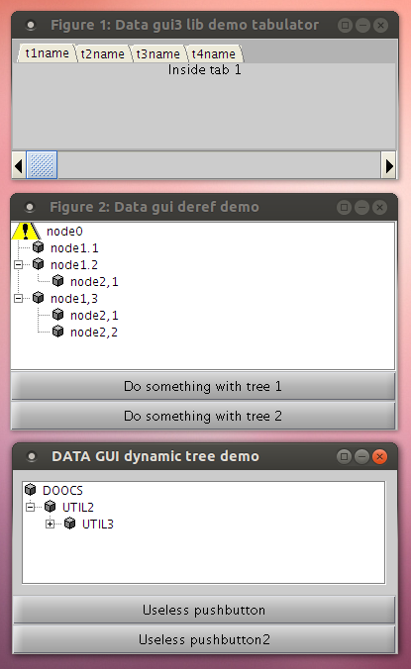
Matlab GUI Bibliothek
deref
timer
tabgroup
tree
treedyn
Special GUI support:
Continuouse slider
Mouse wheel /
Mouse button up/down
Enter/Leave focus events
etc.

Slide 12
Matlab Toolbox ADAQA used for Emittance Measurements
Bolko Beutner, Rasmus Ischebeck
PSI / DESY / KIT Mini-Workshop on Longitudinal Diagnostics for FELs

Slide 13
Scan Framework
These measurements need to be automatised for standard operation and commissioning, task are e.g.:
moving screens in and out
varying quadrupole settings
restore initial lattice configuration
A successful measurement procedure (high level application) needs to be reliable, robust, and usable “Always have the operator at the end of the night shift in mind!”
Accelerator operation in general relies on data acquisition and parameter scans
In the various applications the requirements are actually quite similar
Tasks should be unified and standardised to prevent that every application developer “reinvents the wheel”
ADAQA - An Accelerator Data Acquisition & Analysis Framework

Slide 14
Beispiel Energie- und Kompressionsmanagement

Slide 15
Emittanzmessung
Emittanz Tool
Browser
View detailed information
controls
reads progress
reads results
reads detailed
information
HTTP
HTTP Server
Device Servers
Wire Scanners
Screens
Cameras
Attenuators
Screen Optics
BPMs
BLMs
Optics Server
Screen Optics Database
DOOCS
NFS
NFS
File System
Beam Profile Server
controls/
uses
Data and Results of all Measurements:
Images
Data Series
Measurement Protocols
Beam Profiles
Quality Estimation
stores
Messungen
DOOCS

Slide 16
Undulator-Wire-Scanner Massnahmen
Das Serverprogram der VME-Creates wurde überarbeitet.
Genaue Einmessung von Position und Fahrkurve bei Initialisierung.
Dadurch exaktes Anfahren beliebiger Positionen (+- 15um) möglich.
Verhalten zuverlässig und reproduzierbar.
Erhöhung der Fahrgeschwindigkeit, damit schnelleres Rein- und Rausfahren ermöglicht wird (noch in Arbeit).
Erkennbar, wann eine Initialisierung benötigt wird (Flag).
Hoffnung: Pro Server-Neustart nur noch einmal initialisieren.
Bisher gute Erfahrungen/Tests mit neuem Server
Zuverlässigkeit wurde deutlich verbessert
Kein “Aufhängen” mehr beim Fahren.
Kein häufiges Initialisieren mehr nötig
Einige Probleme werden noch untersucht
Einige WS (UND 5 + 6) halten Zielpositionen nicht.
Versprochene Max. Fahrgeschwindigkeit nicht erreichbar.
Motor bleibt bei vert. Scannern bei Initialisierung manchmal stehen.

Slide 17
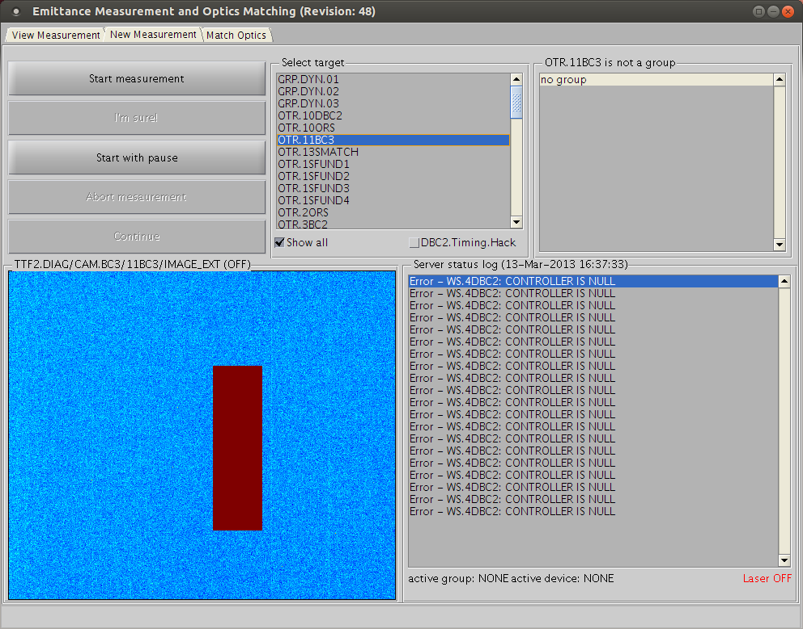
Emittanzmessung: NeueMessung

Slide 18
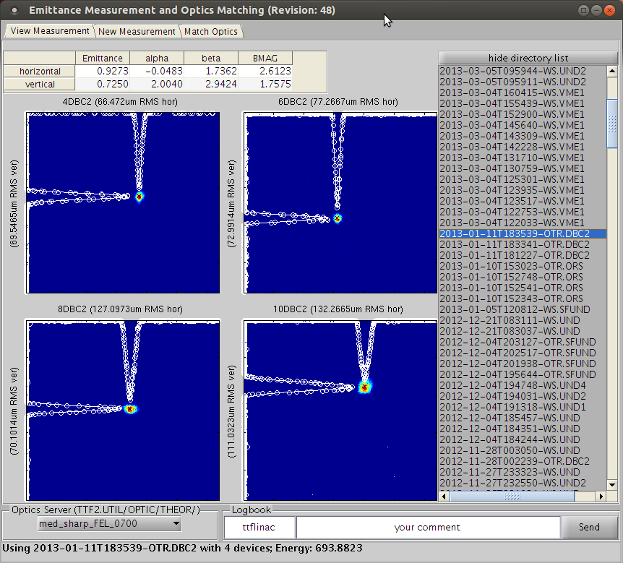
Emittanzmessung: Auswertung

Slide 19
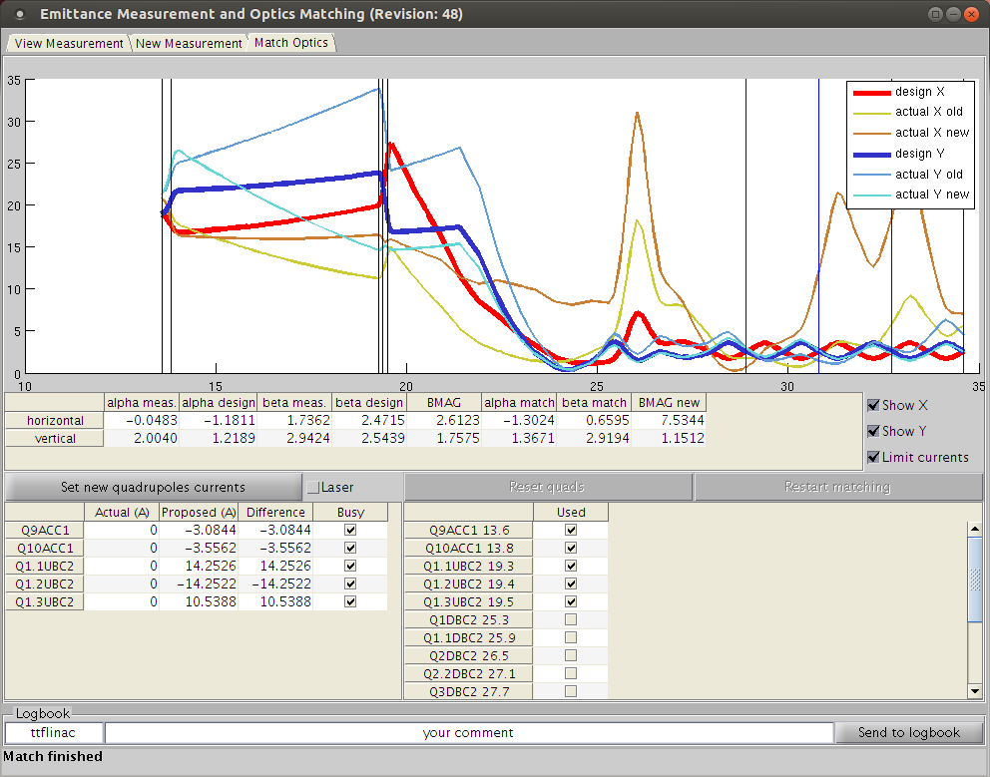
Emittanzmessung: Optik einstellen

Slide 20
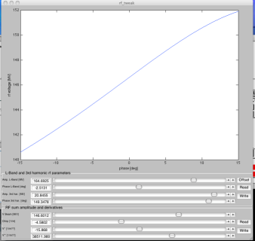
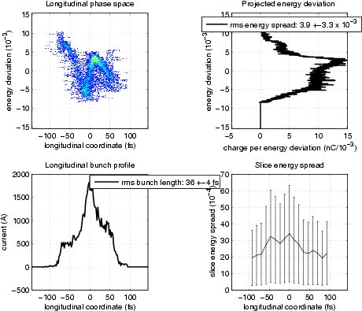
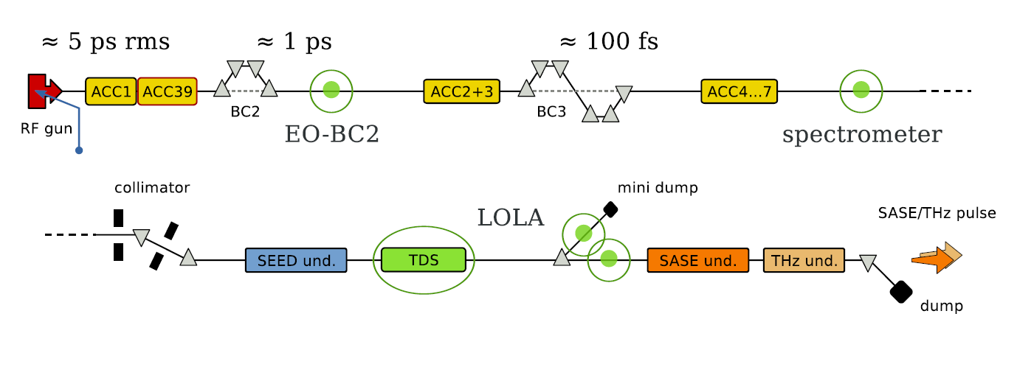
FLASH Bunch Compression Scheme
A_{ACC2/3} , φ_{ACC2/3}
35 fs
150 MeV
450 MeV
CRISP

Slide 21
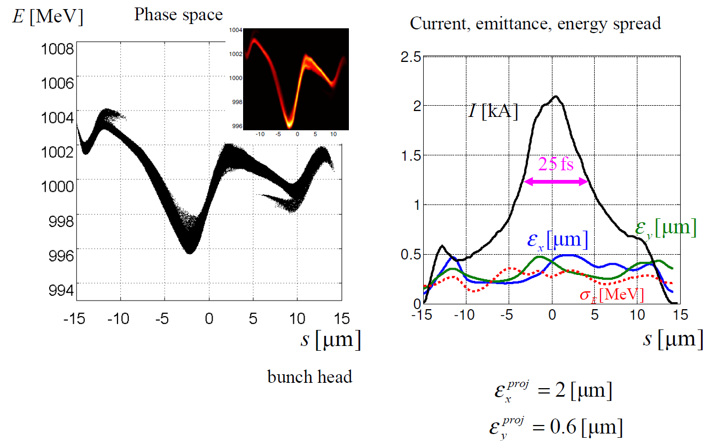
S2E with 100 pC Bunch Charge
Photon Pulse Length (FWHM) : 7 fs

Slide 22
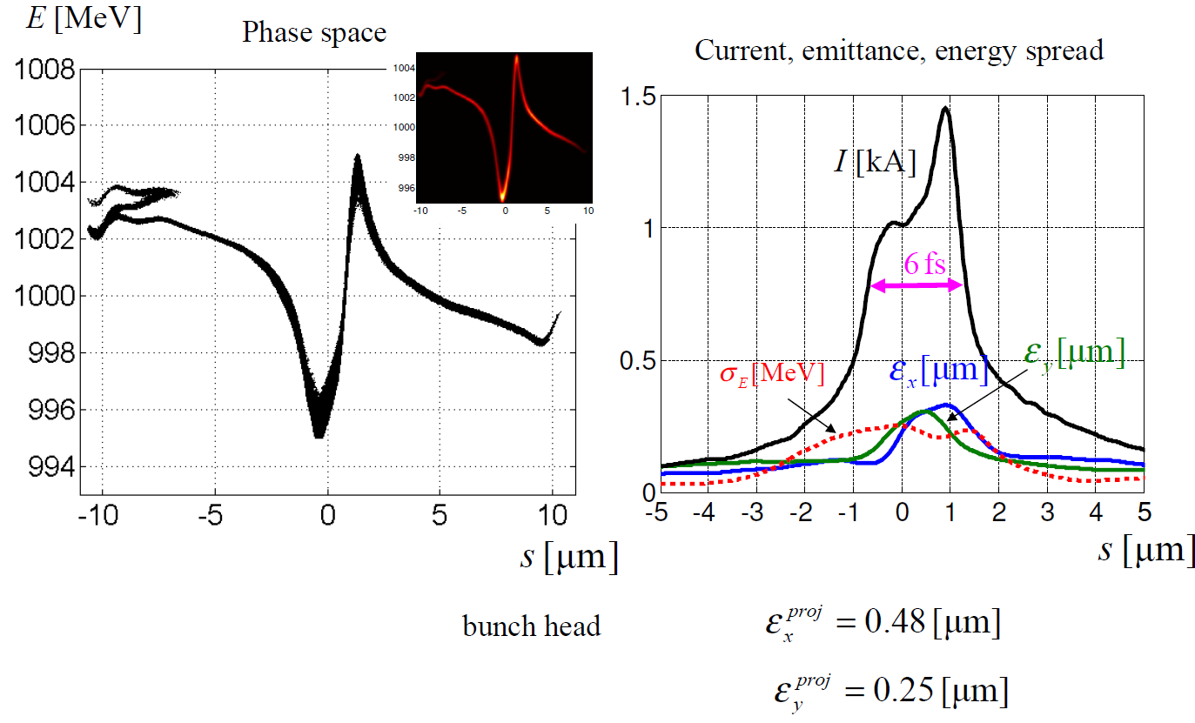
S2E with 20 pC Bunch Charge
Photon Pulse Length (FWHM) : 2 fs

Slide 23
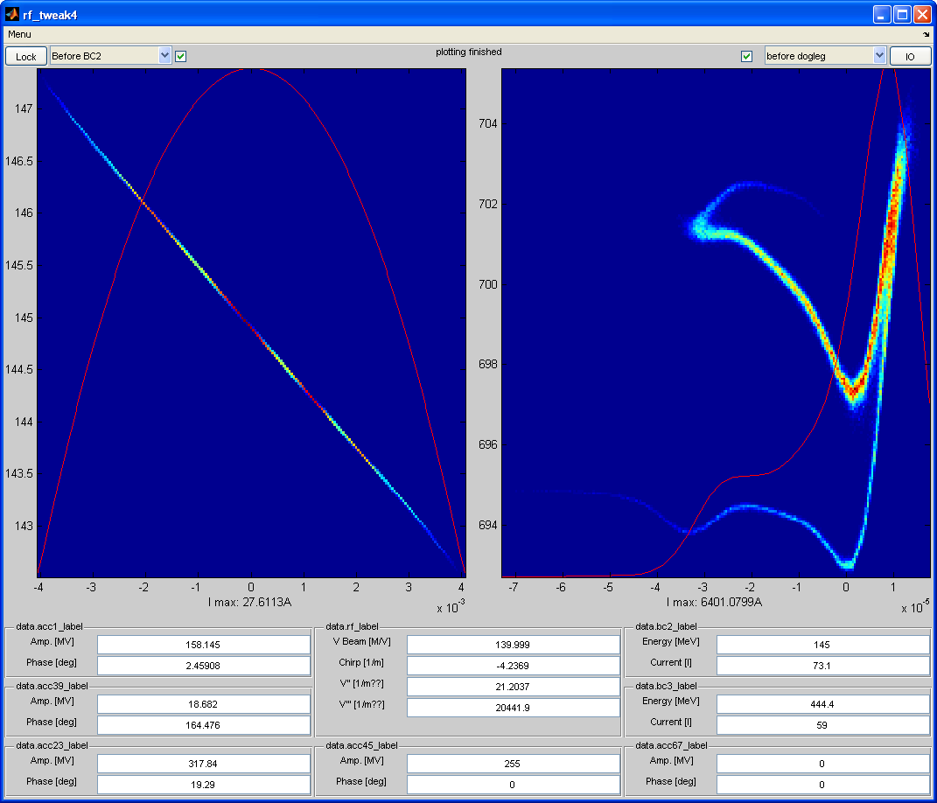
Fast Model for longitudinal Phase Space

Slide 24
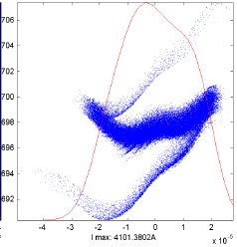
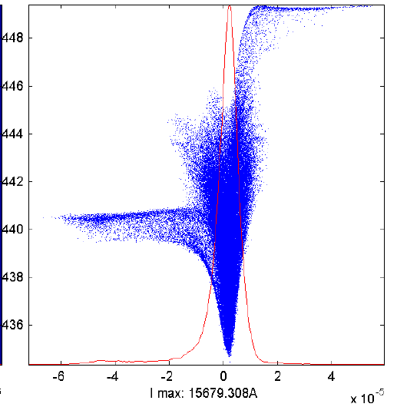
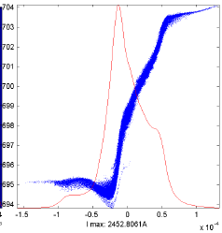
Bunch Shape after Compression vs. First Linac Section Chirp (500 pC)
Minimum bunch length limited by non-linearities
120 fs
30 fs
180 fs
ACC1-Phase: 2.51 deg
ACC1-Phase: 2.6 deg
ACC1-Phase: 2.8 deg
Stability and Tuning Issue

Slide 25
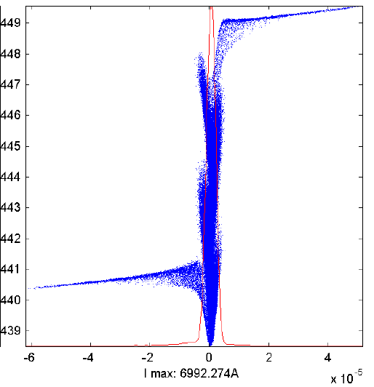
Bunch Shape after Compression (100 pC)
15 fs

Slide 26
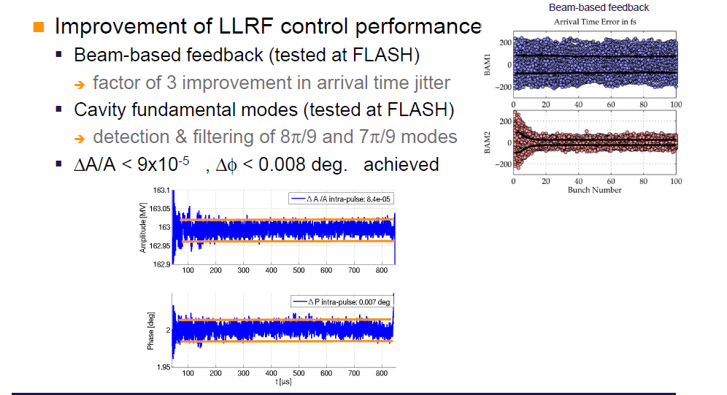
Measurements at FLASH

Slide 27
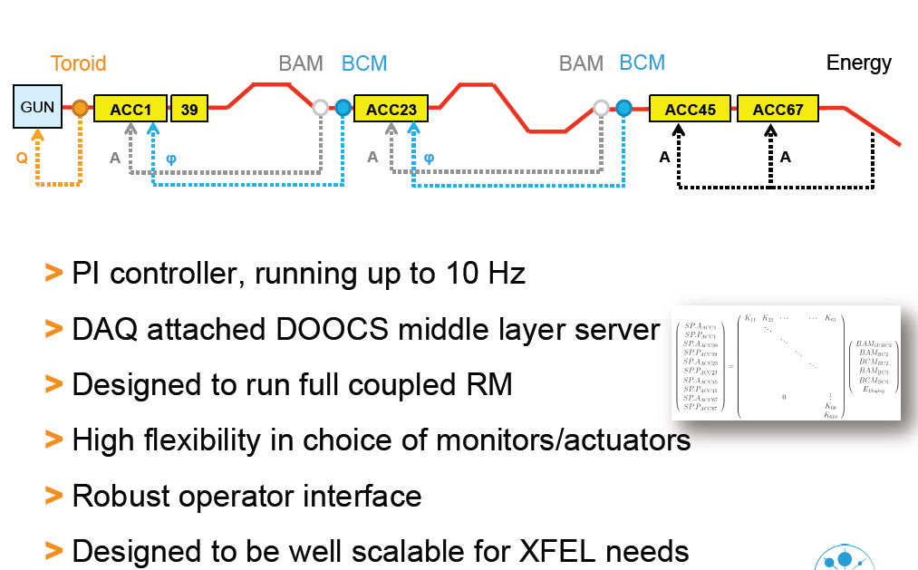
FLASH‘s slow longitudinal feedback (R. Kammering)

Slide 28
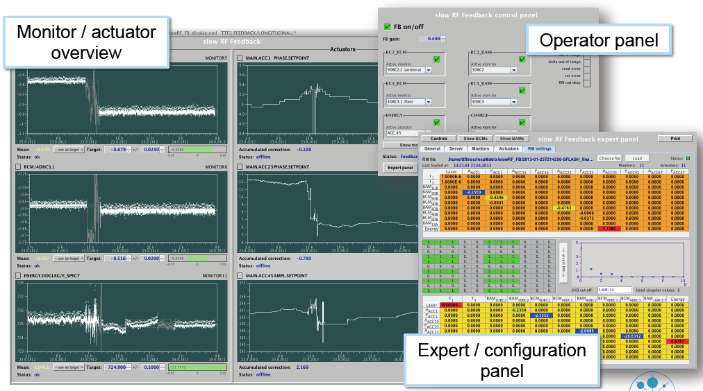
FLASH‘s slow longitudinal feedback

Slide 29
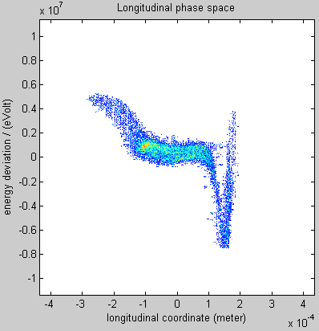
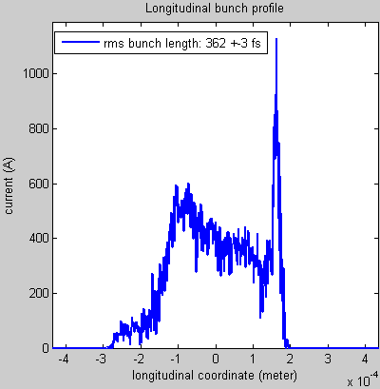
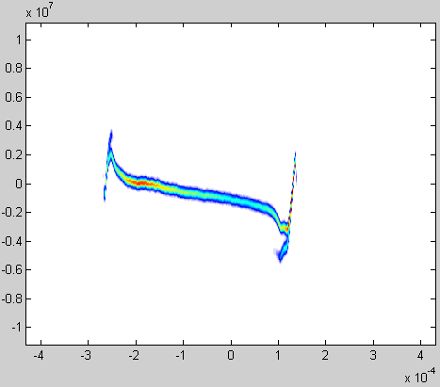
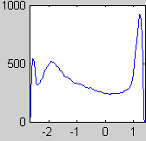
Kompressions-Studien: 1kA Spike
Slope doesn‘t fit

Slide 30
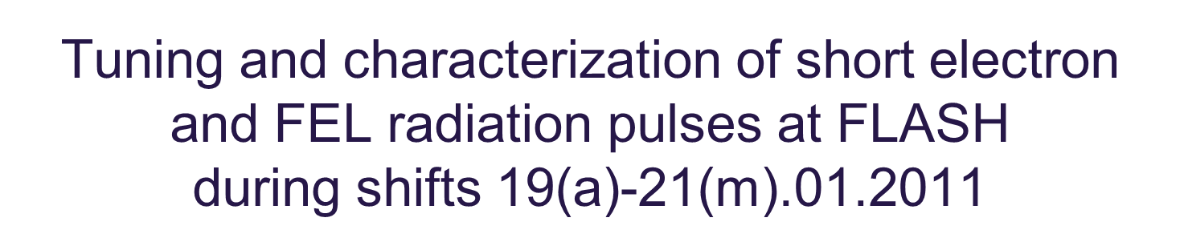
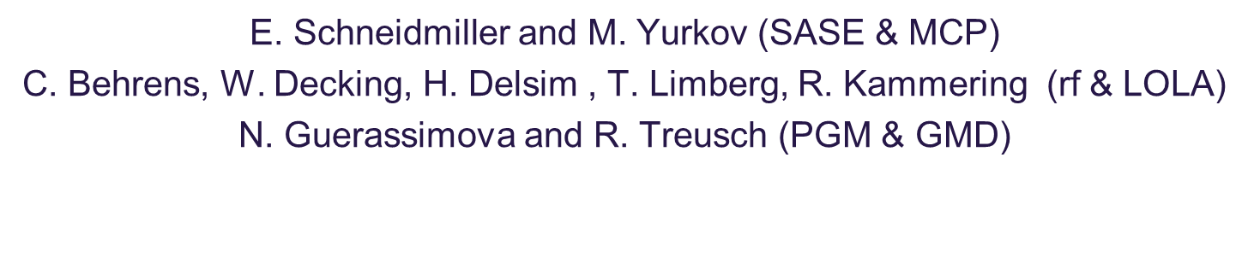
Bunch-Length-Tuning

Slide 31
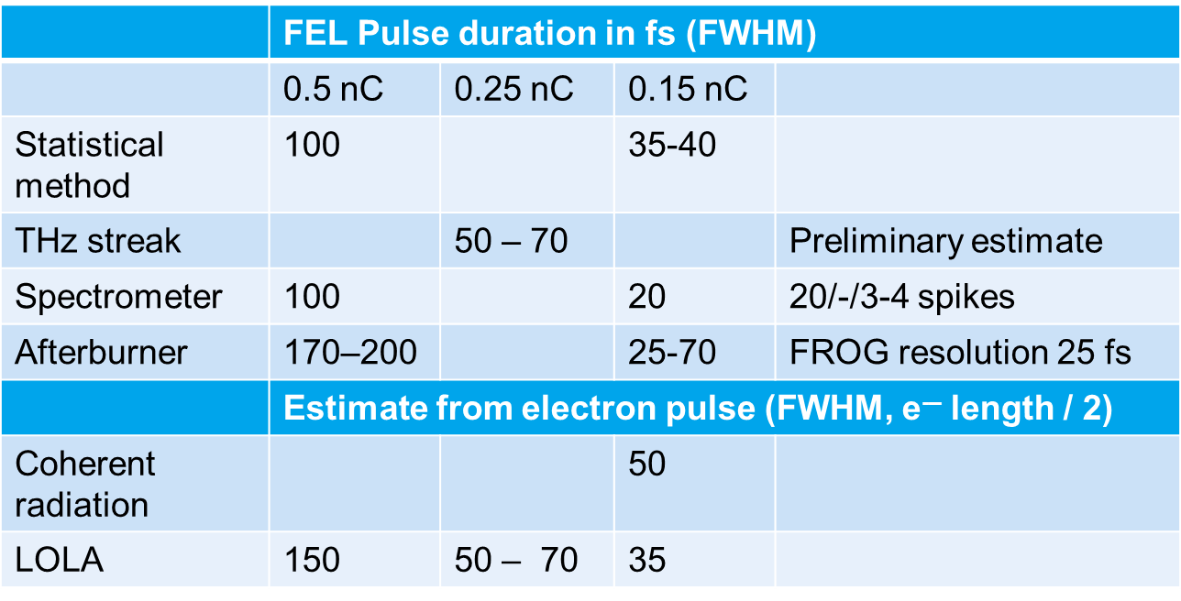
Results from another shift block (compiled by S. Schreiber (still preliminary))
In general good agreement for the short pulses - within a factor of 2
Larger uncertainties for longer pulses

Slide 32
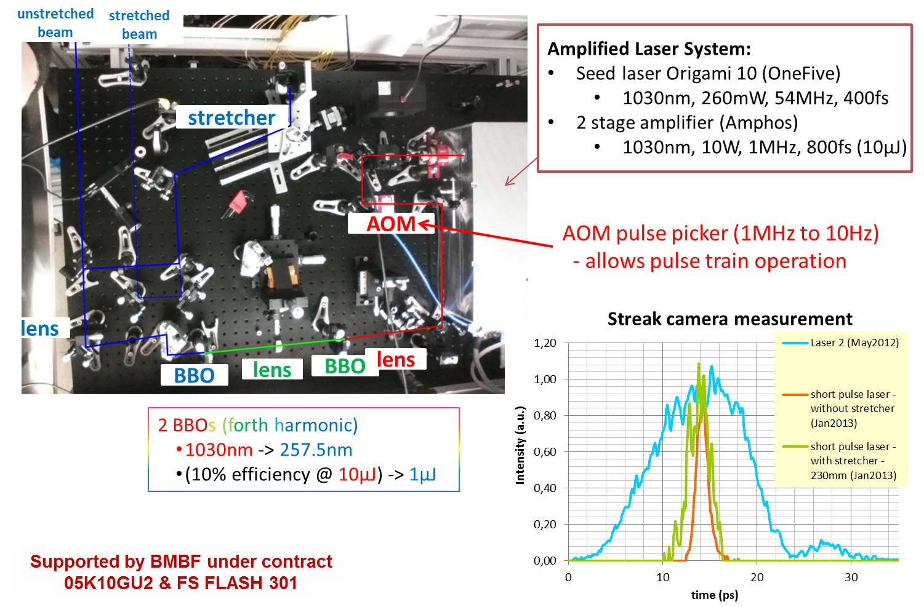
New Laser System for short pulses (J. Roensch et. al, Uni HH)

Slide 33
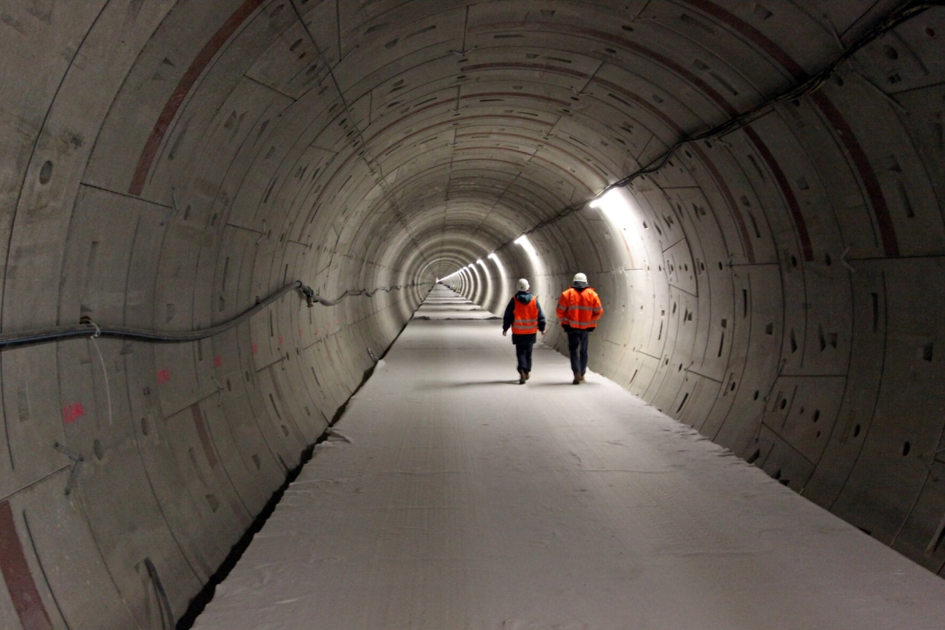
Danke für’s Zuhören!

Slide 34
Summary and Remarks
The tools and methods to tune bunch length exist and have passed first tests
Extensive feedback from users about photon beam quality is important
An on-line photon pulse length and pulse shape measurement would be of great help

Slide 35
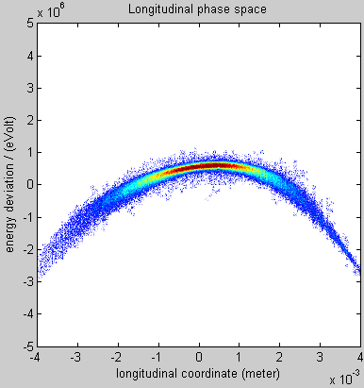
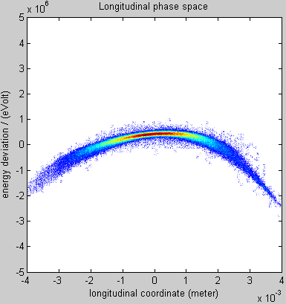
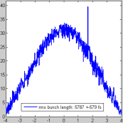
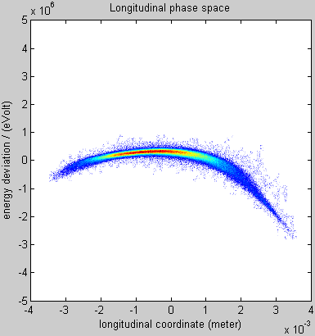
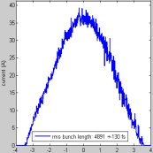
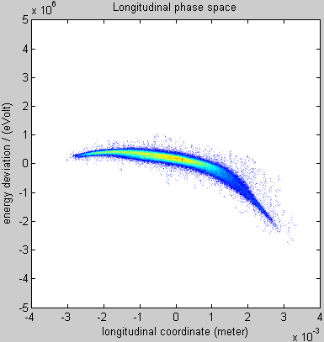
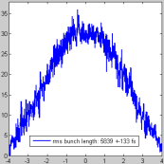
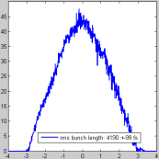
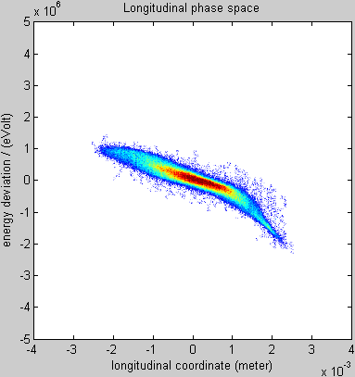
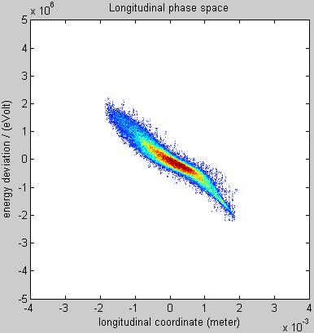
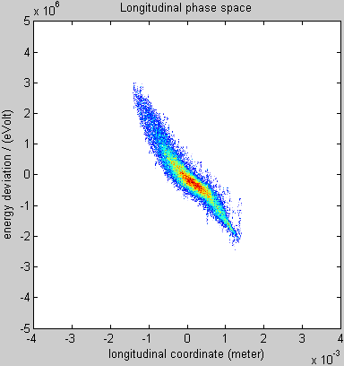
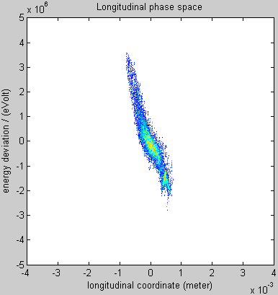
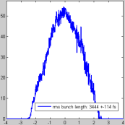
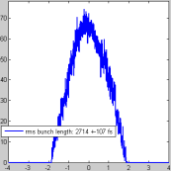
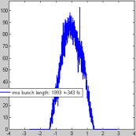
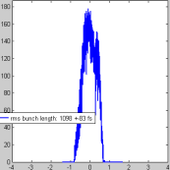
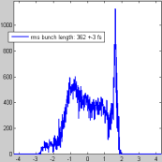
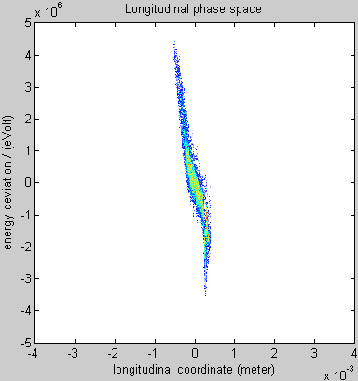
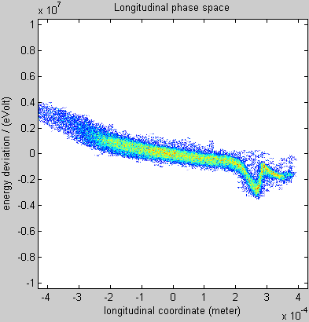
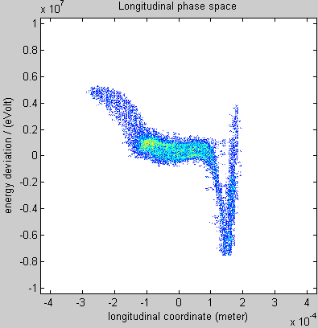
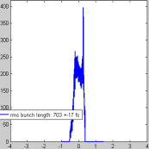

Longitudinal Phase Space and Profile vs. Energy Chirp (ACC1 phase monitored)
0 deg
1 deg
2 deg
3 deg)
4 deg
5 deg
6 deg
7 deg
7.5 deg
7.5 deg
7.9 deg

Slide 36

Measured and calculated compression factor (without self-effects)
Small additional chirp and 10% correction of LOLA energy calibration:
M. Dohlus
C
r56_{nom} = 178.4 mm
off = 0.18
number of measurement
(increasing chirp)

Slide 37



On crest

Slide 38



Compressed to ca. 50 A
No self-effects

Slide 39




Compressed to ca. 150 A
With self-effects

Slide 40
Bunch-Length-Tuning (differential): 150 pC

Slide 41

Bunch-Length-Tuning: Spectra and Statistics

Slide 42

First Lasing

Slide 43
Tuning Issues
Longitudinal bunch shape changes with pulse train length, but LOLA can take only one bunch
Under study/development: UV Pockels cell
Uncertainty in absolute rf phases
Beam Arrival-time Monitors help
rf drifts
LLRF hardware and software upgrades improved situation significantly
Instrumentation specified and designed for the original design charge of 1 nC

Slide 44
Peak Current for Short Pulses (Gaussian like)
Charge [pC] | Peak Current [kA] E-Bunch <100 fs FWHM | Peak Current [kA] E-Bunch <50 fs FWHM
1000 | 8.4 | 16.8
500 | 4.2 | 8.4
250 | 2.1 | 4.2
100 | 0.8 | 1.6
From S2E: At short bunches, peak currents of 2 kA already increase slice emittance.
From SASE Simulations: Peak currents of 1.5 - 2 kA needed for saturation (at least for the shorter wave lengths)
In the charge regime below 250 pC, SASE intensity and very short bunch length should go together

