Slide 1

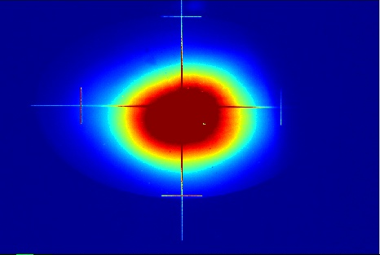
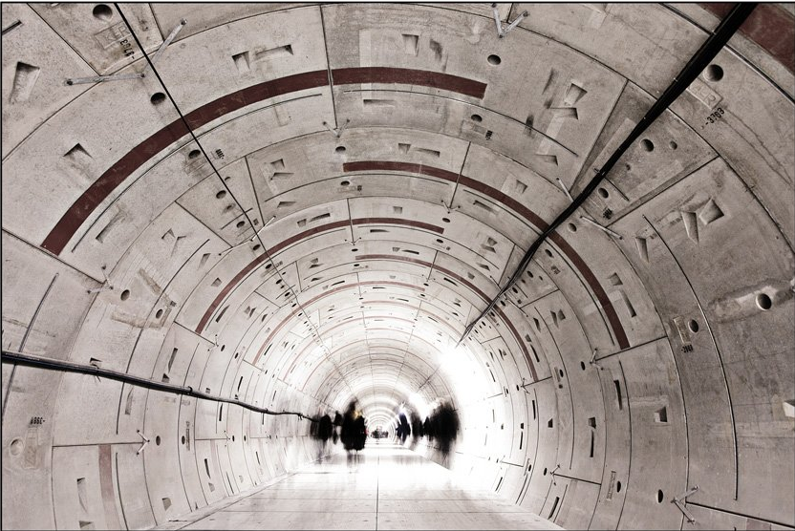
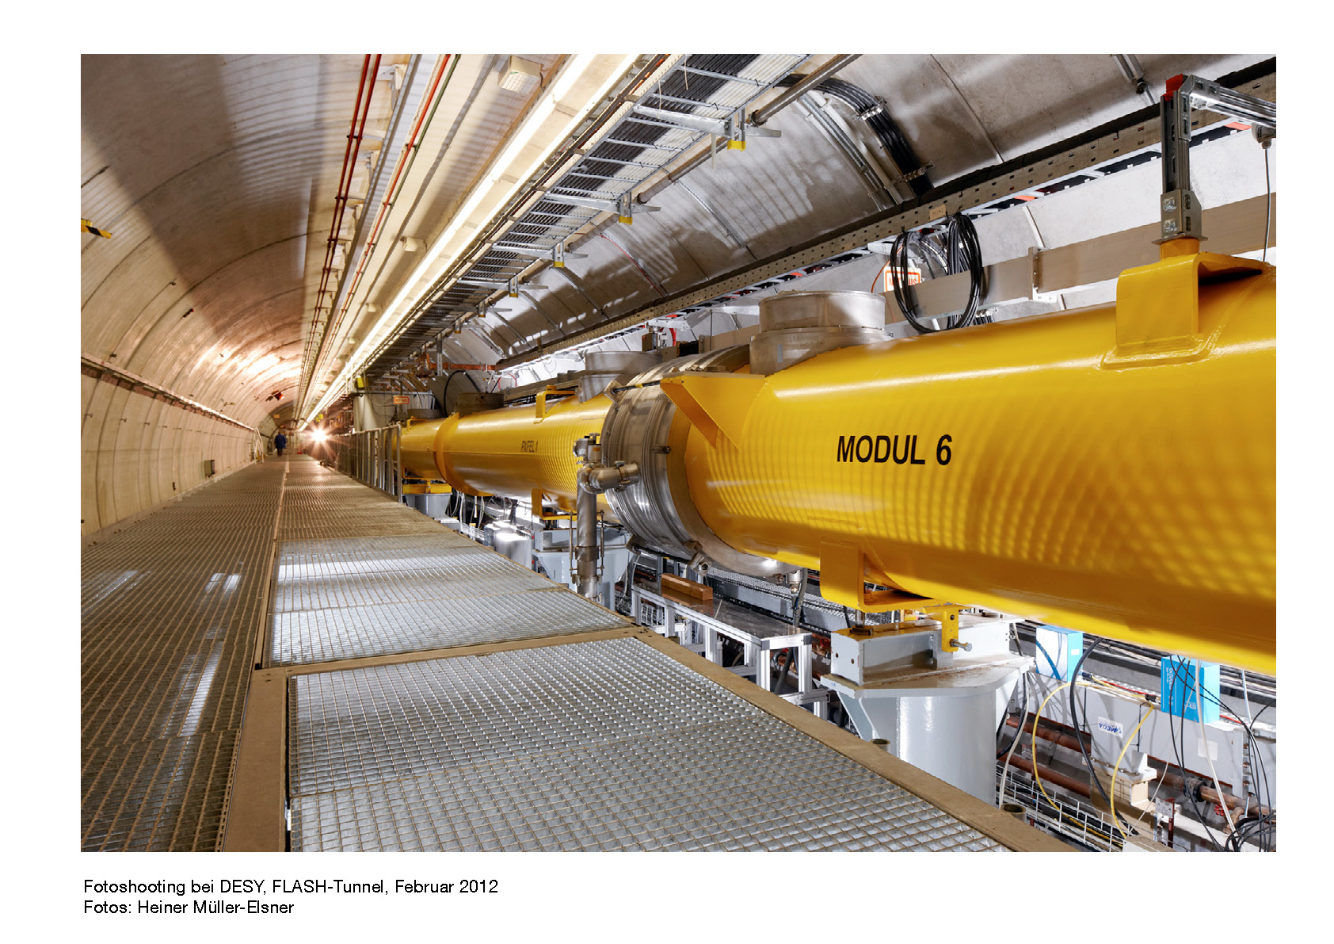
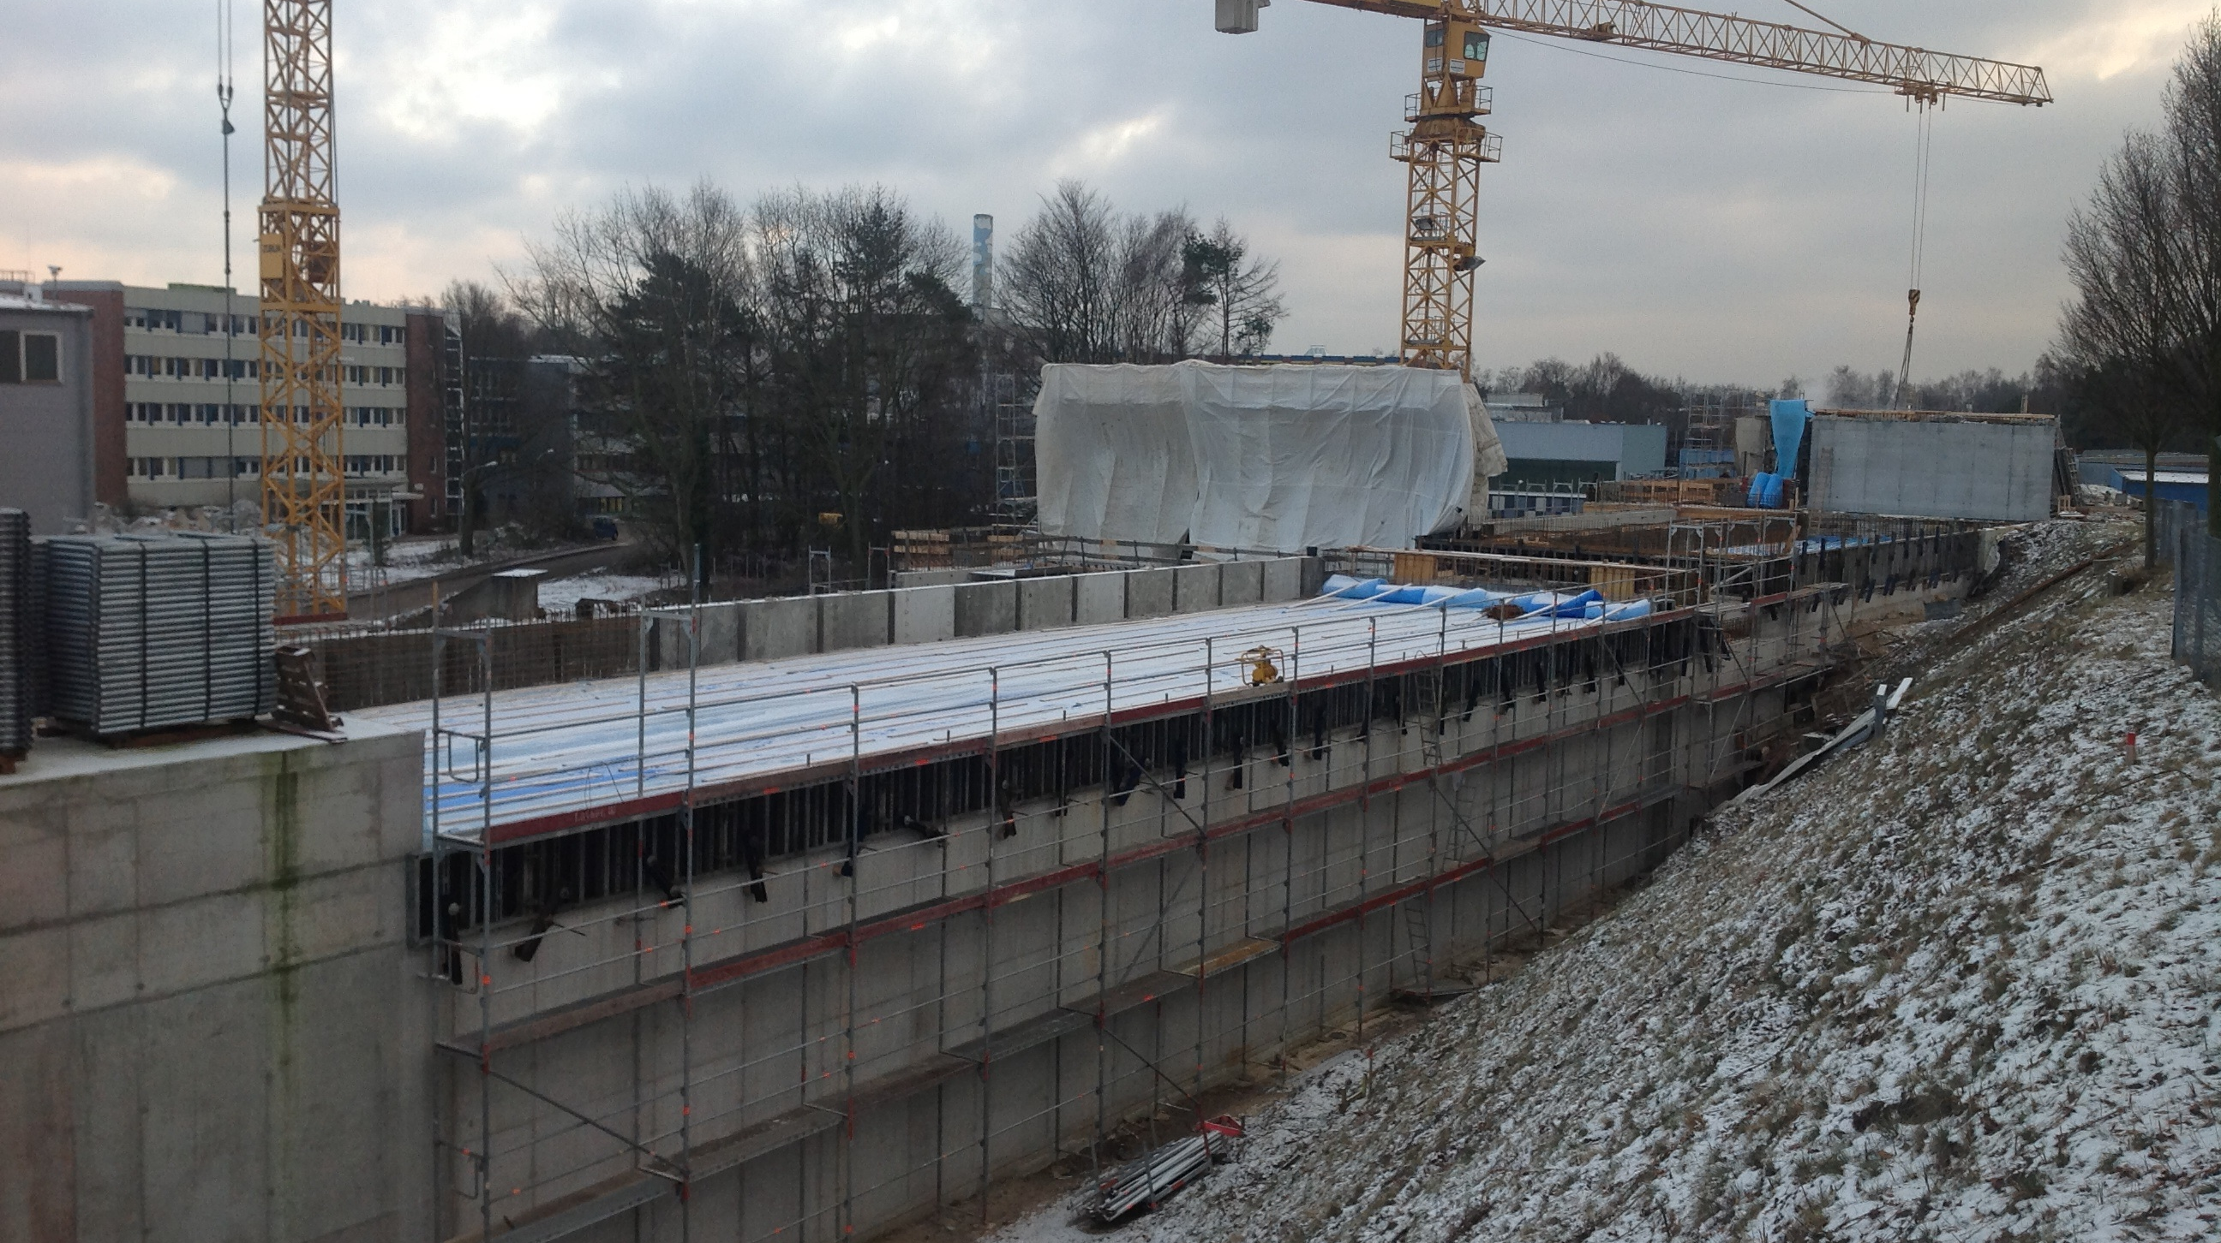
Betrieb von mehreren SASE
Beamlines
Siegfried Schreiber
Winfried Decking
DESY
Betriebsseminar
Grömitz
März 19, 2013

Slide 2
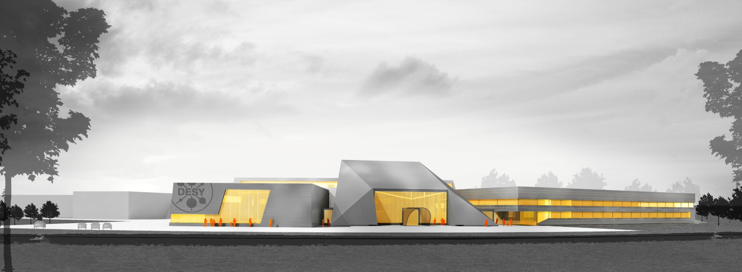
FLASH1 und FLASH2
Sep 2010 – Mar 2011

Slide 3
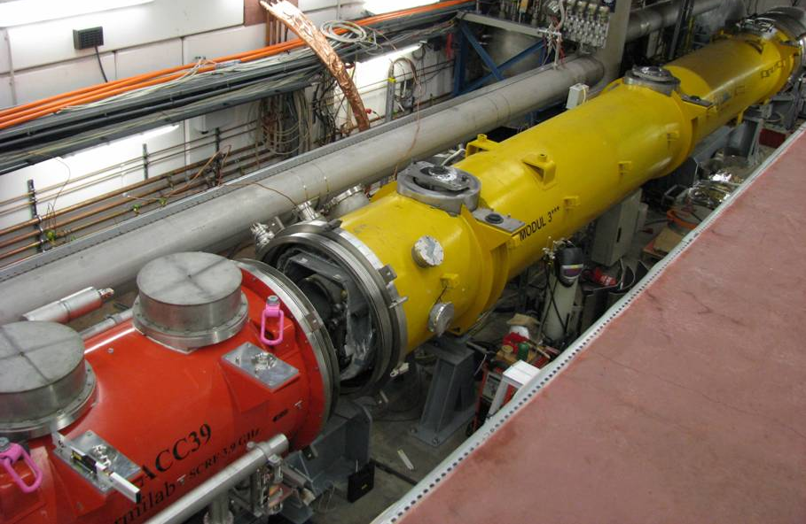

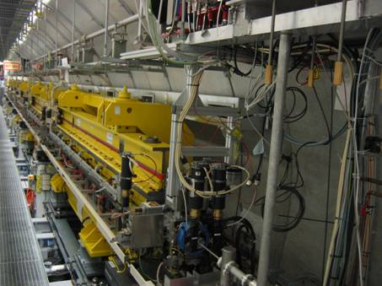
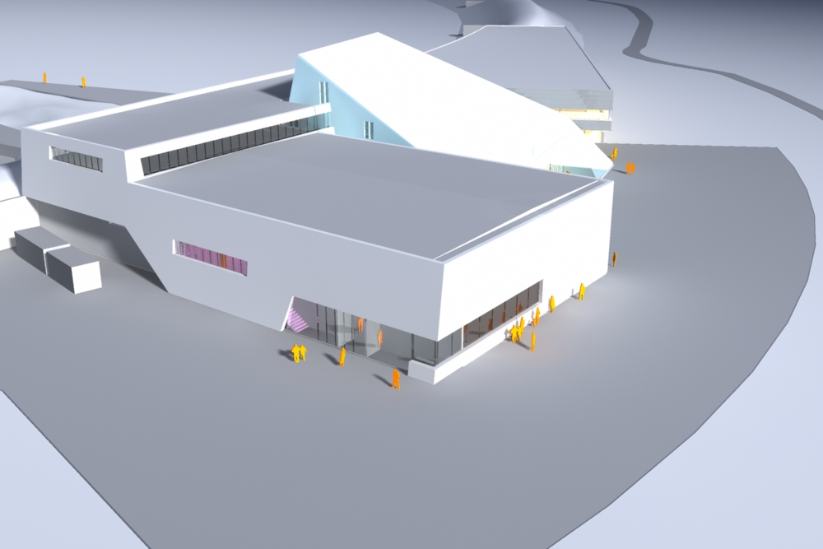
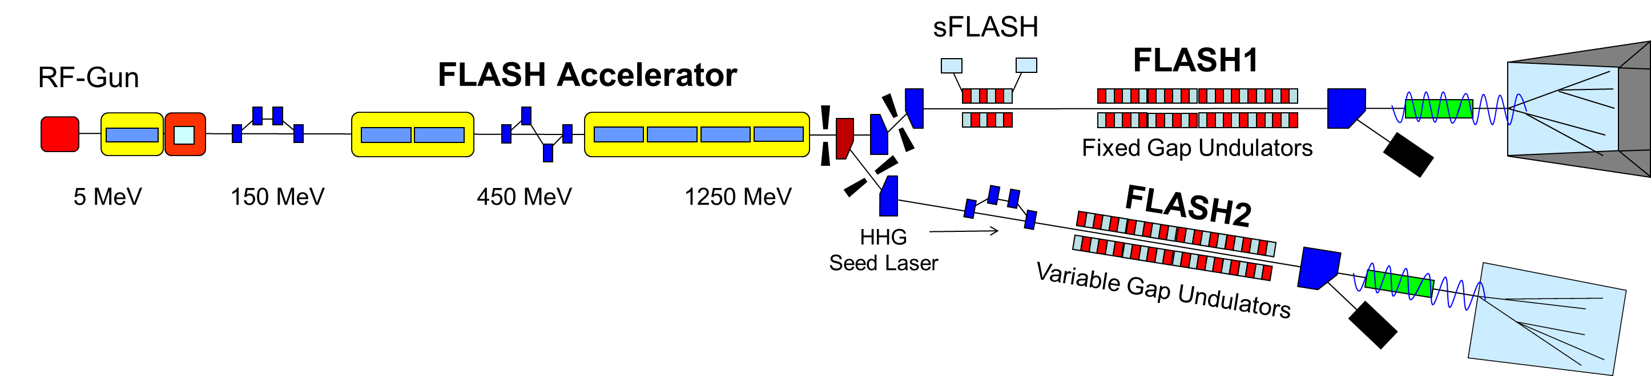
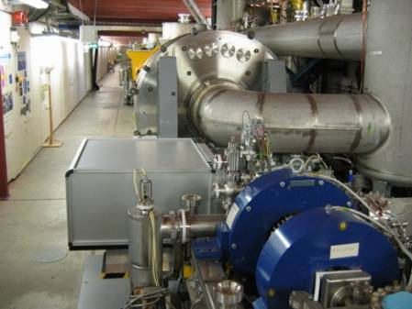
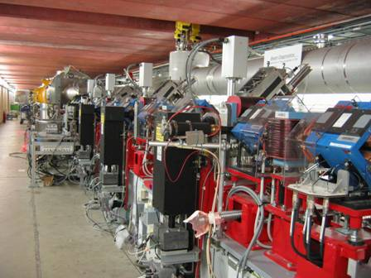
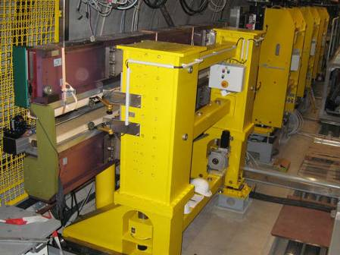
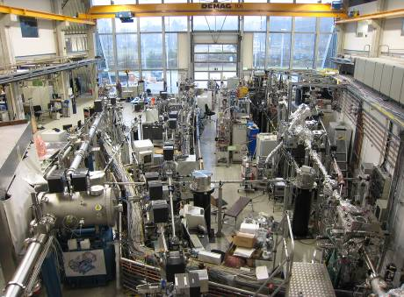
FLASH layout
3rd harmonic module 3.9 GHz
TESLA type superconducting accelerating modules 1.3 GHz
Fixed gap undulator
length ~ 27 m
FLASH2 Experimental Hall
Normal conducting 1.3 GHz RF gun
Ce₂Te cathode
Nd:YLF based ps photocathode laser
Diagnostics and matching
Deflecting cavity LOLA
sFLASH undulators (variable gap)
THz Undulator
FLASH1 Experimental Hall

Slide 4
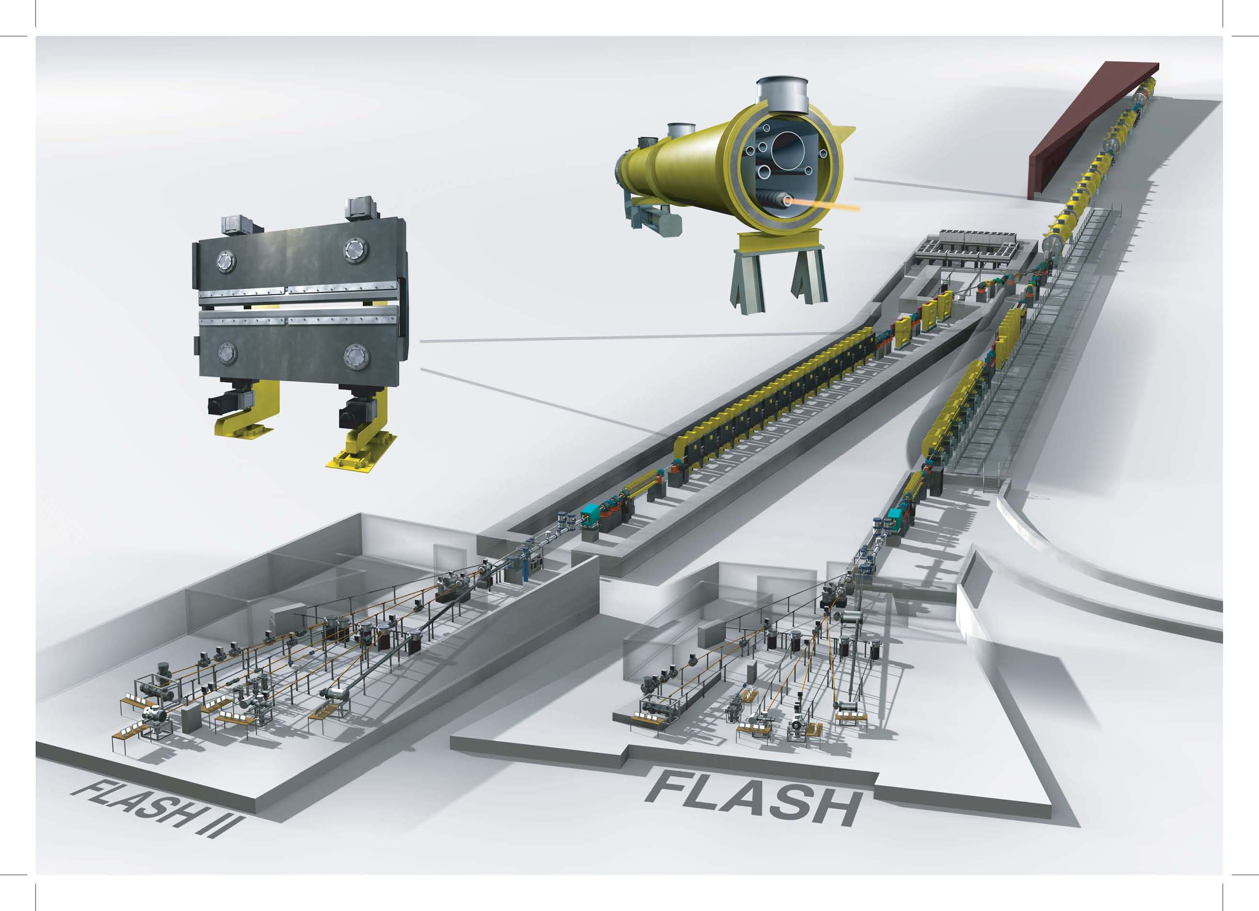
FLASH II project: one accelerator with
two beamlines: FLASH1 and FLASH 2

Slide 5
Lasing of FLASH1 and FLASH2 Simultaneously.
Take advantage of superconducting accelerator
  → Fast switching within a pulse train with a fast kicker
  → FLASH1 and FLASH2 share a long pulse train
Flexibility:
  Different photon pulse lengths
  → requires different bunch compression and thus different bunch charge
  Different wavelengths
  → Variable gap undulator in FLASH2
  Wavelength scans in FLASH1
  → Requires beam energy change (fixed gap undulators)
  → Small changes in RF settings required independent for FLASH 1 and FLASH2

Slide 6
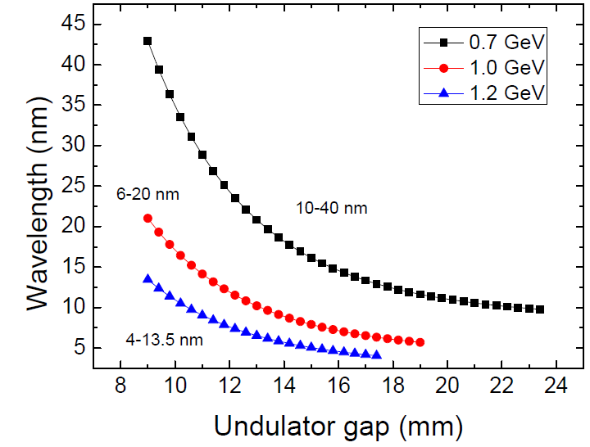
Parameters FLASH2 beamline
Electron beam
Beam Energy | 0.5 – 1.25 GeV
Emittance (norm.) | 1 – 3 mm mrad
Energy Spread | 0.5 MeV
Peak Current | 2.5 kA
Bunch charge | 0.02 – 1 nC
Bunch spacing | 1 – 25 µs
Repetition rate | 10 Hz
Undulator
Period | 31.4 mm
Segment Length | 2.5 m
Segments | 12
Gap | Variable
Focusing | FODO
Energy | Wavelength
0.7 GeV | 10 – 40 nm
1.0 GeV | 6 – 20 nm
1.25 GeV | 4 – 13.5 nm

Slide 7

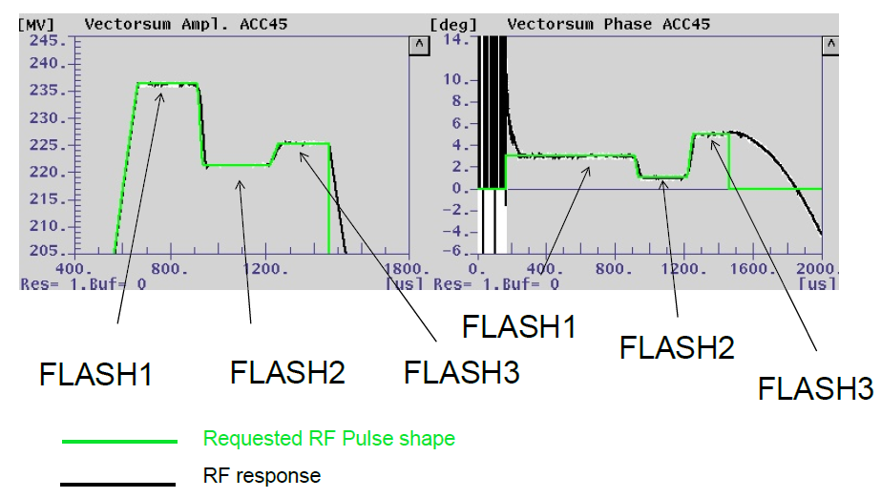
Beamline switching (FLASH1 and FLASH2)
Within 1 RF pulse part to FLASH1 and part to FLASH2
800 μs
99 ms
800 μs
99 ms
800 μs
99 ms
800 μs
t
Amplitude and Phase of Acceleration
Flexibility in
  Intra-train repetition rate
  Number of pulses per train
  Longitudinal pulse shape
  Single pulse energy
for both(!) users
Bunch kicker test successful
Pulse length test successful
Tests with 2 injector lasers successful

Slide 8
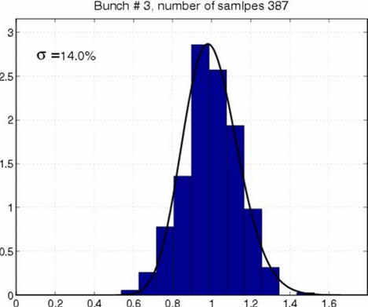
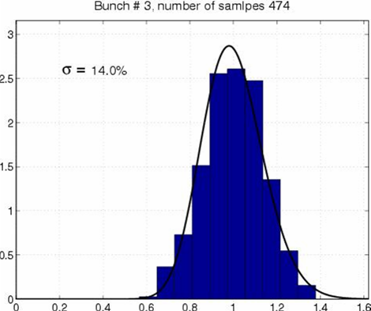
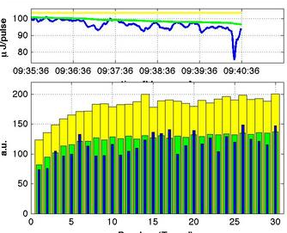
Kicker Tests
SASE energy fluctuation
Without kicker σ=14%
With kicker σ=14%
No significant change of SASE energy along kicker pulse

Slide 9
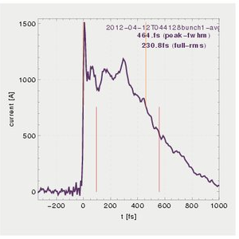
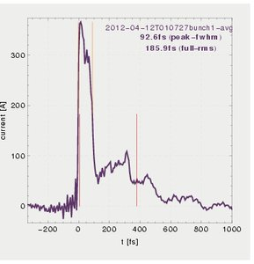
Charge dependence
Charge 0.6 nC
Bunch length 450fs
Charge 0.07 nC
Bunch length 90 fs

Slide 10
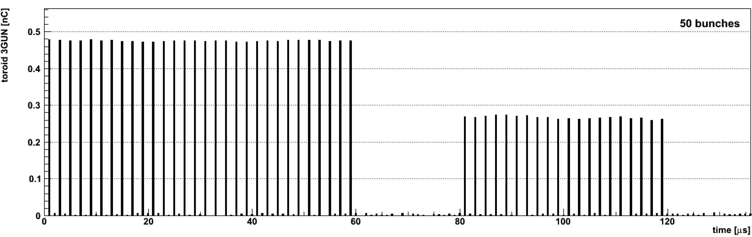
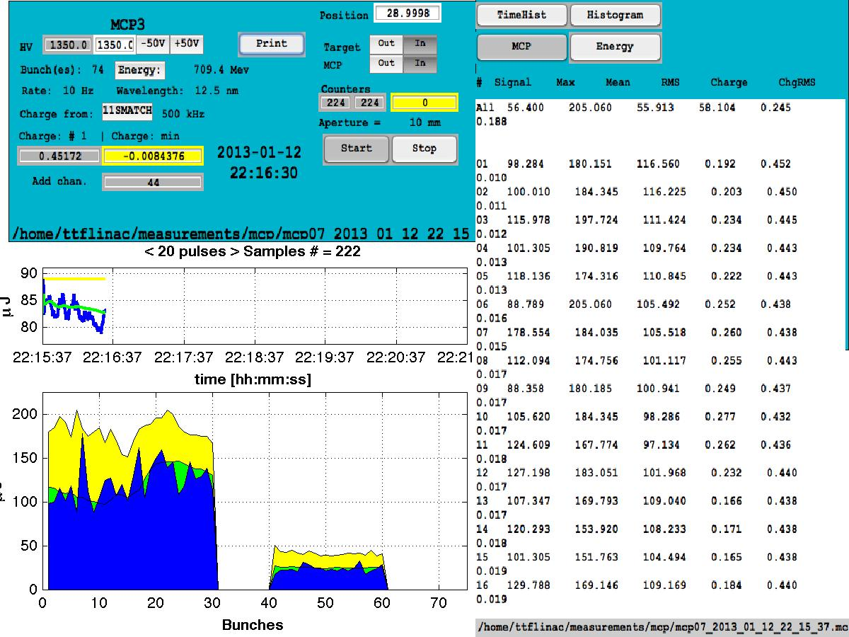
Test with 2 lasers
We used both injector lasers simultaneously
Independent adjustment of pulse train parameters and gap between sub-trains
Train 1, 0.5 nC
Train 2, 0.25 nC
Bunch Charge (nC)
SASE Energy (µJ)
Expected ~50 µJ

Slide 11
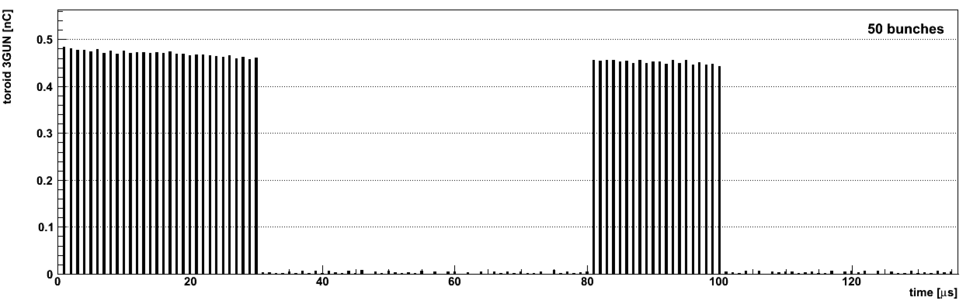
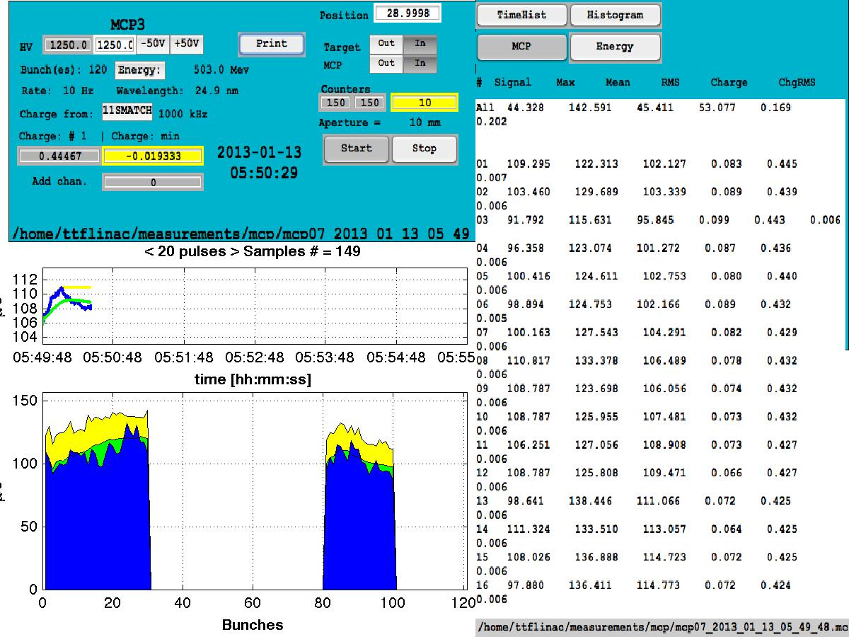
Test with 2 lasers
Both sub-trains with same charge
Bunch Charge (nC)
Same charge → same SASE energy
SASE Energy (µJ)

Slide 12
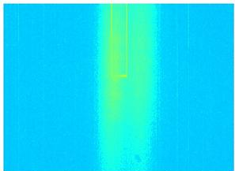
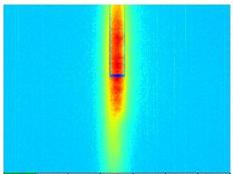

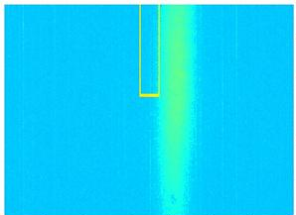
Wavelength tuning
Lasing with both sub-trains simultaneously
With slight energy correction for both lines
FLASH 2 beam energy increased by 7MeV
FLASH1
λ = 13 nm
bw = 0.2 nm
FLASH1 (only)
Wavelength spectrum with both lasers
== FLASH1 & FLASH2
FLASH2 (only)

Slide 13
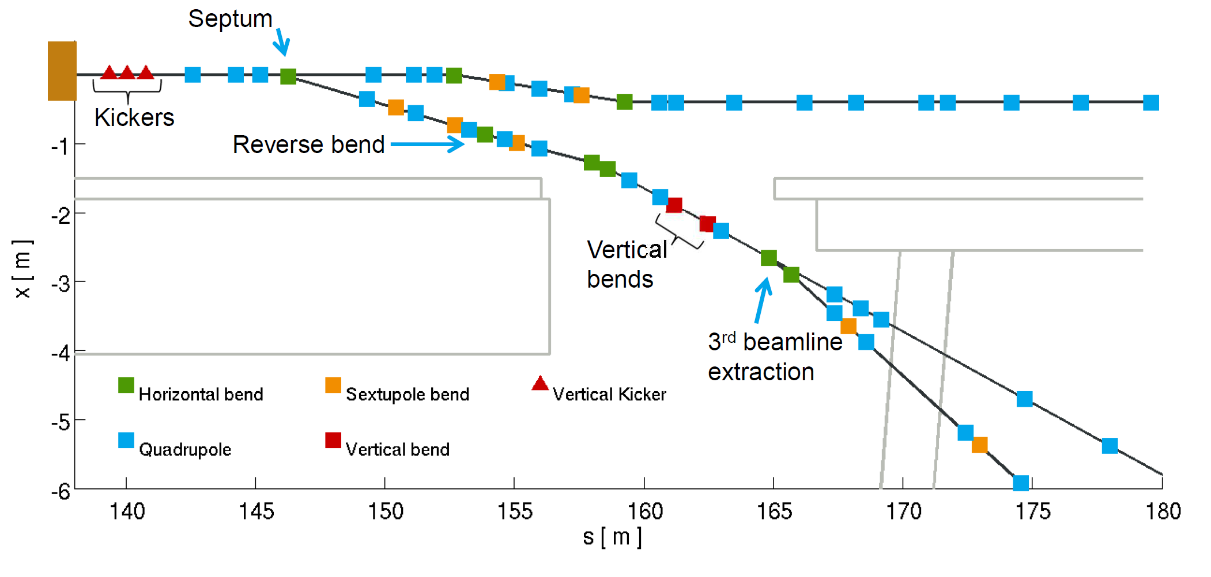
FLASH Extraktion
Mit FLASH3 Option

Slide 14
Strahlweiche FLASH1 und FLASH2
FLASH2
FLASH1
20 μs
10 μs
Pulszug
800 μs
Kicker
Flat-top Kicker in Kombination mit einem Septum
Anstiegszeit etwa 20 us, Abfall etwa 10 us möglich

Slide 15
Strahlweiche FLASH1, FLASH2 und FLASH3
FLASH1
FLASH2
FLASH3
20 μs
>100 μs
Pulszug
800 μs
Kicker
Zeit
Schnell gepulster Dipol
Bisher keine Lösung mit schnellem Kicker-Septum für FLASH3
Daher: Gepulster Magnet
Anstiegszeit 100 us (für Plasma-Experiment bis zu 250 us)
1/8 des RF Pulses bleibt ungenutzt – außer: Kicker/Septum könnte Doppelpulse

Slide 16
Strahlweiche FLASH1, FLASH2 und FLASH3
FLASH2
FLASH1
FLASH3
10 μs
20 μs
Pulszug
100 μs
800 μs
Kicker
800 μs
Zeit
Schnell gepulster Dipol
Besserer Ausnutzung des HF-Pulses:
Falls Kicker Doppelpulse könnte … sollte gehen laut Frank

Slide 17
Operating
Einstellen der Strahlenergie und Phasen für die Erfordernisse des Experiments an FLASH1
Ladung, Pulsfolge und Kompression für FLASH1
  Beispiel: 1 GeV für 6.4 nm, 40 Pulse, 100 kHz (400 us),
  0.2 nC, Kurzpuls
  Start des Pulszuges (bei t = 210 us, Laser 1, LLRF1)
Volle Transmission FLASH1, erstes Lasing
Kicker hochfahren, Start t = -10 us
Pulse für FLASH2 einstellen (Laser 2, LLRF2)
  Beispiel: 200 Pulse, 1 MHz (200 us), 0.2 nC
Anpassung für FLASH2 Experiment
  Beispiel: 0.5 nC, viel SASE, 10 nm (gap 13 mm)
In parallel: tuning FLASH1

Slide 18
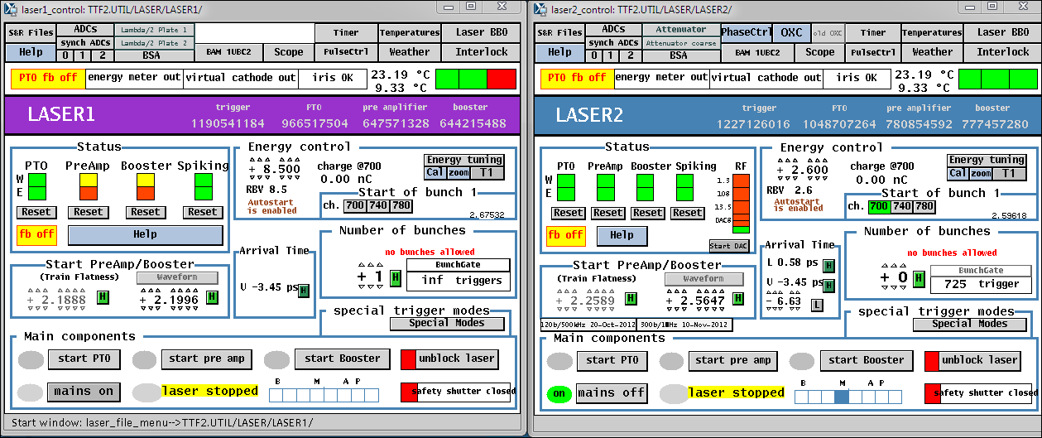
(j)ddd Panel Beispiel Laser
Deutlich unterschieden durch Kennfarben
Problem: Verwechslung

Slide 19
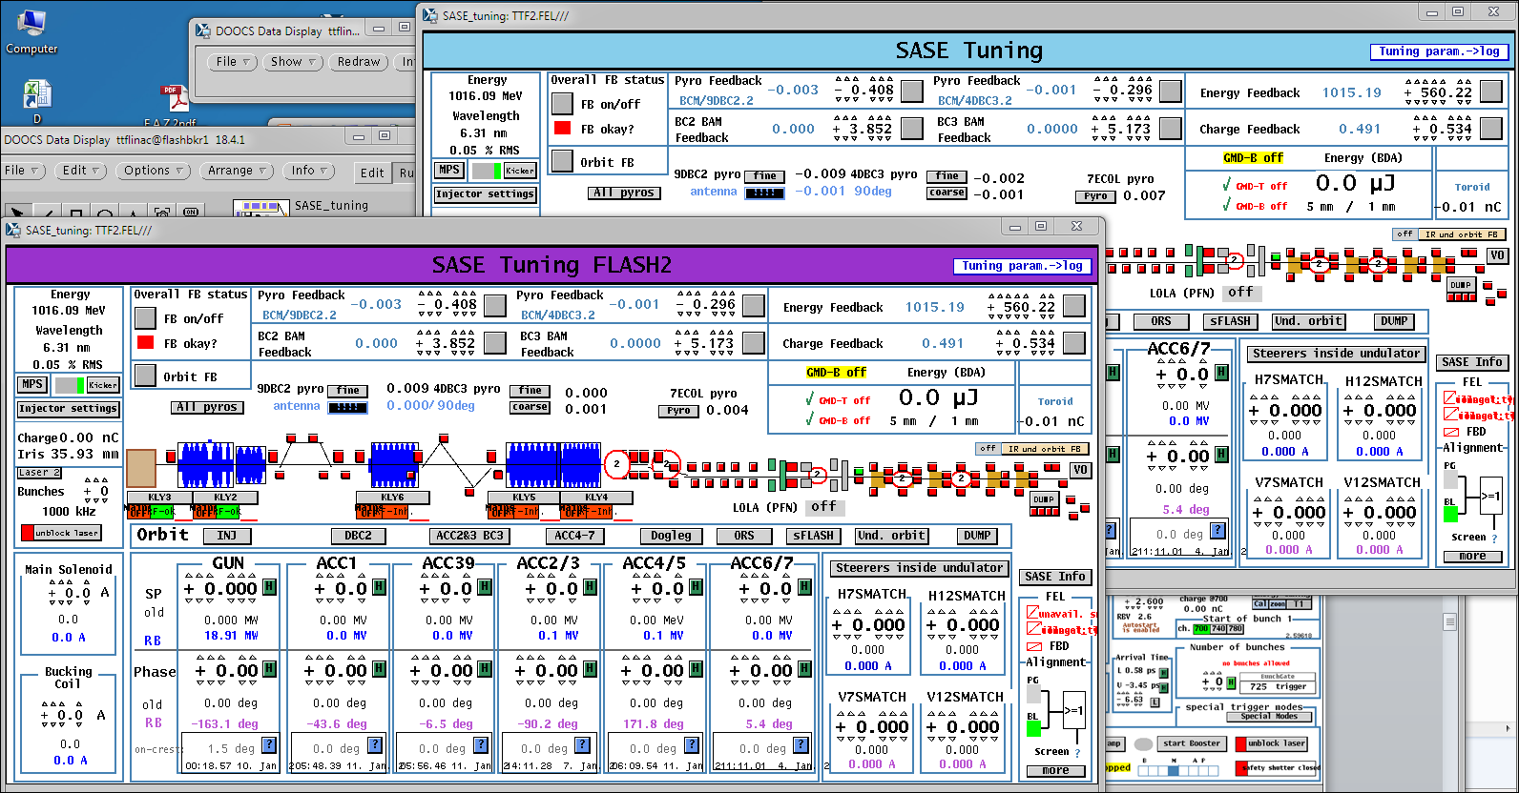
Example: SASE tuning
Ein Server läuft im Hintergrund, der die Grenzen der einstellbaren Parameter dynamische anpasst

Slide 20
Mögliche Ansetze zur Umsetzung ins Kontrollsystem
Es gibt eine gemeinsame Instanz, FLASH-Linac
FLASH1 und FLASH2 haben zwei getrennte Instanzen, die zwar die jeweils andere Beamline und FLASH-Linac darstellt, aber nicht aktiv einstellbar ist
Das schließt Feedbacks mit ein
Die Instanz kennt die Spannweite der einstellbaren Parameter (Laser, Amplitude und Phase der Module, Feedback-Parameter)
Gemeinsame Parameter können nur zusammen verändert werden
Muss zum Beispiel die Energie bei FLASH 1 stark nachjustiert werden, muss bei FLASH2 sofort das Gap der Undulatoren angepasst werden
Definition von ‚Sektionen‘ innerhalb des Trains
  Definition, Speicherung, etc. von Properties für diese Sektion
Darstellung von Werten gegen dynamische Referenz

Slide 21
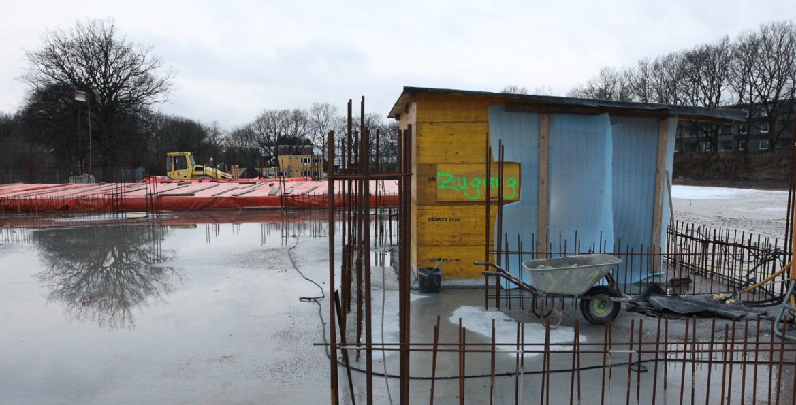
European XFEL
Sep 2010 – Mar 2011

Slide 22
Beam Line Layout
  2 e⁻ beam lines
  3 (5) undulators
  6 (10-15) instruments
MID
HED
SPB
FXE
SQS
SCS
Boxes only placeholders !

Slide 23
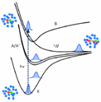
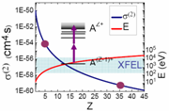

Scientific instruments
SPB : Ultrafast Coherent Diffraction Imaging of Single Particles, Clusters, and Biomolecules
  Structure determination of single particles: atomic clusters, bio-molecules, virus particles, cells.
MID : Materials Imaging & Dynamics
  Structure determination of nano- devices and dynamics at the nanoscale.
FXE : Femtosecond X-ray Experiments
  Time-resolved investigations of the dynamics of solids, liquids, gases
HED : High Energy Density Matter
  Investigation of matter under extreme conditions using hard x-ray FEL radiation, e.g. probing dense plasmas
SQS : Small Quantum Systems
  Investigation of atoms, ions, molecules and clusters in intense fields and non-linear phenomena
SCS : Soft x-ray Coherent Scattering/Spectroscopy
  Electronic and real structure, dynamics of nano-systems and of non-reproducible biological objects
Hard x-rays
Soft x-rays

Slide 24
Bunch Pattern Variations
At laser/linac for variation of spacing (n*111 ns, n >= 2)
  Within minutes
With kicker system after the linac
  DC operation (switch within seconds)
  Distribution within pulse
  Pattern selection within pulse
  ‘Fresh’ bunch in SASE3 (prevent lasing in SASE1 with fast kicker)

Slide 25
Bunch Property Variations
Undulator Gap Motion
  Within seconds
  Should be transparent to beam -> user operation
Beam Energy variations
  Large beam energy variations several ten minutes
  Within 3% bandwidth possible within bunch train with about 40 µs transition time

Slide 26
Multiple – gradient/phase operation
Preparation of software for FLASH 1 & 2 & 3 operation!
FLASH 1
FLASH 2
FLASH 3
Used gradient steps -2% and + 3% with 40us transient time
Setting up time < 10 sec

Slide 27
Bunch Property Variations
Charge/compression Variations
  Within minutes
  In certain limits also within bunch train, several issues under study:
    Keep magnets constant (needs special `working points`)
    Change compression by phase/amplitude variations
    Fast switching of laser, gun properties
    Find special `working points`
    Fast switching of laser heater, ….

Slide 28
Electron bunch distribution to 2 BL / 5 undulators
Linac delivers fixed bunch pattern with 10 Hz repetition rate
e-beam distribution to 2 beamlines
  Equal splitting on both e⁻-BL
  Equal splitting on 3 undulators
  Equal splitting on 5 und. (future)
  Assymetric splitting
  Specific electron bunch properties
SASE 2
SASE 1 & 3
SASE 2
SASE 1
SASE 3
SASE 2
SASE 4
SASE 5
SASE 1
SASE 3
SASE 2
SASE 1
SASE 3
SASE 2
SASE 1
SASE 3

