Slide 1
The New XFEL and FLASH Timing System
Clock and Triggers
Bunch Synchronized Readout
Hardware
Software
Kay Rehlich
19. March 2013

Slide 2
Timing and Data Acquisition Concept
Console Applications: access to all components
DAQ
Orbit Server
Energy Server
Other
Server
Feedback Server
Buffer Manager
Fast Collector
Buffer
Buffer
Buffer
Buffer
Timing System
Event Number + Trigger
ADC
ADC
ADC
Δφ
Δφ
Trigger
Δφ
Clock
FLASH / XFEL

Slide 3
FLASH2 -- XFEL
Gun
ACC1 ACC39
ACC23
ACC45 ACC67
sFLASH
SASE
~4.1 – 44 nm
EXP. Hall
1st BC
2nd BC
FLASH1
SASE
~4 – 60 nm
FLASH2
Keeping Hardware and
Software Compatible …
SASE 5
I1
SASE 2
SASE 4
BC 0
BC 1
BC 2
SASE 1
SASE 3
L1
L2
L3
I2
XFEL

Slide 4
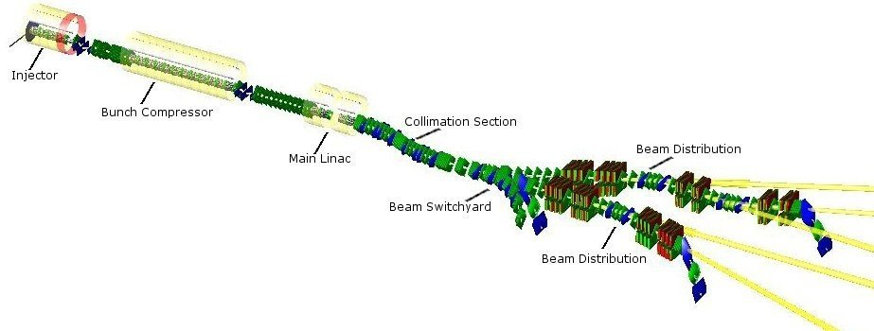
Bunches in XFEL
The XFEL can produce 27 000 bunches per second
bunches in experiment A
<= 2700 bunches in main linac
0.6 ms
100 ms
bunches in experiment B

Slide 5
New Timing System for XFEL and FLASH
Transmitter
L = const.
Receiver
MO
1.3GHz
Trigger
Sender
Event & Pattern
Receiver
delay
Divider
delay
Bunch
Pattern
÷ 26 000 000
÷ 12 960
Sync.
50 Hz
100.3kHz
Clocks
Timing Events &
Pattern Table
Divider
50 Hz
mains
(÷12) 108.333 MHz
(÷288) 4.514 MHz
(÷144) 9.028 MHz
...
MPS
FLASH
9.028 MHZ as the base frequency:
Bunch spacing >= 1 / 4.5MHz
1 or 3 MHz bunch spacing are possible
FLASH compatibility
XFEL
f_{max} = 4.5MHz
1 MHz

Slide 6
Trigger Distribution
Central Delay
Global Events
External Start 10Hz
Local Delay
t0
Laser1
A2
Laser Oscillator
A6
Bunches from laser 1
2.7 ms
700 µs
Laser2
A2
Laser Oscillator
E6
Bunches from laser 2
Kicker
Gun
A6
HV Gun Klystron
LLRF Gun
ADC sampling time

Slide 7
32 Bit Bunch Pattern Defines Every Bunch
! Charge ranges: To be changed !
‘Distortions’ to ignore
Charge: Alternative:
No bunch No bunch
Low: < 0.1 nC < 0.125 nC
0.1 – 1 nC 0.125 – 0.25 nC
High: > 1 nC 0.25 – 0.5 nC
TBD 0.5 – 1 nC
TBD 1 – 2 nC
TBD > 2 nC
TBD free
-
1. Laser
2. Laser
3. Laser
XFEL:
TDS Inj
TDS BC1
TDS BC2
Wire Scanner
FLASH:
-
-
LOLA
Wire Scanner
Photon line deflection (mirror in)
31
30
29
28
27
26
25
24
23
22
21
20
19
18
17
16
15
14
13
12
11
10
9
8
7
6
5
4
3
2
1
0
FLASH:
-
-
FLASH 3 e-
FLASH 2 e-
FLASH 1 e-
-
XFEL:
SASE 5 special mode
SASE 4 special mode
SASE 3 special mode
SASE 2 e-
SASE 1 e-
Main dump

Slide 8
Section Pattern for XFEL and FLASH (MPS)
Gun
ACC1 ACC39
ACC23
ACC45 ACC67
sFLASH
SASE
~4.1 – 44 nm
EXP. Hall
1st BC
2nd BC
FLASH1
SASE
~4 – 60 nm
FLASH2
P-FLASH
FLASH 3
SASE 6++
31
30
29
28
27
26
25
24
23
22
21
20
19
18
17
16
15
14
13
12
11
10
9
8
7
6
5
4
3
2
1
0
SASE 3-5:
e.g. “fresh bunch mode”
SASE 5
I1
SASE 2
SASE 4
BC 0
BC 1
BC 2
SASE 1
SASE 3
L1
L2
L3
XFEL
I2

Slide 9
Beam Modes: max. # of Bunches in Section, 32 bit Word (MPS)
FLASH1
FLASH2
1 | Single
S | <= 30
M | <= 300 / 500
F | Full
1 | S | M | F | 1 | S | M | F | 1 | S | M | F | 1 | S | M | F | 1 | S | M | F | 1 | S | M | F | - | - | - | - | - | - | - | -
31
30
29
28
27
26
25
24
23
22
21
20
19
18
17
16
15
14
13
12
11
10
9
8
7
6
5
4
3
2
1
0
SASE 5
I1
SASE 2
SASE 4
BC 0
BC 1
BC 2
SASE 1
SASE 3
L1
L2
L3
I2
XFEL

Slide 10
Timing System With Restrictions by MPS
Max # bunches in section
From MPS
1 | S | M | F | 1 | S | M | F | 1 | S | M | F | 1 | S | M | F | 1 | S | M | F | 1 | S | M | F | - | - | - | - | - | - | - | -
Max charge
< ?
Calc. tot charge in FLASH1/SASE1
Pattern Request by
Operator
Corrected
Pattern is
Distributed
0
1
2
7198
7199
Max charge
< ?
Calc. tot charge in FLASH2/SASE2
…
…
Ignored bunches
Bunch delivery
Source + charge
Max charge
< ?
Calc. tot charge in linac
Section permit
From MPS
_ Inj 2 _
SASE xx

Slide 11
Example: 4 Bunches in FLASH1, 2 in FLASH2
FLASH1
Kicker gap
FLASH2
700 µs
1 MHz
1364.6 µs
0.5 MHz
Length of pattern table = 7222
= 800µs*1300MHz/144
…
…
…
…
…
…
Bunch
200 pC
8 *
No bunch
5972 *
No bunch
Bunch
50 pC
8 *
No bunch
1212 *
No bunch

Slide 12
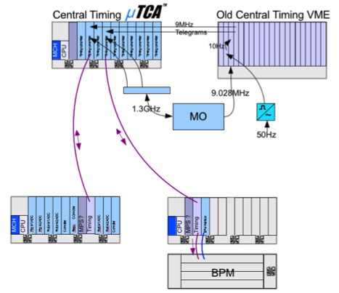
The New Timing System for FLASH
All MicroTCA systems will connect to the new system
VME remains on old 9 MHz timing
First step (shown):
Old system is master.
Second step:
New timing is master

Slide 13
Features of the New Timing
More outputs, more functions, better resolution
Distributes bunch patterns
Fiber optical distribution
Based on 1.3 GHz (old 9.028 MHz)
Less jitter
Trigger and clock distribution on backplane

Slide 14
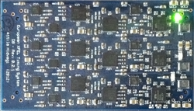
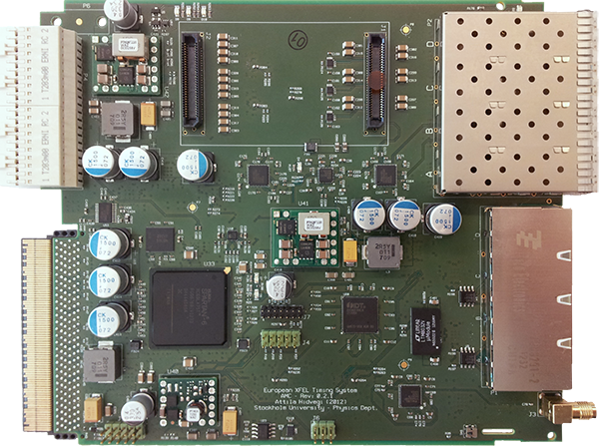
New Timing Module
Transmitter
Piggyback
Optional RTM:
9 transmitters,
Further triggers or clocks
IN OUT OUT OUT
Fiber optics
2 * Trigger out
1 * Clock out
MicroTCA backplane:
TCLKA and TCLKB,
8 * M-LVDS
RJ45
LVDS
2 * Trigger out
1 * Clock out
2 * Trigger out
1 * Clock out
4 * General I/O

Slide 15
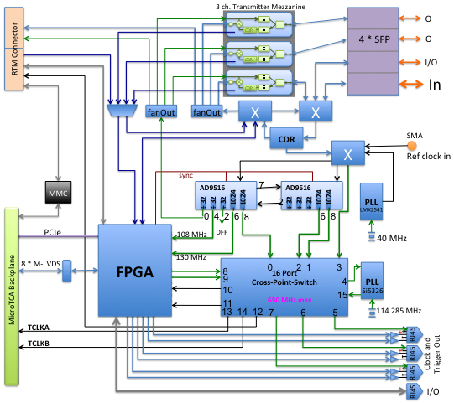
Timing AMC Block Diagram

Slide 16
FPGA Handles Triggers and Tables
Table of
Pattern Generator
Timing
Event
Receiver
Stand-alone or receiver
4*SFP
TrigBlk
evt
Pattern (table), MacroPulse #,
Delay
RTM connector
de
=
Delay measurement
FSM &
Distribution
Abs time in µs
evt
Data of the Encoded Event Trigger
Delay
Event
Event delay 32 bit
PCIe IRQ
TrigBlk
TrigBlk
Event select
Event select
Event select
Event select
Event select
Event select
Delay
Event select
Event select
Delay
Delay
Event select
Clk, Trig
Event select
Delay
Delay
Event select
Delay
Event select
M-LVDS Bus
Delay &
Width
Delay
=
=
Delay
Delay &
Width
Width
Delay
=
=
Delay
Width
Width
Delay
=
=
Delay
Width
Clk, Trig
Width
=
=
Width
Width
=
=
Width
Width
=
=
Width
Clk, Trig
Up-Counter
108 MHz
Sync
Position [sec]
RJ45
Transmitter-Receiver Delay

Slide 17
Timing: One Channel (out of 22) Block Diagram
FSM &
Distribution
Pattern (table), Event#, …
Local bunch select
Ext Divider
Delayed table index
Data of the Encoded Event Trigger
Location Pattern 32 bit
Event
CMD
Event delay 32 bit
Control/Status-Reg
Divider, PLL
Global fast data link
data
CMD decode
clock
RTM
2 * 540 MHz
=
Global UART 115 kbaud
Ch. select
Fine delay
Delay
Global Sync
Gate
Delay
Width
108 MHz
MLVDS
Event select
=
108 MHz
TrigBlk
Delay 24bit
Width 24bit
Fine Delay 10 bit
Front Clk, Trig
Up-Counter
108 MHz
Sync
Position [sec]
Register with local PCIe access
Transmitter-Receiver Delay

Slide 18
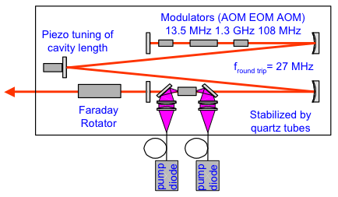
Controlling the Injector Laser
µTCA
MPS
New Timing Receiver
Timing Master
MO 1.3 GHz
Inhibit FLASH 1
FLASH 2
Shutter
13.542 MHz
108.33 MHz
Reset
Bunch Pattern
Trigger
Divider
FPGA: Laser Output Controller
Triggers
φ
fast FB
Shutter
Example layout
of a laser
Pockels cell,
AOM

Slide 19
Example: Timing Connections within a MicroTCA Crate
Ethernet
CPU
CPU
Ethernet
Toroid Protection System
upstream
downstream
LLRF
TPS
FPGA
ADC
PCIe
Pre-Amp
RTM
DAMC 2
MPS
MCH
Interlocks Device status
FPGA
Clock
RTM
DAMC 2
Trigger & Gates
Clock & Data
Interlocks
MPS link
Timing
FPGA
Central Timing
1.3GHz
Timing
Receiver
µTCA Crate
Backplane

Slide 20
LLRF with different Settings FLASH 1 / 2 / 3
FLASH1
FLASH2
FLASH3
FLASH1
FLASH2
FLASH3
RF response
Requested RF Pulse shape

Slide 21
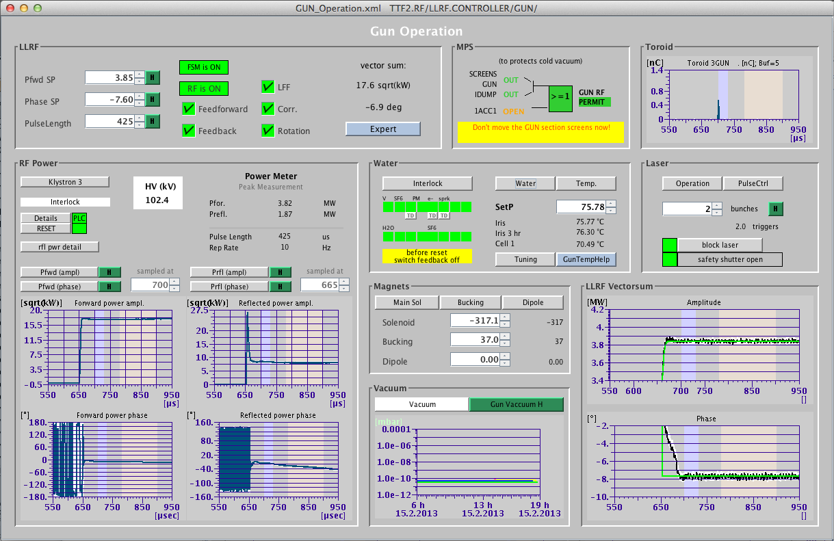
Gun Control Panel
FLASH 1 FLASH 2

Slide 22
New Software for MicroTCA
Ethernet
DAQ
sender
DAQ
Toroid Server
DOOCS
Function
Server
Toroid 1
…
Toroid M
DAQ
Bunch pos
0MQ
Messaging
DAQ
Timing
Server
SIS8300 server .
Loc 1
Loc N
DOOCS
Device Server
MicroTCA
loc1
MacroP
info
s4
s5
. . .
s11
Dev node
Driver
Driver
Linux
Driver
x1timer or x2timer
SIS8300
. . .
SIS8300
AMC

Slide 23
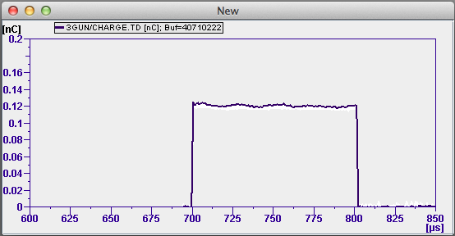
Toroid Front-end Software
Ethernet
First possible bunch: 700 µs
History [FLASH1]
DAQ
9MHZ_DIV = 9, 3, 2 ,1 ➔ 1, 3, 4.5, 9 MHz bunch rate
N_before_first = int (pre_samples / Bunch_inc )
Spectrum parameters:
Offset = 700 – N_before_first * Bunch_inc / SAMPLE_FREQ
Inc. = Bunch_inc / SAMPLE_FREQ
SAMPLE.FLASH1 = N_before_first + IDX.1 / 9MHZ_DIV
SAMPLE.FLASH2 = N_before_first + IDX.2 / 9MHZ_DIV
Toroid Server
Toroid 1
From timing
From timing
IDX.1
IDX.2
Bunch_inc : SAMPLE_FREQ * 144 / 1300 * 9MHZ_DIV [samples]
Header: sample_freq
pre_samples
Data: length
samples[length]
SIS8300 DMA server
Loc 1
Hardware
Trigger
s5
Driver
SIS8300
<pre_samples> = PRE_BUNCH_TIME * SAMPLE_FREQ
SAMPLE_FREQ = e.g. 108,3 MHz
700µs - <pre_samples> / SAMPLE_FREQ
Bold text: property

Slide 24
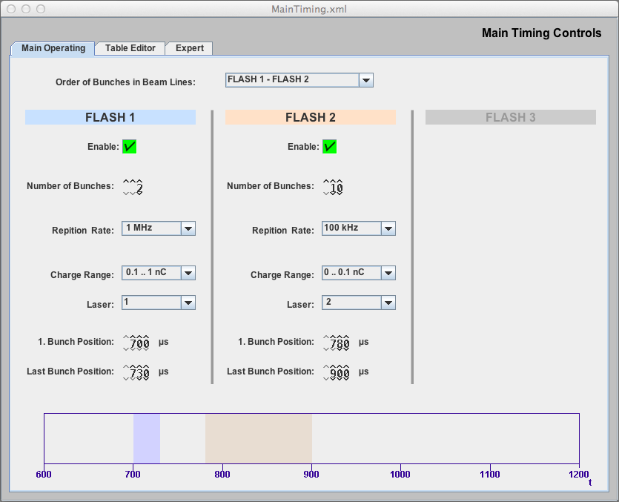
Main Timing Server
Property |  | Description
FIRST_BUNCH_INDEX.1/2 | int | 1. Bunch of FLASH 1/2 in pattern table
FIRST_BUNCH_POSITION.1/2 | float | 1. Bunch FLASH 1/2 in µs
LAST_BUNCH_POSITION.1/2 | float | Last Bunch FLASH 1 in µs
ENABLE.1/2 | int | Single bit to enable bunches in FLASH1/2
NUMBER_BUNCHES.1/2 | int | Fills the number of bunches into the table
REP_RATE.1/2 | int | Repetition rate of the bunches (enum)
CHARGE_RANGE.1/2 | int | Charge range filled into table (enum)
LASER_SELECT.1/2 | int | Selected laser for bunches in FLASH1/2
ORDER_BEAMLINES | int | 0: FLASH1, FLASH2; 1: FLASH2, FLASH1
MACRO_PULSE_NUMBER | int | Unique number
SHOT_ID | Int | ID of the cycle type
BEAM_MODE | Int | Max allowed number of bunches in section
SECTION_PATTERN | Int | Beam permission in sections
Main Timing Server
Calc table from properties
DAQ
Data to DAQ:
Bunch Pattern, MacroPulseNumber, ShotID, Time, BeamMode,
Section Pattern, First and Last Bunch Position of Beam Lines

Slide 25
Vielen Dank!
Das Team:
Attila Hidvégi, Uni Stockholm
Christian Bohm, Uni Stockholm
Pattrick Gessler, XFEL
Holger Kay, MSK
Arthur Aghababyan, MCS4
Gevorg Petrosyan, MCS4
Ludvig Petrosyan, MCS4
Vahan Petrosyan, MCS4
Kay Rehlich, MCS4
Christoph Stechmann, MCS4

