Slide 1

Studies for Particle Driven Plasma Acceleration at PITZ
Experiments planned utilizing PITZ (Photo Injector Test facility at DESY, Zeuthen site)
Matthias Gross
Grömitz,
21. March 2013

Slide 2
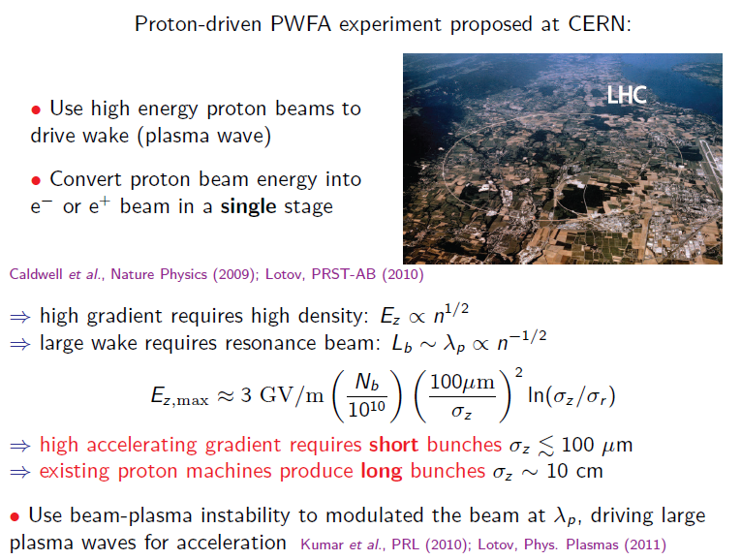
Background
Background:
Courtesy of Carl Schröder, LBNL
Does this work ?
→Dephasing ?
→Hose instability ?

Slide 3
Why Experiments at PITZ?
Favorable circumstances
Pure R&D facility (no users)
Unique laser system (pulse shaper)
Well developed diagnostics (high resolution electron spectrometer, etc.); soon: transverse deflecting cavity + dispersive section for longitudinal phase space measurements
Possible contribution from PITZ:
Self modulation of electron beam
Later: High transformer ratio (needs bunch compressor)

Slide 4
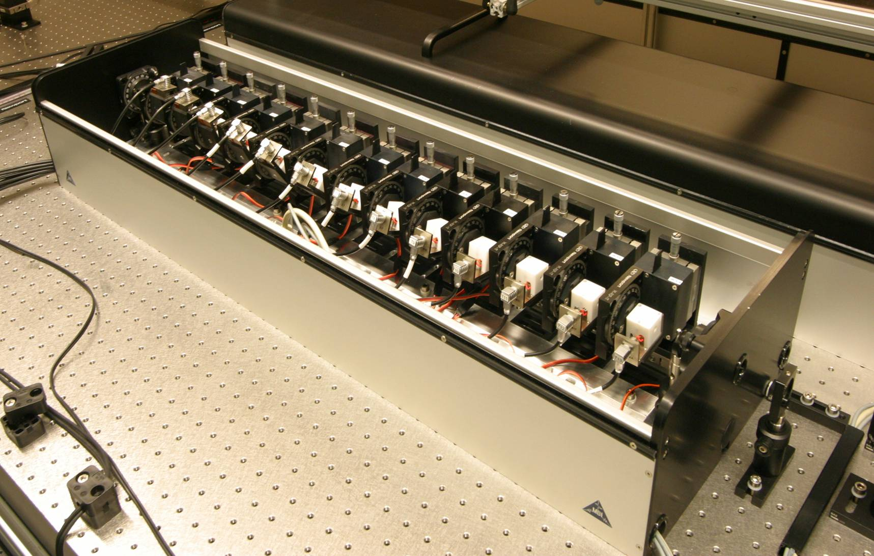
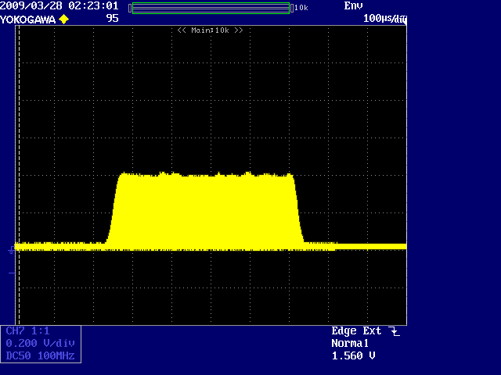
Flexible Laser Pulse Formation at PITZ
Photoinjector laser
Developed and built by Max-Born Institute Berlin
Key element: the pulse shaper
Contains 13 birefringent crystals. Pulses are split according to polarization. Delay is given by crystal thickness; relative amplitude can be varied freely by adjusting relative angle between crystals
motorized rotation stage
Shaped ouput pulses
temperature controlled birefringent crystal
FWHM = 25 ps
OSS signal (UV)
edge₁₀₋₉₀ ~ 2 ps
birefringent shaper, 13 crystals
edge₁₀₋₉₀ ~ 2.2 ps
Gaussian input pulses
birefringent shaper, 13 crystals
Will, Klemz, Optics Express 16 (2008) , 4922-14935

Slide 5
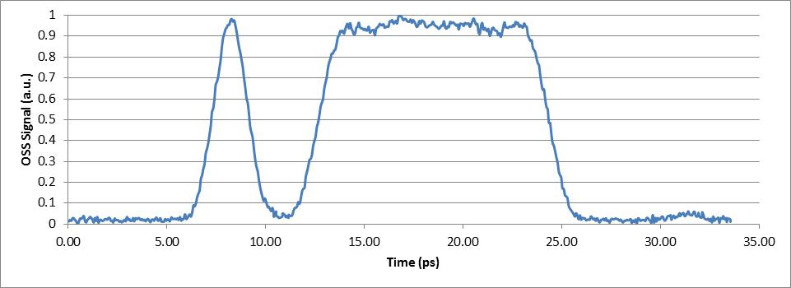
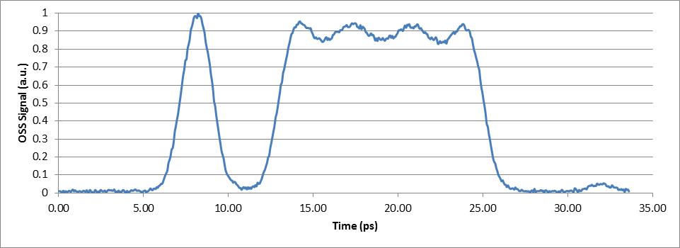
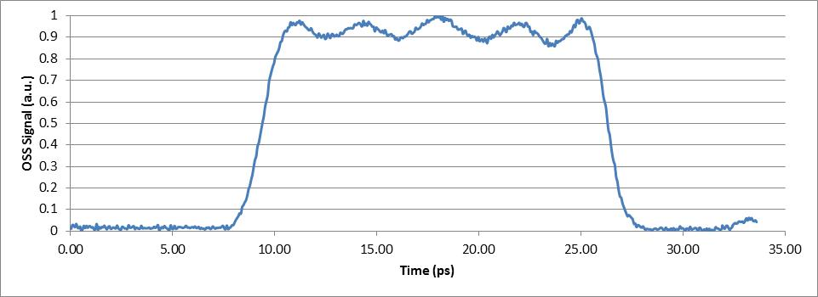
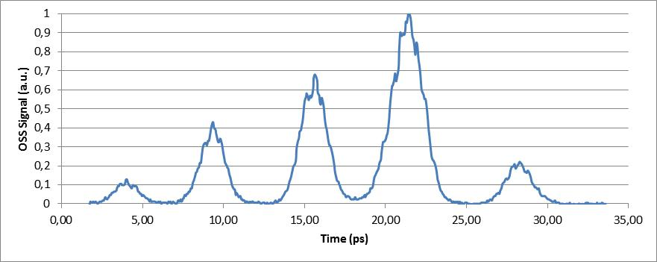
Experimentally Demonstrated Pulse Shapes
Driver + witness bunch
Modulated driver + witness bunch
Modulated driver
Multi bunches

Slide 6
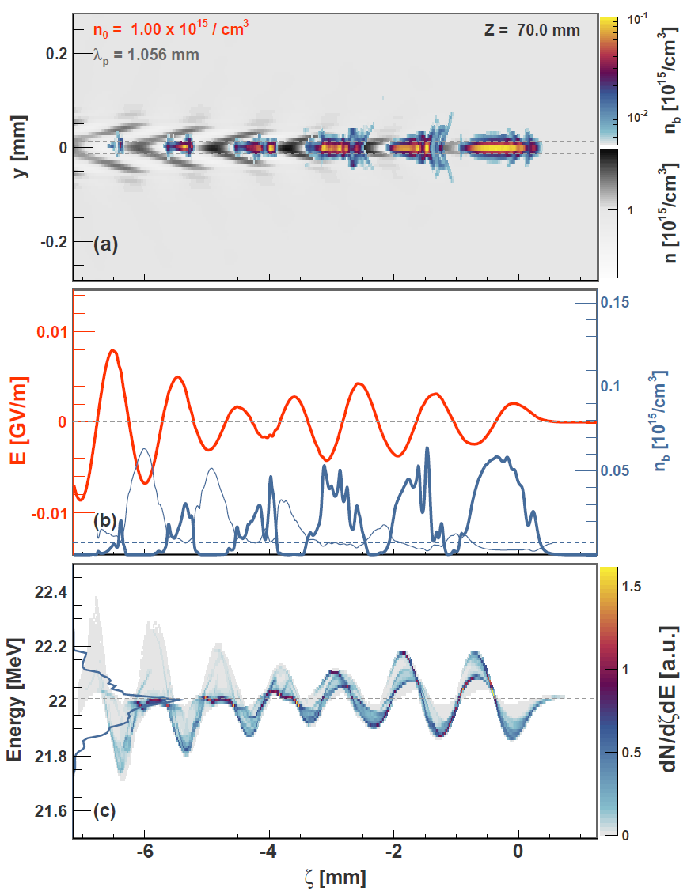

3D PIC (Particle in Cell) Simulation of PITZ Experiment
Expected energy modulation ≈400 keV. PITZ beam energy spread as low as ≈60keV. Resolution of TDS/HEDA2: 10keV and 100μm (Malyutin et al. “Simulation of the Longitudinal Phase Space Measurements With the Transverse Deflecting Structure at PITZ”, Proc. of IPAC 2012, MOPPP034 → Measurable
Beam parameters | Setup 1
Total charge, pC | 100
Longitudinal beam position, m | 6.44
Horizontal rms beam size, um | 42.0
Vertical rms beam size, mm | 42.0
Bunch length in FWHM, mm | 5.93
Average kinetic energy, MeV | 21.5
Peak slice current, A | 5.3
Horizontal rms emittance, mm mrad | 0.372
Vertical rms emittance, mm mrad | 0.372
Peak beam density, 10^13 e / cm^3 | 1.9
PITZ resolution window
Simulations:
Alberto Martinez de la Ossa

Slide 7
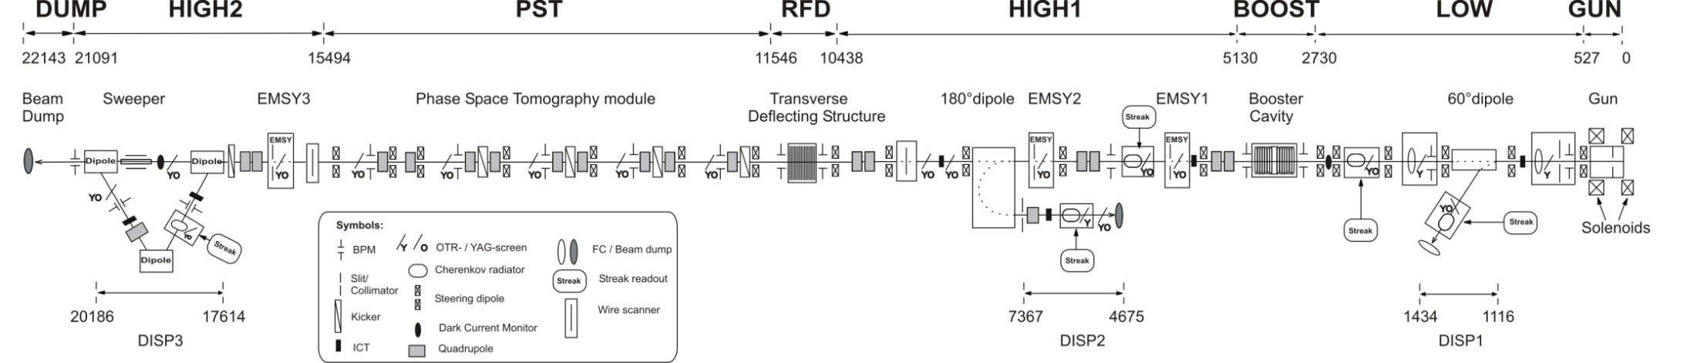
Insertion of Plasma Cell into PITZ Setup
PITZ 2 setup to be used for first plasma experiments
Plasma cell has to be between booster and TDS
Two possible positions, both with a length of about 1m
Beam dynamics simulations to determine which position is more favorable
<25 MeV
<7 MeV
or
plasma cell

Slide 8
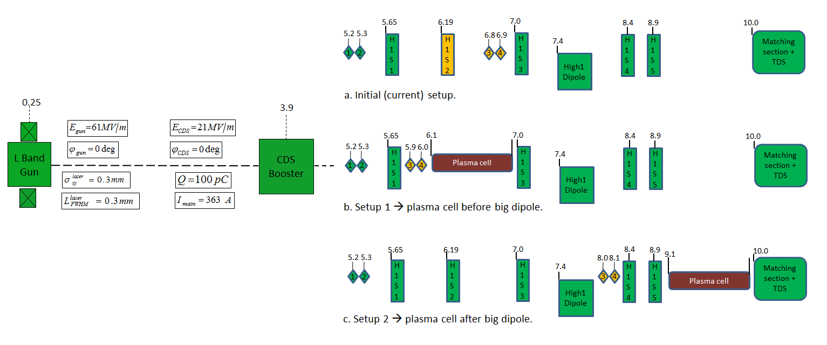
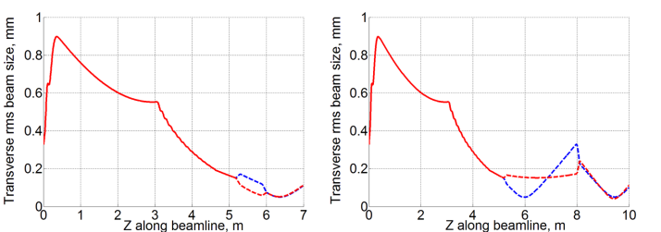
Simulation: Scenarios for Plasma Cell Insertion
Schematic views
Electron beam rms size
More complex beam focusing for setup 2
Setup 1
Setup 2
Simulations:
Martin Khojoyan

Slide 9
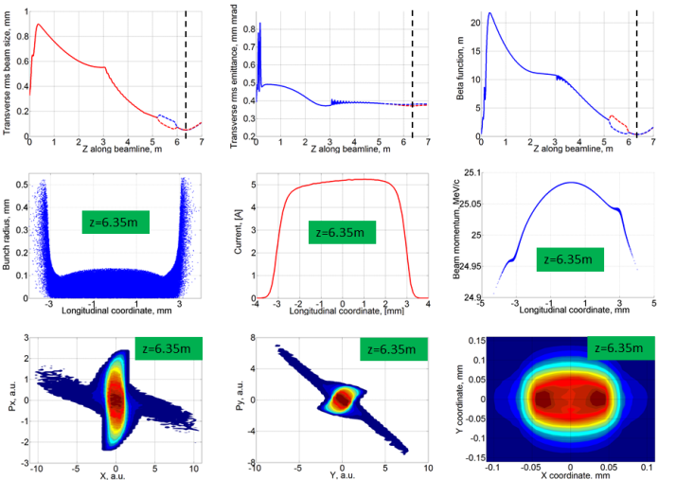
Simulation: Beam Properties
Beam properties for Setup 1 (I_{main} = 363A) Comparison of setups
Setup 1: beam properties acceptable. Smaller beam size, less divergence, higher peak density – overall preferable
Beam parameters | Before dipole | After dipole
Total charge, pC | 100 | 100
Longitudinal beam position, m | 6.35 | 9.45
Horizontal rms beam size, um | 49.8 | 59.4
Vertical rms beam size, mm | 51.2 | 59.4
Rms bunch length, mm | 1.71 | 1.71
Bunch length in FWHM, mm | 5.92 | 5.92
Average kinetic energy, MeV | 24.55 | 24.55
Rms energy spread, keV | 27.5 | 27.8
Peak slice current, A | 5.2 | 5.2
Horizontal rms emittance, mm mrad | 0.37 | 0.38
Horizontal beam divergence, mrad | 0.008 | 0.09
Vertical rms emittance, mm mrad | 0.38 | 0.36
Vertical beam divergence, mrad | 0.002 | 0.13
Longitudinal rms emittance, keV mm | 42.4 | 42.4
Peak beam density, 10^12 e / cm^3 | 9.1 | 6.6
Simulations:
Martin Khojoyan

Slide 10
Key Topic: Ionization of Plasma Channel
Three approaches:
Plasma discharge
RF wave (helicon wave)
Laser ionization
Single photon ionization
Linear process
Need UV light (< 230nm), e.g. ArF laser
Normally partial ionization → percentage is function of local laser intensity (saturation curve)
Field ionization
Nonlinear process
Laser wavelength not important, e.g. Ti:Sapphire or CO₂ laser
Threshold process → Complete ionization in well defined volume

Slide 11
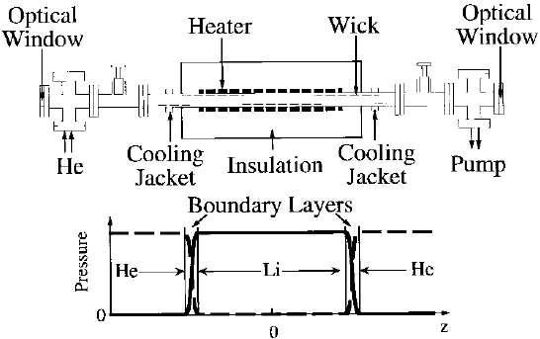
Lithium Plasma Cell
Principle:
Evaporate Lithium in central pipe (700°C)
Define beginning and end of Lithium zone with steep temperature gradient and Helium buffer gas
Once pressure regions have stabilized:
Ionize Lithium gas with laser
Inject particle beam for PWA experiment
Figure from: P. Muggli et al. “Photo-Ionized Lithium Source for Plasma Accelerator Applications”, IEEE Trans. Plasma Science 27 (1999), pp. 791-799

Slide 12
Optics for Laser Plasma Generation – Axial Coupling
Axicon for homogeneous ionization profile
Adjustable aperture to define length of plasma channel
Simple focusing mirror
Length of plasma channel defined by Li gas volume
Li gas
e⁻ beam
Plasma channel
Aperture
Li gas
e⁻ beam

Slide 13
Plasma Ionization –Side Coupling
Independent optimization of electron and laser paths possible
Setup:
x
He
z
He
He
e⁻
Li
Ionized region
He
Dump

Slide 14
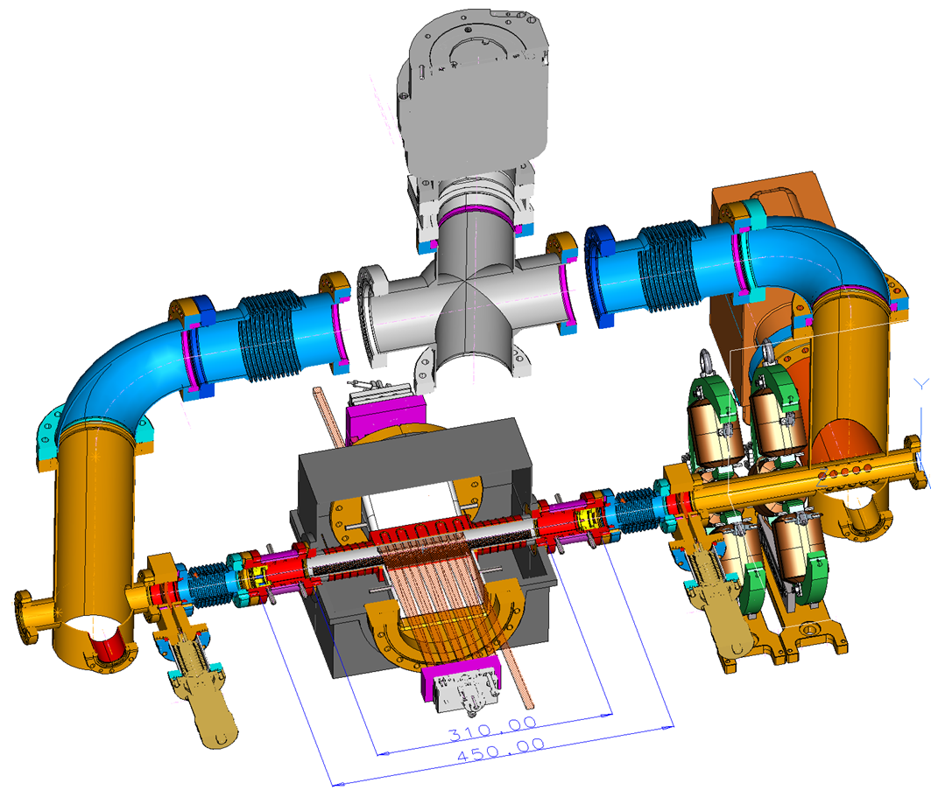
Plasma Cell Assembly: Sketch
Design:
Gerald Koss
Turbo pump
Preliminary Version
Electron
Beam
To
diagnostics
Quadru-
poles
Ionization
laser
Plasma cell

Slide 15
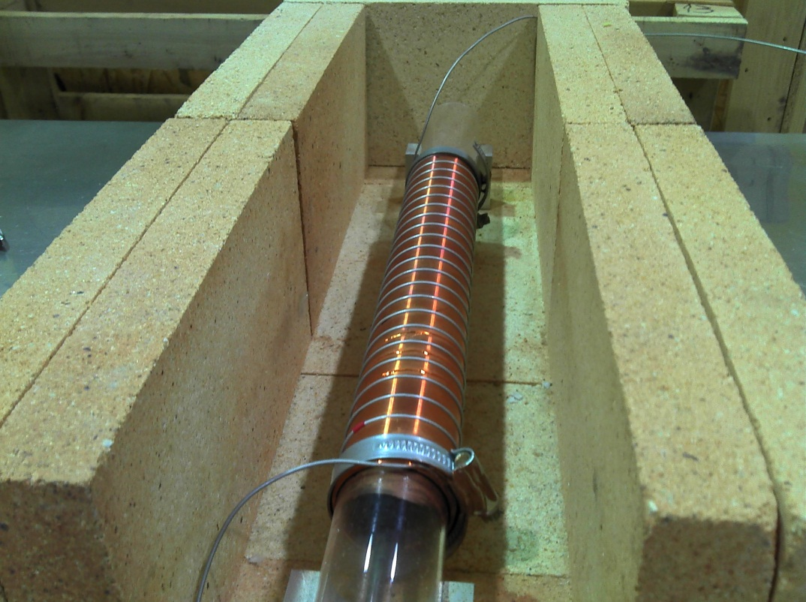
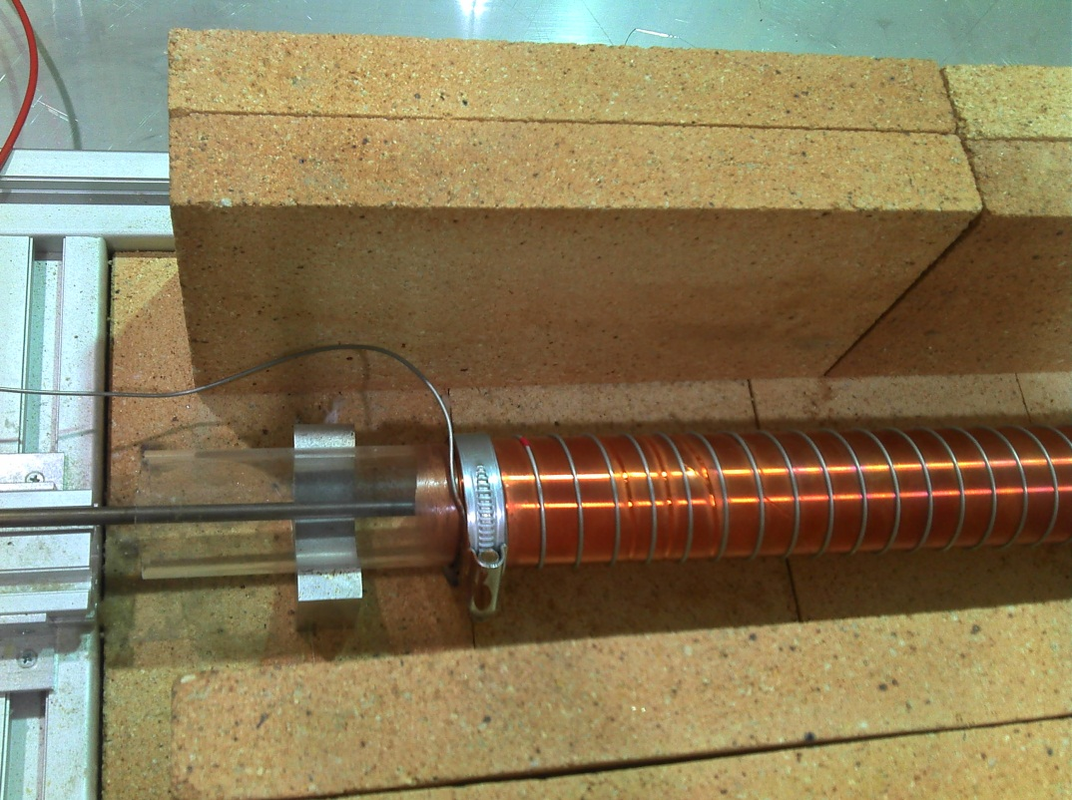
Heat Pipe Oven Prototype
Inner glass tube; outer copper tube with spiral groove to hold heating wire (Thermocoax TET; 1.5mm diameter; 5.5Ω/m)
Length of heating region: 30cm

Slide 16
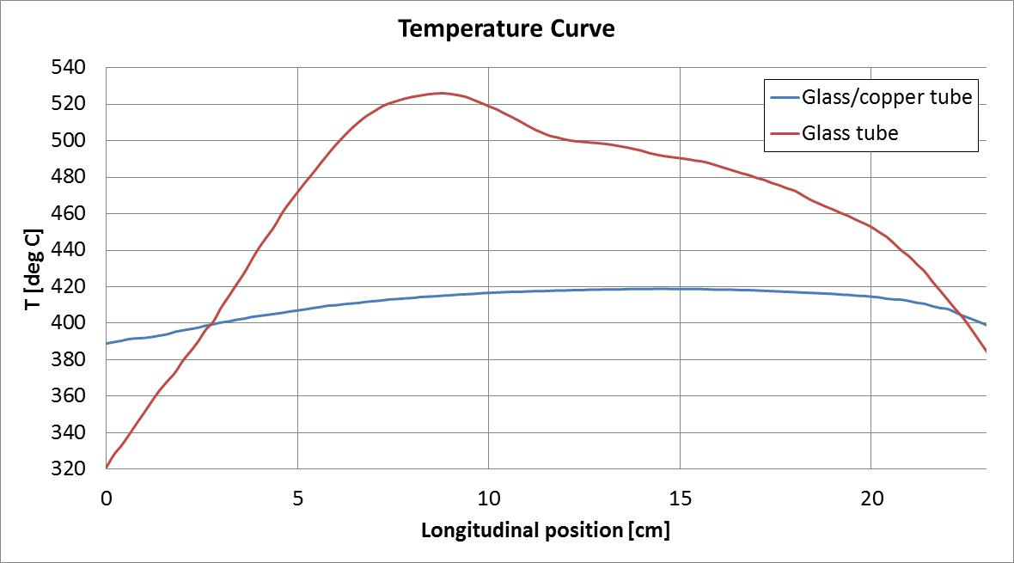
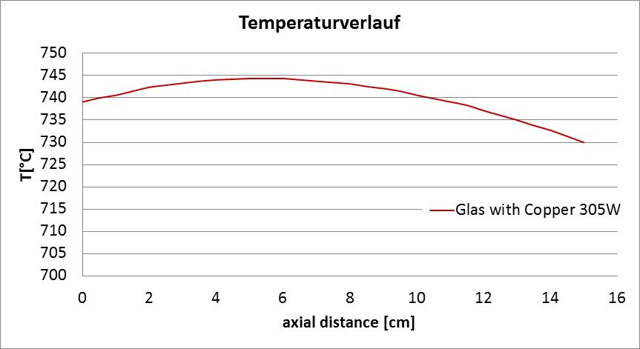
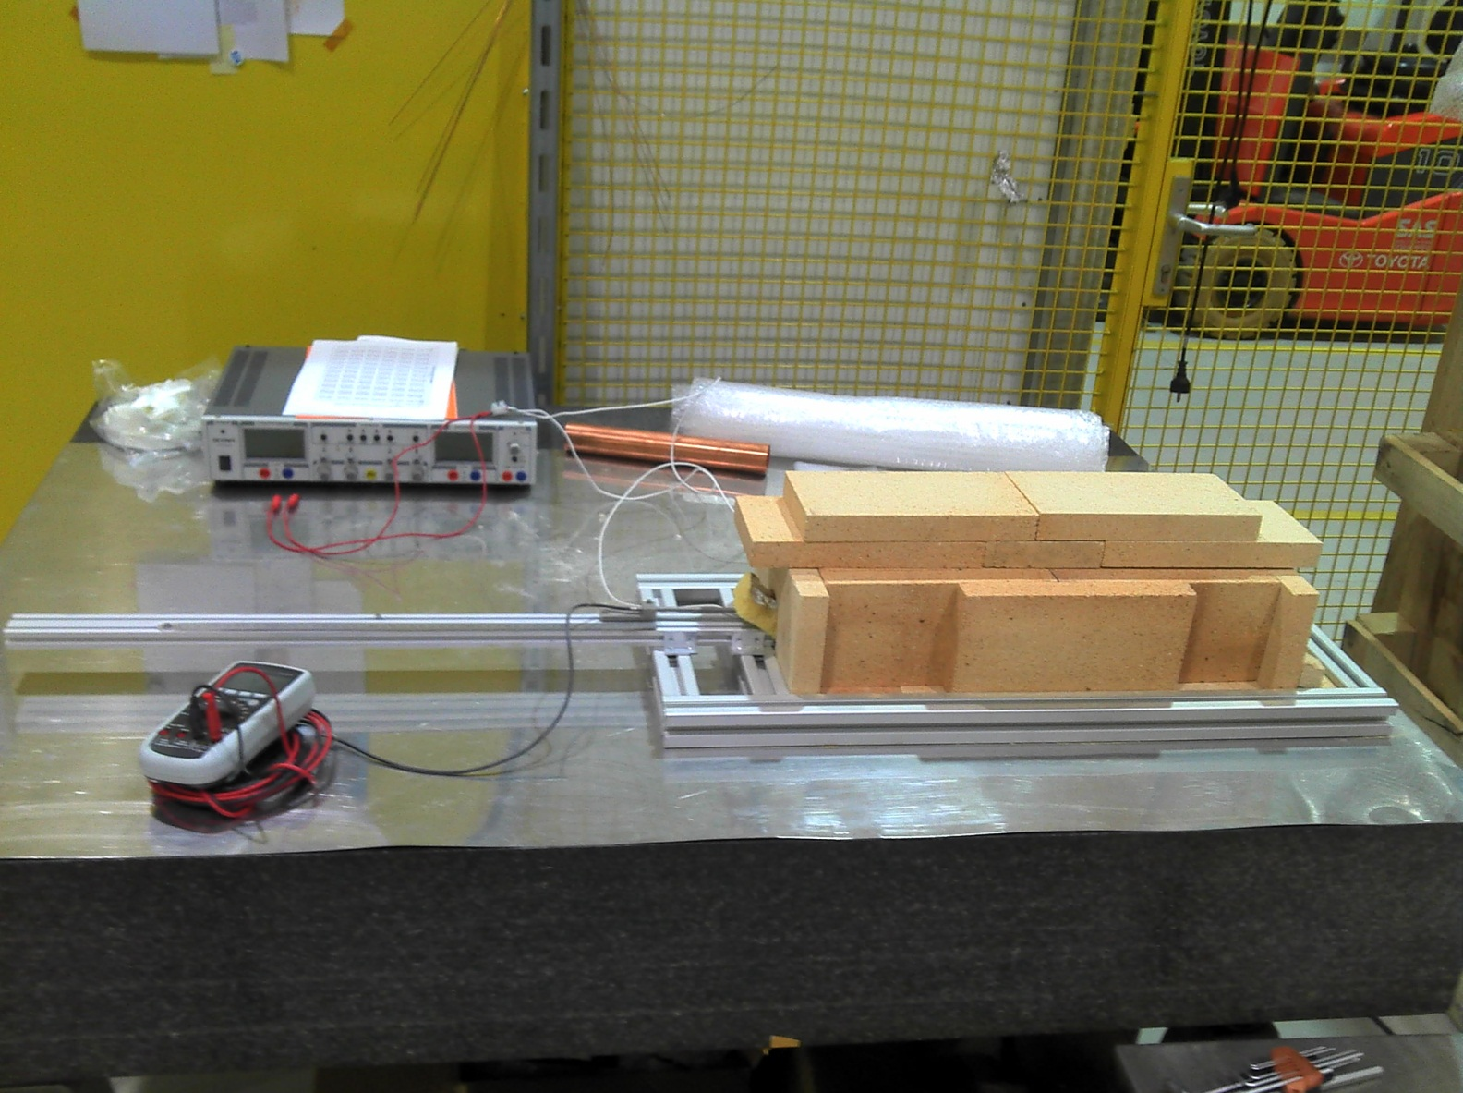
Experiments have started with Plasma Cell Prototype
First: Measurement of temperature profile with air in plasma cell tube
Power supply for heater
Copper tube helps to homogenize temperature distribution: ±2°C (<1%) over 10cm
Temperature is high enough: need ≈650°C in PITZ experiment
Plasma cell with
heat insulation
Temperature probe with measurement

Slide 17
Multi Bunches: High Transformer Ratio
Plasma Acceleration: e.g. 5 bunchlets within bunch → transformer ratio >2
Setup: - use PITZ2 beamline with gun, booster, and matching quads up to z=7m
- install a short bunch compressor (dogleg)
ASTRA simulations through gun and booster up to z=5m
use Elegant for matching
and the dogleg design (ongoing)
Parameters:
Q = 170 pC in 5 pulses
100 000 particles
Gun phase: 10 deg
Booster phase: 40 deg
BC layout:
compression factor C = 4
R₅₆ = 0.15
Total length l = 1m
dipoles: r = 0.6m, α = 60 deg
S2
Longitudinal phase space at z=5m
D2
Longitudinal laser profile at the cathode
S1
Q3
Q2
Q1
D1
l=1m
10pC 30pC 50pC 70pC 10pC
Design with 2 doglegs (↑↓) on the way
Simulation by Anne Oppelt

Slide 18
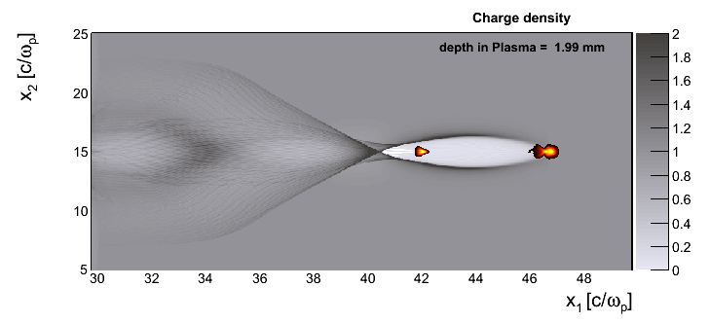
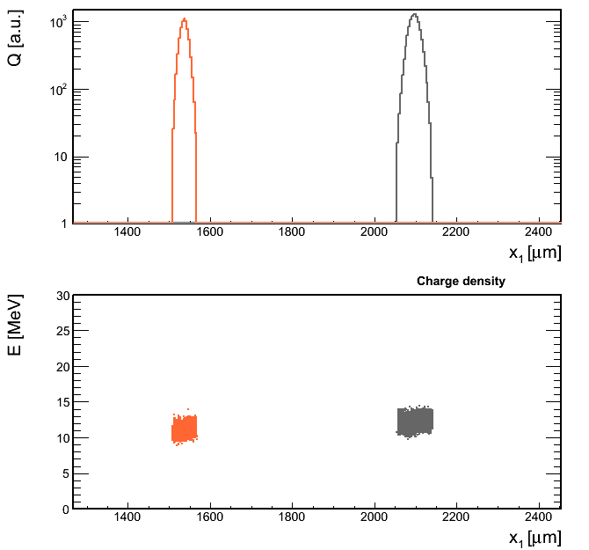
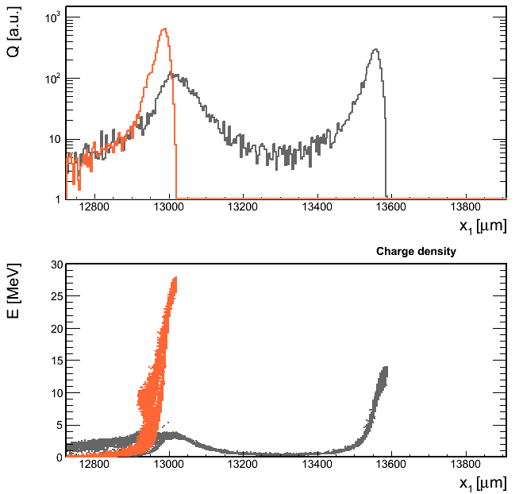
Very Preliminary Results: Needs Optimization
/n0
The witness bunch falls in the region where the wakefield is maximum.
Witness bunch
Driver bunch
In approx. 1 cm of propagation in the plasma, a fraction of the electrons in the witness bunch double their energy.
~λp
Bunches at the beginning:
Bunches after 1 cm in plasma:
Witness bunch
Driver bunch
Energy gain!
Simulation by Alberto Martinez de la Ossa

Slide 19
Outlook
2013: First experiments with plasma cell in laboratory
2014: Characterization of energy modulation of electron beam in plasma
Then: Insertion of bunch compressor – experiments with high transformer ratio etc.
Cooperation with SLAC, CERN etc.

Slide 20
Summary
PWA Experiments are planned at PITZ
Now: Characterization of electron beam self modulation
Later: High transformer ratio
Utilization of good diagnostics and unique laser system
Simulations show promising results
Electron sub bunching and energy modulation with current setup
Energy gain with bunch compressor
First experiments with plasma cell prototype

Slide 21
Backup

Slide 22
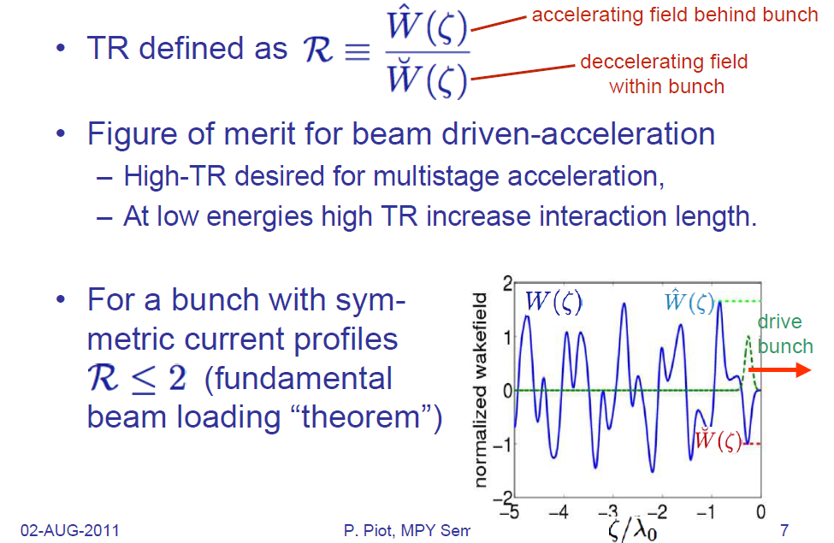
Transformer Ratio (TR)

Slide 23
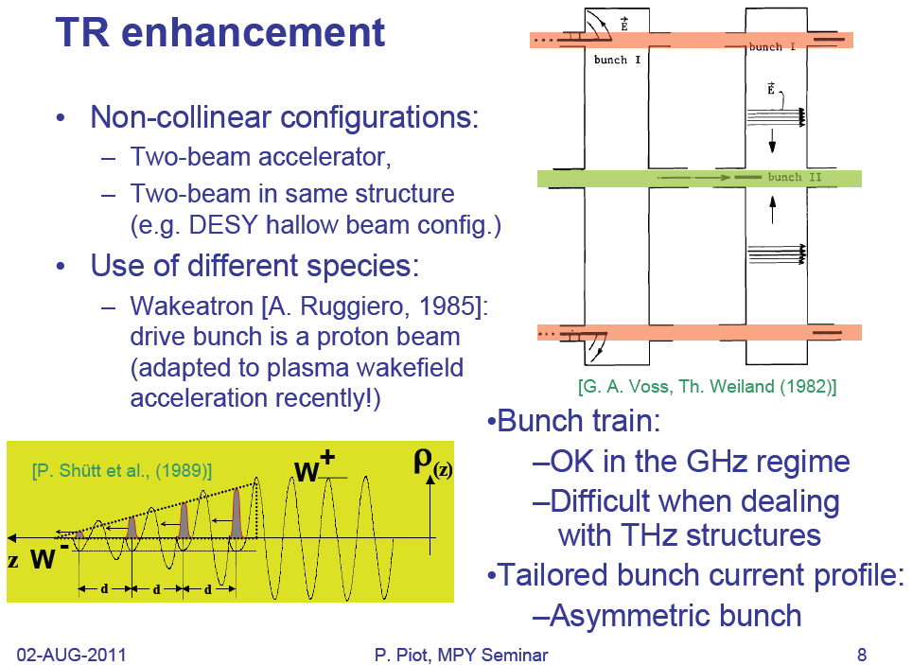
How to Increase the Transformer Ratio

Slide 24
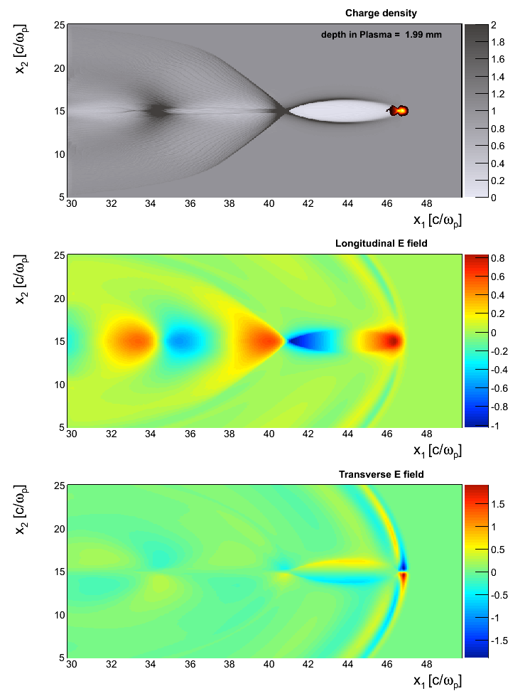
Simulation of Beam-driven Plasma Wakefields
/n0
PITZ’s beam layout after the BC (0.034T)
Driver bunch
2-heads shape separated by ~ 550μm
~λp
1. Driver bunch
Q=526 pC, σz=15μm, <E>=13 MeV
/E0
2. Witness bunch
accelerating field
Q=158 pC, σz=10μm, <E>=12 MeV
Plasma
n0 = 2×10¹⁵ e/cm³
ωp = (4πn0e²/m)^{1/2} = 2.5×10⁻³ fs⁻¹
λp = 2πc/ωp = 750 μm
E0 = mcωp/e = 4.3 GeV/m
/E0
focusing field
The driver bunch enables a longitudinal wakefield of 4.3 GeV/m approx. λp behind the beam’s front.
Simulation by Alberto Martinez de la Ossa

Slide 25
Ionization Processes
Low field
High field
Highest field
1. (Multi) photon
absorption
2. Tunneling
ionization
3. Barrier suppressed
ionization (BSI)
Ti:Sa
ArF
Vacuum
level
Electronic
level
χ⁽⁴⁾ – process for
Li and Ti:Sa laser
(Low probability)
Described by
ADK theory
(Exponential law)
Full ionization
possible

Slide 26
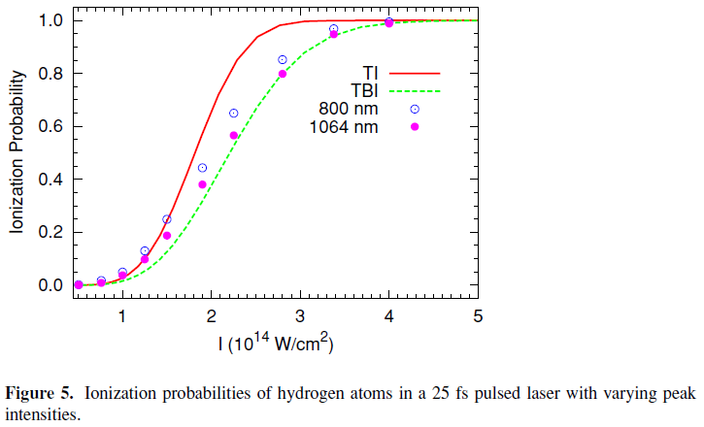
Estimation of Ti:Sa Laser Peak Power
Laser power needed for ideal case (uniform power density over lateral and longitudinal channel dimensions and DC case): P_{id}=I_{th}πr₀²
Channel radius: r₀ ; BSI Ionization threshold I_{th} (3.4*10¹² W/cm² for Li)
Power increased by ≈24
Lateral distribution: factor ≈2
Longitudinal: factor ≈2
Short pulse: factor ≈3
Transport loss etc.: factor ≈2
I
I_{peak}
I_{th}
r_{o}
r
I
DC
threshold
I_{peak}
I_{th}
z
z₁
z₂
from: Tong et al., J. Phys. B 38 (2005) p. 2593

Slide 27
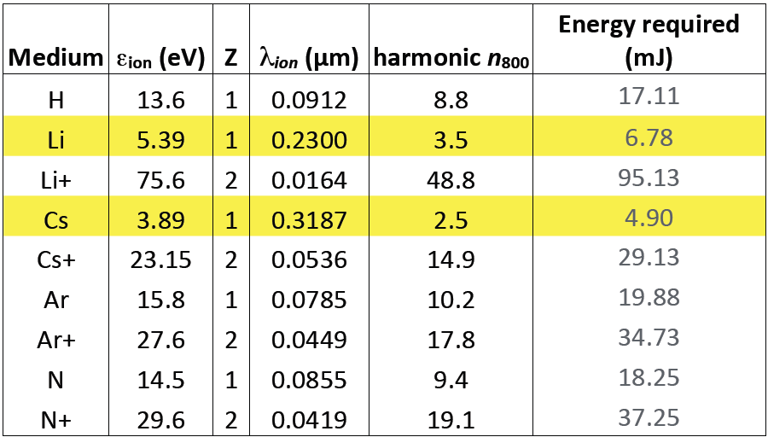
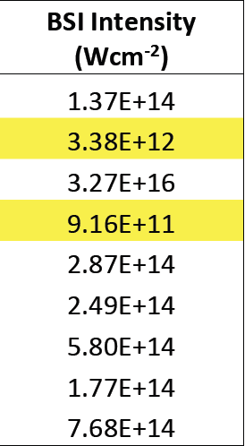
Ionization Energies: Single Photon and Field Ionization
From Z. Najmudin’s talk at PDPWA workshop (Munich, Dec 1st 2011)
Energy required to completely ionize a 1m long, 1mm² plasma channel (Single Photon)
BSI Intensity: Threshold intensity for complete ionization (Field Ionization)

Slide 28
Additional use of Ti:Sa laser
Problem
Measurement of density fluctuation in a plasma for PWA at PITZ
Facts
Alkali metal vapor (e.g. Rb) with density of about 10¹⁵ cm⁻³
Basic Idea from Markus Drescher: Focus laser within gas to ionize small volume, then collect ions
Idea
Use Ti:Sa laser for this measurement and ionization for PWA: gas density = plasma density
Focus laser coaxially into gas volume so that field ionization threshold is exceeded only in small volume around beam waist – scan this focus around plasma cell
Pick up ions with big electrodes, e.g. plates or wires: the electrodes do not need high resolution since that is done by the laser focus – no need for local detector

Slide 29
Setup Details / Back of the envelope Calculation
Axial scan
Vacuum
window
100mm
He
Rb
He
Ti:Sa → λ=800nm
Lateral scan
300mm
100mm
200mm
100mm
r
Assume: Gaussian beam
D_{max} = (300+100+200+100+100)mm = 800mm
r = 5mm (half diameter of vacuum window – worst case: put at D_{max})
→ θ_{max} = 6 mrad
Lateral resolution: 2w_{0,max} = 2λ/πθ ≈ 80μm
Calculation of axial resolution also leads to value <100μm
High resolution measurement possible, could be evaluated at PITZ
w₀
θ
D_{max}

Slide 30
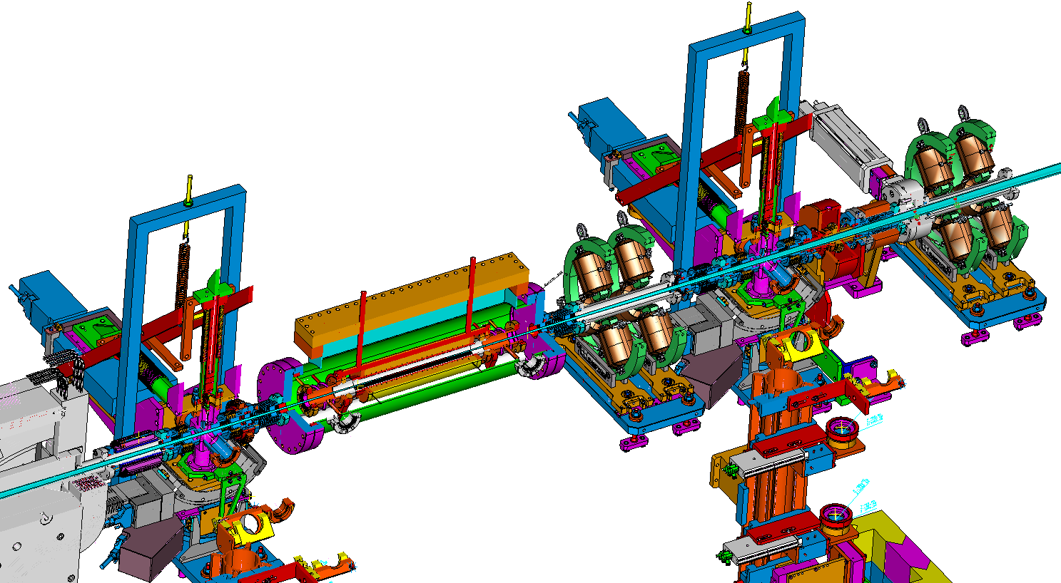
Plasma Cell Assembly: Sketch
Design:
Gerald Koss
Electron
Beam /
Laser
Screen stations
Quadru-
poles
Preliminary Version
Plasma cell

