Slide 1
Longitudinale Strahldiagnostik bei XFEL und FLASH
Presented by: Christopher Gerth
Longitudinale Diagnostik bei FLASH und XFEL: Rückblick und Überblick
Schwerpunkt: Transversal-ablenkende Strukturen
Electro-Optische Diagnostik
Kohärente Strahlungsdiagnose
Energie-BMP
Zusammenfassung
Notes:
How to edit the title slide
Fill in the text written in brown

Slide 2
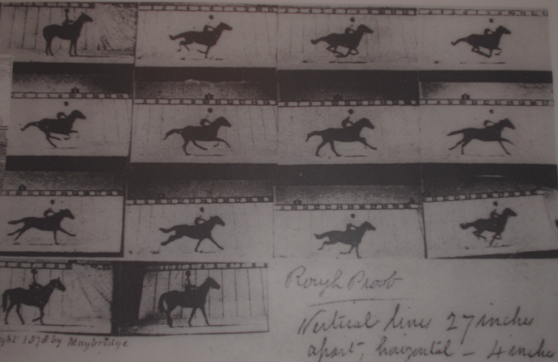
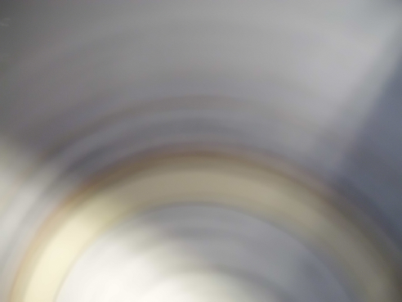
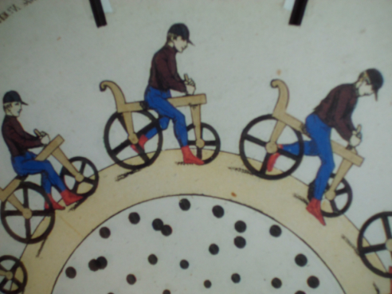
Rückblick: Longitudinale Diagnostik bei FLASH / XFEL
Eadweard Maybridge (1830-1904)
FELs: Erzeugung ultra-kurzer X-Ray Pulse FEL einige 10 fs Bunchlänge ↔ Speicherring einige 10 ps Entwicklung von Messtechniken mit fs-Zeitauflösung
Entwicklung der longitudinalen Diagnostik für FLASH fand bei FLA statt (P. Schmüser, B. Schmidt)
Installation, Betrieb und Wartung beim XFEL: Eingliederung der long. Diagnostik in den M-Bereich => Bedarf an technischer Infrastruktur
Anfang 2010: WP-18 wurde in MSK integriert: M. Felber, Ch. Gerth, H. Schlarb von MPY
MSK schlecht aufgestellt im Bereich Mechanik: Verstärkung durch Mechaniker Martin Schäfer und M-Verbundwerkstatt
MSK verfügte nur über ein Digital/Analog Labor: Labor für Optikaufbauten eingerichtet (Büro-Container 28f)
Entwicklung für das optische Synchronisationssystem finden im Laser-Labor von FLA statt (zusammen mit Laser-wakefield Beschleuniger Entwicklungen)
Weiteres technisches und wissenschaftliches Personal wurde eingestellt

Slide 3
Overview on WP-18 devices
femtosecond optical
timing distribution
Beam energy
Bunch arrival
Longitudinal Diagnostics
MLO – master laser oscillator
FSD – free-space distribution
OXC/RF Link – stabilized links
Energy BPM
EBPM⁽¹⁾
Synchrotron
Radiation
Monitors
SRM
Coherent
Radiation
Diagnostics
CRD
EO
Diagnostics
EOD
Transverse
Deflecting
Structure
TDS⁽¹⁾
Beam energy
Beam Energy
Energy profile
Compression
Bunch profile
Bunch profile
Bunch profile
Slice emittance
Phase space
L2L
Laser
Synchronization
L2RF
RF
Synchronization
BAM
Bunch Arrival
Monitor
Bunch arrival
Beam energy
1)
High-Power RF system and TDS are part of contract between European XFEL GmbH and Inst. for Nuclear Research (INR).
Sehr unterschiedlichen Diagnosekomponenten von denen eine geringe Anzahl benötigt wird.
Strategie: Um F&E Kosten zu sparen und 20 Jahre Wartung zu gewährleisten => möglichst viele kommerzielle Komponenten oder vom LLRF System nutzen => möglichst identische Hardware nutzen wo möglich
Notes:
Before you start editing the slides of your talk change to the Master Slide view: Menu button “View”, Master, Slide Master:
Edit the following 2 items in the 1st slide: 1) 1st row in the violet header: Delete the existent text and write the title of the EoI for WPnumber 2) The row in the footer area: write the institute name
Close Master View

Slide 4
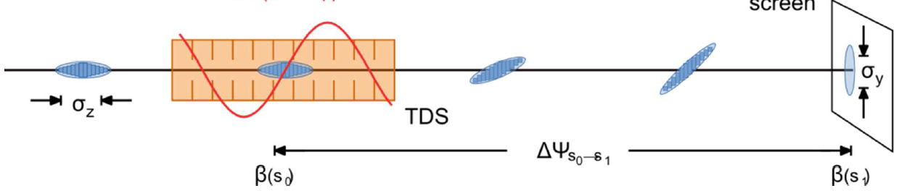
Measurement Principle for Transverse Deflecting Structure
View screen
Notes:
Before you start editing the slides of your talk change to the Master Slide view: Menu button “View”, Master, Slide Master:
Edit the following 2 items in the 1st slide: 1) 1st row in the violet header: Delete the existent text and write the title of the EoI for WPnumber 2) The row in the footer area: write the institute name
Close Master View

Slide 5
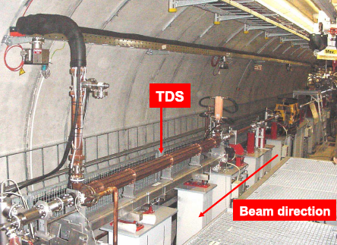
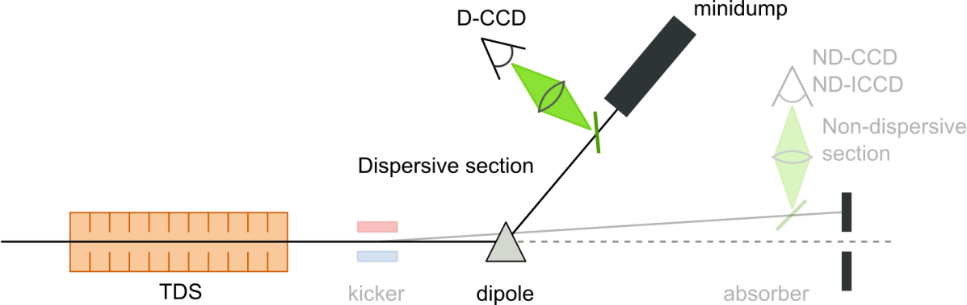
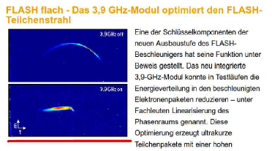
5
LOLA: Transverse Deflecting Structure at FLASH
SDUMP
In the shutdown 2009/2010:
LOLA was moved to a position in front of the SASE undulators.
Installation of Energy Spectrometer SDUMP:
Longitudinal phase space measurements
Record resolution: 5fs

Slide 6
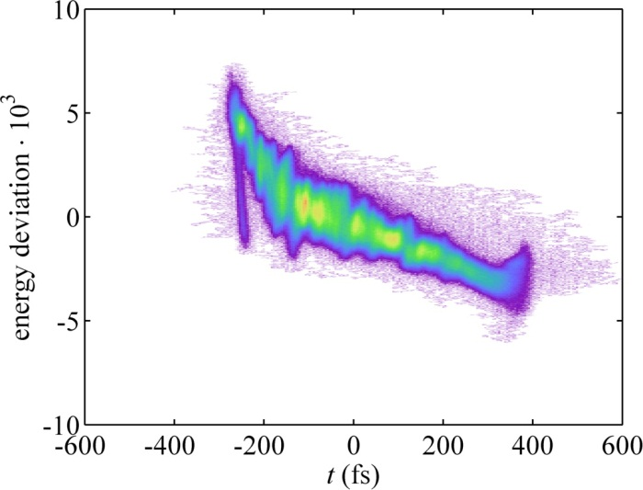
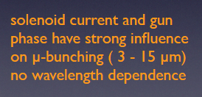
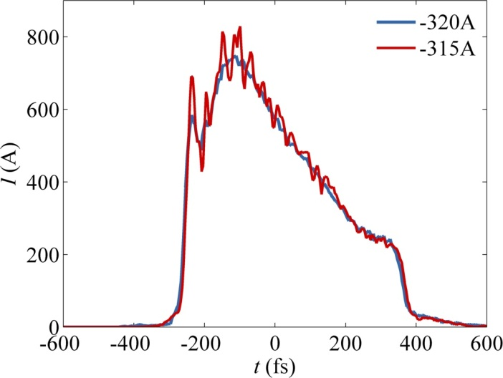
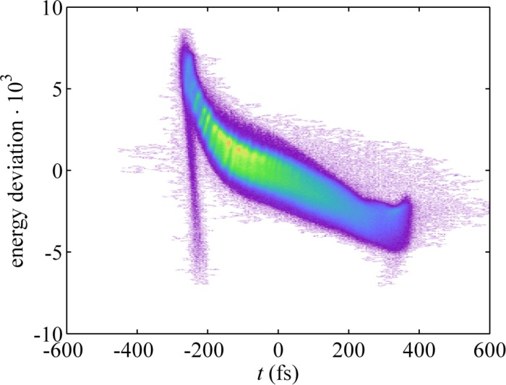
Influence of solenoid on microbunching
6
Prediction from simulations (SSY, M Dohlus): Enhanced micro-bunching at ~ 3 –15 μm due to longitudinal space charge.
Experience from THz spectroscopy (B Schmidt):
I_{S} = -315A σ_{t} = 167±4 fs
Is this micro bunching?
I_{S} = -320A σ_{t} = 168±3 fs

Slide 7
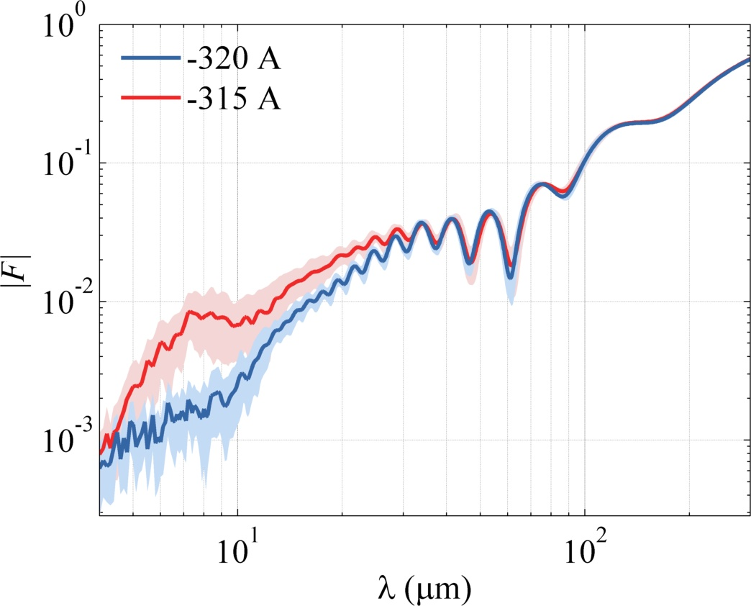

Fourier Transform of the TDS profiles
7
Fourier transform of 30 single-shot profiles at each solenoid setting.
Spectrum shows increase by a factor of 10 at ~8um.
Time resolution TDS

Slide 8
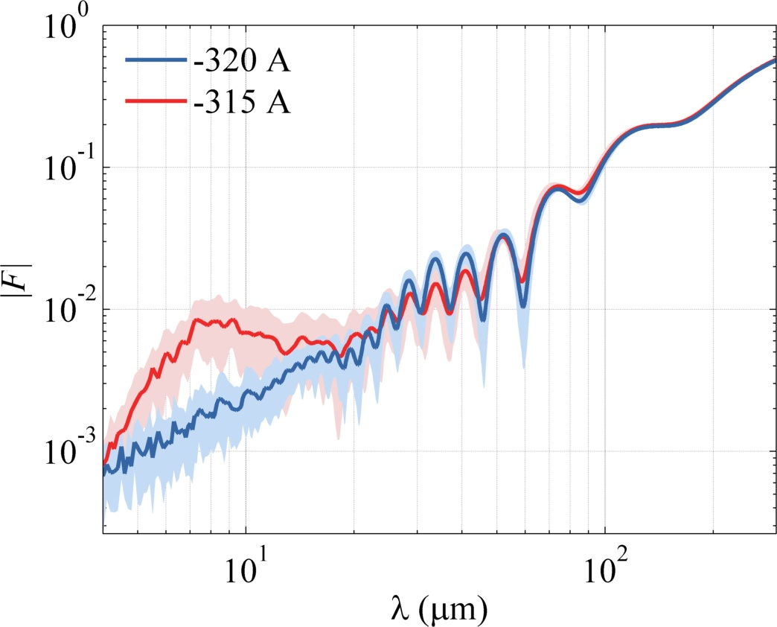
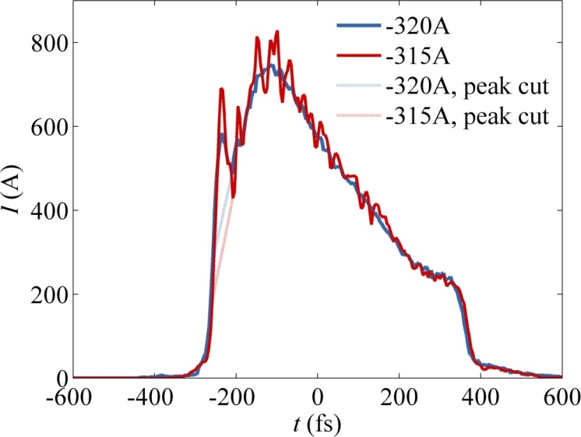
Fourier Transform of the TDS profiles (2)
8
Fourier Transform if the front peak is cut off.
The increase around ~8um stays the same.
Time resolution TDS

Slide 9
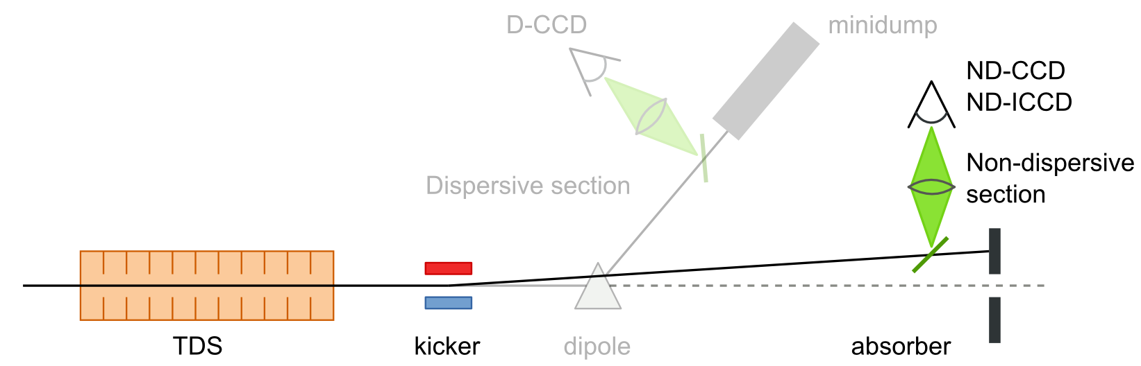
SMATCH: Longitudinal Bunch Profile Monitor
9
Idea: kick 1 bunch onto off-axis screen for diagnostics during FEL operation
BLM
Q
XFEL Prototype Kicker (pulse length ~ 360 ns) not sufficient kick strength, no uniform field distribution => 1 design for all diagnostics kicker
Suppression of Coherent OTR at view screen => Scintillation screen with 35deg tilt
BLM => Mask Beam Loss Monitor signals of 1st undulator for the kicked bunch
TPS => Mask the Toroid Protection System for the kicked bunch
Optimize the machine optics for better longitudinal resolution

Slide 10
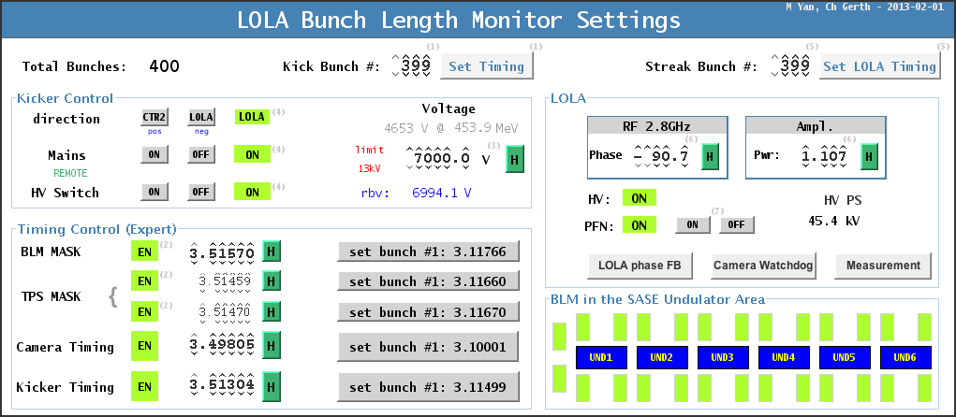
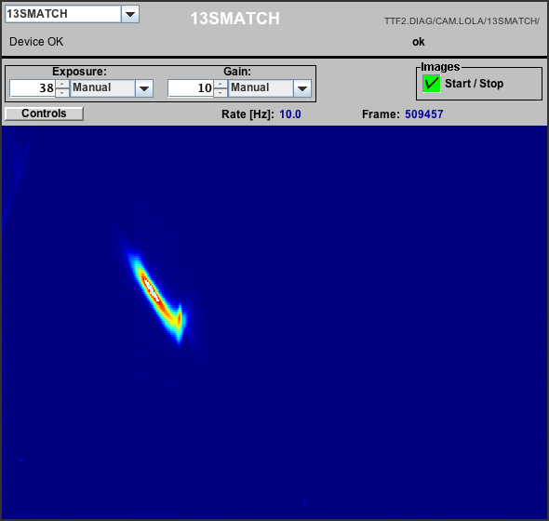
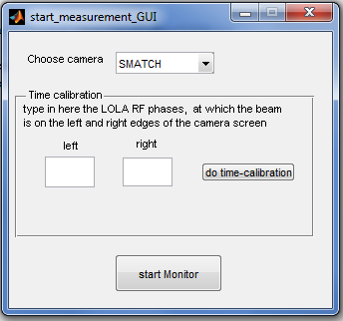
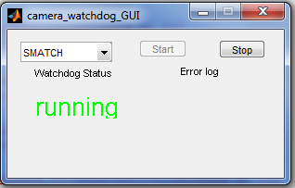
jddd panel: Longitudinal Bunch Profile Monitor
10

Slide 11
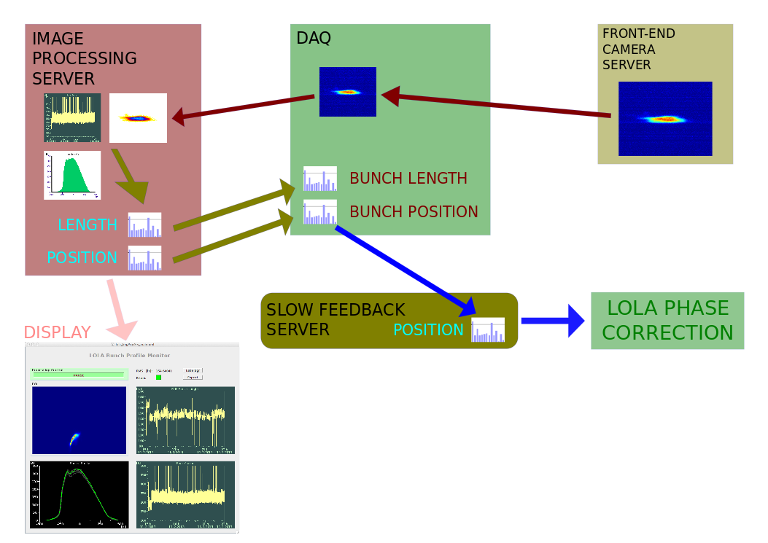
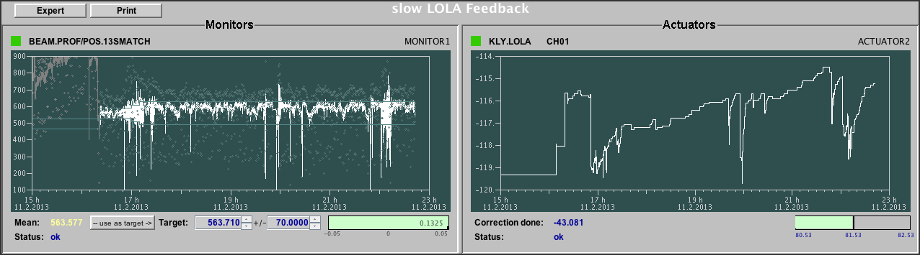
Slow LOLA phase FB: Longitudinal Bunch Profile Monitor
11
Jan Wychowaniak (MSK)
Vladimir Rybnikov
Vladimir Rybnikov
Gerhard Schlesselmann
Raimund Kammering
SASE Delivery

Slide 12
Contributions to Longitudinal Bunch Profile Monitor
Schirmstation und Optischer Aufbau: Chris Behrens, Kai Ludwig, Minjie Yan,
Fast Kicker: Frank Obier & Team
BLM Maskierung: Andy Langner, Christian Gruen, Peter Goettlicher, Martin Staack
TPS Maskierung: Andy Langner, Zlatan Pisarov, Reinhard Neumann, Matthias Werner, Martin Staack
Strahloptik: Andy Langner, Matthias Vogt
DAQ middle-layer Server mit Bildbearbeitung: Jan Wychowaniak
DAQ and Slow-Feedback LOLA Phase : Vladimir Rybnikov, Raimund Kammering
Die Liste ist bestimmt nicht vollständig – Verzeihung falls ich jemanden vergessen habe!

Slide 13
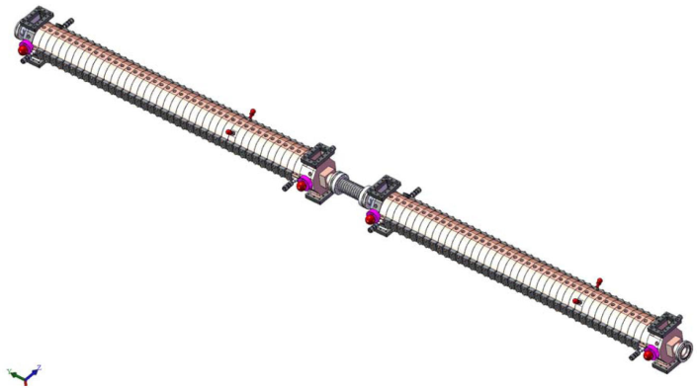
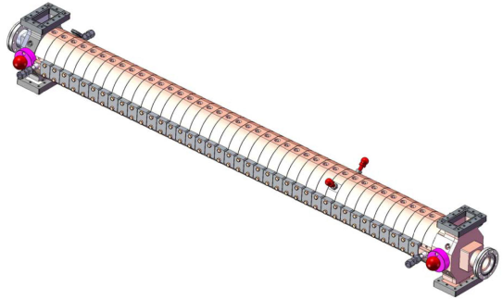
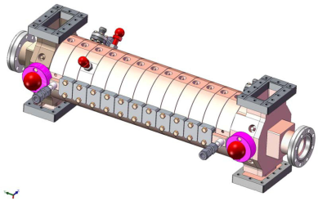
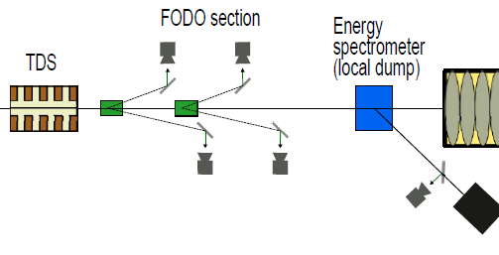
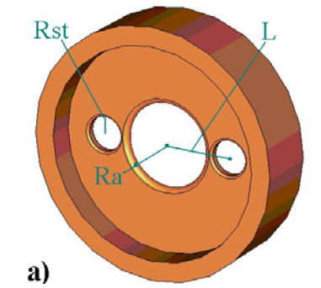
Locations TDS @ XFEL
TDS
TDS
TDS
Kicker Concept (Minjie Yan): 1 kicker for each screen, 1 kick per bunch train
Specifications (time resolution, filling time) can be fulfilled with one cup design!
Notes:
Before you start editing the slides of your talk change to the Master Slide view: Menu button “View”, Master, Slide Master:
Edit the following 2 items in the 1st slide: 1) 1st row in the violet header: Delete the existent text and write the title of the EoI for WPnumber 2) The row in the footer area: write the institute name
Close Master View

Slide 14
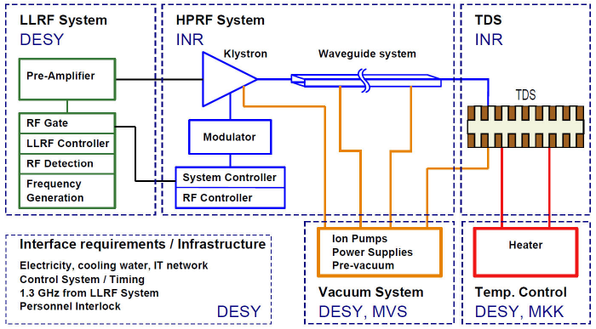
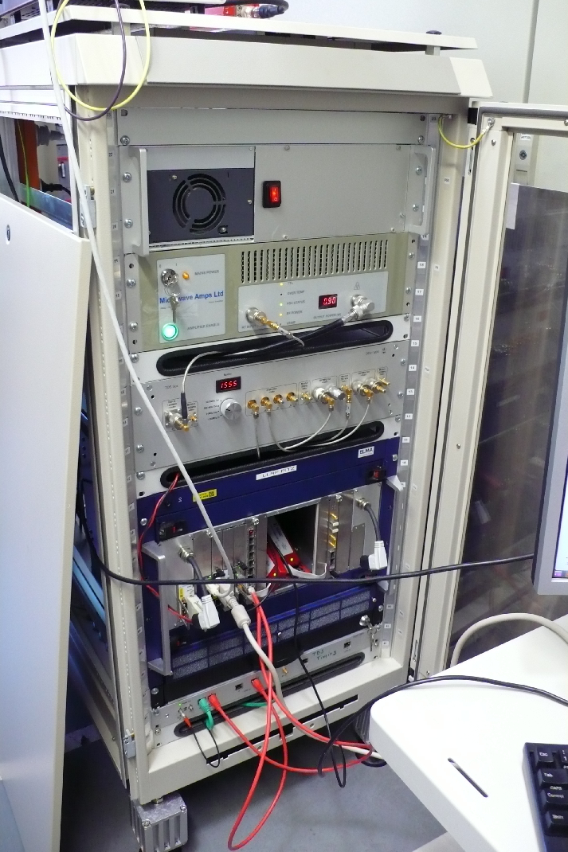
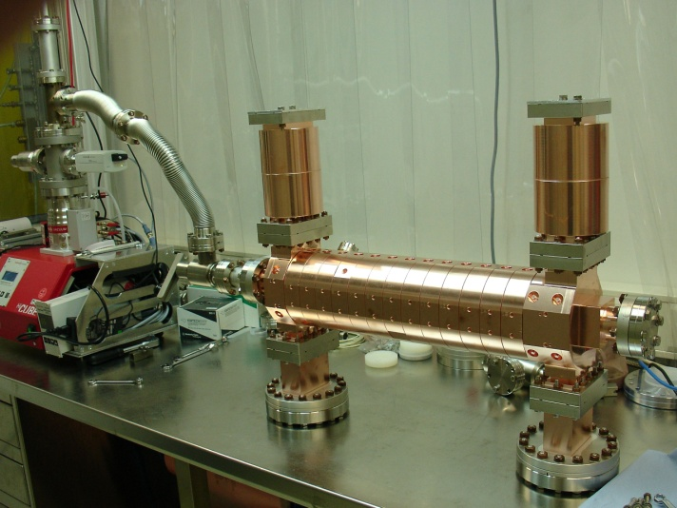
Overview TDS @ XFEL
14
LLRF
PITZ Prototype
LLRF System: ‘standard’ LLRF system for single cavity regulation (Struck SIS8300 + DWC) but at special frequency (=> MSK).
High-Power RF system and TDS: contract between European XFEL GmbH and Inst. for Nuclear Research (INR), Troitsk, Russia.
Vacuum System: Integration in XFEL Vacuum System (=> MVS)
TDS Temperature: Control: Similar as for LOLA (=> MKK)
Prototype system of TDS Injector to be installed at PITZ at DESY Zeuthen. => Unfortunately more than 2 year delay for the modulator
Notes:
14
Before you start editing the slides of your talk change to the Master Slide view: Menu button “View”, Master, Slide Master:
Edit the following 2 items in the 1st slide: 1) 1st row in the violet header: Delete the existent text and write the title of your talk into this text field 2) The 2 rows in the footer area: Delete the text and write the information regarding your talk (same as on the Title Slide) into this text field.
If you want to use more partner logos position them left beside the DESY logo in the footer area Close Master View

Slide 15

TDS Measurement Principle and choice of frequency
View screen
“Streak Strength (Shear Parameter):
V_{y} : TDS Voltage => Powerful commercial klystron
ω : TDS Frequency => As high as possible
Wakefields => Iris > 40 mm => TDS Frequency < 4GHz
Streak 1 - 4 bunches within bunch train => short filling time
=> S-Band at around 3 GHz
=> disk-loaded travelling-wave structure
Notes:
Before you start editing the slides of your talk change to the Master Slide view: Menu button “View”, Master, Slide Master:
Edit the following 2 items in the 1st slide: 1) 1st row in the violet header: Delete the existent text and write the title of the EoI for WPnumber 2) The row in the footer area: write the institute name
Close Master View

Slide 16
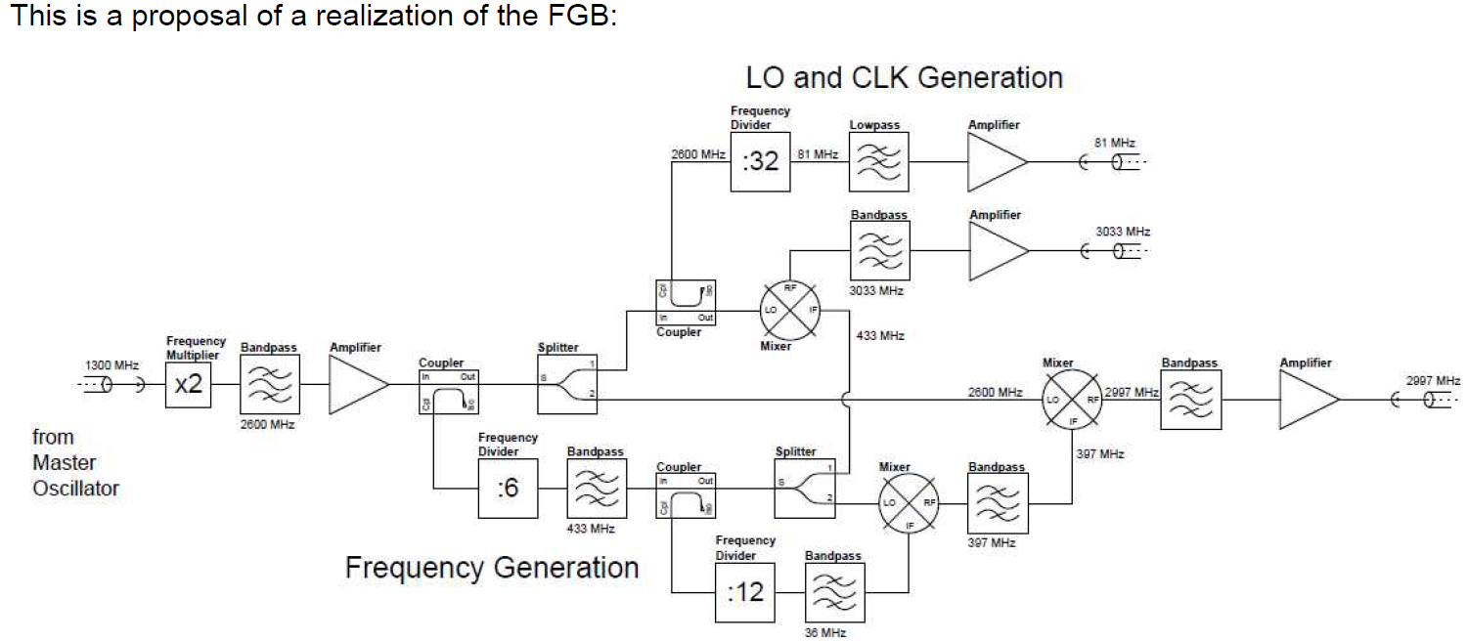
TDS Frequency
LOLA : f_{TDS} = 2 · f_{1.3GHz} + 13/11 · 1/2 · 1/3 · f_{1.3GHz} = 2.856 GHz => ~ 100 deg phase change per bunch at 1 MHz ☹
TDS XFEL: Find frequency that is a harmonic of f_{MO} = 9 MHz f_{TDS} = 332 · f_{MO} = 332/144 · f_{1.3GHz}
f_{TDS} = 2 · f_{1.3GHz} + 1/3 · f_{1.3GHz} - 1/12 · (1/3 · f_{1.3GHz}) = 2997 MHz
f_{LO} = 2 · f_{1.3GHz} + 1/3 · f_{1.3GHz} = 3033 MHz
=> f_{IF} = 36 MHz, f_{CLK} = 81 MHz
Scheme by Matthias Hoffmann and Henning Weddig

Slide 17
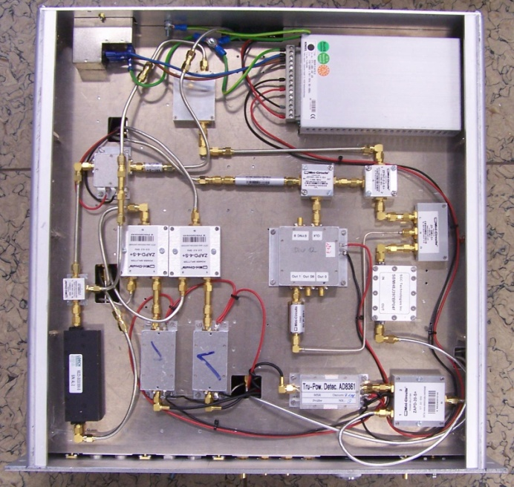
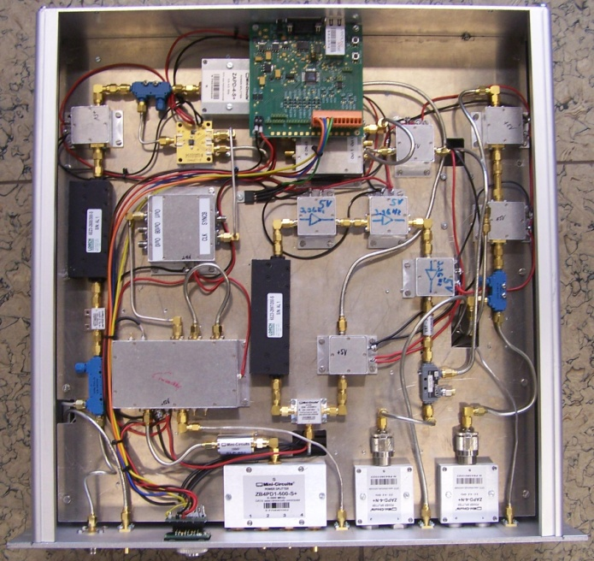
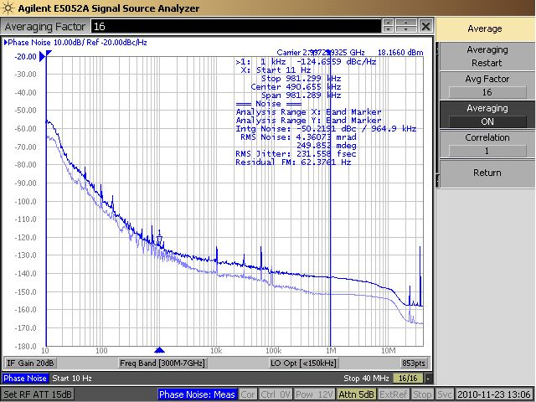
Frequency Generation Box (1): DESY Prototype
Matthias Hoffmann and Henning Weddig
19” crate: Bottom View
19” crate: Top View
Specifications fulfilled!
Make PCB Design? => Erhard Salow (RALAB, INWAVE)
Notes:
Before you start editing the slides of your talk change to the Master Slide view: Menu button “View”, Master, Slide Master:
Edit the following 2 items in the 1st slide: 1) 1st row in the violet header: Delete the existent text and write the title of the EoI for WPnumber 2) The row in the footer area: write the institute name
Close Master View

Slide 18
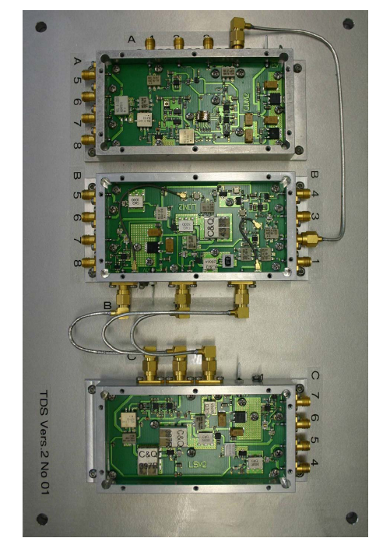
Frequency Generation Box (3): 3 PCBs in ZG4 housings
After 2 years development: Revision 2.2 delivered in February 2013
Performance tests by Henning Weddig ongoing
Notes:
Before you start editing the slides of your talk change to the Master Slide view: Menu button “View”, Master, Slide Master:
Edit the following 2 items in the 1st slide: 1) 1st row in the violet header: Delete the existent text and write the title of the EoI for WPnumber 2) The row in the footer area: write the institute name
Close Master View

Slide 19
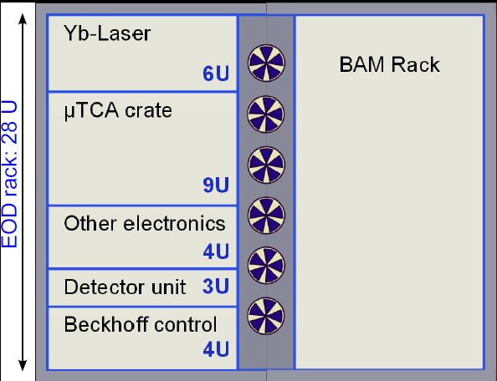
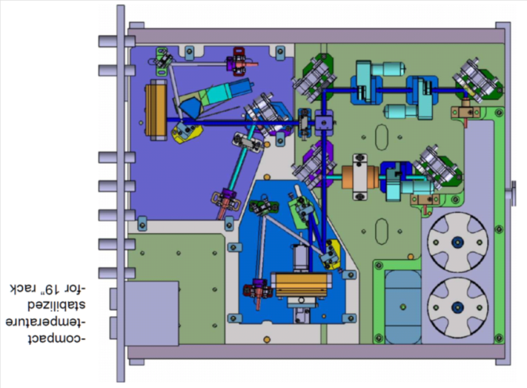
Overview: Electro-Optical Diagnostics
19
Beamline Unit
e⁻
Method: Coulomb field of e-beam changes optical properties of the crystal and imprints longitudinal profile on the laser pulse.
EO as Diagnostics Device: => Complete system to fit into 28U rack in XTL
Spectral Decoding: => time resolution > 150fs
Single-bunch resolution compared to TDS: Changes in the bunch profile within bunch train can be detected => Development of 1D line detector with 1MHz rate (256 pixels)
Close collaboration with PSI (MoU) and KIT (ANKA)
Notes:
19
Before you start editing the slides of your talk change to the Master Slide view: Menu button “View”, Master, Slide Master:
Edit the following 2 items in the 1st slide: 1) 1st row in the violet header: Delete the existent text and write the title of your talk into this text field 2) The 2 rows in the footer area: Delete the text and write the information regarding your talk (same as on the Title Slide) into this text field.
If you want to use more partner logos position them left beside the DESY logo in the footer area Close Master View

Slide 20
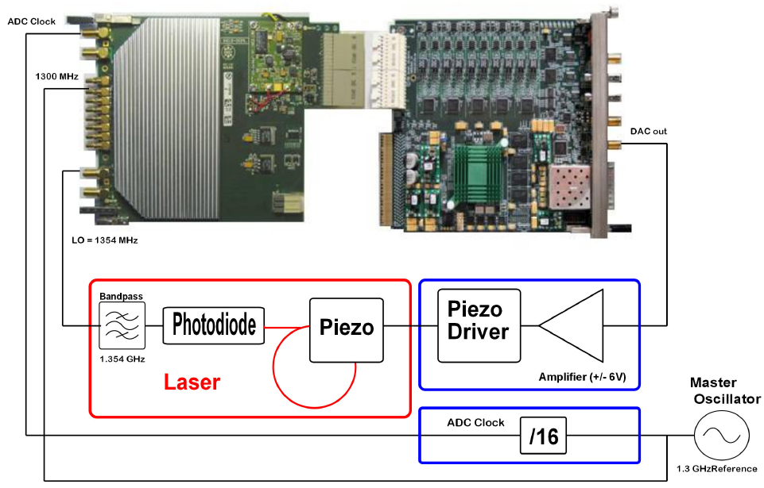
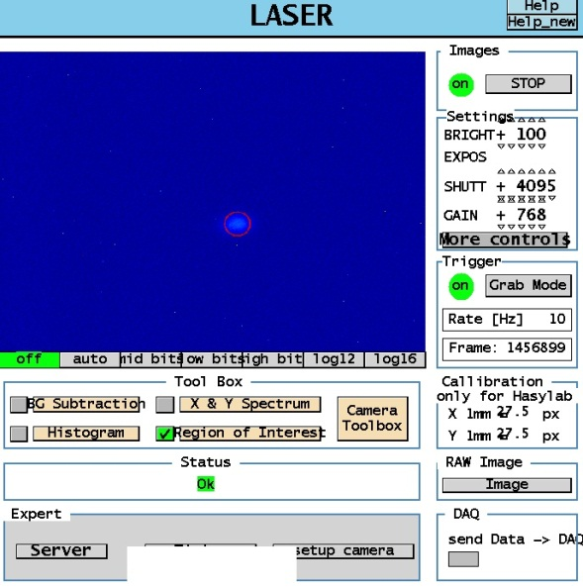
New Laser to RF Synchronization Scheme based on LLRF
Bernd Steffen and Uros Mavric
Laser 3 on virtual cathode
Successful synchronization of short-pulse laser (laser 3) at FLASH => First Lasing in February 2013
MTCA development: New DWC with DAC and ADC Clock and Piezo Driver Board => 3 cables between MTCA crate and Laser – no additional boxes.

Slide 21
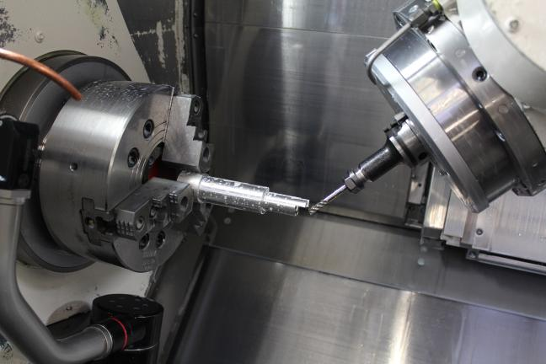
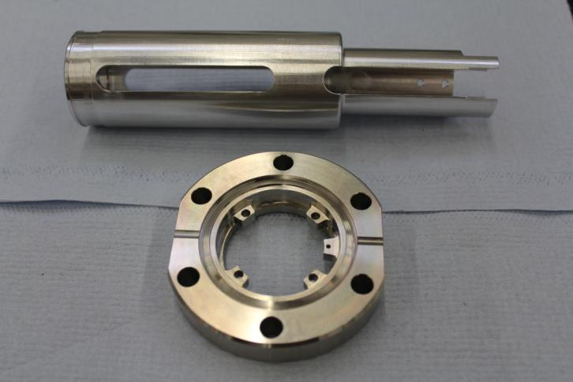
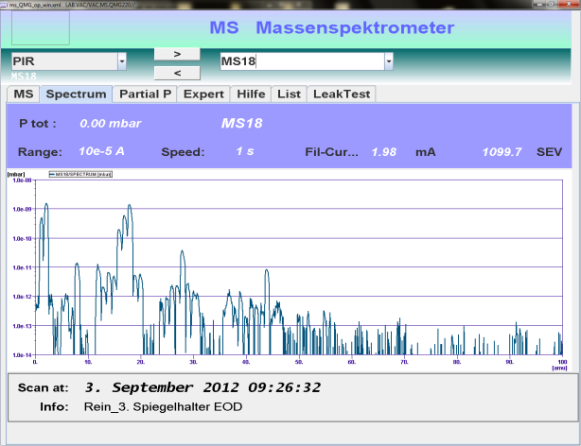
Prototype Electro-Optical Diagnostics v
Prototype EOD vacuum station for XFEL:
Vacuum parts (PSI design) have been re-designed according to XFEL vacuum requirements
Parts manufactured at Okuma (5-axis CNC machining centre, as part of operator training)
Okuma
Vacuum tests and mass spectrum successful (August 2012).
Vacuum Design under review by MVS for ‘Vacuum Stamp’
Notes:
Before you start editing the slides of your talk change to the Master Slide view: Menu button “View”, Master, Slide Master:
Edit the following 2 items in the 1st slide: 1) 1st row in the violet header: Delete the existent text and write the title of your talk into this text field 2) The 2 rows in the footer area: Delete the text and write the information regarding your talk (same as on the Title Slide) into this text field.
If you want to use more partner logos position them left beside the DESY logo in the footer area Close Master View

Slide 22
EOD: Locations
TDS
TDS
TDS
EOD
EOD
EOD
No EO Diagnostics after BC2 due to limited time resolution (< 150 fs)
Placeholder ‘vacuum chamber’ will be installed if future method with better time resolution emerge
Notes:
Before you start editing the slides of your talk change to the Master Slide view: Menu button “View”, Master, Slide Master:
Edit the following 2 items in the 1st slide: 1) 1st row in the violet header: Delete the existent text and write the title of the EoI for WPnumber 2) The row in the footer area: write the institute name
Close Master View

Slide 23
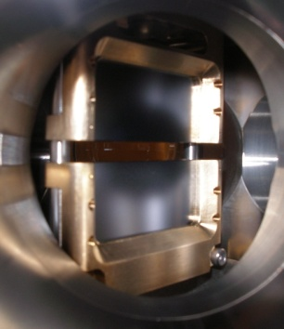

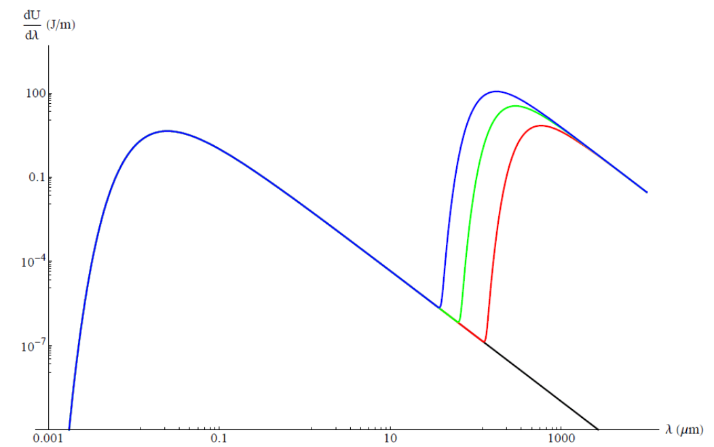

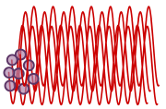
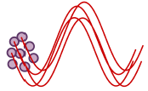
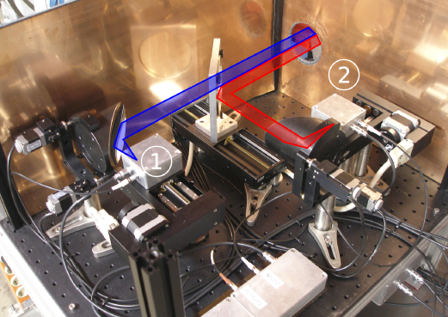
Coherent Radiation Diagnostics (PYRO)
e⁻
FLASH:
F ~ 0
F > 0
Coherent radiation at wavelengths ~ bunch length
Coherent radiation intensity scales with N² => very sensitive to accelerator phase => slow and intra bunch-train RF phase feedback
Postdoc Peter Peier (PSI) will start in April 2013

Slide 24
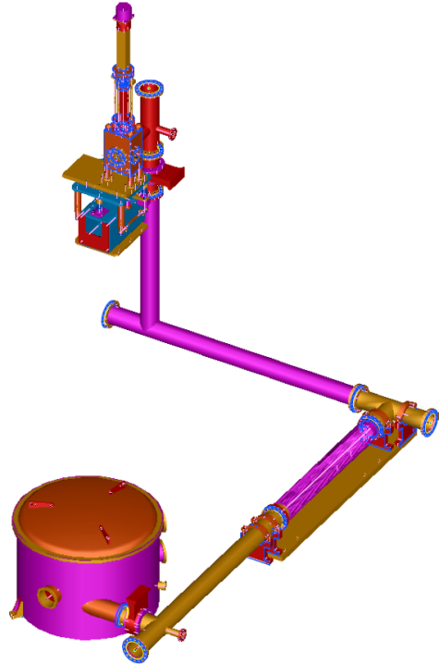
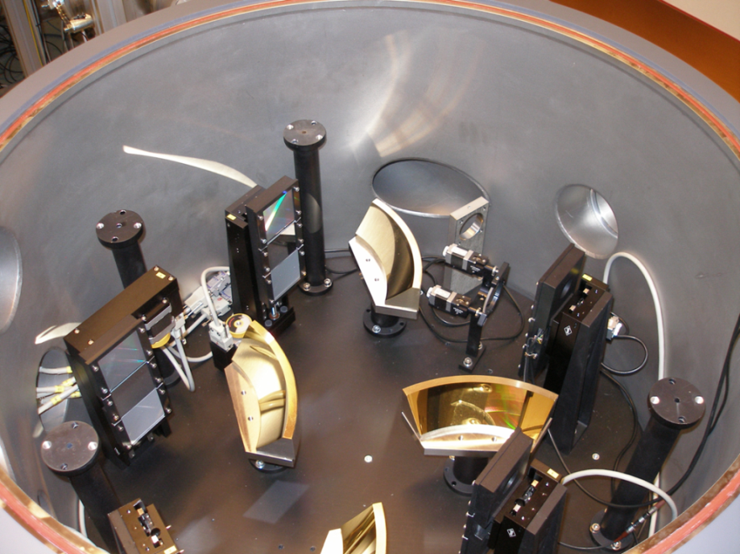
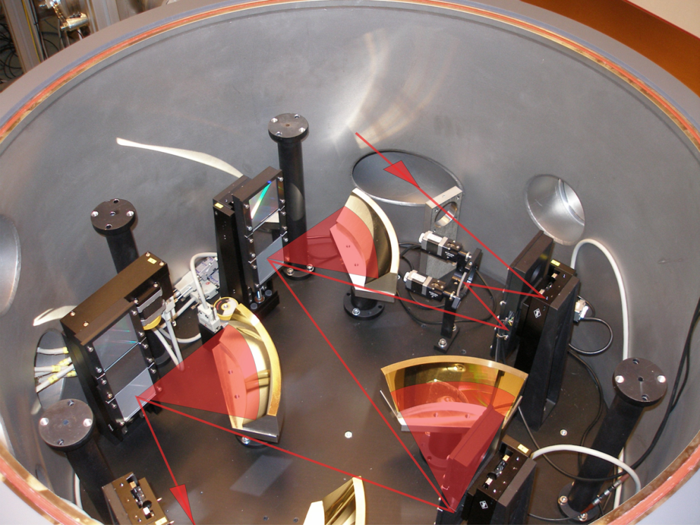
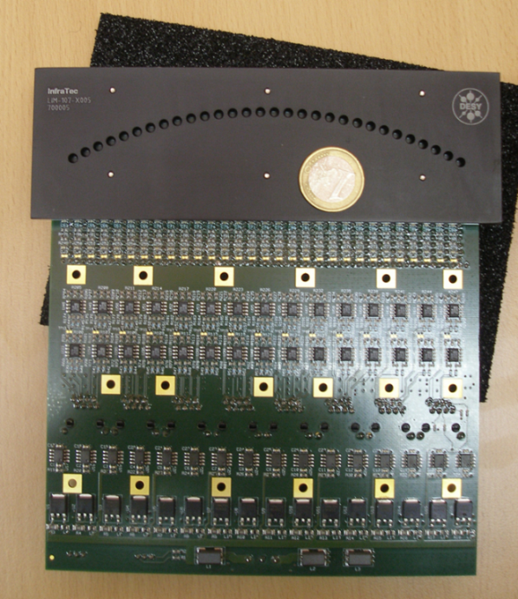
Coherent Radiation Diagnostics (CRISP4)
24
4-stage THz spectrometer CRISP4 developed by FLA (B. Schmidt)
Pyro line-detector was developed together with company InfraTec
120 ADC channel readout is being developed by FLA in MTCA standard
Works best with compressed bunches and at high beam energies => installation in XFEL collimator
Reconstruction of longitudinal bunch profile with Kramers-Kronig
Notes:
24
Before you start editing the slides of your talk change to the Master Slide view: Menu button “View”, Master, Slide Master:
Edit the following 2 items in the 1st slide: 1) 1st row in the violet header: Delete the existent text and write the title of your talk into this text field 2) The 2 rows in the footer area: Delete the text and write the information regarding your talk (same as on the Title Slide) into this text field.
If you want to use more partner logos position them left beside the DESY logo in the footer area Close Master View

Slide 25



Comparison CRISP4 and LOLA measurements
25
Form factor includes:
General experience:
Spike at bunch head
Longer tail than LOLA

Slide 26
BCM/CRD: Locations
TDS
TDS
TDS
EOD
EOD
EOD
CRD
BCM
BCM
BCM
BCM
Notes:
Before you start editing the slides of your talk change to the Master Slide view: Menu button “View”, Master, Slide Master:
Edit the following 2 items in the 1st slide: 1) 1st row in the violet header: Delete the existent text and write the title of the EoI for WPnumber 2) The row in the footer area: write the institute name
Close Master View

Slide 27

EBPM: Overview
27
Pickup
EBPM
Measures the centre-of-gravity of bunch
Relative energy ⇒ dE/E ≈ dx / R₁₆
Absolute energy ⇒ cross-calibration required
Beam Path
Δφ, Δt ~ Δx
New RF detection scheme based on LLRF system. => in operation for EBPM in BC2 at FLASH (Uros Mavric)
EBPM Firmware has been integrated in general LLRF firmware.
RF Design of pickup for XFEL vacuum chambers (400 x 40 mm² ) done by Technical University of Darmstadt
Notes:
27
Before you start editing the slides of your talk change to the Master Slide view: Menu button “View”, Master, Slide Master:
Edit the following 2 items in the 1st slide: 1) 1st row in the violet header: Delete the existent text and write the title of your talk into this text field 2) The 2 rows in the footer area: Delete the text and write the information regarding your talk (same as on the Title Slide) into this text field.
If you want to use more partner logos position them left beside the DESY logo in the footer area Close Master View

Slide 28


EBPM: LLRF Detection Scheme
Dark Current
Fine Meas.
Coarse Meas.
4 x
Notes:
Before you start editing the slides of your talk change to the Master Slide view: Menu button “View”, Master, Slide Master:
Edit the following 2 items in the 1st slide: 1) 1st row in the violet header: Delete the existent text and write the title of the EoI for WPnumber 2) The row in the footer area: write the institute name
Close Master View

Slide 29

EBPM: LO Frequency Generation
Use frequency generation modules of TDS to generate EBPM frequencies:
433 MHz
EBPM LO(2)
LO(1): High resolution but several wavelengths fit into vacuum chamber length L~400 mm.
LO(2): Coarse position in vacuum chamber.
108 MHz
3033 MHz
ADC Clock
EBPM LO (1)

Slide 30
Longitudinal Diagnostics: Summary
TDS
TDS
TDS
EOD
EOD
EOD
BAM
BAM
BAM
BAM
EBPM
EBPM
EBPM
CRD
SRM
SRM
BCM
BCM
BCM
BCM
Notes:
Before you start editing the slides of your talk change to the Master Slide view: Menu button “View”, Master, Slide Master:
Edit the following 2 items in the 1st slide: 1) 1st row in the violet header: Delete the existent text and write the title of the EoI for WPnumber 2) The row in the footer area: write the institute name
Close Master View

Slide 31
Zusammenfassung
Ziel von WP-18: Überführung von experimentellen Aufbauten zu robuster und wartbarer Diagnostik:
Verwendung von gleicher Hardware wo möglich z.B.: LLRF der TDS, EO laser Synchronisation und EBPM Signalverarbeitung basieren auf dem Detektionsschema des LLRF Systems
Longitudinale Diagnostik limitiert auf ~ 20 fs. Neue Konzepte werden entwickelt in Zusammenarbeit mit FLA und PSI
Nächster Schritt ist Automatisierung: => finden des Signals, Abzug von Background, Kalibrierung, Driftstabilisierung, … => erste Erfahrungen mit LOLA Longitudinal Bunch Profile Monitor bei FLASH
Danke für die Aufmerksamkeit

Slide 32
Publications and Prizes with LOLA
Publikationen mit LOLA Messungen 2012:
Generation and Characterization of Electron Bunches with Ramped Current Profiles in a Dual-Frequency Superconducting Linear Accelerator, Phys. Rev. Lett. 108, 034801 (2012), P. Piot, C. Behrens, C. Gerth, M. Dohlus, F. Lemery, D. Mihalcea, P. Stoltz, M. Vogt
Electron Beam Profile Imaging in the Presence of Coherent Optical Radiation Effects, Phys. Rev. STAB 15, 062801 (2012), C. Behrens, Ch. Gerth, G. Kube, B. Schmidt, S. Wesch, M. Yan
Constraints on photon pulse duration from longitudinal electron beam diagnostics at a soft x-ray free-electron laser, Phys. Rev. STAB 15, 030707 (2012), C. Behrens, N. Gerasimova, C. Gerth, B. Schmidt, E. A. Schneidmiller, S. Serkez, S. Wesch, and M. V. Yurkov
Recent Applications of Longitudinal Phase Space Diagnostics, ICFA Beam Dynamics Newsletter Dec (2012), Christopher Behrens and Christopher Gerth
Preise und Auszeichnungen:
2008 Young Scientist FEL Award (mit 1000$ dotiert), Dr. Michael Röhrs
2012 Ot­to-Stern-Preis des Fach­be­reichs Phy­sik der Uni­ver­si­tät Ham­burg (mit 300€ dotiert), Minjie Yan
2012 Promotion mit Auszeichnung (500€ Prämie) Dr. Christopher Behrens

Slide 33




EBPM: Layout for XFEL
FLASH BC3:
XFEL: flange with perpendicular feedthroughs enables later replacement of EBPM without having to dismantle the bunch compressor chicane
Design of vacuum chamber by MDI (Silke Vilcens) – dimensions of flange agreed

Slide 34

Devices
34
 | INJ | BC0 | BC1 | BC2 | COLL | UND | Sum
BAM | 1 | - | 2 | 2 | - | 3 | 8
EOD | 1 | 1 | 1 | - | - | - | 3
BCM | - | 1 | 1 | 2 | - | - | 4
CRD | - | - | - | - | 1 | - | 1
SRM | - | - | 1 | 1 | - | - | 2
TDS | 1 | - | 1 | 1 | - | - | 3
EBPM | - | 1 | 1 | 1 | - | - | 3
Sum | 3 | 3 | 7 | 7 | 1 | 2 | 23
Notes:
34
Before you start editing the slides of your talk change to the Master Slide view: Menu button “View”, Master, Slide Master:
Edit the following 2 items in the 1st slide: 1) 1st row in the violet header: Delete the existent text and write the title of your talk into this text field 2) The 2 rows in the footer area: Delete the text and write the information regarding your talk (same as on the Title Slide) into this text field.
If you want to use more partner logos position them left beside the DESY logo in the footer area Close Master View

Slide 35


EBPM: Simulations by TU Darmstadt
Simulation by TU Darmstadt (Aleksandar Angelovski and Andreas Penirschke):
Microstrip
Rectangular pick-ups critical for reflections: Optimization of
Pin off-set
Tapering
Glass
Feedthrough
Flange
FLASH
XFEL
Q = 20pC

Slide 36
Scope of the contribution
All devices to be designed as monitors with single bunch resolution
All devices have pros and cons: One diagnostics is no diagnostics!
 | Measurement | Pros | Cons
BAM | Arrival time Beam energy | Multi bunch resolution High resolution | Laser-based synchronization system Small dynamic range
EBPM | Beam energy | Multi bunch resolution Large dynamic range | -
SRM | Beam energy profile | Energy profile | Single bunch resolution Limited resolution
View Screen (WP17) | Beam energy profile | Absolute reference | Destructive Method Single Bunch Operation
TDS | Longitudinal beam profile Longitudinal phase space slice emittance | Direct method | Single bunch resolution Destructive to measured bunch
EOD | Longitudinal beam profile | Multi bunch resolution | Limited resolution (> 200 fs)
CRD | Spectral dist. of THz radiation (Longitudinal beam Pprofile) | Multi bunch resolution High resolution | Reconstruction depends on profile Only compressed bunches (< 1ps)
BCM | Integrated THz radiation Compression | Multi bunch resolution Simple RF phase monitor | Only compressed bunches (< 1ps) No reconstruction of profile possible
Notes:
Before you start editing the slides of your talk change to the Master Slide view: Menu button “View”, Master, Slide Master:
Edit the following 2 items in the 1st slide: 1) 1st row in the violet header: Delete the existent text and write the title of the EoI for WPnumber 2) The row in the footer area: write the institute name
Close Master View

Slide 37
Overview WP-18 Special Diagnostics at XFEL
WP-18: Measurement of beam energy, bunch length and bunch arrival time
E = 0.15 GeV
σ_{s} = 2 mm
I_{peak} = 50 A
E = 0.15 GeV
σ_{s} = 1 mm
I_{peak} = 50 A
E = 0.6 GeV
σ_{s} = 0.1 mm
I_{peak} = 1 kA
E = 2.0 GeV
σ_{s} = 0.02 mm
I_{peak} = 5 kA
E = 17.5 GeV
σ_{s} = 0.02 mm
I_{peak} = 5 kA
I0
BC0
L1
BC1
L2
BC2
L3
Energy change (x 100) after accelerating sections: I0, L1, L2, L3
Bunch length change (x 100) after bunch compressors: BC0, BC1, BC3
Bunch arrival change after dispersive sections: BC0, BC1, BC3
Im Gegensatz zum LLRF System wird eine geringe Anzahl von sehr unterschiedlichen Diagnosekomponenten benötigt.
Strategie: Um F&E Kosten zu sparen und 20 Jahre Wartung zu gewährleisten => möglichst viele kommerzielle Komponenten oder vom LLRF System nutzen => möglichst identische Hardware nutzen wo möglich
Notes:
Before you start editing the slides of your talk change to the Master Slide view: Menu button “View”, Master, Slide Master:
Edit the following 2 items in the 1st slide: 1) 1st row in the violet header: Delete the existent text and write the title of the EoI for WPnumber 2) The row in the footer area: write the institute name
Close Master View

Slide 38
MSK at FLASH and XFEL
LLRF Regulation
(XFEL WP02)
Longitudinal Diagnostics
Laser-based Synchronisation
(XFEL WP18)
I, Q
Controller
E, C, Δt, …
L2RF
MLO
Optical
Laser
MO
Notwendig für den Betrieb!
Performance-Verbesserung

Slide 39







Comparison CRISP and LOLA measurement (1)
SDUMP
SMATCH
700 MeV, 0.33 nC Resolution: SDUMP ~15fs SMATCH ~45fs
Different profiles measured for different zero-crossings. reconstructed profiles are in good agreement.
122±4 fs
140±5 fs
+90 deg
103±6 fs
86±4 fs
-90 deg

Slide 40


Synchrotron Radiation Monitor: Overview
40
FLASH
Measurement of beam position in the bunch compressor chicanes by imaging the visible SR emitted in the 3rd dipole
Beam energy measurement ⬄ EBPM
SR port in vacuum chamber is defined
Complicated vacuum setup to out-couple SR due to large chambers
Detection scheme to be decided (1D line detector, ICCD, PMT, Fast camera, …) to be installed outside of vacuum
Notes:
40
Before you start editing the slides of your talk change to the Master Slide view: Menu button “View”, Master, Slide Master:
Edit the following 2 items in the 1st slide: 1) 1st row in the violet header: Delete the existent text and write the title of your talk into this text field 2) The 2 rows in the footer area: Delete the text and write the information regarding your talk (same as on the Title Slide) into this text field.
If you want to use more partner logos position them left beside the DESY logo in the footer area Close Master View

