Slide 1
Algebraic Reconstruction of X-ray Tomography on parallel computing Architecture of LSDF
Xiaoli Yang, Thomas Jejkal, Halil Pasic, Rainer Stotzka, Achim Streit, Jos van Wezel, Tomy dos Santos Rolo

Slide 2
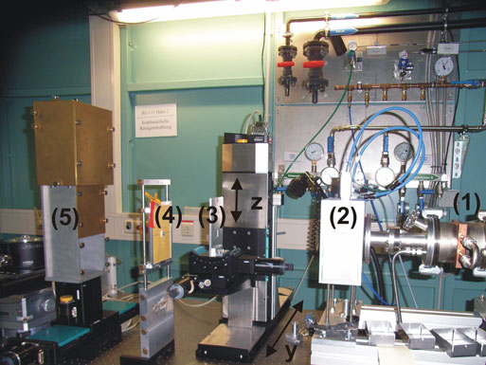
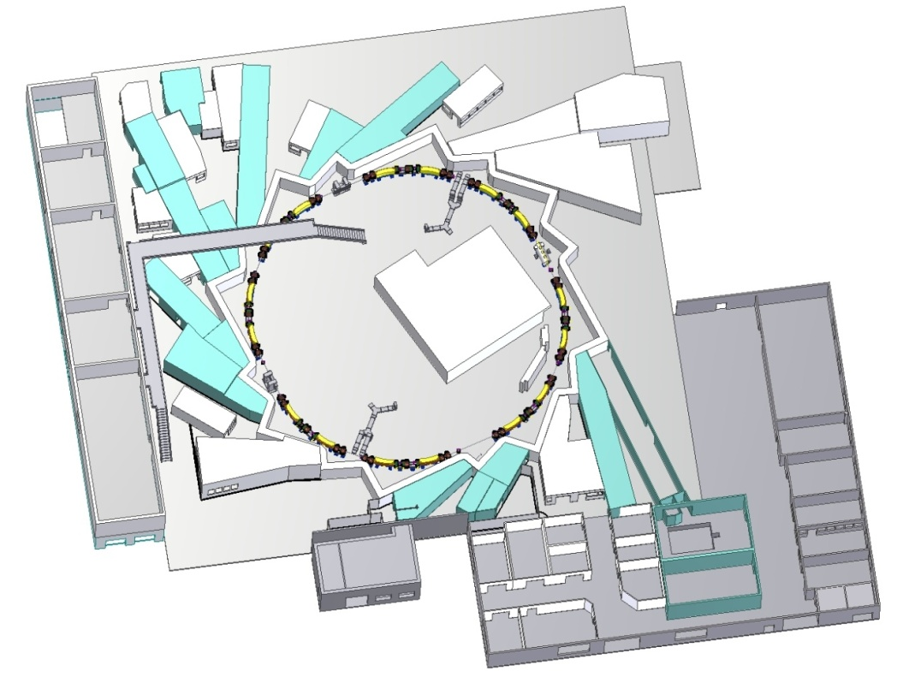
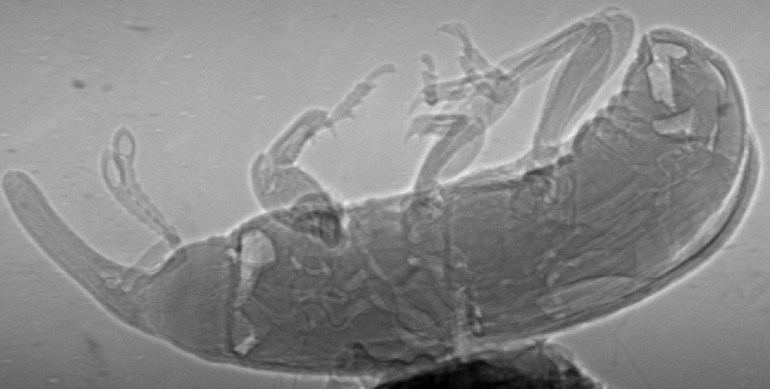
Motivation for X-ray tomography
ANKA
Synchrotron light source at KIT: storage ring, beamline labs
Topo-Tomo beamline: parallel X-ray, tomography experiment platform
Studying moving biological objects in 3D

Slide 3
Motivation for X-ray tomography
World fastest tomography system
Rotation: continuously, high speed
Several GB/s → hundreds TB per day
200 - 400 projections in [0°-180°]
Reconstruction
Standard reconstruction method: filtered-back projection
→ artifacts
Better reconstruction algorithm needed
CS-ART(Compressive Sampling-based Algebraic Reconstruction Technique)

Slide 4
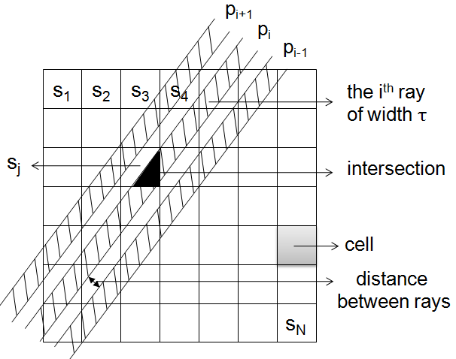
Reconstruction method CS-ART
Algebraic Reconstruction Technique : Equation system (ill-posed)
Flexible for forward models
Prior knowledge
Precise forward model
Geometry of sensor
X-ray: beam with width and distance
Compressive Sampling theory
Image restoring from less samples
Sparse representation in some space
Total Variation: assuming that the gradient space is sparse

Slide 5
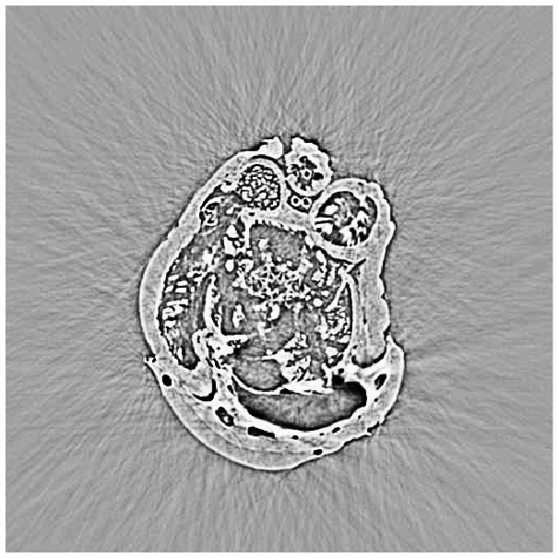
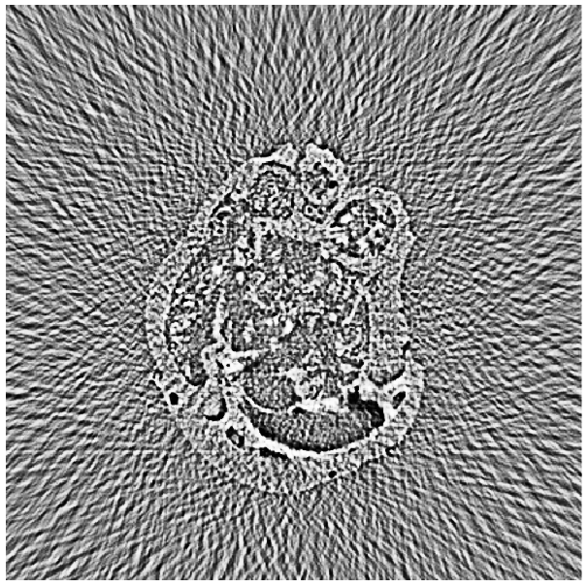
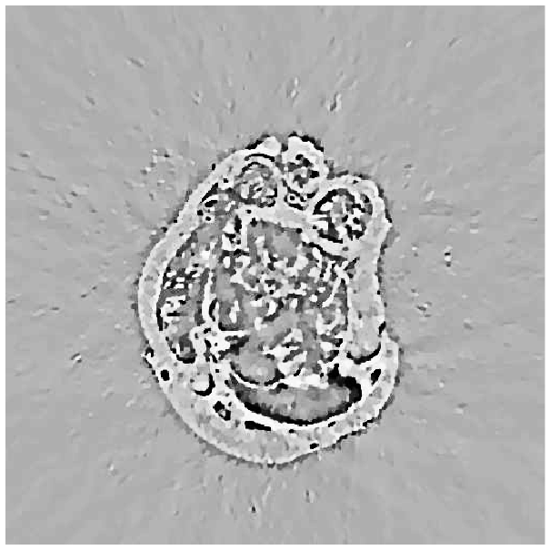
Reconstruction images
CS-ART algorithm produces high quality images using only a few projections.
(a) reference (b) (c)
Standard: 1500 projections
Standard: 60 projections
CS-ART: 60 projections
Data reduction
High quality image
Computing expensive
Thousand parallel slices: 1~3 min (standard), tens of hours (CS-ART)
→ Parallelization required

Slide 6
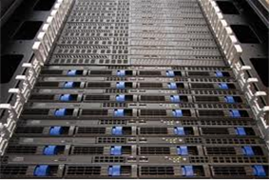
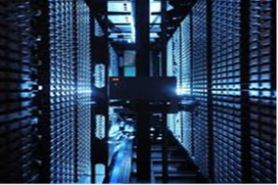
LSDF
LSDF: Large Scale Data Facility at KIT for data intensive scientific experiments
Storage facility: at Petabyte scale
Data storage, archives and access
Computer cluster with 58 nodes: each with 8 cores, 36GB memory
Data computing and analysis in parallel
Online Storage
Computing & Analysis
Workflow of LSDF in application of ANKA
Archives

Slide 7
Parallel computing
Data parallel
Each slice: MATLAB software, independently
1024 slices → 37 nodes (of 58 nodes)
1024 slices
Computing cluster
3D Reconstruction
→a number of tasks
(slice-sequential)
Mapping Task
node
Mapping Task
Tasks → cluster nodes
(in parallel)
Mapping Task
node
Mapping Task
1 task : sequential
Up to 222 tasks in parallel (37 nodes* 6)
node
Mapping Task

Slide 8
Parallel computing performance
Measured time and speedup factor
Parallel tasks | Time [s] | Speedup
1 | 39727 (~11 hours) | --
12 | 3415 | 11.63
24 | 1747 | 22.73
37 | 1107 | 35.85
74 | 650 | 61.08
111 | 488 | 81.39
148 | 417 | 95.20
185 | 360 | 110.2
222 | 330 (5.5 min) | 120.0

Slide 9
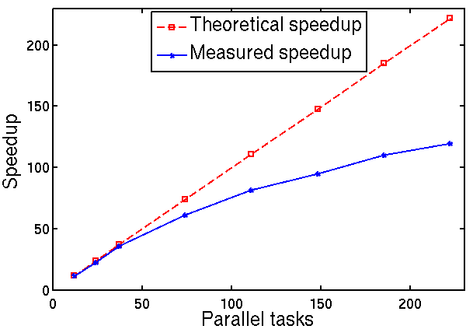
Parallel computing performance
Comparison with theoretical value

Slide 10
Parallel computing performace
Comparison with theoretical value
Lower increasing speed
Reason: multiple tasks in one node
Share cores
Share memory
Share data access bandwidth
High computing performance achieved
330 seconds (less than 6 min), 120 speedup
Enable the application of novel algorithm
→ better images for ultrafast tomography

Slide 11
Conclusions
Algorithm CS-ART shows high potential to reconstruct better images for reduced data.
Workflow of LSDF will enhance the data storage, management and automatic data intensive computing for ANKA.
(finished at the end of the year 2013)
The promising reconstruction result and high computing performance at LSDF greatly support the construction of the world fastest tomography system at ANKA.
Workflow of LSDF is not limited to ANKA. It also supports other institutes involving data intensive computing (micro-tomograph and other tomograph experiments).

