Slide 1
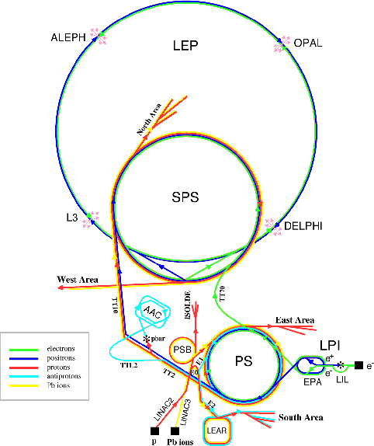


From LEP/SLC to the LC
Fourth Linear Collider Physics School
7 - 9 October 2013 DESY, Hamburg
An introduction to the physics of Linear Colliders
François Richard LAL/Orsay

Slide 2
Introduction
The purpose of this talk is to recall LEP1+SLC and LEP2 aspects which are relevant for designing the e+e- strategy
I will also discuss the limitations (physics, detector, machine, theory) which serves as lessons to define future e+e- colliders
I will then sketch what we can expect from the LC results for the future of HEP

Slide 3
LEP

Slide 4
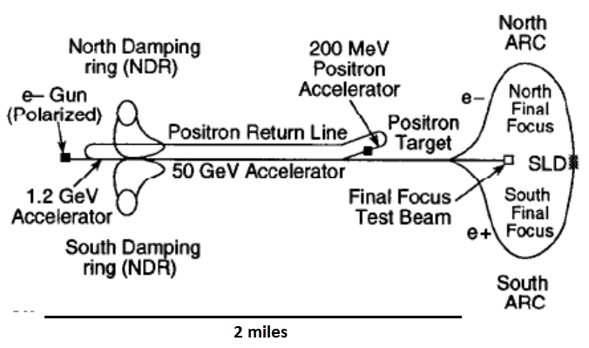
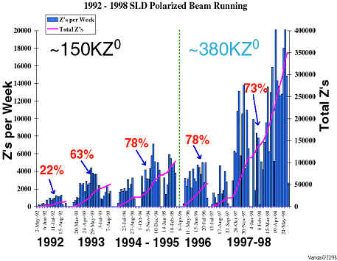
SLC

Slide 5

Some parameters
Beamstrahlung for ILC ~4.5%
ILC is upgradable, with present technology, with 300 MW at 1 TeV
CLIC could reach 3 TeV but with 560 MW ~constant luminosity (same δΕ )

Slide 6
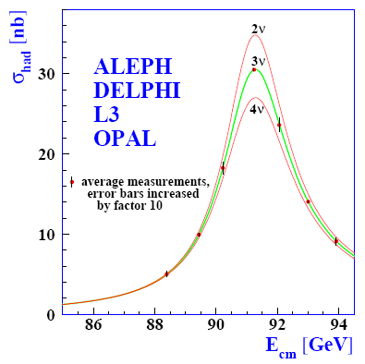
LEP1 legacy
LEP1 allowed PM well beyond foreseen
Provides a full and successful test of the SM for the fermion sector
Gives the number of neutrinos
It has provided the essential tools to discover the SM and predict the mass of missing particles: top, Higgs

Slide 7
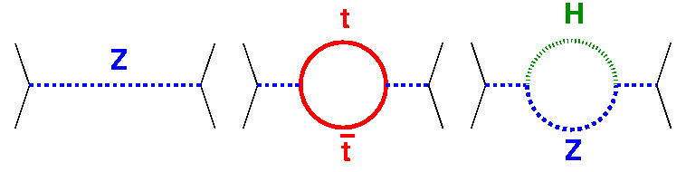
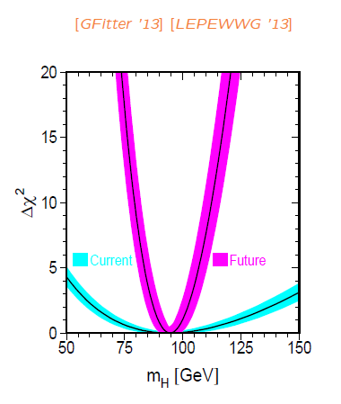
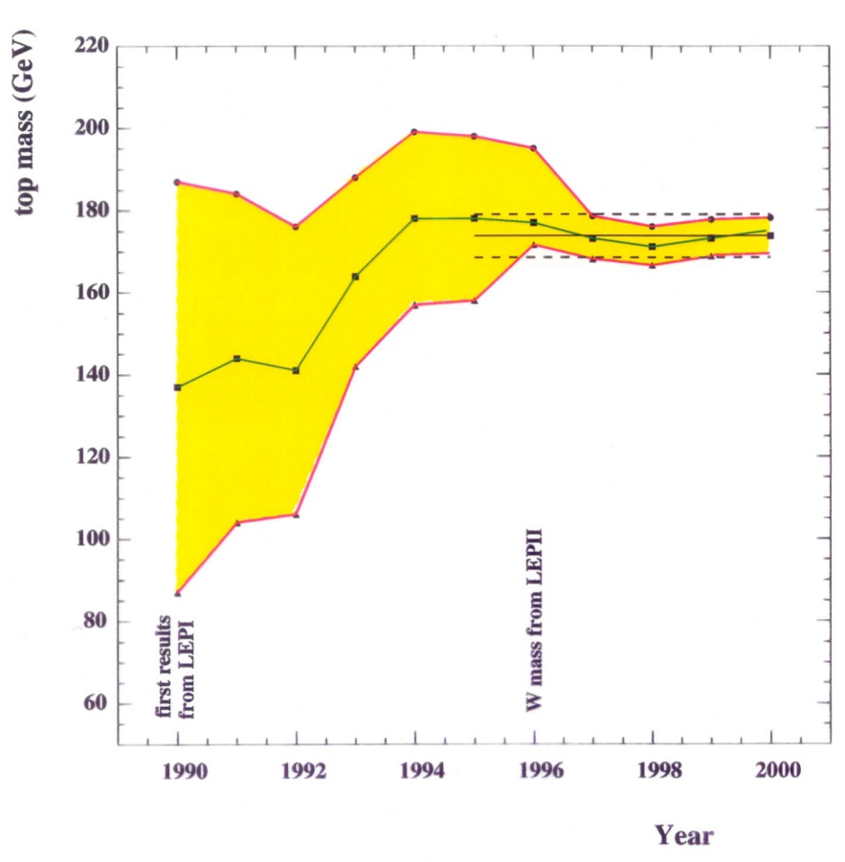
QUANTUM SENSITIVITY
+ BSM theory killer (TC)

Slide 8
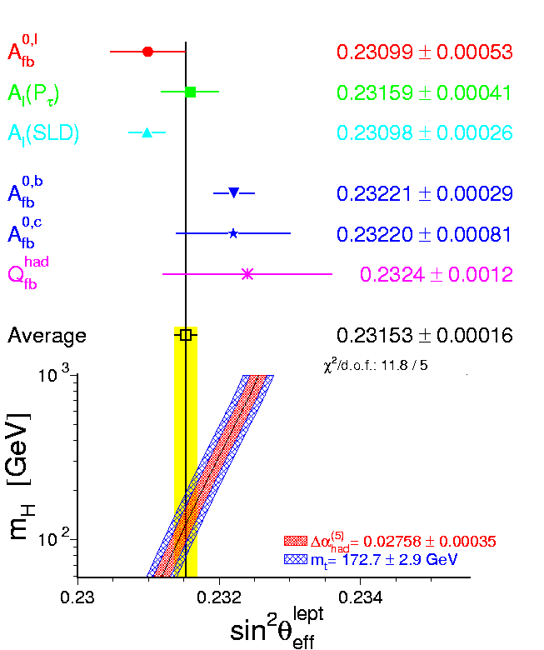
LEP/SLC precision measurements

Slide 9
Unfinished story ?
Possible interpretation of AFBb: 3d generation anomaly or underestimated errors ?
Watch carefully for the top sector where many scenarios BSM predict deviations
Will be tested with ttZ at LHC but with very limited precision
It is plausible that with more accuracy MH indirect could be incompatible with the SM
More accurate measurements are needed

Slide 10
Lessons from LEP1/SLC
LEP1 still statistically limited (mh indirect)
There is an intriguing deviation on Z->bb
The absence of polarization at LEP1 limits the number of observables and the accuracy e.g. for s²w has the same precision in SLC with >10 times less events
NEXT STEP is clear: GigaZ but with polarisation
Remeasuring Z couplings at GigaZ would allow to increase dramatically LEP1/SLC accuracies

Slide 11
What is GigaZ ?
LC luminosity >100 higher than LEP1
10⁹ Z can be easily accumulated meaning stat errors down to 0.01%
The issue then becomes systematics on L, P, Mz measurements and theory extrapolated errors
With polarized electrons (P) and positrons (P’),the Blondel scheme allows to extract to <0.1% P & P’ by flipping P to –P and P’ to –P’
Gives 4 configurations ++ -- +- -+ allowing to measure 4 cross sections and extract the 4 unknowns:
4σ =(1-PP’)(σL+σR)+(P+P’)(σR-σL)

Slide 12
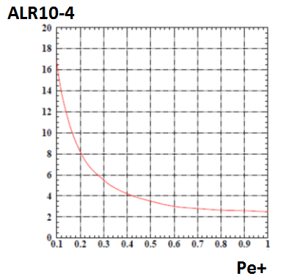
GigaZ and positron polarisation
At GigaZ statistical accuracy on mh saturates predictable theory/exptal uncertainties
LC-PHSM-1999-002-TESLA K. Moenig P’>0.5 is needed

Slide 13
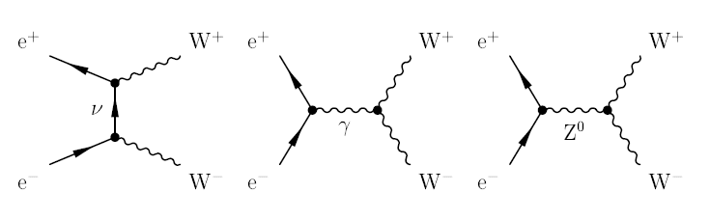
LEP2
LEP2 has allowed to measure the self-coupling Z->WW for the 1st time establishing the non-Abelian nature of these couplings
Essential proof of the SM
1st precise Mw and coupling measurements (Pe-=0 !)
First look into HZ

Slide 14
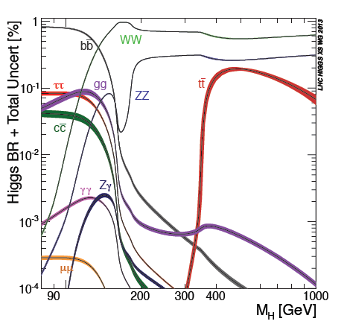
Higgs sector
Below 80 GeV can cope with Higgs produced with >10 reduced coupling (non minimal Higgs type) but not true for 80-115 GeV
The lesson is that the present limit is not robust enough to cope with a modest reduction of the coupling which is likely to occur in non minimal models
Very important to use higher luminosity searches of Higgs at future e+e-
LHC can look into H->γγ but with lower S/B

Slide 15
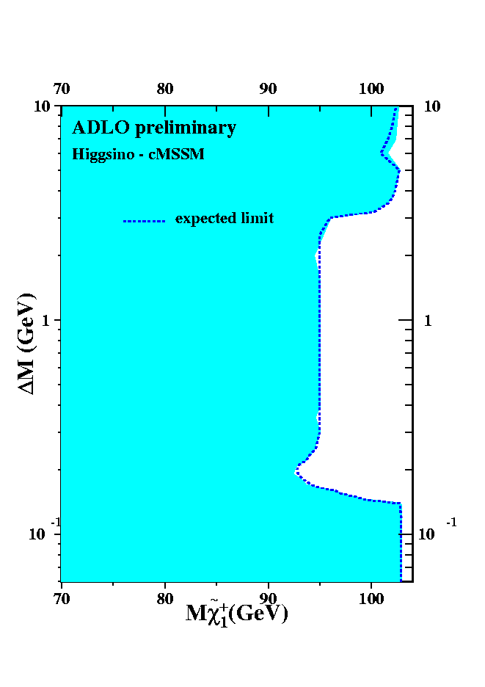
Other examples
Has allowed to search for BSM particles in particular for SUSY up to the kinematical limit for colorless particles even in case of quasi invisible decays (mass degenerate chargino-neutralino) using ISR tagging
Could cover a blind spot for LHC
In some cases these limits have extended well beyond ECM: example Z’

Slide 16
LEP2 history on Higgs search
LEP2 maximum energy was initially planned to access to WW production
With the emergence of SUSY ideas (MH<MZ at tree level, MH<130 GeV with corrections), the focus became HZ production and the priority for energy upgrade increasing the number of SC cavities and the gradient of these cavities
This strategy came too late (decision to stop cavity production in view of an early start of LHC) and in spite of the heroïcal efforts of CERN engineers LEP2 was short of 5% of energy (20% of cavities) to reach the goal

Slide 17
LEP/SLD detectors
Jet reconstruction, in particular in the forward regions, was imperfect which was acceptable for 4 jet topologies but not with 8 jets at LC (e.g. ttbarH)
Needs to be dramatically improved with detectors proposed for ILC & CLIC

Slide 18
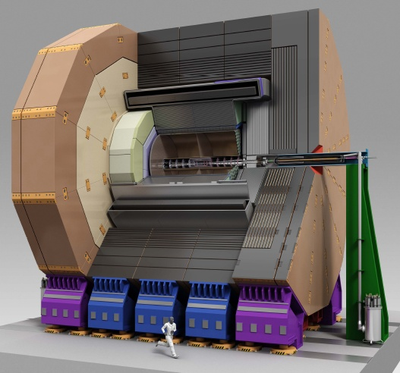
2 concepts: SiD & ILD

Slide 19
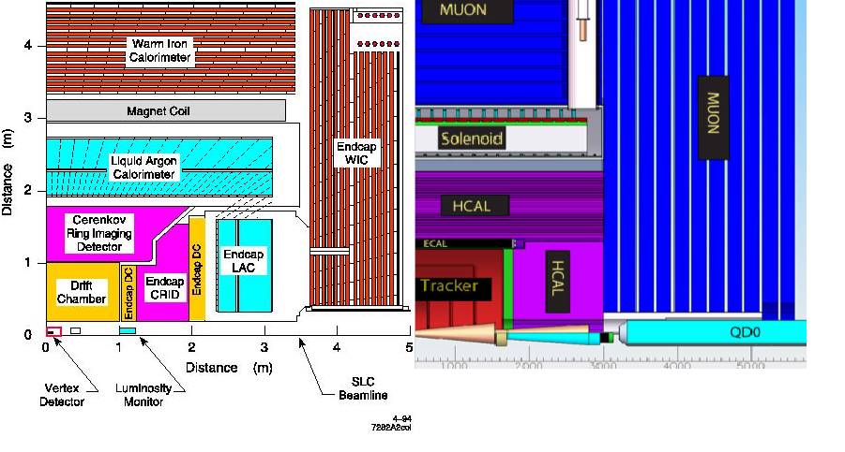
From SLD to SiD
Compact (ECAL !), HCAL inside coil, B from 0.6 to 5 T, Drift chamber to all Si, No particle ID Rµvertex 3cm to <2 cm, cost 50 M$ -> 440 M$

Slide 20
Particle Flow Algorithm (PFA)
Plays a major role in the optimization of the 2 detectors
What is the problem ?
Optimization of PFA shows that the main limitation is confusion not energy resolution
Compact (limited shower radial expansion) and granular calorimeters needed (0.5x0.5 cm² Si pads for ECAL), excellent tracking efficiency (>99%) and low material in front

Slide 21
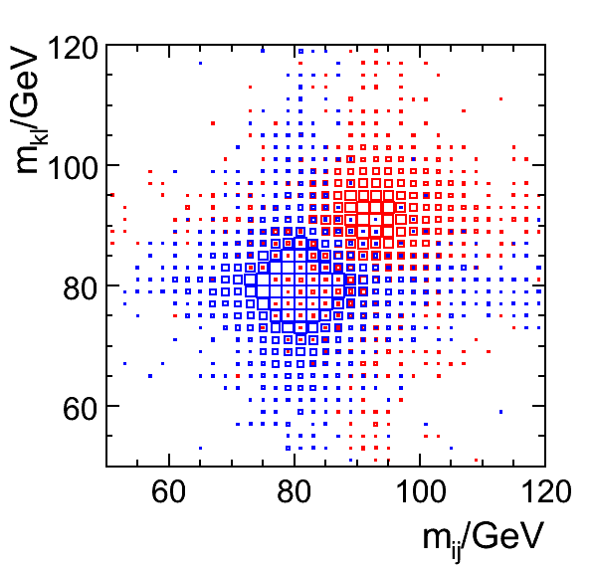
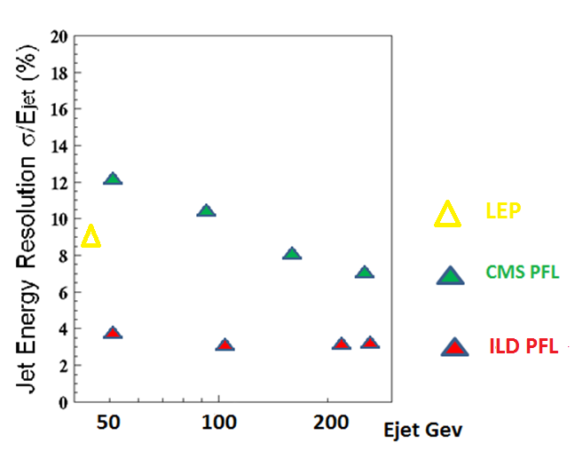
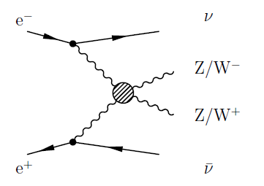
Particle Flow

Slide 22
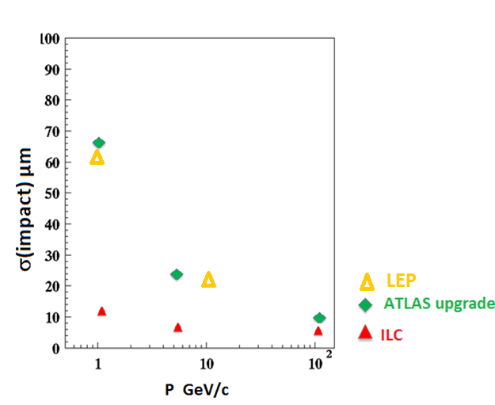
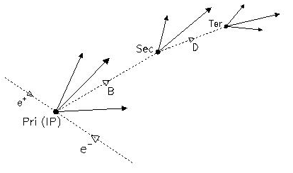
Flavor tagging
Tagging of flavors was limited by the radius of the vacuum chamber (R=5cm) and the material thickness
Will be dramatically improved (R<2cm) allowing not only better b/c separation needed for Higgs measurement but, for the 1st time, the possibility to measure the b charges using multi secondary vertices separation

Slide 23
Machine limitations
Luminosity: factor 100 needed to measure Higgs BR at % since most likely deviations will be small
Also to cover non minimal Higgs scenarios (including mH<100GeV)
Polarization: indispensable to test EW, brings additional observables
Energy flexibility: LEP2 has missed the Higgs boson by very little (in the past ADONE was limited at 3 GeV !) while an energy extension of a LC is much easier

Slide 24
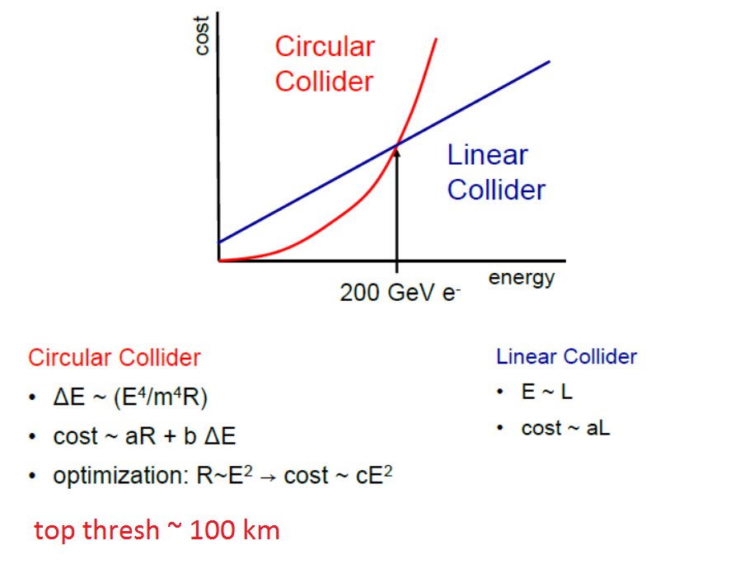
Circular vs Linear e+e-

Slide 25
Possibilities
Extension of LEP2 is under consideration (TLEP)
Good luminosity but energy limited (up to top threshold with 100 km tunnel) and with no clear scheme to produce longitudinal polarization
µµ colliders: very compact since it can overcome SR but has serious handicaps: need for cooling (we need very thin beams) and severe backgrounds (could perhaps be overcome but dead regions)
LC: first demonstrator was SLC but since then major international R&D effort with facilities in the 3 regions
This long effort (>15 y) has resulted into two projects ILC (TDR level) and CLIC (CDR level)

Slide 26
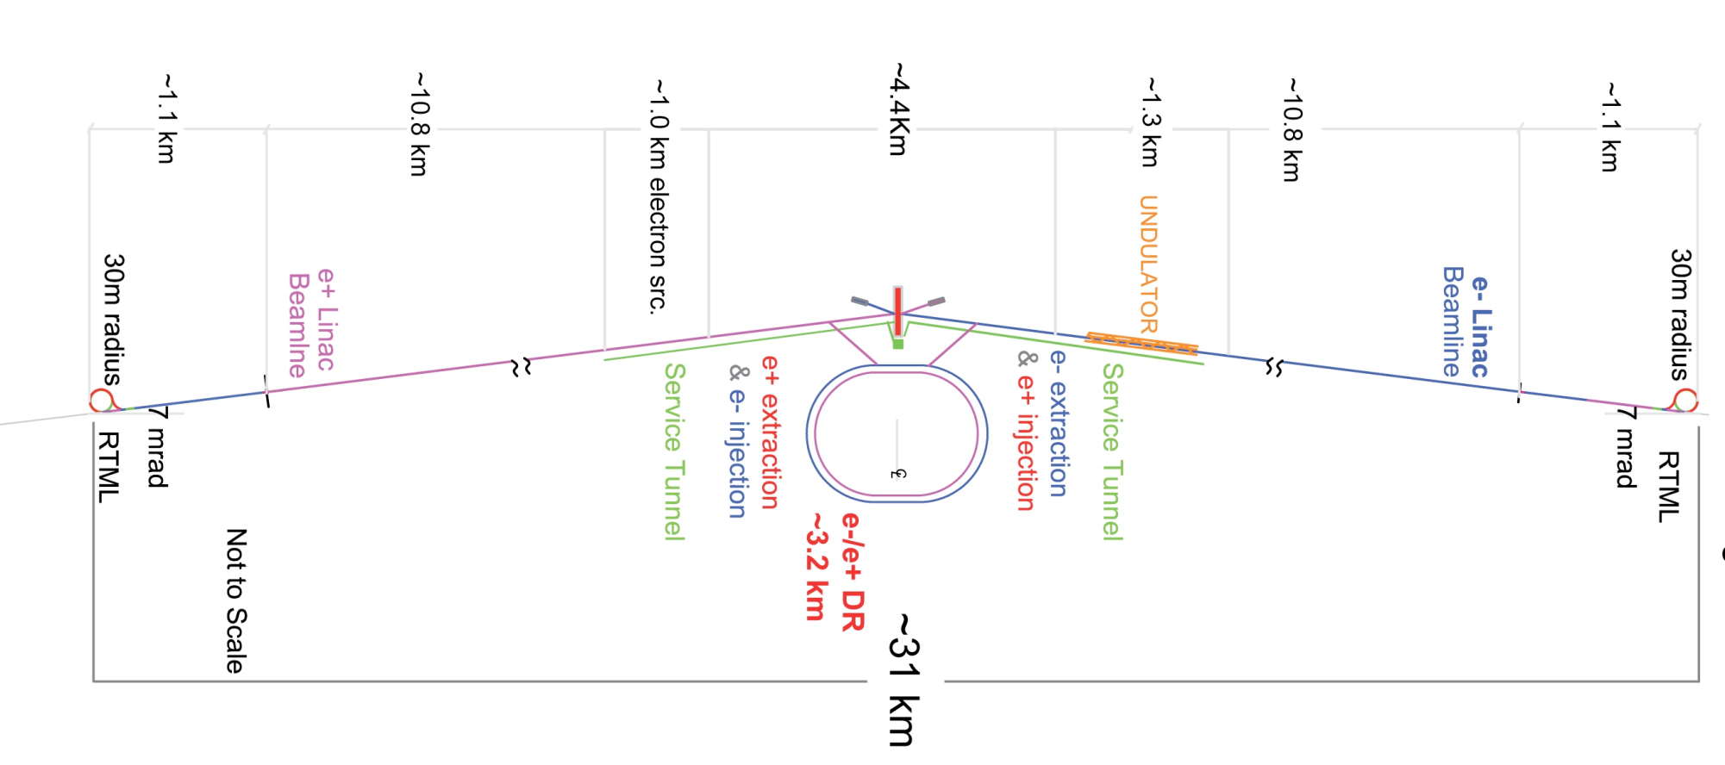
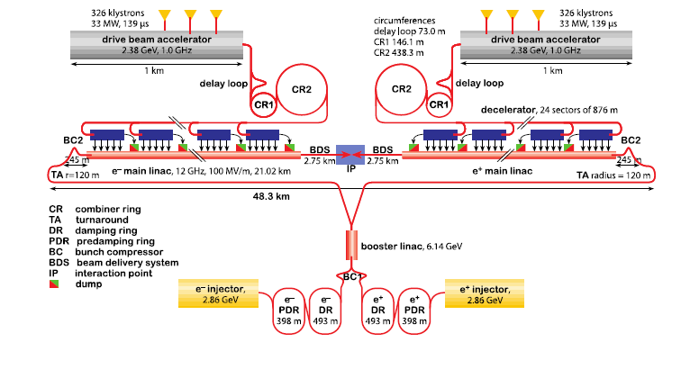

Slide 27
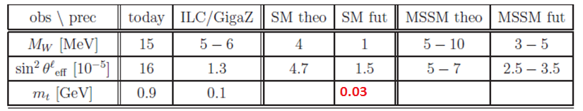
Potential limitations
With the high luminosity expected, statistical errors as low as a few 0.1% will be achieved (0.01% at GigaZ)
One therefore need to master not only luminosity, polarization and reconstruction effects at this level but also theoretical errors arXiv:1307.3962
On top physics QCD and EW corrections can reach ~10% and therefore HO need to be computed
Major challenge for theory which requires careful planning

Slide 28
What is the main goal ?
Breakdown the SM and elect a BSM theory
Still achievable at LHC14 but we should be prepared for a scenario without new direct discoveries
The existence of dark matter, the observations of neutrino oscillations, the matter-antimatter asymmetry in the Universe, and the cosmological inflation, all require some physics beyond the Standard Model
However none of the above points to a concrete mass scale where new phenomena must show up at colliders
Significant and interpretable deviations from a LC and/or from B factories may be the indispensable ingredient to guide our choice for the next energy frontier collider

Slide 29
How to make an indirect discovery ?
We need to measure a significant effect (>4sd) which requires the highest possible accuracy from a LC
It also requires as many observables as possible hence the importance of polarization and a large lever arm in energy
Much discussed today is to find a significant deviations in Higgs BR
Clear breakthrough with respect to LHC

Slide 30
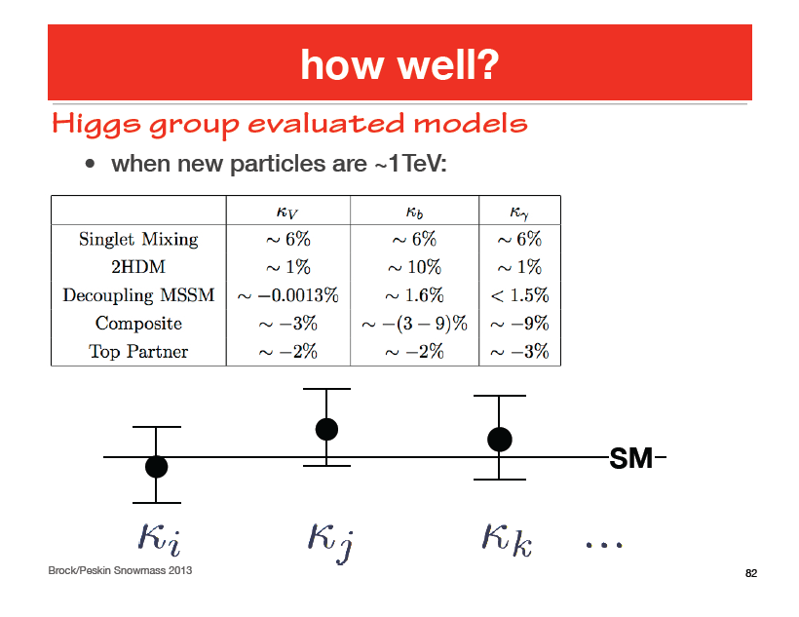
Snowmass 2013

Slide 31
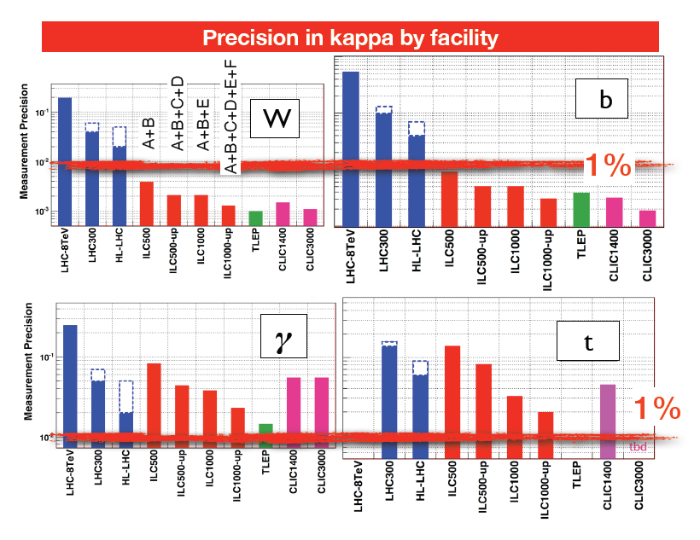

Slide 32
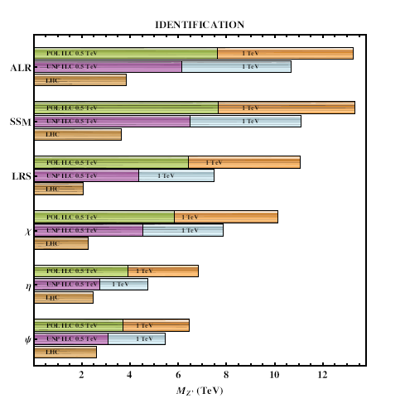
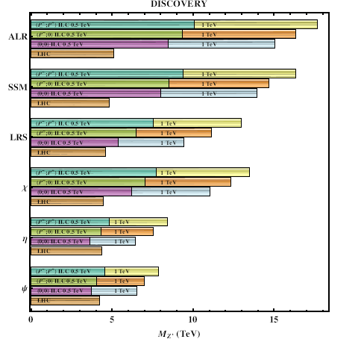
Z’->ff
arXiv:1307.3962

Slide 33
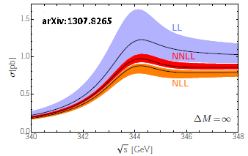
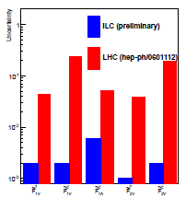
Top physics
Top mass is a key quantity for EWSB, BSM and cosmology (Higgs properties at very high scales)
ILC will give δMt<100 MeV (including theory)
ILC provides 6 independent observables allowing a very good separation of the axial and vector couplings of γ/Z
Allows, e.g., to test extra dimension models beyond 10 TeV (<4 TeV at HL-LHC)

Slide 34
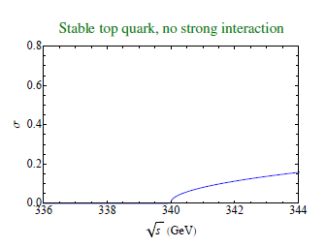
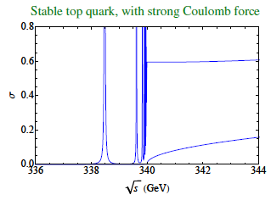
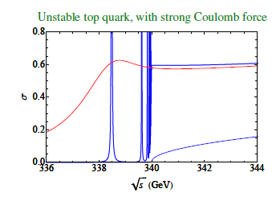
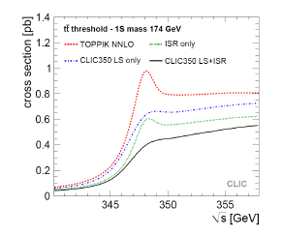
Top threshold (M. Beneke)

Slide 35
Summary
LEP and SLC have provided invaluable inputs to develop the strategy on a new LC
With increased luminosity, polarised electrons and a wide range in energy covering top and Higgs physics, ILC (and later CLIC) allows to improve dramatically on the results from LEP/SLC in our understanding of the standard model and its proposed extensions
With polarized positrons, GigaZ can complete the test of the SM well beyond LEP1/SLD
If no discovery shows up, these inputs will allow to explore indirectly a new mass domain which will allow to define the new energy frontier after LHC
Direct discoveries (non-minimal Higgs, ‘invisible SUSY’…) are also possible in complement to LHC

Slide 36
BACK UP SLIDES

Slide 37
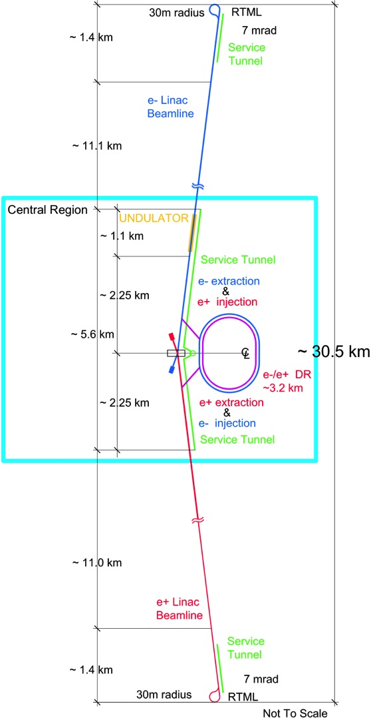

Slide 38
How to go from LEP/SLC to the next LC
SLC luminosity needs a 10000 increase
Use very intense beams with focussing 1000 smaller than SLC (improving emittance)
Requires large damping rings (multi-bunch)
Large power needed in such machines -> crucial is η=Beampower/Plug power
Bunch separation is an issue for detectors
Standard way like SLC: warm cavities, klystron+ modulators with low η
Two other ways:
ILC supraconductive (2⁰ Kelvin) linac allowing long bunch with good bunch separation but moderate gradient
CLIC a two beam accelerator with higher gradient but <ns bunch separation

Slide 39
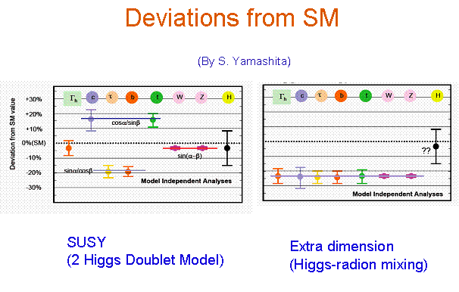
Why so precise ?

Slide 40
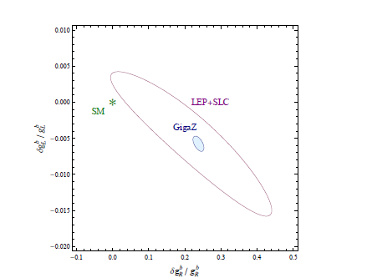
Z->bb at GigaZ

Slide 41
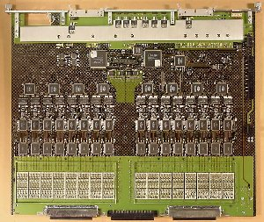
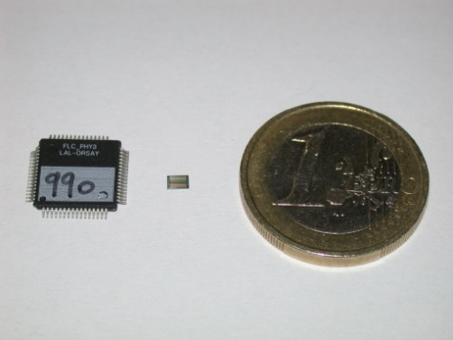

Imaging calorimetry
High granular calorimetry with >10⁸ channels becomes practical with low consumption µ-electronics inside the calorimeters
Power pulsing at 5 Hz
with ~1ms duration
ILC : 25µW/ch
Physics Proto. 18ch 10*10mm 5mW/ch
ATLAS LAr FEB 128ch 400*500mm 1 W/ch

Slide 42
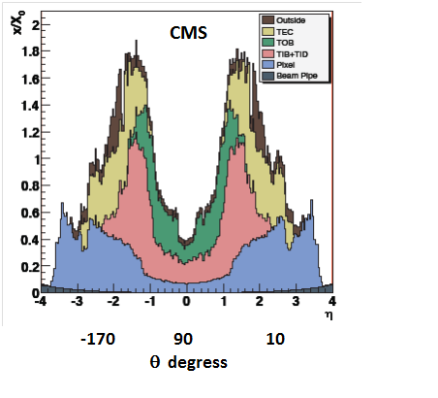
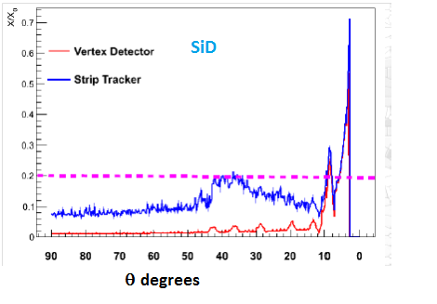
How do they compare to existing detectors ?
Material budget
Intrinsic reasons (radiation hardness) but we should remain very careful in maintaining this feature

Slide 43
Differences
Different B field & tracker radius achieving similar energy/momentum resolution
100% Silicon tracker for SiD
ILD has a large volume gaseous tracker (TPC >>LEP) supplemented by silicon tracking
Various calorimeter technologies are considered, ILD leaving open its final choice
SiD 5T
ILD 3.5T
SiD 1.2m
ILD 1.8m

Slide 44
Higgs BR

Slide 45
Degeneracy case
LEP2 has covered the possibility mχ±~mχ⁰ using ISR+long lived charged particles
This possibility corresponds to the ‘low µ scenario’ favored in some schemes

Slide 46
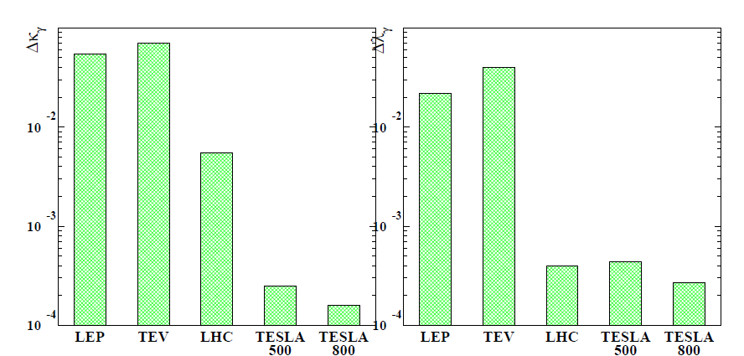
Anomalous ZWW & γWW couplings

Slide 47
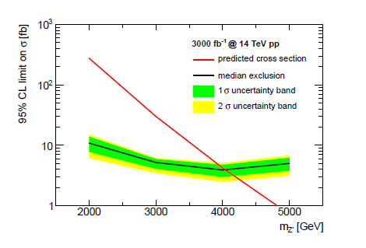

Z’ RS model (Snowmass)

Slide 48
Top threshold (M. Beneke)

