Slide 1
WG: Cav. a. Modules
WP03 - DESY parts
Notes:
How to edit the title slide
Upper area: Title of your talk, max. 2 rows of the defined size (55 pt)
Lower area (subtitle): Conference/meeting/workshop, location, date, your name and affiliation, max. 4 rows of the defined size (32 pt)
Change the partner logos or add others in the last row.

Slide 2
Parts for Module assembly @ Saclay I
103 Cold Masses and Vacuum Vessel
58 - IHEP-Beijing
8 at DESY, 7 has to be rework by the supplier
The next 4 on the shipping expected mid May at DESY
45 - E. Zanon
6 at Saclay, some minor reworks necessary
7 at DESY
Remark:
From May 2013 Zanon will deliver direct to Saclay with a rate of 2/month!
Also the already delivered Zanon cryostats to Desy must be shipped in the next time to Saclay!
Since Feb. 2013 delivery rate of 2/month.
The storage capacity at Desy is needed for the IHEP deliveries
Notes:
Before you start editing the slides of your talk change to the Master Slide view: Menu button “View”, Master, Slide Master:
Edit the following 2 items in the 1st slide: 1) 1st row in the violet header: Delete the existent text and write the title of your talk into this text field 2) The 2 rows in the footer area: Delete the text and write the information regarding your talk (same as on the Title Slide) into this text field.
If you want to use more partner logos position them left beside the DESY logo in the footer area Close Master View

Slide 3
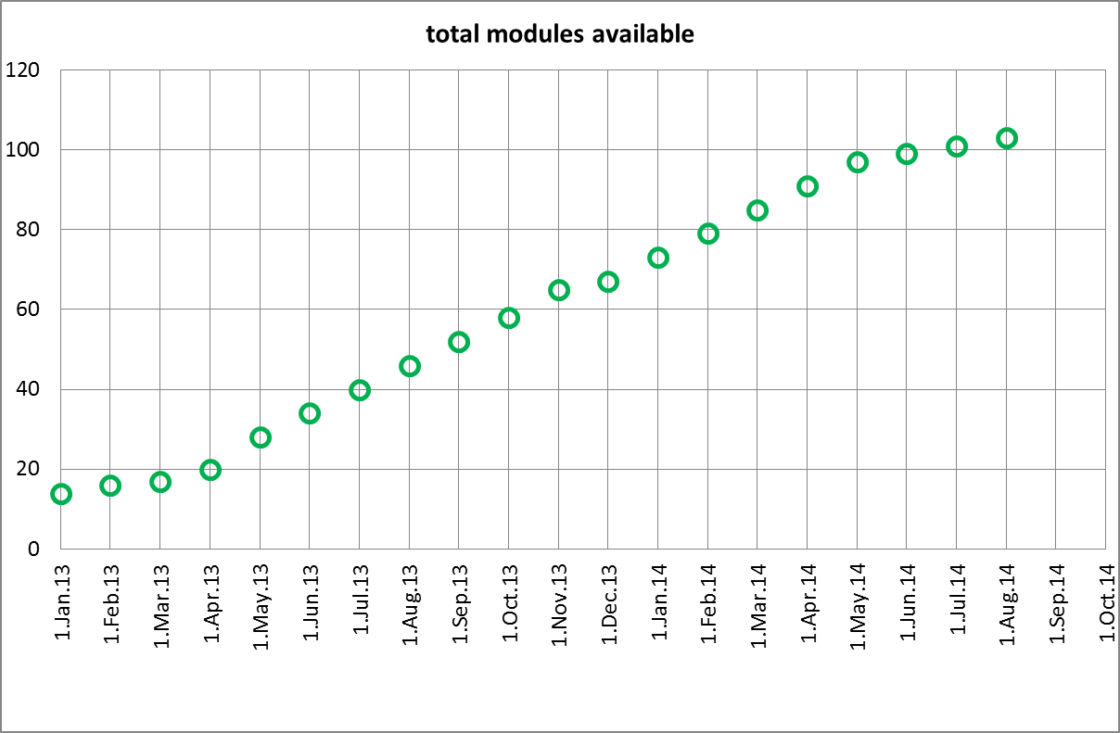
Parts for Module assembly @ Saclay Ia
Delivery Schedule of European-XFEL Cryostats
58 modules IHEP |  |  | 25 modules ZANON
(schedule from Ge Rui + 6 weeks for shipping) |  |  | (schedule from Zanon for 2012 + 2 modules / month)
01 August 2012 | 2 | Desy | 15 August 2012 | 1 | Saclay
15 October 2012 | 2 | Desy | 02 October 2012 | 1 | Saclay
10 November 2012 | 2 | Desy | 07 November 2012 | 2 | Saclay
15 November 2012 | 2 | Desy | 20 December 2012 | 2 | Saclay
15 May 2013 | 2 | Desy
15 May 2013 | 2 | Desy | 30 January 2013 | 2 | Desy
01 June 2014 | 2 | Desy | 22 February 2013 | 1 | Desy
01 June 2013 | 2 | Desy | 30 March 2013 | 3 | Desy
01 June 2013 | 2 | Desy | 02 May 2013 | 2 | Desy
01 July 2013 | 2 | Desy | 30 May 2013 | 2 | Desy
01 July 2013 | 2 | Desy | 30 June 2013 | 2 | Saclay
01 August 2013 | 2 | Desy | 30 July 2013 | 2 | Saclay
01 August 2013 | 2 | Desy | 30 August 2013 | 2 | Saclay
01 September 2013 | 2 | Desy | 30 September 2013 | 2 | Saclay
01 September 2013 | 2 | Desy | 15 October 2013 | 1 | Saclay
01 October 2013 | 2 | Desy
01 October 2013 | 2 | Desy
01 November 2013 | 2 | Desy
01 November 2013 | 2 | Desy
01 January 2014 | 2 | Desy
01 January 2014 | 2 | Desy
01 February 2014 | 2 | Desy
01 February 2014 | 2 | Desy
01 March 2014 | 2 | Desy
01 March 2014 | 2 | Desy
01 April 2014 | 2 | Desy
01 April 2014 | 2 | Desy
01 May 2014 | 2 | Desy
01 May 2014 | 2 | Desy
 |  |  | +20 modules ZANON
 |  |  | 30 October 2013 | 2 | Saclay
 |  |  | 30 November 2013 | 2 | Saclay
 |  |  | 30 December 2013 | 2 | Saclay
 |  |  | 30 January 2014 | 2 | Saclay
 |  |  | 28 February 2014 | 2 | Saclay
 |  |  | 30 March 2014 | 2 | Saclay
 |  |  | 30 April 2014 | 2 | Saclay
 |  |  | 30 May 2014 | 2 | Saclay
 |  |  | 30 June 2014 | 2 | Saclay
 |  |  | 30 July 2014 | 2 | Saclay
total | 58 |  |  | 45
Notes:
Before you start editing the slides of your talk change to the Master Slide view: Menu button “View”, Master, Slide Master:
Edit the following 2 items in the 1st slide: 1) 1st row in the violet header: Delete the existent text and write the title of your talk into this text field 2) The 2 rows in the footer area: Delete the text and write the information regarding your talk (same as on the Title Slide) into this text field.
If you want to use more partner logos position them left beside the DESY logo in the footer area Close Master View

Slide 4
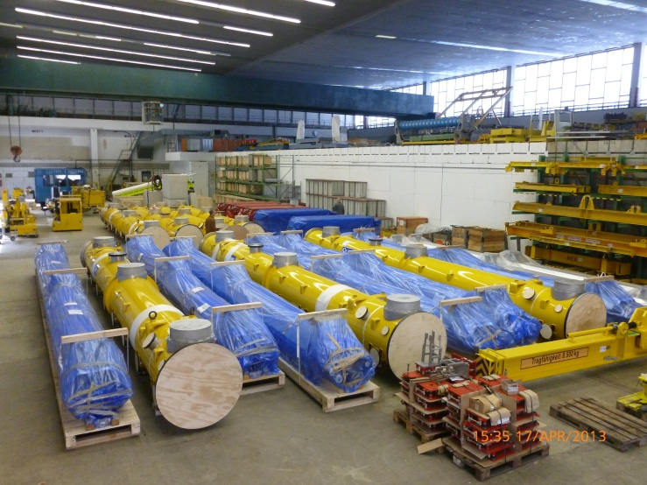
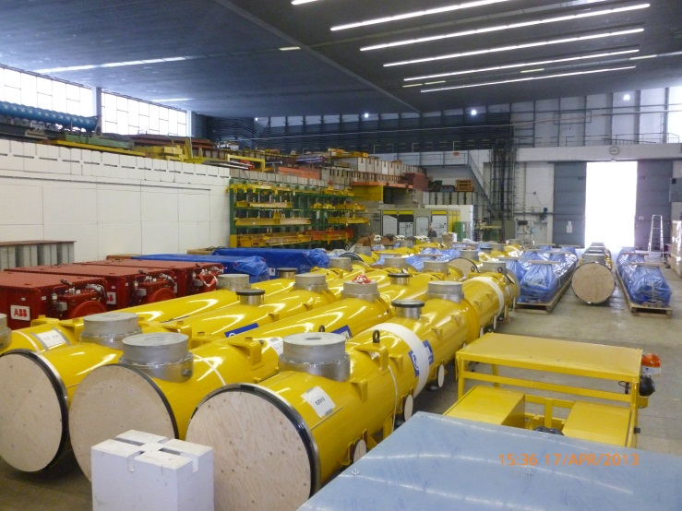
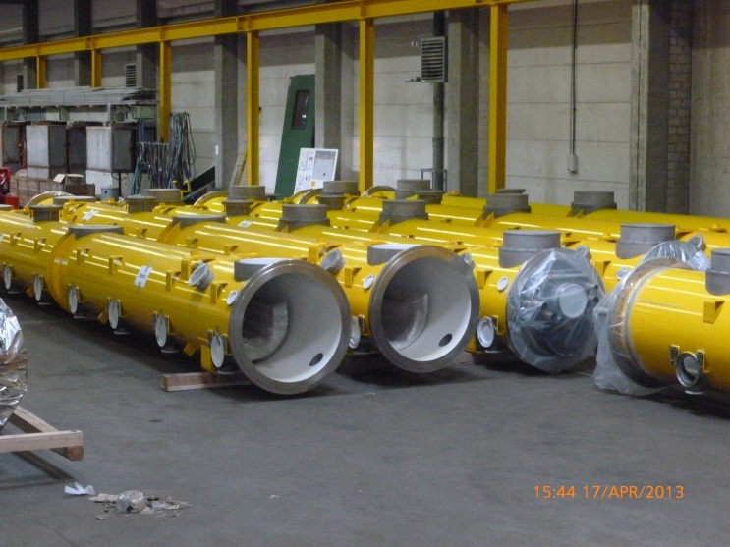
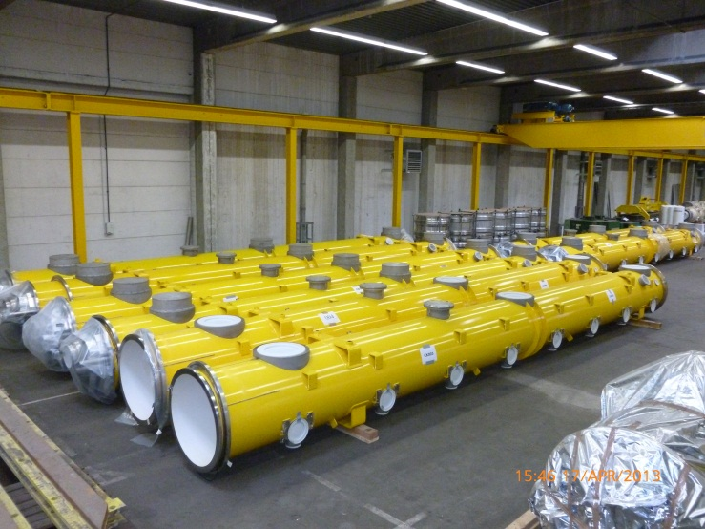
Parts for Module assembly @ Saclay Ib
Hall 1:
Reception and
short storage
Reemtsma 80d:
Long time storage
Remark:
Lot of space blocked
by not XFEL equipment
Notes:
Before you start editing the slides of your talk change to the Master Slide view: Menu button “View”, Master, Slide Master:
Edit the following 2 items in the 1st slide: 1) 1st row in the violet header: Delete the existent text and write the title of your talk into this text field 2) The 2 rows in the footer area: Delete the text and write the information regarding your talk (same as on the Title Slide) into this text field.
If you want to use more partner logos position them left beside the DESY logo in the footer area Close Master View

Slide 5
Parts for Module assembly @ Saclay II
103 2Phase end connection
Supplier DESY
36 (+1) at Saclay, rest expected for late summer 2013
103 Q-pole pipes
Supplier Desy
38 (+1) at Saclay
Rest expected for late summer 2013
103 Ti gate valve supports
Supplier DESY
102 (+1) at Saclay
103 x 8 Tuner motor cables harness
Supplier DESY
30 (+1) at Saclay, rest expected for late summer 2013
Notes:
Before you start editing the slides of your talk change to the Master Slide view: Menu button “View”, Master, Slide Master:
Edit the following 2 items in the 1st slide: 1) 1st row in the violet header: Delete the existent text and write the title of your talk into this text field 2) The 2 rows in the footer area: Delete the text and write the information regarding your talk (same as on the Title Slide) into this text field.
If you want to use more partner logos position them left beside the DESY logo in the footer area Close Master View

Slide 6
Parts for Module assembly @ Saclay III
103 x 17 CERNOX Temperature sensors
Supplier DESY
78 (+1) at Saclay, rest expected for late summer 2013
103 D-Flanges with feedthroughs
Supplier DESY
24 (+1) at Saclay
721 A-flanges (Cav. 1-7)with feedthroughs
Supplier DESY
14 (+7) at Saclay, next 25 expected for May
Currently the SMA feedthroughs are the bottleneck all other parts are in house
Notes:
Before you start editing the slides of your talk change to the Master Slide view: Menu button “View”, Master, Slide Master:
Edit the following 2 items in the 1st slide: 1) 1st row in the violet header: Delete the existent text and write the title of your talk into this text field 2) The 2 rows in the footer area: Delete the text and write the information regarding your talk (same as on the Title Slide) into this text field.
If you want to use more partner logos position them left beside the DESY logo in the footer area Close Master View

Slide 7
Parts for Module assembly @ Saclay IV
103 A-flanges (Cav. 8) with feedthroughs
Supplier DESY
2 (+1) at Saclay, next 5 expected for May
Currently the SMA feedthroughs are the bottleneck all other parts in house
721 Titanium bellows f. 2Phase pipe
Suplier DESY/Skodock
721 at Saclay
Copper braids f. HOM a. Tuner motors cooling
Supplier NCNR Poland
24 sets (+1) at Saclay, next 50 sets expected end of April 2013
Notes:
Before you start editing the slides of your talk change to the Master Slide view: Menu button “View”, Master, Slide Master:
Edit the following 2 items in the 1st slide: 1) 1st row in the violet header: Delete the existent text and write the title of your talk into this text field 2) The 2 rows in the footer area: Delete the text and write the information regarding your talk (same as on the Title Slide) into this text field.
If you want to use more partner logos position them left beside the DESY logo in the footer area Close Master View

Slide 8
Parts for Module assembly @ Saclay V
2 Modules Transport Frames
Supplier DESY/BNG
Both available and tested
3 Sets of Modules Transport Caps
Supplier DESY/RI
All three sets available and tested (currently some minor modifications have to be done)
Module Transport Saclay-DESY
Contract placed April 2013
Tools:
2 Girder for modules craning
Delivered and in operation at Saclay
Welding bladders
Delivered and in operation at Saclay
Notes:
Before you start editing the slides of your talk change to the Master Slide view: Menu button “View”, Master, Slide Master:
Edit the following 2 items in the 1st slide: 1) 1st row in the violet header: Delete the existent text and write the title of your talk into this text field 2) The 2 rows in the footer area: Delete the text and write the information regarding your talk (same as on the Title Slide) into this text field.
If you want to use more partner logos position them left beside the DESY logo in the footer area Close Master View

Slide 9
Conclusion
Up to XM10 the cold Mass and vacuum vessel available at Saclay and DESY
Up to XM20 all subcomponents at Saclay exclude the A-flanges because of limited SMA-feedthroughs
Some components delivered 100%
Aim: Late summer last delivery of the rest of all subcomponents to Saclay
Cold Mass and vacuum vessel continuous delivery to Saclay till summer 2014.
Notes:
Before you start editing the slides of your talk change to the Master Slide view: Menu button “View”, Master, Slide Master:
Edit the following 2 items in the 1st slide: 1) 1st row in the violet header: Delete the existent text and write the title of your talk into this text field 2) The 2 rows in the footer area: Delete the text and write the information regarding your talk (same as on the Title Slide) into this text field.
If you want to use more partner logos position them left beside the DESY logo in the footer area Close Master View

