Slide 1
Installation of Photon Beamlines
Martin Dommach (WP-73)
2nd Collaboration Meeting of the European XFEL, 23.04.2013
Notes:
How to edit the title slide
Upper area: Title of your talk, max. 2 rows of the defined size (55 pt)
Lower area (subtitle): Conference/meeting/workshop, location, date,
your name and affiliation,
max. 4 rows of the defined size (32 pt)
Change the partner logos or add others in the last row.

Slide 2
Overview
Almost 3 km of beam transport have to be installed
Intended start January 2014
Installation order: SASE1, SASE3, SASE2
roughly 9 months time per beamline
Notes:
Start with SASE3 because the tunnel XTD10 will be the first which is ready for installation
Overlapping installation

Slide 3
Installation schedule
Installation of photon beamlines follows installation of tunnel infrastructure (water, electricity)
Intended start is beginning of 2014
  Starting with XTD2
  Last tunnel will be XTD6, installation starts spring 2015
6 – 20 months of installation time for each tunnel
Photon beamline installation will be done by
  WP-73 vacuum team
  European XFEL groups (WP-74, WP-76)
  DESY groups (WP-32, WP-33, ZM5, …)
  External contractors (electrical installations, …)

Slide 4
Installation plan
More details can be found in the Project Integration Timeschedule (PIT) or the Technical Design Report: X-Ray Optics and Beam Transport
XFEL.EU TR-2012-006

Slide 5
Requirements for installation in the tunnel
MKK tunnel installations finished:
  Electrical power / light
  Cooling water
  Compressed air
  For installation of electronics the tunnel temperature und humidity have to be controlled, planned from April(?) 2014 on
Cleaning of tunnel floor after drilling of holes / before installation of vacuum equipment
Rack installation (WP-76)
IT network ready for technical commissioning

Slide 6
Requirements above ground
Intermediate storage available on Schenefeld campus
  Tents / containers (warm, dry…)
Receiving department, someone, who…
  checks incoming deliveries
  helps to unload trucks (fork-lift)
Temporary offices for WP-73 staff

Slide 7
Installation work flow
Drilling holes, building concrete blocks
Cleaning of tunnels
Transport and distribution of components in the tunnels
Mounting of beam pipe supports and frames
Placing beam pipes on supports, first rough alignment
Assembly of vacuum pipes and X-ray optics components under a local cleanroom
Electrical cabling between racks and beamline components
Rough pumping, He-leak test
Final alignment
Commissioning and test of control system

Slide 8
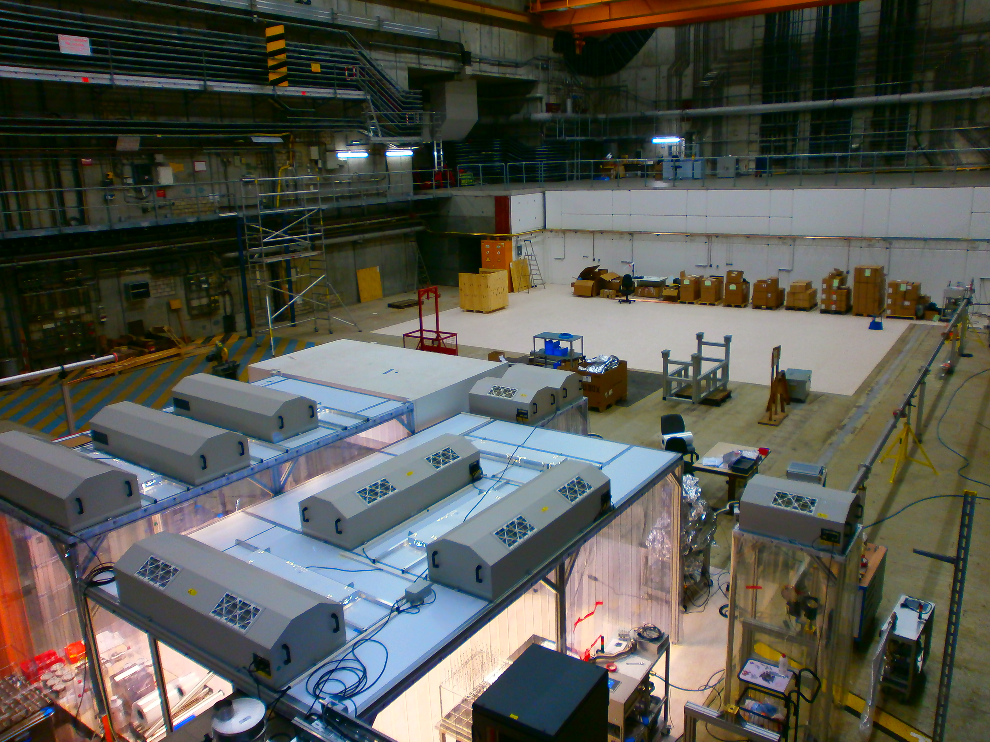
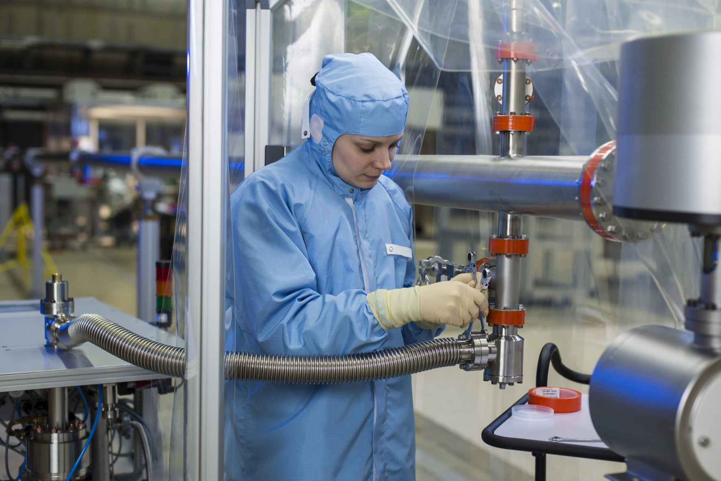
WP-73 HERA lab
Intermediate storage
Test of prototypes
Preassembly of
  SASE3 gas attenuator
  Differential pumping units
  X-Ray optics
  Fast valves, shutters
Cleaning of vacuum components
Training of new staff

Slide 9
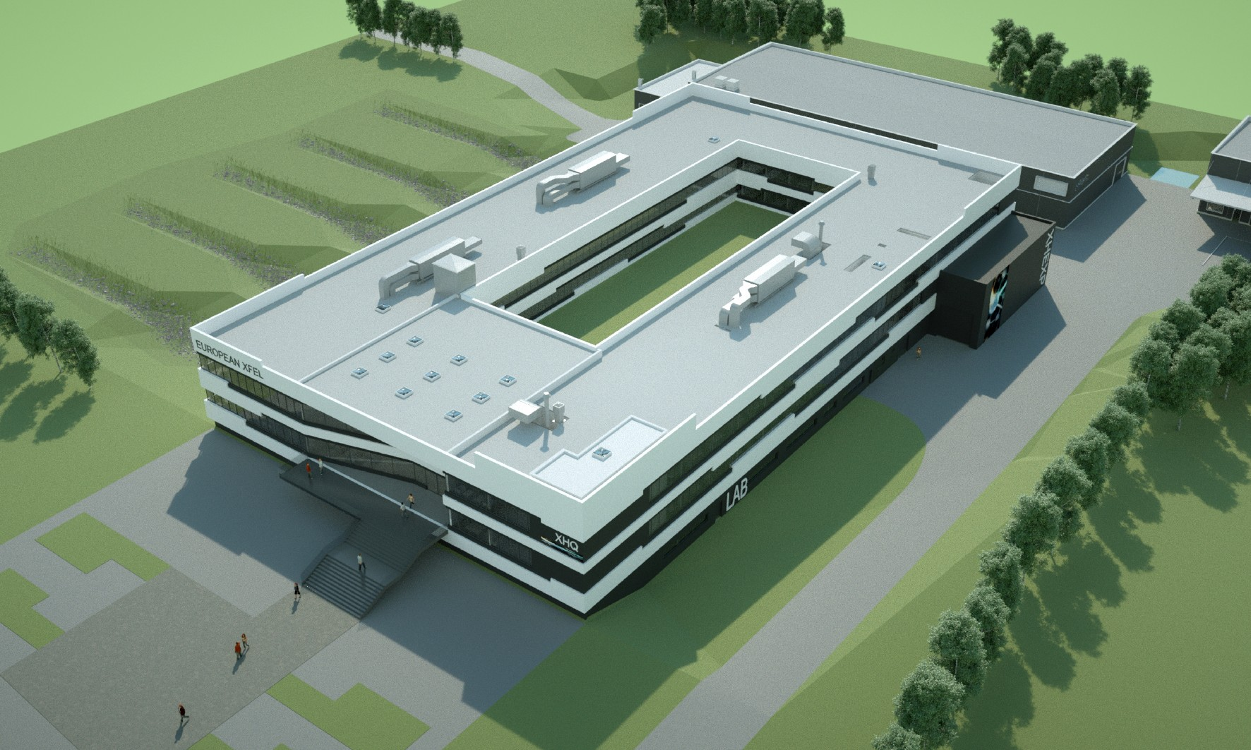
Thank you for your
attention!

