Slide 2
Content
Introduction: Beam lines at the end of XTL
Standard Support | Hanging “Standard Support”
Variant 1: Simple Suspension
Variant 2a: Single Suspender
Variant 2b: Double Suspender
Variant 2c: Cross beam
Variant 3a: Cantilever with suspender
Variant 3b: Gantry w/o suspender
Introduction: Beam lines in XSE

Slide 3
Introduction: Beam lines at the end of XTL
I will report the current status of the study the DESY design office (ZM1), mainly Roland Platzer and Susanne Adler, perform.
At the end of the XTL-tunnel the machine splits in 3 beam lines plus the option of a forth for a possible extension of XFEL.
In addition the transport way crosses the beam lines.
A rack (germ. Regal) allows to support or suspend magnets or magnet units (BPM, Quadrupole, Steerer w/ or w/o Vacuum pump)
Different variants are shown

Slide 4
End of XTL-tunnel (room 37 – 41)
XQK

Slide 5
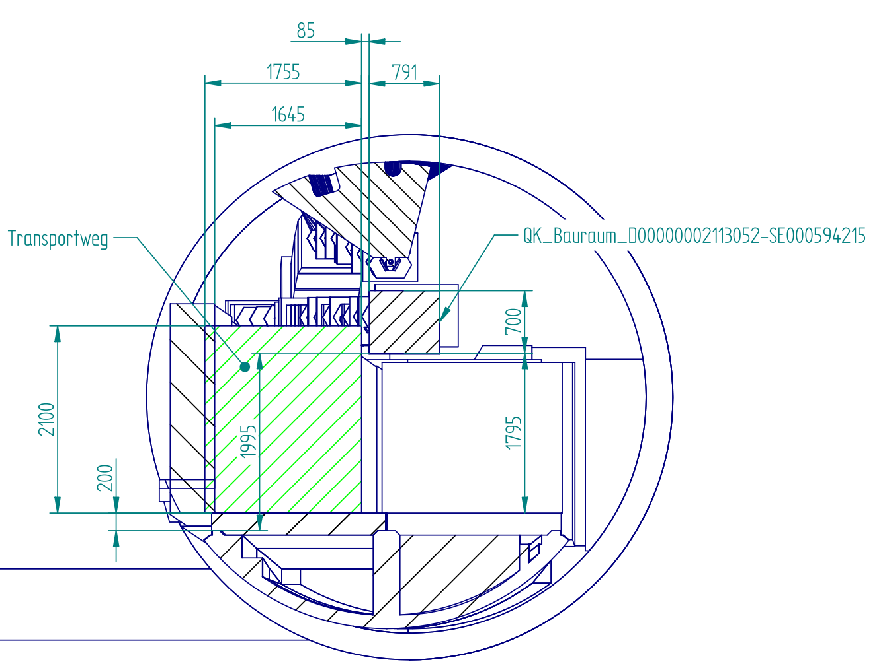
Cut at XQK
Transport way:
2100 (h) 1600 (w)
Clearance:
85mm

Slide 6
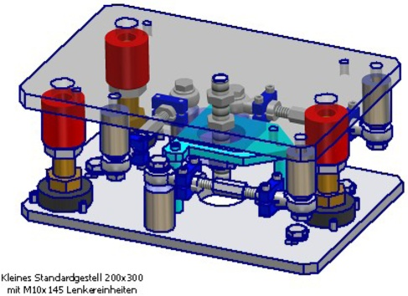
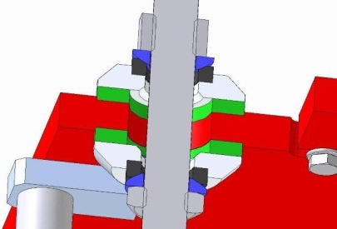
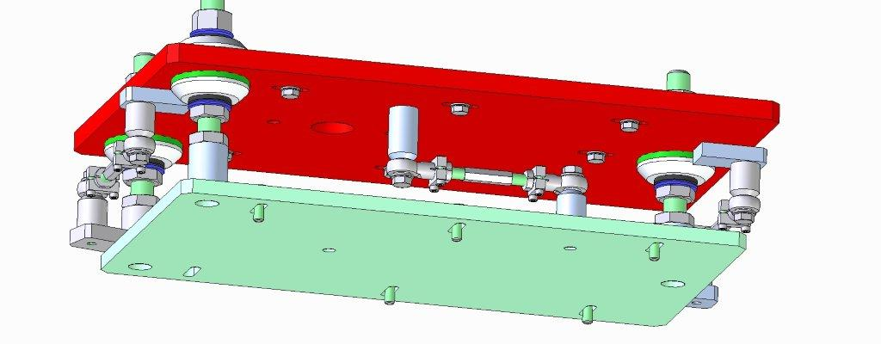
Standard Support | Hanging “Standard Support”
Standard adjustment unit
Developed for PETRA 1 by Gerhard Meyer, MPL (’70th)
3 point support (adjustable)
3 adjustment rods (turnbuckle style)
Securing bolds (Kippsicherung)
➔ Precise, fast, economical adjustment
We stick to it when ever possible!
1. Idea:
Adjustment unit turned 180°
Designed and ordered a prototype for XQK (2t)
Test setup

Slide 7
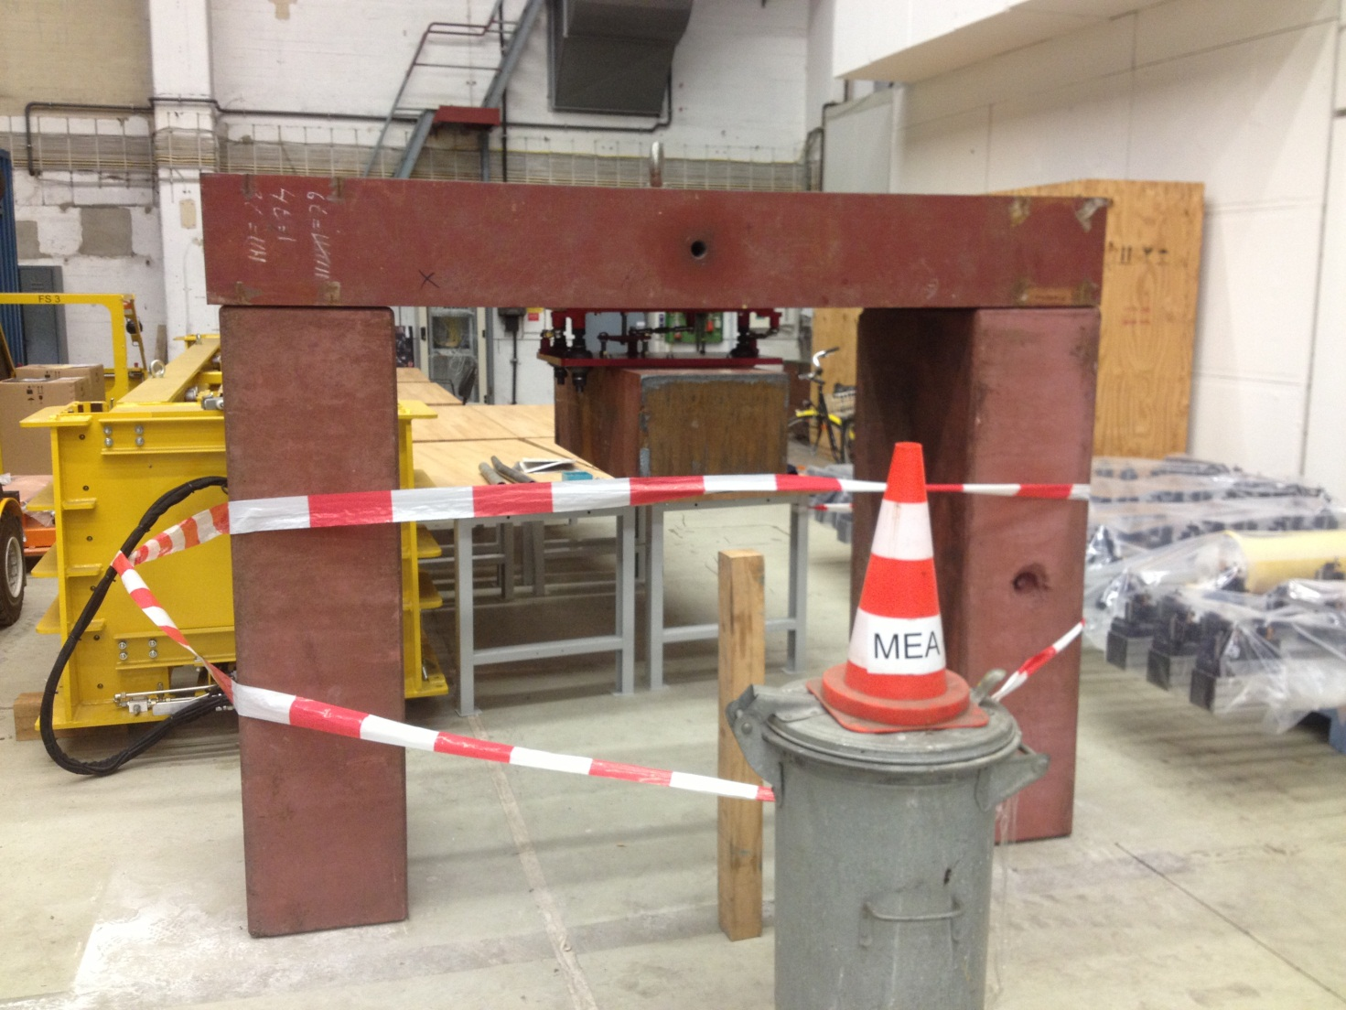
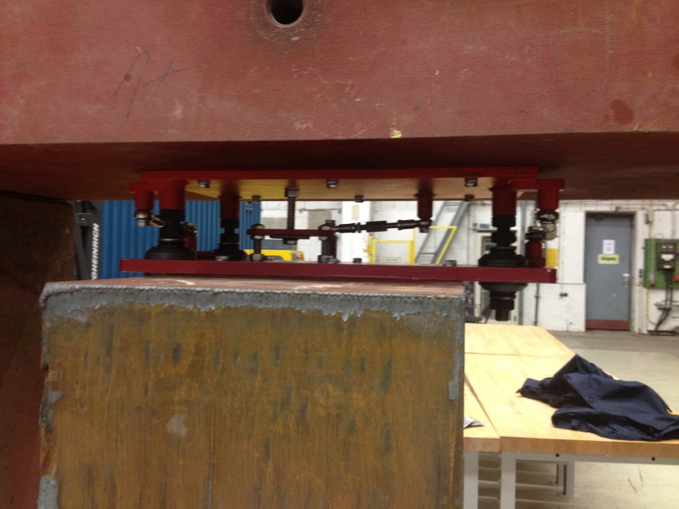
Test Setup Hanging “Standard Support”
Result:
Handling: OK
Adjustment OK
Two standard solutions available
Choose what fits best the needs

Slide 8
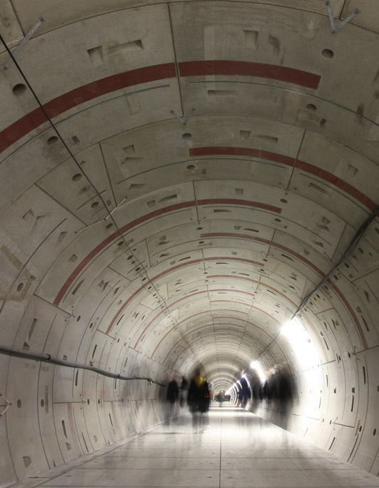
In-casted Steel Plates in XTL Tunnel
Picture from wrong location! Sorry!

Slide 9
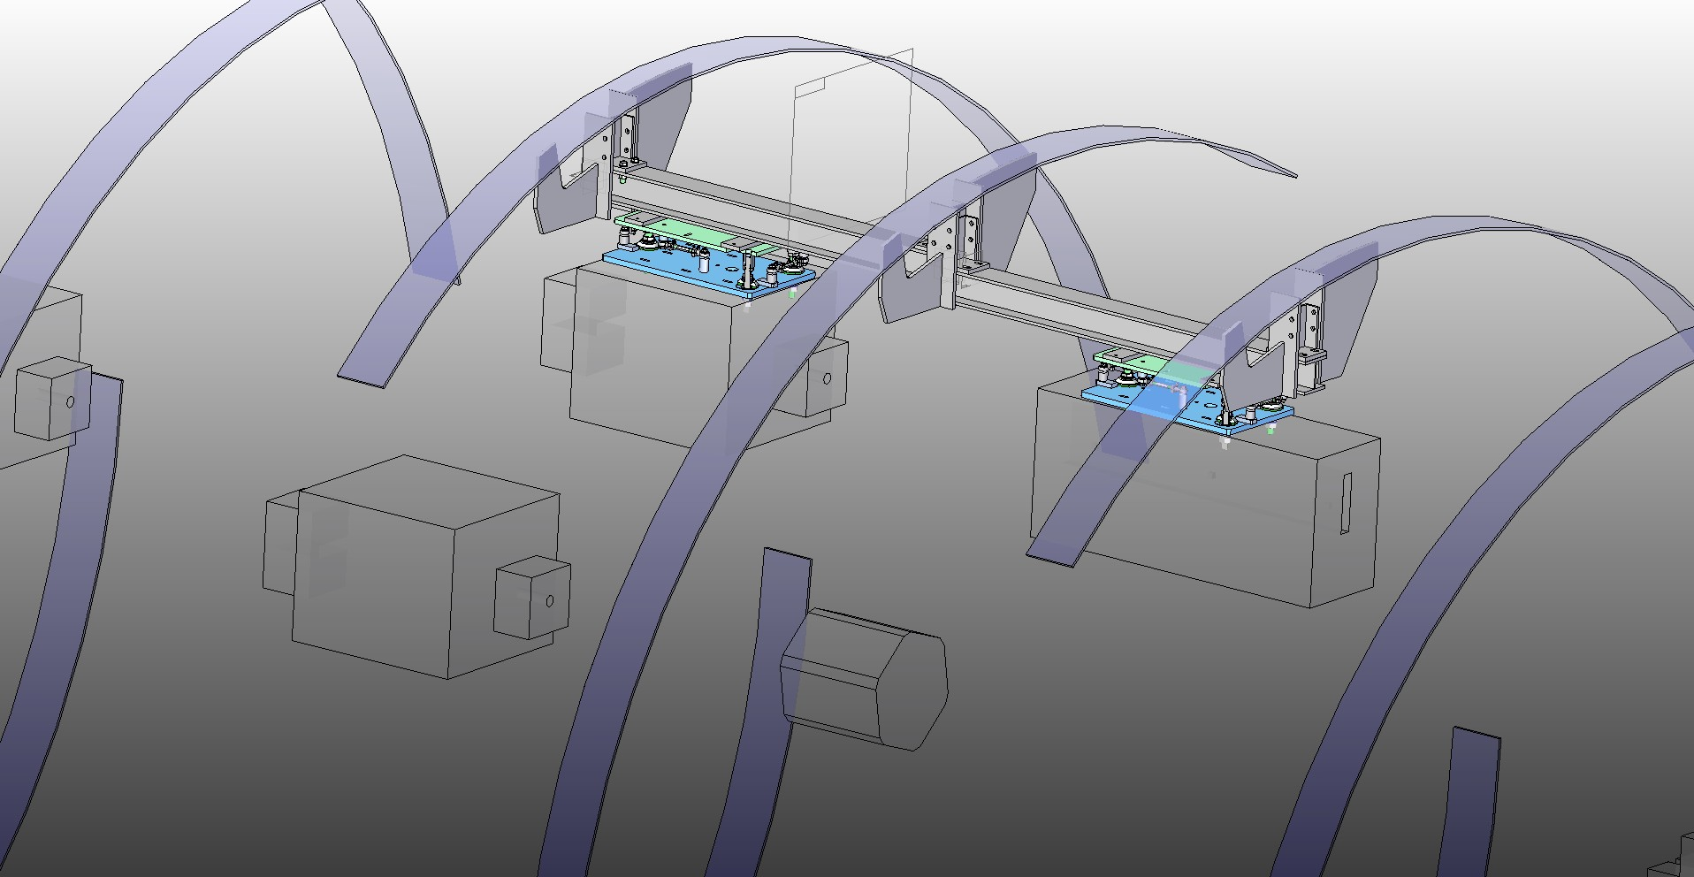
In-casted Steel Plates in XTL Tunnel (modeled)
iso_Einzelaufhaengung
At the end of the XTL +/- 45º contracted

Slide 10
Variant 1: Simple Suspension
iso_Einzelaufhaengung

Slide 11
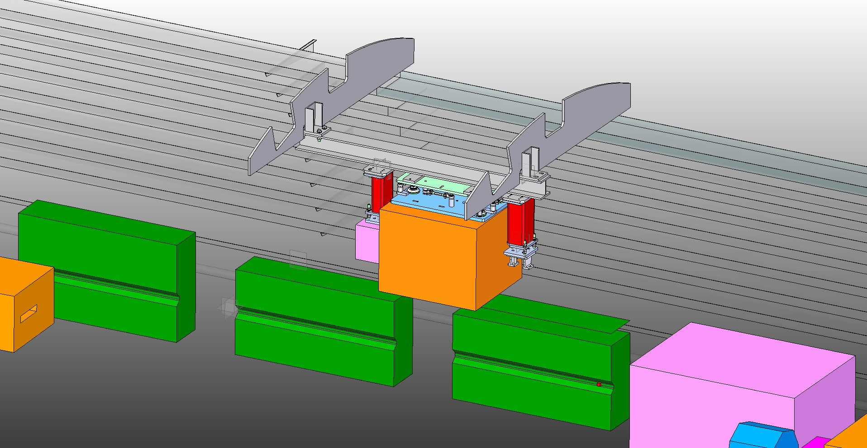
Variant 1: Simple Suspension
Strahl_rechts_KompGruppe_Bearing

Slide 12
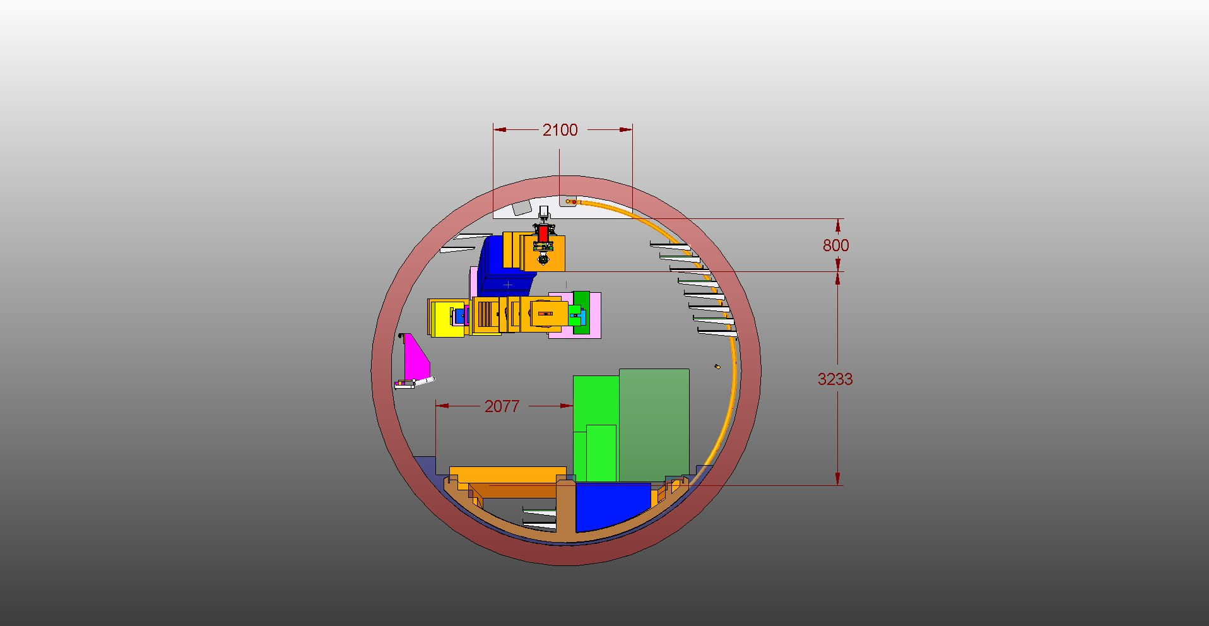
Variant 1: Simple Suspension
Frontal

Slide 13
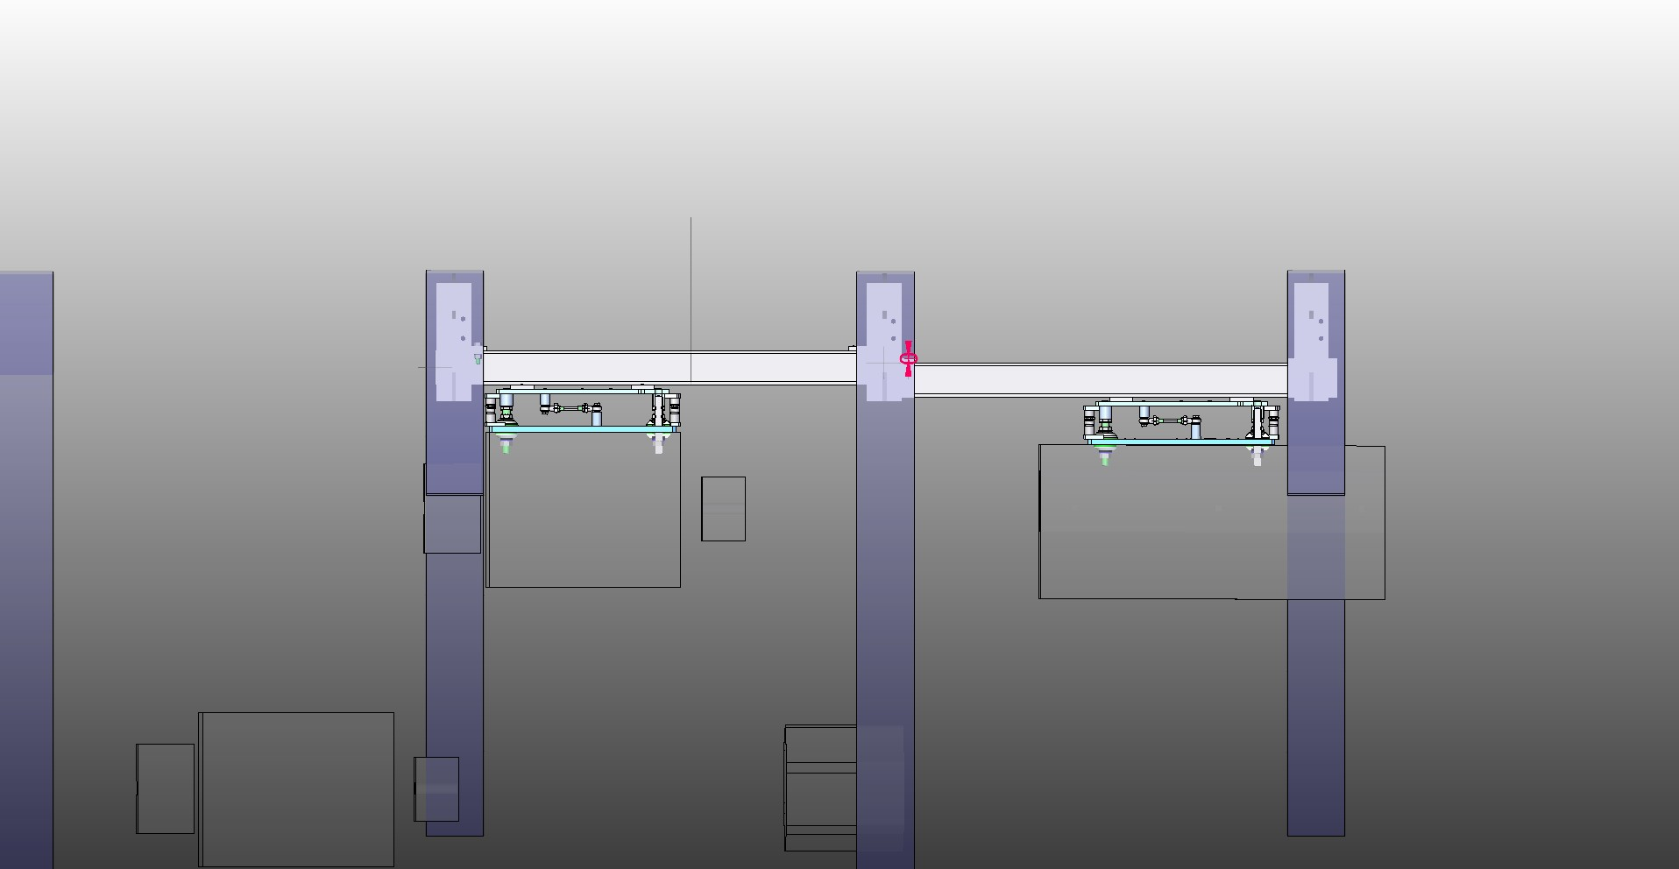
Variant 1: Simple Suspension
Strahl_rechts_Einzelaufhaengung

Slide 14
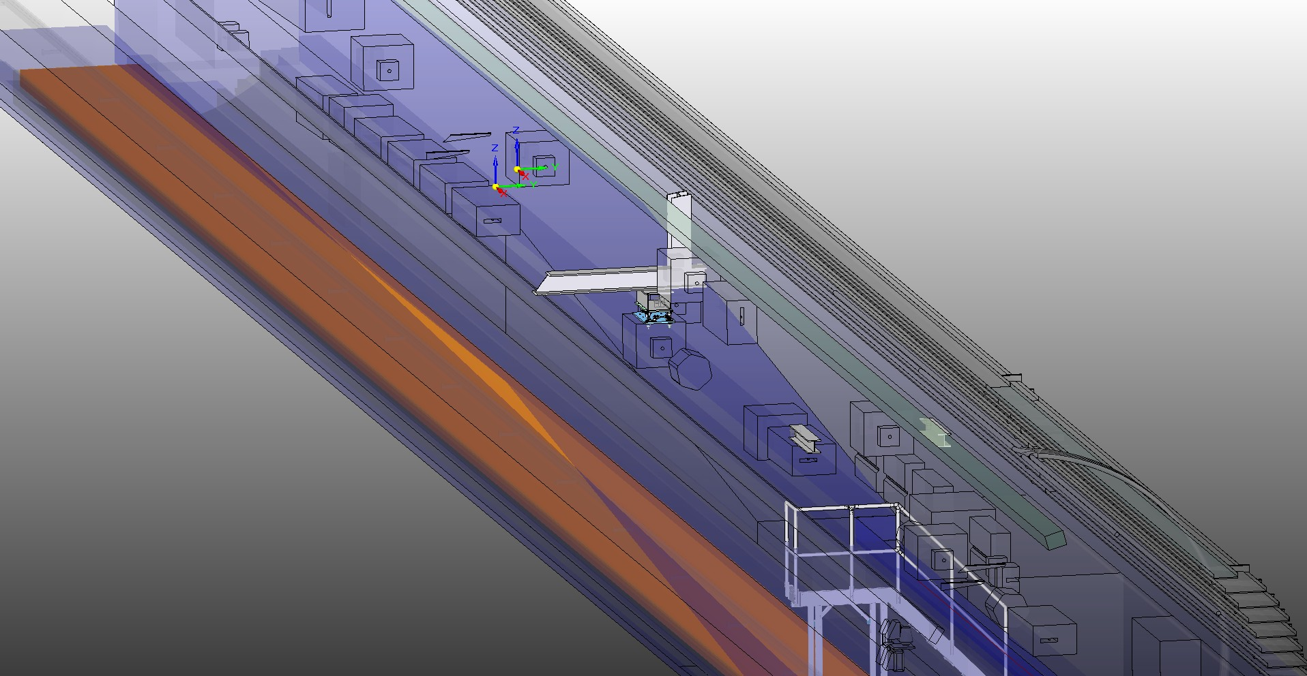
Variant 2a: Single Suspender (w/ cross beam)
iso

Slide 15
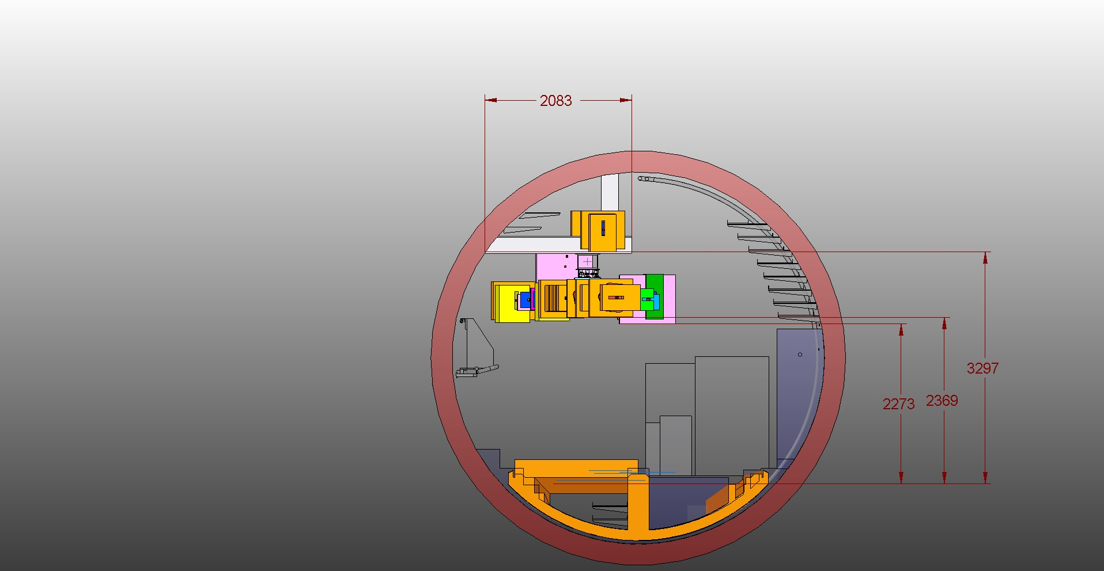
Variant 2a: Single Suspender (w/ cross beam)
in_Strahlrichtung

Slide 16
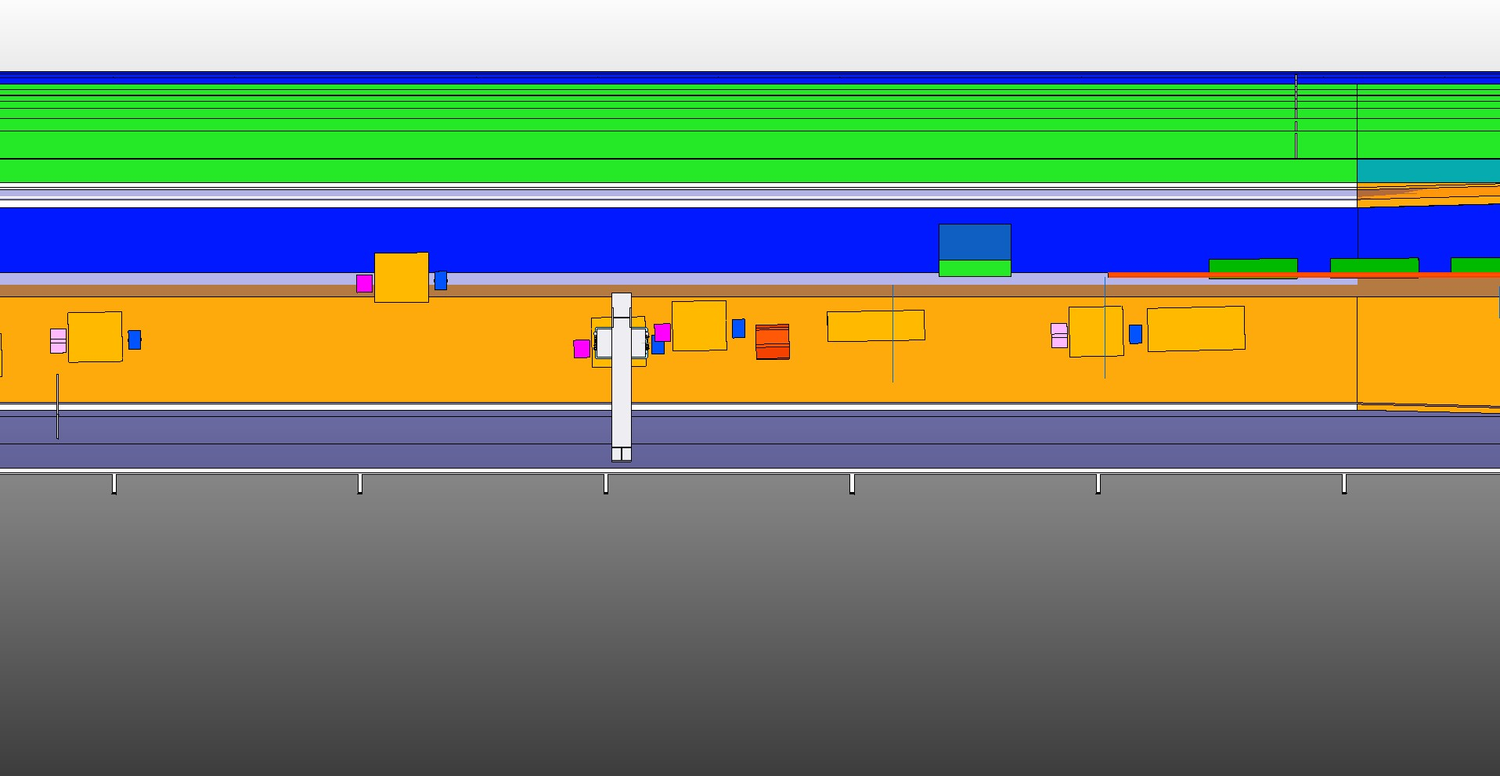
Variant 2a: Single Suspender (w/ cross beam)
Draufsicht

Slide 17
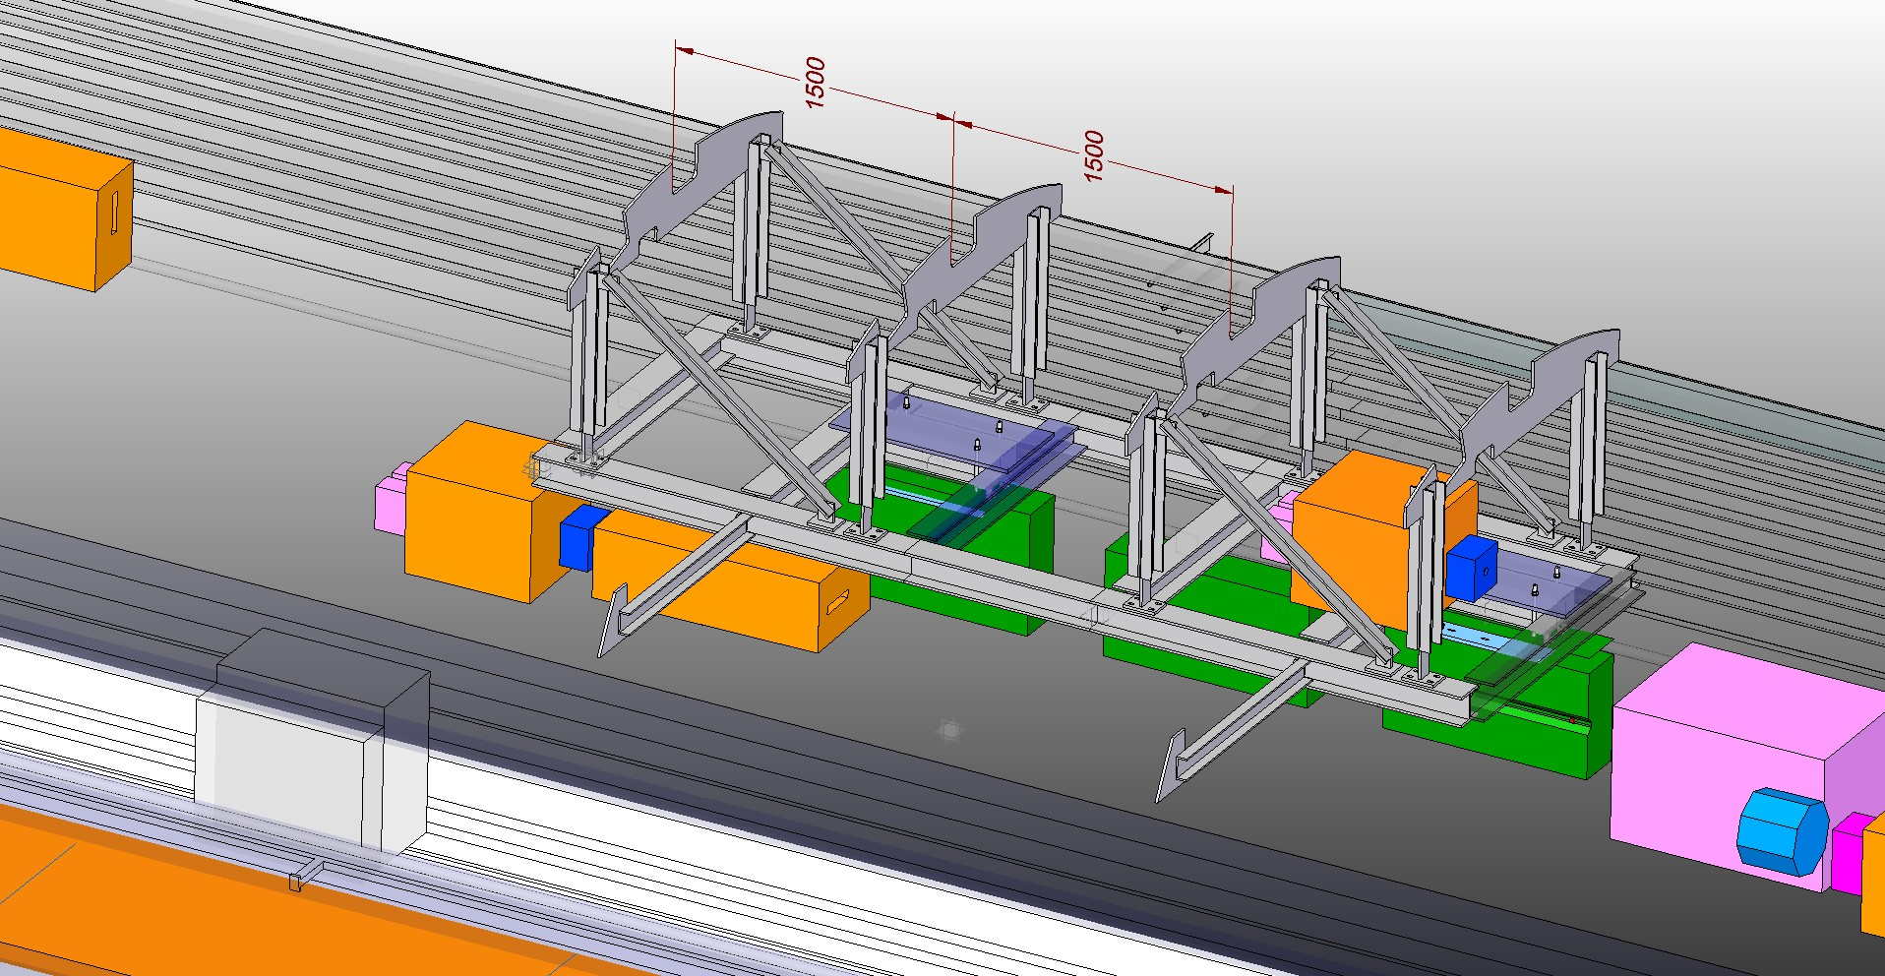
Variant 2b: Double Suspender (w/ cross beam)
Iso_mit2_Gestellen

Slide 18
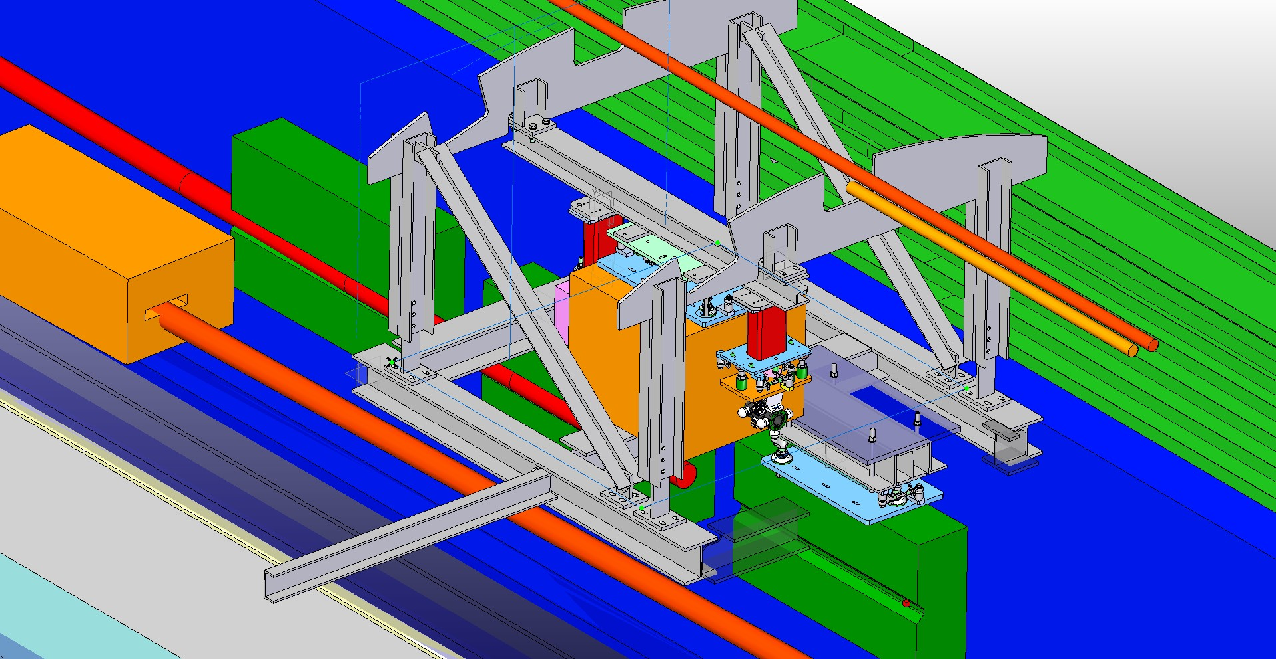
Variant 2b: Double Suspender (w/ cross beam)
Iso_Schnitt

Slide 19
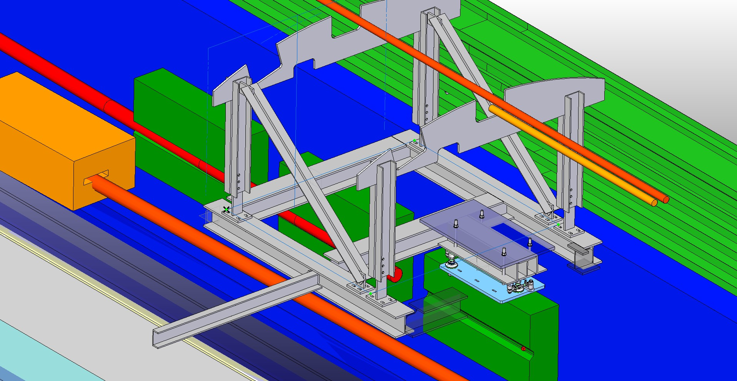
Variant 2b: Double Suspender (w/ cross beam)
Iso_Schnitt_ohne TDL

Slide 20
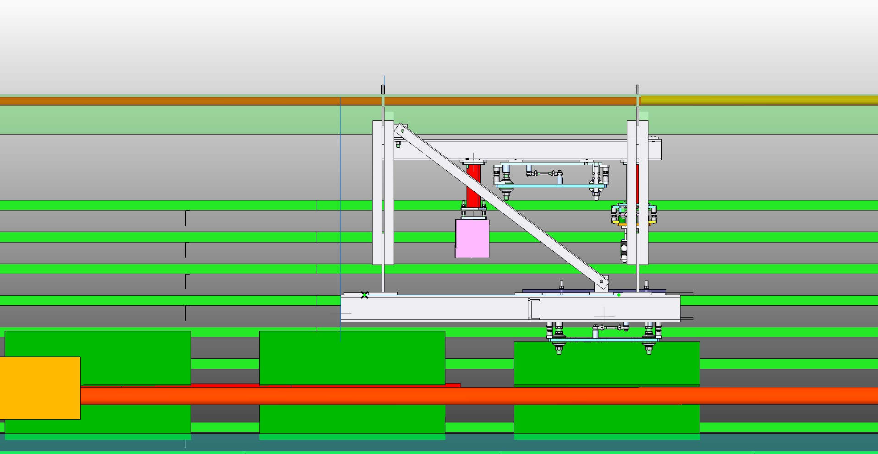
Variant 2b: Double Suspender (w/ cross beam)
Strahl_von_rechts

Slide 21
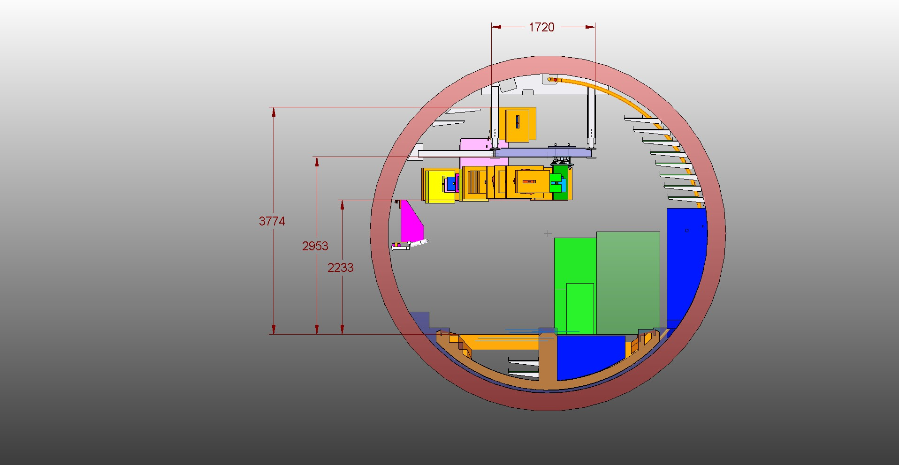
Variant 2b: Double Suspender (w/ cross beam)
Front_in Strahlrichtung

Slide 22
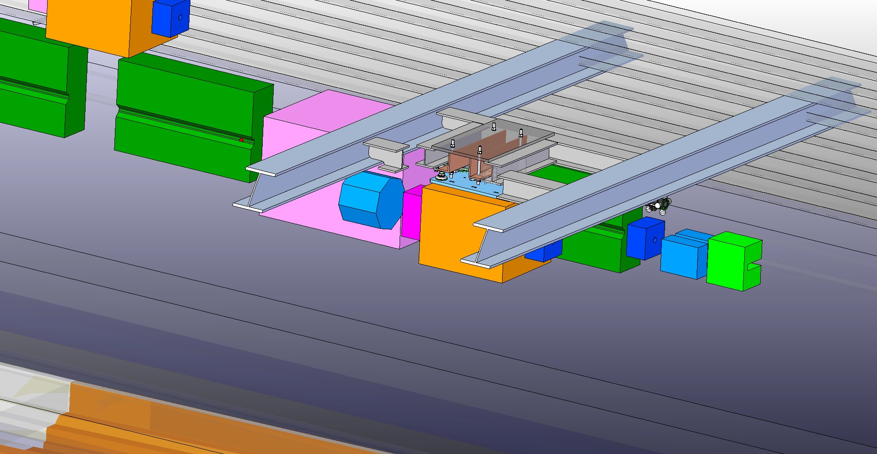
Variant 2c: Cross beam w/o suspender
Iso_Schnitt2
Cons: Cable trays would have to be modified

Slide 23
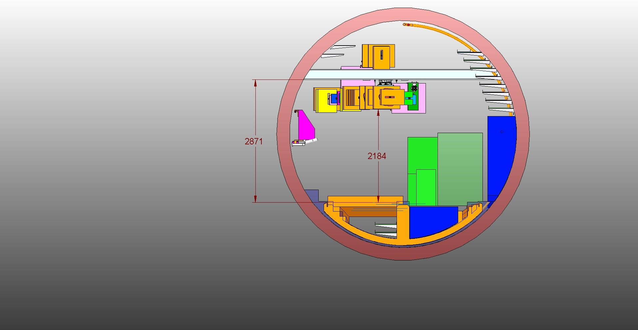
Variant 2c: Cross beam w/o suspender
Front_in Strahlrichtung2
Cons: Cable trays would have to be modified

Slide 24
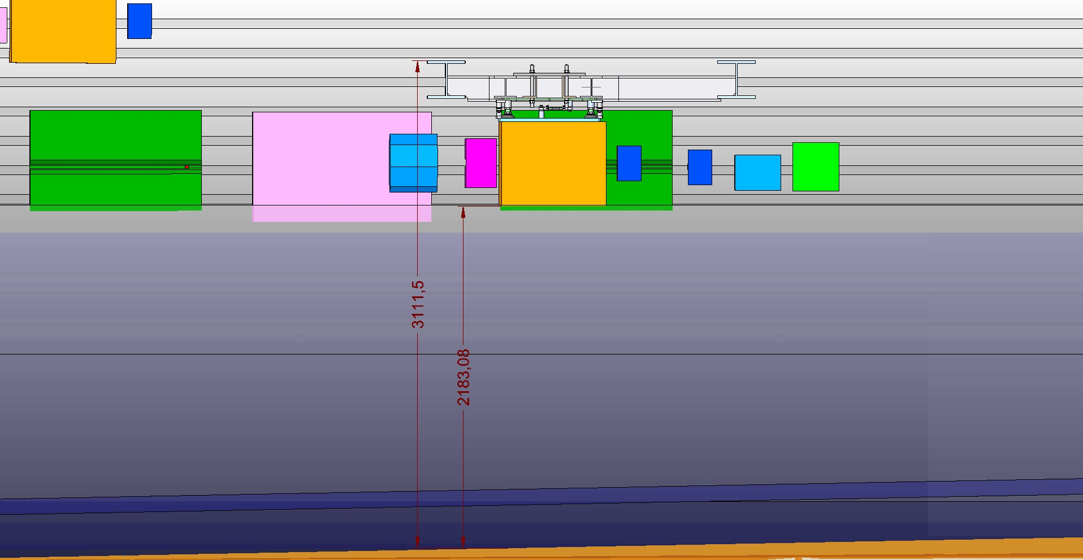
Variant 2c: Cross beam w/o suspender
Strahl von rechts3

Slide 25
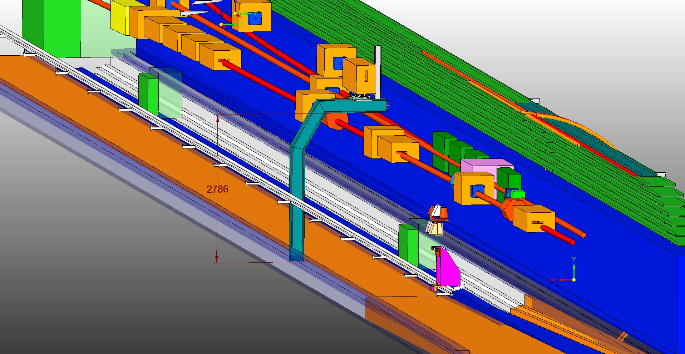
Variant 3a: Cantilever with suspender
ISO_T1_T2_stehend

Slide 26
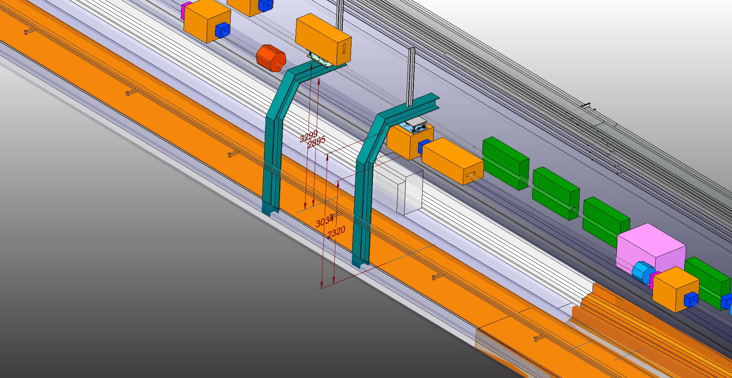
Variant 3a: Cantilever with suspender
ISO_haengend_u_stehen

Slide 27
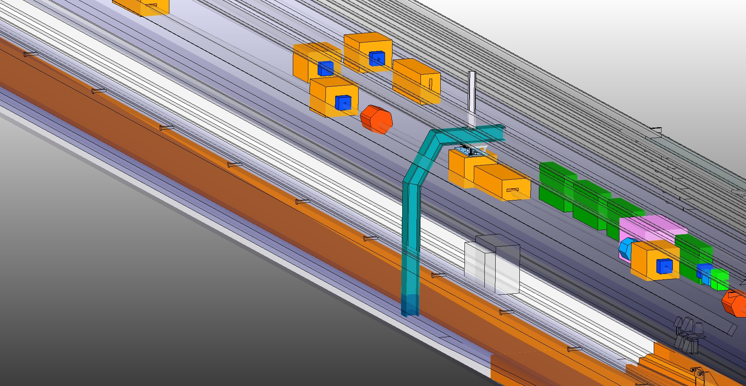
Variant 3a: Cantilever with suspender
ISO_T1_T2_haengend

Slide 28
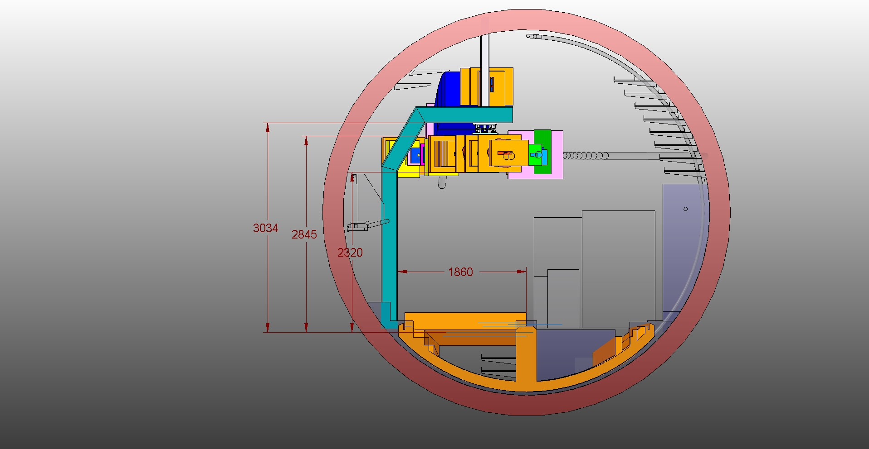
Variant 3a: Cantilever with suspender
Frontal_T1_T2_haengend

Slide 29
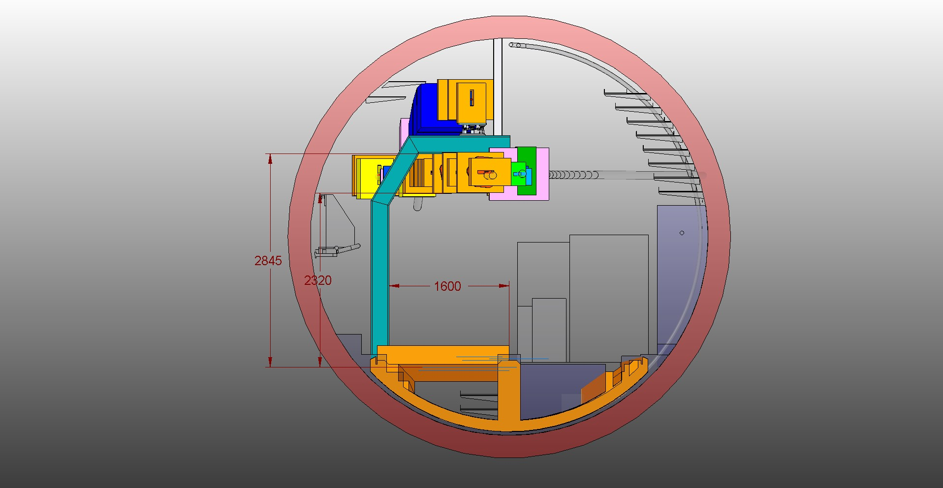
Variant 3a: Cantilever with suspender
Frontal_T1_T2_stehend

Slide 30
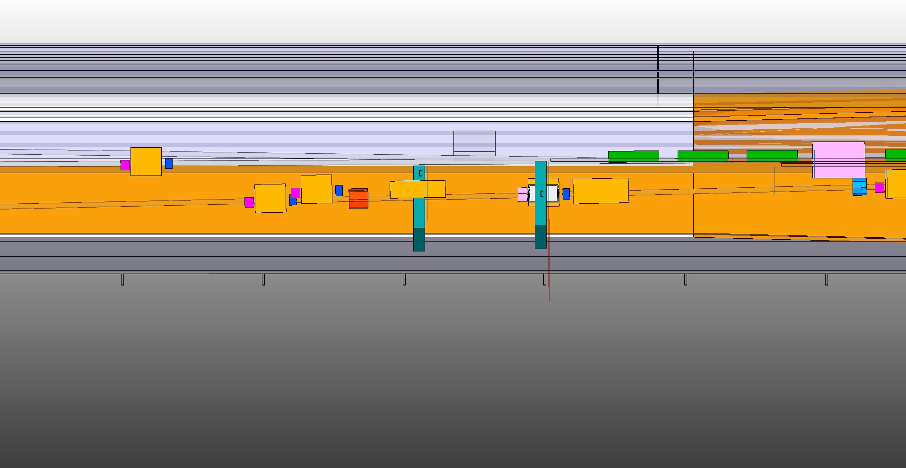
Variant 3a: Cantilever with suspender
Draufsicht_T1_T2_haengend_u_stehend

Slide 31
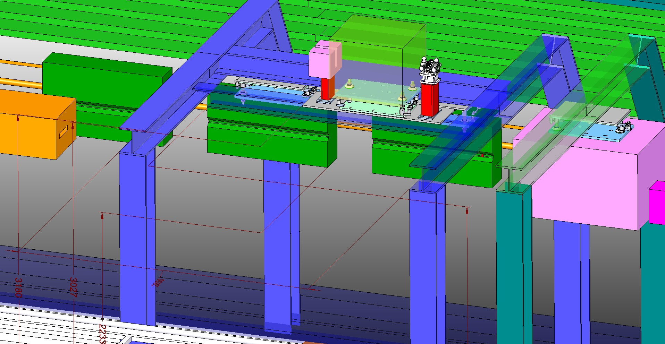
Variant 3b: Gantry w/o suspender
iso2

Slide 32
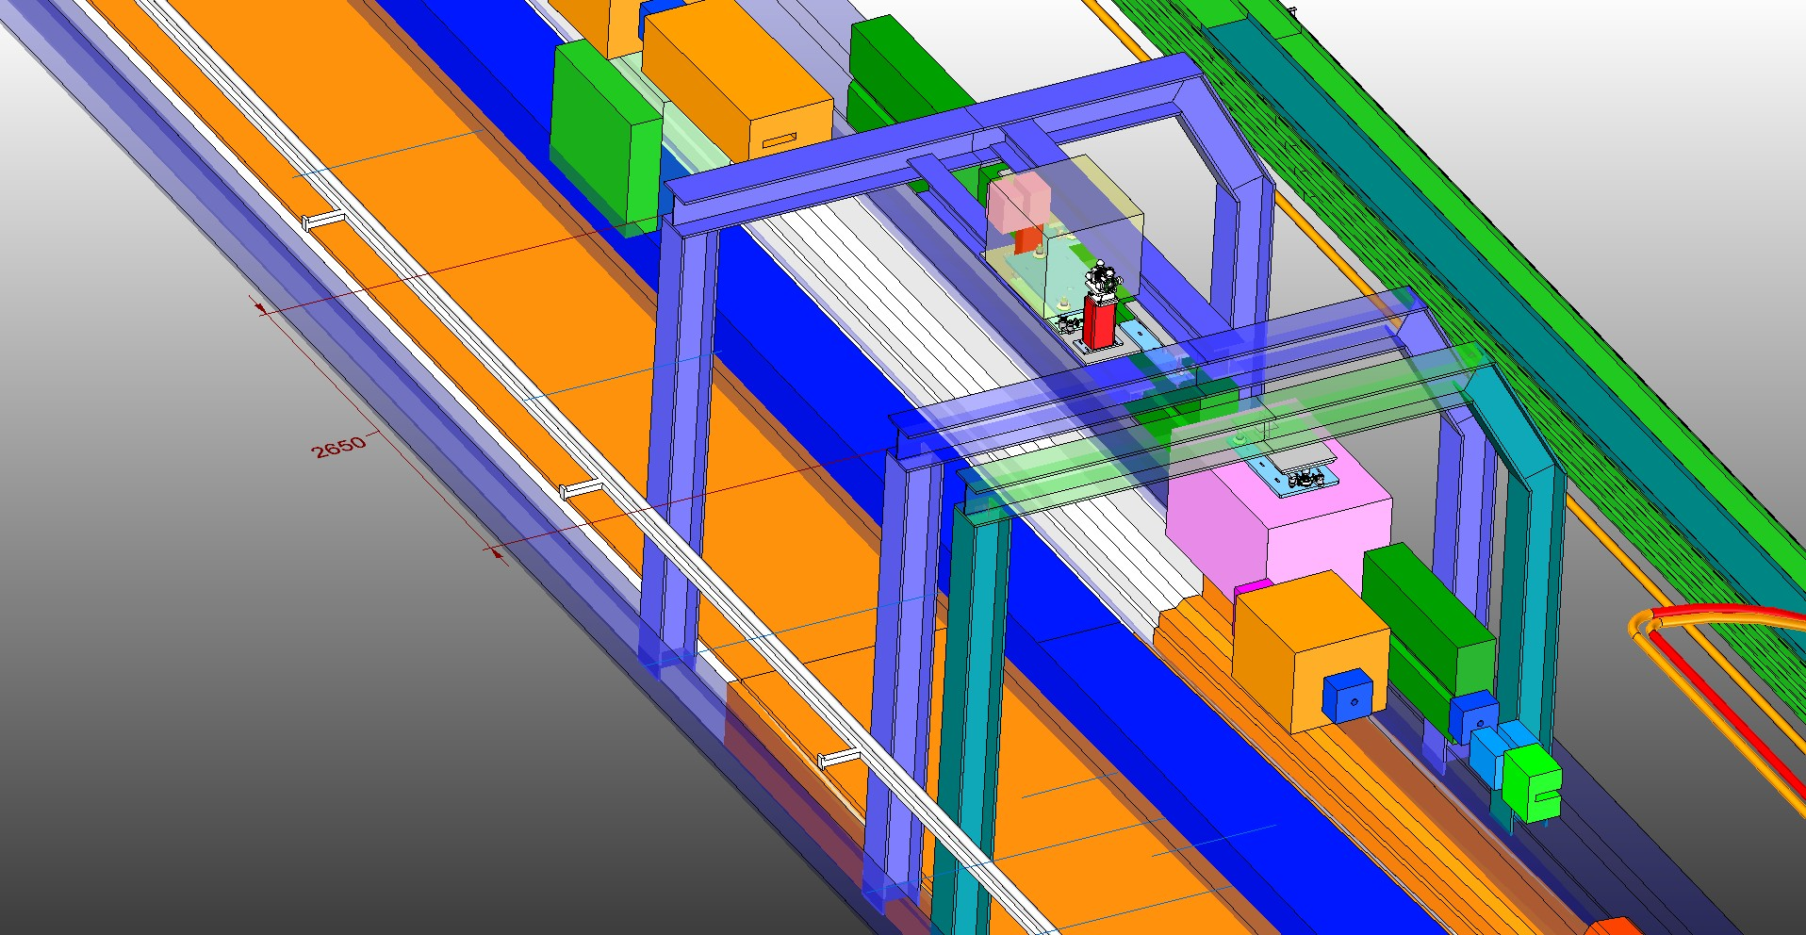
Variant 3b: Gantry w/o suspender
iso3

Slide 33
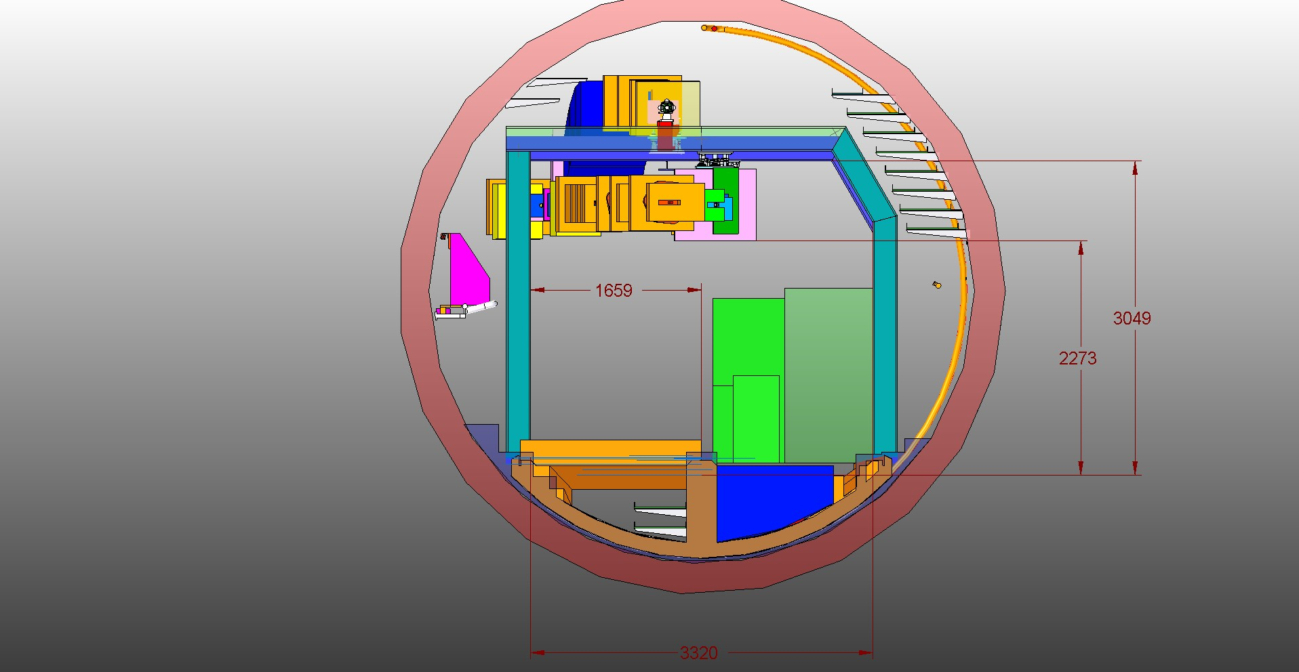
Variant 3b: Gantry w/o suspender
Front_in_Strahl

Slide 34
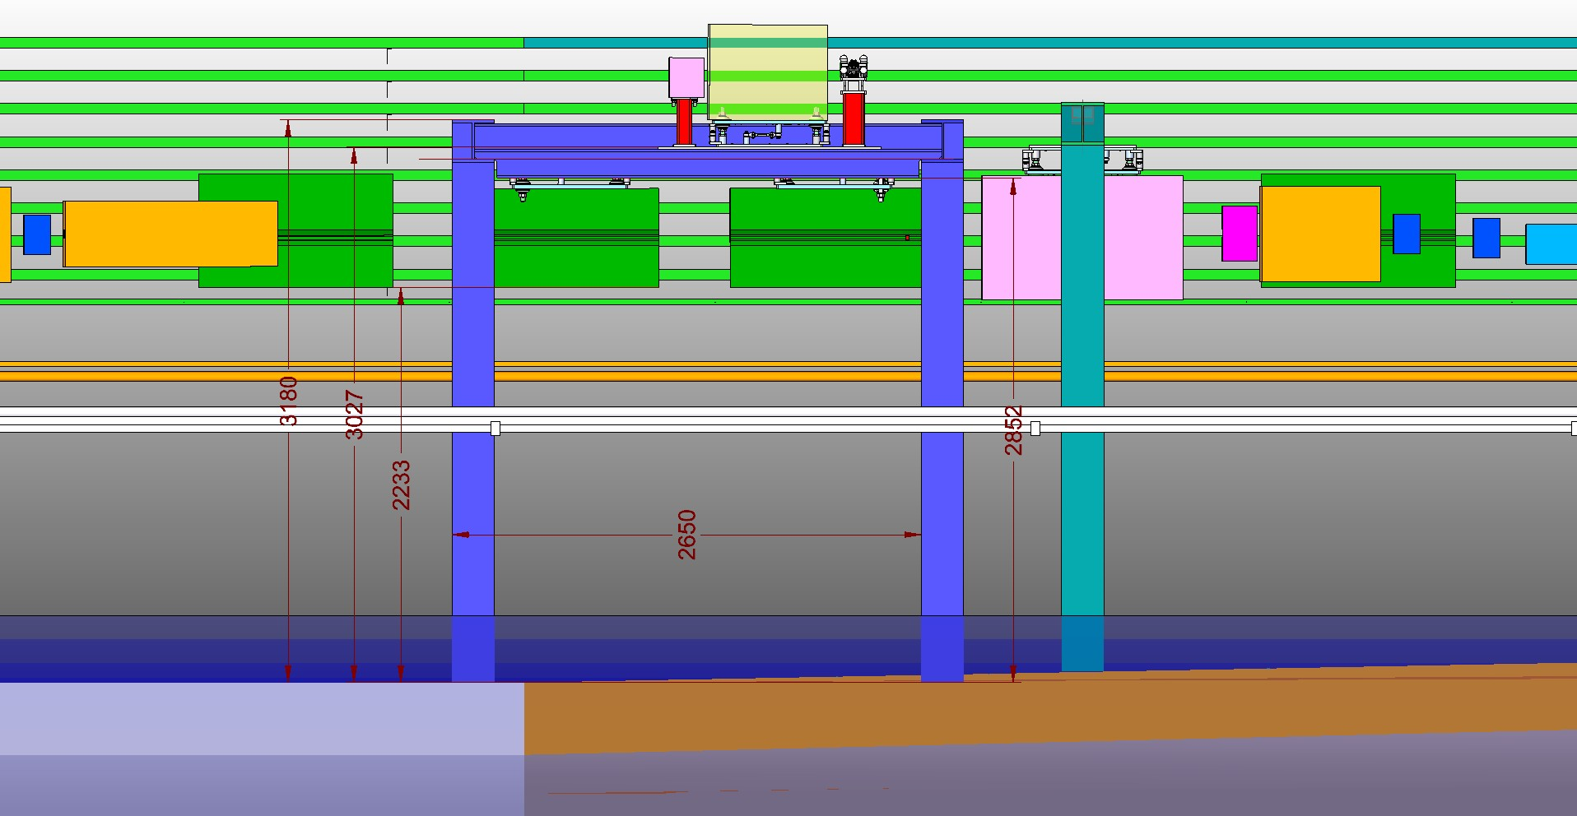
Variant 3b: Gantry w/o suspender
Strahl von rechts

Slide 35
Summary XTL R37-41
Variant | Description | Pros | Cons
1 | Simple Suspension | Magnet Installation | Vibration
2a | Single Suspender | Magnet Installation | Vibration
2b | Double Suspender | Vibration | Magnet Installation
2c | Cross Beam | Vibration | Magnet Installation, Collision w/ cable tray
3a | Cantilever with suspender | Magnet Installation | Vibration, Cross section
3b | Gantry w/o suspender | Vibration | Cross section
We have interesting discussions ahead of us!

Slide 36
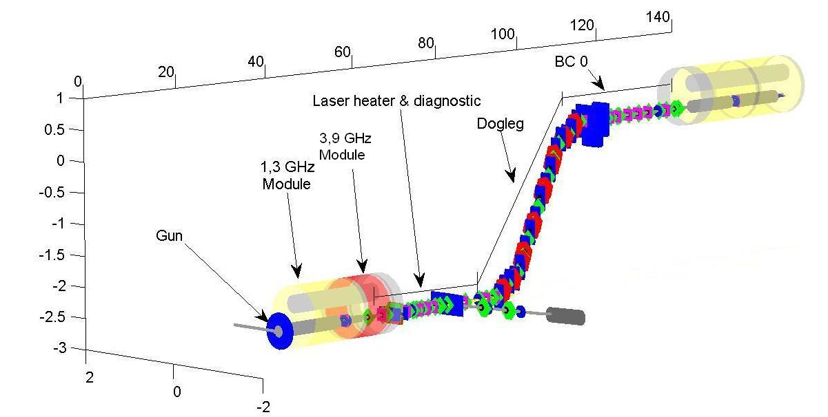
Lattice: Injector (until L1)
L1
4 modules 2 cryo boxes
Laser Beam
Beam Dump

Slide 37
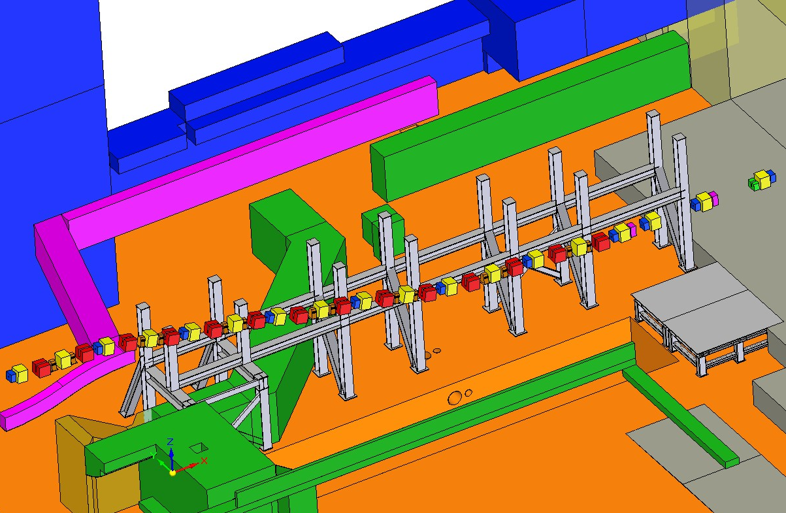
Shaft XSE / Injector dog leg

Slide 38
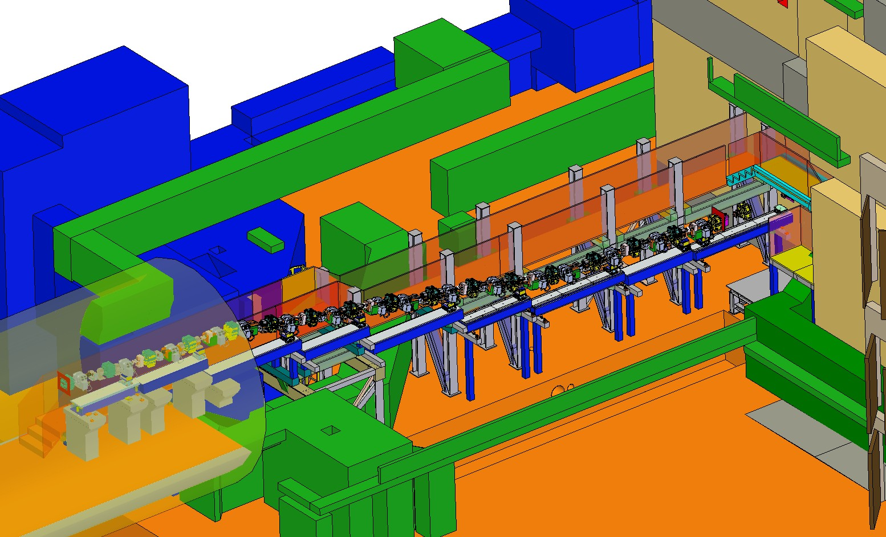
Beam line in XSE | Girder solution
Adapt BC-girder concept (2m/2,8m)
Big steel framework as a base

Slide 39
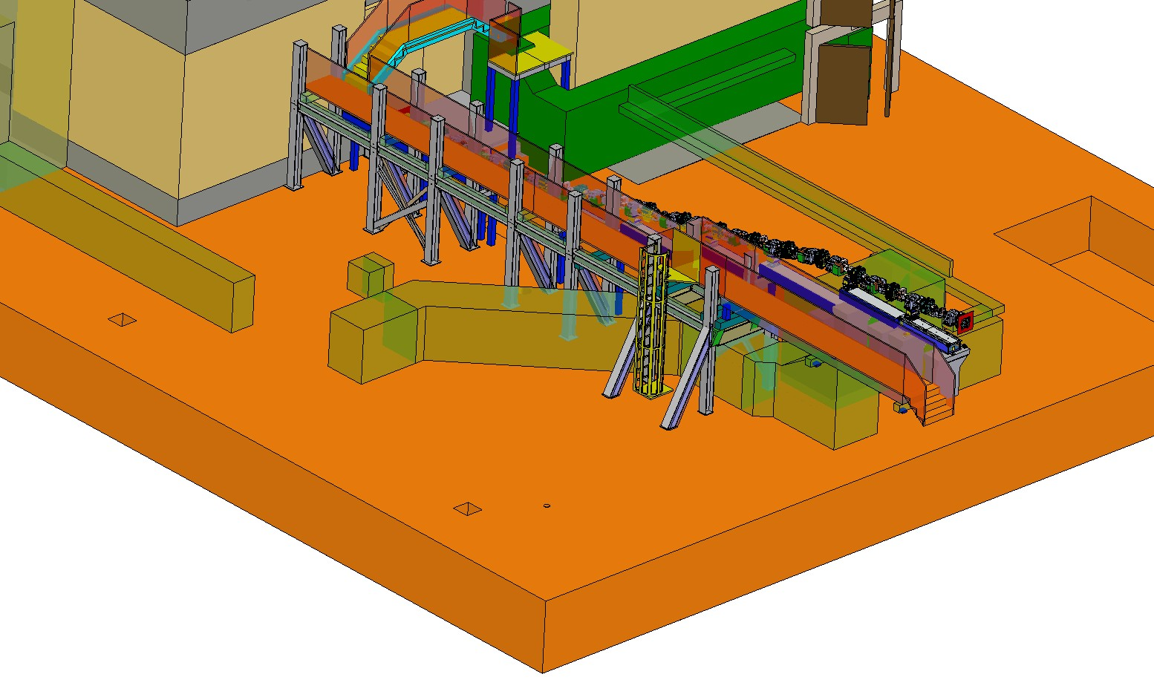
Beam line in XSE | Framework
Tight situation with …
pulse cables
cooling water
optical fibres
Solved after several iterations
1. part installed end Oct.’12
2. part installed mid Nov.’12

Slide 40
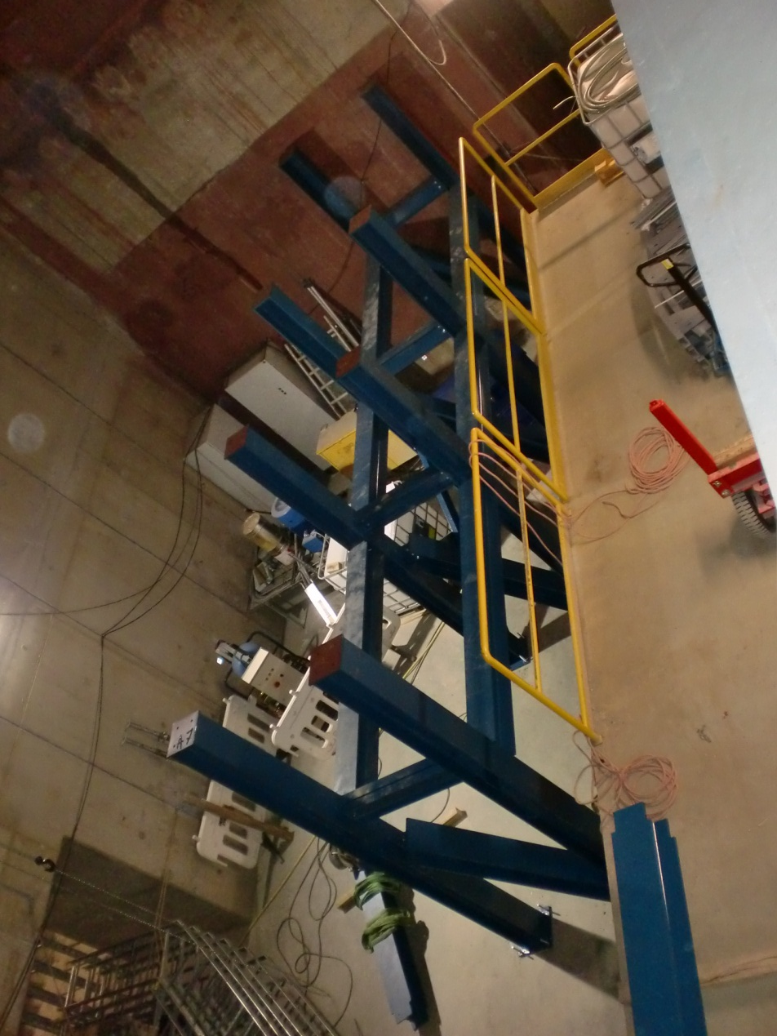
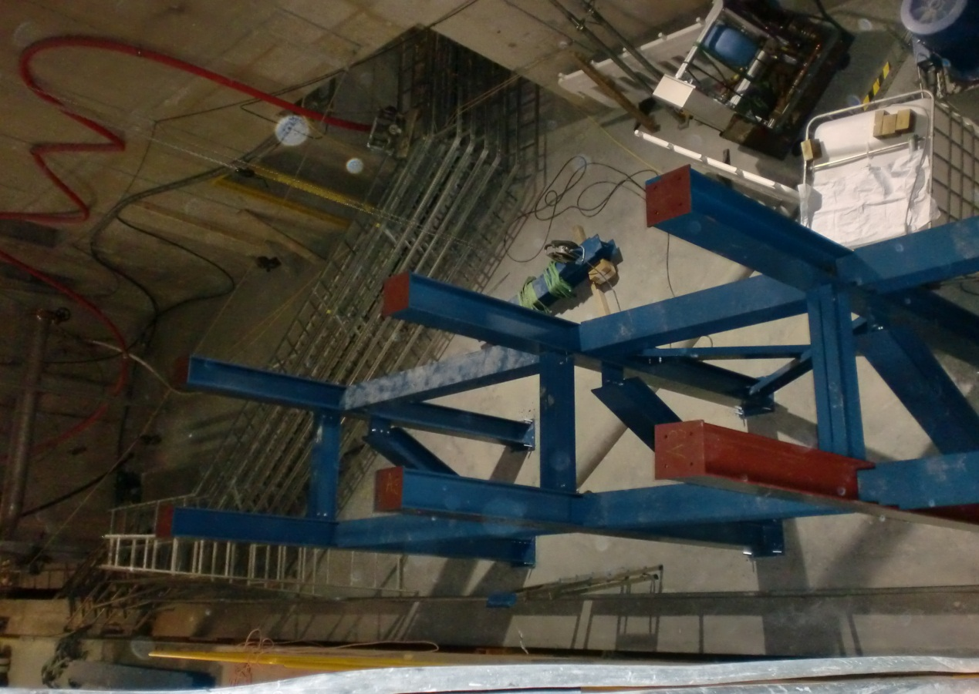
Beam line in XSE | Framework under construction
Oct. 29; 2012

Slide 41
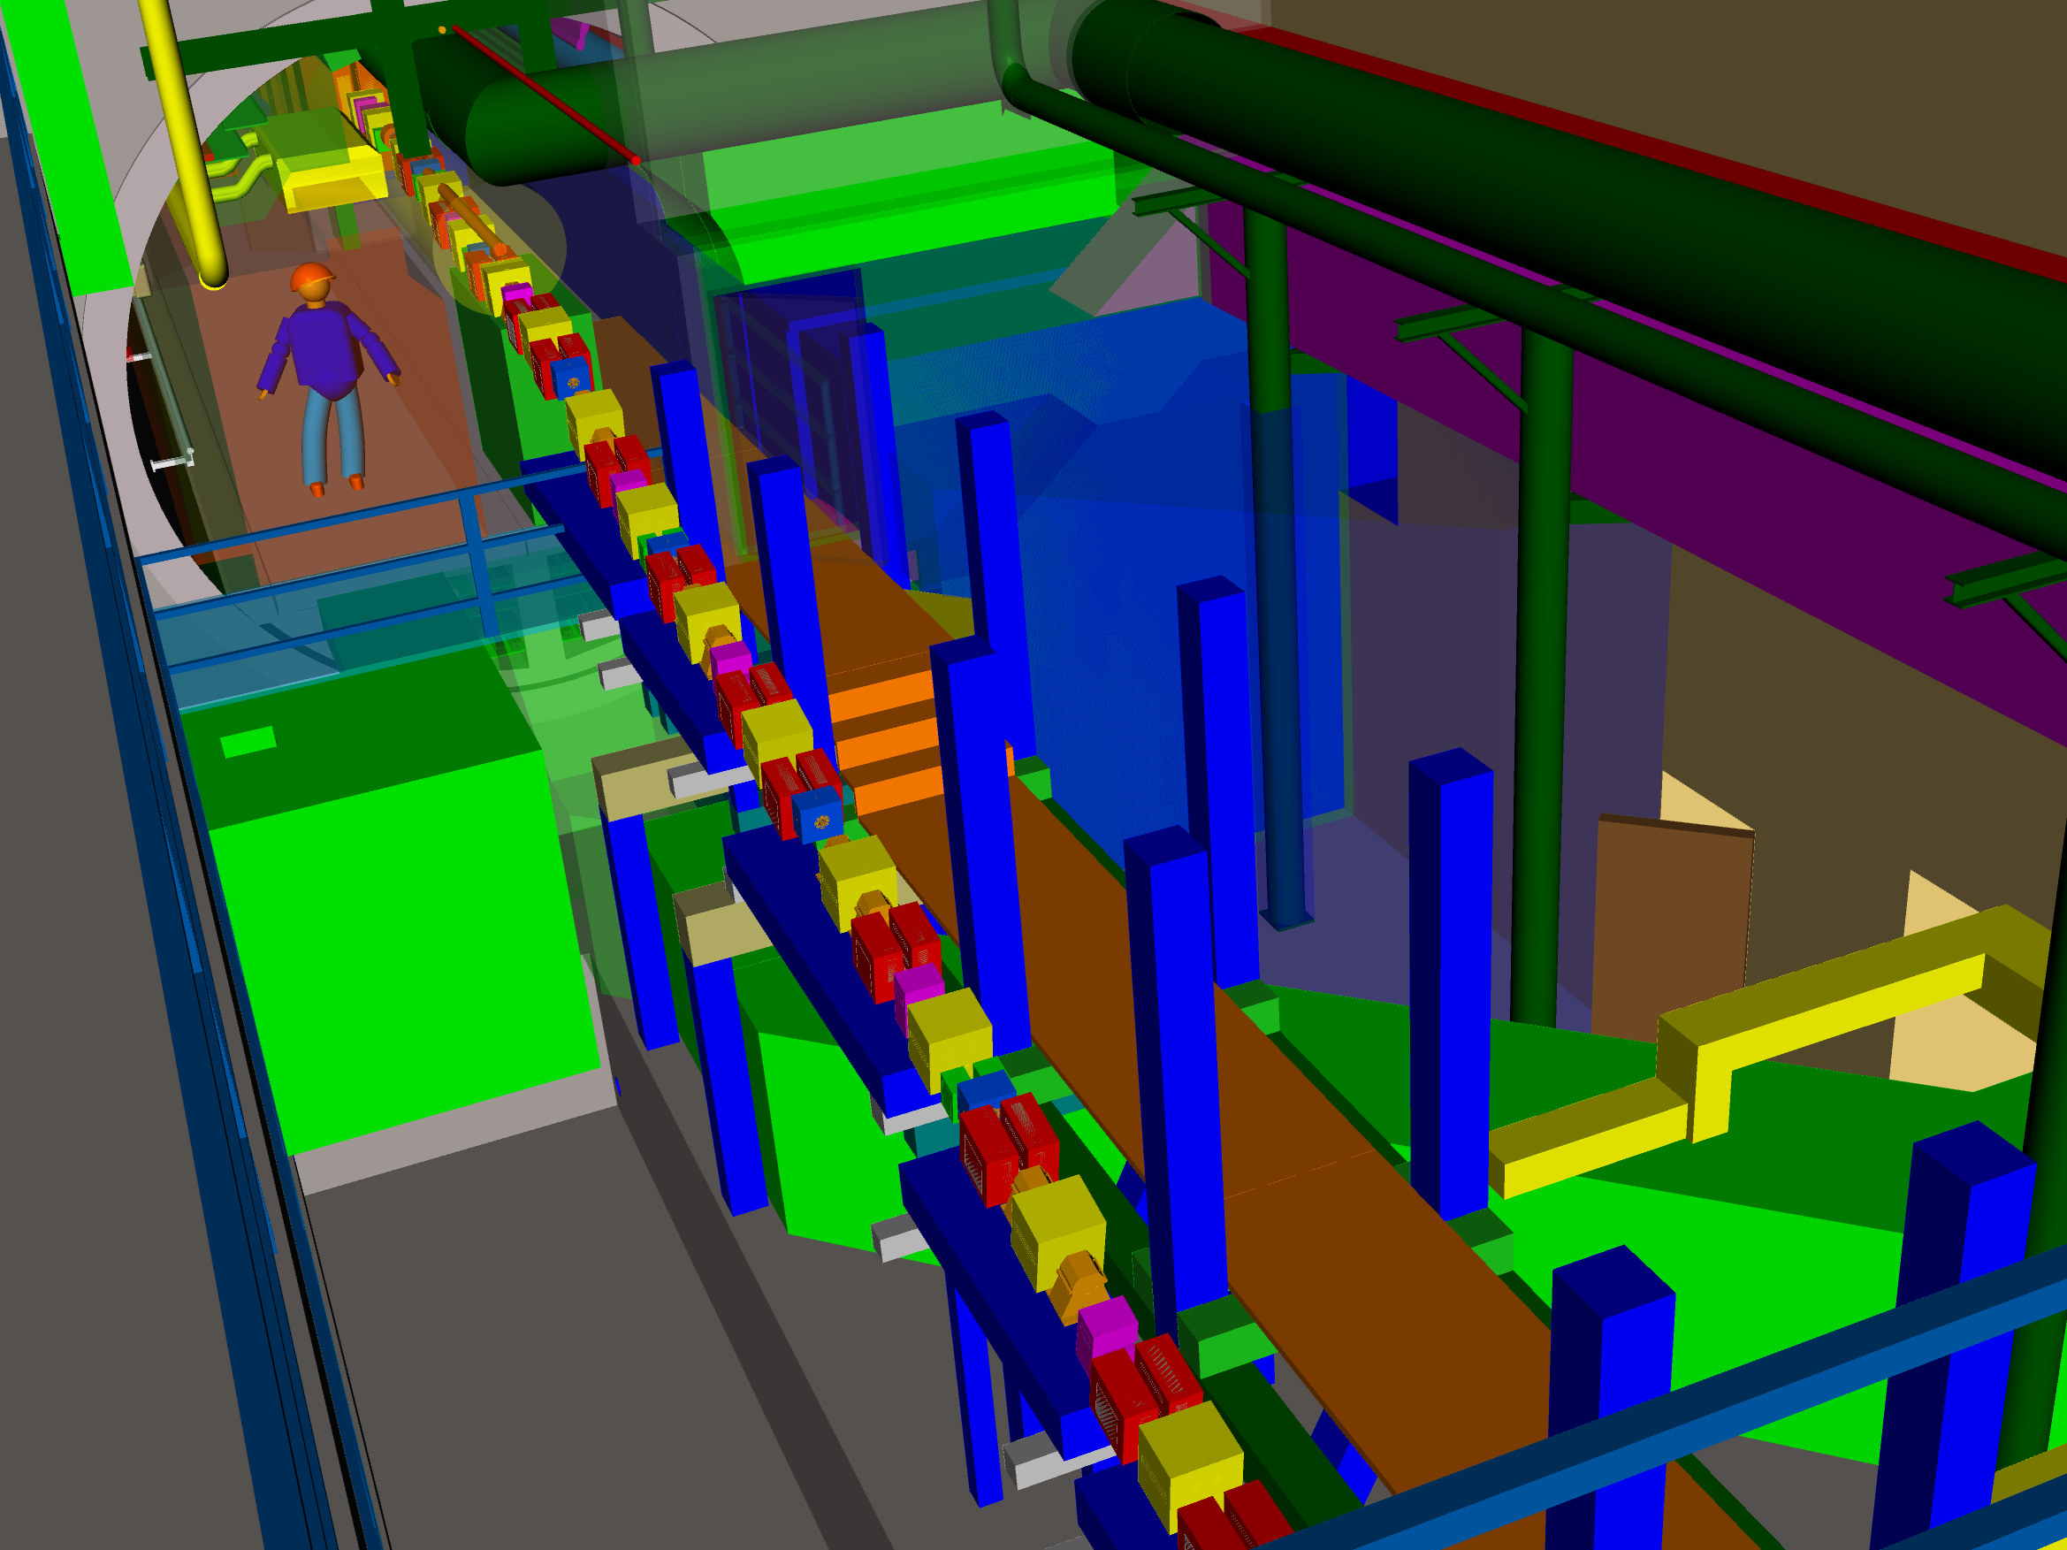
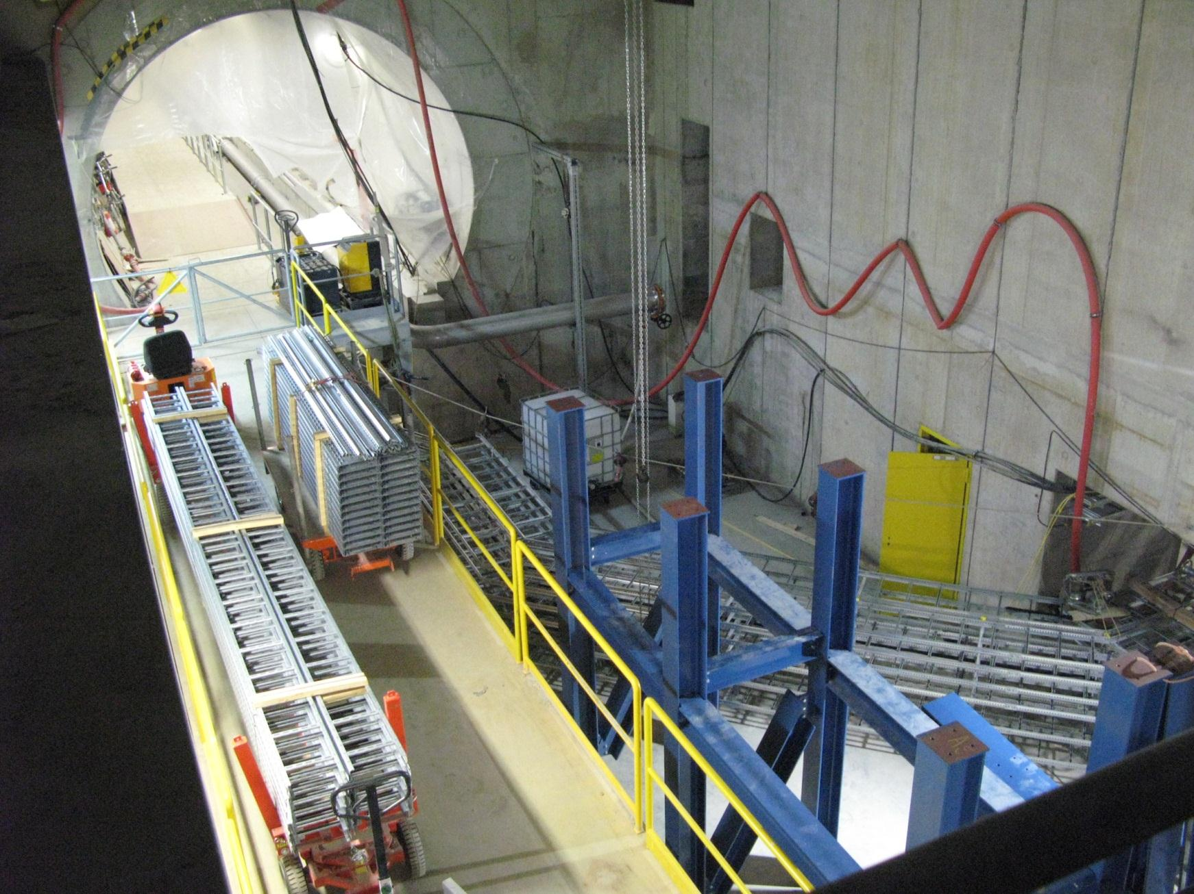
Bottom of XSE Main Shaft (Oct. 2012)

Slide 42
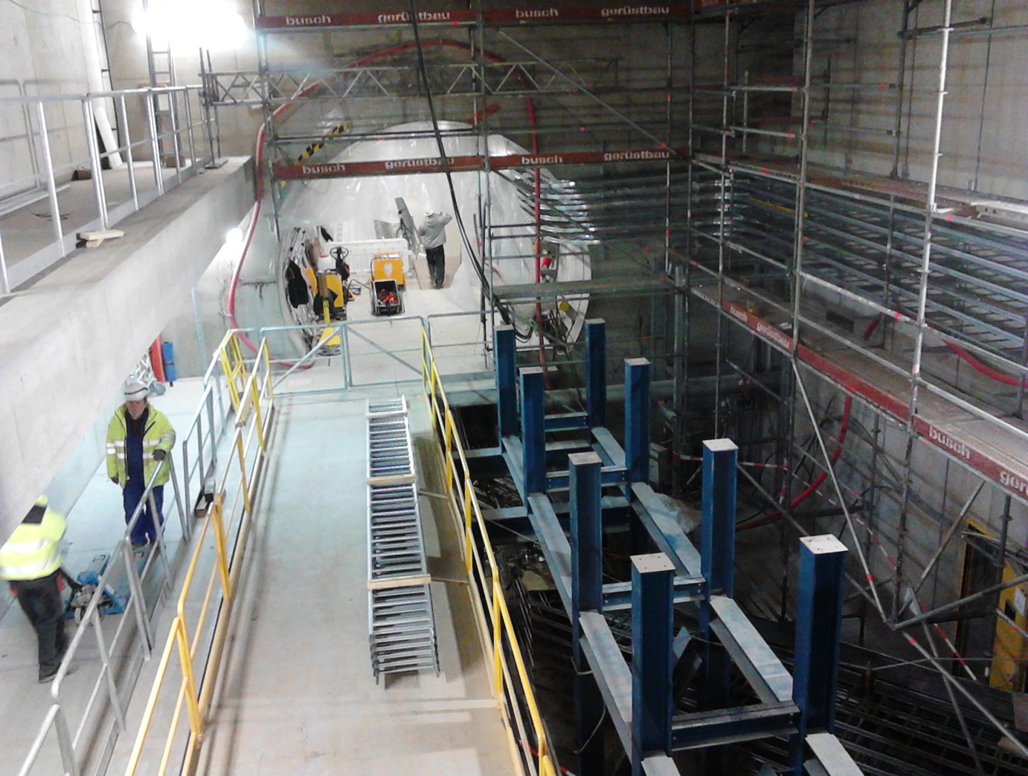
Bottom of XSE Main Shaft (Apr. 2013)

Slide 43
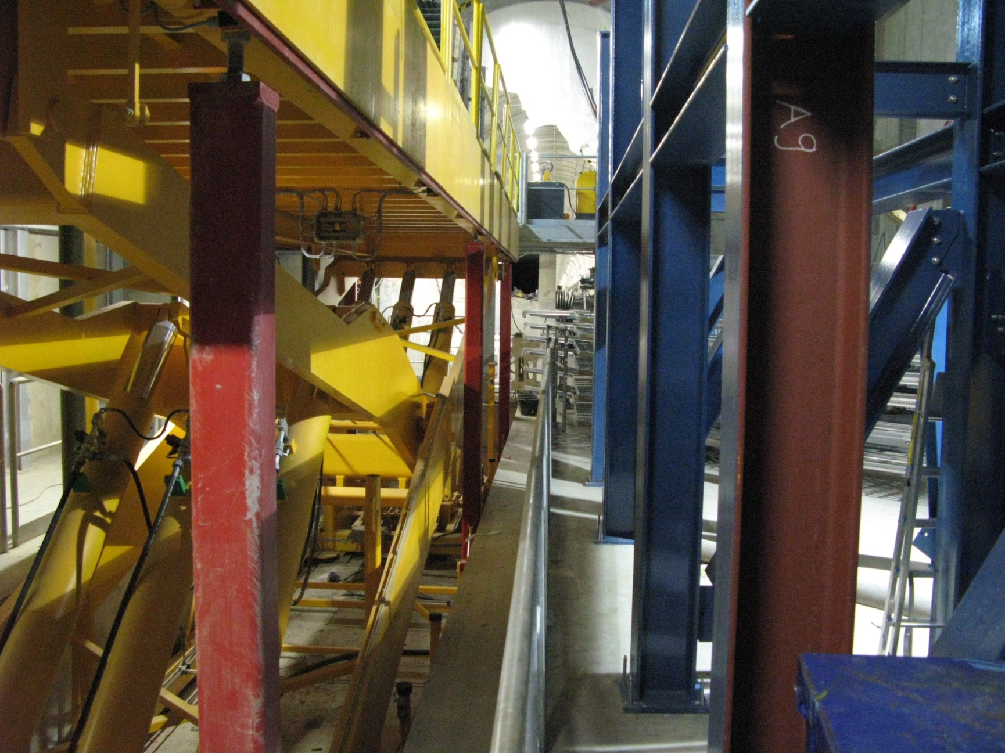
1m Gap for XSE beamline

Slide 44
Beam line in XSE | Next Step
Detailed design of the magnet supports on the girder

Slide 45
End
Thank you for your attention

Slide 46
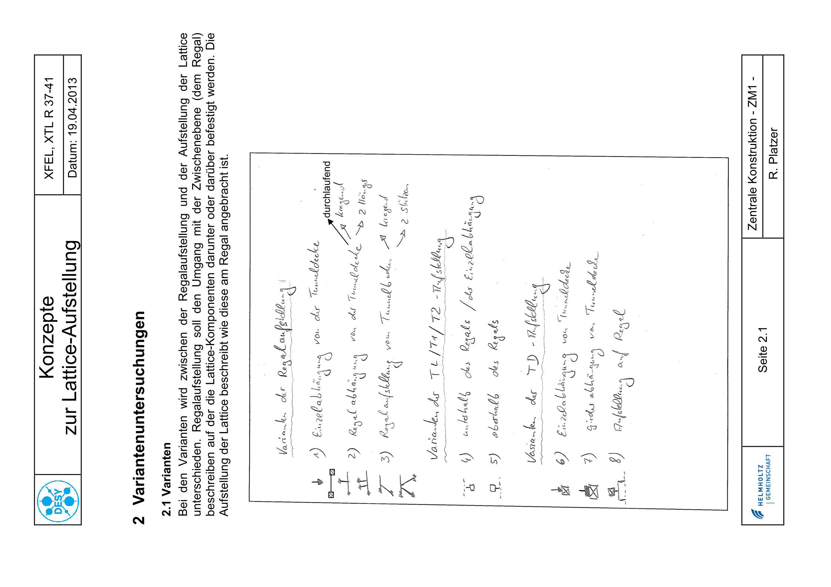
Variants

Slide 47
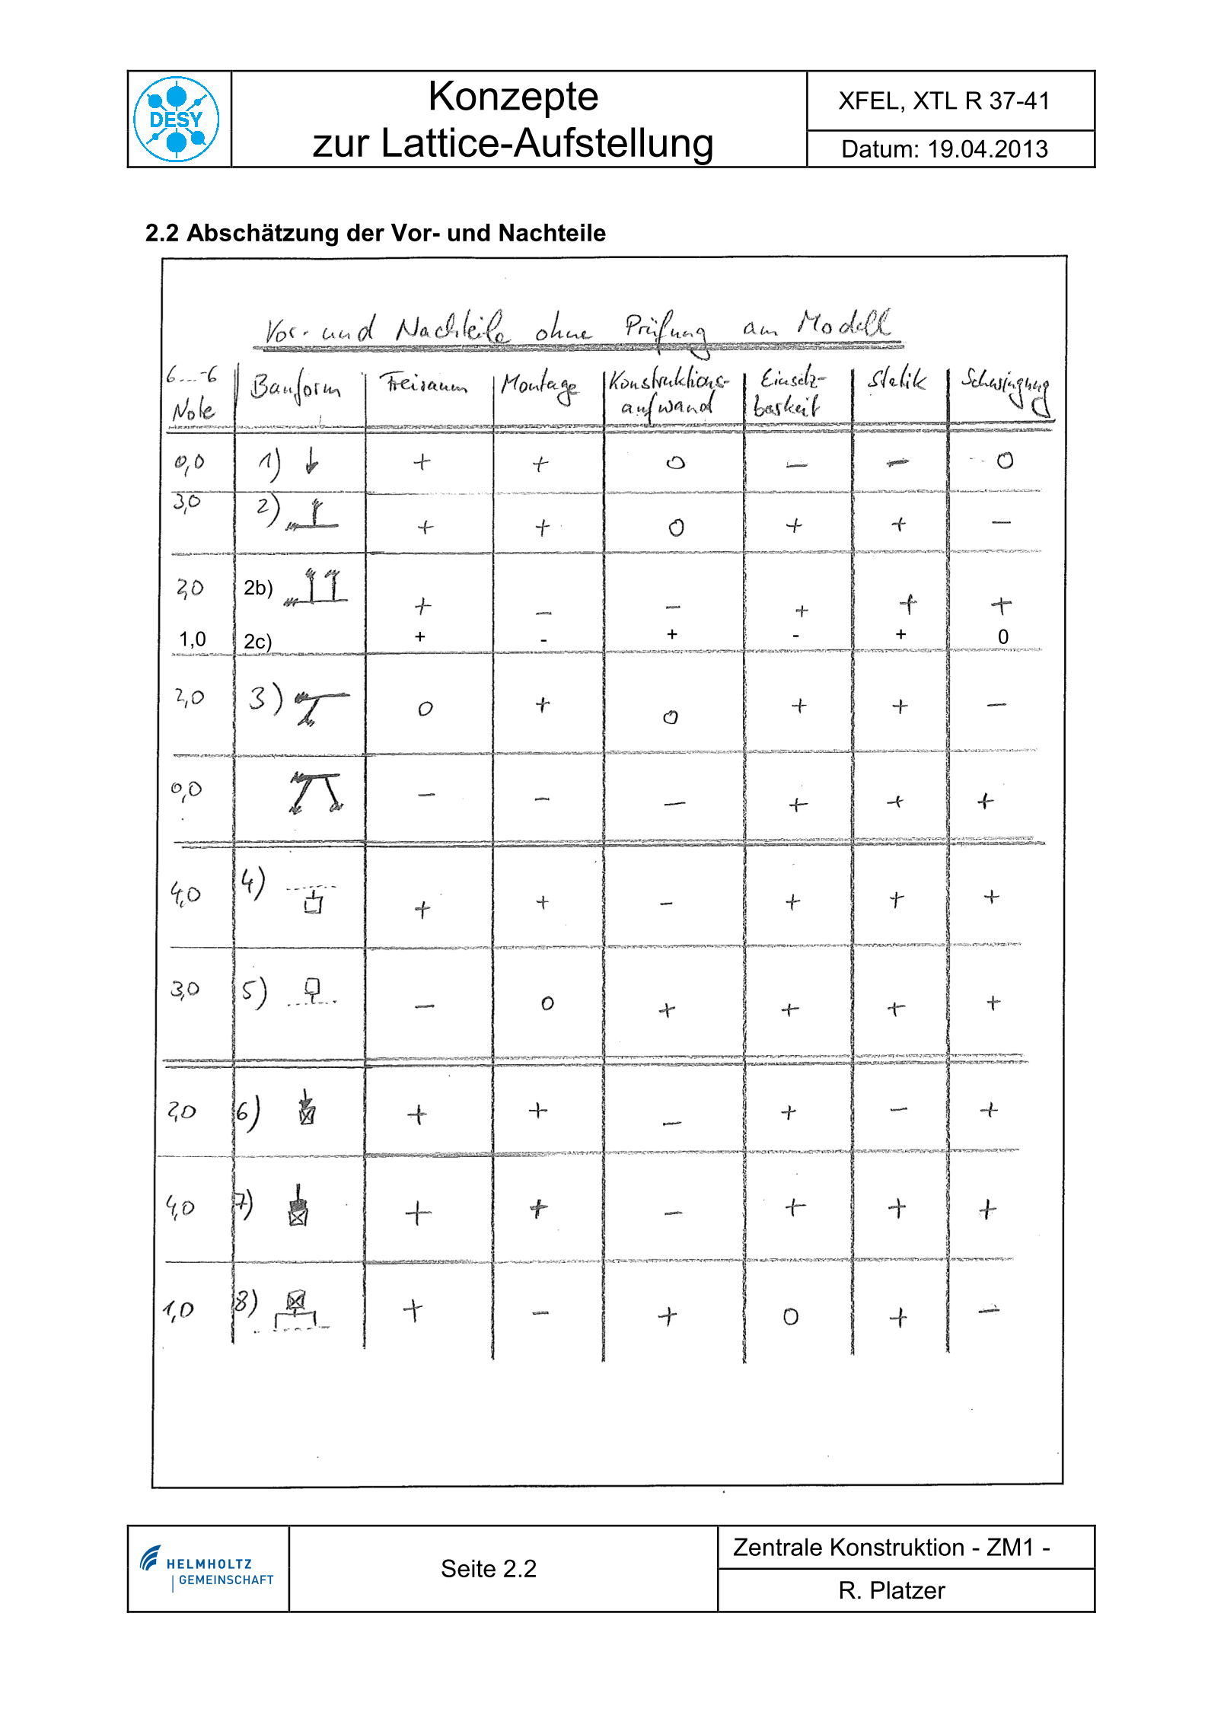
Comparison (again)

Slide 48
Comparison (1. Half)

Slide 49
Comparison (2. Half)

Slide 50
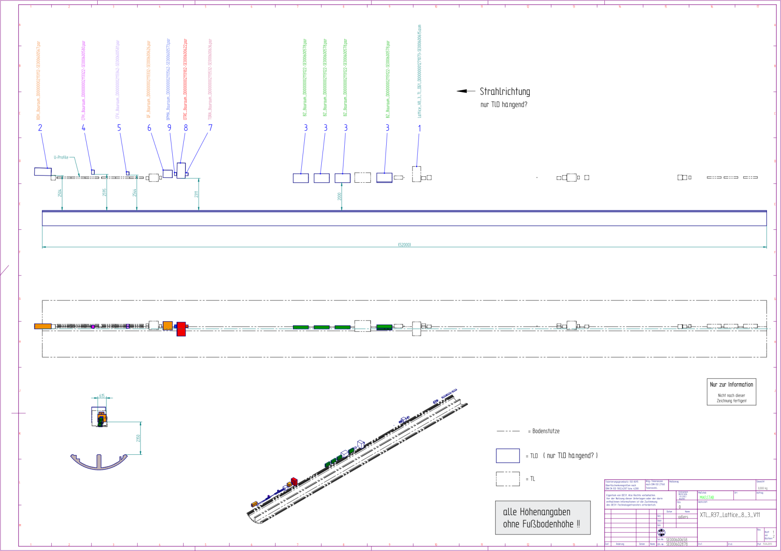
XTL R37

Slide 51
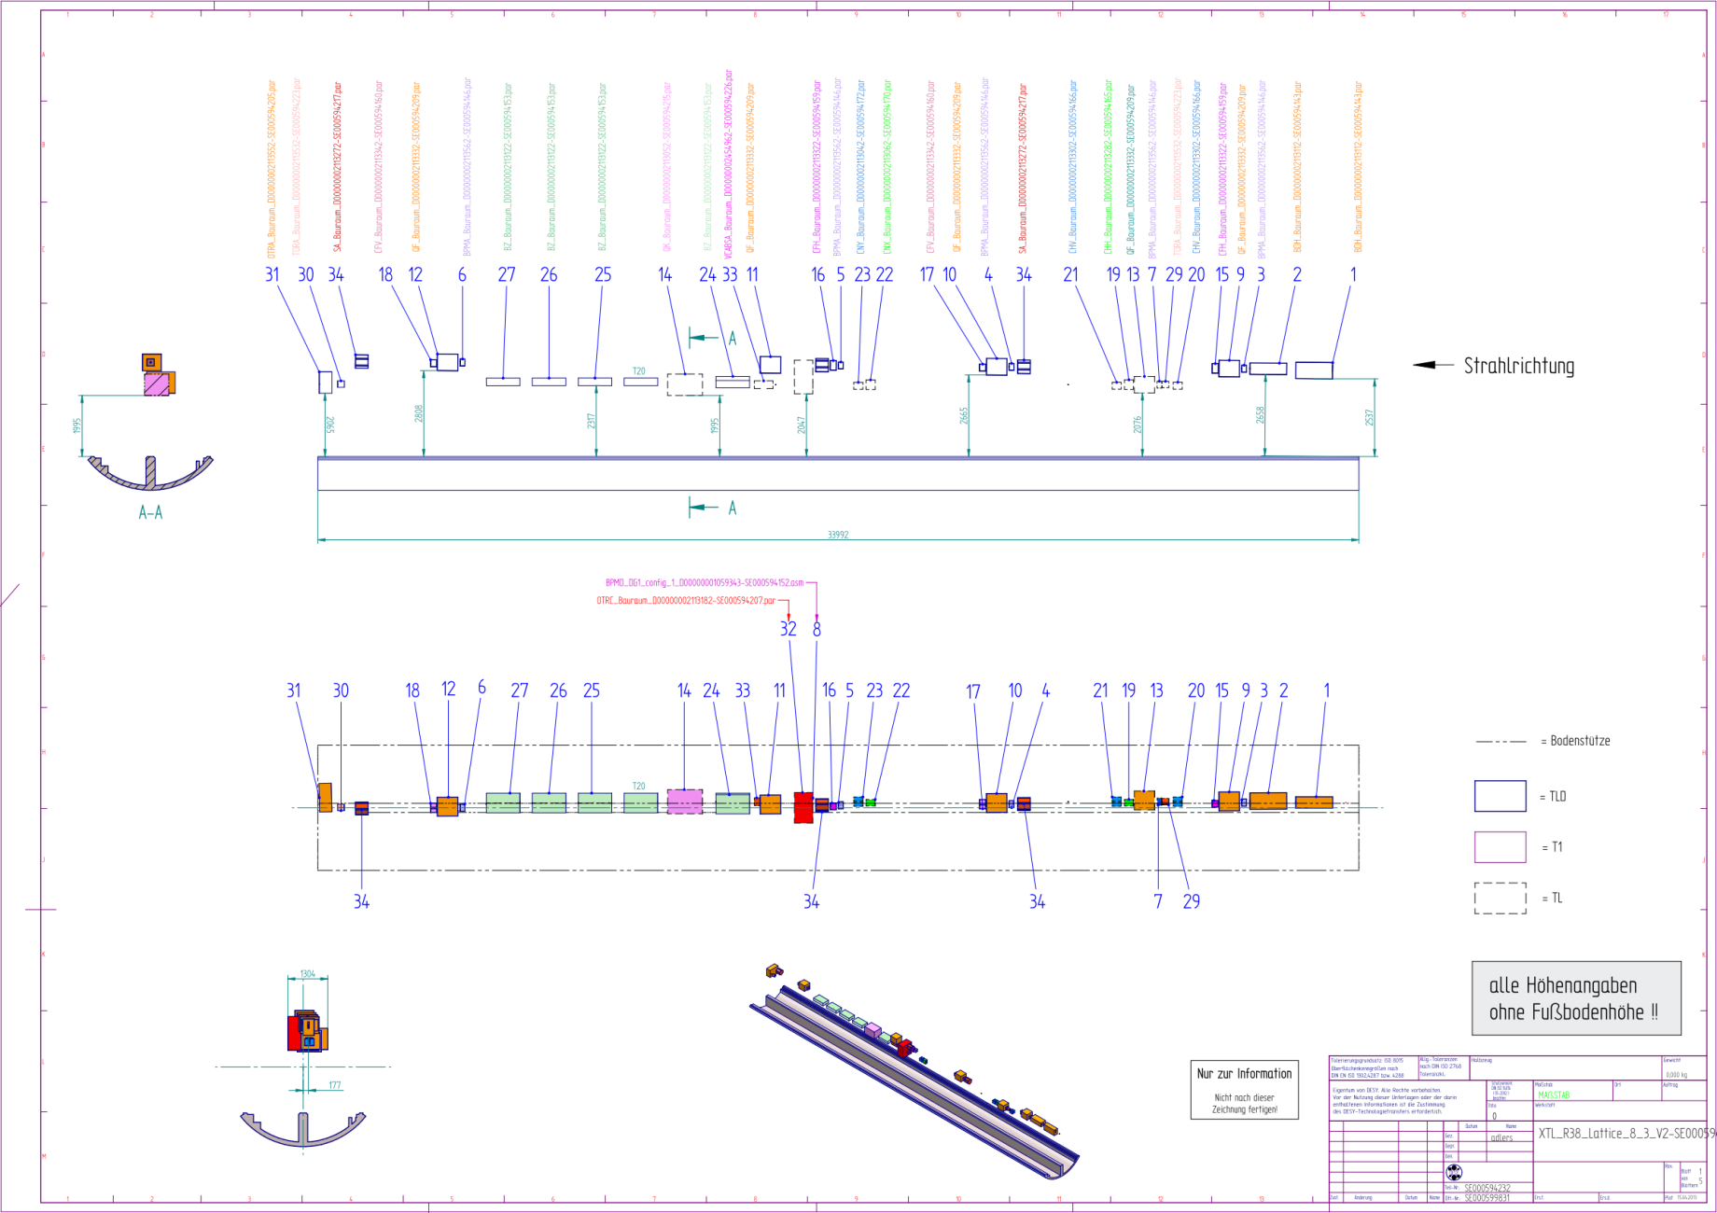
XTL R38

Slide 52
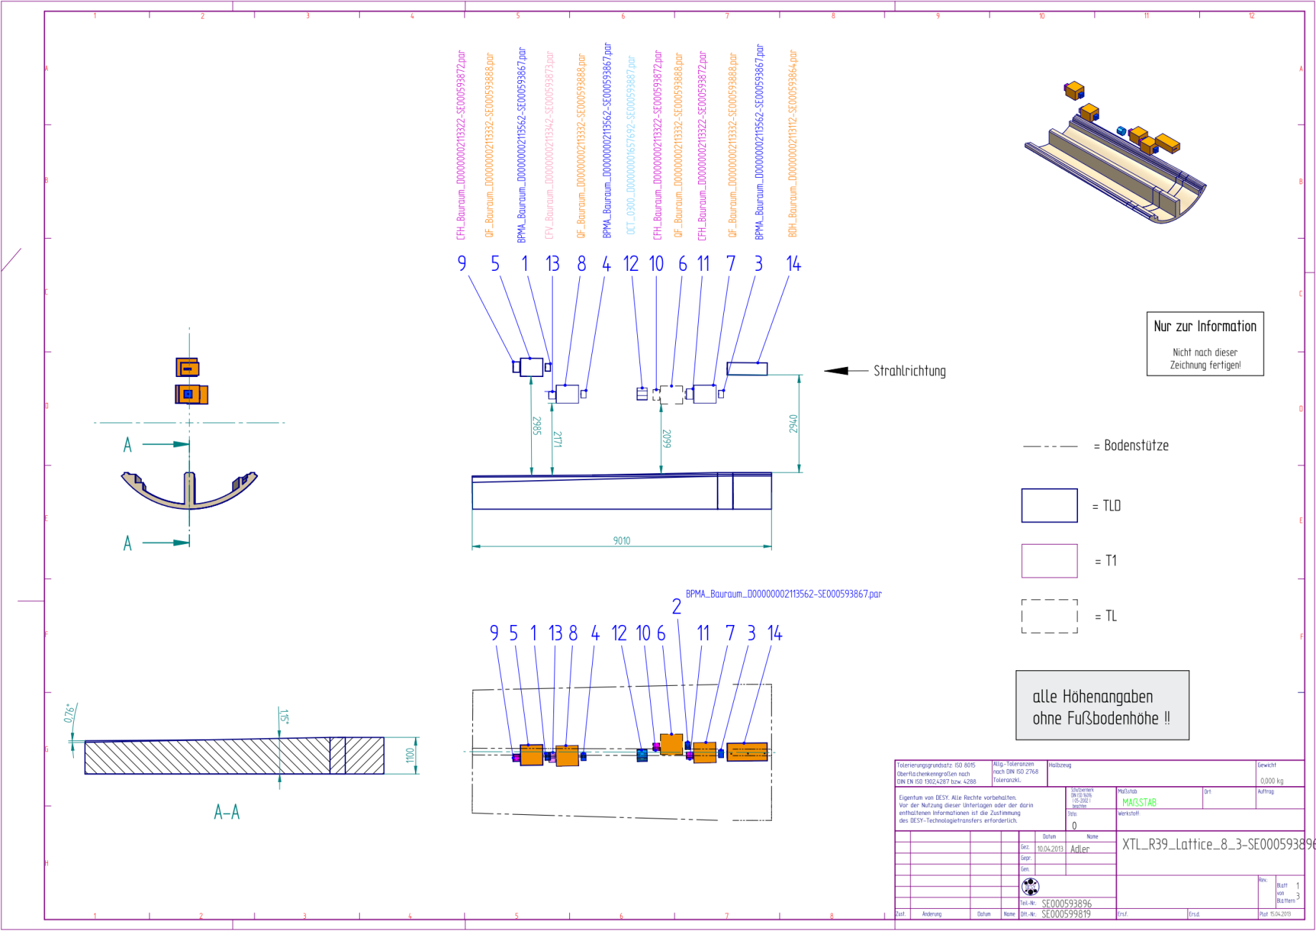
XTL R39

Slide 53
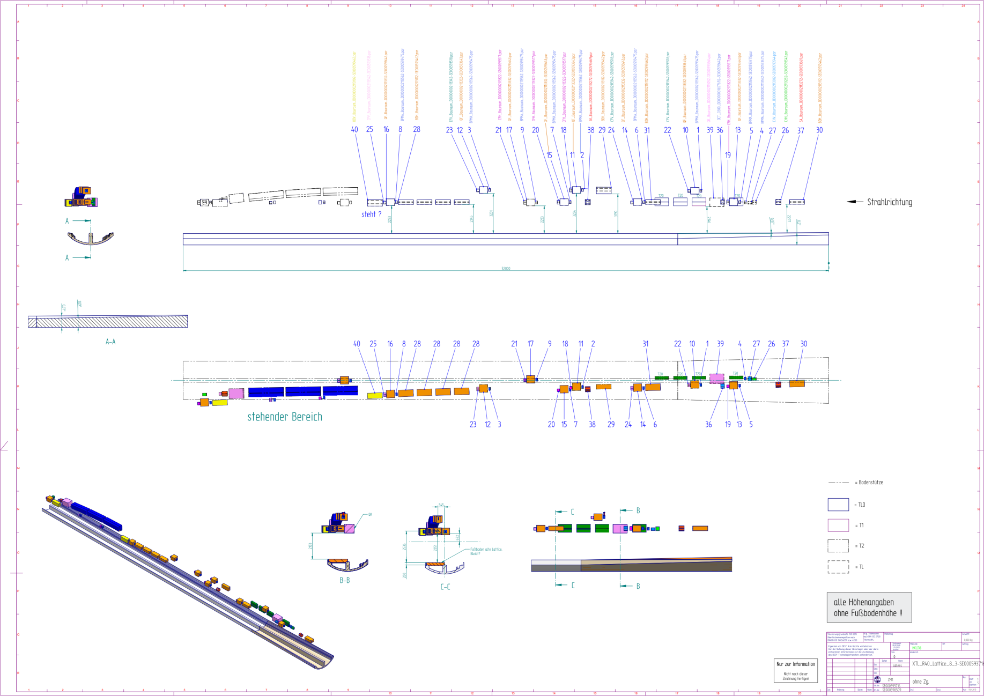
XTL R40

