Slide 1
Status of the XHEXP1 from the TC-perspective
G. Wellenreuther
Notes:
How to edit the title slide
Upper area: Title of your talk, max. 2 rows of the defined size (55 pt)
Lower area (subtitle): Conference/meeting/workshop, location, date, your name and affiliation, max. 4 rows of the defined size (32 pt)

Slide 2
Activities
CAD integration
Status of the current hall model.
Concept: Avoiding previous mistakes where possible.
Tools + Guidelines
Status: Installations in the experimental hall
(Pre-)planning of XHEXP1-installation
Who is doing what? When?

Slide 3
Current status of the CAD-integration model

Slide 4
Current status of the CAD-integration model
We do not need / want much more detail on the hall level.

Slide 5
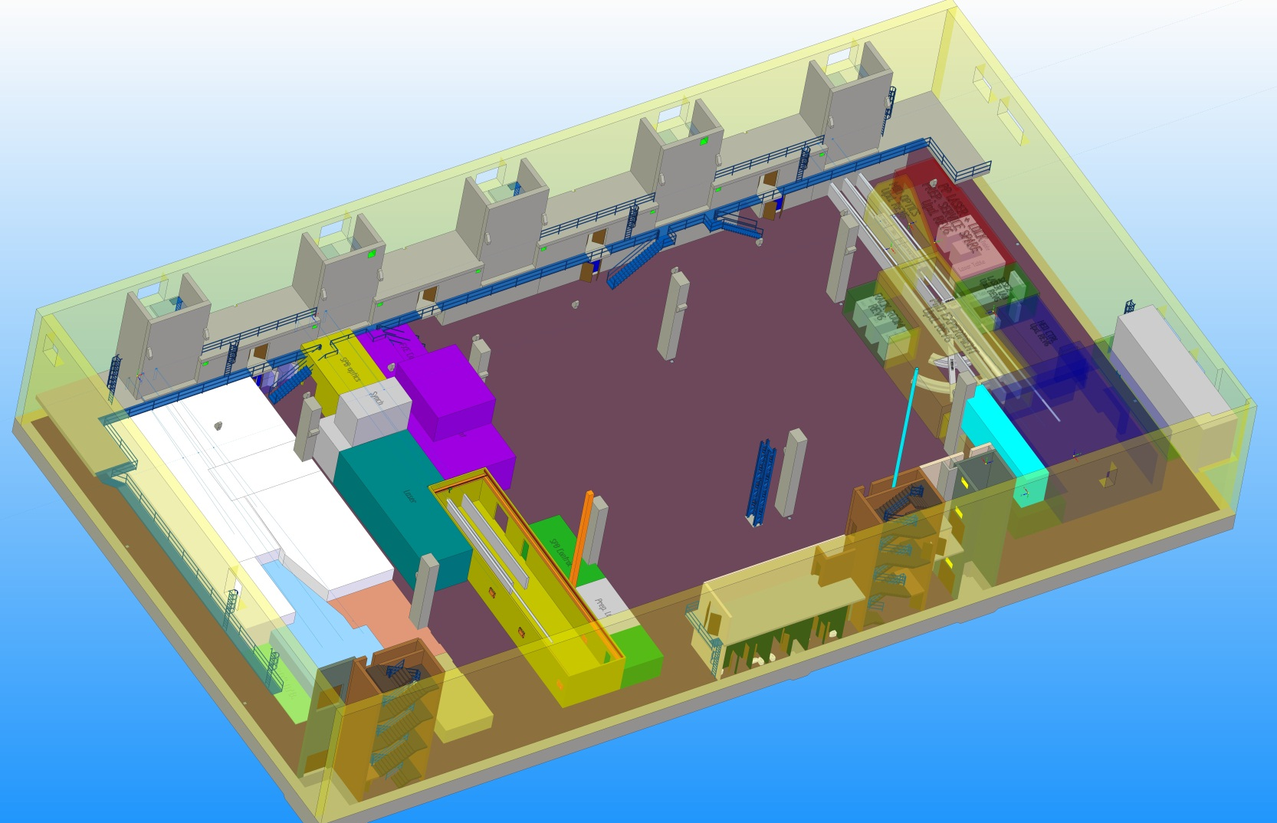
Instrument, area + hall level models.
Area
Instrument (e.g. SPB)

Slide 6
Base-Template: Coordinate systems
Ensures everybody uses proper coordinate systems:
Basis of any larger installation assembly.
Has been implemented as an actual template for SE.

Slide 7
More tools
List of most-important assemblies:
Contains the basic information required to import any ASM.
Basis for automatic creation of JTs.
JT vs. SE:
JT: Ideally suited to the needs of scientists:
Visualizes large models fast, can move, cut & measure, and no SE-license required, no write-access (!!!!)
Archived in EDMS ➔ version control, finally!
2 courses already organized, more to come…
CAD-Guidelines established:
Nomenclature, rules of good practice, SP-structure…
Examples of template usage of template, How tos…

Slide 8
Planning of the installations in the XHEXP1
Currently, Fa. DERU has been entrusted with preplanning
In parallel, gathering requirements for the individual, conflicting installations in the XHEXP1:
Casting + polishing of final floor ←→ HED-enclosure (almost 1000 t) ←→ Installations by MKK require large platforms…
➔ Installation of hutches ➔ Cable trays + Racks + GTI
➔ Cables + DAQ + IT + …
➔ Radiation / Laser interlocks
➔ Radiation tests + commissioning

Slide 9
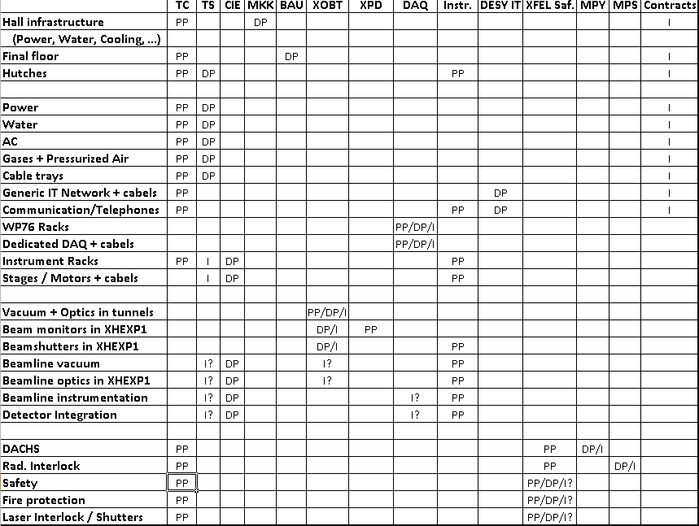
Current task-list
PP: Preplanning
DP: Detailed Pl.
I: Installation
Still incomplete, still under discussion, top-down.
Enables us to find tasks which have not yet been properly assigned.

Slide 10
Who is doing what?
Some tasks have not been assigned properly yet.
Who is designing, installing + supporting the actual beamline + vacuum-components (rad. safety shutters!) in the instruments?
Instruments: Is each instrument supposed to upkeep a vacuum-group of its own? Is this efficient?
TS / CIE: Should design, install & support, but are a new group and have no technicans to do the actual work, yet.
XOBT: Has both the experience and some manpower, but have no mandate.
Can we get along without a dedicated vacuum-group at all?
Can the structure TC + TS + CIE + XOBT work?

