Slide 1
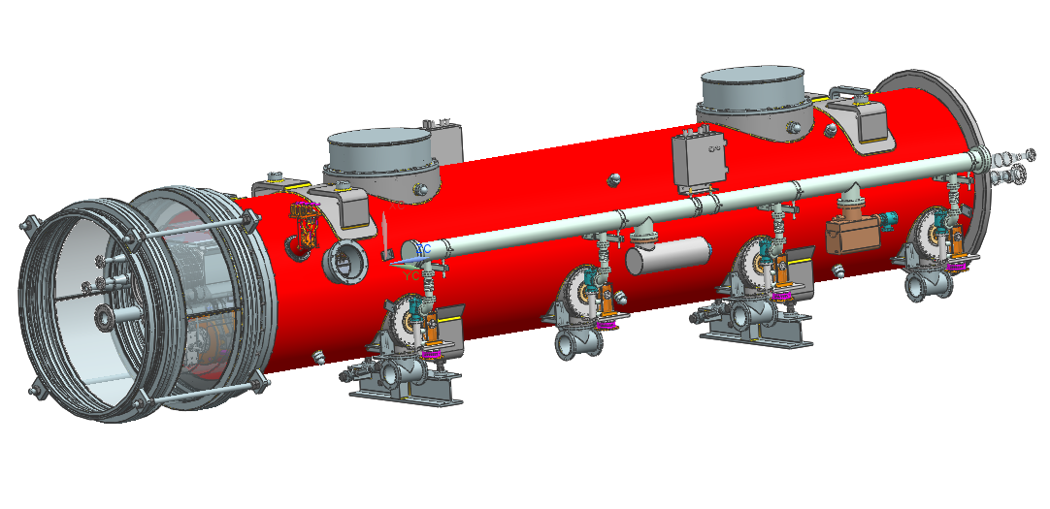
Status of the 3H Module at Injector [XFEL WP46: 3.9 GHz system]
+ INFN/DESY contributors
Paolo Pierini
Second Collaboration Meeting of the European XFEL
Injector Session
PPT version 21/4/2013

Slide 2
Design and procurement
Cavity Prototypes
All tested vertically
(Still) to be assembled in tanks for horizontal tests
All main system components designed
Cavity PRR in 2011
Tender assigned to EZ
Module PRR in 2013
CFT ongoing
In procurement phase for all main components
at INFN and DESY

Slide 3
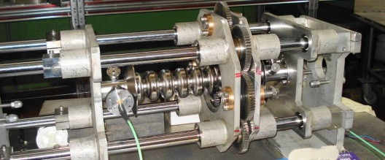
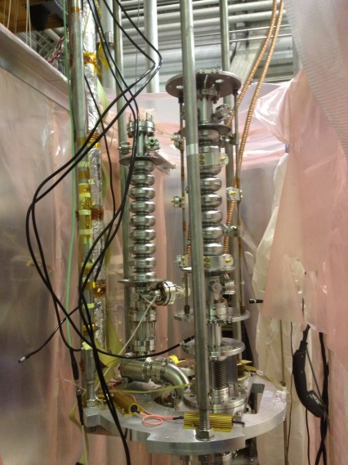
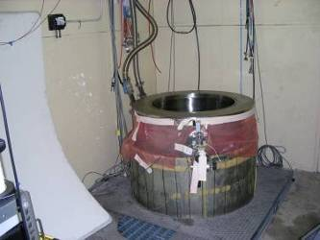
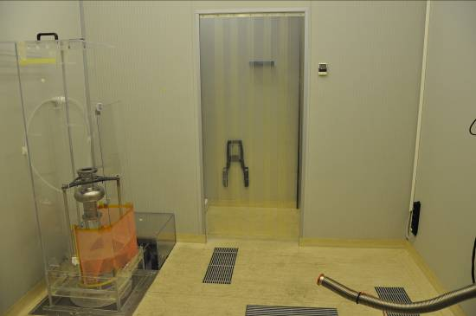
Prototypes
Test of all 3.9 GHz cavities at INFN
Vertical Test Facility
18 W @ 2 K / 10 W @ 1.8 K
less than 1 W static
VT insert 2x3.9 GHz cavities
200 W RF
Clean room (9m²), UPW plant and HPR qualified for operation with 1DE15
CR with HPR
VT

Slide 4
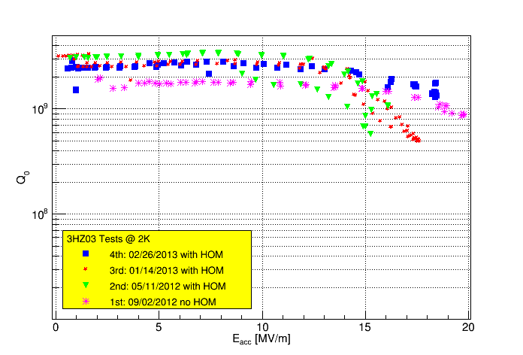
Outcome of VT on prototypes: 3HZ03
Full qualification of 3HZ03, also with HOM antennas
Q>2 10⁹, Max E_{acc} 19 MV/m

Slide 5
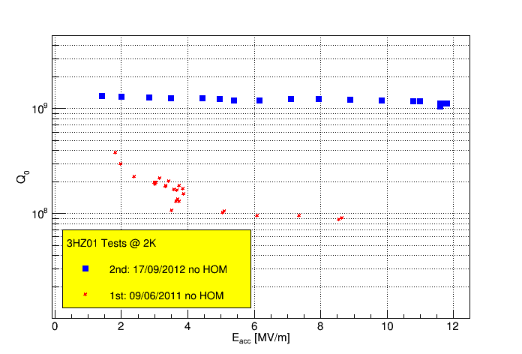
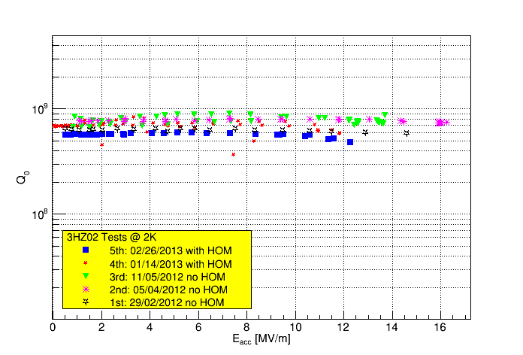
3HZ01 & 3HZ02
Show low Q at low fields and quenches at 12-15 MV/m
No clear reason but:
1°time EZ did step/recess equatorial weld
Now standard on 1.3 GHz, with EBW improvements
In general less «clean» conditions than actual state
1° test,
Trouble with VC antenna,
switched to FC

Slide 6
3HZ01
3HZ01 was sent to FNAL for further benchmarking
Vertical test reproduce Milano results
A chemistry at ANL was tried but a leak developed
Investigating repairs
HR X scan at avonix by FNAL
Courtesy E. Harms, FNAL

Slide 7
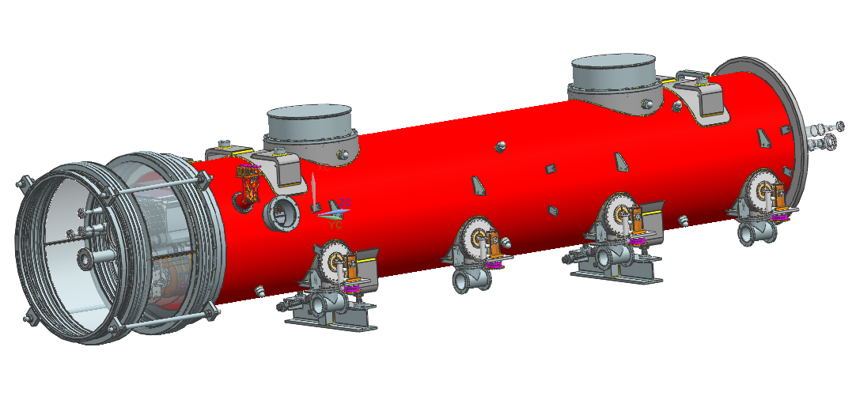
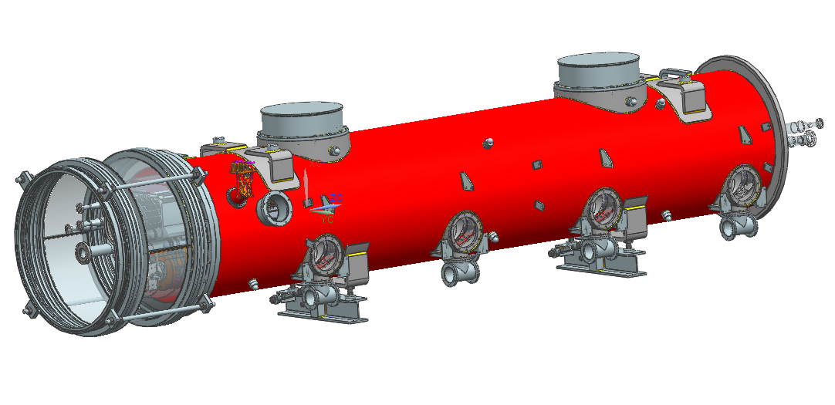
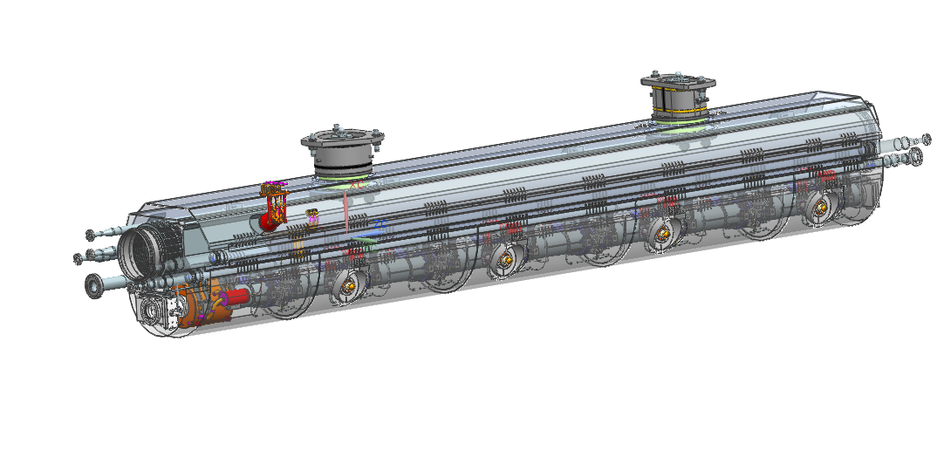
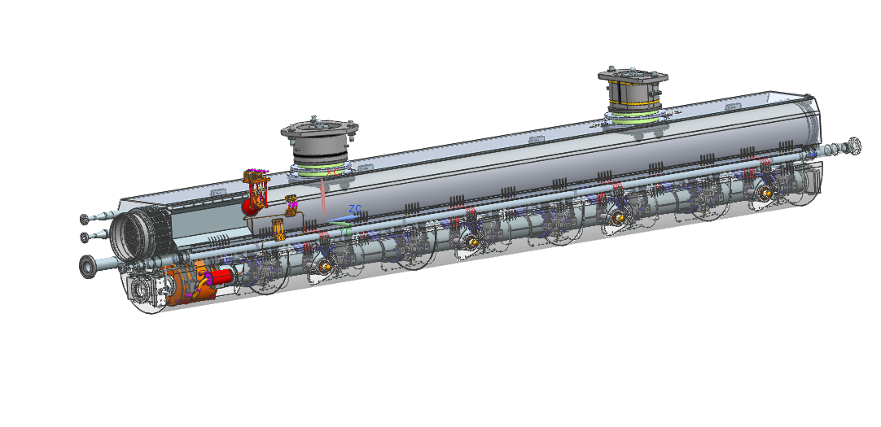
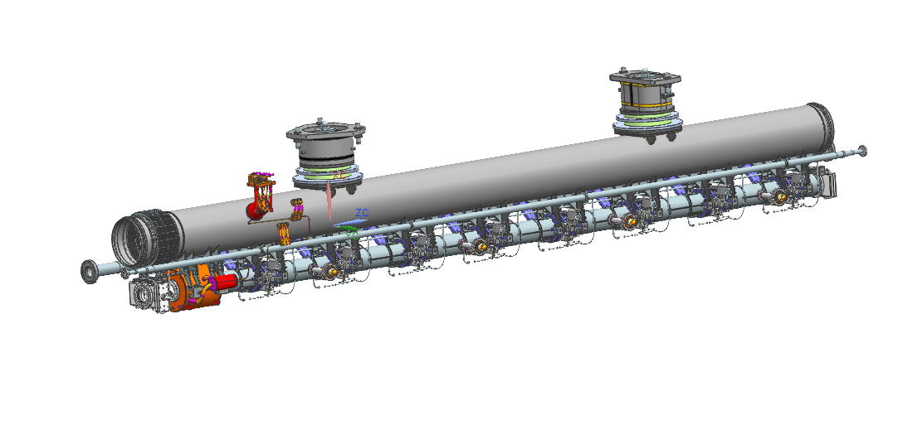
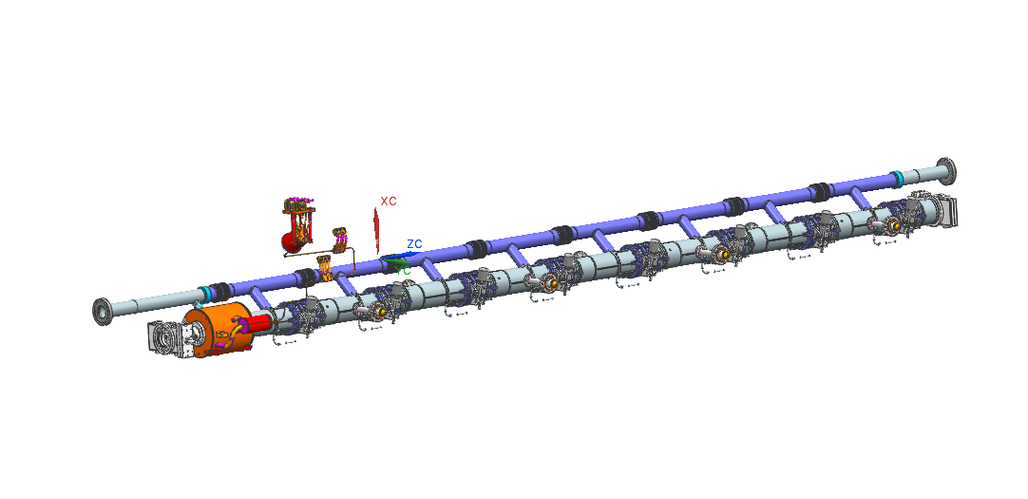
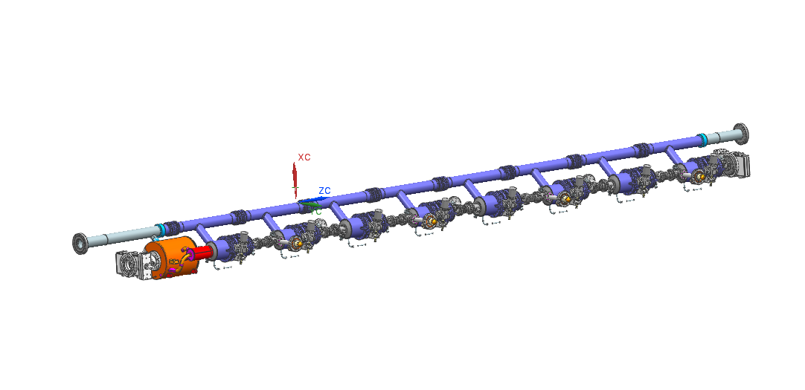
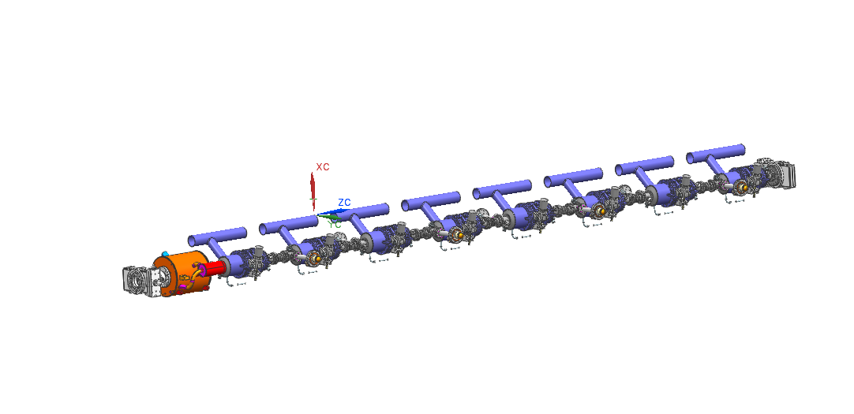
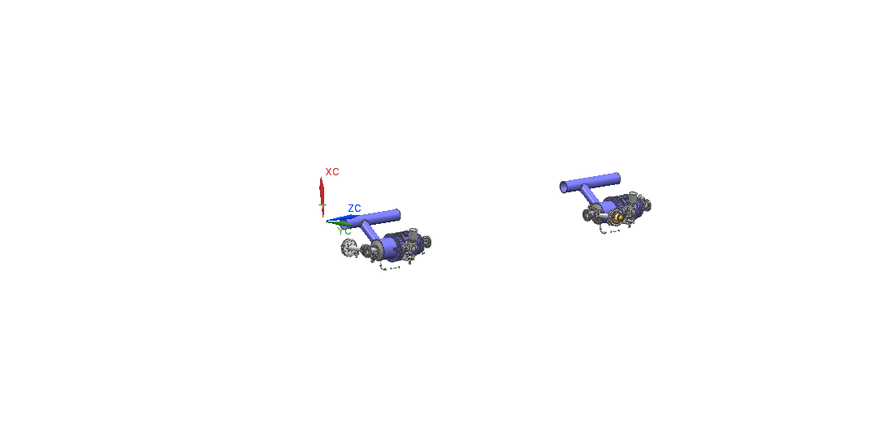
The module

Slide 8
Interfaces
Main interfaces discussed at the PRR for the Cold Mass and Vessel in March 2013
Models and specifications uploaded in EDMS
D*3331741
Technical specification document, draft form
D*2128441
3.9 GHz 3D Models (STEP & JT)
D*2666811
3H Module Drawings Baseline
Third iteration, first two rounds discussed with KJ
Updated documents after PRR changes not yet updated

Slide 9
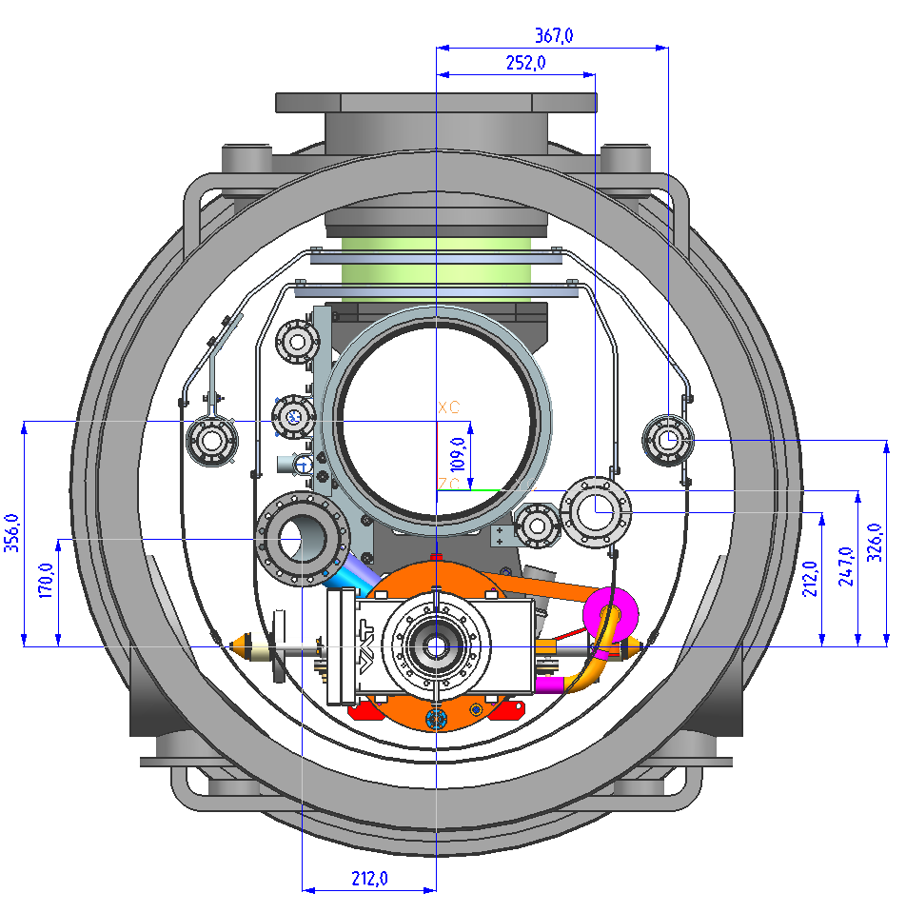
XFEL 3.9 Cryomodule design: transverse layout
Design is “Plug compatible” with Type III+/XFEL modules
Identical transverse X-section for all cryo piping
Module part of the same cryo line with the injector module
Adapts at interfaces of standard cryo components
Shorter module/string lengths
All cryo piping in the same relative position with respect to beam axis

Slide 10
Same X-Section as XM1-100...

Slide 11
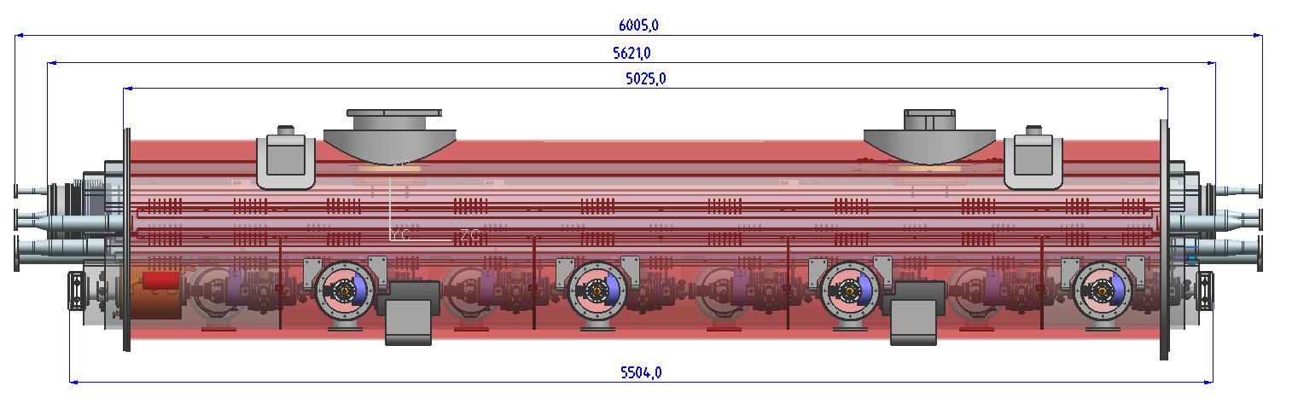
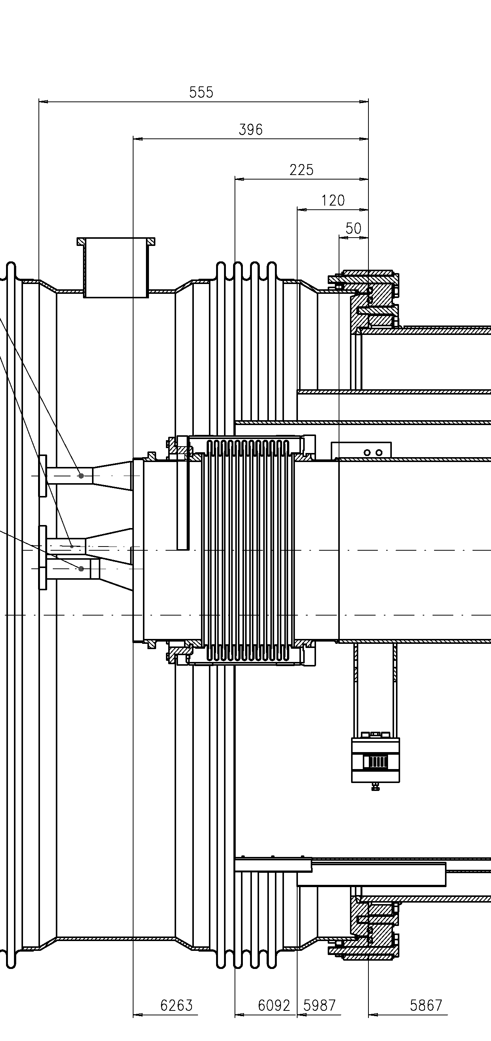
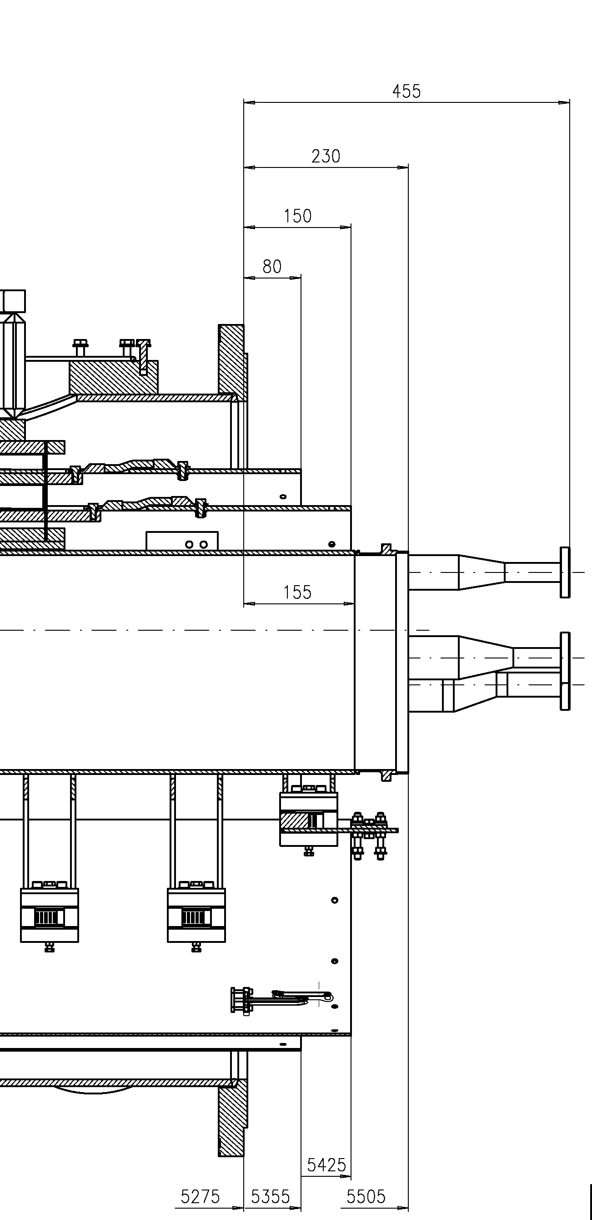
Longitudinal interfaces preserved as XM
Shorter module length...
XFEL Module @ 1.3 GHz

Slide 12
Injector Modules Interconnection

Slide 13
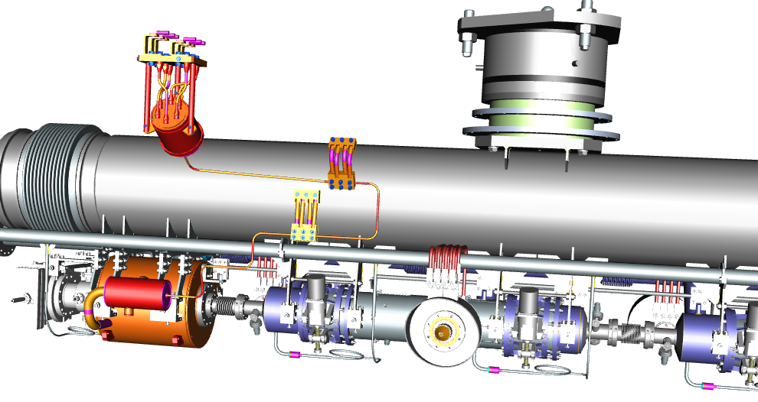
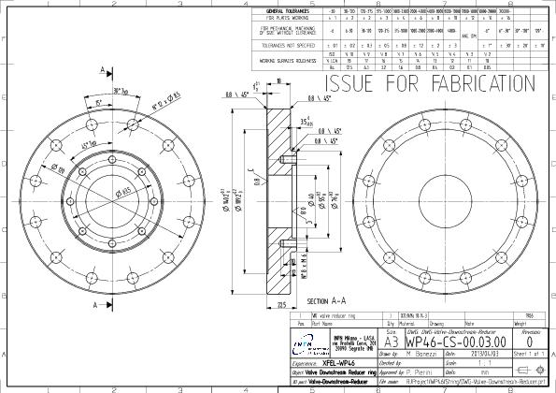
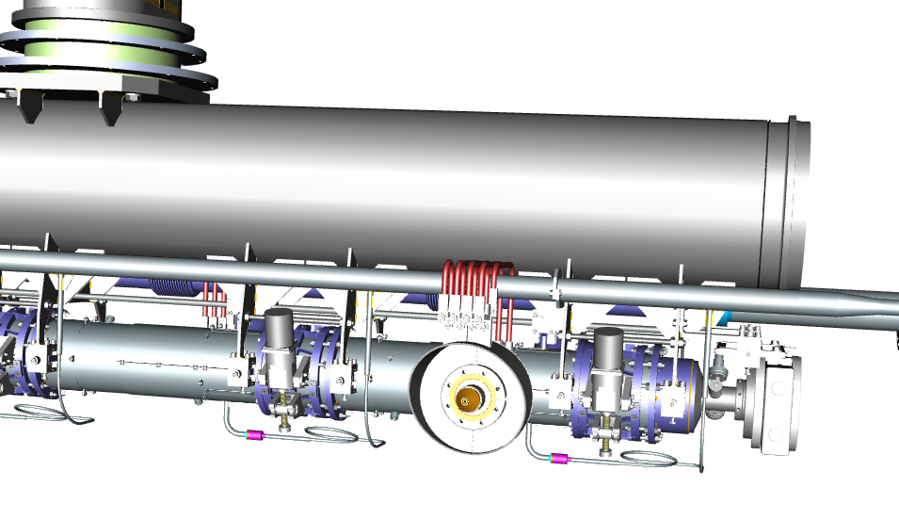
Vacuum beam components
Pending WP8 approval
Interfaces discussed
INFN procuring
NW 78-40 transition flanges
Intercavity bellows
DESY procuring
Standard and «modified» gate valve

Slide 14
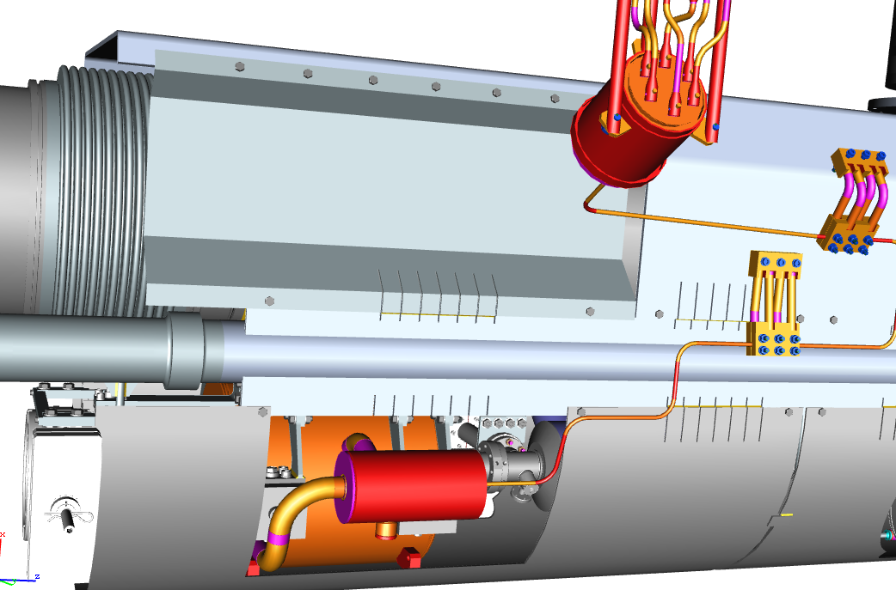
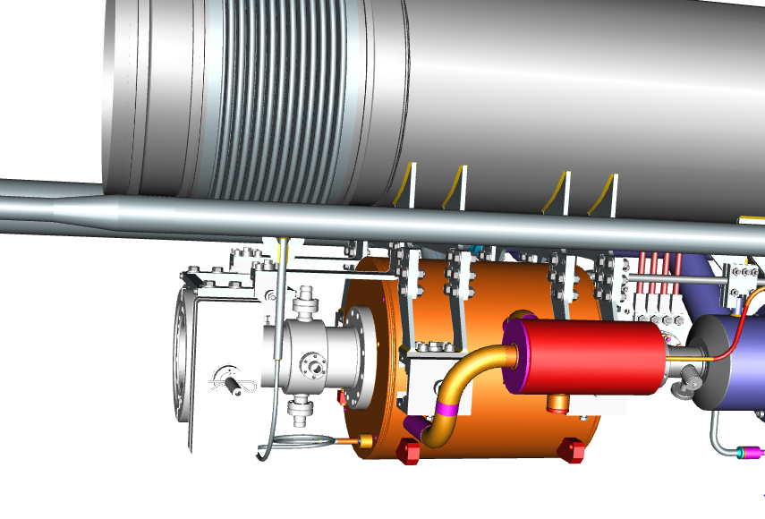
Quad BPM region
Discussed with HB in several iterations
4K shield mods for assembly

Slide 15
Vessel interfaces
Coupler vacuum supports agreed and integrated after PRR
Full model provided by DESY (JH) and integrated
Waveguides supports agreed and integrated after PRR
Can integrate in model if DESY provides models (JR)

Slide 16
Interfaces: To Do
Cabling and signal inventory
XM documentation made available (KJ)
Will provide similar list to EDMS

Slide 17
Schedule: Cavities
Kick-Off 17/4
Contact with Notified Body for design approval and Module G
INFN will likely act as Manufacturer (TBC)
All Nb/NbTi material in-house at INFN
N.B. asked design documentation
Operating conditions, risk analysis, test conditions
Will need precise info from DESY
MAWP=4 bar, agreed
Statement of pressure used for the tests of cavity/string (complete with tuner?)
Crude estimate: 40+ wks for 8 cavities ready for string installation from T0 (design approval by Notified Body)
Review in 4 weeks with vendor timeplan /documentation and further contact with Notified Body

Slide 18
Test capacity
Cavity schedule based on
Process at LASA Max 1 cavity/week coming after fine BCP
2 VT needed (1 w/o HOM, 1 with HOM)
1 cooldown with 2 cavities every 3 weeks
Dominated by He batch operation
Horizontal testing
FNAL is the only short term solution
We don’t have a cavity ready for HT
Prototype this summer
First series in Sep/13 (w/o tank), with tank Oct/13 (T0)
Discussing use of a modified cryostat adapter in AMTF
Meeting next Thursday to assess timeline

Slide 19
Schedule: Couplers & module
4 prototypes ready and conditioned at FNAL
Series of 8(+8) ordered by DESY
First couple of couplers from CPI to FNAL Sep/2013
Delivery of others 2/week to FNAL
Coupler processing at FNAL
After 4 weeks (max.) at DESY
First couplers from series ready Oct/2013
Still compatible but with small margins
String assembly May/2014
Module installation August/2014
Technical commissioning September/2014
Start inj. beam operation October/2014

