Slide 1
The Adaptive Gain Integrating Pixel Detector (AGIPD) Project
Heinz Graafsma, DESY
on behalf of the AGIPD-Consortium

Slide 2
What is the Goal ?
K. J. Gaffney and H. N. Chapman, Science 8 June 2007

Slide 3
XFEL Detector requirements
What are the Challenges ?
4.5 MHz

Slide 4
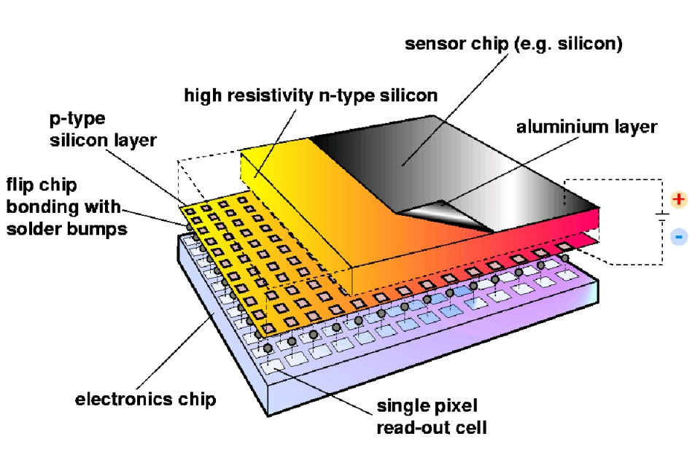
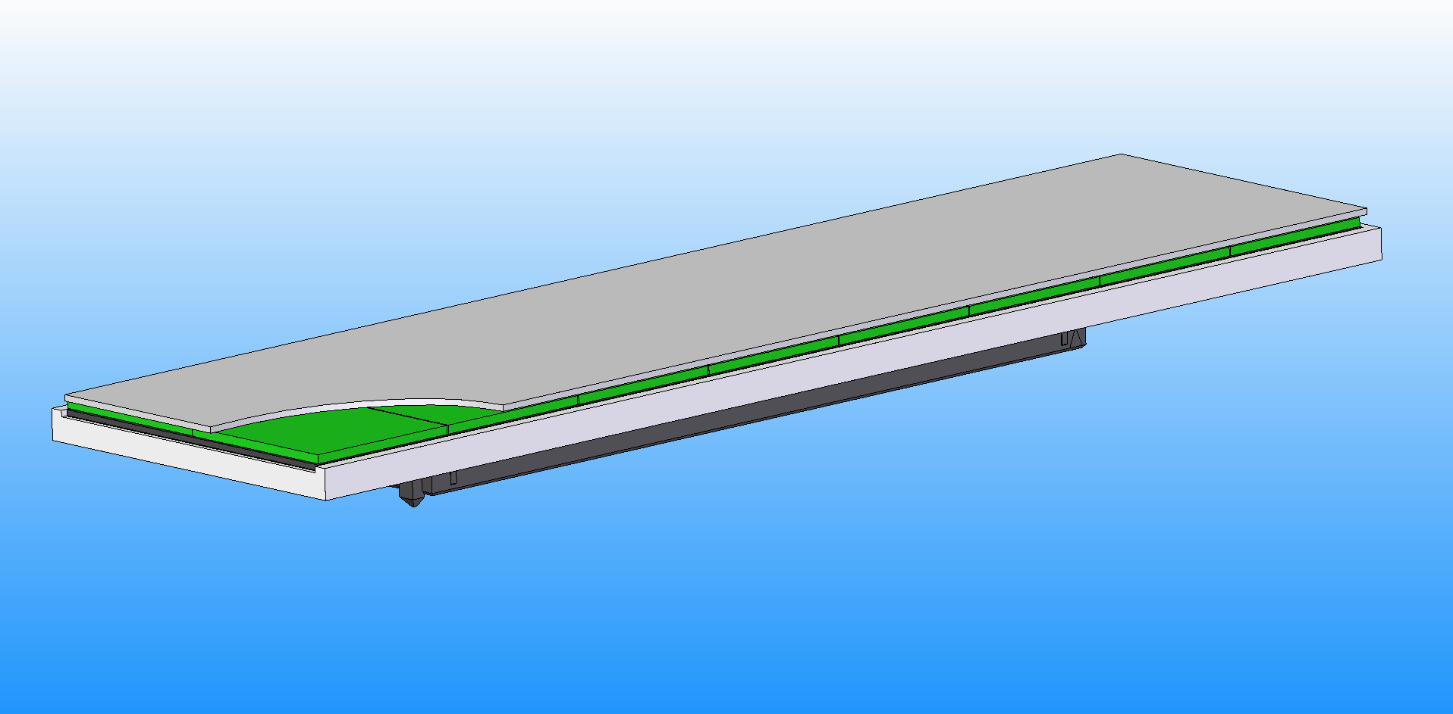
Hybrid Pixel Array Detectors
Pixellated Silicon Sensor:
absorbs photons and produces electrical signal
Pixellated readout chip (ASIC):
Processes signal produced in sensor and sends data out
Single silicon sensor: 128 X 512 PIXELS
readout by 8 x 2 chips; ~ 26 X 105 mm²
Chip carrier board to talk to and readout chips

Slide 5
Radiation hardness sensor
No bulk damage expected for 12 keV (<300 keV)
Surface and interface damage:
➔
Higher leakage current

Slide 6
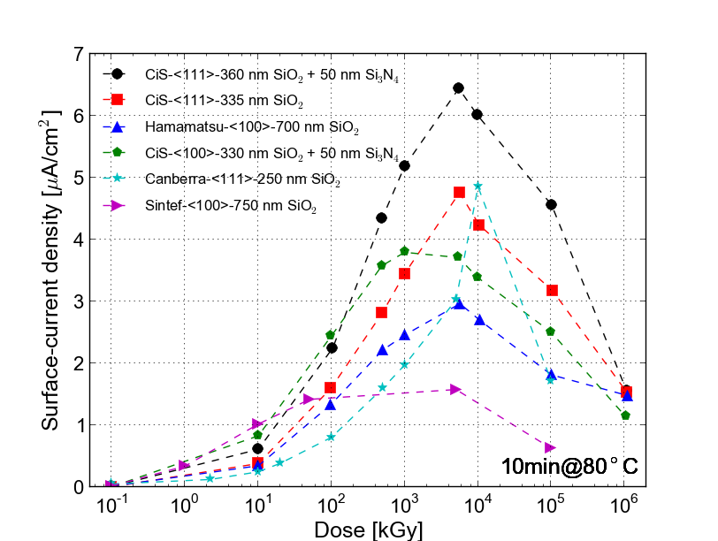
Radiation hardness sensor

Slide 7
Radiation hardness sensor
No bulk damage expected for 12 keV (<300 keV)
Surface and interface damage:
➔
Higher leakage current
Higher depletion voltage
Lower breakdown voltage
Charge losses at interface
Increased inter-pixel
capacitance
Special high voltage design:
withstands 10¹⁶ photons
(= 1 GGy )

Slide 8
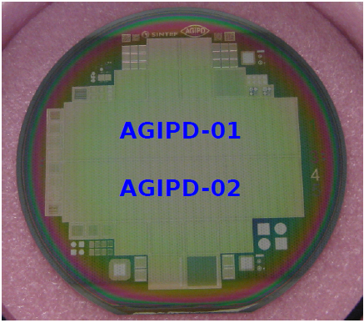
Sensors delivered and validated
20 wafers; 40 sensors from SINTEF
Quality control tests:
Flatness
Leakage current
Break-down voltage
Inter-pixel capacitance
Radiation hardness
…
All tests passed!

Slide 9
The AGIPD RO-Principle
Sensor
Electronics per pixel
Pixel matrix
…
HV
Analog Mem
CDS
RO bus (per column)
+
SW
RO Amp
…
-
CTRL
DAC
Analog Mem
THR
Calibration circuitry
ASIC periphery
Chip output driver
Mux
Adaptive gain amplifier
352 analog memory cells
Notes:
Mention random vetoing possibility.

Slide 10
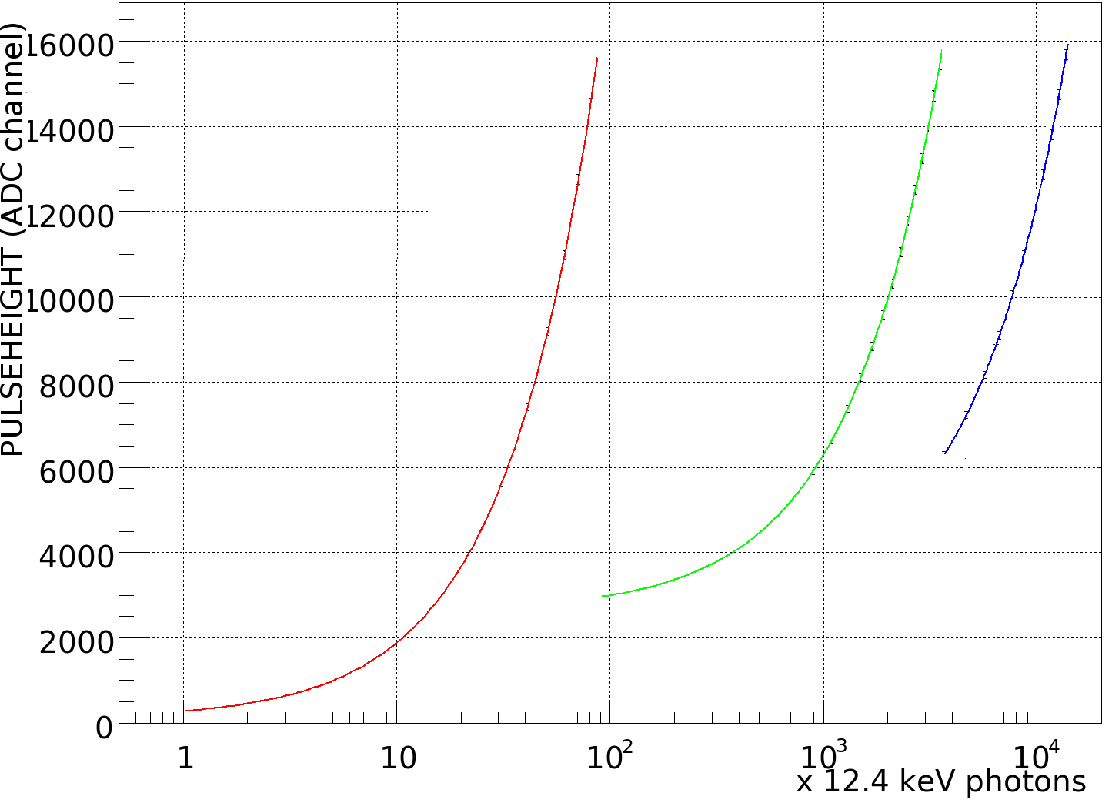
Dynamic Range

Slide 11
The Analogue Storage
Sensor
ASIC per pixel
Pixel matrix
…
HV
Analog Mem
CDS
RO bus (per column)
+
SW
RO Amp
…
-
CTRL
DAC
Analog Mem
THR
Calibration circuitry
ASIC periphery
Chip output driver
Mux
Adaptive gain amplifier
352 analog memory cells
Notes:
Mention random vetoing possibility.

Slide 12
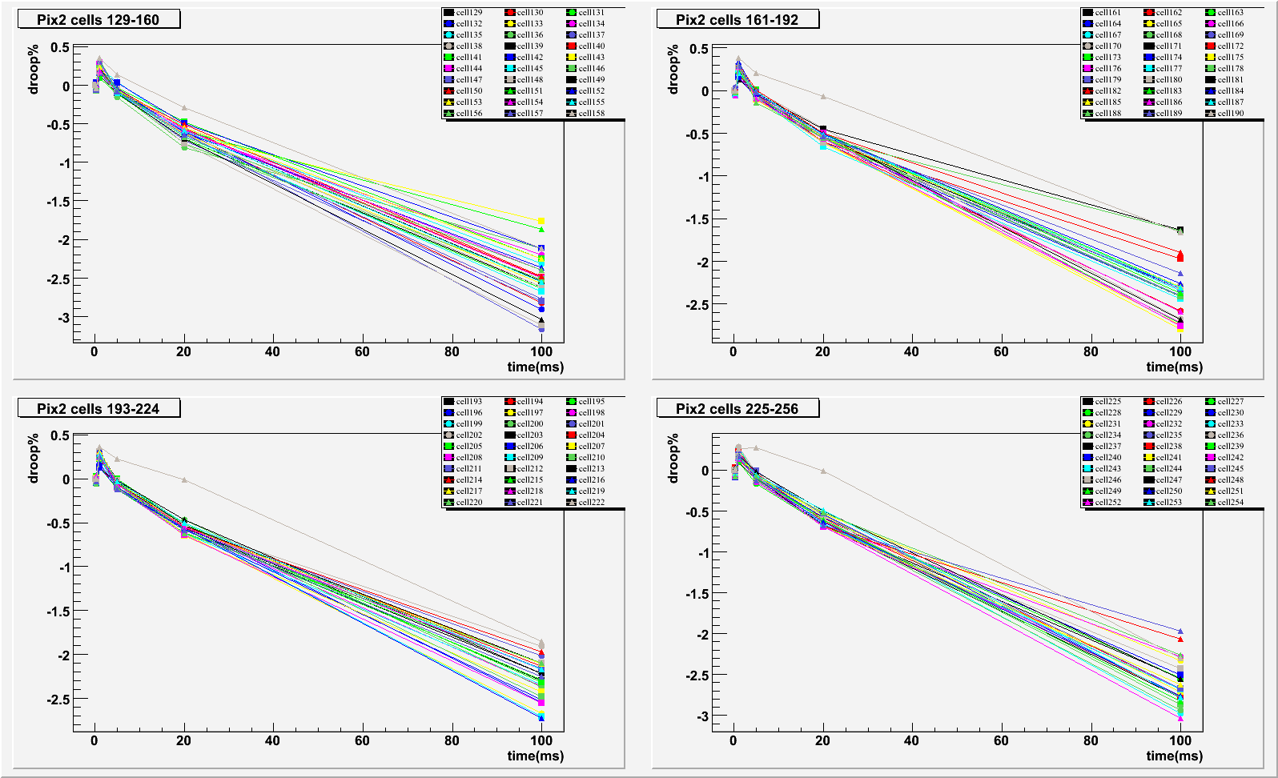
Droop curve: Pix 2 cell 128-256

Slide 13
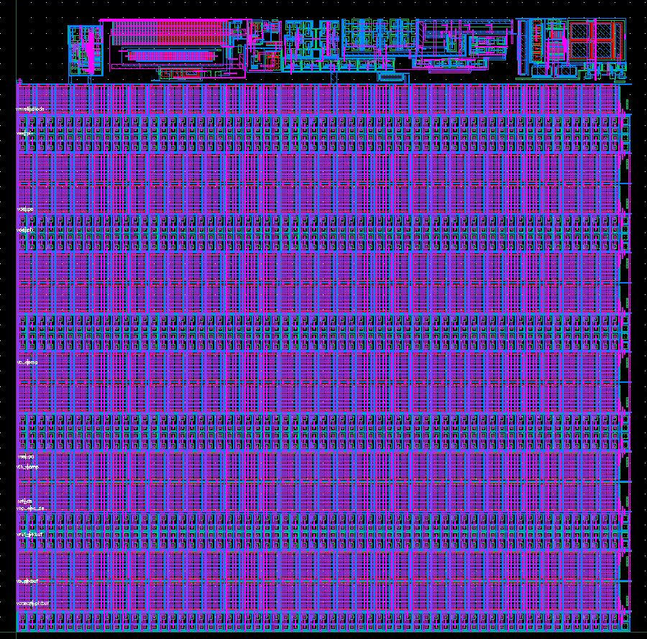
AGIPD 1.0 Pixel Electronics
200 x 200 micron² pixels
352 storage cells + veto possibilities.
Minumum signal ~ 300 e⁻ =
0.1 photon of 12.4keV
Maximum signal ~ 33 10⁶ e⁻ =
10⁴ photons of 12.4keV
4.5 MHz frame rate
64 x 64 pixels per ASIC
2 x 8 ASICs per module (128x512 pixels, no dead area)
4 modules per quadrant
Chip submitted: 19th April 2013.

Slide 14
The front-end
Sensor
Single silicon sensor: 128 X 512 PIXELS
readout by 8 x 2 chips; ~ 26 X 105 mm²
Chip
Chip carrier board
to talk to and readout chips

Slide 15
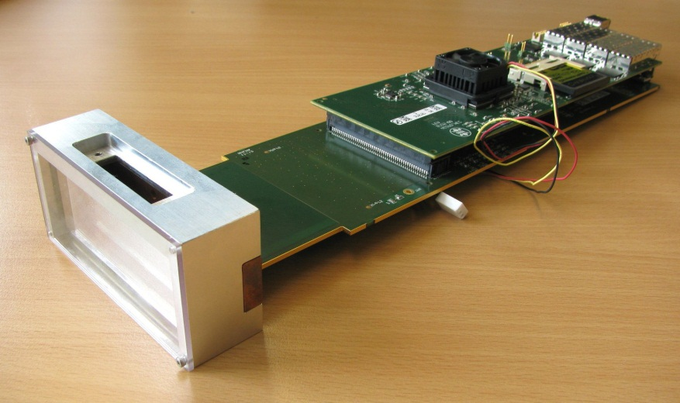
The module building block
FPGA + 4 x 10 Ge links
Analogue board with ADC’s
Sensor plus readout ASIC

Slide 16
Folded or seagull design
(Due to limited length of hutch)
Motion system
Closed air loop around electronics
Cooling block
External motors ~ 6W each
Easy to service
Vacuum chamber/flange
can have any shape

Slide 17
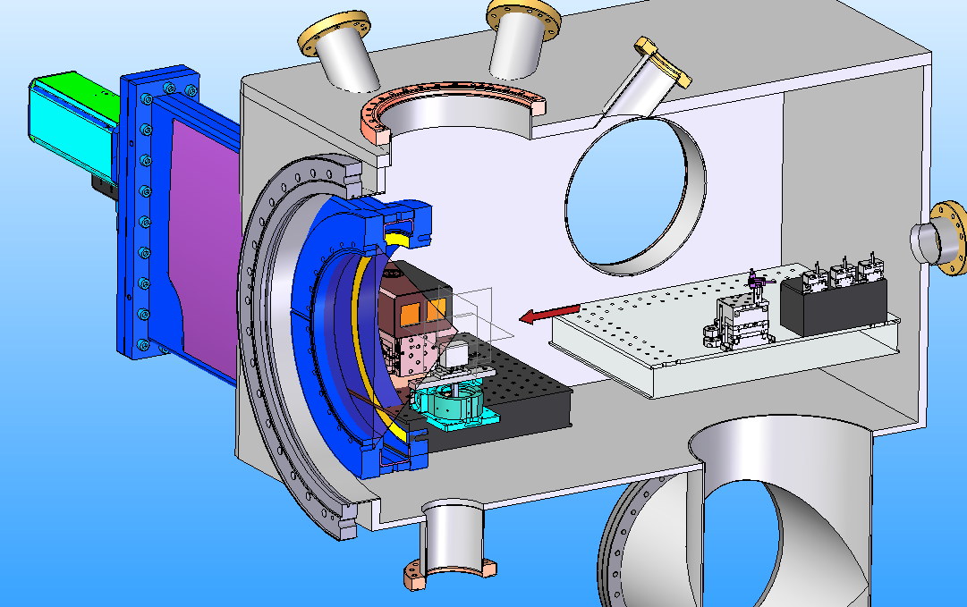
Integration with sample chamber:
Work in progress with EU-XFEL
SPB needs 100 mm sample detector distance
Closest vacuum flange is > 200 mm away from sample
Working with EU-XFEL engineers to find solution
Likely AGIPD front-end has to stick through gate-valve
200mm
Drawings Courtesy
of Eu-XFEL

Slide 18
The AGIPD RO-Principle
Sensor
Electronics per pixel
Pixel matrix
…
HV
Analog Mem
CDS
RO bus (per column)
+
SW
RO Amp
…
-
CTRL
DAC
Analog Mem
THR
Calibration circuitry
ASIC periphery
Chip output driver
Mux
Adaptive gain amplifier
352 analog memory cells
Notes:
Mention random vetoing possibility.

Slide 19
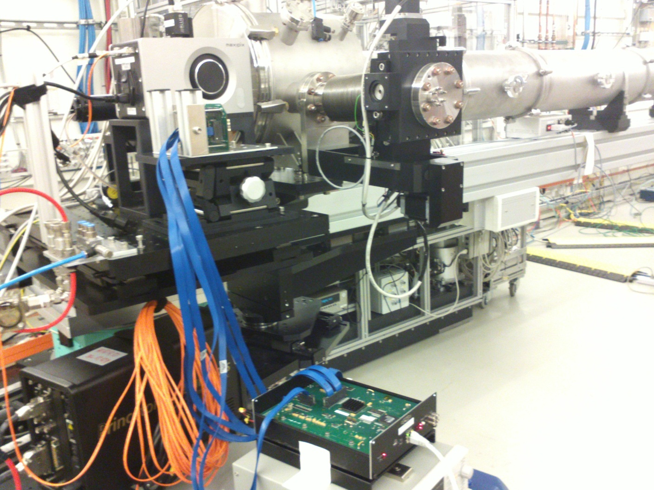
At the P10 beamline
Beam direction (coming from sample)
AGIPD system
It took about 1 ½ hours to set up, after about 2 hours we saw the first image
Chip tester box
Not in the picture: Sample, Alexanders PC, people, …

Slide 20
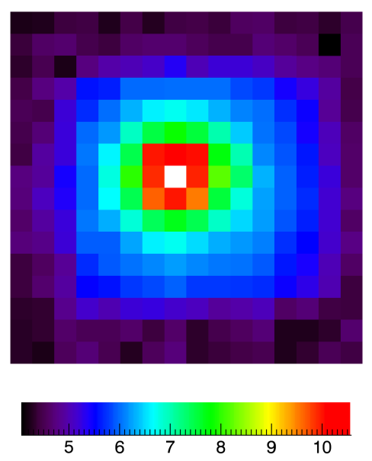
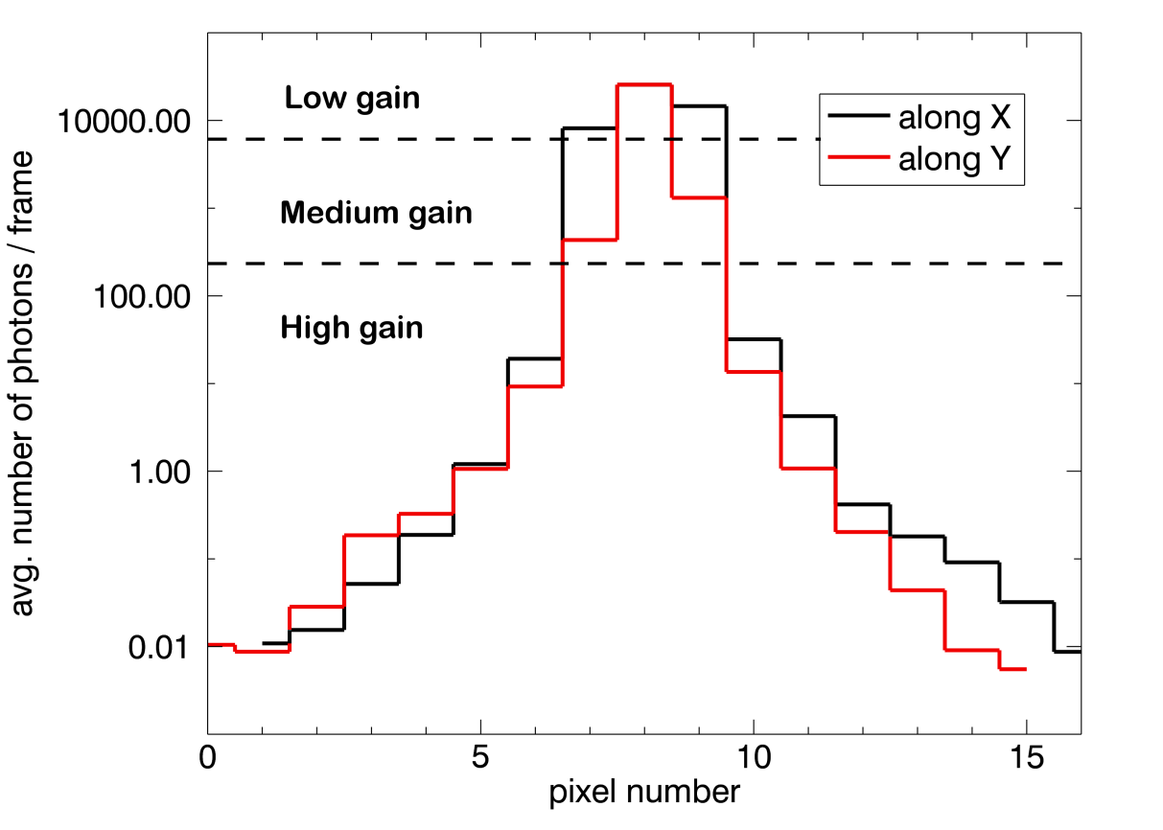
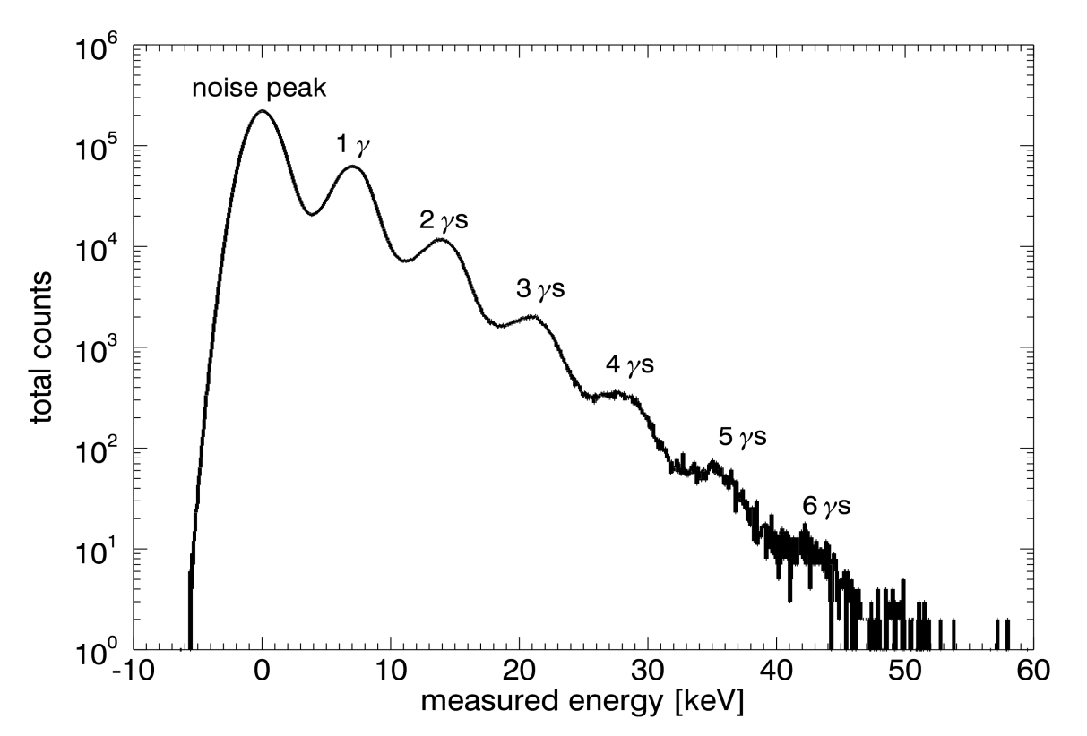
Looking at the direct beam
10
10
10
10
10
10
photons/second/pixel
Gain switching experimentally proven
10⁴ photons / pulse
Single photon sensitivity
4.5 MHz frame rate

Slide 21
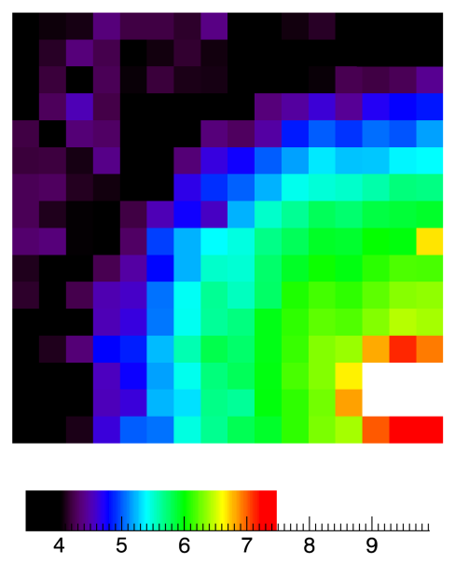
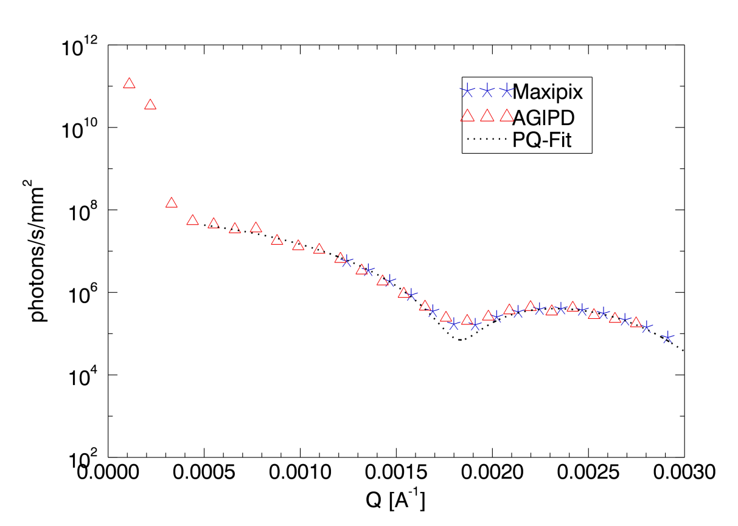
Some XPCS measurements
AGIPD
Maxipix
10
10
10
10
10
10
photons/second/pixel
Scientific quality data obtained
Complete system proven to work
Calibration proven to be adequate

Slide 22
Planning
Sensors delivered; design validated
AGIPD 1.0 submitted 19th April 2013
Interface boards designed and ordered
Single chip assemblies: summer 2013
First modules (8x2 chips): beginning 2014
1k x 1k system(s) beginning 2015

Slide 23
What could be next? AGIPD2?
Smaller pixels with
Reduced dynamic range (no gain switching);
Reduced number of frames?
New Technologies including:
3D CMOS: second layer (more functionality)

Slide 24
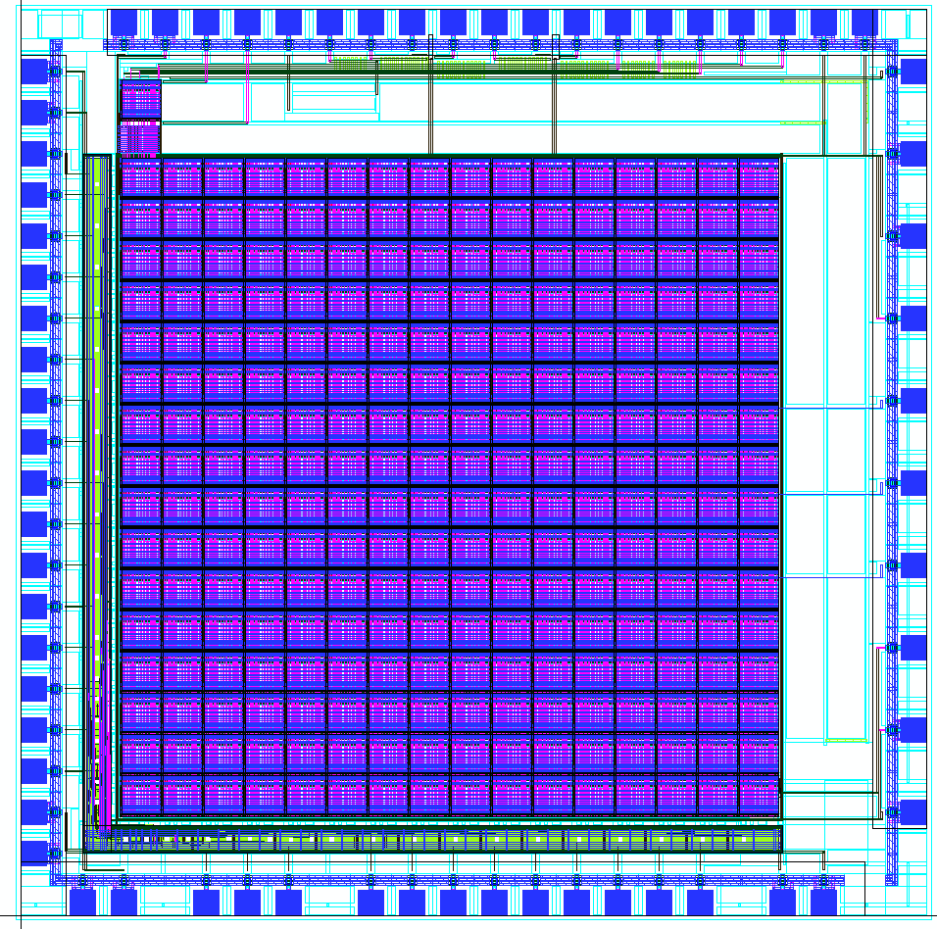
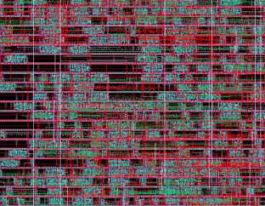
3D-CMOS
1) bump-bond to the detector (TSV)
2) amplification & double sampling
4) signal readout
3) store the analog signal in a memory cell in 1st/2nd layer (544 memory depth)
5x5 mm2 double-tier dice
MPW, via CMP
submitted 2011
to be delivered „early“ 2013
Standard Cells

Slide 25
What could be next? AGIPD2?
Smaller pixels with
Reduced dynamic range (no gain switching);
Reduced number of frames?
New Technologies including:
3D CMOS: second layer (more functionality)
65 nm CMOS technology (more functionality)
3D CMOS + 65 nm CMOS
Notes:
HGF Portfolio activity

Slide 26
Who are the People ?
DESY PSI Uni-HH Uni-Bonn
Julian Becker Roberto Dinapoli Eckhard Fretwurst Markus Gronewald
Laura Bianco Doninic Greiffenberg Robert Klanner Hans Krueger
Peter Goettlicher Beat Henrich Joern Schwandt
Heinz Graafsma Aldo Mozzanica Jiaguo Zhang
Helmut Hirsemann Xintian Shi
Stefanie Jack Bernd Schmitt
Alexandre Klyuev
Sabine Lange
Alessandro Marras
Bjoern Nilsson
Seungyu Rah
Igor Shevyakov
Segrej Smoljanin
Ulrich Trunk
Manfred Zimmer
E-XFEL
Jolanta Sztuk-Dambietz

