Slide 1

Status of the XFEL.EU Undulator Systems
J. Pflüger, WP71
Notes:
How to edit the title slide
Upper area: Title of your talk, max. 2 rows of the defined size (55 pt)
Lower area (subtitle): Conference/meeting/workshop, location, date,
your name and affiliation, max. 4 rows of the defined size (32 pt)

Slide 2
Overview
XFEL.EU Undulator Systems & Controls
Undulator Segments
  Serial Production of Undulator Segments:
  Representative Results
Intersections
Summary

Slide 3
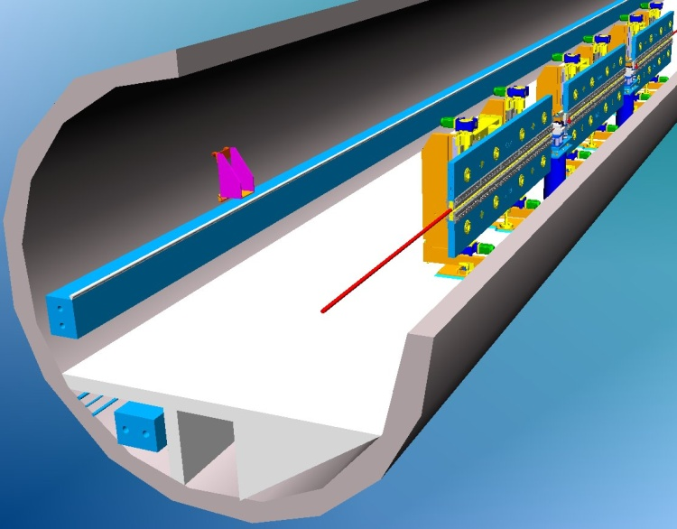
Undulator Systems

Slide 4
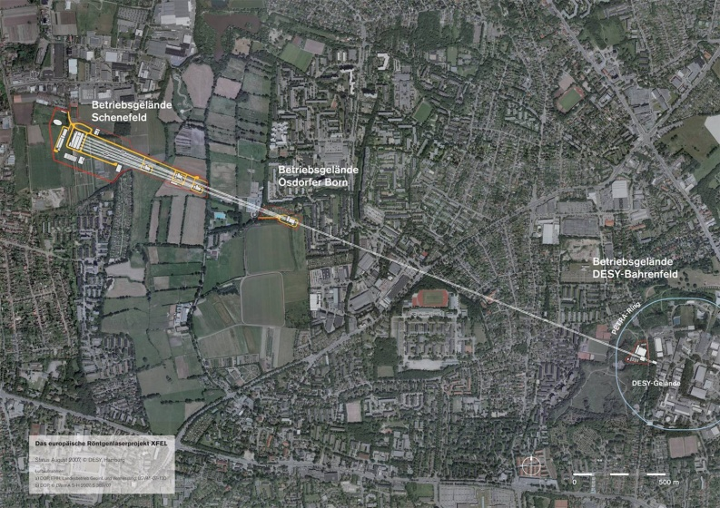
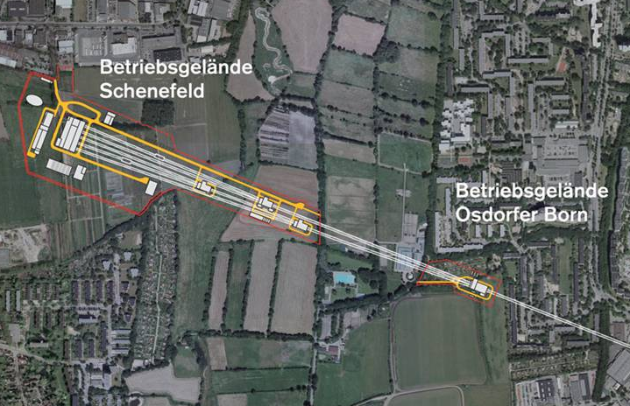
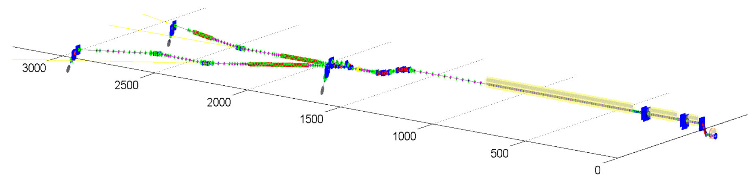
European XFEL Overview
Aerial View
Dumps
SASE 3
SASE 1
Switchyard
SASE 1- 3 : Undulator Systems
SASE 2
SC Accelerator
Dogleg
Injector
Accelerator Layout
W. Decking

Slide 5
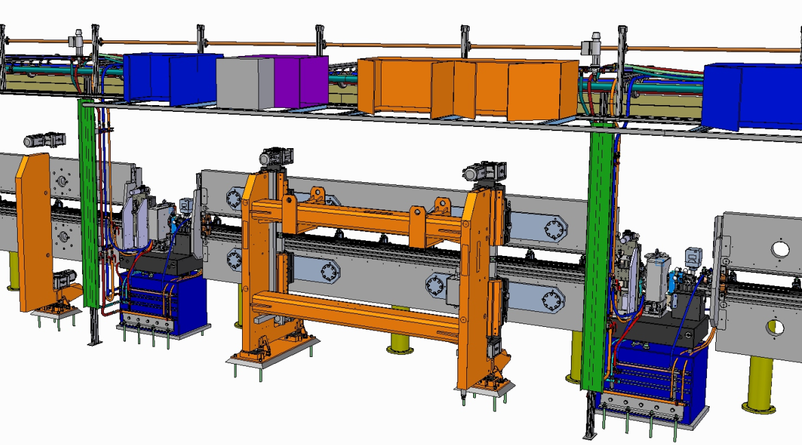
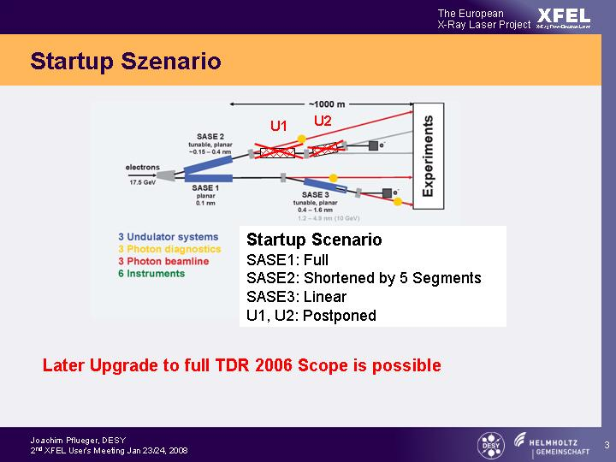
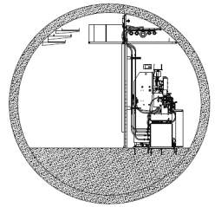
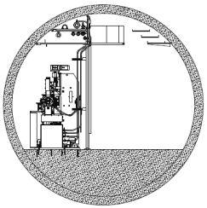
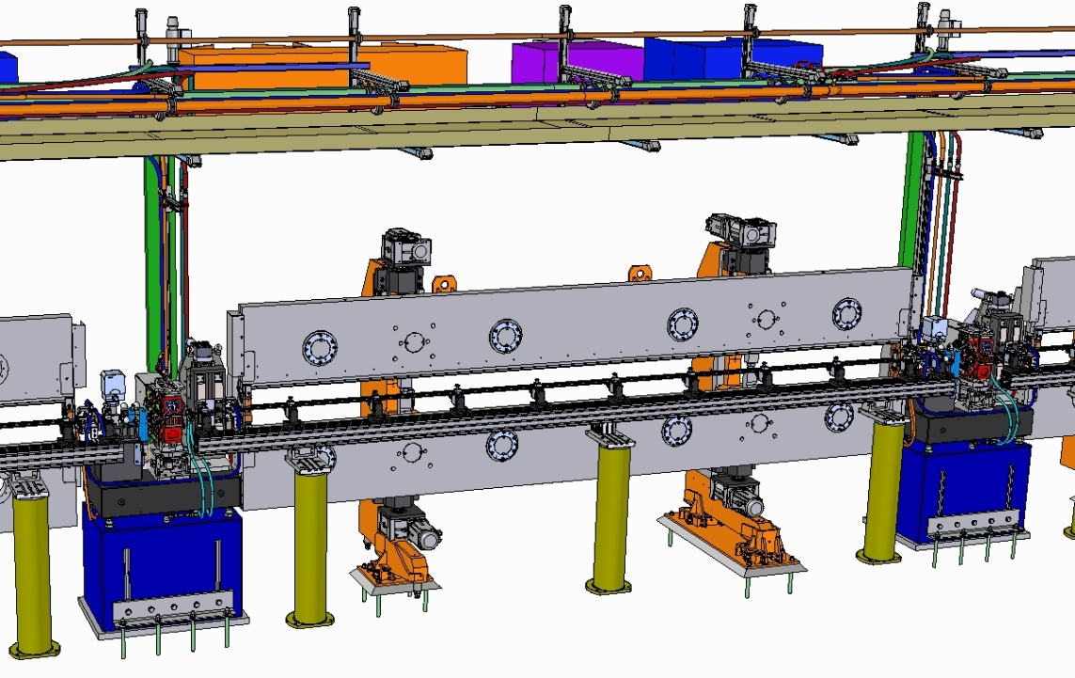
Tunnel Installation of SASE2 Undulator System – Final WP71 Deliverables
SASE2
e ⁻
Local Control Systems
e ⁻
SASE2 SASE1/3
Downstream View
Minor Differences of Components in
SASE2 and SASE1/3:
Undulator Segments reversed 180°
Different Arrangement in SASE1 of
  Components on Intersections
  Control Cabinets, cabling
System Sizes:
SASE1: 35 Cells; λ₀=40mm ; L=213.5m
SASE2: 35 Cells; λ₀=40mm ; L=213.5m
SASE3: 21 Cells; λ₀=68mm ; L=128.1m
e ⁻
Undulator Segment 5m
Intersection
1.1 m
Undulator Cell 6.1m
W.Tscheu

Slide 6



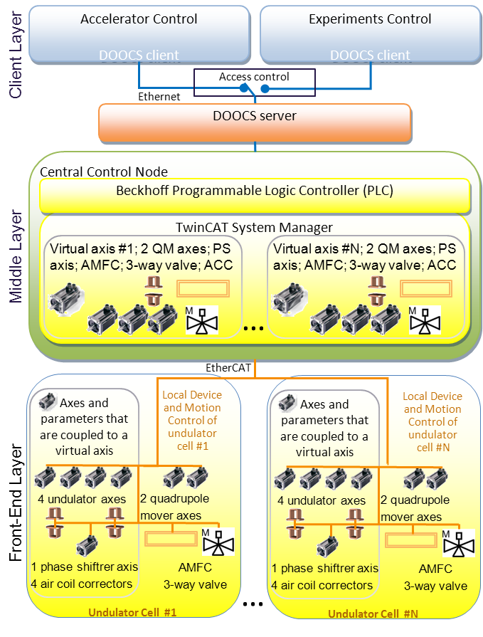
Undulator Control System
Developed at XFEL.EU
XFEL.EU guidelines & standards
Based exclusively on industrial Automation Technology
Using the fast EtherCAT protocol
Hardware from Beckhoff GmbH
Running the TwinCAT software
The Topology reflects Hardware
External
Access
for DOOCS
and Experiments
Global Control
in Computer
Service Room
Up to 35
Local Control
Systems in Tunnel
1…. up to 35
S. Karabekyan, A Beckmann, M. Yakopov

Slide 7
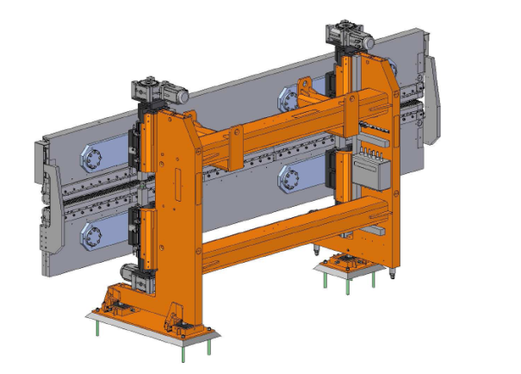
Undulator Segments

Slide 8




Production of Undulator Segments
The Focus is on Serial Production. R&D is long ago!!
Industrial Part
  Mechanical Support System including Local Motion Control System: 2 Suppliers
  Magnetic Structure
  Documentation in EDMS
XFEL.EU Part
  Integration: Mechanics & Magnetics @ XFEL.EU
  Commissioning @XFEL.EU
  Magnetic Measurement & Tuning
  Preparation for Installation
  Documentation in EDMS

Slide 9
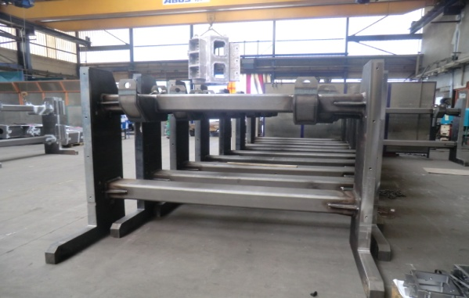
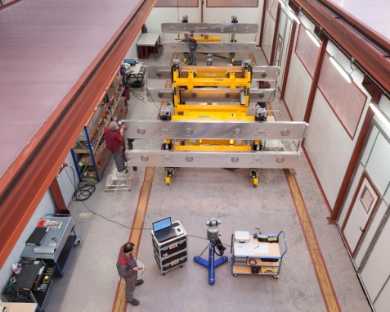
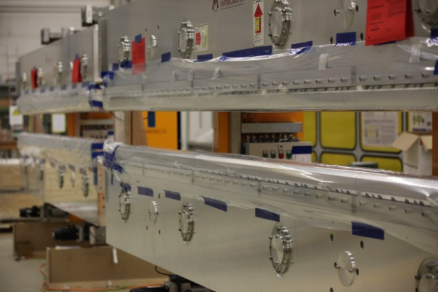
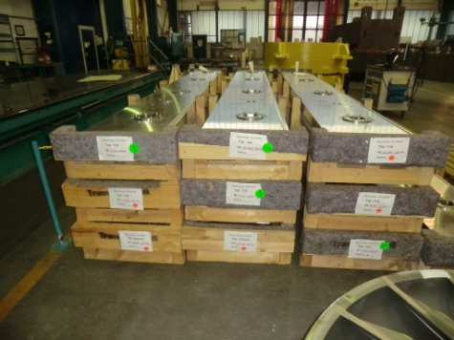
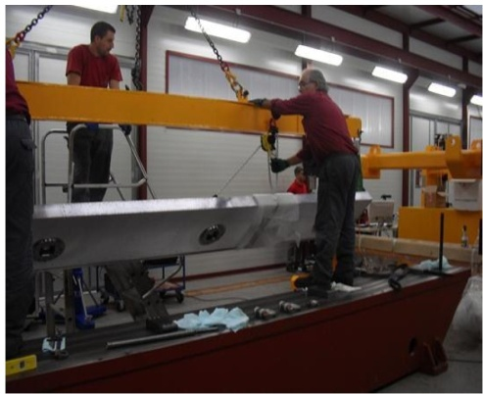

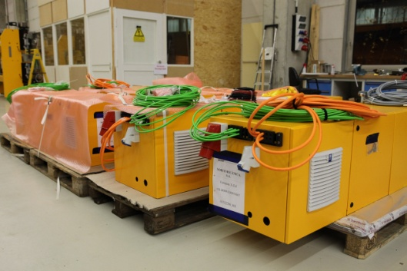
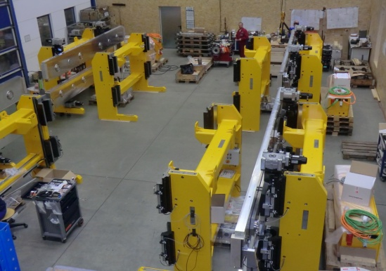
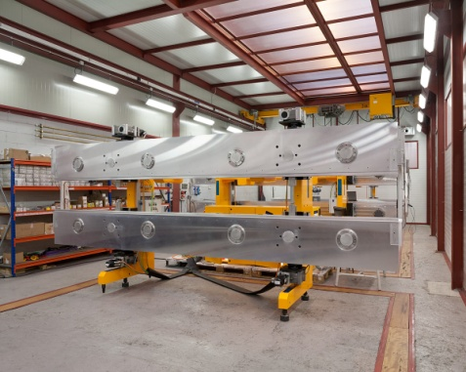
Production Cycle: Industrial Production
Mechanical Support Systems
Magnetic Structuress
July 2012
Nov 2012
Local Control Systems
July 2012
Nov 2012
Dec 2012
Dec 2012

Slide 10
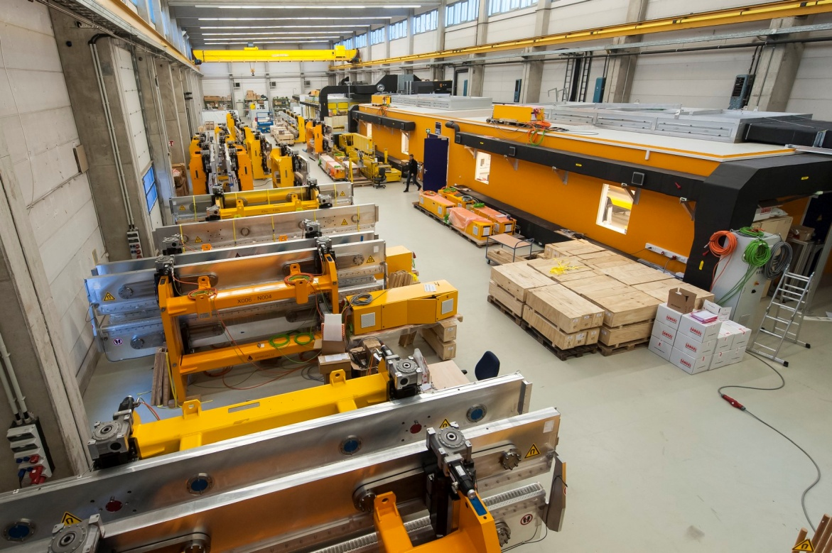
Production @ XFEL.EU in Building 36
New Undulator Segments
3 climatized Magnetic Labs
Steps @ XFEL.EU:
Mounting of magnetic structures
1st Commissioning
Magnetic Measurements & Tuning
Preparation for Installation
Schedule:
Total Time ≈ 2 Years
(starting Oct/12)
3 Weeks/Segment
→ 3 Magnetic Labs needed running in parallel
Scheduled End:
Oct / End 2014
Assembly Area for
Magnetic Structures
Segments waiting for Magnetic Measurements
Measured and tuned Segments
Incoming Magnetic
Structures from VAC
Hall 36 is rapidly filling up!
December 2012

Slide 11
Results
Magnetic Measurements
U. Englisch, Y. Li, S.Utermann, F. Wolff-Fabris

Slide 12
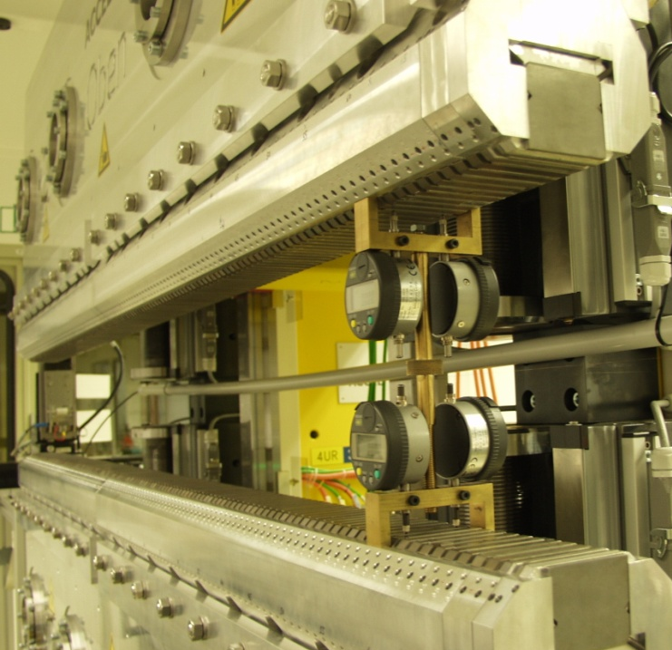
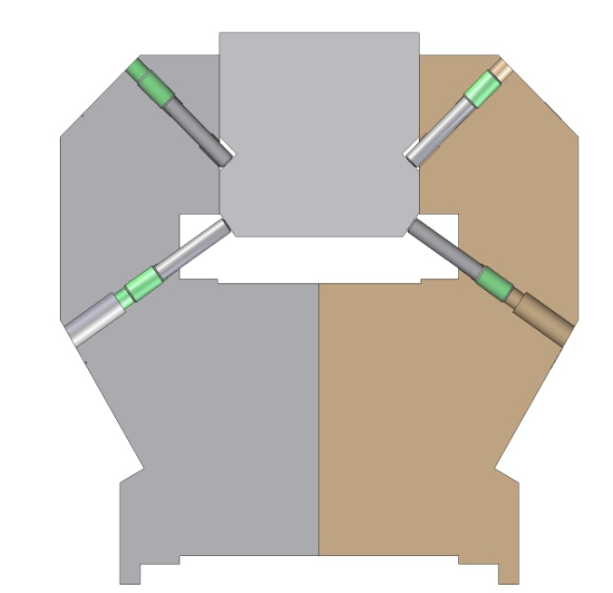
Pole Tuning at XFEL Undulator Segments
Tuning Screws
Locking Screws
5m
≈± 300μm
≈± 4mrad
U40: 246 pairs of poles
U68: 144 pairs of poles
B_{Y} and B_{Z} tuning is combined
No Shims are used
All errors are tuned by moving Poles
Bipolar Field Corrections

Slide 13
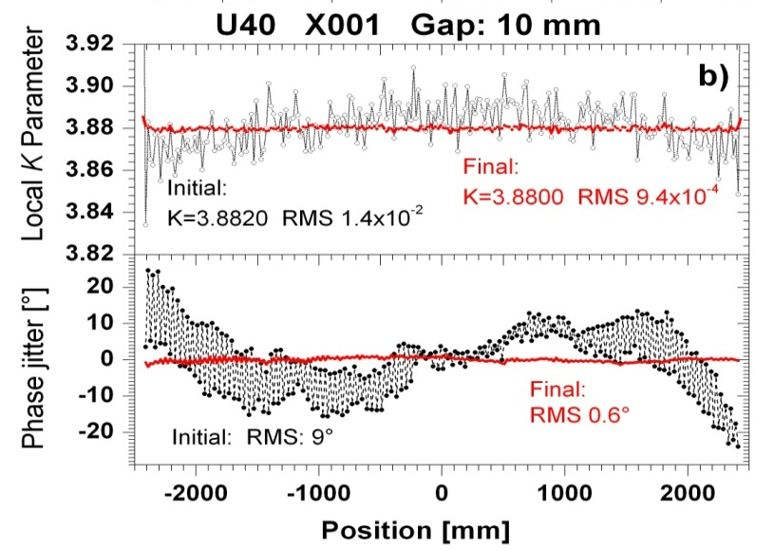

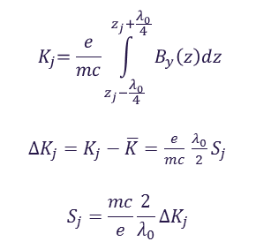
B_{Y} Field: Pole Height Tuning I
Local K-Tuning
$${ K}_{j}=\frac{e}{mc}\int_{z_{j}−\frac{λ_{0}}{4}}^{z_{j}+\frac{λ_{0}}{4}}{B_{y}\left(z\right)dz}$$
${ΔK}_{j}=K_{j}−\overline{K}=$ $\frac{e}{mc} \frac{λ_{0}}{2}S_{j}$
$$S_{j}=\frac{mc}{e}\frac{2}{λ_{0}}{ΔK}_{j}$$
Limit to 3 next neighbors
≈± 300μm
$$S_{j}=\sum_{i=−3}^{3}{a_{i} p_{j+i}}$$
Local gap change
Local Field Change
Influence of neighbors
Determination
of a_{i}
FLASH
Notes:
p

Slide 14
B_{Y} Field: Pole Height Tuning II
Tuned Poles:
U40: N =246
U68: N= 144
The Characteristic Coefficients a_{i} were measured for U40/U68:
For the 3 poles next to the end ‘End Poles’
For all other poles ‘Bulk Poles’
Tuning done at the ‘Tuning Gap’:
U40: 14mm
U68: 16 mm
♦Most Poles need to be tuned
♦ One Tuning Step is (usually) sufficient
Bulk poles

Slide 15
B_{Z} Field: Pole Tilt
B_{Z} is due to errors only.
Ideal B_{Z} trajectory 2nd Field Integral is a Null line
Correction by Tilting Poles
≈± 4mrad
 | λ₀ [mm] | Tuning Gap [mm] | Tilt Kick Signature [Tmm/mrad]
U40 | 40 | 14 | 0.0127
U68 | 68 | 16 | 0.0325

Slide 16
Pole Tuning: U68-X003-N001 @ Gap=16mm
Notes:
Before you start editing the slides of your talk change to the Master Slide view:
Menu button “View”, Master, Slide Master:
Edit the following 2 items in the 1st slide:
1) 1st row in the violet header:
Delete the existent text and write the title of your talk into this text field
2) The 2 rows in the footer area: Delete the text and write the information
regarding your talk (same as on the Title Slide) into this text field.
If you want to use more partner logos position them left
beside the DESY logo in the footer area
Close Master View

Slide 17
U68-X003 / X004:
Comparison of Gap dependent Results
Transverse Overlap
K-Parameter
Longitudinal Overlap / Phase Jitter
 | Specs | Result
Operational Gap Range [mm] | 10-25 | ---
B₀ @ 10mm Gap [T] | 1.69 | 1.66
K @ 10mm Gap | 10.5 | 9.3
RMS I2_{Y} [Tmm²] | < 210 | < 90
RMS I2_{Z} [Tmm²] | < 100 | < 70
Phase Jitter [°] | < 8 | < 8

Slide 18
Pole Tuning : U40-X044-K004 @ Gap=14mm
Notes:
Before you start editing the slides of your talk change to the Master Slide view:
Menu button “View”, Master, Slide Master:
Edit the following 2 items in the 1st slide:
1) 1st row in the violet header:
Delete the existent text and write the title of your talk into this text field
2) The 2 rows in the footer area: Delete the text and write the information
regarding your talk (same as on the Title Slide) into this text field.
If you want to use more partner logos position them left
beside the DESY logo in the footer area
Close Master View

Slide 19
U40-X044 / X004:
Comparison of Gap dependent Results
Transverse Overlap
K-Parameter
Longitudinal Overlap / Phase Jitter
 | Specs | Result
Operational Gap Range [mm] | 10-20 | ---
B₀ @ 10mm Gap [T] | 1.14 | 1.13
K @ 10mm Gap | 4 | 3.9
RMS I2_{Y} [Tmm²] | < 100 | < 50
RMS I2_{Z} [Tmm²] | < 100 | < 40
Phase Jitter [°] | < 8 | < 7
Notes:
Before you start editing the slides of your talk change to the Master Slide view:
Menu button “View”, Master, Slide Master:
Edit the following 2 items in the 1st slide:
1) 1st row in the violet header:
Delete the existent text and write the title of your talk into this text field
2) The 2 rows in the footer area: Delete the text and write the information
regarding your talk (same as on the Title Slide) into this text field.
If you want to use more partner logos position them left
beside the DESY logo in the footer area
Close Master View

Slide 20
Comparison of Magnetic Results
Measurement Results be independent of the Bench→ Comparison
of Measurements done at all labs
Influence of low temperature exposition
≈2°C
Further Plans: Influence of Transport Conditons to Osdorfer Born

Slide 21
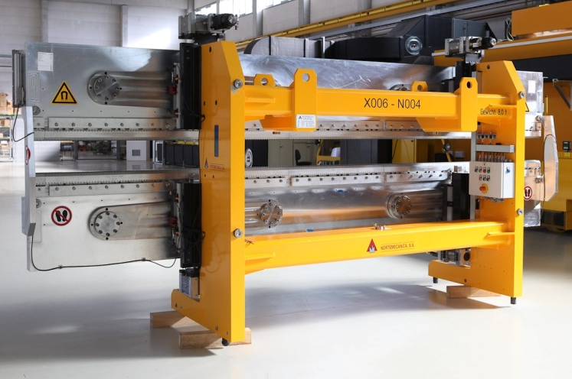
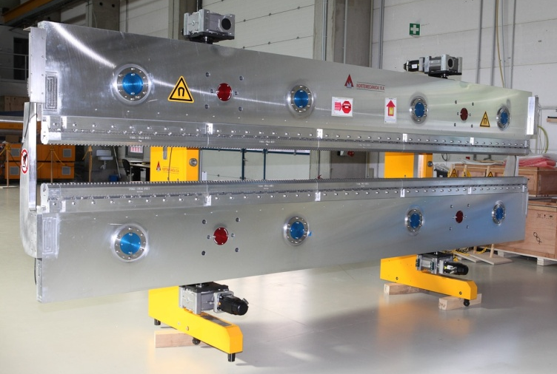
Present Status of Production
Status of Undulator Production April 19, 2013
Delivery Status:
  43 Support Systems
  38 Magnet structures
Prepared for Measurements: 33
Measured & tuned: 22 Segments, 110m
Waiting for magnetic measurements: 11 Segments
Ready for Installation: 18
In Preparation for Installation: 3
Scheduled End of Production: 12 / 2014

Slide 22
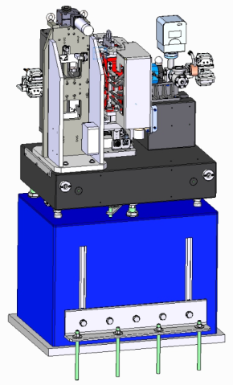
Intersections

Slide 23





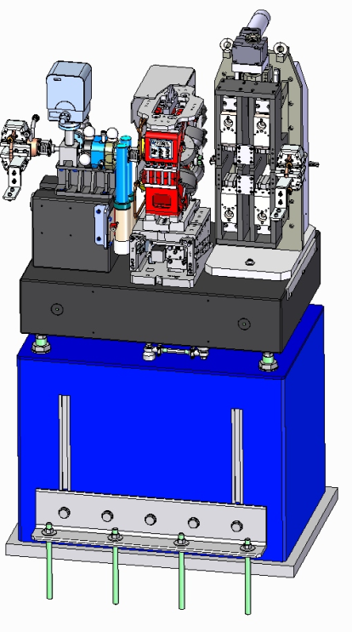






SASE2 Type Intersection
WP17
WP17
Re-entrant Cavity
BPMs+ Electronics
Beam Loss Monitors
WP71
WP19
Vacuum System
Phase Shifters
Status 1/2013:
Delivered: Quadrupoles, WP12
In Production 91 Intersections:
  Phase Shifters (Nov 12), WP71
  BPMS, WP17
  BLMs, WP17
  Vacuum systems, WP19
  Air Coil Correctors, WP71
  Base Plates, WP71
  Adjustors, WP71
  Concrete Pillars , WP71
Released for production:
  Quadrupole Movers (Dec12), Ciemat
Start of Assembly @ XFEL: June 2014
WP12
WP71
Air Coil
Correctors
Quadrupoles
WP71
WP71
Quadrupole Movers
Support Bases
Adjustors
Concrete Pillars

Slide 24
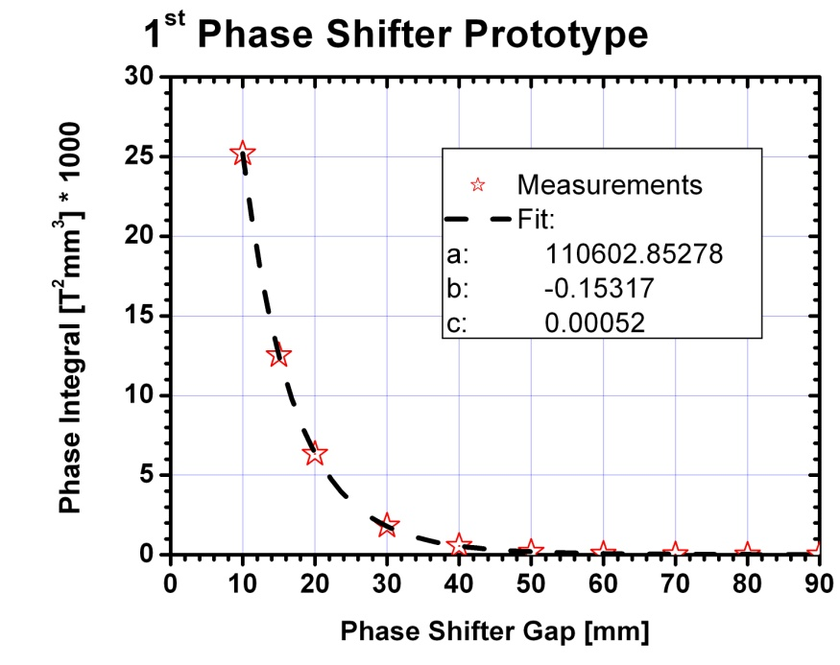
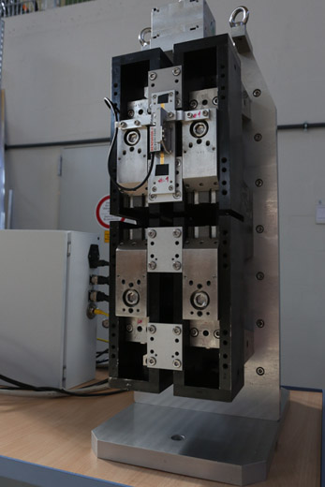
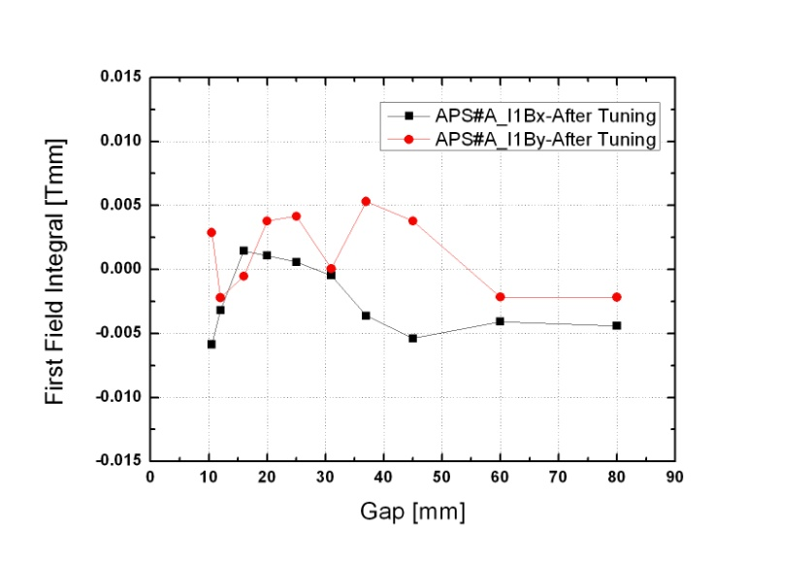
Phase Shifter Prototypes by IHEP Beijing
Period length: 55mm
Gap range: 10.5 to ≈>100mm
Max. Phase Integral
@ gap 10.5mm : ≥23400 T²mm³
1st Hor/Ver Field
Integral Tolerance: ±0.004 Tmm
Dynamic Operation without retuning!
2nd Hor/Ver Field
Integral Tolerance: ±67 Tmm²
Phase adjustment
accuracy: ± 10° (5°)
Min. Gap precision for 5/10°
at SASE1/2 ±15/30 µm
Tolerance Band &
Operational Range
H. Lu, S. Sun, C. Wan, IHEP, Beijing
H. Lu, Y. Li, J. Pflueger, NIM A605 (2009),399

Slide 25
Summary
Production of Undulator Segments in full Swing
  Industrial Production is well in Schedule
  Magnetic measurements & Tuning @XFEL.EU
  being ramped up
  Magnetic Measurements & Tuning:
    Methods and techniques work fine
    22 Segments tuned to Specs
Intersections:
  Phase Shifter Prototypes in Specs
  (Almost) all Components are in production
Production of Undulator Systems in schedule!

Slide 26
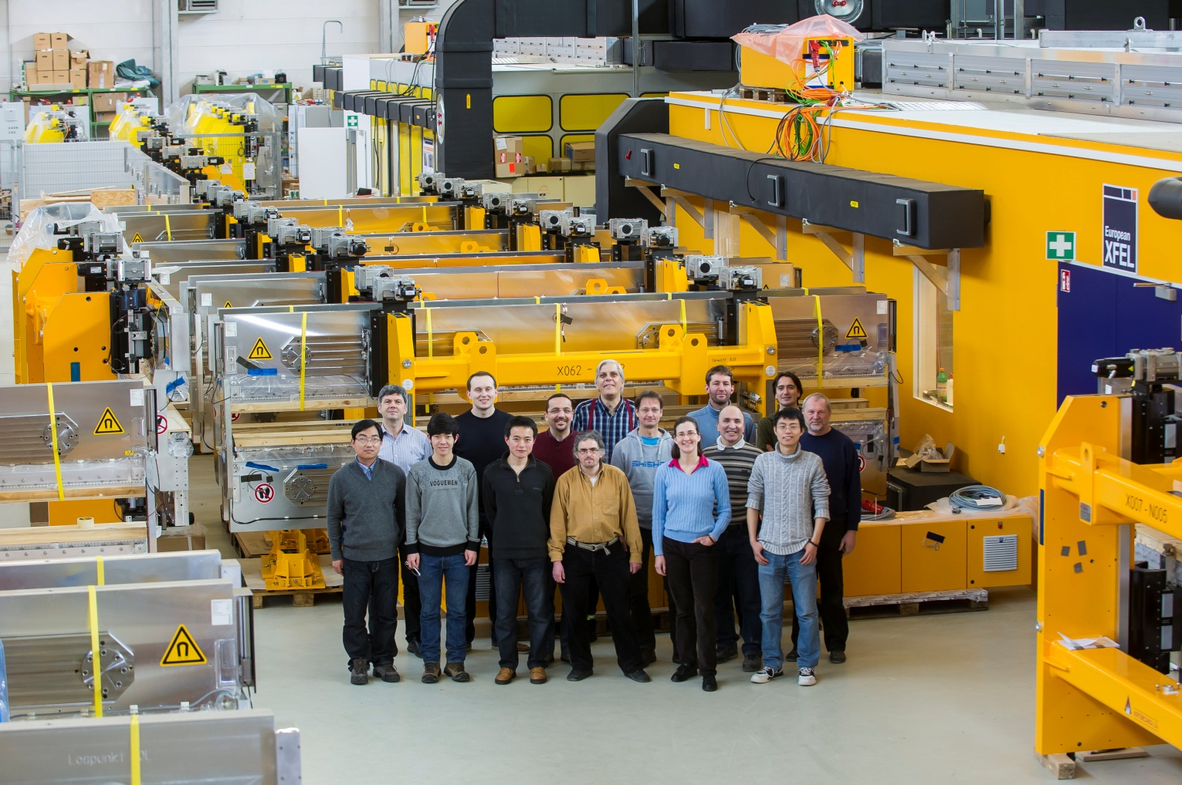
XFEL.EU Undulator Systems Group, WP71
WP71 Status March 3, 2013, left to right:
Yufang Yang, Suren Karabekyan, Xiaoyu Li, Georg Deron, Yuhui Li, Bora Ketenoglu, Uwe Englisch, Joachim Pflüger, Andreas Beckmann, Sonia Utermann, Martin Knoll, Majid Bagha-Shanjani, Fredrik Wolff-Fabris, Hongxian Lin, Karl-Heinz Berndgen, not shown: Mikhail Yakopov

Slide 27
The End

Slide 28


