Slide 1
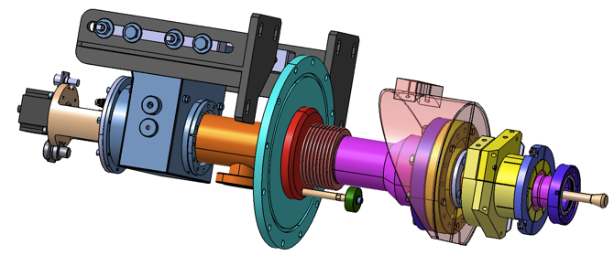
Power couplers
DESY, April 23th 2013
Walid KAABI
2nd XFEL Collaboration Meeting
Notes:
How to edit the title slide
Upper area: Title of your talk, max. 2 rows of the defined size (55 pt)
Lower area (subtitle): Conference/meeting/workshop, location, date,
your name and affiliation,
max. 4 rows of the defined size (32 pt)
Change the partner logos or add others in the last row.

Slide 2
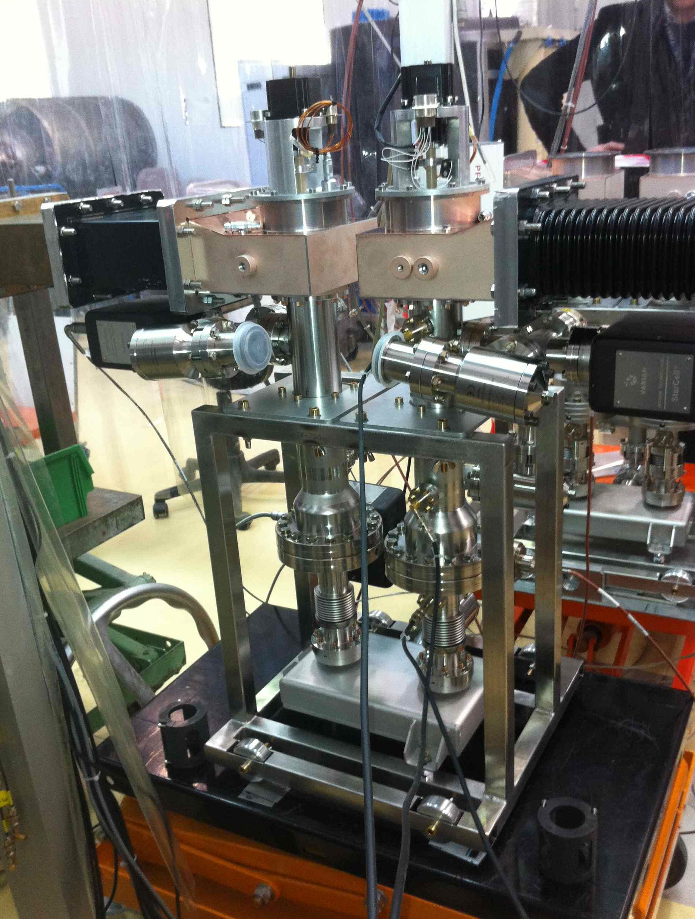
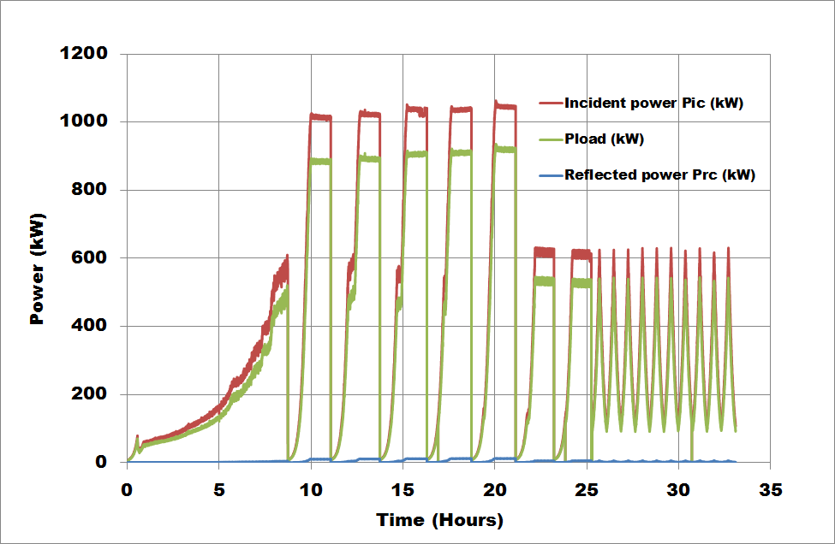
Coupler Status at LAL
4 XFEL couplers were received at LAL.
During conditioning, the first pair was limited by one cold part, the conditioning was stopped. The second pair was successfully conditioned.
Conditioning in 33h without interlock.
Notes:
Before you start editing the slides of your talk change to the Master Slide view:
Menu button “View”, Master, Slide Master:
Edit the following 2 items in the 1st slide:
1) 1st row in the violet header:
Delete the existent text and write the title of your talk into this text field
2) The 2 rows in the footer area: Delete the text and write the information
regarding your talk (same as on the Title Slide) into this text field.
If you want to use more partner logos position them left
beside the DESY logo in the footer area
Close Master View

Slide 3
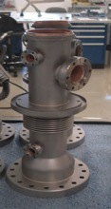
Coupler fabrication status and challenges
Next delivery will follow at a frequency of 1 pair/week starting from April 24th.
Ramp up to 2 pair/week is foreseen end of June.
Today, the limitation is the low yield of most critical part coppering (Warm External Conductor: WEC): 40%. Other parts (Cold External Conductor and Warm Internal Conductor) have a coppering yield of 80%.
Thales is now working on improving the WEC coppering yield.
It still unclear when the rate of 8 coupler/week will be reached. It is strongly linked to the yield improvement.
Notes:
Before you start editing the slides of your talk change to the Master Slide view:
Menu button “View”, Master, Slide Master:
Edit the following 2 items in the 1st slide:
1) 1st row in the violet header:
Delete the existent text and write the title of your talk into this text field
2) The 2 rows in the footer area: Delete the text and write the information
regarding your talk (same as on the Title Slide) into this text field.
If you want to use more partner logos position them left
beside the DESY logo in the footer area
Close Master View

Slide 4
Couplers delivery schedule
According to the last planning update with Thales and RI (April 11th), the delivery schedule will be the following:
- First 8 couplers → delivery to IRFU: 03/06/2013
- Second 8 couplers → Delivery to IRFU: 05/07/2013
- Third 8 couplers → Delivery to IRFU: 26/07/2013
Notes:
Before you start editing the slides of your talk change to the Master Slide view:
Menu button “View”, Master, Slide Master:
Edit the following 2 items in the 1st slide:
1) 1st row in the violet header:
Delete the existent text and write the title of your talk into this text field
2) The 2 rows in the footer area: Delete the text and write the information
regarding your talk (same as on the Title Slide) into this text field.
If you want to use more partner logos position them left
beside the DESY logo in the footer area
Close Master View

Slide 5
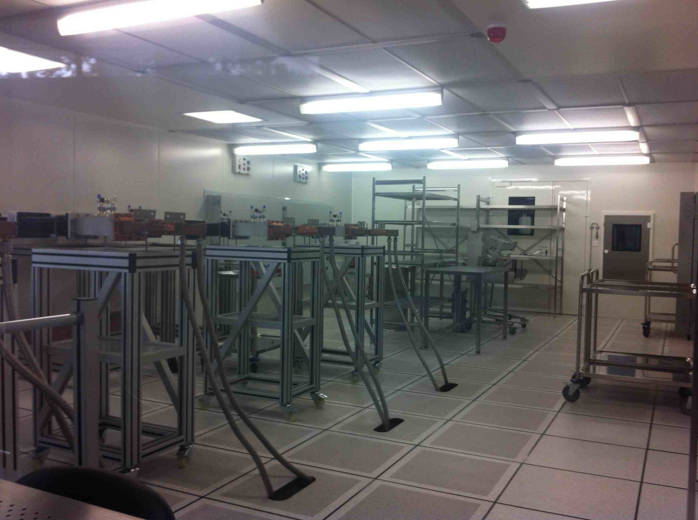
Infrastructure at LAL
The ISO5 clean room hosting the conditioning process is now available at LAL.
Commissioning of the clean room and its RF station starts on W16.
Notes:
Before you start editing the slides of your talk change to the Master Slide view:
Menu button “View”, Master, Slide Master:
Edit the following 2 items in the 1st slide:
1) 1st row in the violet header:
Delete the existent text and write the title of your talk into this text field
2) The 2 rows in the footer area: Delete the text and write the information
regarding your talk (same as on the Title Slide) into this text field.
If you want to use more partner logos position them left
beside the DESY logo in the footer area
Close Master View

