Slide 1


Electronics Racks for XFEL
LINAC Racks
April 2013
E. Negodin
Notes:
How to edit the title slide
Upper area: Title of your talk, max. 2 rows of the defined size (55 pt)
Lower area (subtitle): Conference/meeting/workshop, location, date,
your name and affiliation,
max. 4 rows of the defined size (32 pt)
Change the partner logos or add others in the last row.

Slide 2
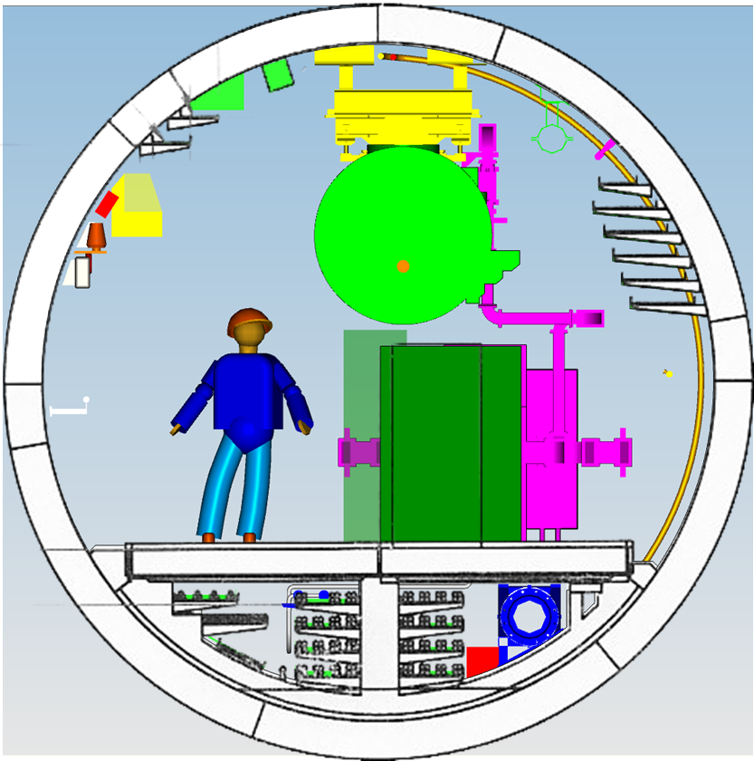
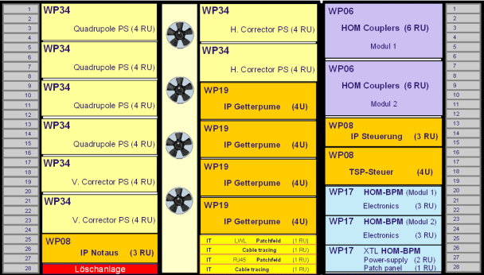

LINAC Rack Layout

Slide 3
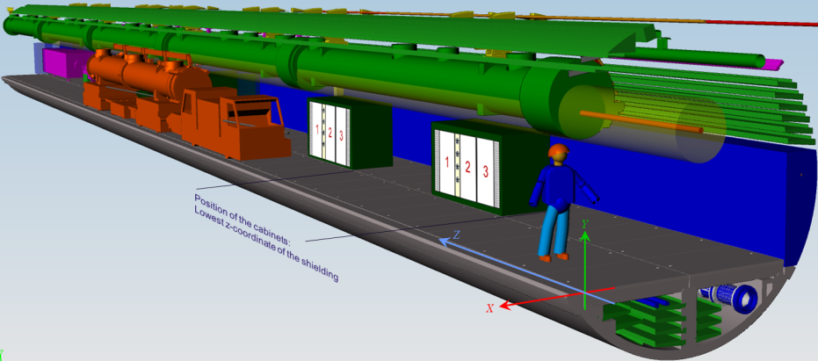
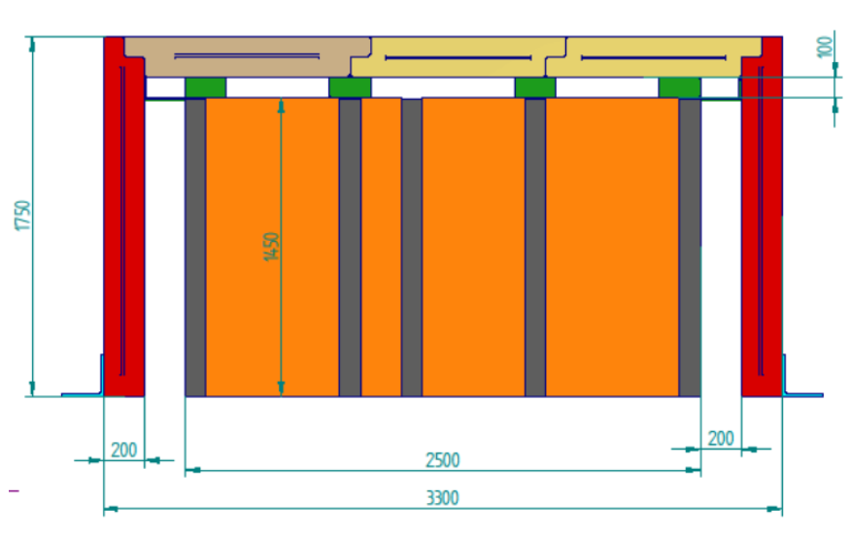
Radiation shielding

Slide 4
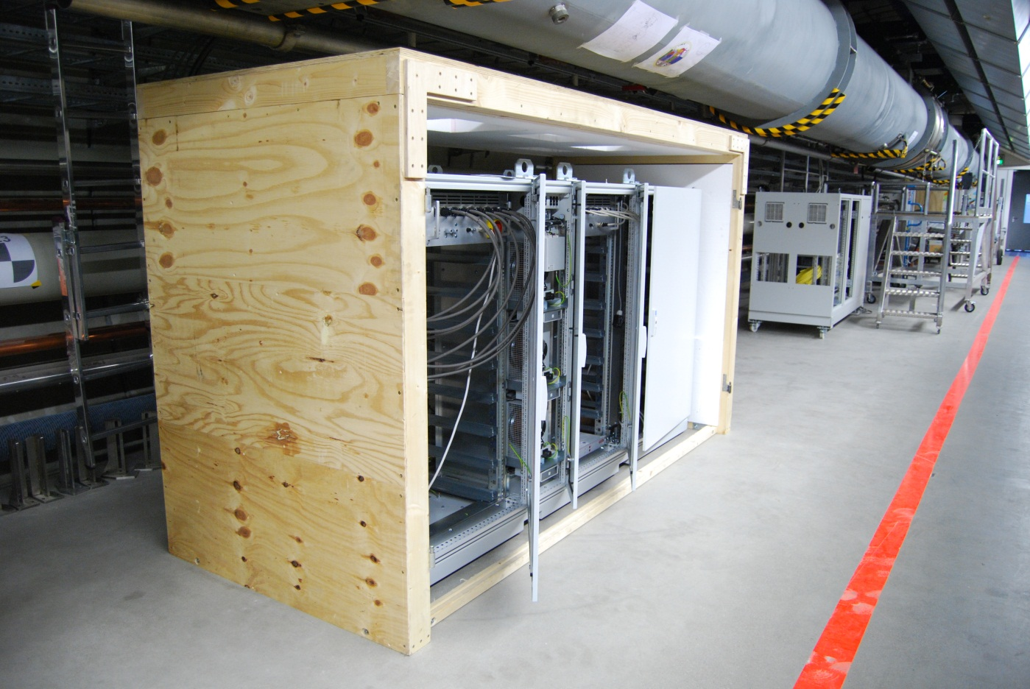
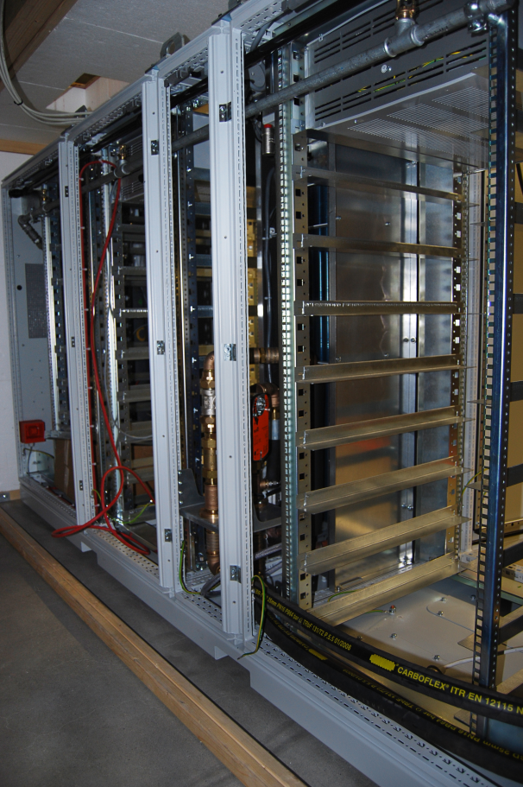
Rack Prototype

Slide 5
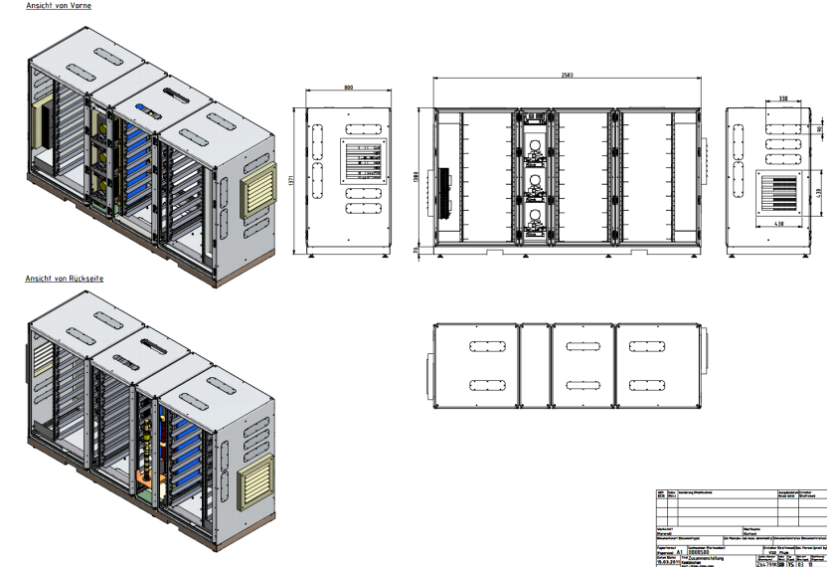
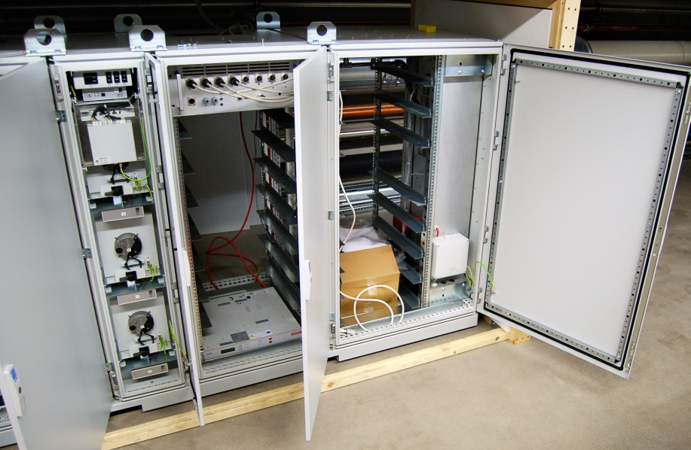
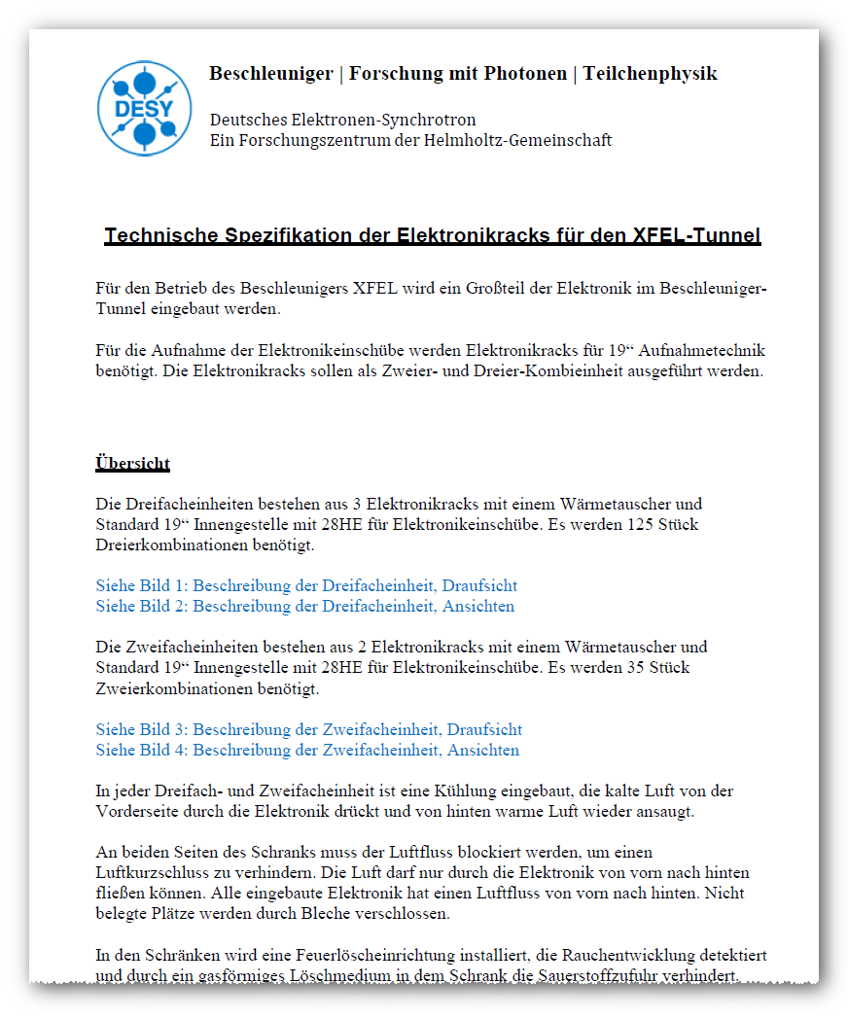
XTL Tunnel Racks Specifications
Within the last 6 month we have to update the specifications twice.
Most essential modifications were depth of the cabinet and fire protection attachments
EDMS: D*1846271
http://edmsdirect.desy.de/edmsdirect/file.jsp?edmsid=1846271

Slide 6
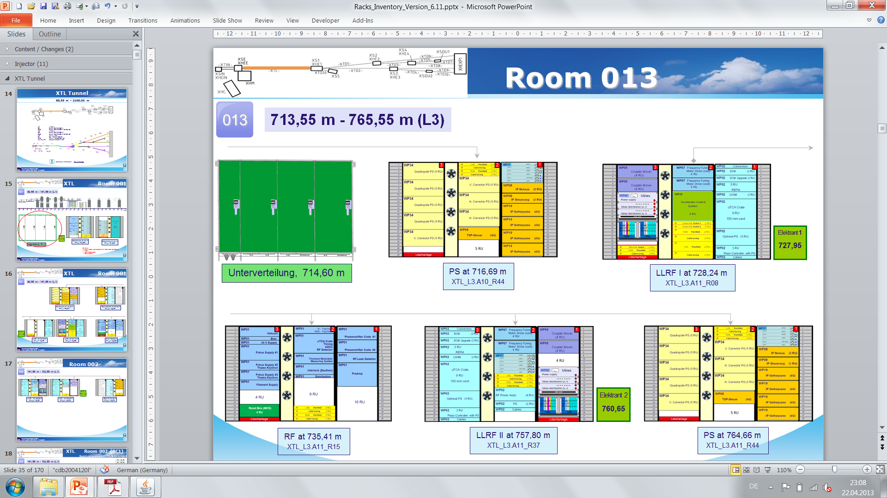
Racks Inventory

Slide 7
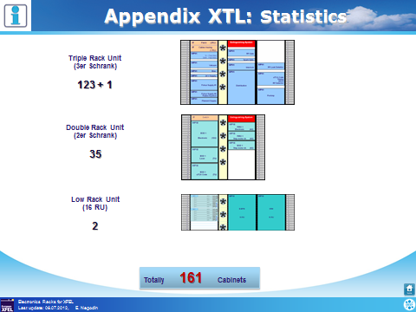

Slide 8
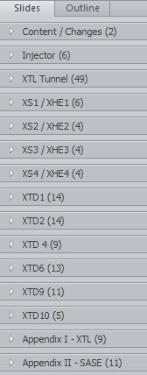

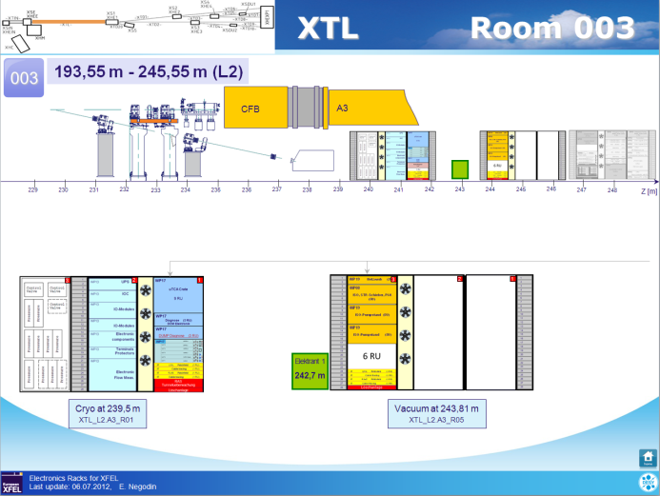
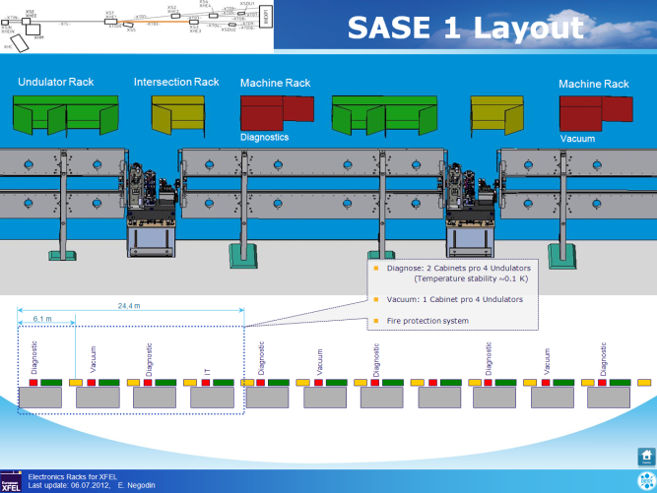
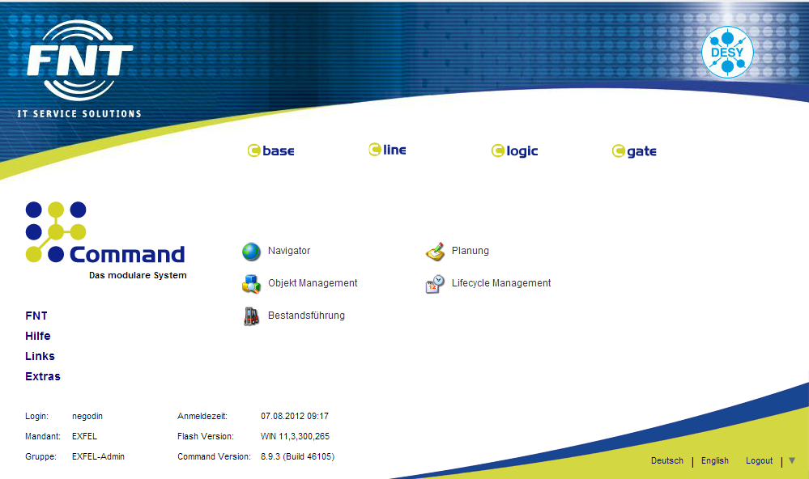
Kabel Dokumentation System - KDS
Racks Inventory serves as intermediate step to the KDS (Kabel Dokumentation System) and allows us to perform rack administration until KDS will be fully implemented within the frame of XFEL

Slide 9
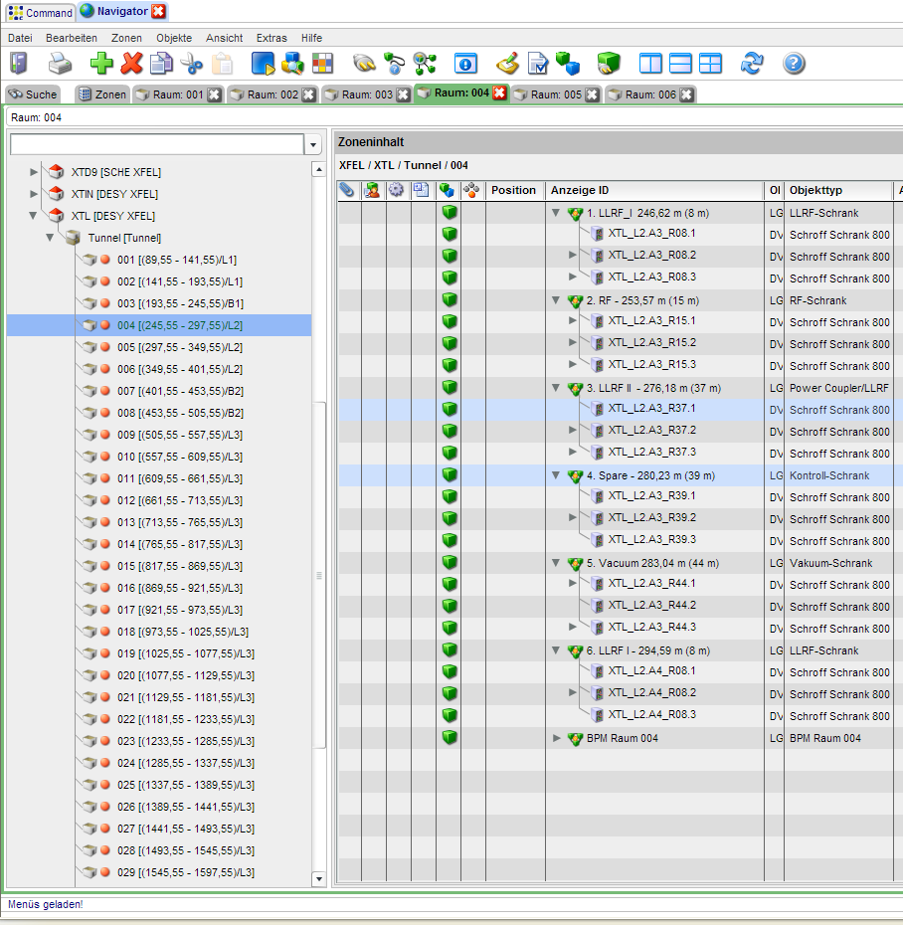
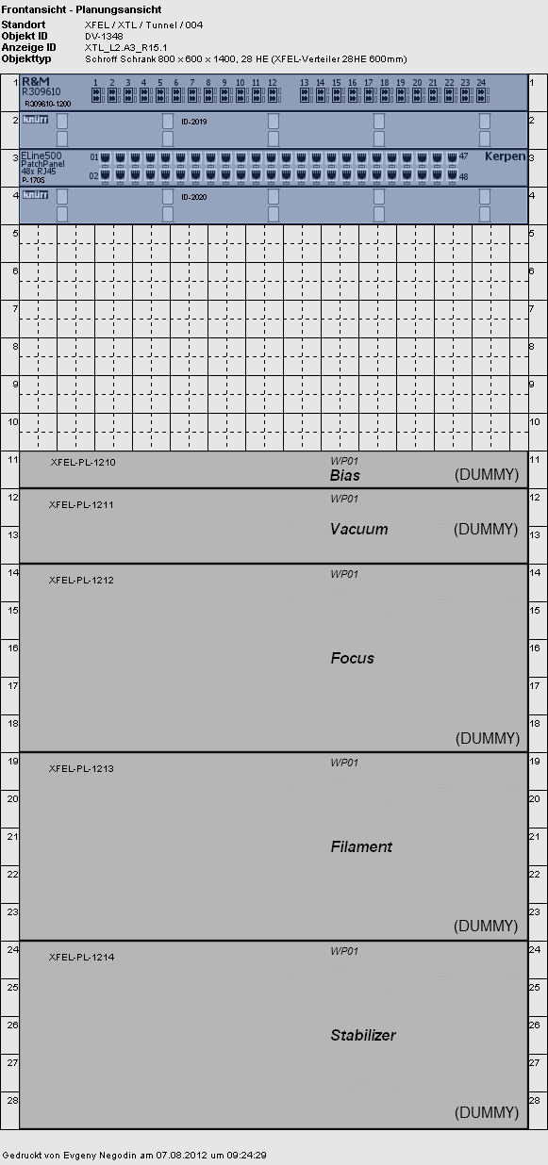
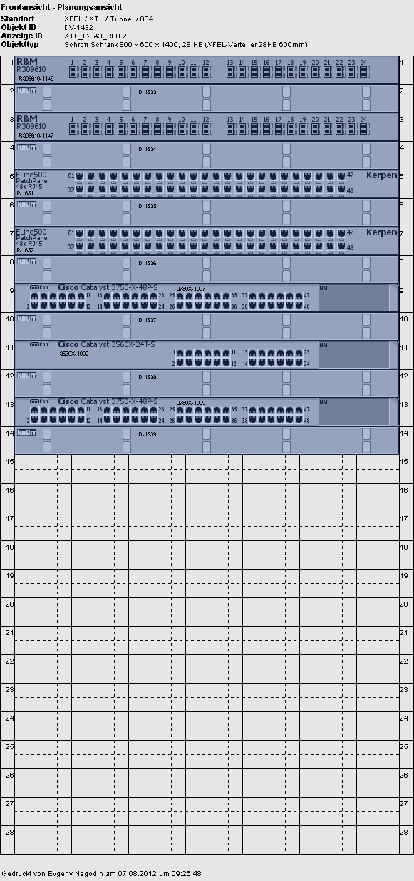
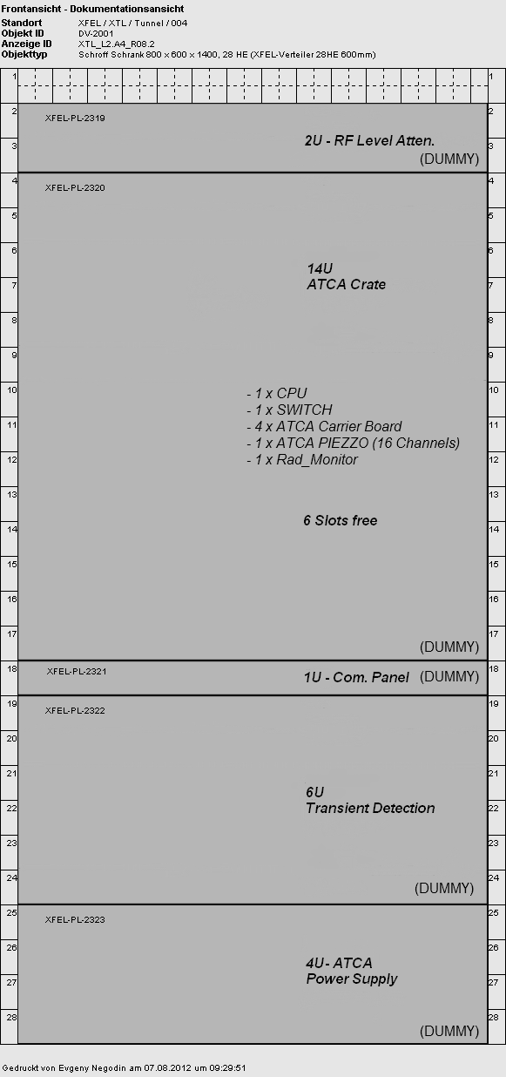
Kabel Dokumentation System - KDS

Slide 10
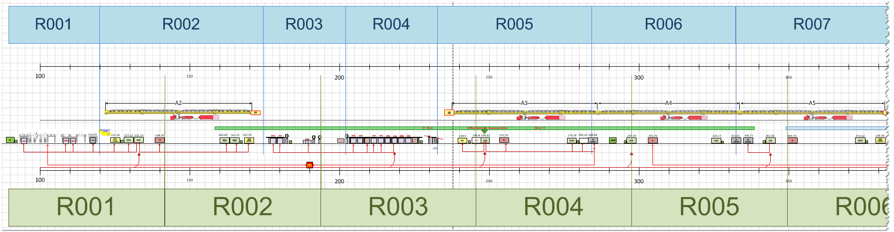
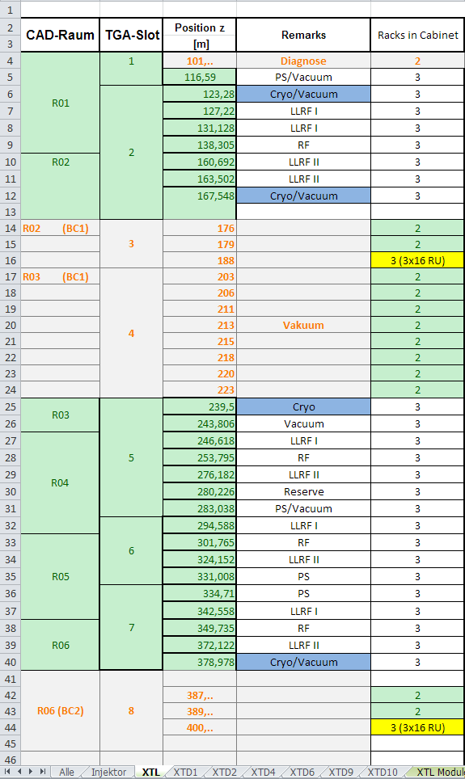
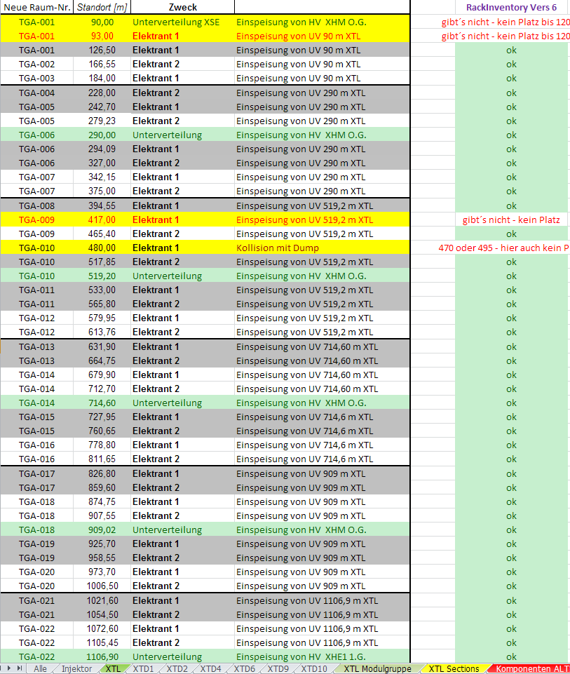
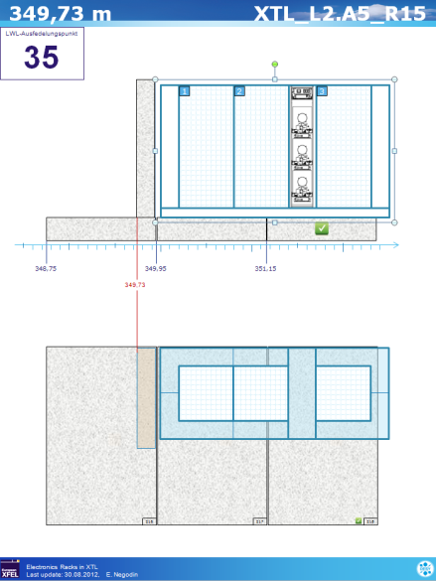
Other information sources
XTL overview as Visio-file
Excel Tables
Floor slabs and Racks

Slide 11
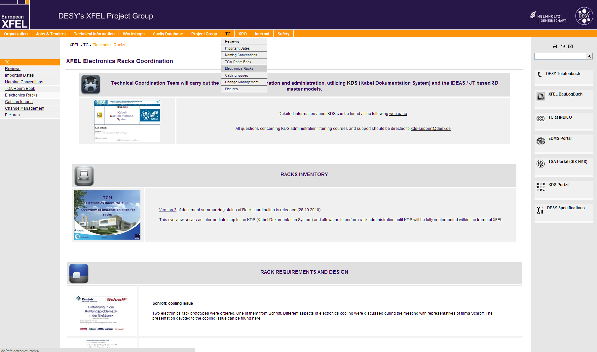
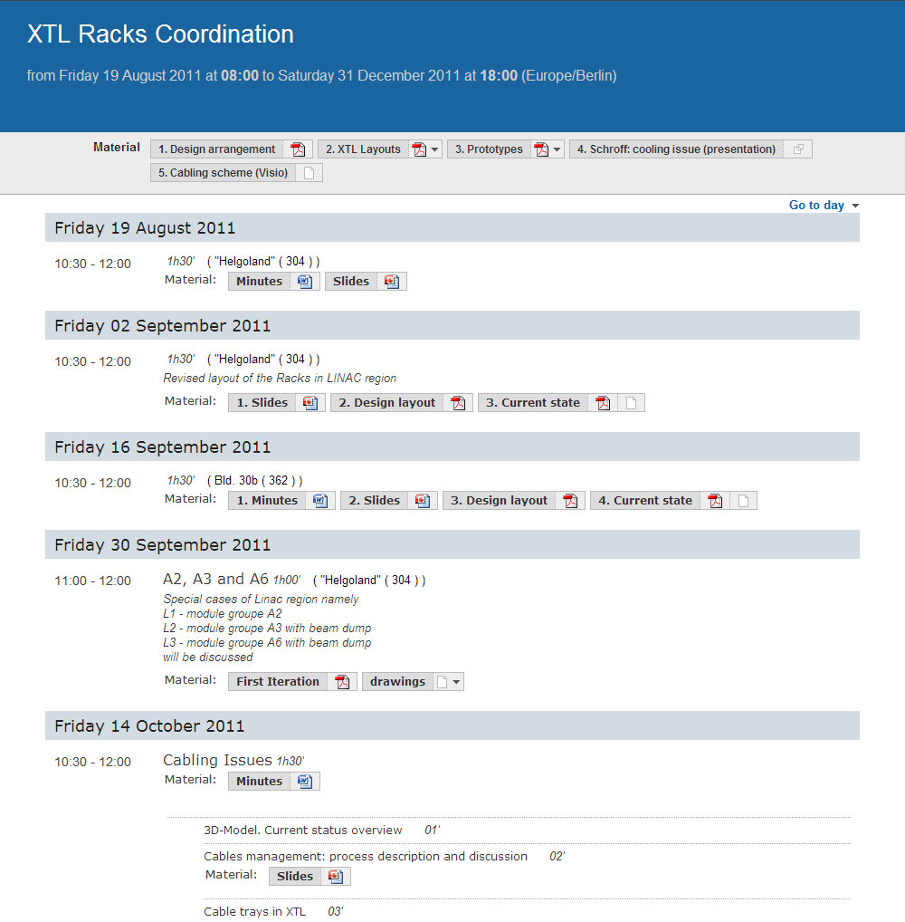
TC on the Web
http://xfel.desy.de/tc/electronics_racks/
https://indico.desy.de/conferenceDisplay.py?confId=4841

Slide 12
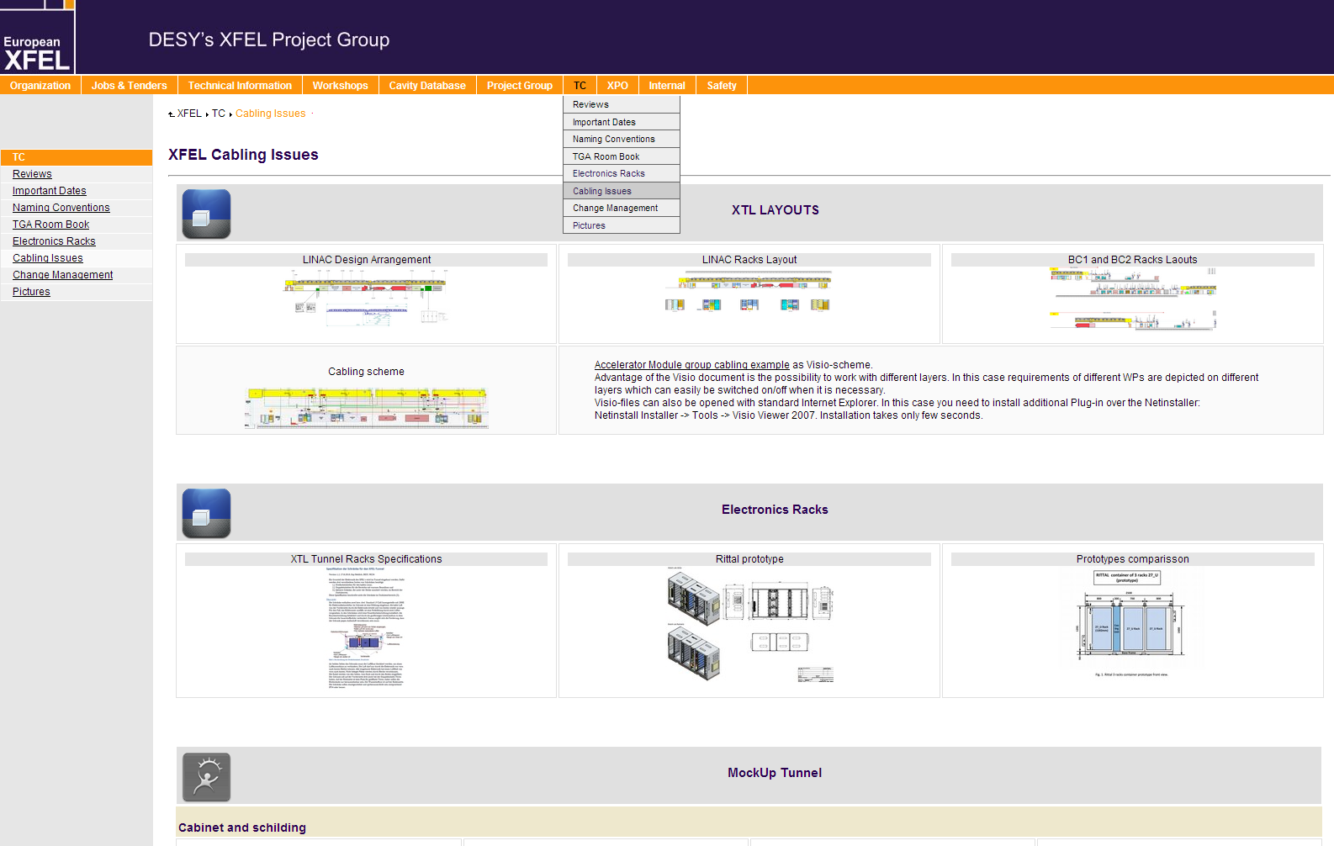
TC on the Web

Slide 13
Open questions
Ordering schedule
We need space to store the cabinets before they can be installed. Where? How much? At what time? How long?
Cabinets must be equipped and tested –> end user groups. Locality? Transport? Personnel?
Cabinets must be transported to the final position –> transport group -> Installation schedule.
Installed cabinets must be plugged to water, power and IT -> Installation schedule.
Racks cabling

