Slide 1
Post-Linac Collimation System for the European XFEL
2d Collaboration Meeting of the European XFEL, 22-25 April 2013, DESY
Nina Golubeva, DESY
Notes:
How to edit the title slide
Upper area: Title of your talk, max. 2 rows of the defined size (55 pt)
Lower area (subtitle): Conference/meeting/workshop, location, date, your name and affiliation, max. 4 rows of the defined size (32 pt)
Change the partner logos or add others in the last row.

Slide 2
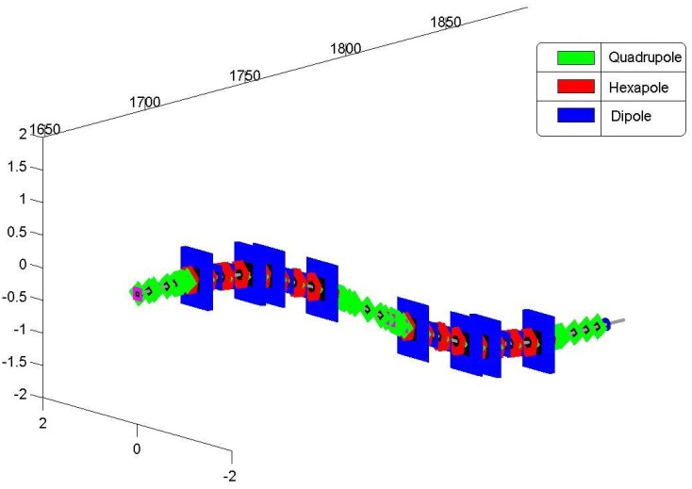
Post-Linac Collimation System
Main Linac
Beam Distribution
Collimation
Sextupole
IBFB section
Detailed description can be found in:
► Report TESLA-FEL 2007-05
► Proceedings of PAC09, Vancouver, BC, Canada
http://trshare.triumf.ca/~pac09proc/Proceedings/papers/th6pfp030.pdf
Notes:
Before you start editing the slides of your talk change to the Master Slide view: Menu button “View”, Master, Slide Master:
Edit the following 2 items in the 1st slide: 1) 1st row in the violet header: Delete the existent text and write the title of your talk into this text field 2) The 2 rows in the footer area: Delete the text and write the information regarding your talk (same as on the Title Slide) into this text field.
If you want to use more partner logos position them left beside the DESY logo in the footer area Close Master View

Slide 3
Post-Linac Collimation System
The collimation system should simultaneously
fulfill several different requirements:
► During routine operations, it should remove off-momentum and large
amplitude halo particles, which could be lost in the downstream beam
lines and inside the undulators.
► The system also must protect the downstream equipment and undulators
against miss-steered and off-energy beams in the case of machine failure.
► Switching off the beam production as quickly as possible.
► Collimators have to withstand a direct impact of ~100 bunches
(which can be delivered to collimator locations).
► From the beam dynamics point of view, the collimation section, as a part of the
beam transport line from the main linac to the undulators, should be able to
accept bunches with different energies (up to ±1.5% from nominal energy)
and transport them without any noticeable deterioration of beam parameters.
Notes:
Before you start editing the slides of your talk change to the Master Slide view: Menu button “View”, Master, Slide Master:
Edit the following 2 items in the 1st slide: 1) 1st row in the violet header: Delete the existent text and write the title of your talk into this text field 2) The 2 rows in the footer area: Delete the text and write the information regarding your talk (same as on the Title Slide) into this text field.
If you want to use more partner logos position them left beside the DESY logo in the footer area Close Master View

Slide 4
Layout
180 m
► vertical dogleg
► two arcs
► phase shifter between arcs,
n x 90˚ (n - odd number) phase advance
► upstream and downstream
matching sections
Δy=-2.4 m
COLLIMATION SECTION
MATCHING
PHASE SHIFTER
MATCHING
LINAC
FIRST ARC
SECOND ARC

Slide 5
Magnet Lattice
Arc of collimation section:
DIPOLES
QUADRUPOLES
SEXTUPOLES
Each arc:
► consists of four 90˚ cells (360˚ phase advance)
► constitutes a second-order achromat (symmetry and sextupoles)
Total collimation section:
► the first-order isochronous beam line with R56 = 0 (weak negative dipoles)
► n x 90˚ (n is odd number) phase advance between arcs

Slide 6
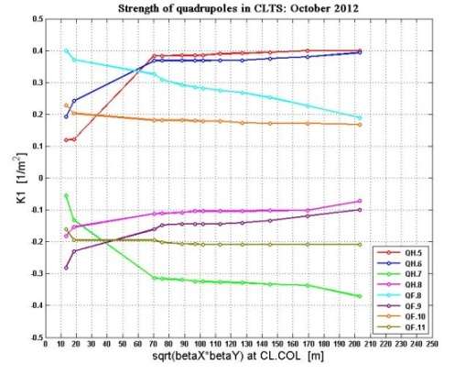
Linear Optics Functions and Optics Flexibility
A
B
C
D
► Betatron functions can be varied (A, B, C) by tuning of quadrupoles
in matching sections and in the phase shifter (arc quadrupoles are fixed).
► This tuning includes also the possibility of FODO-like transport through
the whole collimation section (D).
► The commissioning will be started with FODO-like transport, which can
be translated step by step into standard collimation optics (Mode A).
Example:
Tuning of quadrupoles in
the downstream matching
section CLTS.
FODO
B
A

Slide 7
Collimators
► Main primary collimators (with exchangeable apertures)
► to provide the collimation of large amplitude and off-energy halo particles
► to provide a passive protection against miss-steered and off-energy
beams in the case of machine failure
► Supplementing collimators (with apertures larger than main collimator apertures)
► to help main collimators to shade a beam pipe from uncontrolled beam losses
► to absorb a part of the beam halo power

Slide 8
Locations of Main Collimators
Main collimators:
► four main collimators, two in each arc
► round exchangeable apertures
► 180˚ between two collimators in each arc
► n x 90˚ (n -odd number) between collimators in 1st and 2d arcs
► located at position with large betatron functions
► located in dispersive region
Standard Mode A
A
collimators
The possibility of betatron function tuning combined with
exchangeable apertures will allow to regulate (in some limits)
the transverse and energy collimation depths separately,
despite that collimators are placed in the dispersive region.

Slide 9
Estimate of Required Collimator Apertures
Details of calculation procedure can be found in TESLA-FEL 2007-05 Report.
Example (transverse collimation):
► Standard Mode A (βx,y ≈ 200 m at main collimator locations)
► Diameter of the beam pipe in collimation section = 40.5 mm
► Protection target is defined:
► radius of undulator vacuum chamber (2, 3, 4, 5 mm)
► <β> betatron functions in undulator (15, 30, 45, 60 m)
► Beam energy 17.5 GeV, normalized emittance 1.4 mm mrad
Transverse Collimation
Energy Collimation
Aperture radii of 4 collimators:
Blue curve:
Aperture radius required to protect
the undulator vacuum chamber
as a function of the energy deviation
(transverse collimation).
Red curve:
Aperture radius required to block
the corresponding off-energy fraction
of incoming particles in the collimation section
(energy collimation).
<β>
2mm 3mm 4mm 5mm
15 2.95 3.70 4.26 5.02
30 2.45 3.00 3.60 4.00
45 2.10 2.62 3.26 3.59
60 1.97 2.48 2.94 3.36
R_und

Slide 10
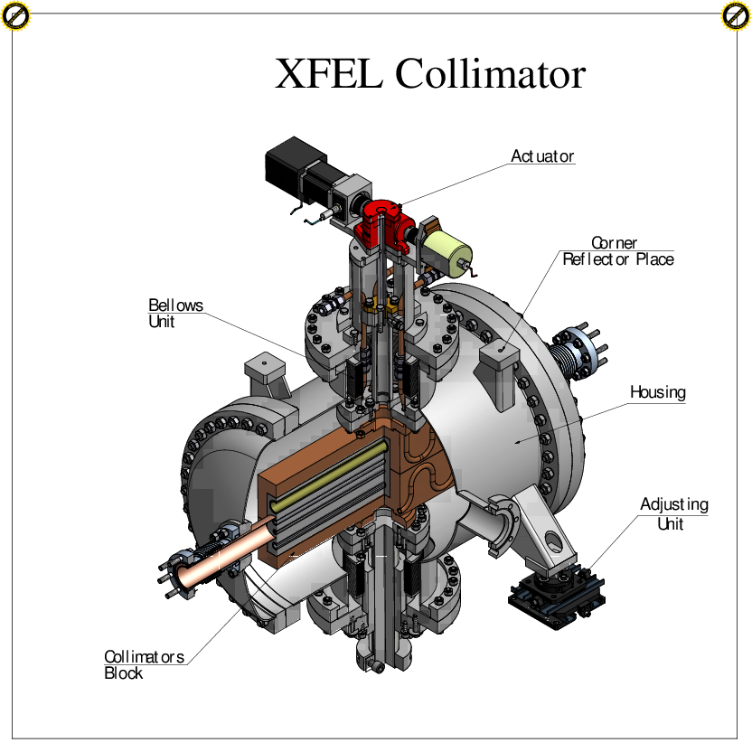
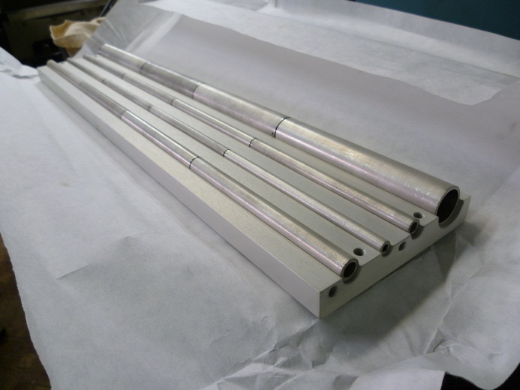
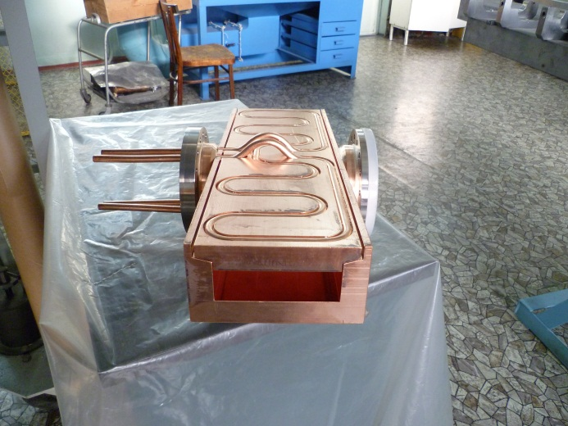
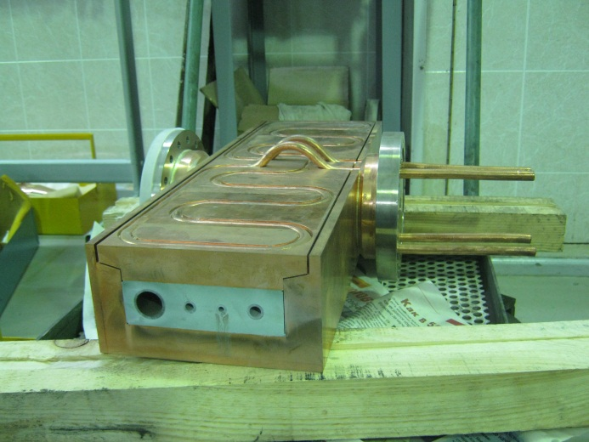
Main Collimators
XFEL main collimators: In-kind Contribution, Russia, Novosibirsk,
Budker Institute of Nuclear Physics (BINP)
► 5 units
► 50 cm length (collimator body)
► 4 Ti alloy tubes (ID 4, 6, 8, 20 mm),
split onto 4 parts
► internal pure Al block
► outer Cu block with brazed cooling tubes
The first collimator body is currently at BINP.
Photos from A. Krasnov, 16 April 2013

Slide 11
Other Issues
IBFB section
Screens in the front of each collimators
Energy jitter measurements in collimations arcs:
► two BPM’s in 1st arc (dispersive region) and
one BPM in upstream matching section
► two BPM’s in the 2d arc (dispersive region)
and one of the downstream IBFB BPM’s
IBFB kickers
Errors of energy jitter reconstruction:
► for 1 μm BPM resolution
► ~ 2e-5 (rms) for both locations
(estimates based on DESY 10-023 Report)

Slide 12
Thank you !

