Slide 1


Bunch Compression
T. Limberg
Notes:
How to edit the title slide
Upper area: Title of your talk, max. 2 rows of the defined size (55 pt)
Lower area (subtitle): Conference/meeting/workshop, location, date,
your name and affiliation,
max. 4 rows of the defined size (32 pt)
Change the partner logos or add others in the last row.

Slide 2
Longitudinal Bunch Compression Basics
Space Charge prevents high charge densities at lower beam energies
Velocity differences vanish towards higher beam energies
→ path length differences in dispersive sections

Slide 3
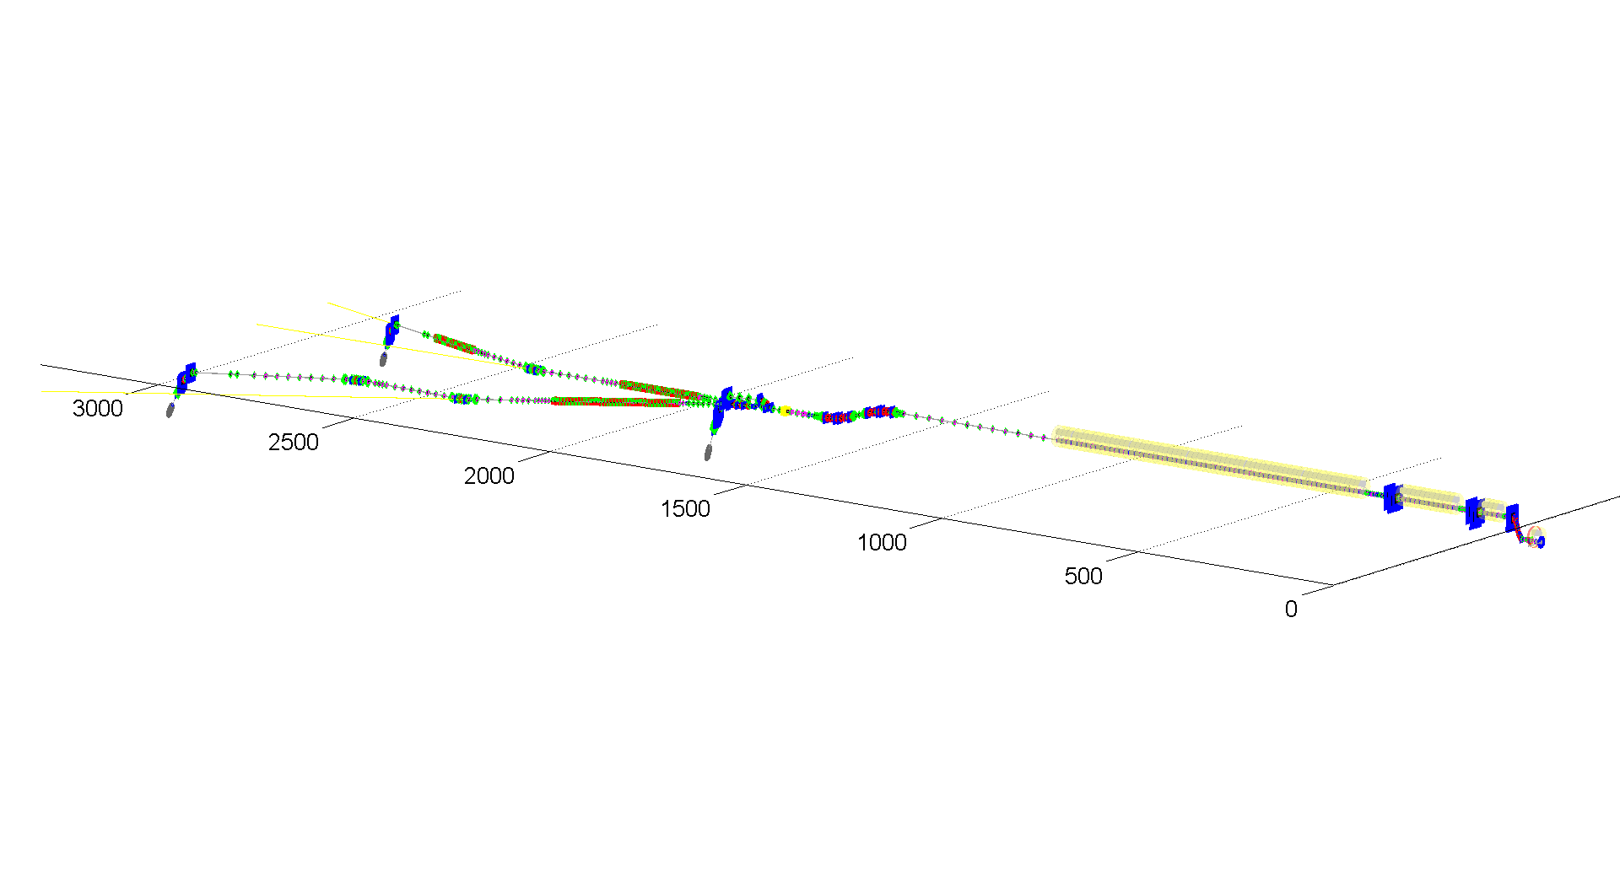
XFEL – New Parameter Set
 | Baseline | New Parameter Set
Electron Energy | 17.5 GeV | 10.5/14/17.5 GeV
Bunch charge | 1 nC | 0.02 - 1 nC
Peak current | 5 kA | 5 kA
Slice emittance | < 1.4 mm mrad | 0.4 - 1.0 mm mrad
Slice energy spread | 1.5 MeV | 4 - 2 MeV
Shortest SASE wavelength | 0.1 nm | 0.05 nm
Pulse repetition rate | 10 Hz | 10 Hz
Bunches per pulse | 3000 | 2700

Slide 4
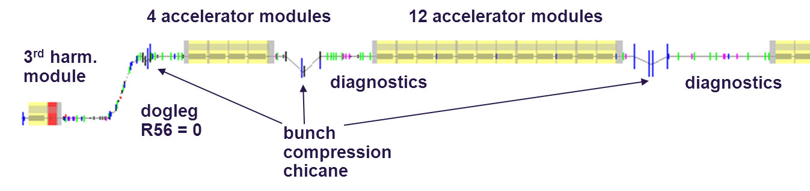
Bunch Compression
3 stage bunch compression for wide range of compression scenarios and minimized sensitivities to RF-regulation imperfections and electron beam driven instabilities
R56=60-120mm
R56=
60-120mm
R56=30-100mm
σ_{σ} = 2 mm
I_{peak}= 50 A
σ_{Ε} = 0 %
E = 130 MeV
σ_{σ} = 1 mm
I_{peak}= 100 A
σ_{Ε} = 1.5 %
E = 130 MeV
σ_{σ} = 0.1 mm
I_{peak}= 1 kA
σ_{Ε} = 1 %
E = 500 MeV
σ_{σ} = 0.02 mm
I_{peak}= 5 kA
σ_{Ε} = 0.3 %
E = 2000 MeV

Slide 5
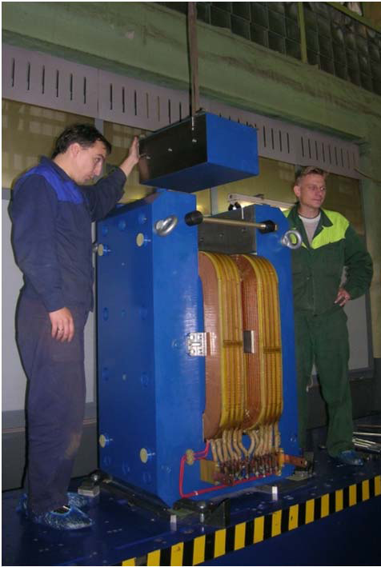
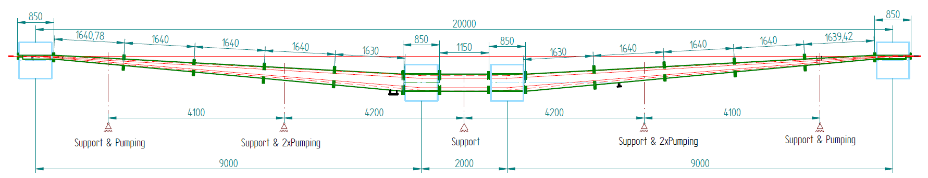
Bunch Compression Chicanes
Fixed wide vacuum chamber for variable R56
  No moving vacuum parts in the vicinity of superconducting structure
  No wake from bellows
  Fast changes of R56 via beam energy
First dipole magnets for the chicane produced
  Challenging field quality requirements will be achieved by individual pole shimming

Slide 6
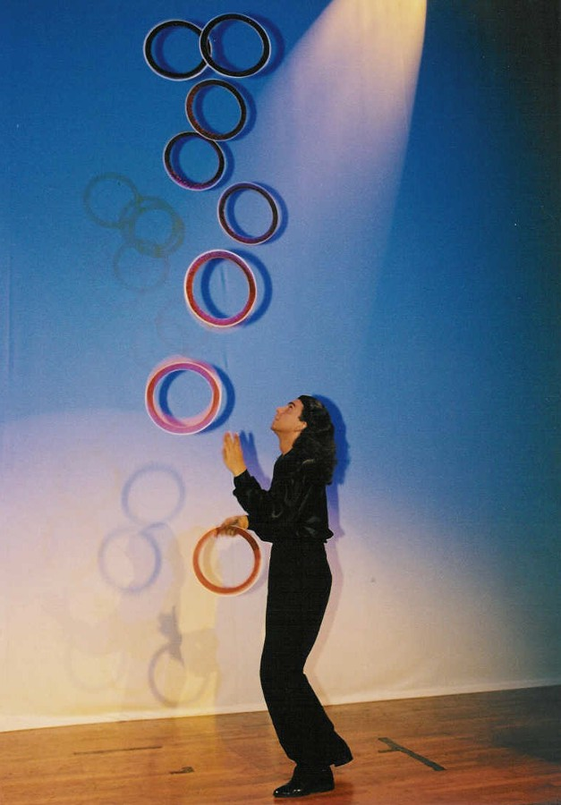
Calculation of BC Working Points: Criteria and Constraints
peak current
arrival time stability
projected emittance
slice emittance
µ-bunch stability
uncorrelated
energy spread
rf parameter sensitivity
remaining chirp

Slide 7
Example: XFEL – BC working point vs. rf Sensitivity
Sensitivity L0
RMS Sensitivity (rf system)
compression in BC1
compression in BC1
compression in BC0
compression in BC0

Slide 8
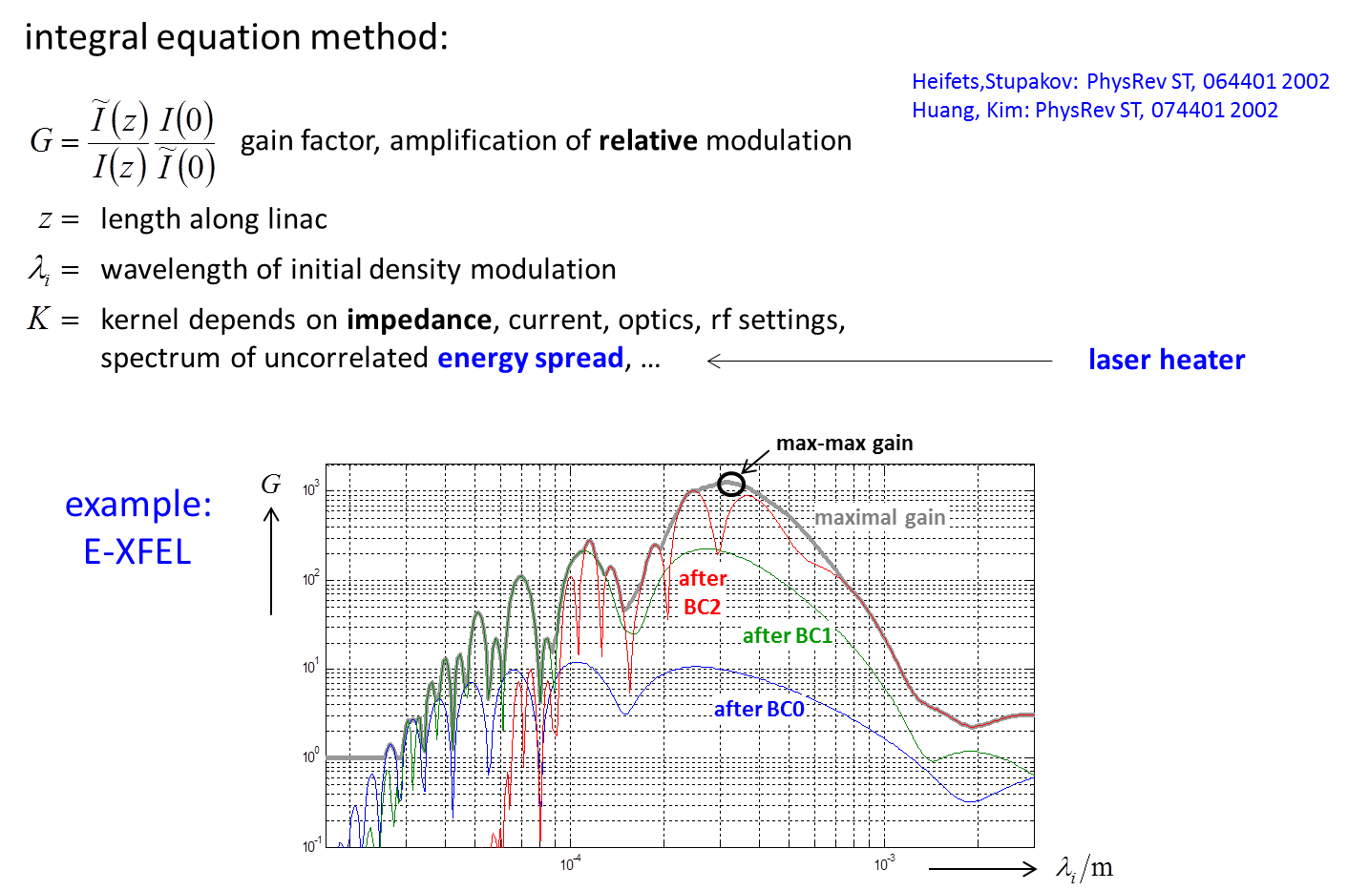
Micro-Bunching Instability Gain Curves

Slide 9
High Level Simulation
Full 3D simulation method (200 CPU, ~10 hours)
ASTRA (tracking with 3D SC) since 2011: ASTRA with wakes
CSRtrack (tracking with CSR, “projected” model)

Slide 10
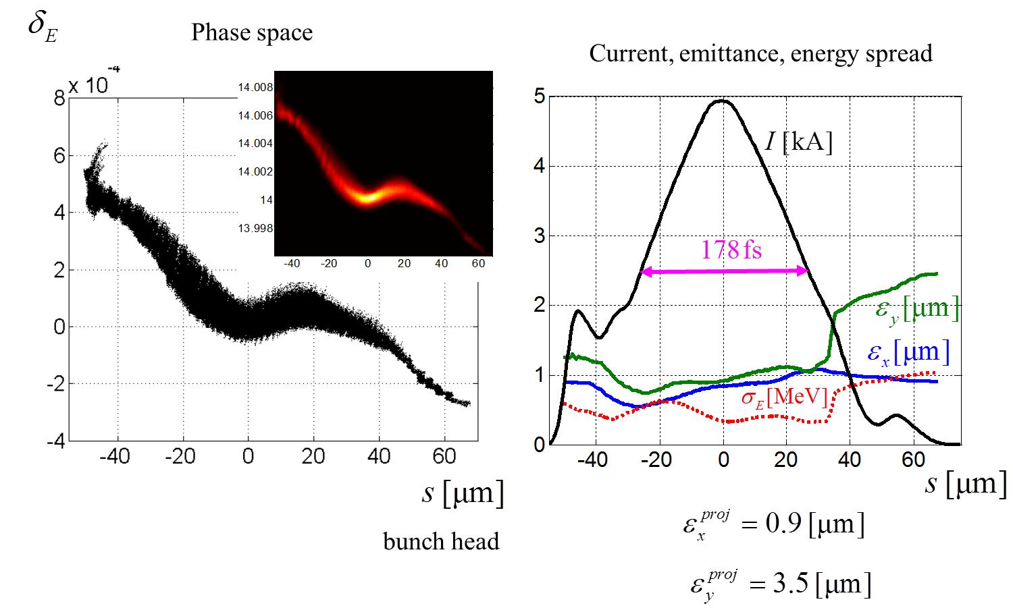
European XFEL BC Exit: 1 nC, 5 kA,
Total Compression Factor: 100

Slide 11
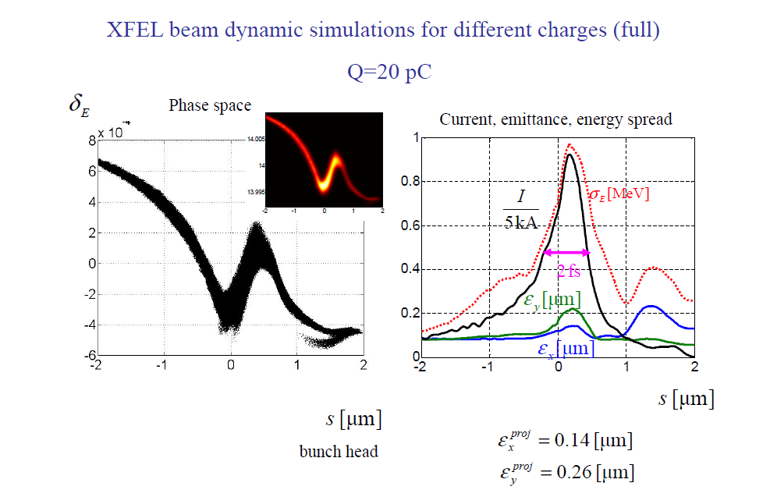
Q = 20 pC

Slide 12
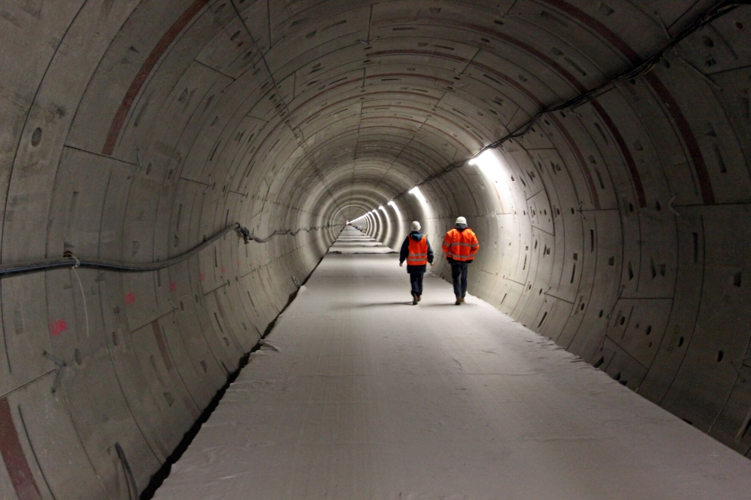
Thank you for your attention!

