Slide 1
Gun RF-Test in September Collaboration Meeting April 2013
K. Floettmann
Notes:
How to edit the title slide
Upper area: Title of your talk, max. 2 rows of the defined size (55 pt)
Lower area (subtitle): Conference/meeting/workshop, location, date, your name and affiliation, max. 4 rows of the defined size (32 pt)
Change the partner logos or add others in the last row.

Slide 2
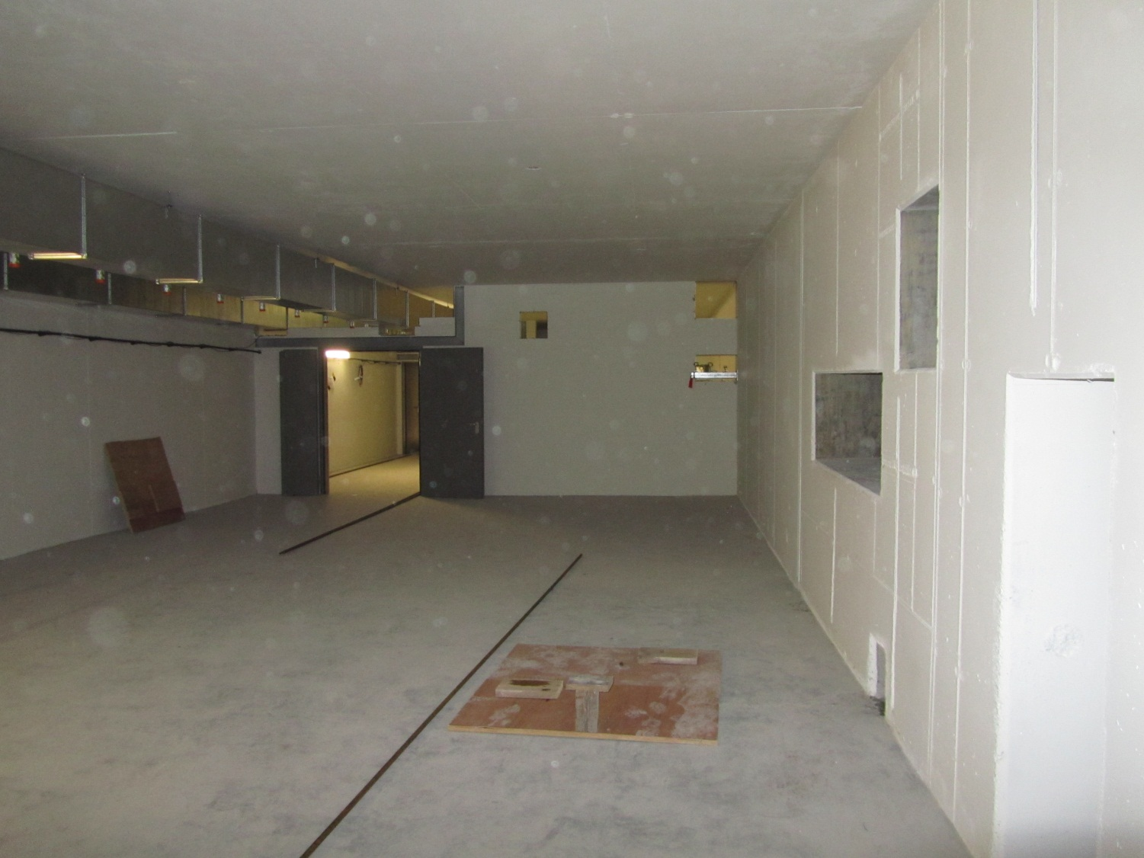
Laser Room (Apr. 2013)

Slide 3
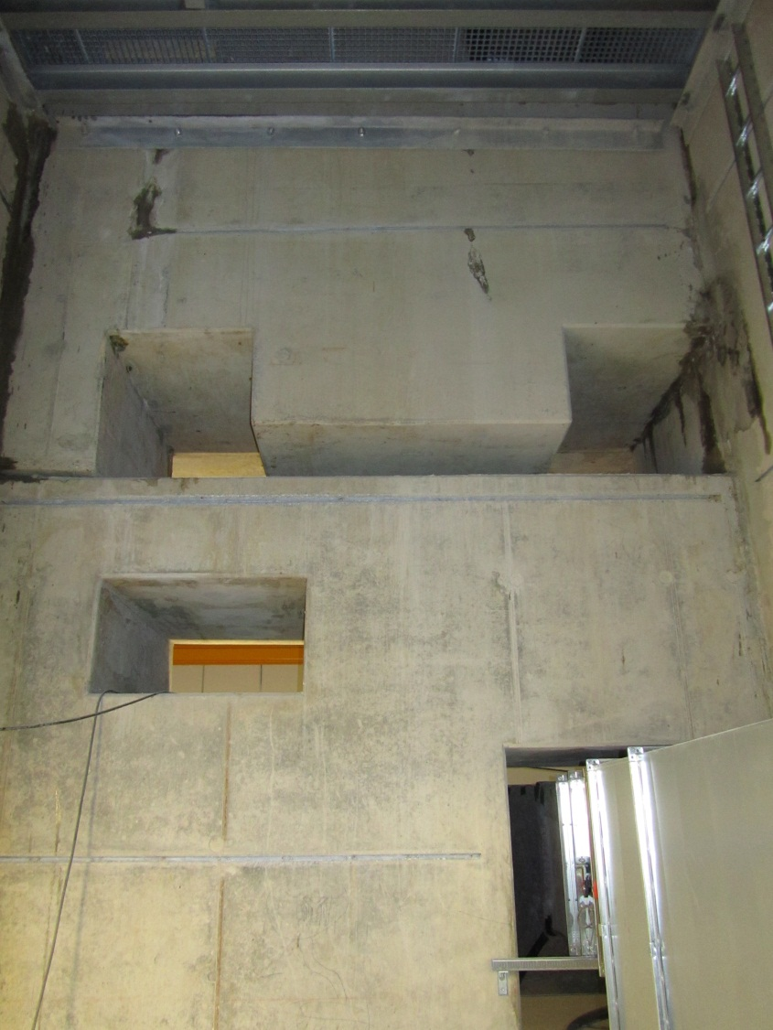
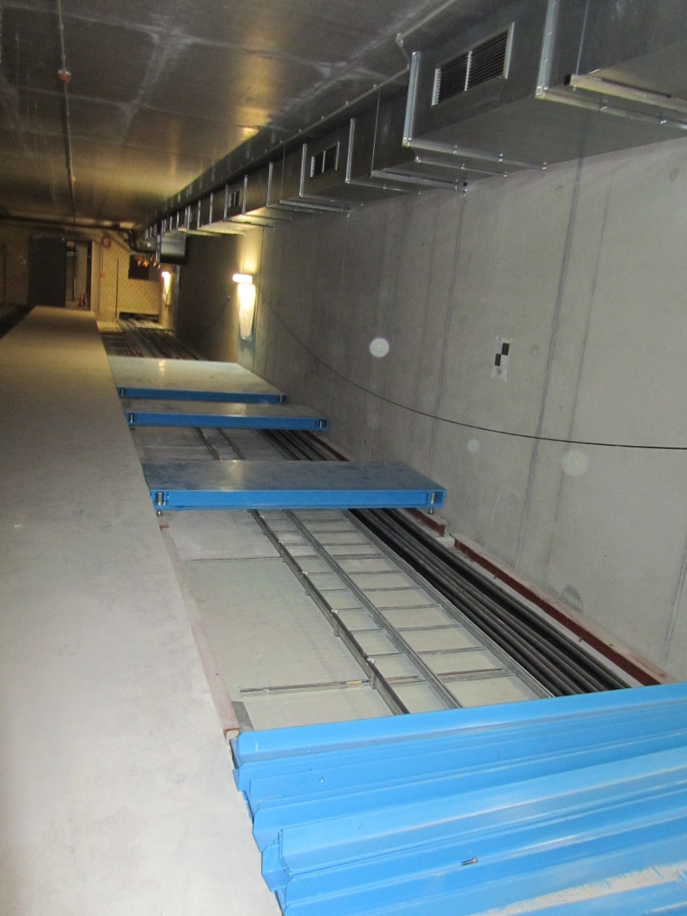
Klystron Room and Media Shaft (Apr. 2013)

Slide 4
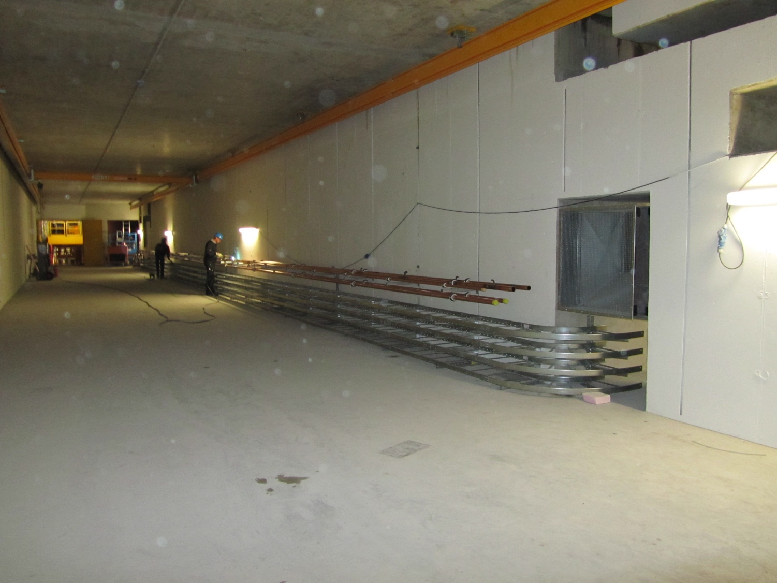
Injector Tunnel (Apr. 2013)

Slide 5
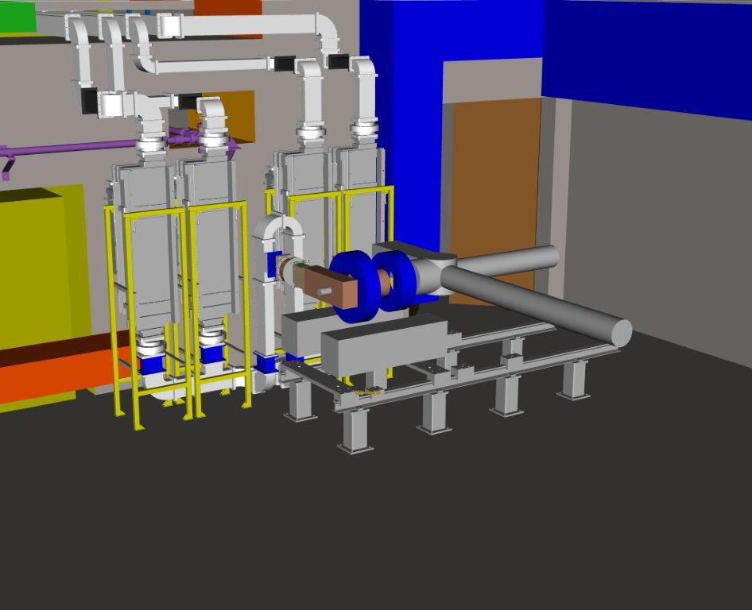
Injector Tunnel in September 2013
Why an RF Test?
First test of the complete RF power distribution
with 4 waveguides & circulators and without SF6

Slide 6
Klystron Room in September 2013

Slide 7
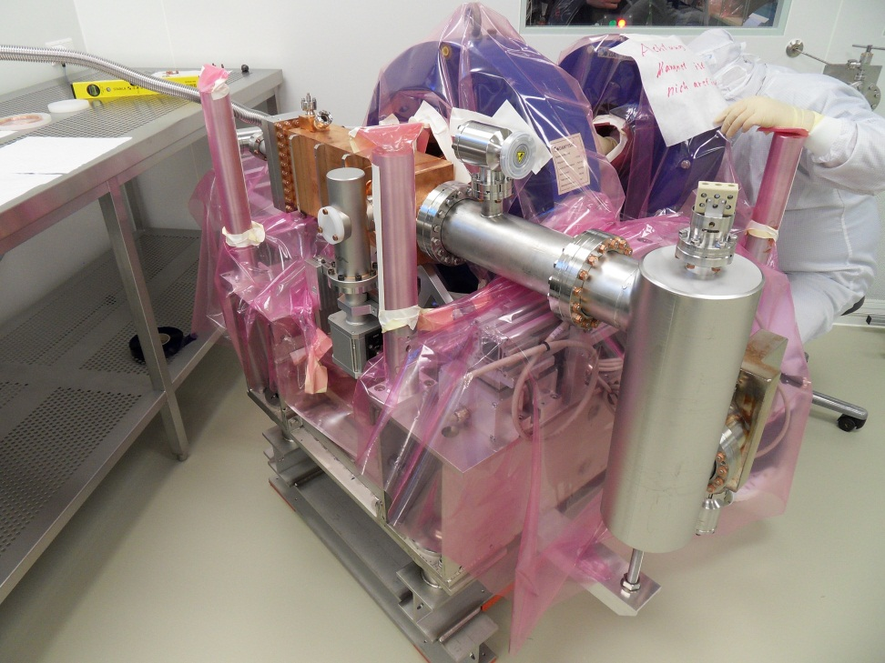
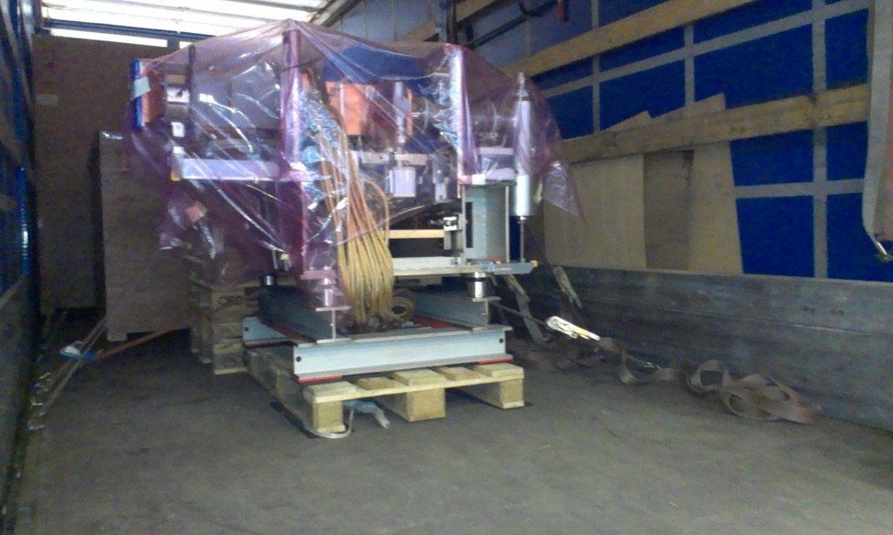
Status
On the way to Zeuthen
Assembly of the gun in the clean room
Gun is mounted at PITZ, conditioning has started
Cathode system is under construction
RF-window test: 6 MW full pulse length with air on the air side
up to 7 MW full pulse length with SF6 on the air side and light emission at high power (PITZ)

Slide 8
What else do we need for the test?
personal interlock system incl. emergency off
technical interlock for cavity, klystron, solenoids…
Temperature control system for gun (and cooling for solenoids)
power supplies & controller for solenoids
vacuum & vacuum controls
basic LLRF (no feedback or learning feed forward but a possibility to remotely control the RF amplitude)
preamp, klystron, waveguides, circulators
calibrated power signals
basic control system

