Slide 1
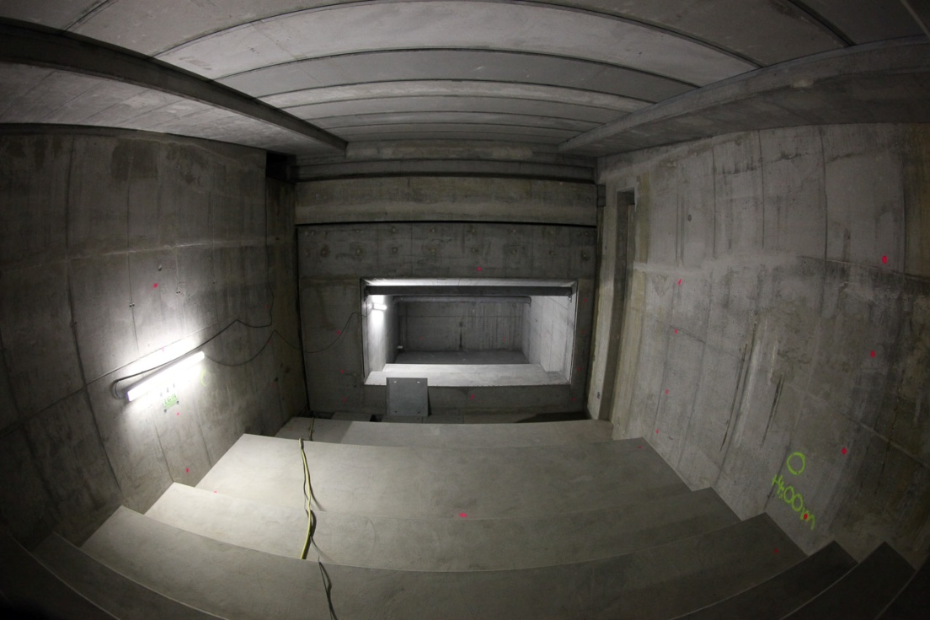
Beam Dumps
bunch compressor diagnostic dumps
0.5 and 2.5 GeV
small fraction of max. beam power
injector dumps
130 MeV
P_{ave}= 12 kW
max. beam power
main beam dumps
up to 25 GeV
P_{ave}= 300 kW
1/2 max beam power
beam magnified
slow sweep to distribute heat

Slide 2
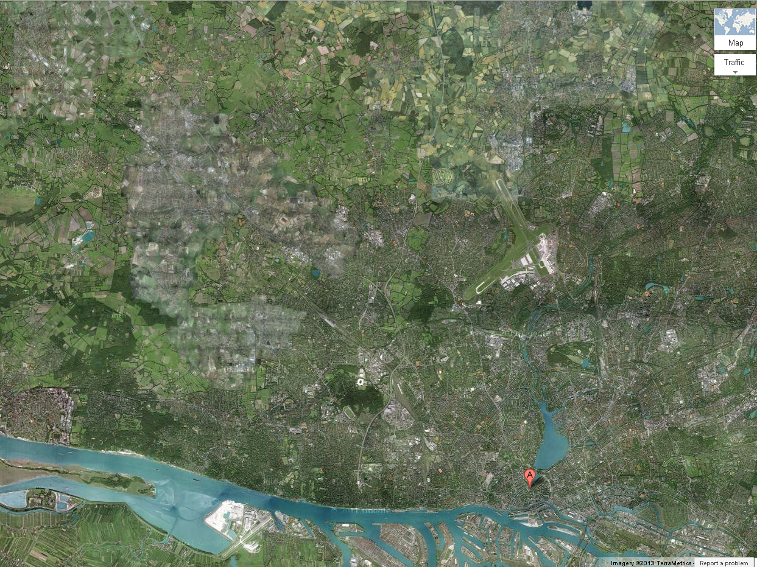
XSDU2
TD4 Dump
Dump after SASE1 & SASE3
Alster
XS1
TLD Dump
Linac Dump
Dϋpenau
XSDU1
TD5 Dump
Dump after SASE2
Elbe

Slide 3
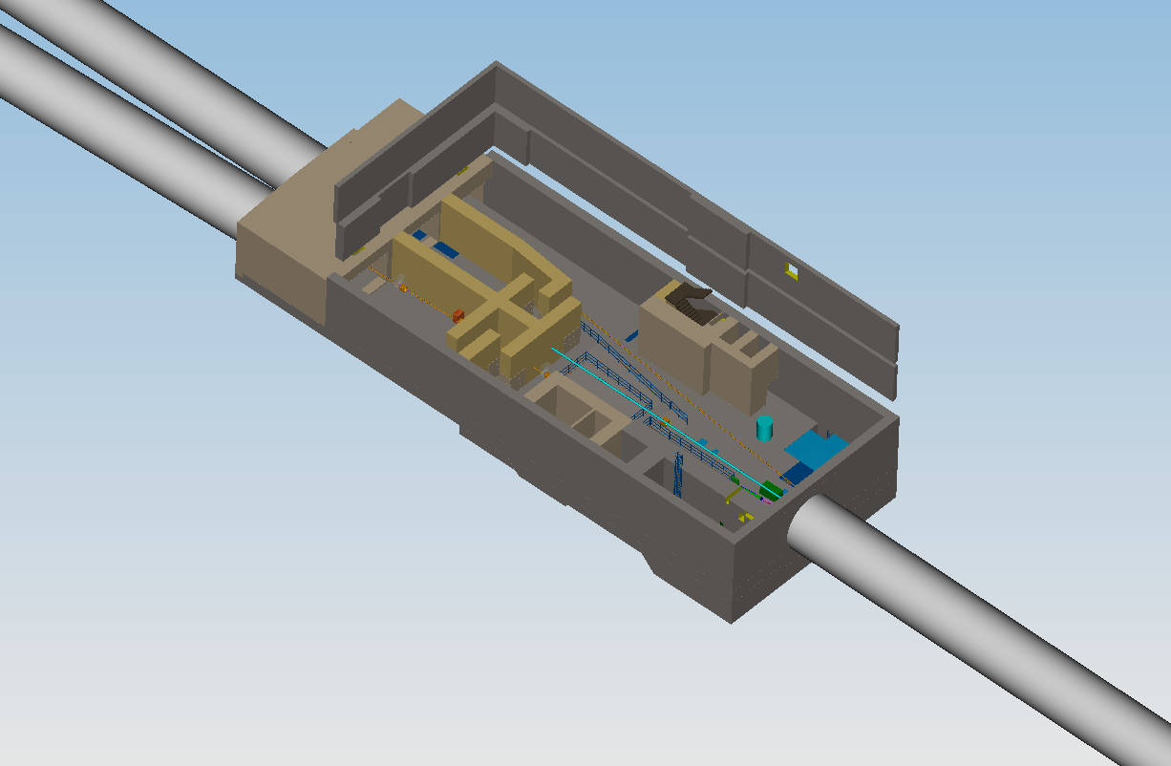
Beam Distribution
Undulators
Collimation
Dump

Slide 4
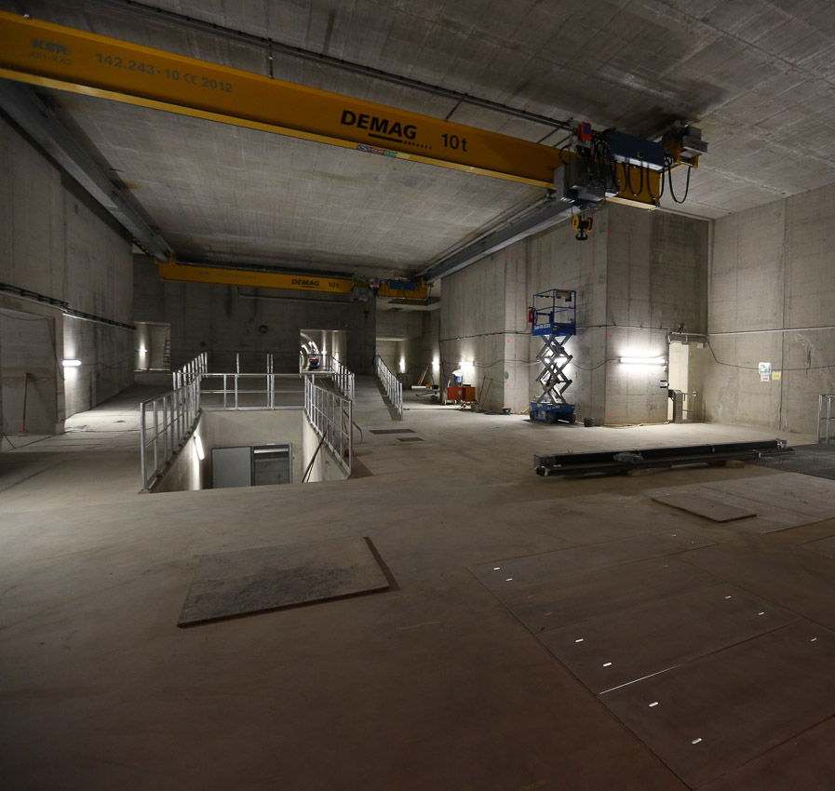
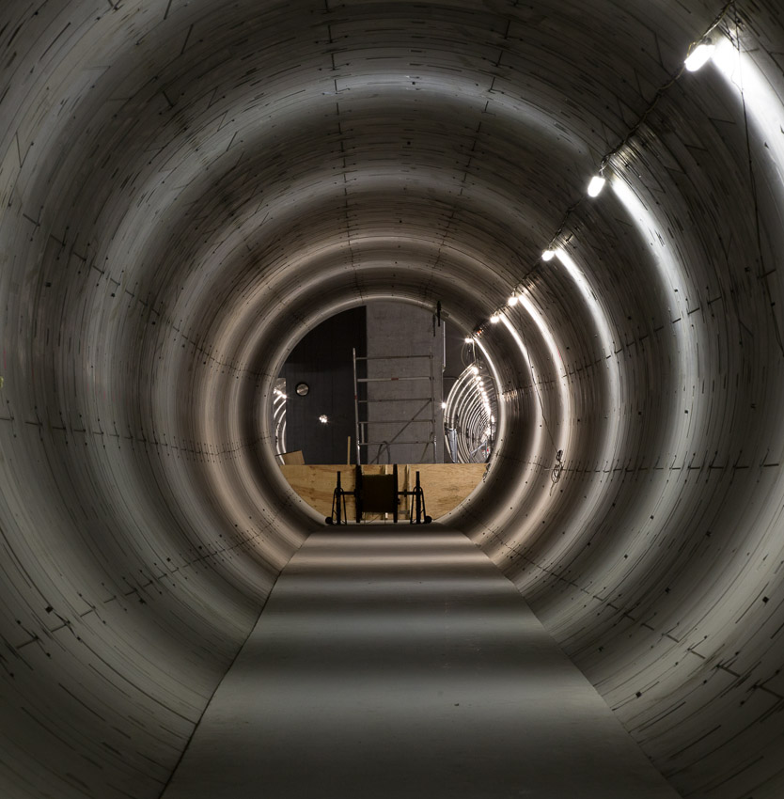
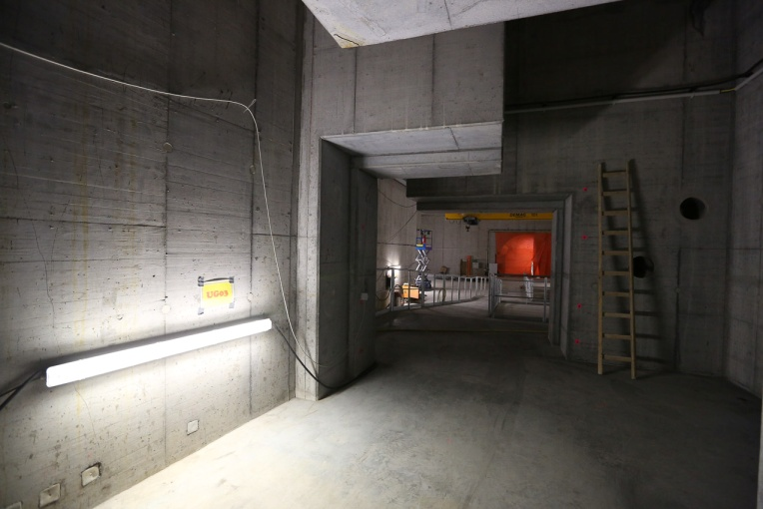

Slide 5
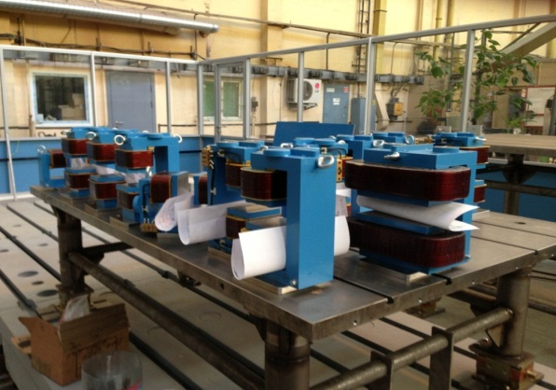
Beam Distribution
MID
HED
SPB
FXE
SQS
SCS

Slide 6
Beam Distribution
MID
HED
SPB
FXE
SQS
SCS

Slide 7
Beam Distribution
MID
HED
SPB
FXE
SQS
SCS

Slide 8
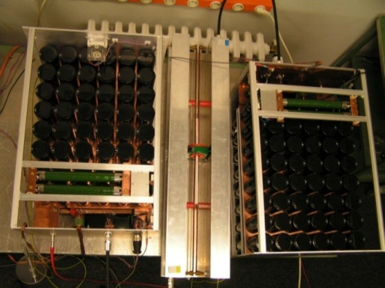
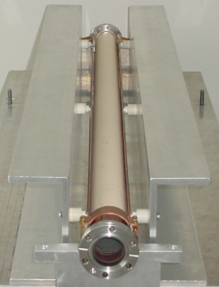
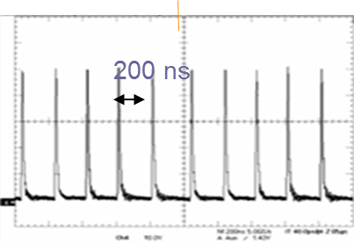
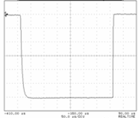
Beam Distribution
MID
HED
SPB
FXE
SQS
SCS
300 μs

Slide 9
Beam Distribution
MID
HED
SPB
FXE
SQS
SCS
300 μs

Slide 10
Beam Distribution
MID
HED
SPB
FXE
SQS
SCS

Slide 11
Beam Distribution
MID
HED
SPB
FXE
SQS
SCS
Dedicated kicker not baseline
Might use beam distribution system

