Slide 1
Procurement of Accelerator Components

Slide 2
Magnetic Shieldings
“Cryophy” material, from Aperam, has been qualified by cold measurements at DESY → identical properties as “Cryoperm” (VAC)
Eight units of “Cryophy” shieldings fabricated by “MecaMagnetic” (MM) and eight units fabricated by Magnetic Shields L^{td} (MSL^{td}), available for PXFEL3_1 and PXFEL2_1:
four each have equipped PXFEL3_1 cavity string (MM for cavities 1-4, MSL^{td} for cavities 5-8).
four each have equipped PXFEL2_2 cavity string (MSL^{td} for cavities 1-4, MM for cavities 5-8).
Another eight units of “Cryophy” shieldings fabricated by “MecaMagnetic” (MM) and eight units fabricated by Magnetic Shields L^{td} (MSL^{td}), available for spares for XFEL configuration.
Restricted call for tender in 2011 led to 3 bidders : VAC, MM, MSL^{td}. The PRR took place at Saclay on 31 January 2012 to validate the choice of MM, the lowest bidder and best technical offer.
Contract has been awarded to MecaMagnetic by CEA in April 2012.
Kick-off meeting took place on 10 May 2012.

Slide 3
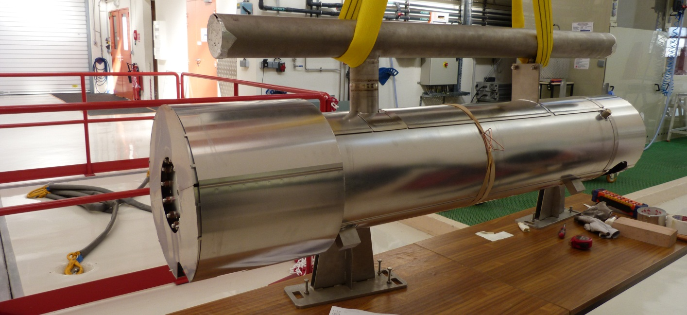
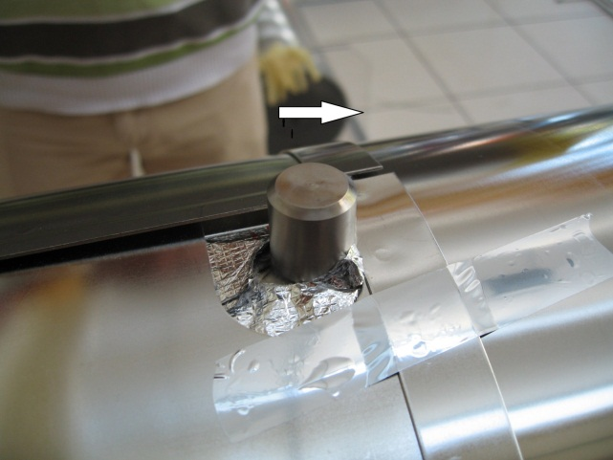
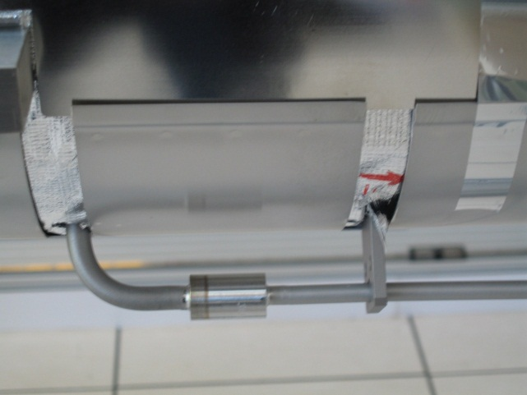
Magnetic Shieldings: PXFELs & XM-3
Prototype by MecaMagnetic for PXFEL configuration
(warm-up tube with flange)
Pre-series by MecaMagnetic for XFEL configuration
(warm-up tube with Ti/SS transition): benchmarking XM-3 cavities !

Slide 4
Magnetic Shields: Production Schedule
Contract awarded for 83 modules + 20 modules in option
2 pre-series shields:
XM-3
XM-2, in stock.
81 (=79+1+1) series produced at the rate of 1 module/week after a ramp-up period of 1 module / 2 weeks.
XM-1 requested for Week n°24 (10 June 2013),
Actual production schedule to be defined with MM.
2 spares, from two earlier separate orders:
MecaMagnetic, same configuration without engraving,
Magnetic Shield Ltd, different configuration.

Slide 5
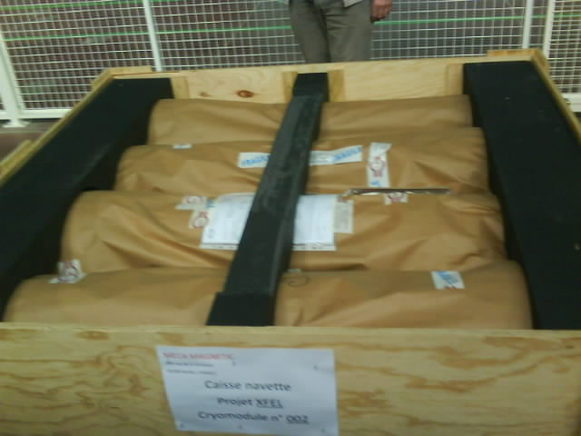
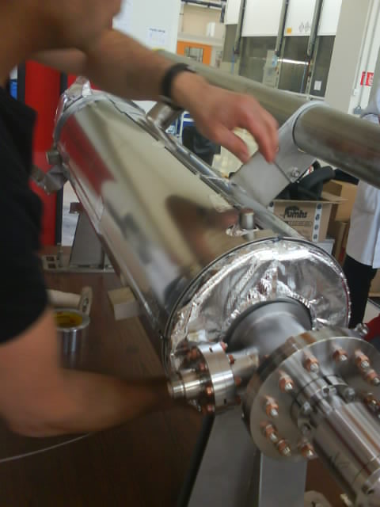
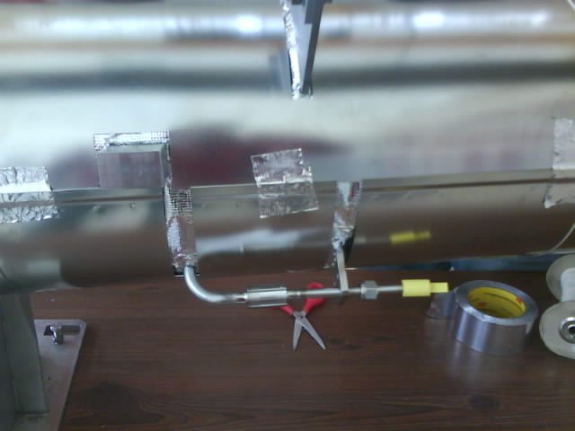
Magnetic Shieldings: XM-2
Pre-series by MecaMagnetic for XM-2 cryomodule

Slide 6
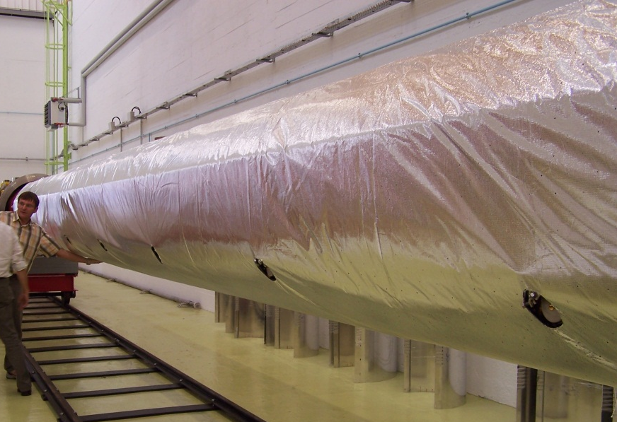
Super-insulation Blankets
Super-insulation blankets have been qualified (PXFEL2_1 and PXFEL3_1).
The 40/80 K super-insulation blanket (2x15 layers):
costs about 4 k€
saves 1 day on cantilever and about 7 p.day (balance at ~600 € / day)
saves about 30 W @ 40 K with respect to multilayers (30 + 29 separators).
Cryolossat | PXFEL 3 | PXFEL 3_1 cooldown Dec 2011 | PXFEL 3_1 cooldown Feb 2012 | PXFEL 2_3 cooldown March 2013
40 / 80 K | 134 W | 96 W | 97-102 W | 95 W
Negotiations with Jehier allowed about 10% reduction / CfT offer, through:
more flexible (rapid) delivery rate
simplification of 2K blankets fabrication
70 K blankets ordered in advance for XM-3, XM-2, XM-1 (delivered in June 2012)

Slide 7
Super-insulation Blankets
Contract awarded for 80 modules + 20 in option + 2 sets of 2K blankets (XM-2, XM-1) (option lifted)
Kick-of meeting on 27 August 2012.
Pre-series modules:
XM-3 : 2K from DESY, 70 K from Jehier,
XM-2 and XM-1, in stock from Jehier.
80 series produced by batches
10 modules on 6 May 2013
10 modules on 14 June 2013
20 modules on 31 October 2013
20 modules on 14 March 2014
20 modules on 25 July 2014
Option of 20 additional modules needed by mid-2014.

Slide 8
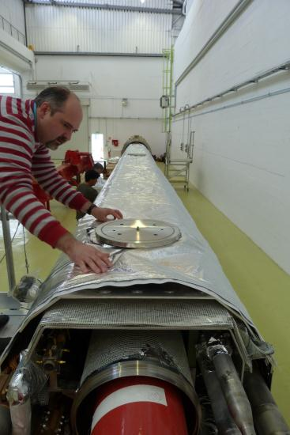
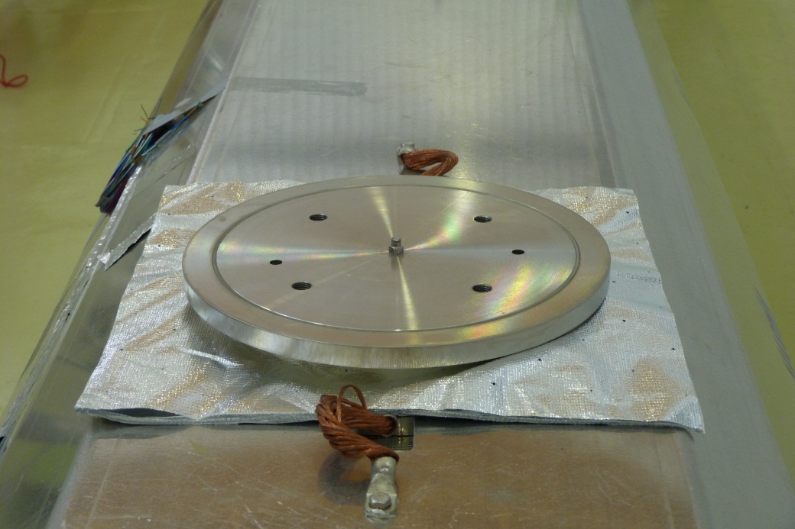
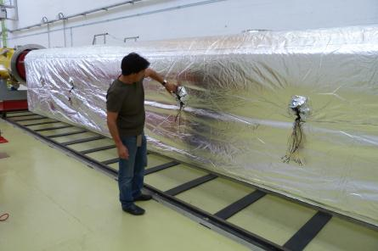
70 K Blankets:
Prototype by Jehier for PXFEL2_2

Slide 9
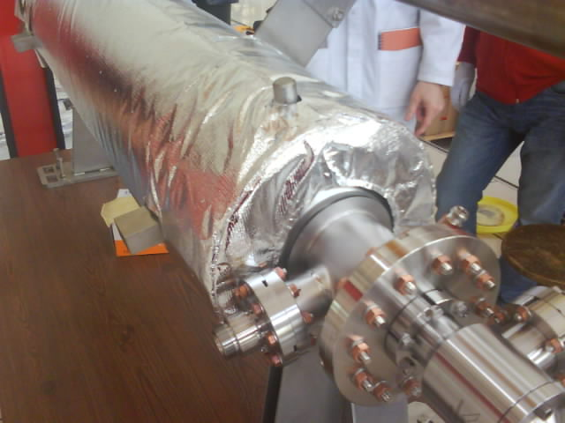
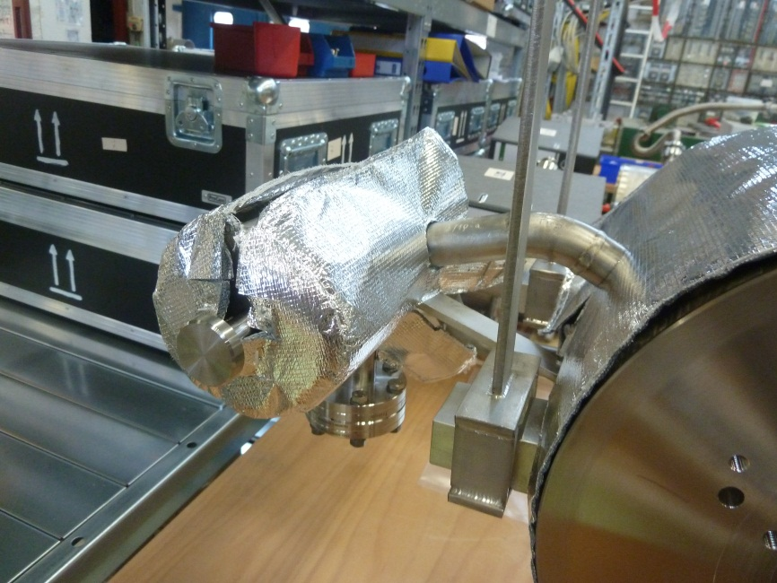
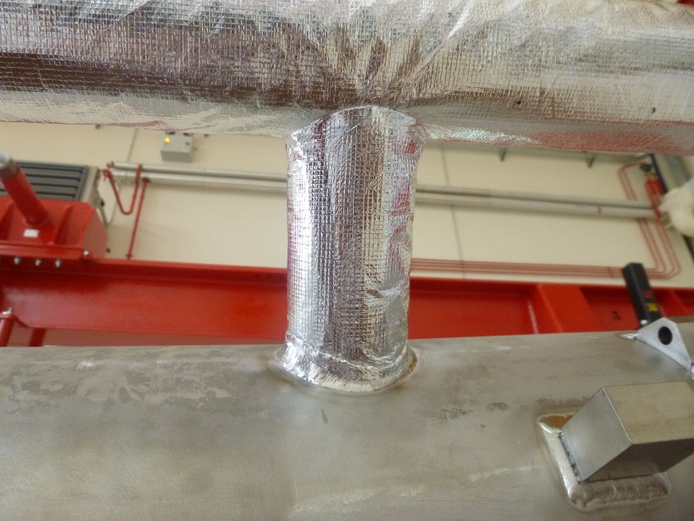
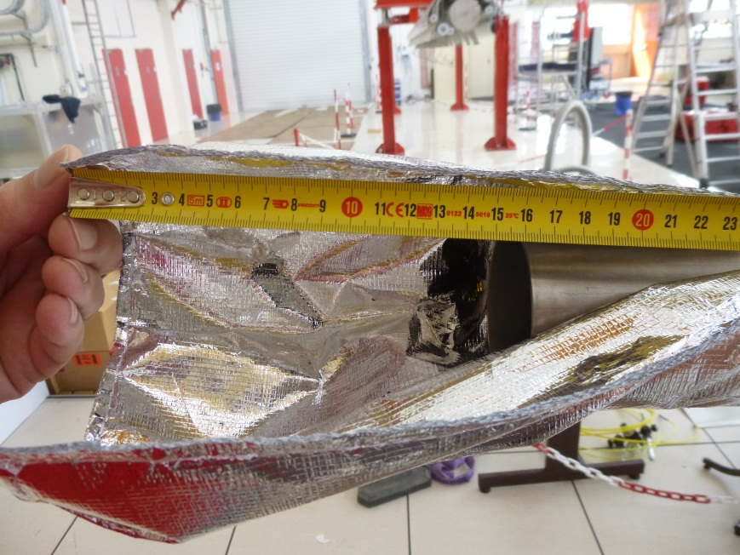
2 K Blankets:
Prototype by Jehier for XM-2

Slide 10
Clean Fastening Hardware of String Assembly
Call for tender for supply/cleaning/packaging issued in March 2012 : cancelled
Call for tender for cleaning/packaging started in February : 3 candidates
Clean hardware sets for PXFEL2_2 and XM-3, from a separate early order.
Clean hardware sets for XM-2, XM-1 and XM1 have been ordered separately and are available at Saclay.
CEA will supply the fastening hardware, about year by year
Threaded rods : only one offer, expensive*.
CuNi1Si nuts : no vendors so far because material is very rare*.
CuNi2Si would be easily available and cheap (competition)
Copper seals : two offers, no order yet.
Aluminum gaskets : four offers. CEA ordered gaskets for 40 cryomodules (~20 €/piece). First delivery June 2013, then 5 modules / month
Screws (coupler pumping line) : CEA ordered screws for 40 cryomodules, received at Saclay.
Washers : CEA ordered screws for 40 cryomodules, received at Saclay.
* As far as we know, Guldner is the only vendor in Europe.

Slide 11
Assembly Industrialization

Slide 12
Industrial Contract for String and Module Assembly
Tender process: ALSYOM, lowest bidder / best technical offer, has been selected by CEA.
The contract has to be awarded on 27 July 2012 for the integration of 83 cryomodules + 20 in option.
Up to 29 people will be on Saclay site during 2 ½ years
Kick-off meeting : 05/09/2013
Review of Quality Plan and Management Plan : 27/09/13 with DESY
After 9 months collaboration, these people are GOOD and the CEA-Alsyom collaboration is EXCELLENT !

Slide 13
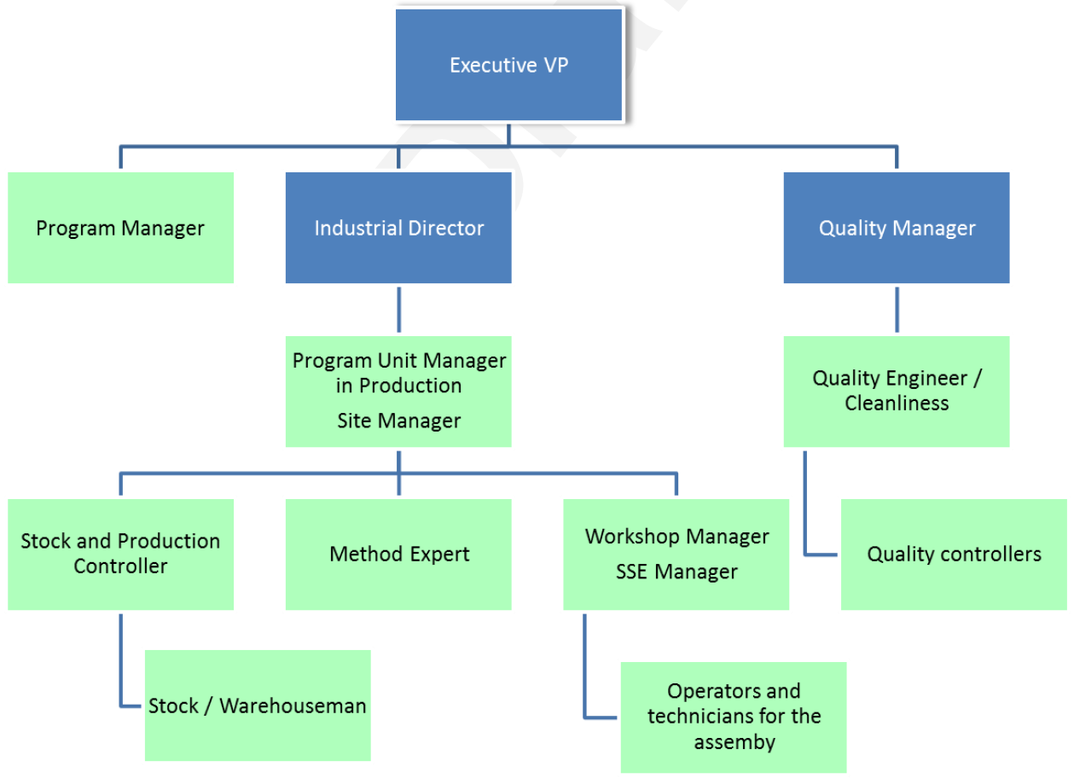
Industrial Contract : ALSYOM Management Plan
Off site
29 persons
on site
1*
* from mid- sept. 2012
1*
1*
** from beg- febr. 2013
1
1*
1*
2 (1**)
1**
20 (4**)

Slide 14
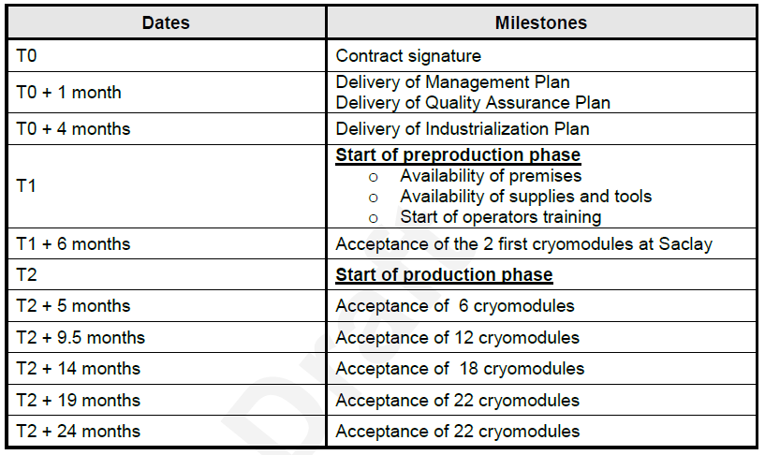
Industrial Contract with Alsyom: Schedule
20/08/2012
= T0 + 4 months
= T0 + 9 months
for 80 cryomodules
= T2 + 22 ½ months
T3 | Start of production phase for 20 modules in option
T3 + 6 months | Acceptance of 20 cryomodules
N.B. : after T2, this schedule includes some margin.

Slide 15
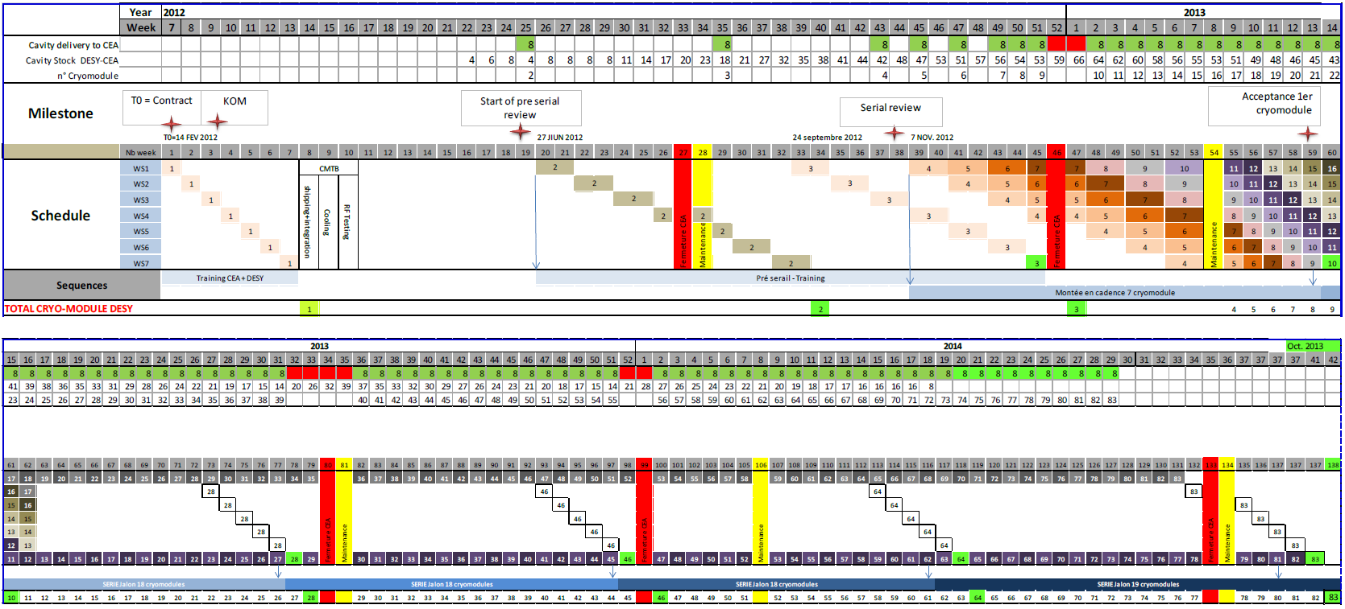
Industrial Contract with Alsyom: Schedule (2/2)
The Call for Tender was released in August 2011 with the following schedule in CEA Specifications:
End date of XM80 = oct. 2014 ⇒ XM100 = March 2015

Slide 16
Industrial Contract : Initial Schedule (1/2)
Phase 1: observation phase which covers the assembly of XM-3 by CEA with ALSYOM staff as observers.
Initially, this phase starts at T0 (20 August 2012) until T0 + 4 months (20 December 2012).
Phase 2 : training phase which covers the assembly of XM-2 and XM-1 by mixed CEA-Alsyom teams (co-activity or transfer of knowledge) from T1 = T0 + 4 months till T1 + 6 months.
XM-2 XM-1

Slide 17
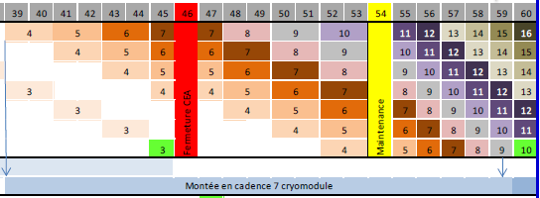
Industrial Contract : Initial Schedule (2/2)
Phase 3: production phase which covers the assembly of XM1 to XM80 by Alsyom from T2 = T0 + 9 months (20 May 2013) till T2 + 24 months (20 May 2015).
Phase 4 : production phase (option) which covers the assembly of XM81 and XM100 by Alsyom from T3 (5 April 2015) till T3 + 6 months (5 October 2015).
XM1

Slide 18
Industrial Contract : Current Schedule
Phase 2 : the training phase is shifted by 3 to 4 months with the availability of XM-2 cavities.
We do not wish to compress the training phase !
Counter-productive !

Slide 19
Pre-Series Training Phase: Rationale for Schedule (1/4)
T1 = 2 April 2013 : start of string assembly with XM-2 cavities
first 4 cavities received 7 March 2013
last 4 cavities received 12 April 2012
at least one week is needed for reception + RF control + leak check
8 cavities are needed for string pre-alignment in the clean room
We need 6 months for XM-2 and XM-3 to train Alsyom
already a factor 2 reduction with respect to XM-3 (2 modules in 6 months !)
Alsyom does not want to compromise the quality of the training
Alsyom is considering faster rate of production at a later stage
XM-2 XM-1
(from CEA specs)

Slide 20
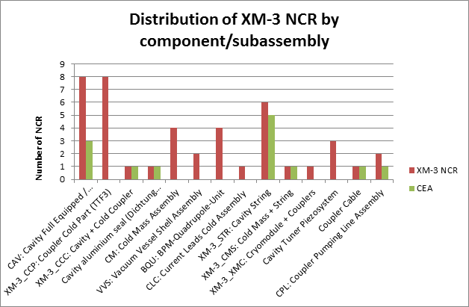
Pre-Series Training Phase: Rationale for Schedule (2/4)
We anticipate still many non-conformities
In total 43 Non-Conformance Reports (NCR) were issued for XM-3, about 13 NCR under the responsibility of CEA: main reason for 7 month assembly.

Slide 21
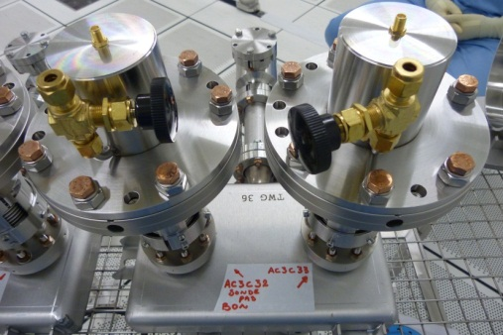
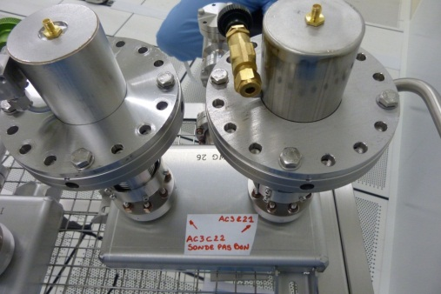
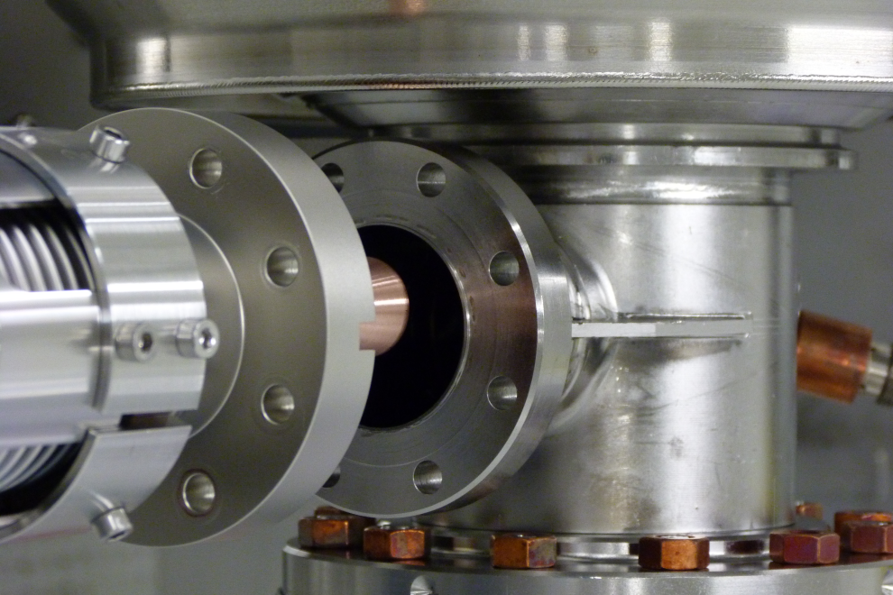
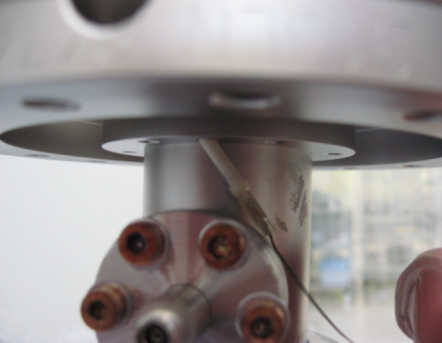
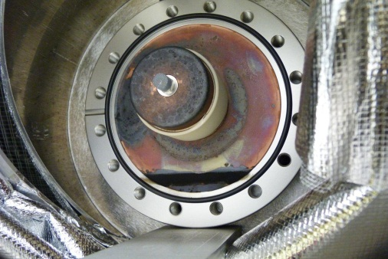
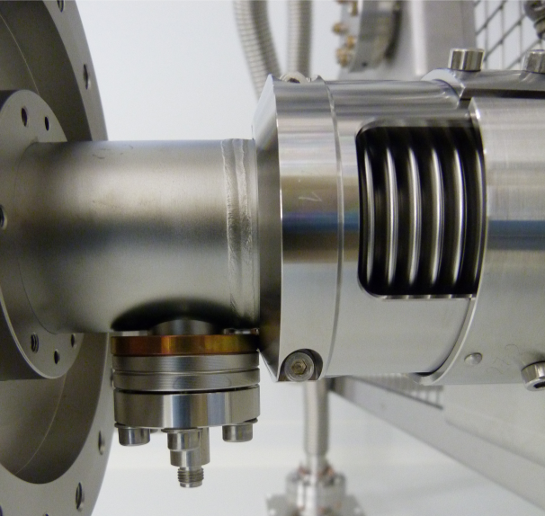
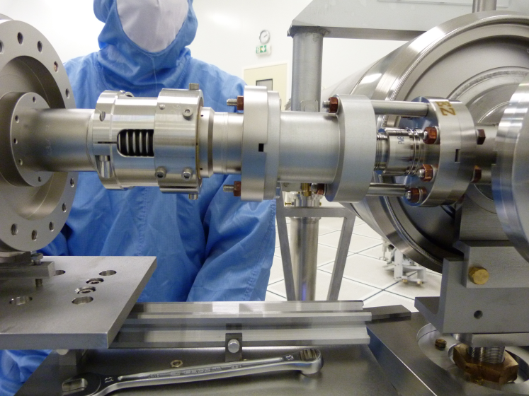
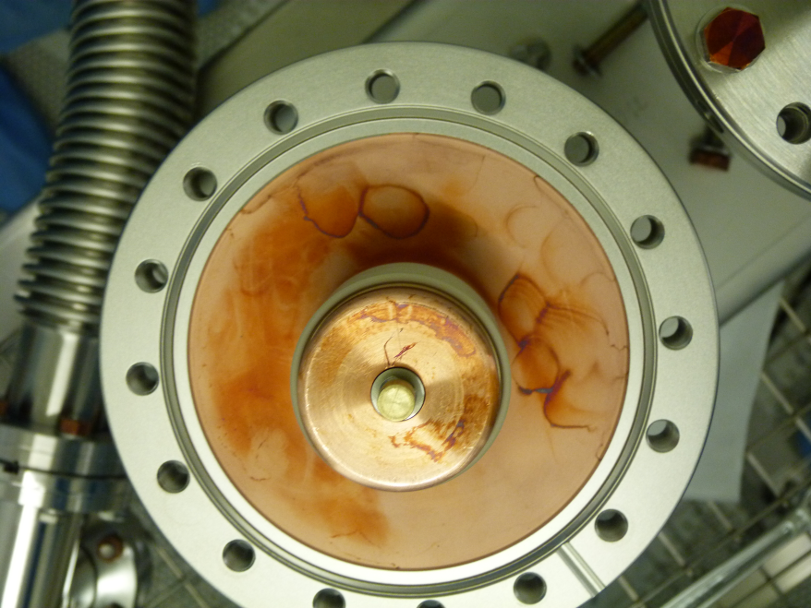
Pre-Series Training Phase: Rationale for Schedule (3/4)
CEA and Alsyom want to assemble XM-1 with XFEL couplers from the Thales-RI production:
No co-activity for the series (XM1-XM100): Alsyom staff do not have the competence to treat properly the non-conformities arising from the new coupler production and new configuration
First batch of XFEL couplers expected on 3 June 2013 (HW comm.) which is consistent with the start of XM-1 string assembly mid-June.
TTF3 couplers are generating too many assembly problems: ceramics caps, bellow clamps, e-pick-ups, RF antenna.
XM-3
XM-3
XM-3
XM-3
XM-3
XM-2
XM-2

Slide 22
Pre-Series Training Phase: Rationale for Schedule (4/4)
High financial risk for CEA:
In case of supply chain interruption (component shortage), CEA will compensate Alsyom with xx k€/day for maintaining 29 staff on the Saclay site, yyy k€ for dismissing and recruiting after 3 months interruption.

Slide 23
Fabrication parts released Physical part released

Slide 24
NON ReleaseD fabrication WP03
D00000000574027,A,1,1 | Isolation for Cables | Isolation for cables
D00000000574437,A,1,1 | Capton Isolation for Flexible Electrical Connection | Capton isolation for flexible electrical connection
D00000000574447,A,1,1 | Capton Isolation for Welding Sleeve | Capton isolation for welding sleeve
D00000000574647,A,1,1 | Hex. Screw M10x20 | Hexagon screw M10x20 (for coupler supports)
D00000000574657,A,1,1 | Washer 10 | Washer 10 (for coupler supports)

Slide 25
Fabrication parts to be released WP05
D00000000573387,A,1,1 | TMP-PT: Temperature Sensor Coupler | Temperature sensor coupler
D00000000573637,A,1,1 | 70K Interface Assembly | 70K interface assembly
D00000000573917,A,1,1 | 4 K Interface Assembly | 4 K interface assembly
D00000000575247,A,1,1 | Cable e-1_70K_CY (1.5m) | Cable e-1_70K_CY for pick-up on 70K part, cavity side
D00000000578807,A,1,1 | XM-3_CWP: Coupler Warm Part (TTF3) | TTF3 Coupler warm part for XM-3
D00000000574687,A,1,1 | Warm Bellow Horizontal Holder | Warm bellow horizontal holder
D00000000574737,A,1,1 | Copper Seal for CF100 | Copper seal for CF100
D00000000574747,A,1,1 | Screw S08 | Screw S08, CuNi2Si, M8x35
D00000000574757,A,1,1 | Washer W08 | Washer W08
D00000000574767,A,1,1 | Electrical Feedthrough | Electrical feedthrough
D00000000574777,A,1,1 | Electrical Feedthrough assembly kit | Electrical feedthrough assembly kit
D00000000574827,A,1,1 | Copper Seal CF25 | Copper seal CF25
D00000000574837,A,1,1 | ANT-scr: Antenna Screw | Antenna screw
D00000000574847,A,1,1 | Push Rod Assembly | Push rod assembly
D00000000574857,A,1,1 | Push Rod Assembly Set | Push rod assembly set
D00000000574887,A,1,1 | Big Flange Ã˜250 mm | Big flange Ã˜250 mm
D00000000574897,A,1,1 | Big Flange Assembly Set | Big flange assembly set
D00000000574927,A,1,1 | Big Turning Flange | Big turning flange
D00000000574937,A,1,1 | Big Turning Flange Assembly Set | Big turning flange assembly set
D00000000574987,A,1,1 | Coupler Support Assembly | Coupler support assembly
D00000000575057,A,1,1 | WGB: Waveguide Box Assembly | Waveguide box assembly
D00000000575257,A,1,1 | Cable e-2_70K_WG (1.0m) | Cable e-2_70K_WG for pick-up on 70K part, waveguide side

Slide 26
Fabrication parts to be released WP06
D00000000573347,A,1,1 | Cab-CAV: Cavity RF Cables | Cavity RF cables

Slide 27
Fabrication parts to be released WP07
D00000000573347,A,1,1 | Cab-CAV: Cavity RF Cables | Cavity RF cables

Slide 28
Fabrication parts to be released WP08
D00000000575267,A,1,1 | CPL: Coupler Pumping Line Assembly | Coupler Pumping Line assembly
D00000000575277,A,1,1 | CPL-BL: Bellow | Bellow
D00000000575337,A,1,1 | Pumping Line Type1 | Pumping line type1
D00000000575347,A,1,1 | Pumping Line Type2 | Pumping line type2
D00000000575407,A,1,1 | Easy Close Valve SE40 | Easy close valve SE40
D00000000575437,A,1,1 | Pumping Line (PL) Support | Pumping line (PL) support
D00000000575497,A,1,1 | TSP: TSP Insert and Pot | TSP insert and pot
D00000000575527,A,1,1 | IGP: Ion Getter Pump | Ion Getter pump

Slide 29
Fabrication parts to be released WP10/DR
D00000000572127,A,1,1 | CAV: Cavity Full Equipped / Measured | Cavity fully equipped/measured

Slide 30
Fabrication parts to be released WP11
D00000000594747,A,1,1 | QUAD: Quadrupole (XFEL Magnet Assembly) | XFEL magnet assembly
D00000000573677,A,1,1 | Invar Rod Fixture for Q-pole | Invar rod fixture for Q-pole
D00000000573687,A,1,1 | Cover for Q-pole Diagnostic Tube | Cover for Q-pole diagnostic tube (Deckel)
D00000000573997,A,1,1 | Leads Assembly Thermal Connection 4K and 70K | Leads assembly thermal connection 4K and 70K
D00000000574007,A,1,1 | Insulation tube | Insulation tube
D00000000574017,A,1,1 | Insulation Disk | Insulation disk
D00000000574257,A,1,1 | Countersunk-head Screw | Countersunk-head screw M4x10
D00000000574267,A,1,1 | Threaded Flange | Threaded flange
D00000000574277,A,1,1 | Special Nut | Special nut
D00000000574287,A,1,1 | EL-FEED: Cover + Elec. Feedthroughs | Cover with electrical feedthroughs
D00000000574297,A,1,1 | WELD-SL: Welding Sleeve | Welding sleeve
D00000000574307,A,1,1 | Flexible Connection Interior | Flexible connection interior
D00000000574337,A,1,1 | Electrical Connection External | Electrical connection external

Slide 31
Fabrication parts to be released WP17
D00000000573307,A,1,1 | Cab-BPMC: BPM1 Cable | BPM1 cables for button BPM

Slide 32
Physical PARTS to be released
All the physical part you can release please do so

Slide 33
Fabrication/Physical Part released
All the fabrication part and physical part you can release please do so

