Slide 1
Time schedule XFEL 1.3 GHz Cavity Production
Waldemar Singer
For WP04
Notes:
How to edit the title slide
Upper area: Title of your talk, max. 2 rows of the defined size (55 pt)
Lower area (subtitle): Conference/meeting/workshop, location, date, your name and affiliation, max. 4 rows of the defined size (32 pt)
Change the partner logos or add others in the last row.

Slide 2
Status: Delivering of cavity material (SFP) to DESY. 2013 will be finished
lot | Semi-finished product | Fa. Heraeus |  | Fa. Ningxia OTIC |  | Fa. Plansee |  | Fa. Tokyo Denkai |  | sub total ordered
 |  | order for 560 CAVs | order for 240 CAVs | order for 560 CAVs | order for 240 CAVs | order for 560 CAVs | order for 240 CAVs | order for 560 CAVs | order for 240 CAVs
1 | Nb-sheet 2.8mm |  |  | 2943 | 1484 | 2943 |  | 5886 | 1484 | 14740
2 | NbTi-ring 220x100x5 |  |  | 1366 | 330 |  |  |  |  | 1696
3 | Nb-sheet 2mm |  |  | 71 | 32 | 55 |  |  |  | 158
4 | Nb-sheet 9mm |  |  | 22 | 12 | 22 |  |  |  | 56
5 | Nb-rod D20x800 | 73 |  |  |  |  |  |  | 18 | 91
6 | Nb-tube 84x3x22 | 1366 | 330 |  |  |  |  |  |  | 1696
7 | Nb-tube 84x3x105 | 683 | 166 |  |  |  |  |  |  | 849
8 | Nb-tube 84x3x140 | 683 | 166 |  |  |  |  |  |  | 849
9 | Nb-tube 45x2.5x45 | 683 | 166 |  |  |  |  |  |  | 849
10 | Nb-ring 135x75x27 | 683 |  | 683 | 330 |  |  |  |  | 1696
11 | Coupler Housing | 1366 | 330 |  |  |  |  |  |  | 1696
12 | NbTi-rod D142 |  |  | 36 | 8 |  |  |  |  | 44
- 100% delivered
- 90% delivered
Total: 24420
- 50% delivered
Ca. 300 pcs of 2,8 mm Nb-sheets has to be reordered

Slide 3
CAVs production schedule till end of May 2013
Year | 2013
Month | March |  |  |  | April |  |  |  |  | May
Week | 10 | 11 | 12 | 13 | 14 | 15 | 16 | 17 | 18 | 19 | 20 | 21 | 22
EZ CVs No. | 515 | 520 | 523 | 520 | 531 | 529 | 537 |  |  | 544 | 518 | 546 | 553
 | 517 | 522 | 525 | 530 | 532 | 534 | 538 | 539 | 543 | 545 | 547 | 549 | 554
 | 521 |  | 526 |  |  | 535 |  | 540 |  |  | 551 | 552 | 555
 |  |  |  |  |  |  |  | 541
RI CVs No. |  |  |  |  |  |  |  |  | 011 |  | 013 | 015 | 017
 |  |  |  |  |  |  |  |  | 009 |  | 014 | 016 | 010
 |  |  |  |  |  |  |  |  |  |  |  | 012 | 018
SCVs delivered | 3 | 2 | 3 | 2 | 2 | 3 | 2 | 3 | 3 | 2 | 5 | 6 | 6
In total SCVs delivered | 10 | 12 | 15 | 17 | 19 | 22 | 24 | 27 | 30 | 32 | 37 | 43 | 49

Slide 4
CAVs Production schedule till end of July 2013
Year | 2013
Month | May |  |  |  | June |  |  |  | July
Week | 19 | 20 | 21 | 22 | 23 | 24 | 25 | 26 | 27 | 28 | 29 | 30/31
EZ CVs No. | 544 | 518 | 546 | 553 | NN | NN | NN | NN | NN | NN | NN | NN
 | 545 | 547 | 549 | 554 | NN | NN | NN | NN | NN | NN | NN | NN
 |  | 551 | 552 | 555 | NN | NN | NN | NN | NN | NN | NN | NN
RI CVs No. |  | 013 | 015 | 017 | 019 | 024 | 027 | 031 | 036 | 040 | NN | NN
 |  | 014 | 016 | 010 | 020 | 022 | 028 | 032 | 037 | 041 | NN | NN
 |  |  | 012 | 018 | 025 | 026 | 029 | 033 | 038 |  | NN | NN
 |  |  |  |  | 023 |  | 030 | 034 | 039 |  | NN | NN
 |  |  |  |  |  |  |  | 035
SCVs delivered | 2 | 5 | 6 | 6 | 7 | 6 | 7 | 8 | 7 | 5 | 7 | 7
In total SCVs delivered | 32 | 37 | 43 | 49 | 56 | 62 | 69 | 87 | 94 | 99 | 106 | 113

Slide 5
E.Zanon: Production time schedule. Finish production of 400 CAVs mid of May 2015
400 CAVs

Slide 6
RI: Production time schedule. Finish production of 400 CAVs mid of March 2015
400 CAVs

Slide 7
Thank you

Slide 8
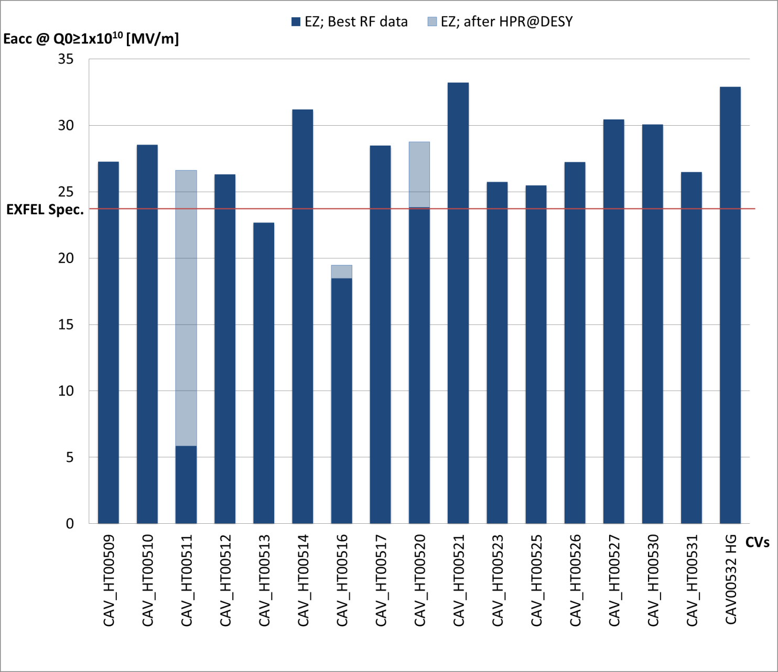
Eacc at Qo=1x10¹⁰ (or max Eacc for curves with Qo>1x10¹⁰)

