Slide 1
Diode Measurements – Macroscopic Effects
Preliminary Results from the Diodes Group
Brown University, CERN, DESY, Hamburg University, Santander (IFCA), KIT, Vilnius
Doris Eckstein
HPK Workshop

Slide 2
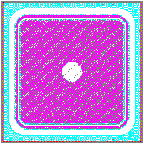
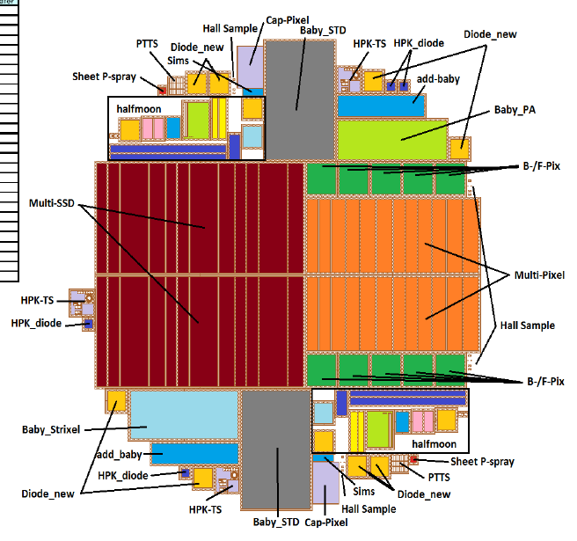
Diodes (Pad sensors) in the HPK Campaign
simple structures
  non-segmented pads on both sides
allow to study material properties:
  volume current
  depletion voltage/ effective doping concentration
  trapping (charge collection)
  temperature dependence
  fluence dependence
  dependence on irradiating particle type
Al contact
p+ implant
n bulk
n+ implant
Al contact

Slide 3
Irradiations and Measurements
radius | proton Φ_{eq} [cm⁻²] | neutron Φ_{eq} [cm⁻²] | total Φ_{eq} [cm⁻²] | Active thickn.
40 cm | 3 ∙ 10¹⁴ | 4 ∙ 10¹⁴ | 7 ∙ 10¹⁴ | ≥ 200 μm
20 cm | 1 ∙ 10¹⁵ | 5 ∙ 10¹⁴ | 1.5 ∙ 10¹⁵ | ≥ 200 μm
15 cm | 1.5 ∙ 10¹⁵ | 6 ∙ 10¹⁴ | 2.1 ∙ 10¹⁵ | ≥ 200 μm
10 cm | 3 ∙ 10¹⁵ | 7 ∙ 10¹⁴ | 3.7 ∙ 10¹⁵ | ≤ 200 μm
5 cm | 1.3 ∙ 10¹⁶ | 1 ∙ 10¹⁵ | 1.4 ∙ 10¹⁶ | < 200 μm
Neutrons: 1 MeV (TRIGA Reaktor Ljubljana) annealing not an issue
Protons: 23 MeV (Karlsruhe cyclotron) irradiation in cooled environment
800 MeV (Los Alamos) air cooling to ~RT
23 GeV (CERN PS) sensors get warm during irradiation
-> fluence dependent annealing
Measurements according to:
https://twiki.cern.ch/twiki/pub/CMS/SLHCSensorDevelopment/HPK_measurement_specs_V2.7.pdf

Slide 4
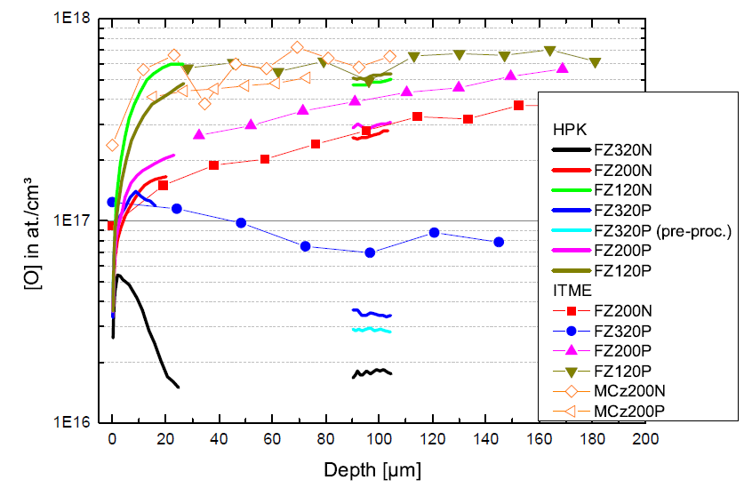
Materials and oxygen content
material | thinning | active thickness | thickness | O[10¹⁷]
Float Zone (FZ) | deep diffusion | 320μm 200 μm | 320 μm | 0.8-1 3-4
Float Zone (FTH) | thinned | 200 μm | 200 μm | ?
MCz | --- | 200 μm | 200 μm | 5
important to keep in mind:
this FZ material is different
concentrate on 200µm
p-on-n (n-type):
FZ320N
FZ200N
MCz200N
n-on-p (p-type)
with p-stop⁽¹⁾ with p-spray
FZ320P FZ320Y
FZ200P FZ200Y
MCz200P MCz200Y
no difference as concerns the diodes
(1) no isolation of pad and guard ring
not an issue after irradiation anymore

Slide 5
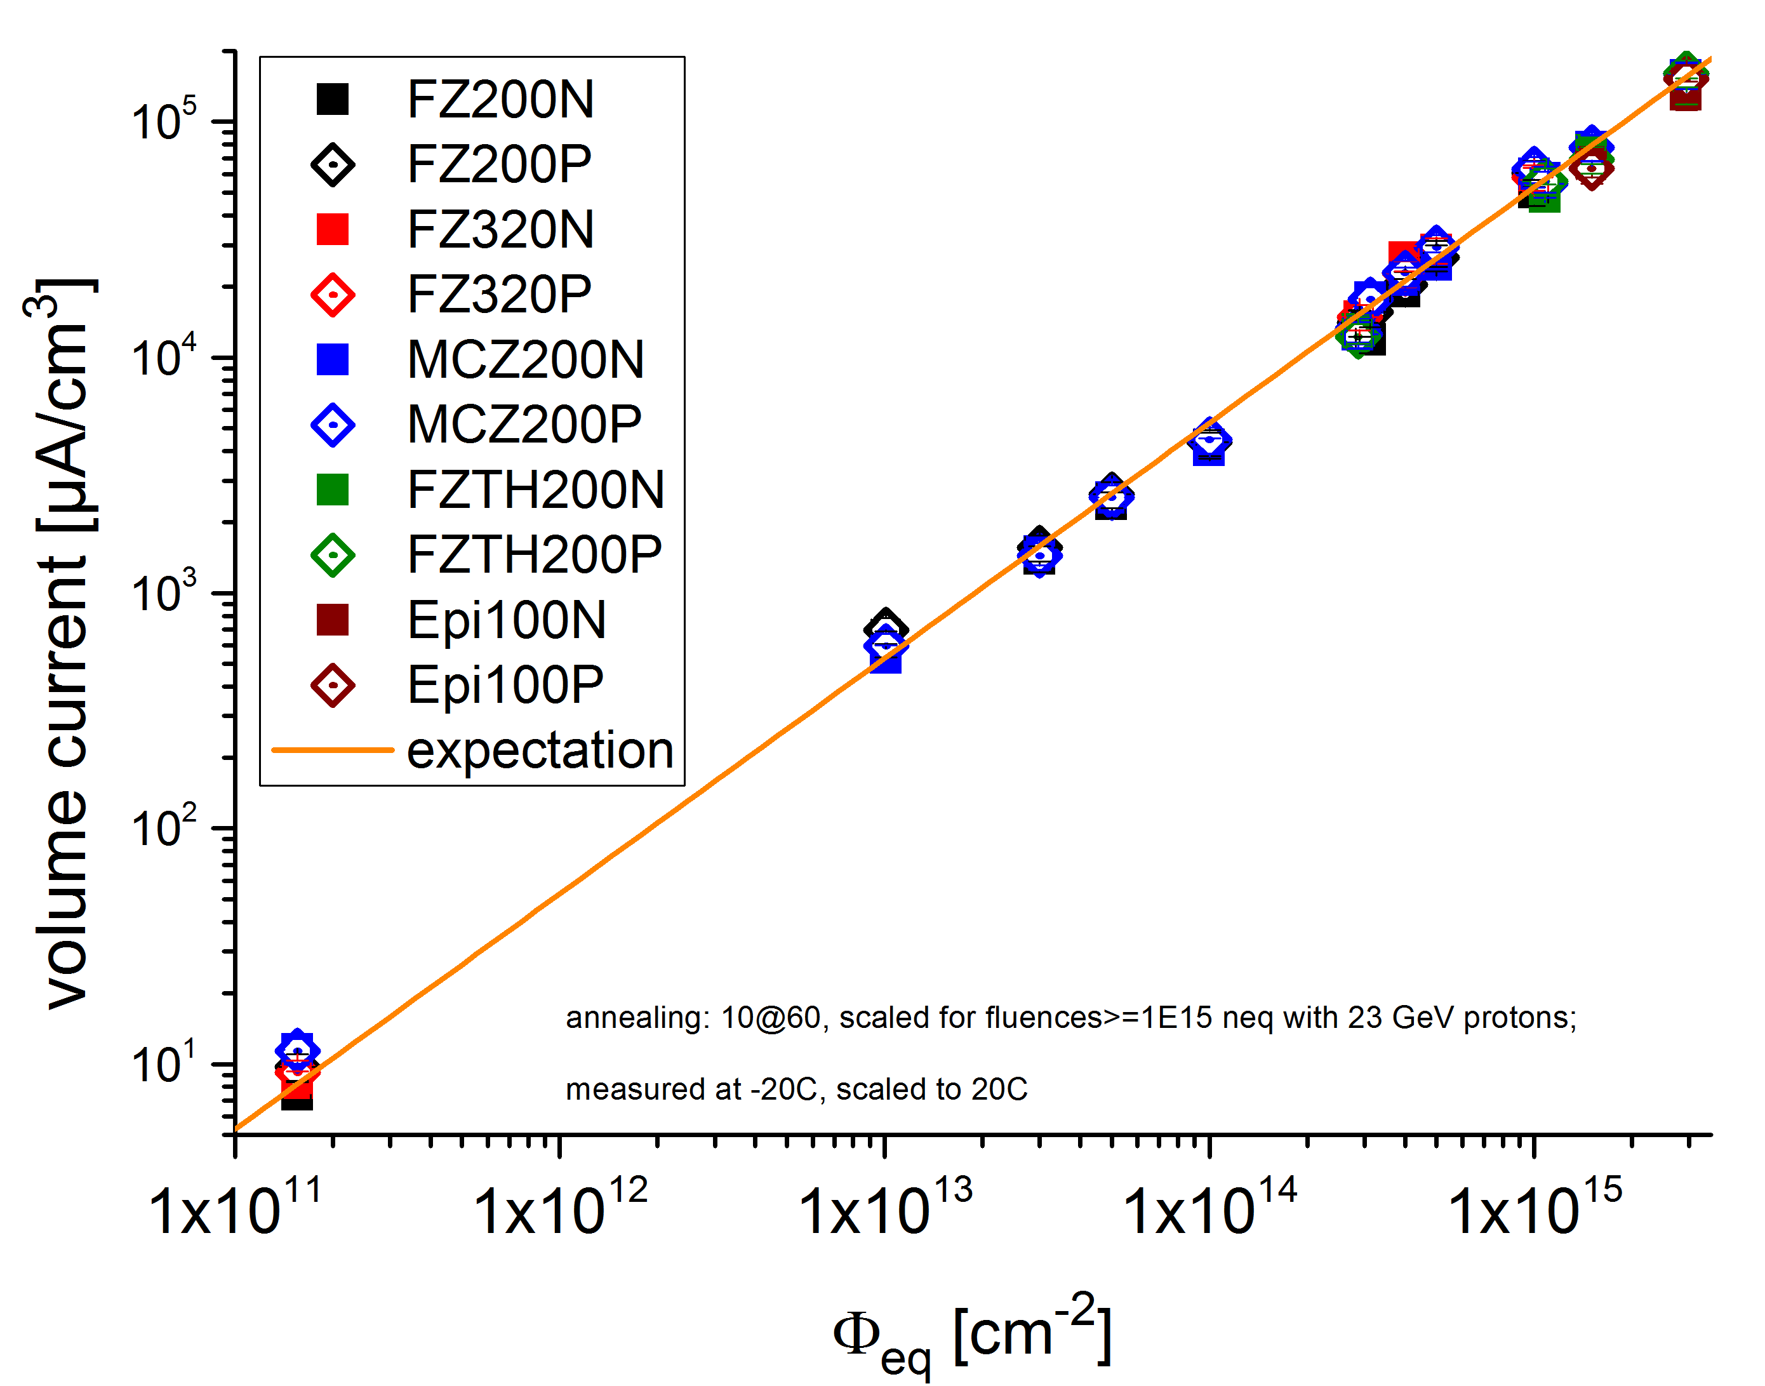
Current above full depletion
current at V_{fd} + 20%
𝐼/𝑉= 𝛼∙Φ_{𝑒𝑞}
independent of material
and irradiation type
𝛼_{𝑀𝑜𝑙𝑙} = 5.3∙10⁻¹⁷𝐴/𝑐𝑚

Slide 6
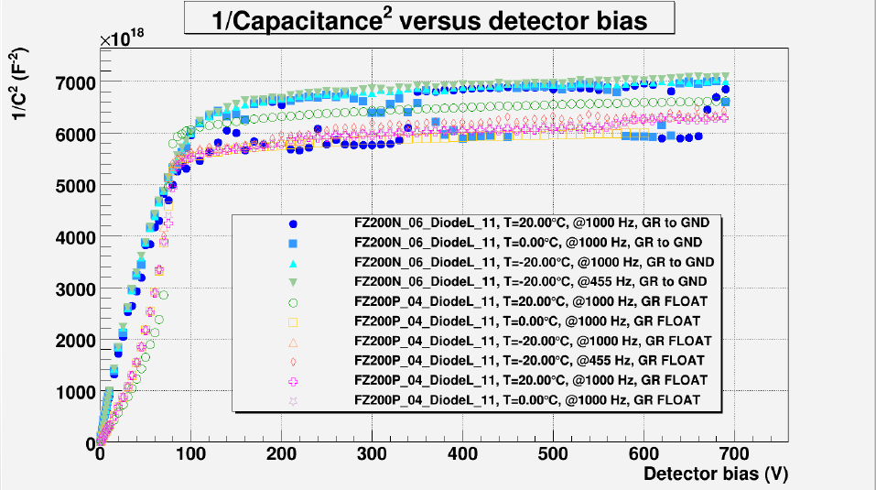
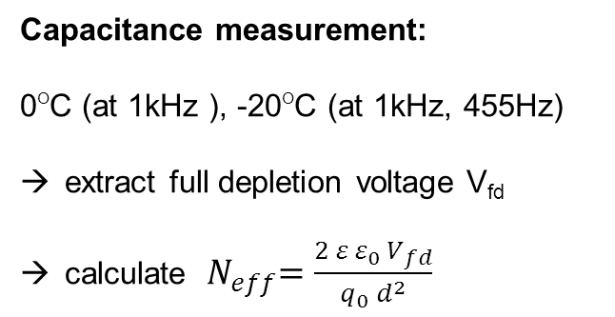
Capacitance measurements
Capacitance measurement:
0^{O}C (at 1kHz ), -20^{O}C (at 1kHz, 455Hz)
extract full depletion voltage V_{fd}
calculate ${ N}_{eff}=\frac{2 ε ε_{0 }V_{fd}}{q_{0} d^{2}}$
fluence dependence of N_{eff} after p irradiation (for n we have only two points)
  fix an annealing step (ideally 8 min @ 80^{O}C corr. to 80 min @ 60^{O}C )
annealing of N_{eff} for a given fluence

Slide 7
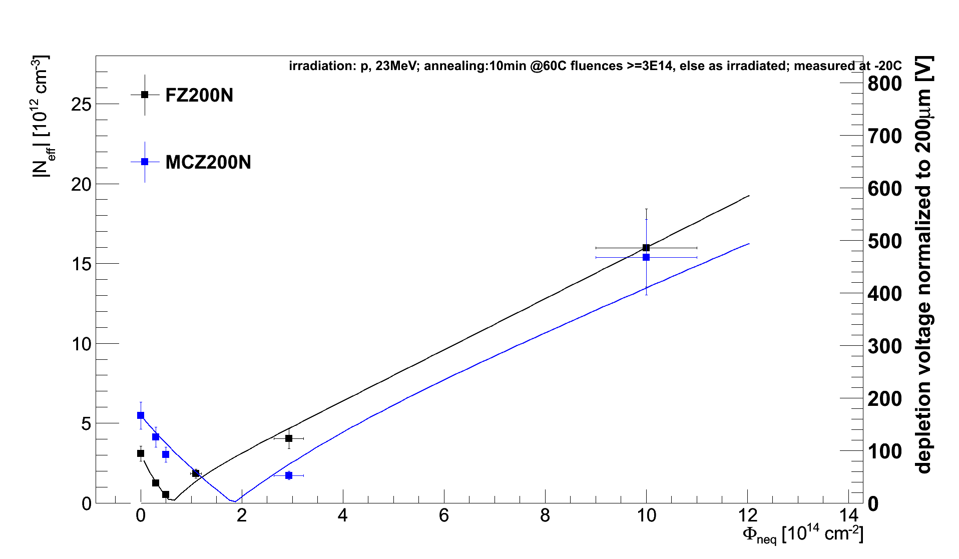
N_{eff} – fluence dependence
23 MeV protons
n-type material
material comparison
→ MCz200N and FZ200N behave similar

Slide 8
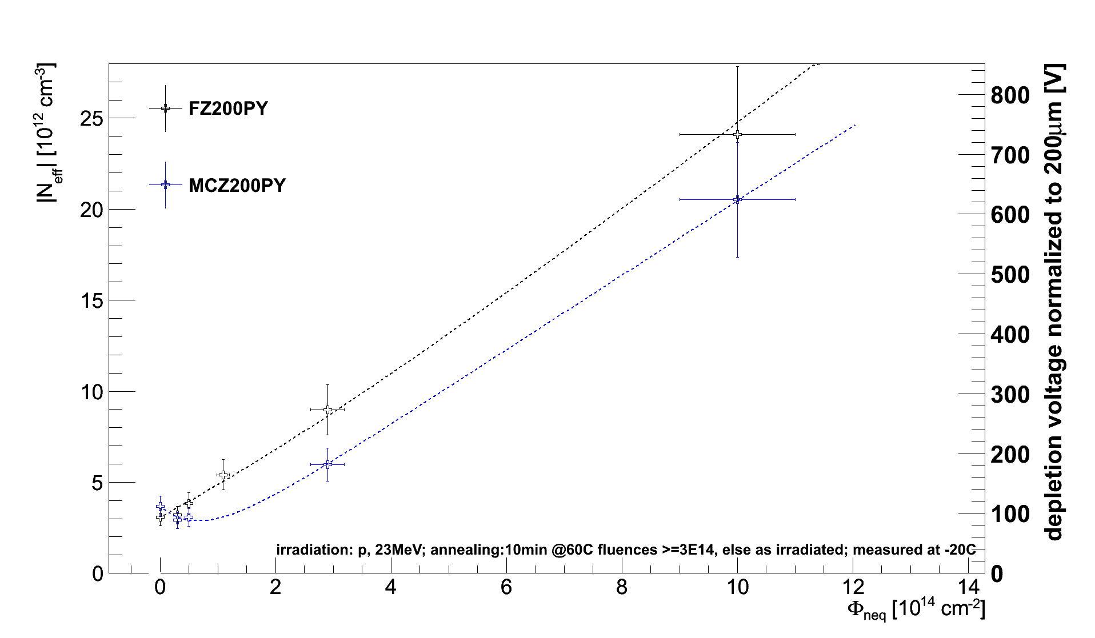
N_{eff} – fluence dependence
23 MeV protons
p-type material
material comparison
→ p-type rise from start

Slide 9
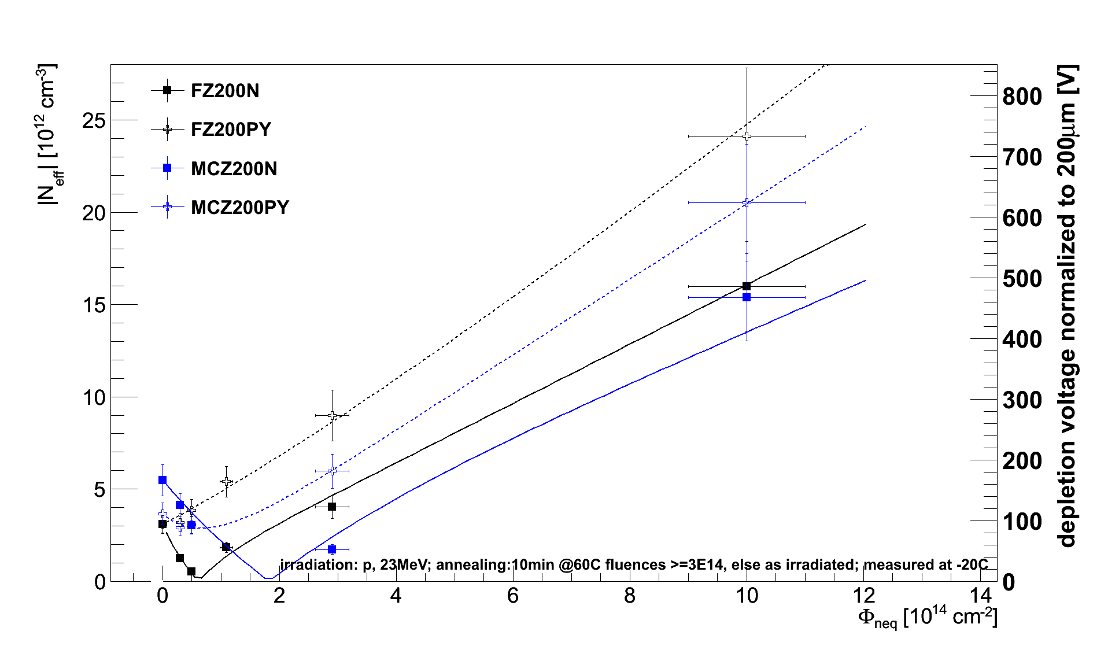
N_{eff} – fluence dependence
23 MeV protons
n-and p-type material
material comparison
→ p-type depletion voltage higher

Slide 10
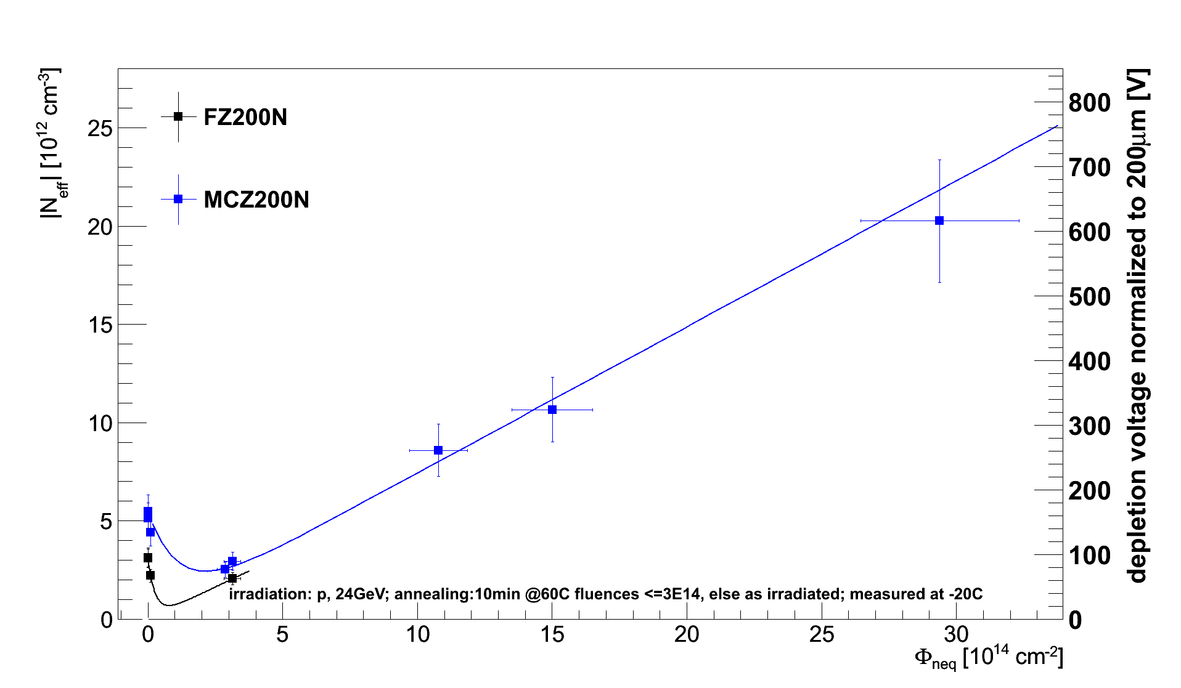
N_{eff} – fluence dependence
23 GeV protons
n-type material
material comparison

Slide 11
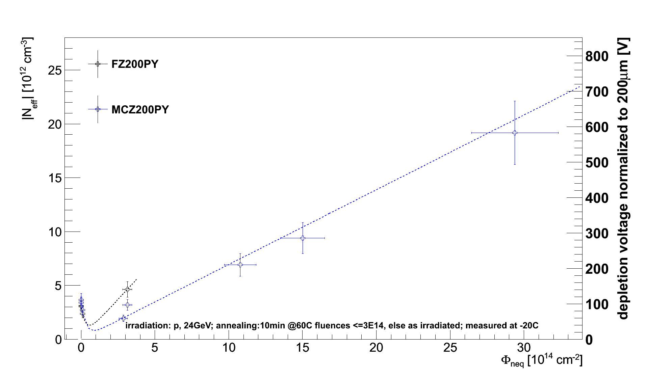
N_{eff} – fluence dependence
23 GeV protons
p-type material
material comparison

Slide 12
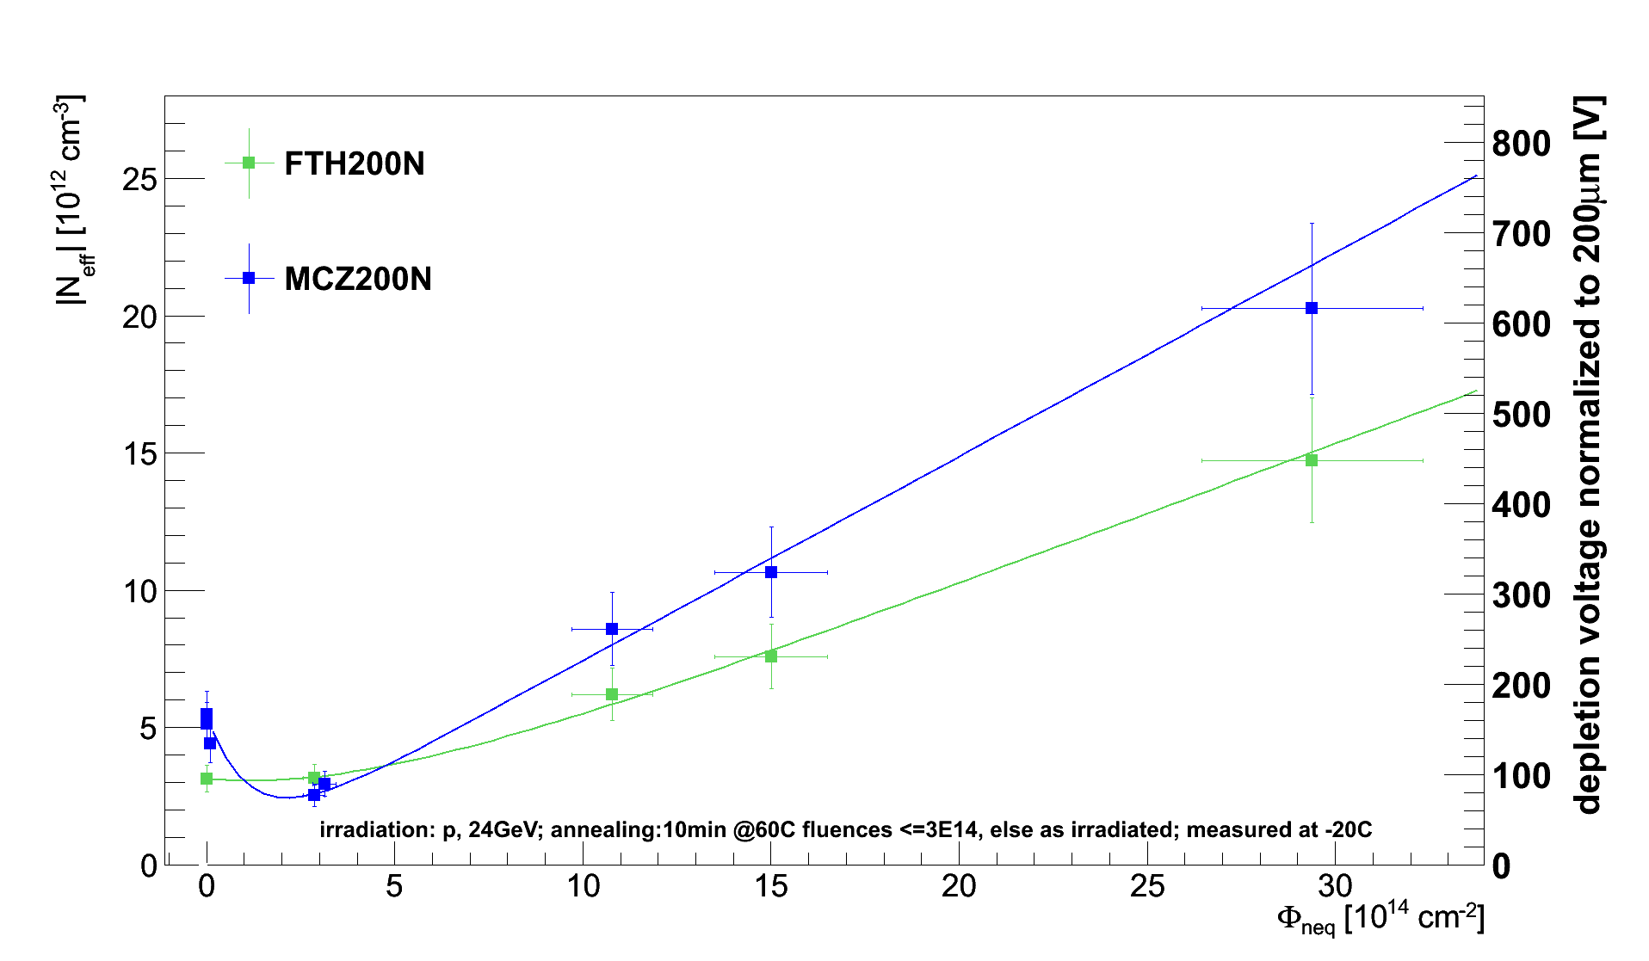
N_{eff} – fluence dependence
23 GeV protons
n-type material
thinned 200 um FZ
material comparison
→ FTH200N has smaller depletion Voltage

Slide 13
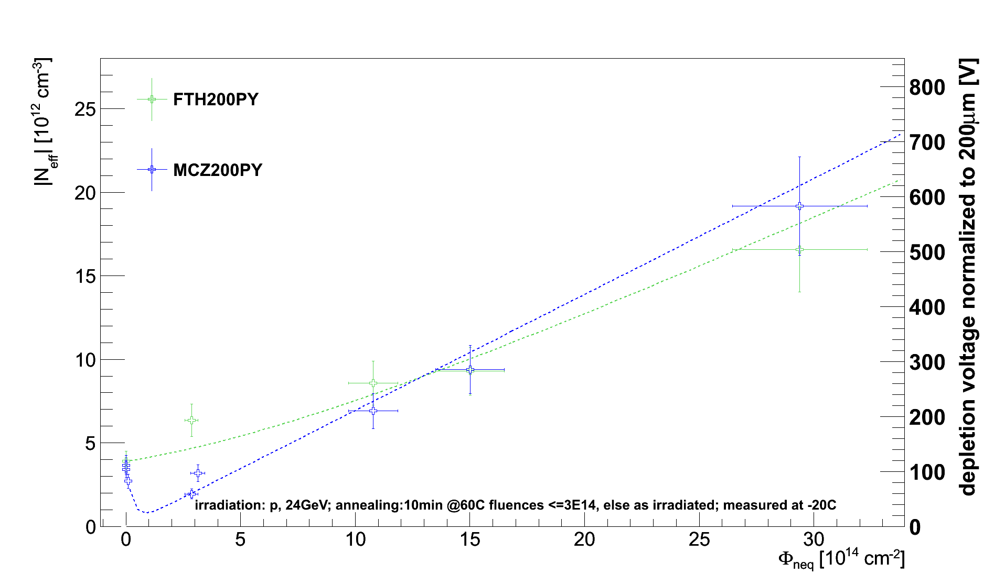
N_{eff} – fluence dependence
23 GeV protons
p-type material
thinned 200 um FZ
material comparison

Slide 14
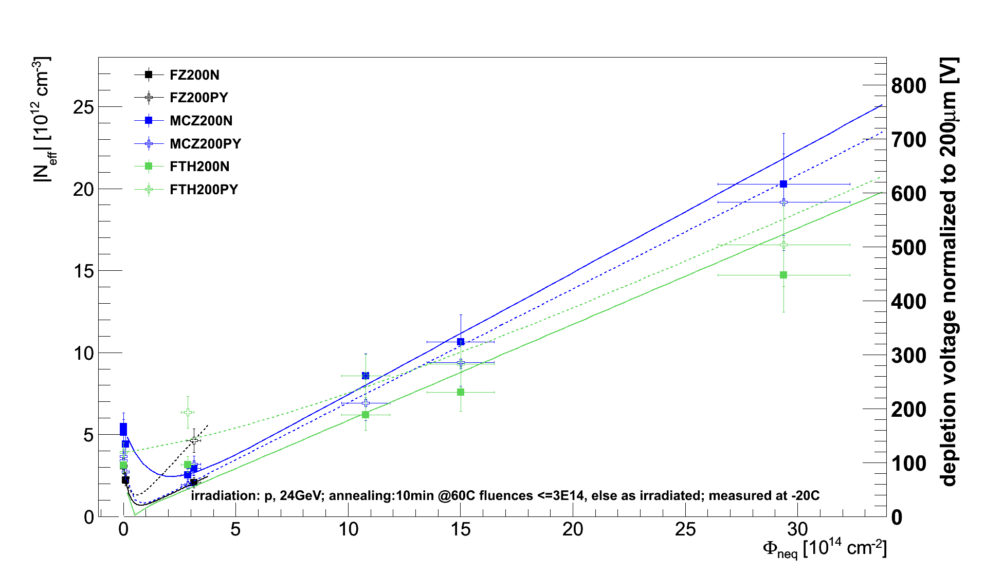
N_{eff} – fluence dependence
23 GeV protons
n- and p-type material
material comparison
→ p- and n-type similar, thinned more flat

Slide 15
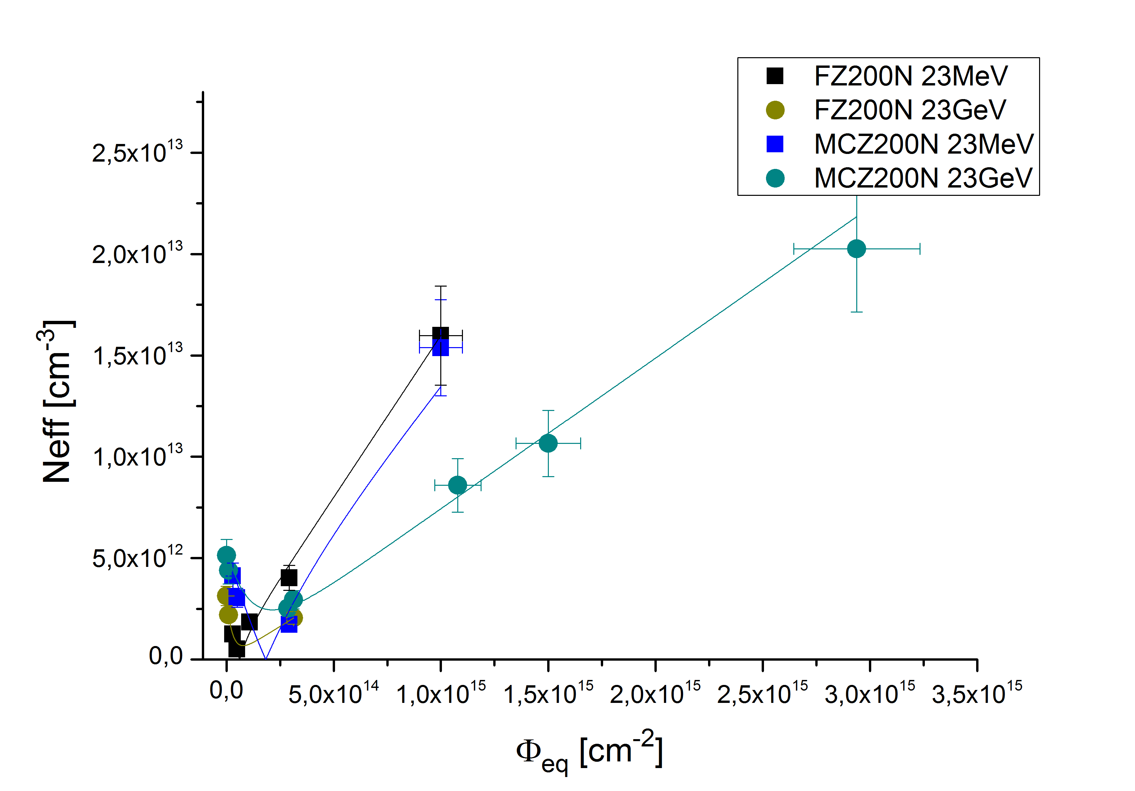
N_{eff} – fluence dependence after 23GeV and 23 MeV protons
dependence on particle energy
n-type material
steeper rise of depletion
voltage after 23MeV protons
which material does invert and
which not?

Slide 16
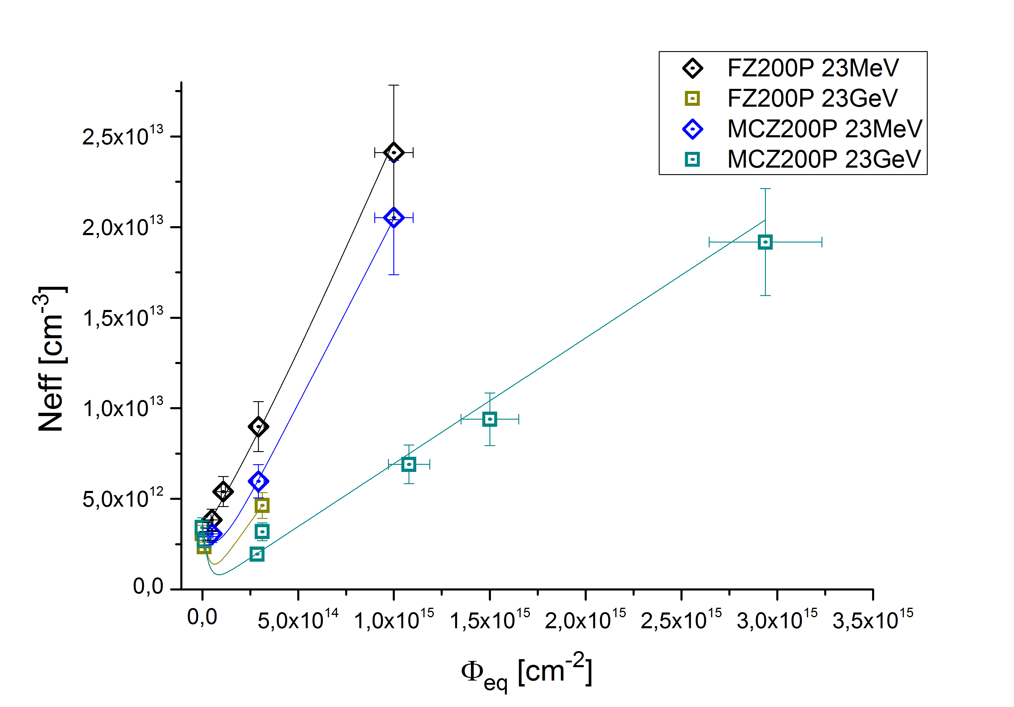
N_{eff} – fluence dependence after 23GeV and 23 MeV protons
dependence on particle energy
p-type material
steeper rise of depletion
voltage after 23MeV protons

Slide 17
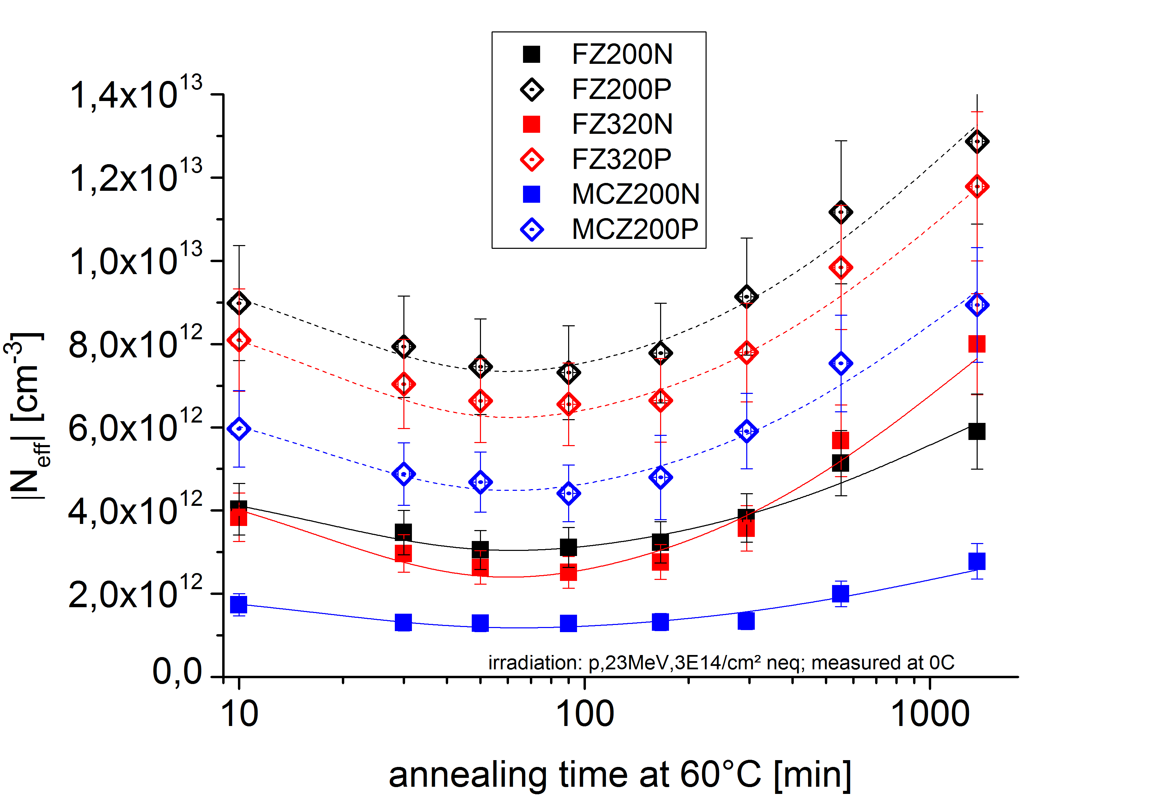
Annealing of N_{eff}
Irradiation with protons 23MeV
Fluence: 3e14 neq
all materials are p-type
after this fluence

Slide 18
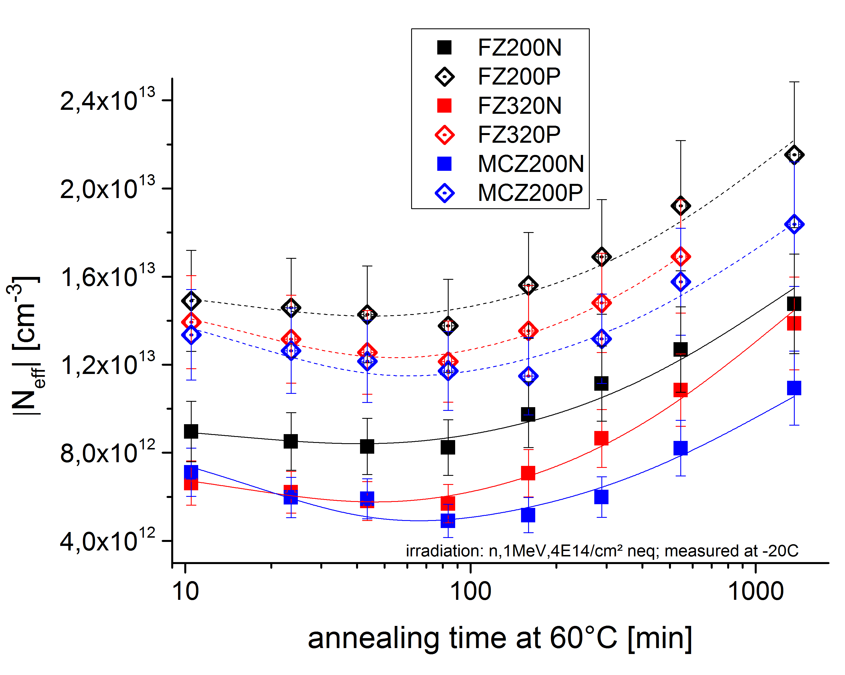
Annealing of N_{eff}
Irradiation with neutrons
Fluence: 4e14 neq
all materials are p-type
after this fluence

Slide 19
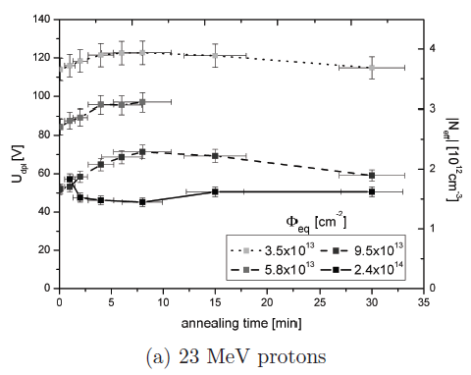

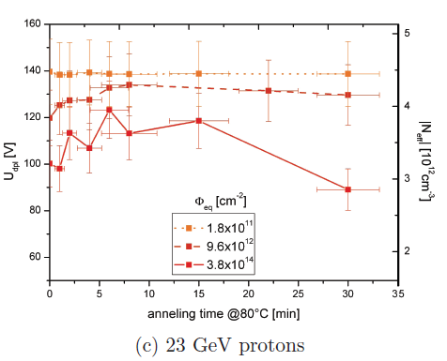
MCz200N after 23MeV and 23 GeV Protons
3.5x10¹³
n-type
annealing behaviour
5.8x10¹³
9.5x10¹³
p-type
annealing behaviour:
2.4x10¹⁴
1.8x10¹¹
9.6x10¹²
3.8x10¹⁴
With increasing fluence the annealing behaviour:
Changes to p-type after 2.4x10¹⁴ 23MeV p
Stays n-type up to 3.8x10¹⁴ 23GeV p

Slide 20
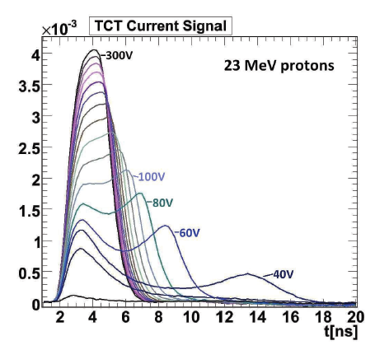
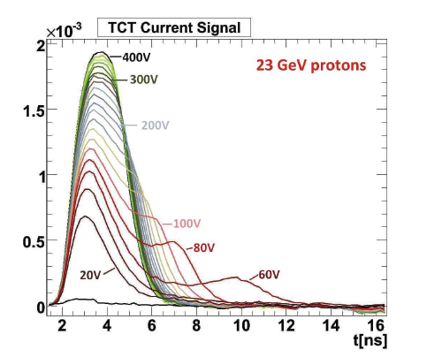
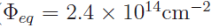

MCz200N after 23MeV and 23 GeV Protons
red laser TCT illumination from the front
charge injected close to p+ electrode
electrons drift through bulk to backplane
high field
→ p-type
small field
→ n-type
1 min @ 80^{O}C
MCz inverts after 23 MeV protons
does not invert after 23 GeV protons
1 min @ 80^{O}C

Slide 21
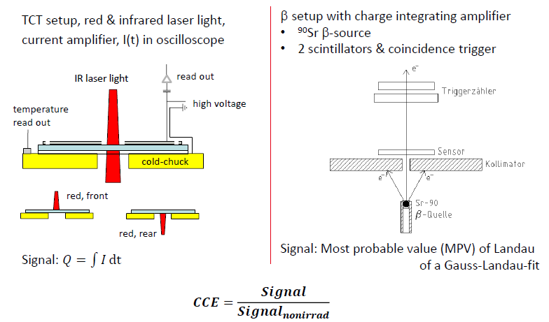
Charge Collection Efficiency with TCT

Slide 22
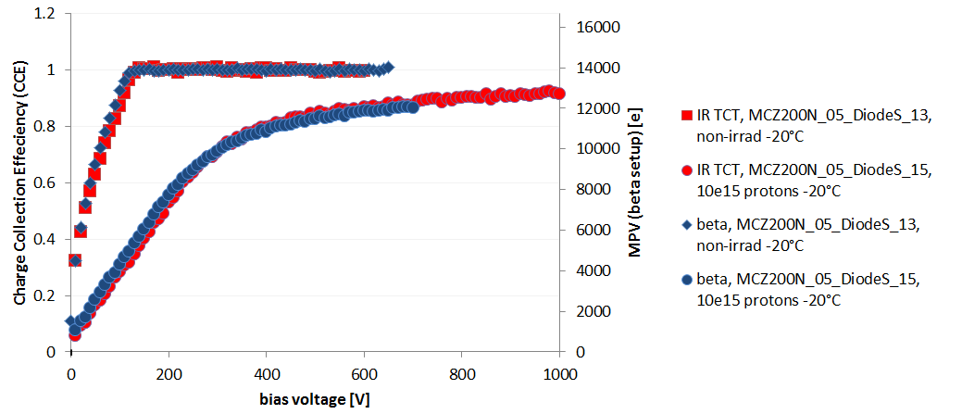
Charge Collection Efficiency with TCT and Source
Details on CCE measurement
CCE measured with radioactive source (Sr-90) and infrared laser
Advantage source: Absolute energy scale
Advantage laser: much larger signal, less influenced by noise
Result: CCE relative to non-irradiated sensor.
Shape between laser and source agrees very well!
→ now show laser

Slide 23
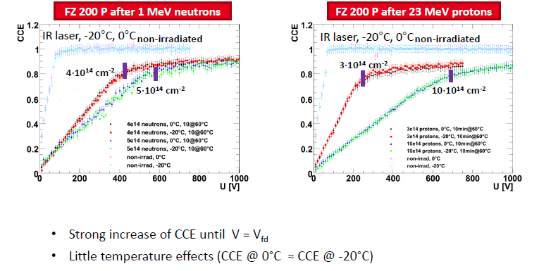
Charge Collection Efficiency – Fluence Dependence

Slide 24
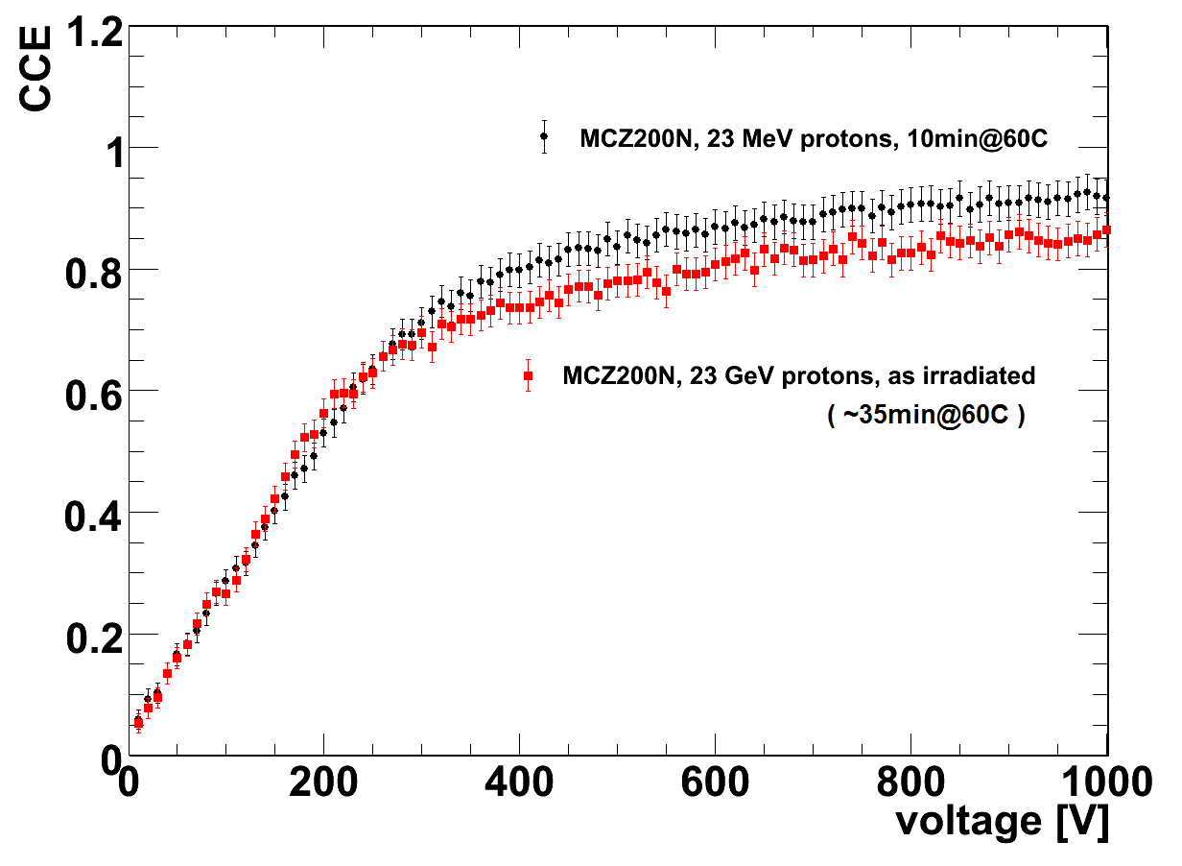
CCE GeV vs. MeV Protons
-20º C at 1e15
CCE after GeV proton irradiation smaller above depletion than after MeV protons
Could be attributed to trapping
➔ Have to bring all sensors to same level of annealing

Slide 25
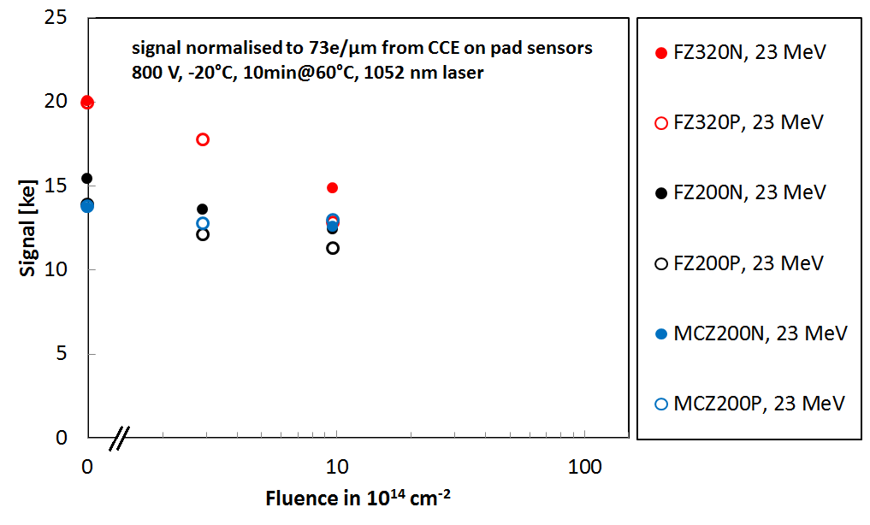
Charge Collection in Diodes
signal calculated from CCE as CCE * 22000e * d/300µm
at 800V bias (above depletion) after 23MeV proton irradiation
* FZ320 looses faster
* n-type and p-type rather similar

Slide 26
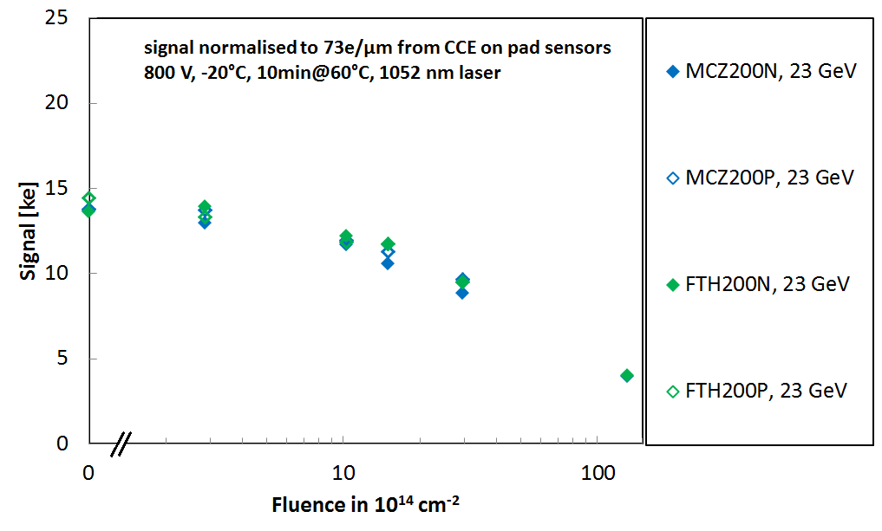
Charge Collection in Diodes
signal calculated from CCE as CCE * 22000e * d/300µm
at 800V bias (above depletion) after 23GeV proton irradiation
All fairly similar

Slide 27
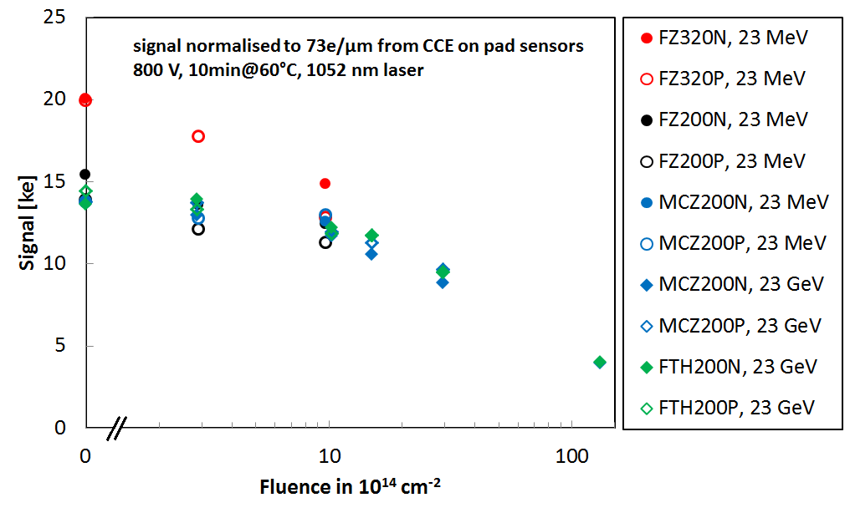
Charge Collection in Diodes
signal calculated from CCE as CCE * 22000e * d/300µm
at 800V bias (above depletion) after 23 MeV and 23GeV proton irradiation
Charge collection equivalent for all materials
Thicker sensors loose faster

Slide 28
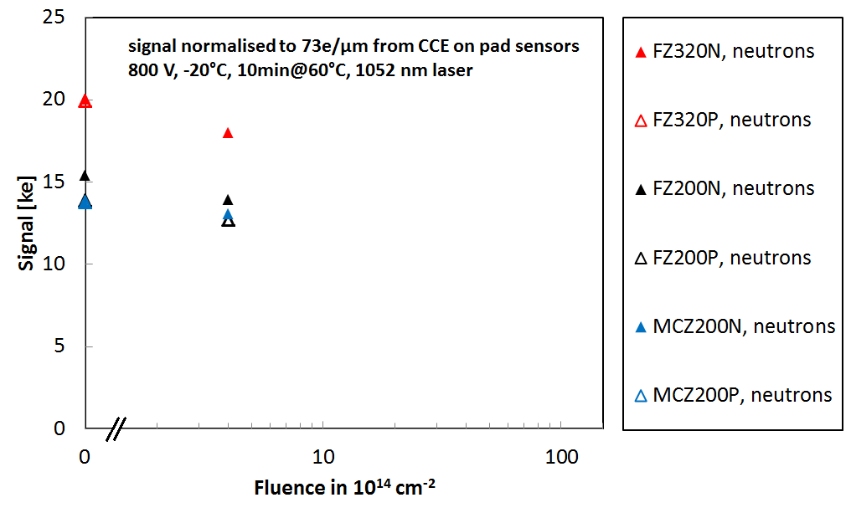
Charge Collection in Diodes
signal calculated from CCE as CCE * 22000e * d/300µm
at 800V bias (above depletion) after neutron irradiation
n-type and p-type similar

Slide 29
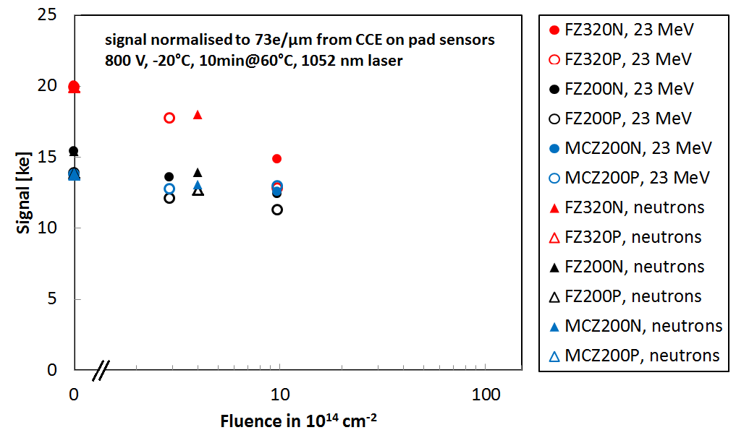
Charge Collection in Diodes
signal calculated from CCE as CCE * 22000e * d/300µm
at 800V bias (above depletion) after neutron and 23 MeV proton irradiation
need more neutron data

Slide 30
Charge Collection on Strips vs. Diodes
a pad diode has a symmetric structure
strips (weighting field) , electron vs. hole
collection play a role
Al contact
p+ implant
n bulk
n+ implant
Al contact
Al contact
n+ implant
p bulk
→ Can not base decision about material solely on diodes
p+ implant
Al contact

Slide 31
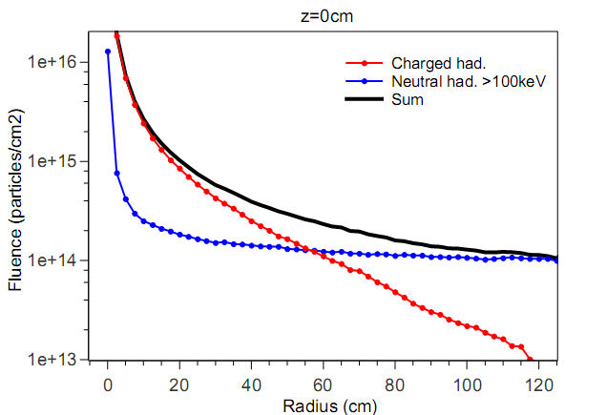
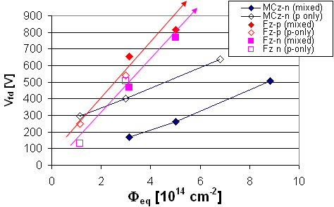
Mixed Irradiations
leakage current increases in accordance with received Φ_{eq}
FZ: damage accumulated
MCz-n: damage compensated
➔ donors introduced in p irradiation compensated by acceptors introduced in n irradiation
Pion/Neutron mixture
[ G. Kramberger et al., NIM A609 (2009), 142-148
L_{int}=3000 fb⁻¹ @14 TeV
Pixels
Strips
Note:
Particle Fluences
are shown!

Slide 32
Mixed irradiations: 23 MeV Protons

Slide 33
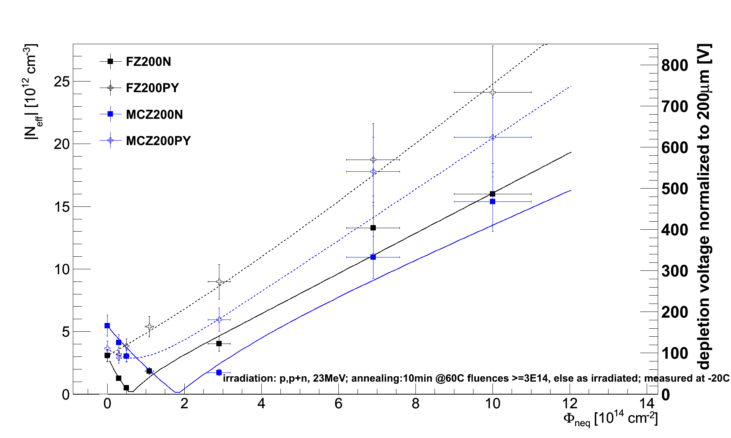
Mixed irradiations: 23 MeV Protons + Neutrons
fluences add
no compensation effect
n+p mixed

Slide 34
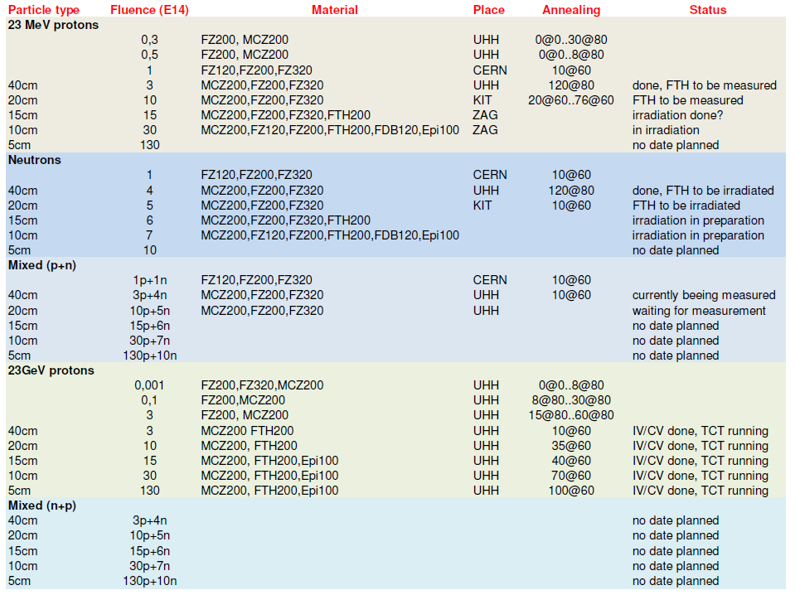
Current status

Slide 35
Conclusions
Huge amount of information already available
MCz200N and FZ200N behave similarly due to the similar level in oxygen concentration.
  This FZ deep deffused is not what we have known as FZ so far.
We need to know more about the oxygen content of the FTH
  ITME SIMS measurements (send diode)
Charge collection with diodes shows similar behaviour of all material types.
Propose to cut down on CCE measurements on pad diodes
  Measure at 80min@60ºC only
We need to get all diodes to at least 80min@60ºC annealing
Feed-back meeting with Hamamatsu

Slide 36
Thanks
To all involved in the measurements
To Joachim and Thomas for the plots

Slide 37
More Material
BACKUP

Slide 38
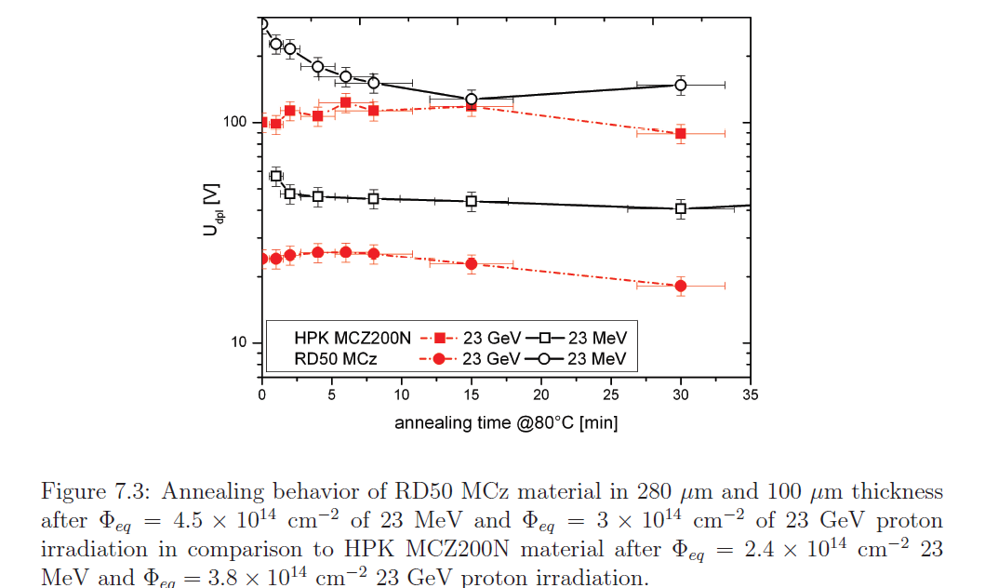
Is it the MCz?

Slide 39
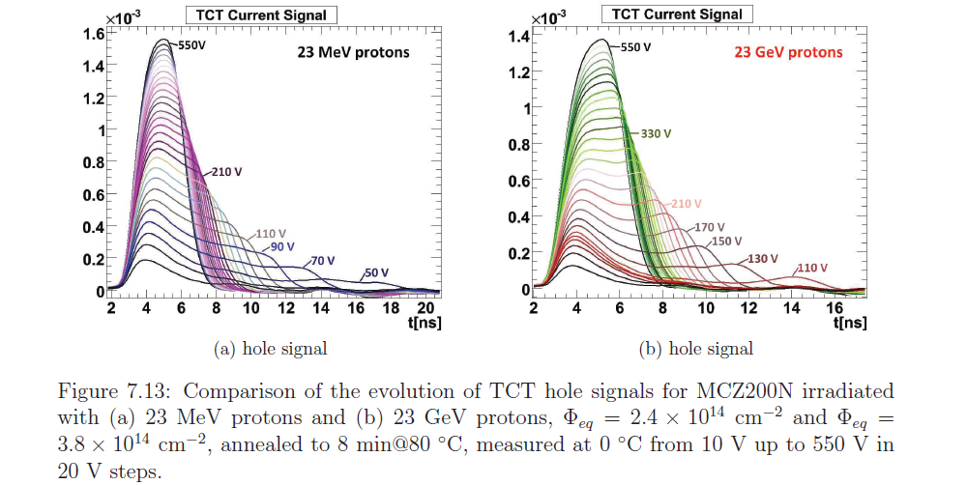
MCz TCT illumination from back

Slide 40
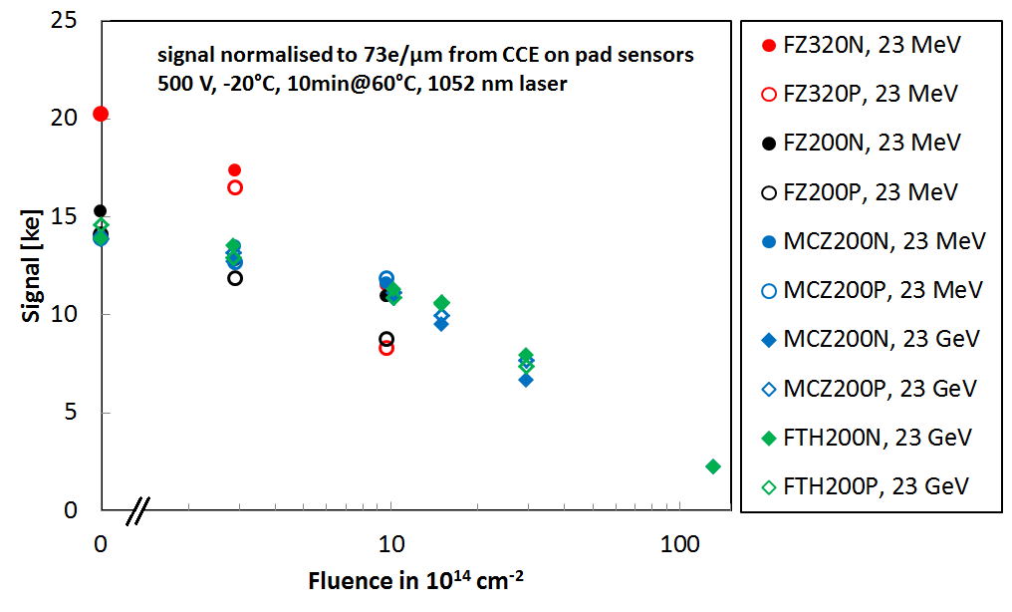
Charge Collection in Diodes
signal calculated from CCE as CCE * 22000e * d/300µm
at 500V bias (above depletion) after 23 MeV and 23GeV proton irradiation

Slide 41
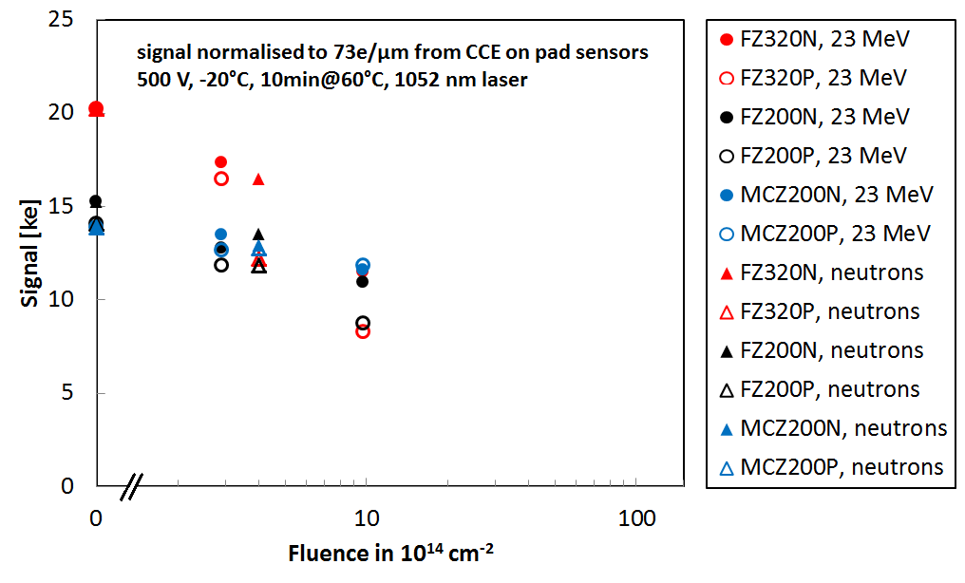
Charge Collection in Diodes
signal calculated from CCE as CCE * 22000e * d/300µm
at 500V bias (above depletion) after 23 MeV p and n irradiation

Slide 42
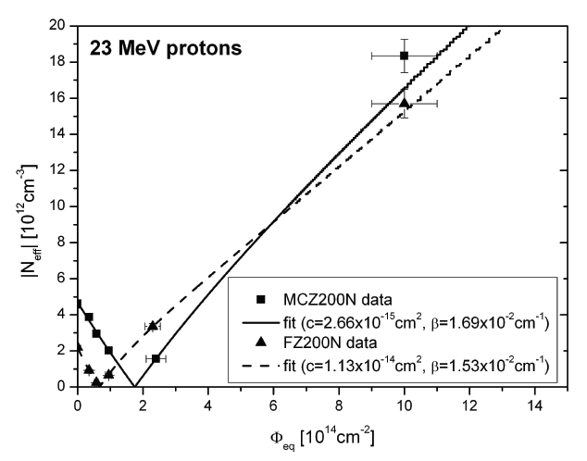
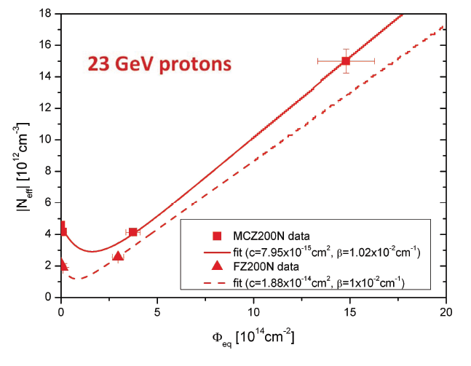
FZ200N compared to MCz200N
remember high oxygen content, similar level
diodes behave quite similar

Slide 43
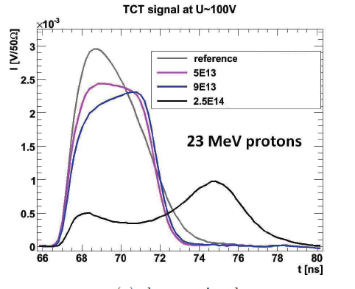
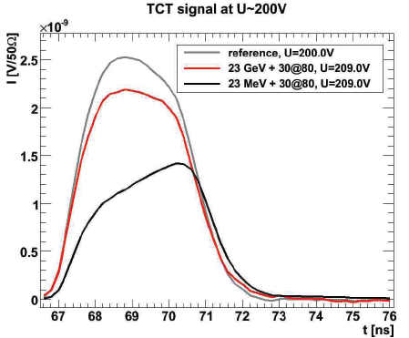
FZ200N - Red laser Illuminations
different fluences of 23 MeV protons
different energies for ~same fluence
as irradiated (no annealing) at 0ºC
2.5 e14 for 23 MeV and 23 GeV protons
30 min @ 80ºC
FZ200 inverts after 23 MeV protons
does not invert after 23 GeV protons

