Slide 1
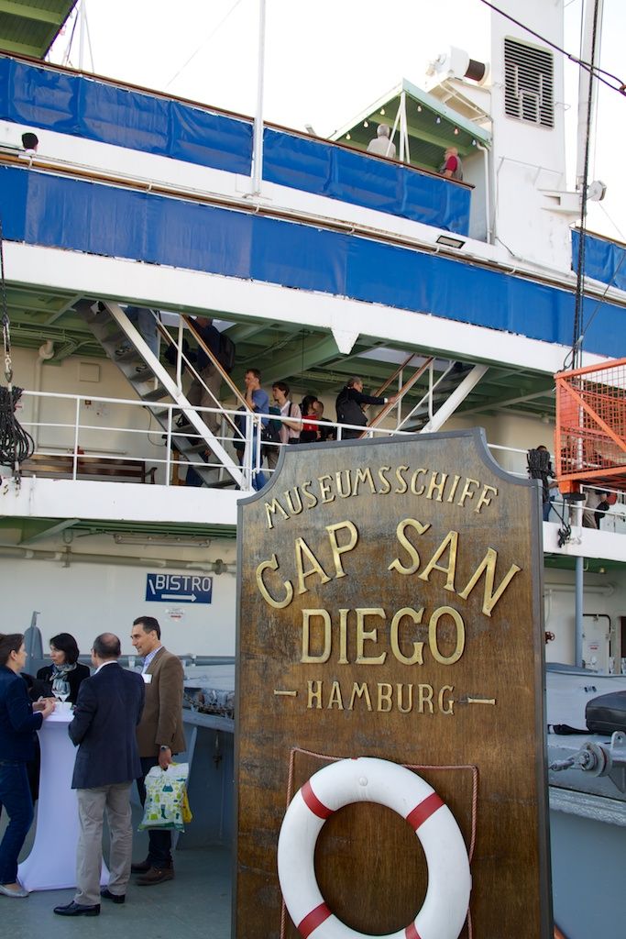
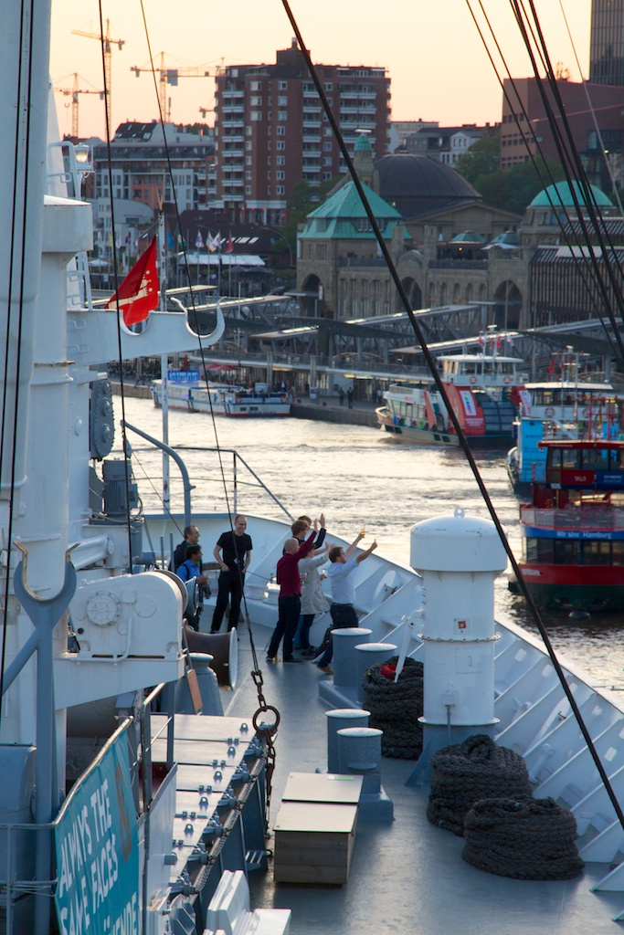

Slide 2
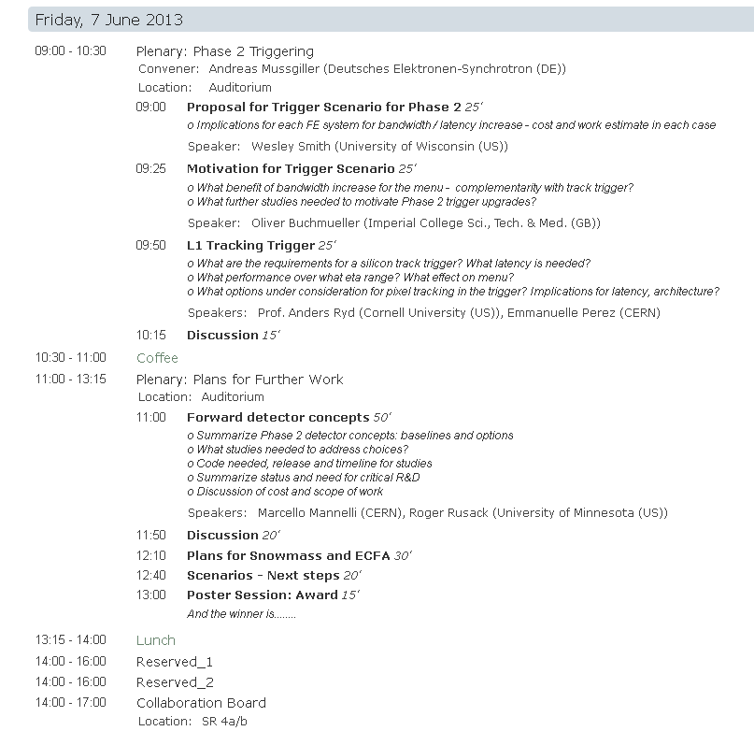
Agenda of today:
Last minute change :
10:30 – 10:45 Coffee
10:45 – 13:15
10:45 Poster Session Award

Slide 3
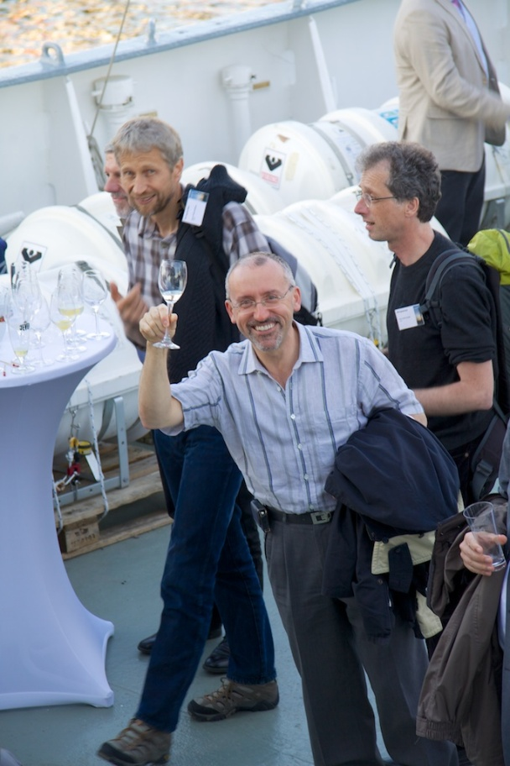
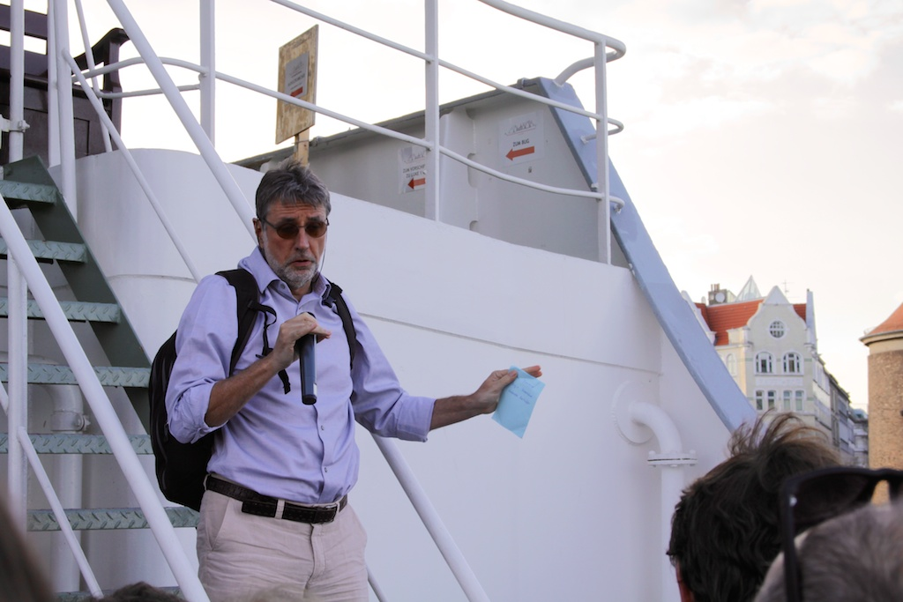
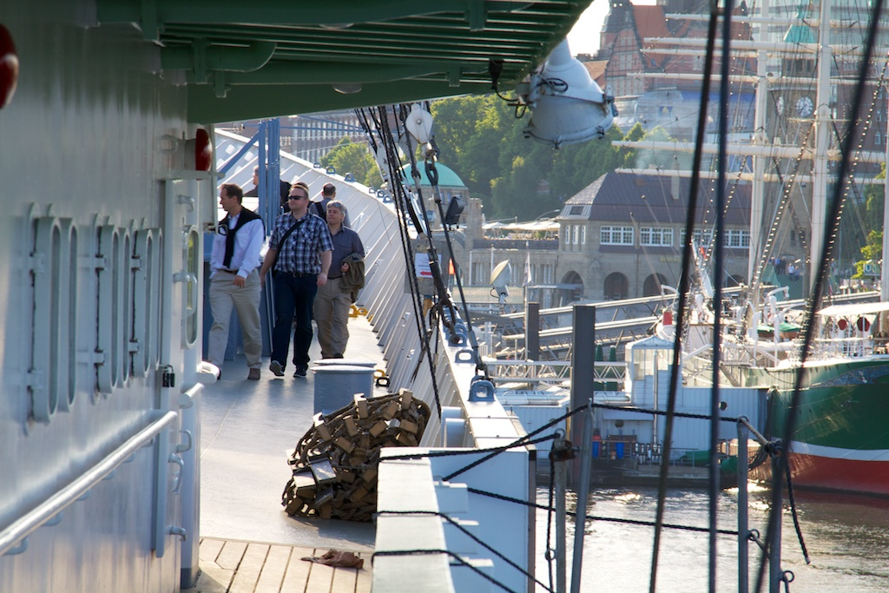
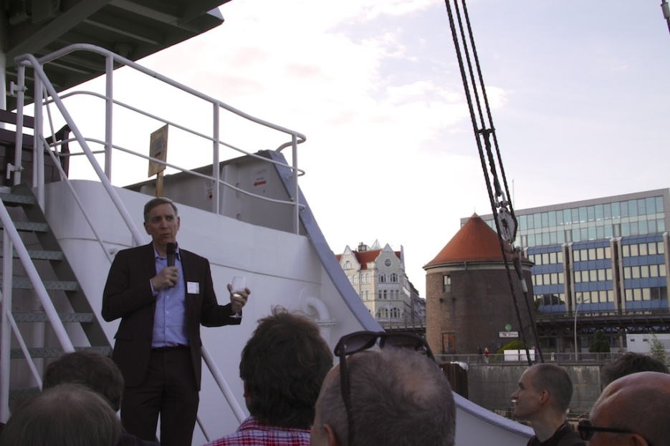

Slide 4
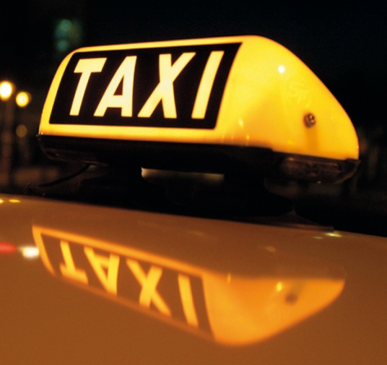
Order before 12:00 with Reception if you need one!
Later: ask the gate keepers
Printing of (plane- /train-) tickets:
Send pdf to Secretary (cms-sec@desy.de) before 12:00 and pick it up at registration desk.

Slide 5
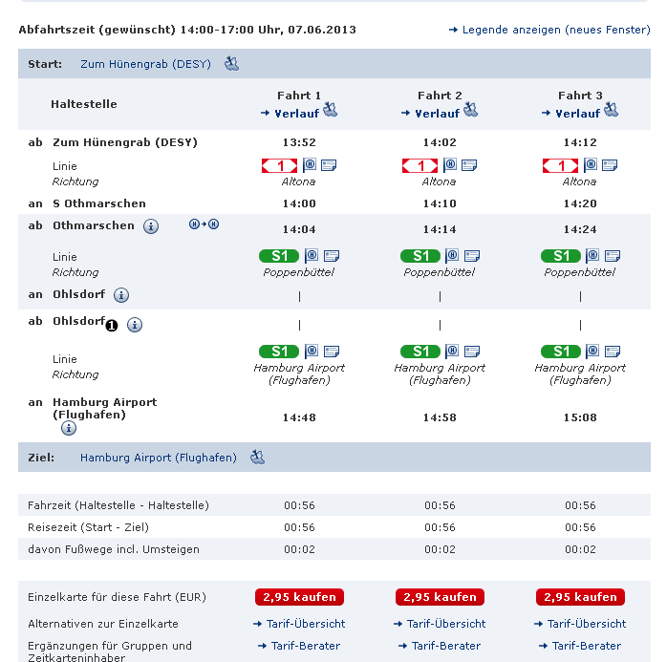
How to get to the AIRPORT with
Bus and S-Bahn
Busses leave every 10min’s
Change to S1 in S Othmarschen:
direction Poppenbüttel
! Front part of train goes to Airport!
Tickets with the bus driver
start
change

