Slide 1

Welcome !

Slide 2
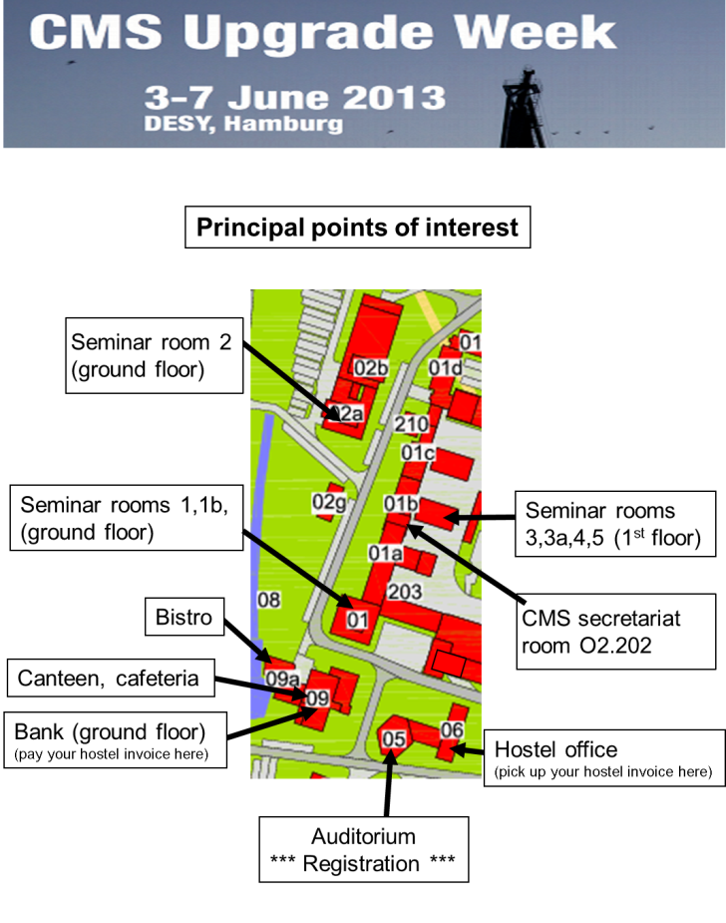
DESY Tour:
More places available:
Tuesday, 15:00 20 places
Thursday, 15:00 21 places
Register at Registration Desk
Meeting point is in front of Seminar room 1
(building 1 ground floor)

Slide 3
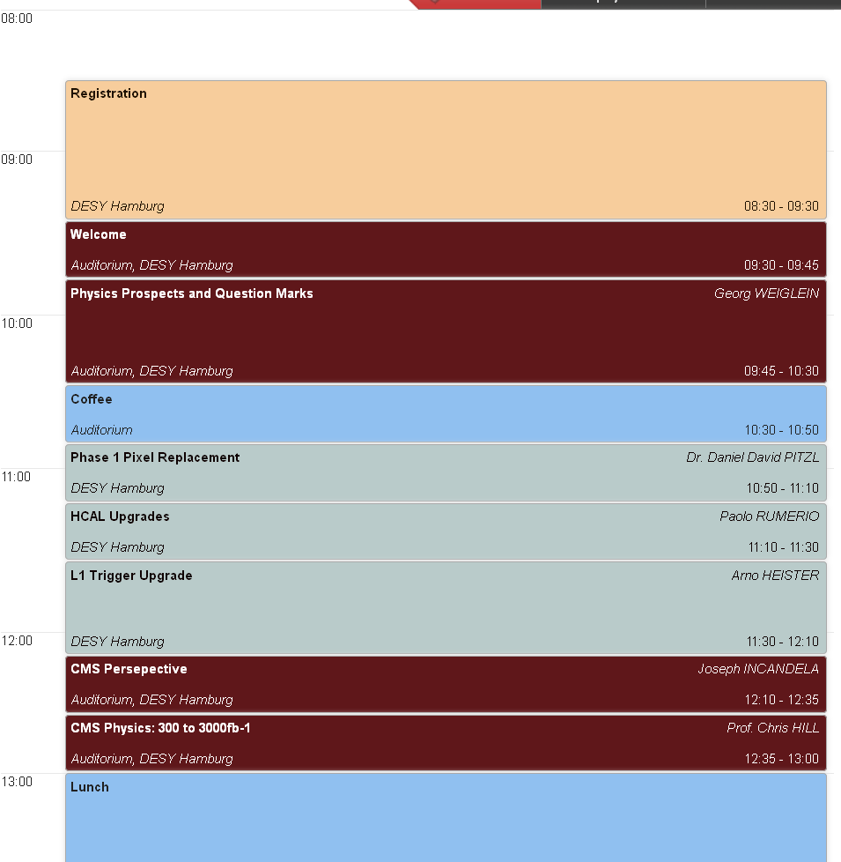
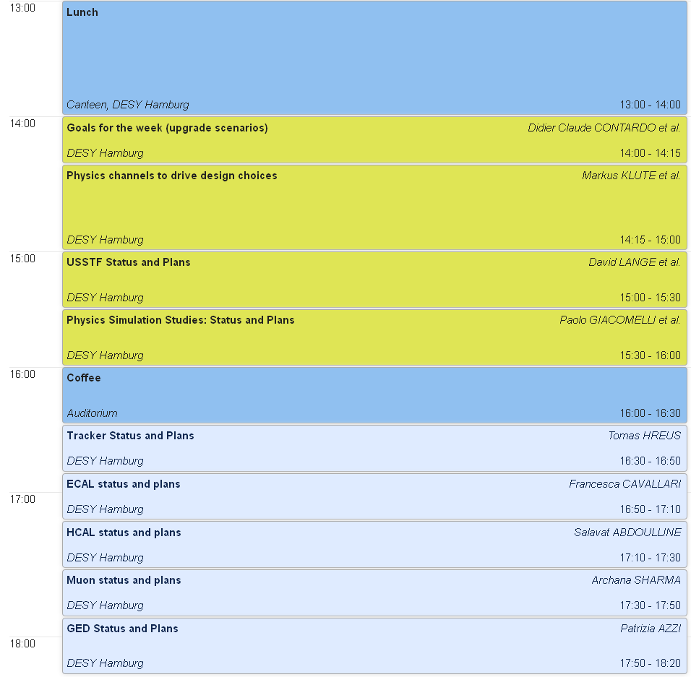
Agenda of the Morning session:
Agenda of the Afternoon session:

