Slide 1
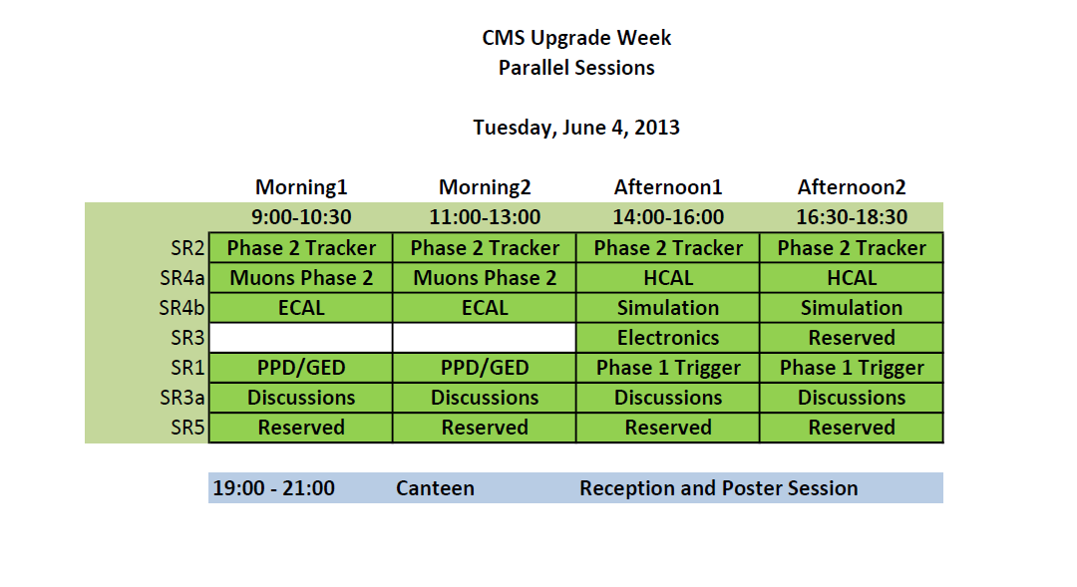

Slide 2
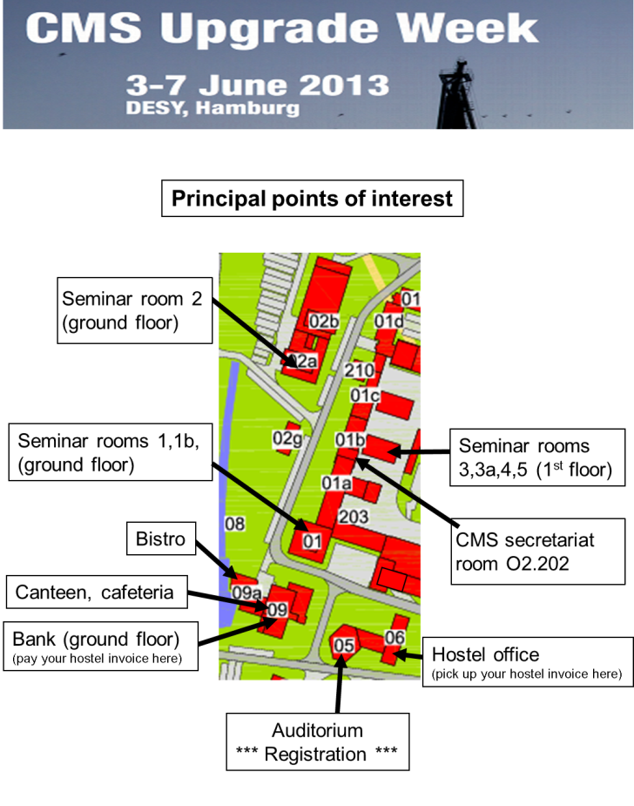
for people which signed up:
Today DESY Tour at 15:00
Meeting point is in front of Seminar room 1
(building 1 ground floor)

Slide 3
today
RECEPTION and Poster Session
Start at 19:00
Do not forget to vote (ballot!)
Location: Canteen

Slide 4
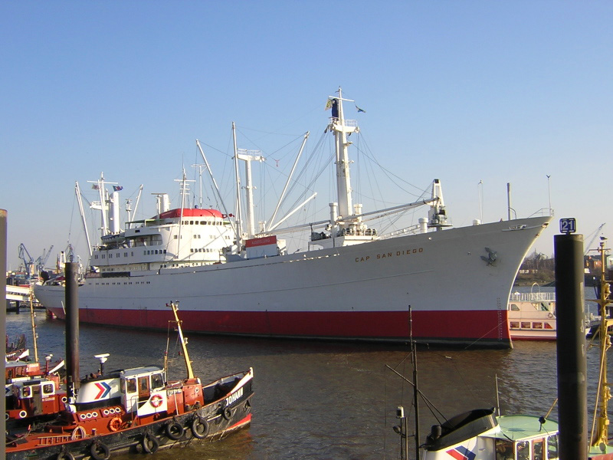
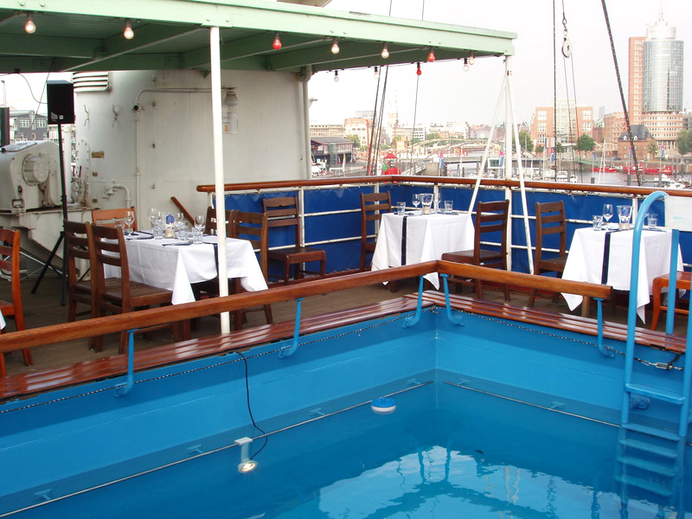
Although we expect nice weather tomorrow, it might get chilly in the evening.
Please bring warm clothes with you already in the morning (as the time after plenary is too short to go to your hotels).
tomorrow
Dinner on the Cap San Diego

