Slide 1
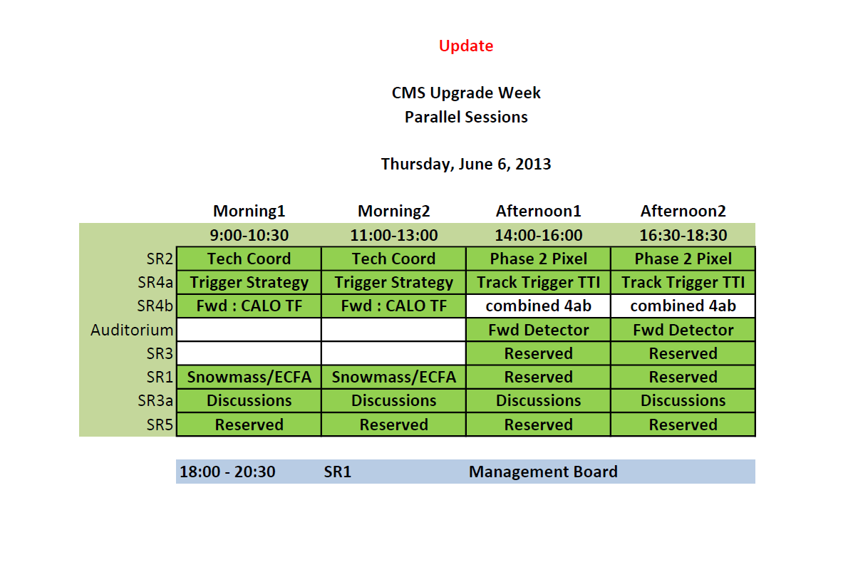

Slide 2
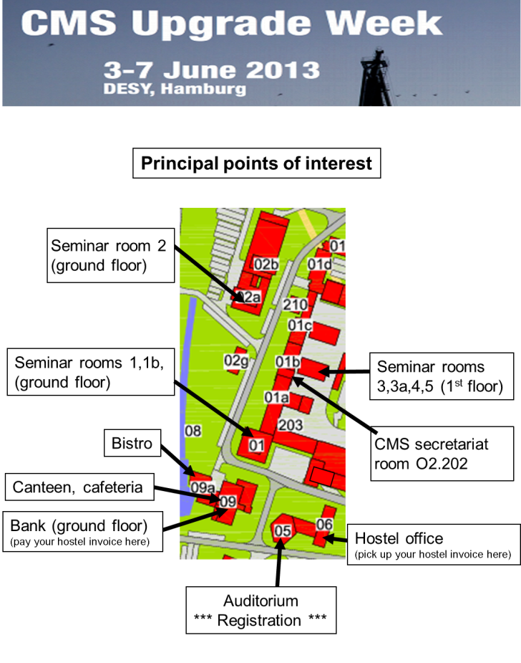
for people which signed up:
Today DESY Tour at 15:00
Meeting point is in front of Seminar room 1
(building 1 ground floor)

Slide 3

Order today if you need one tomorrow !
In the CMS Secretariat

