Slide 1
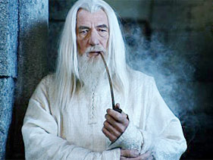
Close-Out BHM
Maria Hempel
Workshop on CMS Beam Conditions, Radiation Monitoring and Luminosity Systems
Zeuthen, 24.4.2013

Slide 2
BHM Simulations- Stella Orfanelli
Golden location
Separation of B1 and B2+collision products
Best location at 68.75ns
Small MIB rates compared to background
high background flux
Electrons & positrons
Muons
Gammas
Reducing the background
Al shielding
timing
Directionality
Open questions are size and material
Test beams and measurements

Slide 3

BHM Proposal- Marina Giunta
Many studies are ongoing
Optical coupling medium
Magnetic shielding
HV system
Cabling (timing of signal)
Readout systems (HF like readout)
A lumi DAQ is planned
Many test beams are needed
More manpower
VOTE!!!

