Slide 1
Real Time Histogramming Unit (RHU) Hardware and Commissioning Results
Marek Penno, DESY Zeuthen

Slide 2
Overview
RHU Hardware Rev.1
Setup and Commissioning 2012
RHU DAQ Software
RHU Hardware Rev.2
Proposal for „Lumi Nibble Control“
Outlook 2013

Slide 3
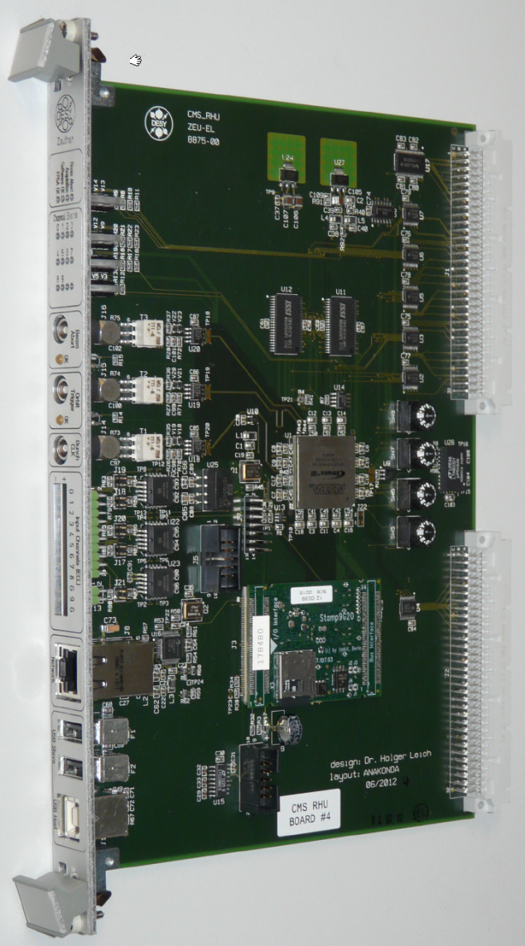
Hardware Rev.1 (2012)
RHU → Real Time Histogramming Unit
FPGA based digital recorder
3x NIM Inputs for clock/control
12x ECL Inputs for input data
VME Interface (not used yet)
System On Board Embedded Linux System, RISC CPU 400MHz
Ethernet Readout
5MBit RAM in FPGA
16MBit external RAM (3.2GBit/s)

Slide 4
RHU Schematic

Slide 5
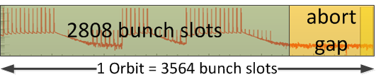
RHU Features
8 input channels with Histogramming
  Internal 320MHz Sampling Rate: two samples get „OR-ed“ and stored into one bin
  → result is 160MHz Sampling Rate
Histograms:
  6.25ns per bin
  14256 bins/orbit
  Max. 5839ms meas. period
No deadtime (double buffering histograms)
Continuous Postmortem Ring Buffer
Configurable # of Orbits for Histogramming

Slide 6
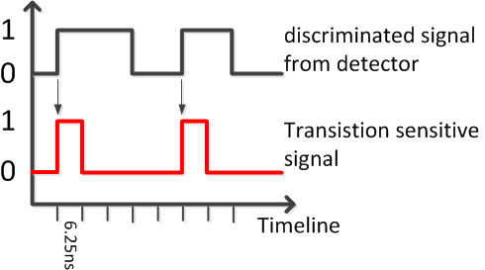
RHU Features
Configurable delay for Orbit Trigger
Readout and Control via Network
Configurable Sampling Mode: Edge/Level
Postmortem Buffer for > 50 Orbits
LEVEL Trigger Mode:
EDGE Trigger Mode:

Slide 7
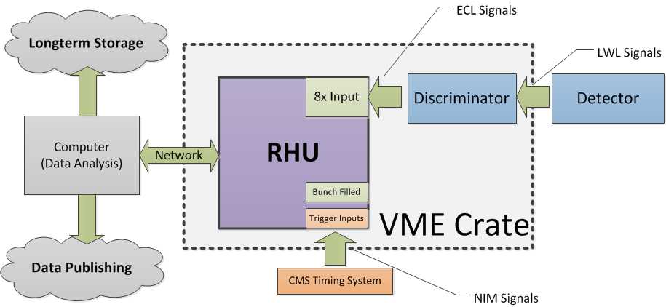
RHU Setup

Slide 8
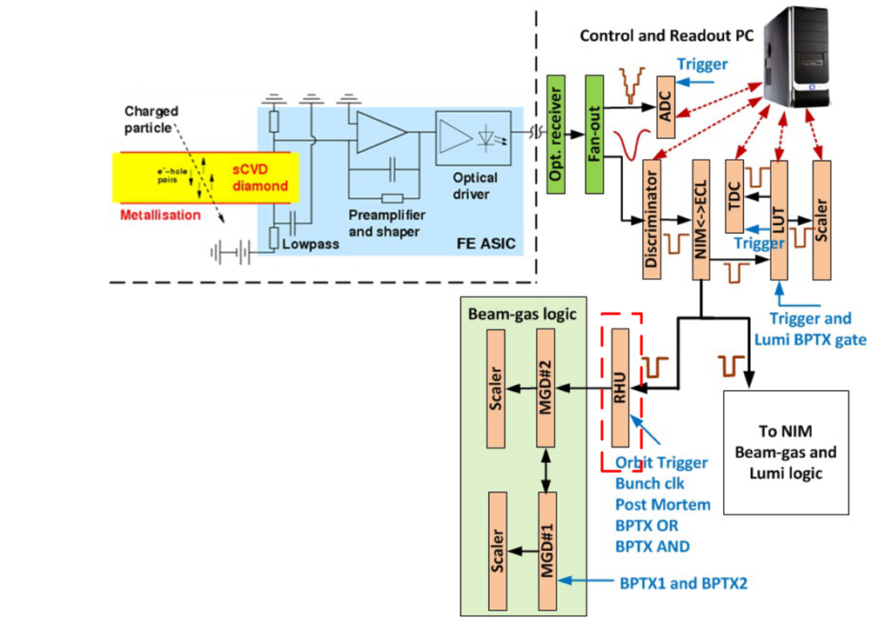
Setup at BCM1F
Source: Leonard-ADAMAS-18Dec12.odp

Slide 9
RHU Commissioning 2012
1 Device installed at CMS
1 Device installed at Prevessin
Data taken since 4Q 2012 stored in ROOT files
Data send via SSH Tunnels to DAQ Software at DESY Zeuthen
DAQ Software also installed at computer at CMS but no data recording yet.

Slide 10
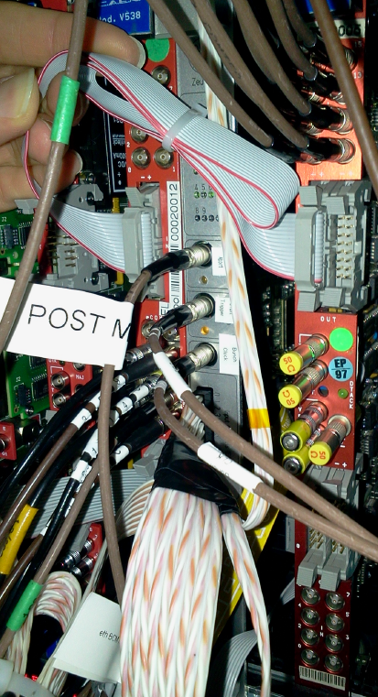
RHU Commissioning 2012
Electrical corrections at the board made by the SMD workshop at CERN
Mechanical correction of front panel made by mechanical workshop at CERN
Made special 10-channel signal cable and installed it to intercept existing signal path at the crate
Verified all input-signals via scope
Some Firmware / Software adaptions

Slide 11
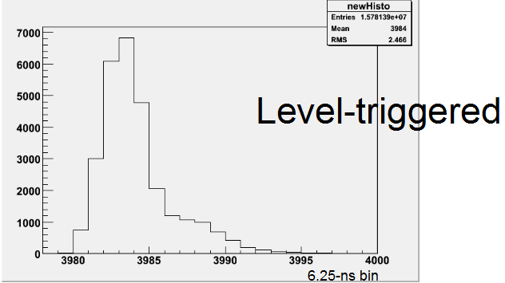
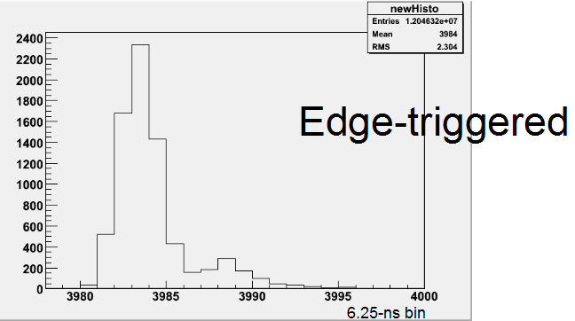
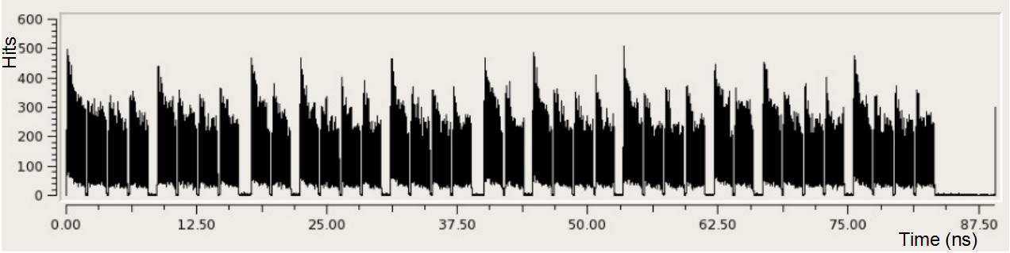
RHU Validation
RHU Device validated in Edge and Level Trigger Mode
Postmortem Function still to be tested
Source: Leonard-ADAMAS-18Dec12.odp

Slide 12
RHU Software Architecture
And more, f.ex. Data Link for Lumi Nibble Measurment
unlimited connections
Max. 3 simul. connections

Slide 13
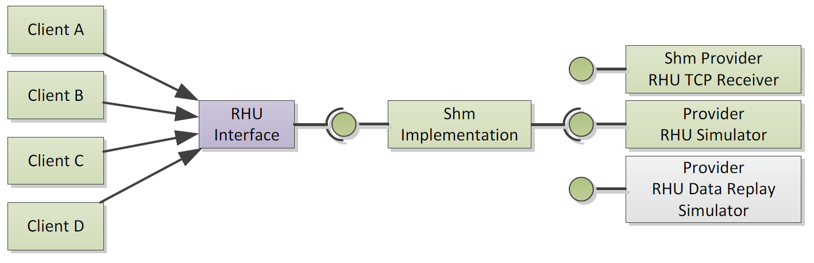
RHU Software Review
Shared Memory Concept works
  Client Software/Library is kept simple, data transportation details not exposed to clients
  Implementation Details hidden from Clients
  RHU Data Connection can be reused without performance drop
  RHU Data Provider can be changed between Simulator and Real-time-Receiver
Current Software Dependencies:
  ROOT Framework 5.x
  Boost C++ Library >= 1.43 (needed in general)
  QT4 & QWT (For GUI only)
  DIP Library (for DIP Server only)
  OpenEmbedded 2008 / Angstrom Distribution + Taskit Overlay (for Embedded Software Part)

Slide 14
RHU Software outlook
Move RHU DAQ Software to CERN Network
  Increase Performance and stabilize communication
  Create Development Environment for future
Provide RHU Development Environment at CERN
  Need Scientific Linux > 4 on Target Machines
Provide Post Mortem Readout Functionality
Improve GUI usability and stability for better user experience
Improve RHU Slow Control Protocol (remote configuration)
Provide Documentation
More Software thinkable
  RHU data replay provider, replays history data
  RHU DIP Server, distributes data to DIP clients
  RHU Lumi Nibble Server, combines data of several RHU’s
  RHU Shared Library for ROOT Scripts
But: Software Development Capacities limited

Slide 15
Hardware Rev.2 (2013)
Experiences from installation and test run
Room for improvement:
  Other 8ch connector for easier installation
  Additional signals needed for „lumi nibble control“
  Improve software and firmware stability
→ Final Hardware Design

Slide 16
Hardware Rev.2 (2013)
Fix optional ECL Termination
Change 8ch ECL Input to Caen compatible connector
Provide 4 ECL Inputs for control (f.ex. Lumi Nibble control)
1 ECL Output for future applications
  WHY? Provide ability for fast decisions / reaction in real-time that are based on measured data
Removed USB Host

Slide 17
RHU Firmware Outlook
Implement „Lumi Nibble Control“
Optional: Implement individual delay (3.125ns steps) configuration for each Input Signal
  Idea: compensate for big differences in cable lengths (> 2m)
Optional: Implement VME Interface
But: No Firmware Engineer Capacity for „heavy changes“ available

Slide 18
Lumi Nibble Measurement
The Idea:
Histogram of 2048 Orbits = 1 Lumi Nibble
Each Lumi Nibble has a Lumi Nibble ID, is incremented for each nibble
→ Data of Lumi Nibbles can be correlated of several systems
Need for „Lumi Nibble Control“ to synchronize several RHU Devices and/or other systems that do Lumi Measurements

Slide 19
„Lumi Nibble Control“
RHU Devices used in groups for f.ex. a 24 channel detector (3x 8 channel)
Need for event/time-synchronization for the Lumi nibble measurement
Lumi Nibble Information must be transferred in real-time → need for a hardware protocol
Lumi ID should be transferred absolute/full to keep systems always synchronous
RHU Rev.1 „prepared“ with 2 ECL inputs
RHU Rev.2 „prepared“ with 4 ECL inputs

Slide 20
Proposal for Lumi Nibble Protocol
1 ECL Line for „Lumi Nibble Clock“
  Each Clock Period → New Lumi Nibble starts/last data is send
1 ECL Line for asynchronous protocol
  f.ex. RS232 like, 115Baud, (easy to implement)
  Transfer of the absolute „Lumi Nibble Id“ before the next „Lumi Nibble Clock“

Slide 21
What‘s next in 2013?
Production of 12 RHU Devices Rev.2 in 2013
Agree to a „Lumi Nibble Concept“
RHU Firmware extended with „Lumi Nibble Control“
Postmortem Function Test
Improve Software Stability
Software Documentation
Move DAQ Software to CERN Network

Slide 22
Long term planning
Acquire Software/Firmware Engineering Capacity for the RHU Hardware Project to ensure long term support
  Current Firmware Engineer at DESY is going to retire within next 2 years and is occupied with new projects until then
  Current Software Engineer at DESY also occupied with new projects within next two years
Its good to have an expert „nearby“

Slide 23
Thank you!

