Slide 1
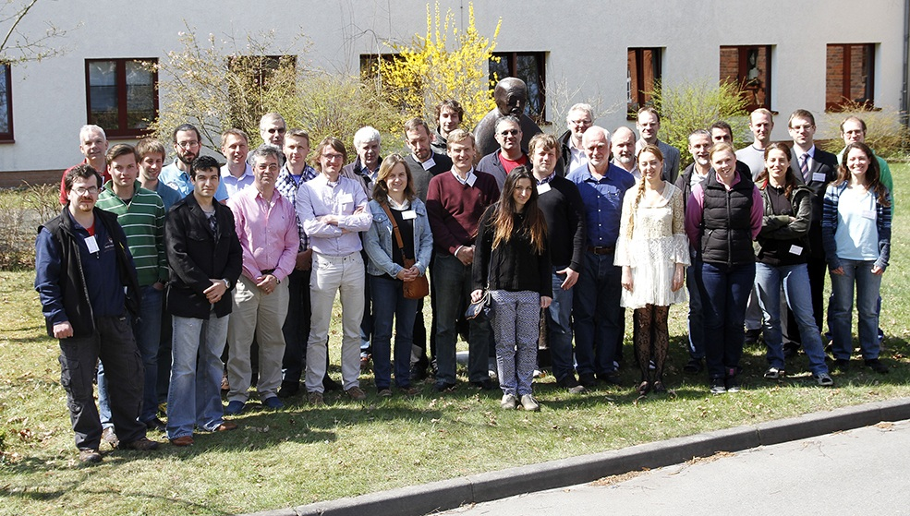
Close-out - Introduction
THANK YOU FOR SUPPORTING THE BCM ACTIVITIES!!!
Maria Hempel
Workshop on CMS Beam Conditions, Radiation Monitoring and Luminosity Systems
Zeuthen, 24.4.2013

Slide 2
BRM Highlights
CMS project BRIL with defined tasks
Beam abort functionality
Radiation simulation
Beam timing
Luminosity monitoring
Beam background measurements
Updates of the BRM systems are planned for >LS1
BCM1F: new FE ASIC, more sensors, higher HV, backend setup
BCM1L: grounded issues needed, new services
BCM2: readout of tunnel card
BHM: new frontend, services, maybe HF electronics, other backend modules
BPTX: a stable BPTX system

Slide 3
LHC Plans
Highest priority is machine protection
New settings after LS1
25ns bunch spacing (maybe leveling)
Higher emittance
No non-colliding bunches
More bunches 1380 → 2760
New LHC running modes/sequences (squeeze and ramp at the same time)
Different luminosity monitors are required
Bunch-by-bunch lumi
Combiantion of different lumi systems
Problems for >LS1
E-clouds
More UFOs
Beam losses for non-colliding bunches

