Slide 1
Radiation Simulation for Upgrade Scenarios
Anne Dabrowski, Moritz Guthoff
BRM workshop, DESY Zeuthen
24th April 2013

Slide 2
Outline
Introduction
Versioning Fluka Geometry
Fluka for CMS users
Requests for additional scorings
Requests for modifications of Geometry
Sub-detector upgrade studies
Machine interface upgrade studies

Slide 3
Introduction
So far radiation simulations performed for present installed system.
Upgrades of many detectors in planning
Heavy detectors influence radiation environment of other detectors
Neutron Fluence of upgrade concepts are important before launching more detailed detector designs
Many requests for FLUKA simulations from sub-detectors.
At the moment they can’t be handled by BRM, although with additional manpower, some service to sub-detectors will be possible
Managing organ of radiation simulations should remain in BRIL project
Particle spectra (without geometry modification) already a dedicated simulation study,
Other interested groups have started performing simulations.

Slide 4
Versioning Fluka (Mars) Geometry
This is more important now than ever before
The book keeping of this code is essential
A particular FLUKA (Mars) release version should be tagged for
Bench marking exercises
FLUKA web-based plotting tool (cms internal use)
Reference for a release of a FLUKA (Mars) plot to show in official public use
Documentation is required for each FLUKA (Mars) release
Manpower consuming but essential
Slawek to provide some software assistance and additional FLUKA (Mars) manpower is needed
Investigate FLUKA to MARS conversion support of Geometry to keep studies consistent and aid bench marking

Slide 5
Versioning Fluka Geometry
Versioning considerations for Geometry for CMS Phase 2 and Phase 3 Upgrades:
Starting point:
Starting version of code provided by BRM to sub-detectors, we assist to run this
Sub-detector Fluka expert contact then makes geometry modification
Once Upgrade community converges of geometry solution
This geometry should be uploaded and versioned
Corresponding CMSSW GEANT4 version(s) should also be tagged

Slide 6
Fluka for CMS users
With new (versioned) Geometry a FLUKA for users package will be released.
Special scorings can be performed by sub-detectors themselves.
No geometry modifications: upgrade scenarios can’t be simulated.
We can make releases with upgrade geometries.
Making geometry change often quite easy.
If we don’t have to run ourselves we save time.
Could think of making changes on request and create “FLUKA for users” package.

Slide 7
Open requests to BRM for simulations scoring
Nominal Geometry & Dedicated scoring:
RPCs
Particle spectra at RPC locations
Scoring of the Phi asymmetry due to cavern floor (There are results, but they need processing)
Limited our reception of requests until additional manpower is added (Sophie, Moritz PhD graduation)

Slide 8
Modified Geometry requests
DTs
Shielding study to cover outer neutron DTs to shield from Neutron background.
Forward Calorimeter Group
Study of new tungsten detector in front of HF (Worked on by sub-detector group)
Phase 2 configuration of Ecal endcap

Slide 9
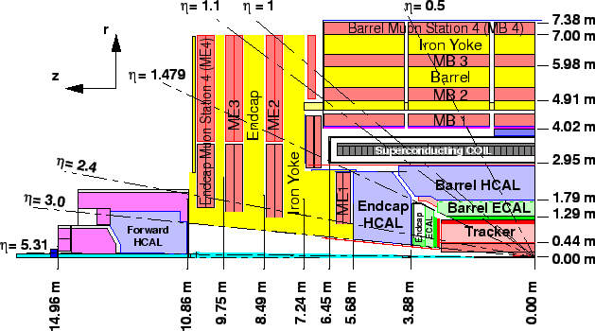
Modified Geometry requests
Ecal endcap with Shashlik design of 20 cells of 4mm W plates (replacing present PbWO4, but same eta range)
First options plus a new HF calorimeter (block of W) covering eta from 3.0 to 4.6 with front face at 6.625 m ("up close" HF W calorimeter).
Second option plus a new HF calorimeter (block of W)covering eta from 3.0 to 4.6 with front face at 3.964 cm ("very close" HF W calorimeter)

Slide 10
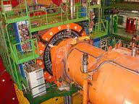
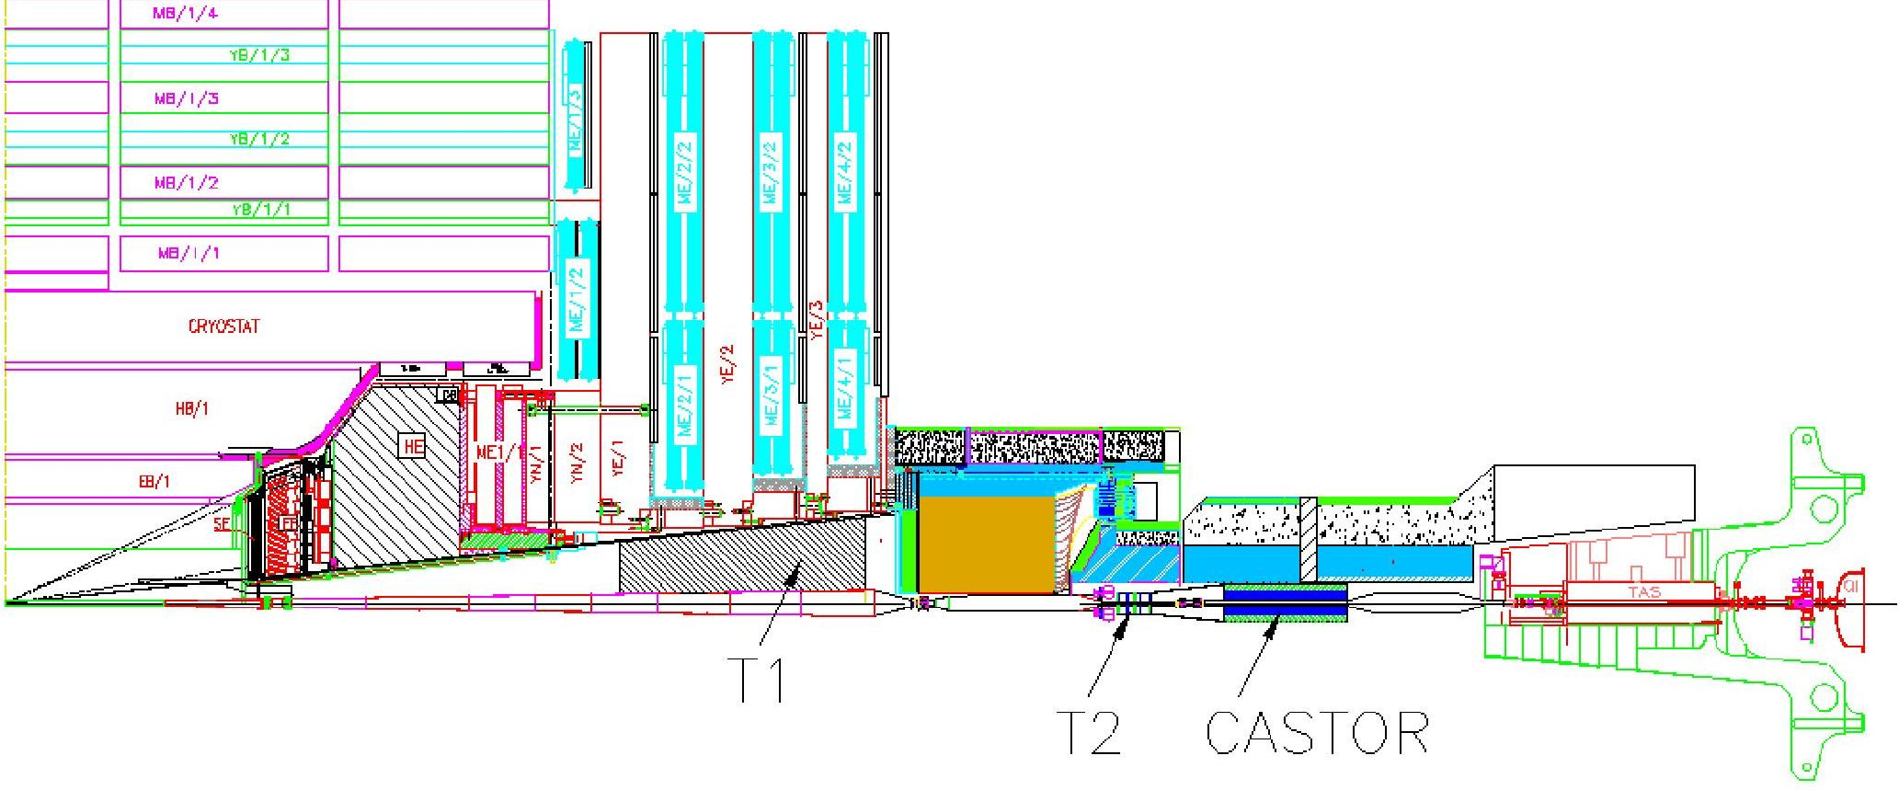
Modified Geometry studies: BRIL
Machine Interface & Shielding optimisations for HL-LHC
HL-LHC shielding should allow only the same level of neutrons in the cavern as during nominal LHC
Minimize electronics damage and SEUs
➔ Rotating shielding & TAS designs required for HL-LHC
Investigate any consequence on YE4 absorber/shielding
Design work & engineering feasibility 2013-2015
First engineering drawings 2016-2017
Potential Collaboration IHEP Prodvino

