Slide 1
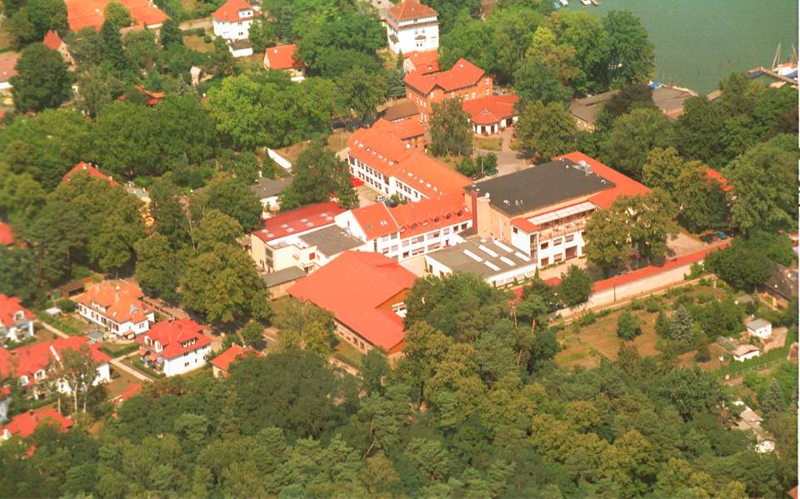
Welcome in DESY, Zeuthen
Special workshop;
February 3-4 2012, Zeuthen

Slide 2
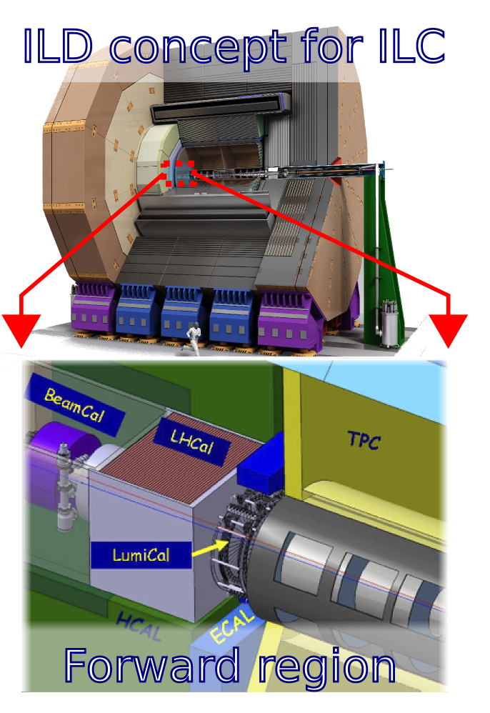
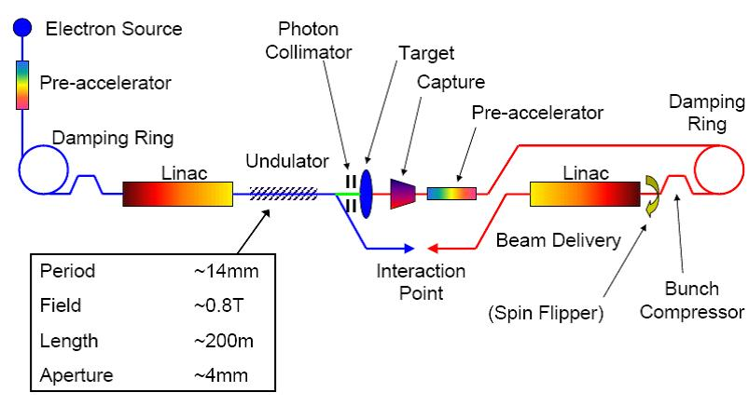
Welcome in DESY, Zeuthen
HEP experiments: ATLAS & CMS
ILC/CLIC (FCAL R&D, positron source, polarisation)

Slide 3
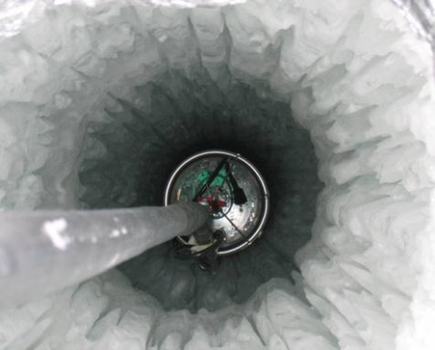
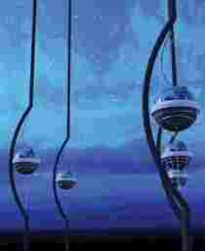
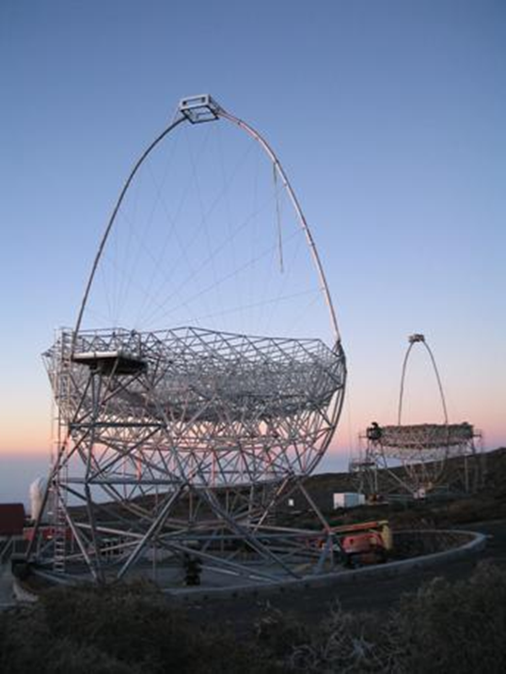
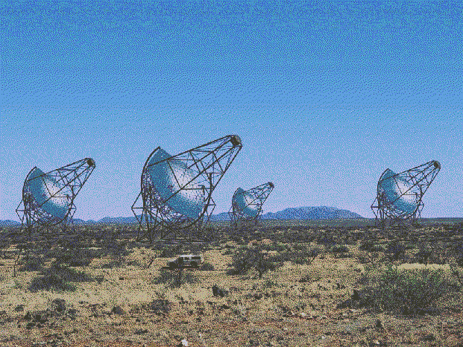
Welcome in DESY, Zeuthen
Astro-particle physics experiments
Icecube (neutrinos)
Magic, Veritas, HESS (Photons)

Slide 4
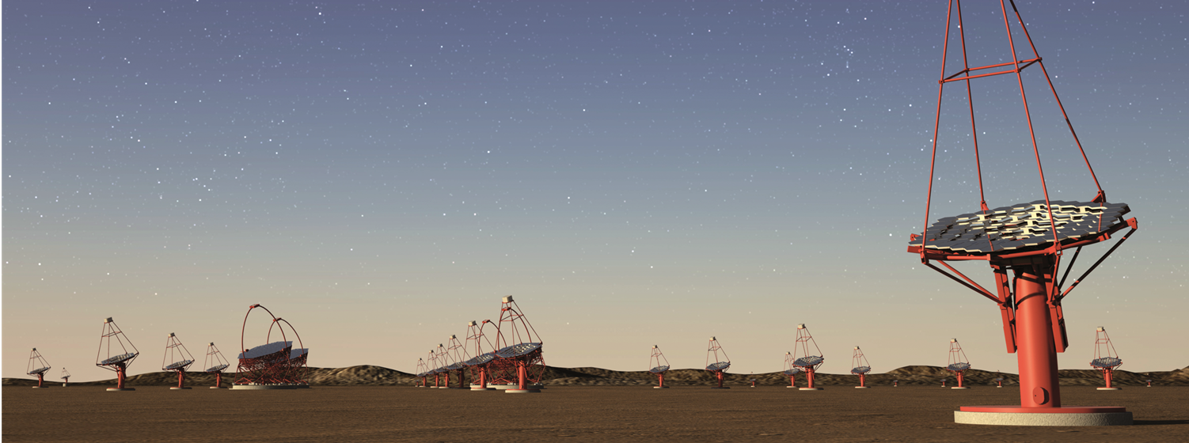
Welcome in DESY, Zeuthen
Cerenkov Telescope Array (under development)

Slide 5
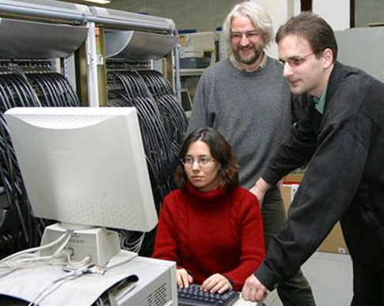
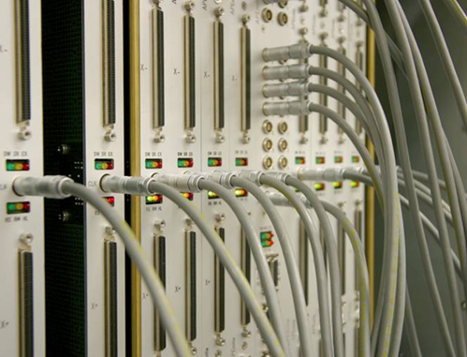
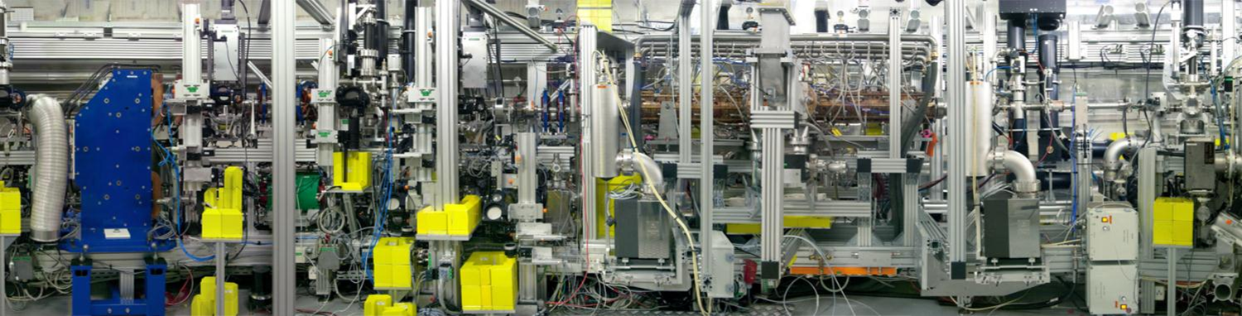
Welcome in DESY, Zeuthen
Theory (lattice QCD, phenomenology ) Computing
Photoinjector teststand (PITZ)

Slide 6
Welcome in DESY, Zeuthen
DESY, Zeuthen in a nutshell
~ 200 employees (scientists, engineers, technicians,
library, administration)
~20 Ph.D.
~20 Postdocs
Bachelor and master students
Summer students

Slide 7
Welcome in DESY, Zeuthen
Conference secretary:
Mrs. Martina Mende
Local organisers: Maria Hempel & Jessica Leonard

Slide 8
Welcome in DESY, Zeuthen
my expectation for this workshop:
understanding of the current status of BRM/luminosity
defining our future goals
set priorities
develop the BRIL project successfully

Slide 9
Welcome in DESY, Zeuthen

Slide 10
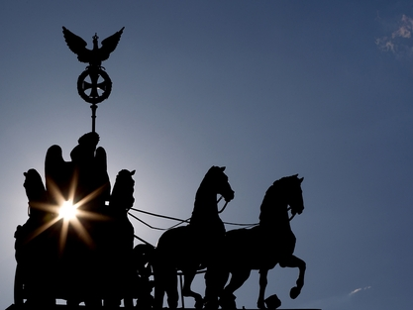
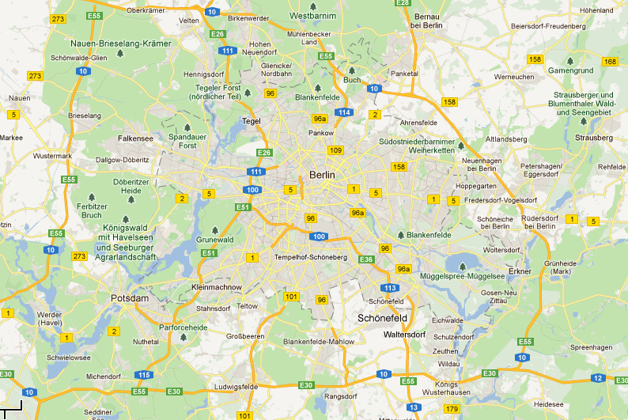
Welcome in DESY, Zeuthen
Geographical info

