Slide 1
BCML Sensor Efficiency and Consequence on Abort Threshold
Moritz Guthoff
BRM workshop, DESY Zeuthen, 22nd April 2013

Slide 2
Overview
Initial abort threshold philosophy
Observed drop in signal efficiency, non-linearity
Suggested planning for LS1:
What happens with what diamond.
Measurements/quantification of diamond damage
Processing
Shuffling
Test-beam to reevaluate diamond performance after processing
Reevaluating abort thresholds
Simulation based approach?

Slide 3
Initial abort considerations
RS1 – 40μs integration threshold
Based on the tracker community’s damage tolerances studies.
10⁹ MIP/cm² per "short-loss” is the damage threshold defined by the tracker community.
40μs is the shortest loss period measured by the BLM electronics.
A safety factor of 1000 is included for the threshold corresponding to a threshold set to 10⁶ MIP/cm²/40μs.
Based on calibrations between the BCM detector and MIP flux during test beam, this corresponds to a detector leakage current of 36μA.
An even more conservative value of 10μA (= 2050 ADC counts) was chosen.
RS12 – 83s integration threshold
Based on an increased beam background activity compared to the expected particle flux at nominal CMS luminosity, averaged over 83 s.
Originally: 290nA, 126M ADC counts. This was well above the expected rate at that time with the intention to increase it with higher Luminosity.
Since August 2011: 3 times the expected signal given by data driven extrapolations at nominal LHC luminosity.

Slide 4
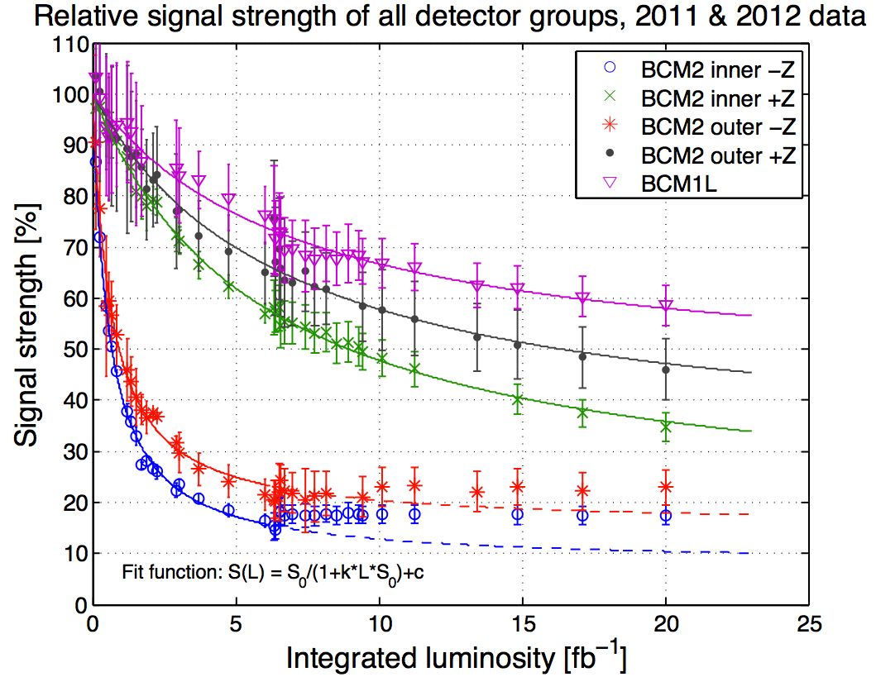
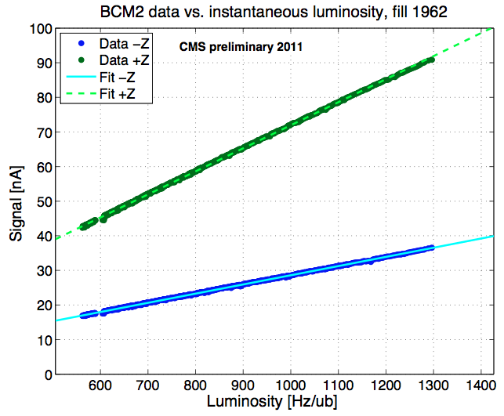
Diamond sensitivity
Detector sensitivity monitored by comparing detector current with lumi. (Linear fit to correlation plot)
Efficiency decrease for all channels observed. Correlated with neutron flux.
Abort threshold adapted to decrease twice during 2011/2012 period.
EDMS no.: 1157274 v.3, 1236236_v.1
Limitations on RS1 threshold due to FE noise (spikes): Thresh. min. 500 ADC

Slide 5
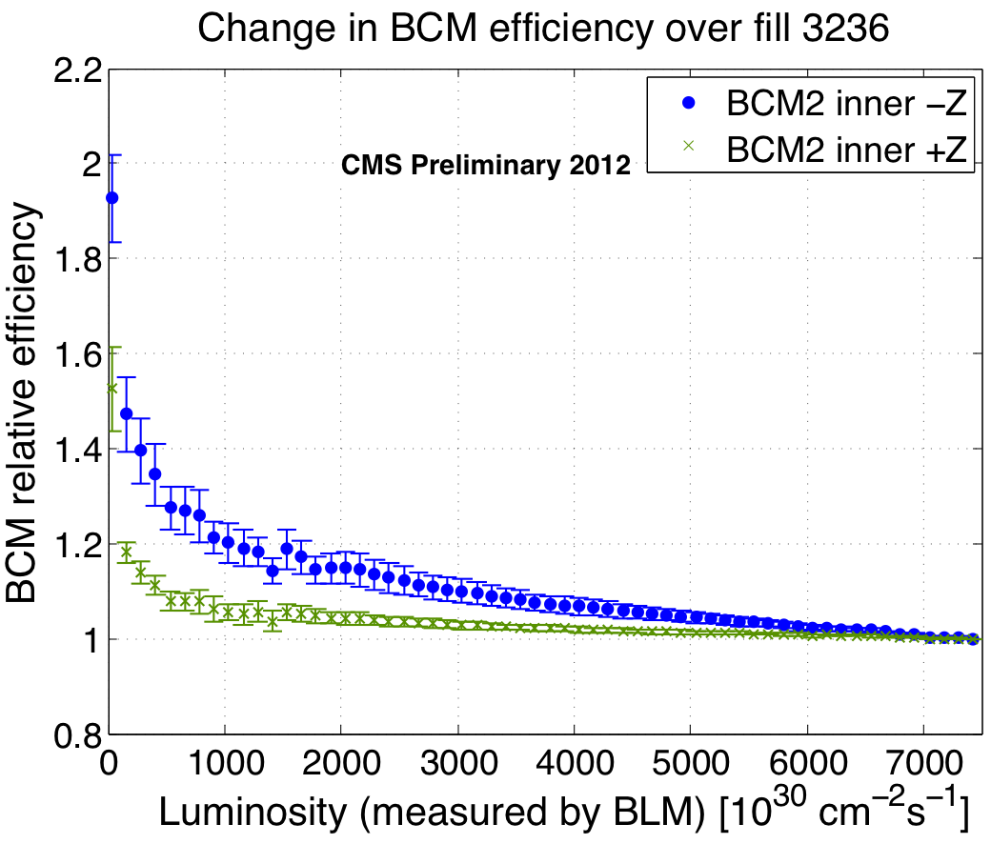
Rate dependency of efficiency
Data from one long fill with VdM scan at the end.
Signal efficiency lower at high rates.
Not activation since VdM scan tracks the slope.
Possible explanation: Polarization less strong at low rates.
Linearity was shown in test beam before. Repeat with irradiated samples?
VdM
“Constant” Lumi
0 2.7 5.4 8.1 10.8 13.6 16.3 19.0 x 10⁷
Simulated MIPs [cm⁻²s⁻¹]

Slide 6
New pCVD diamonds
E6 pCVD have shown very bad performance lately.
Zeuthen had bought diamonds that draw erratic current at low field.
CERN bought 3 pCVD in 2010 (from DDL), all drawing high current.
One CERN diamond was RIEed and tested again for erratic current. Problem still exists. Erratic currents in pCVD are not cured by RIE ☹
12 new pCVD diamonds are ordered from II-VI and will be delivered to ETH end of April, then CERN.
Performance of those diamonds completely unknown.
Need to metallize and electrical characterization.
Important: HV stability, CCD, High rate efficiency.

Slide 7
Diamond shuffle, suggestion
BCM2 -Z
BCM2 +Z
BCM1L
Rough pCVD
Single-crystal
HIGH DAMAGE
MEDIUM DAMAGE
LOW DAMAGE
No processing, only testing, educational.
High priority processing (new metal, maybe RIE)
Medium priority processing (new metal, maybe RIE)
Low priority processing (new metal, maybe RIE)
Trash

Slide 8
Diamond shuffle - Summary
7 diamond for “after removal” tests. No processing.
CCD, TCT (maybe only sCVD)
Test beam to check high rate stability.
New BCM 1 L:
Use high priority processed diamonds.
Alternatively: Use new II-VI diamonds
New BCM 2 L:
Use best diamonds that are left. (At least medium priority diamonds)
After processing test all diamonds for HV stability and Signal output (preferably in high rate test beam) and choose best for BCM1L (higher priority) and BCM2L inner.
Choose HV at which no erratic currents develop.
Test beam should ideally provide a flux in a range from about 10⁶ up to 2x10¹⁰ MIPs/cm²/s

Slide 9
Space in the BCM2 wheel
Situation:
After BSC2 removal there is a lot of free space in the BCM2 wheel.
BCM2 outer were never really used. (Idea was to use them as background monitor.)
Suggestions:
Reinstall BCM2L outer.
New or old concept for alternative background monitoring.
Install BCM2F (poly or single)
Higher rate environment. Gain experience for higher lumi running and predict behavior of radiation damage in BCM1F.
Accessible after one year for tests with “irradiated” modules.
New diamond concepts: DOI, B-doped (neutrons), DLC-contacts, red light, alternating HV.
Either in leakage or fast readout.

Slide 10
New abort thresholds
RS1 40 us threshold:
Maintain limit of 10⁶ MIPs/cm²/40μs as threshold for protection of the tracker
Measure diamond performance and expected signal vs. MIP flux.
Needs high rate test beam (~10¹⁰ MIPs/cm²/s).
Assumption: FLUX at Pixel/Tracker is not bigger than at BCML locations.
Could do a simulation based extrapolation of ratio: Flux at most sensitive part of Tracker vs. BCML locations. Include ratio in threshold calculation.
RS12 83.3 s threshold:
Keep data driven method.
Configure something not too high, not too low at first.
Not below something we could get.
Monitor levels during ramp up.
Redo data driven calculation after a fill with decent instantaneous luminosity (~5 x 10³³ cm⁻²s⁻¹)

Slide 11
Summary
Signal efficiency much decreased due to polarization
Replacement of diamonds not necessary
Still high signal
Refurbishing (RIE, new metal) could recover signal.
RIE before metallize potentially allows higher HV in sCVD, for pCVD this needs further testing.
Hopefully soon available new diamonds need extensive testing.
No experience with vendor.
Abort threshold philosophy stays the same
Need test beam to measure performance of diamonds to properly calculate thresholds.

Slide 12
Thank you

Slide 13
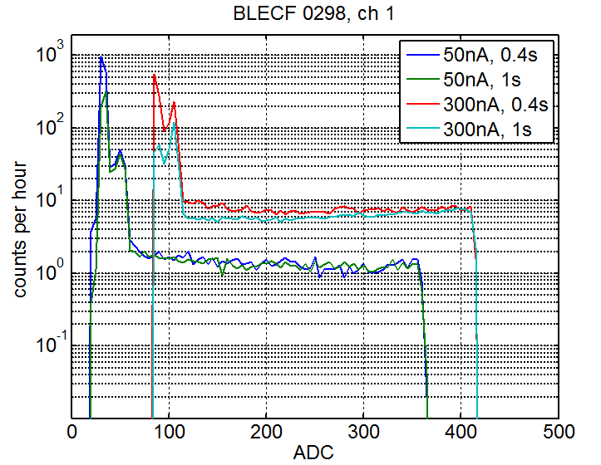
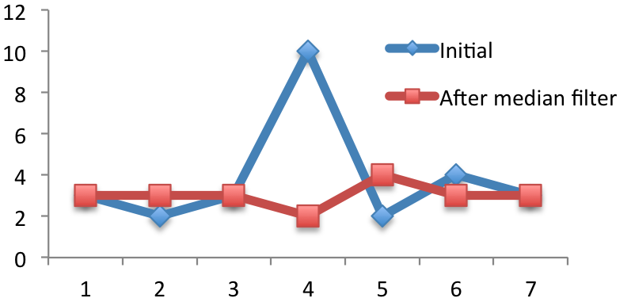
Spike problem in detail
A spike is a false value transmitted from the tunnel card. This happens randomly, but the chance increases linearly with measured current.
Data taking reports highest value between two readouts. Spike is always higher than normal data. -> Data point invalid (less problematic for high running sum)
To reduce number of spikes for monitoring a median filter is applied.
Median filter data for spike detection.
Do NOT remove spike if: two channels have spike, RS2 * 0.5 > RS1
If confirmed as spike: replace with median filtered value.
Median Filter:
Take n successive values
Sort values
New value = “middle” number

