Slide 1
BCMF “Backend” Requirements
D.Stickland

Slide 2
New Frontend Response

Slide 3
The ABC
Overlap
Albedo
Background
Collisions
Collision ~12ns after incoming beam at BCM1F position
Collision occupancy may reach ~50% post LS1
(OR will become useless, must calculate separate - or grouped - Lumi’s and then average)

Slide 4
Peak Finding Algorithms
In real time….
Simple Discriminator
Will not see second hit…
V895 has updating width
Perhaps can be used to tag hits within 12ns of each other….?
Does CFD timing actually help
given high occupancies?

Slide 5
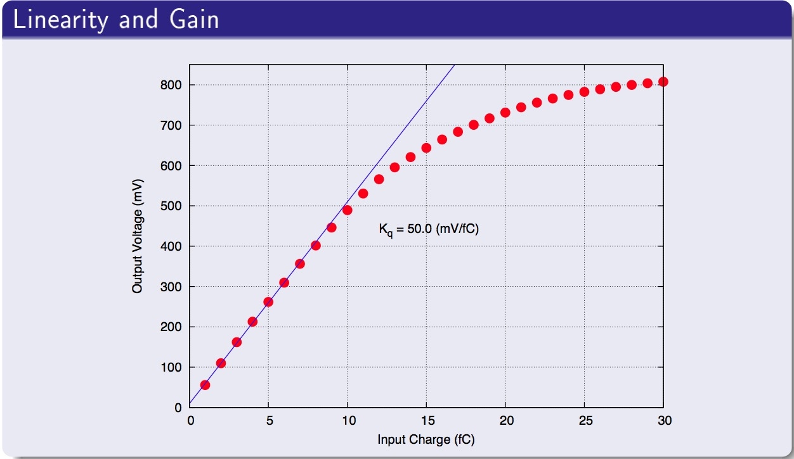
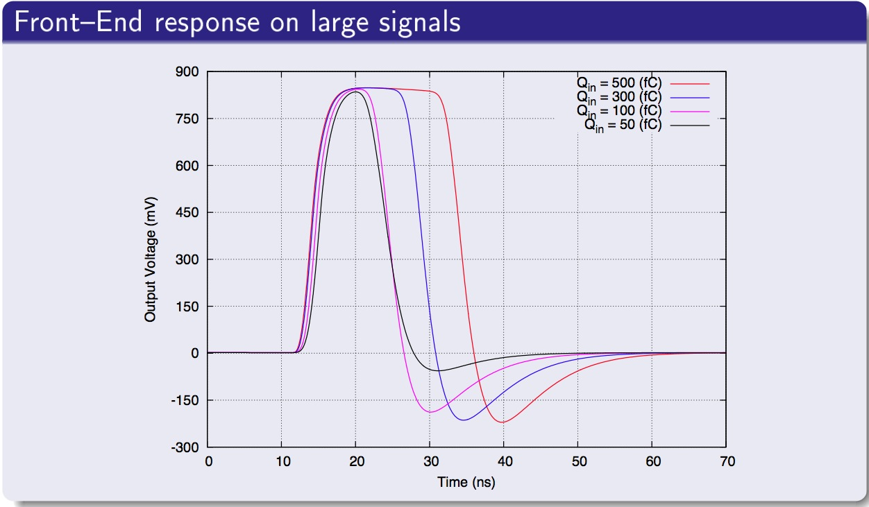
Untangle
Distinguish Multiple hits
Overlapping hits from A,B,C (or even C+C)
Saturated pulses
Deadtime effects
Fast polarization effects

Slide 6
Sensitivity to Temperature? (Approximately 1-2% effects)

Slide 7
Three approaches?
LUT/(MGD).
Gated Coincidences for Luminosity and Background
(1)
Discriminator
(Time resolution)
(Multi-Hit sensitivity)
Histogramming unit
Orbit Analysis for Bunch by Bunch
(2)
Pulse Analysis
Peak Finding & Intergrals
Systematics and/or ABC Combined Analysis
(3)

