Slide 1
Closing Remarks
the value of a meeting depends
on the people participating
on the quality of talks
on the scientific appeal of the topics

Slide 2
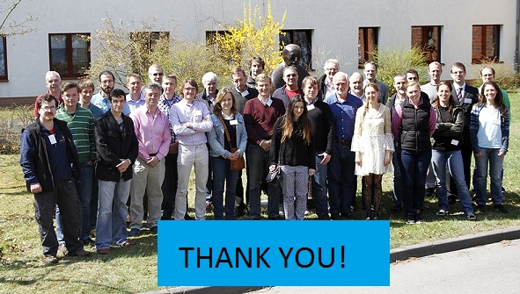
Closing Remarks

Slide 3
Closing Remarks
my personal impression -
We had excellent presentation and interesting discussions
The scientific case is of ‘first class’ and of high value for the success of the CMS experiment

Slide 4
Closing Remarks

Slide 5
Closing Remarks
understanding of the current status of BRM/luminosity
defining our future goals
set priorities
develop the BRIL project successfully
The first two topics are clearly settled
The last will need continous effort by all of us !

Slide 6
Closing Remarks
Thank you for coming
We wish you a safe trip back

