Slide 1
BHM Detector Motivation: FLUKA Simulations, Frontend Design and Test Beam Results
Orfanelli Stella
(CERN-NTUA)
R & D Team:
A. Dabrowski(CERN), M. Giunta(CERN), S. Orfanelli (CERN-NTUA)
M. Ambrose(Univ Minnesota), R. Rusack (Univ Minnesota), & D. Stickland (Princeton)
Workshop on CMS Beam Conditions, Radiation Monitoring and Luminosity Systems
DESY, Zeuthen, 24th April 2013

Slide 2
Outline
Detector Motivation and Concept
Choice of Location
Challenges and Principles of Detection
Expected rate
Background suppression
Design
Geometry and Material
Orientation
Photomultiplier choice

Slide 3
Detector Motivation
Purpose:
To provide an on-line measurement of the Machine Induced Background(MIB) in CMS .
At High Radius with overlapping acceptance with the CMS CSC chambers
During both colliding and circulating beams
Separate B1 and B2 measurements
After LS1:
Exceeding nominal luminosity.
25ns bunch spacing.
Increasing bunch charge.
Tighter LHC collimators settings.
Electron cloud effects.
Why?
MIB contaminates Level 1 trigger rate and results in low data taking efficiency.
At High radius, to complement BCM1F MIB measurement at small radius.
Verification of FLUKA model.
Flag poor beam conditions for CMS and LHC by lumi-section.
Higher MIB expected,
Beam Halo & Beam Gas.

Slide 4
Detector concept- Challenges
Goal to reach | Challenge | Requirement | Solution
Measure MIB arriving in time with the incoming bunches from the tunnel side. | CMS cavern environment dominated by the pp products arriving from the IP side. | DIRECTIONALITY | CHERENKOV RADIATION
 | Stay shielded from IP → pp products should be shielded and albedo reduced | SENSITIVE TO LESS BACKGROUND SIGNAL | LOCATION IN THE CAVERN SHIELDED BY CMS DETECTOR FROM IP
CMS cavern environment. | High radiation exposure | RADIATION HARDNESS | RADIATION HARD COMPONENTS CHERENKOV RADIATION
 | Mostly gammas and thermal neutrons | SENSITIVITY ONLY TO CHARGED PARTICLES | CHERENKOV RADIATION
Be able to cope with the 25ns bunch spacing. | Maximum time separation between MIB and the collision products = 12.5ns. | FASTER THAN 10ns | CHERENKOV RADIATION FAST ELECTRONIC COMPONENTS (PMT, READ-OUT)
Cost | Limited budget. | COST EFFECTIVE | MAKE WISE CHOICES.

Slide 5
Detector Location in CMS cavern
Golden locations:
where it’s easier to discriminate the MIB products from the collisions products based on the fact they are arriving well separated in time.
For the 25ns this maximum timing separation corresponds to 25/2=12.5ns.
Must sit in one of the golden locations.
GL6
68.75ns
GL5
56.25ns
GL4
43.75ns
GL3
31.25ns
GL2
18.75ns
GL1
6.25ns
t = 0.0 ns
Beam2
B1
B1
B1
IP
COLLISION=1
Beam1

Slide 6
Detector Location in CMS cavern
Golden locations:
where it’s easier to discriminate the MIB products from the collisions products based on the fact they are arriving well separated in time.
For the 25ns this maximum timing separation corresponds to 25/2=12.5ns.
Must sit in one of the golden locations.
GL6
68.75ns
GL5
56.25ns
GL4
43.75ns
GL3
31.25ns
GL2
18.75ns
GL1
6.25ns
t = 6.25 ns
Beam2
B1
B1
B1
B2
IP
Beam1

Slide 7
Detector Location in CMS cavern
Golden locations:
where it’s easier to discriminate the MIB products from the collisions products based on the fact they are arriving well separated in time.
For the 25ns this maximum timing separation corresponds to 25/2=12.5ns.
Must sit in one of the golden locations.
GL6
68.75ns
GL5
56.25ns
GL4
43.75ns
GL3
31.25ns
GL2
18.75ns
GL1
6.25ns
t = 12.5 ns
Beam2
B1
B1
B1
IP
B2
Beam1

Slide 8
Detector Location in CMS cavern
Golden locations:
where it’s easier to discriminate the MIB products from the collisions products based on the fact they are arriving well separated in time.
For the 25ns this maximum timing separation corresponds to 25/2=12.5ns.
Must sit in one of the golden locations.
GL6
68.75ns
GL5
56.25ns
GL4
43.75ns
GL3
31.25ns
GL2
18.75ns
GL1
6.25ns
t = 18.75 ns
Beam2
B1
B1
B2
B1
IP
Beam1

Slide 9
Detector Location in CMS cavern
Golden locations:
where it’s easier to discriminate the MIB products from the collisions products based on the fact they are arriving well separated in time.
For the 25ns this maximum timing separation corresponds to 25/2=12.5ns.
Must sit in one of the golden locations.
GL6
68.75ns
GL5
56.25ns
GL4
43.75ns
GL3
31.25ns
GL2
18.75ns
GL1
6.25ns
t = 25.00 ns
Beam2
B1
B1
B1
IP
B2
Collision=2
Beam1

Slide 10
Detector Location in CMS cavern
Golden locations:
where it’s easier to discriminate the MIB products from the collisions products based on the fact they are arriving well separated in time.
For the 25ns this maximum timing separation corresponds to 25/2=12.5ns.
Must sit in one of the golden locations.
GL6
68.75ns
GL5
56.25ns
GL4
43.75ns
GL3
31.25ns
GL2
18.75ns
GL1
6.25ns
t = 31.25 ns
Beam2
B1
B1
B2
B1
B2
IP
Beam1

Slide 11
Detector Location in CMS cavern
Golden locations:
where it’s easier to discriminate the MIB products from the collisions products based on the fact they are arriving well separated in time.
For the 25ns this maximum timing separation corresponds to 25/2=12.5ns.
Must sit in one of the golden locations.
GL6
68.75ns
GL5
56.25ns
GL4
43.75ns
GL3
31.25ns
GL2
18.75ns
GL1
6.25ns
t = 37.5 ns
Beam2
B1
B1
B1
IP
B2
B2
Beam1

Slide 12
Detector Location in CMS cavern
Golden locations:
where it’s easier to discriminate the MIB products from the collisions products based on the fact they are arriving well separated in time.
For the 25ns this maximum timing separation corresponds to 25/2=12.5ns.
Must sit in one of the golden locations.
GL6
68.75ns
GL5
56.25ns
GL4
43.75ns
GL3
31.25ns
GL2
18.75ns
GL1
6.25ns
t = 43.75 ns
Beam2
B1
B2
B1
B2
B1
IP
Beam1

Slide 13
Detector Location in CMS cavern
Golden locations:
where it’s easier to discriminate the MIB products from the collisions products based on the fact they are arriving well separated in time.
For the 25ns this maximum timing separation corresponds to 25/2=12.5ns.
Must sit in one of the golden locations.
GL6
68.75ns
GL5
56.25ns
GL4
43.75ns
GL3
31.25ns
GL2
18.75ns
GL1
6.25ns
t = 50.00 ns
Beam2
B1
B1
B1
IP
B2
B2
Collision=3
Beam1

Slide 14
Detector Location in CMS cavern
Golden locations:
where it’s easier to discriminate the MIB products from the collisions products based on the fact they are arriving well separated in time.
For the 25ns this maximum timing separation corresponds to 25/2=12.5ns.
Must sit in one of the golden locations.
GL6
68.75ns
GL5
56.25ns
GL4
43.75ns
GL3
31.25ns
GL2
18.75ns
GL1
6.25ns
t = 56.25 ns
Beam2
B1
B2
B1
B2
B1
B2
IP
Beam1

Slide 15
Detector Location in CMS cavern
Golden locations:
where it’s easier to discriminate the MIB products from the collisions products based on the fact they are arriving well separated in time.
For the 25ns this maximum timing separation corresponds to 25/2=12.5ns.
Must sit in one of the golden locations.
GL6
68.75ns
GL5
56.25ns
GL4
43.75ns
GL3
31.25ns
GL2
18.75ns
GL1
6.25ns
t = 62.5 ns
Beam2
B1
B1
B1
B2
B2
B2
IP
Beam1

Slide 16
Detector Location in CMS cavern
Golden locations:
where it’s easier to discriminate the MIB products from the collisions products based on the fact they are arriving well separated in time.
For the 25ns this maximum timing separation corresponds to 25/2=12.5ns.
Must sit in one of the golden locations.
GL6
68.75ns
GL5
56.25ns
GL4
43.75ns
GL3
31.25ns
GL2
18.75ns
GL1
6.25ns
t = 68.75 ns
Beam2
B2
B1
B2
B1
B2
B1
IP
Beam1

Slide 17
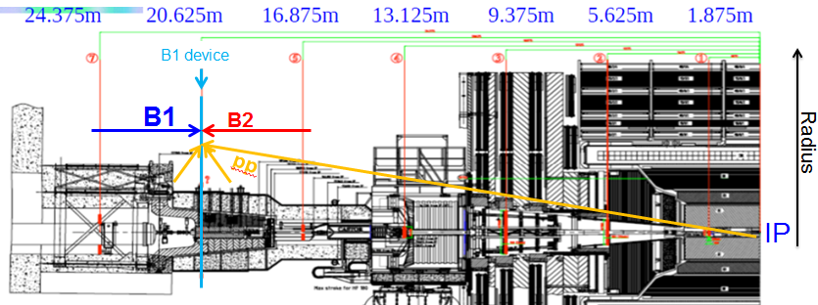
Golden Location 6
GOLDEN LOCATION 6 : the most promising location.
GL7 GL6 GL5 GL4 GL3 GL2 GL1
Golden location:
MIB – pp products maximum time separation
Good environmental conditions
Available space around the rotating shielding.
Absolute MIB flux is higher w.r.t. other golden locations closer to the IP.
φ
0deg
+z
Golden Location 6
IP

Slide 18
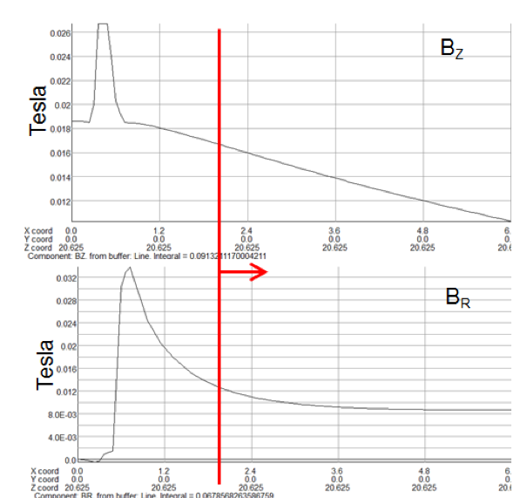
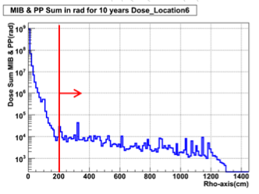
Golden Location 6 Environmental Parameters
Magnetic Field
1)Expected dose for 10 years of operation <1kGy
2)Magnetic Field <200gauss
Bz
Radiation dose in rad for 10years of operation
Radial distance[m]
Free space
Free space
Br
Radial distance[m]
Radial distance[cm]
from beam axis

Slide 19
Golden Location 6 MIB/PP flux ratio & MIB flux
Two metrics used to conclude to GL6 as the most preferable:
MIB/PP flux ratio 2) Absolute value of MIB flux.
MIB/PP flux ratio of all charged particles above Cherenkov threshold, Golden Location 6.
MIB(red) & PP(black) fluxes of all charged particles above Cherenkov threshold, Golden Location 6.
MIB Flux / pp Flux
Flux (/cm²/sec)
MIB flux ~ 1particle/cm²/sec
10⁻³
MIB/PP ~4e-4 – 4e-3
Radial distance[cm] from beam axis
Radial distance[cm] from beam axis
Results from FLUKA simulations : 20k pp events VS 3e6 MIB particles (N.Mohkov input files produced by MARS).Both simulations for a nominal machine.

Slide 20
Golden Location 6 MIB/PP flux ratio & MIB flux
Two metrics used to conclude to GL6 as the most preferable:
MIB/PP flux ratio 2) Absolute value of MIB flux.
Need to suppress the pp signal to 0.1%.
MIB/PP flux ratio of all charged particles above Cherenkov threshold, Golden Location 6.
MIB(red) & PP(black) fluxes of all charged particles above Cherenkov threshold, Golden Location 6.
MIB Flux / pp Flux
Flux (/cm²/sec)
MIB flux ~ 1particle/cm²/sec
10⁻³
MIB/PP ~4e-4 – 4e-3
Radial distance[cm] from beam axis
Radial distance[cm] from beam axis
Results from FLUKA simulations : 20k pp events VS 3e6 MIB particles (N.Mohkov input files produced by MARS).Both simulations for a nominal machine.

Slide 21
Golden Location 6 MIB/PP flux ratio & MIB flux
Two metrics used to conclude to GL6 as the most preferable:
MIB/PP flux ratio 2) Absolute value of MIB flux.
Need to suppress the pp signal to 0.1%.
Stay in radius less than 220cm to have a succeed in a MIB rate of at least 1 hit/cm²/sec
MIB/PP flux ratio of all charged particles above Cherenkov threshold, Golden Location 6.
MIB(red) & PP(black) fluxes of all charged particles above Cherenkov threshold, Golden Location 6.
MIB Flux / pp Flux
Flux (/cm²/sec)
MIB flux ~ 1particle/cm²/sec
10⁻³
MIB/PP ~4e-4 – 4e-3
Radial distance[cm] from beam axis
Radial distance[cm] from beam axis
Results from FLUKA simulations : 20k pp events VS 3e6 MIB particles (N.Mohkov input files produced by MARS).Both simulations for a nominal machine.

Slide 22
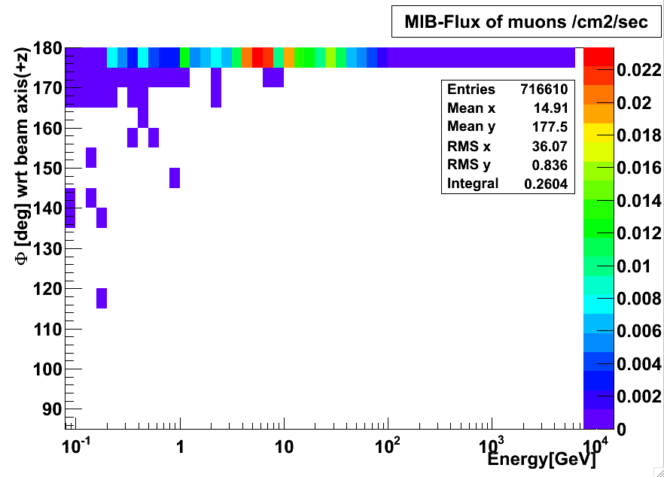
Golden Location 6 Properties of the MIB signal
Mostly expected type of particles: Beam Halo Muons produced at the collimators.
Most of the MIB muons
are concentrated near the 10GeV region.
arrive pretty concentrated in angle
(0 -15deg).
Angle vs Energy (for mu above Cherenkov threshold)
MIB Muons /cm²/sec
0.26 muons/cm²/sec are expected to arrive at golden location 6, while the total MIB rate is 0.4particles/cm2/sec.

Slide 23
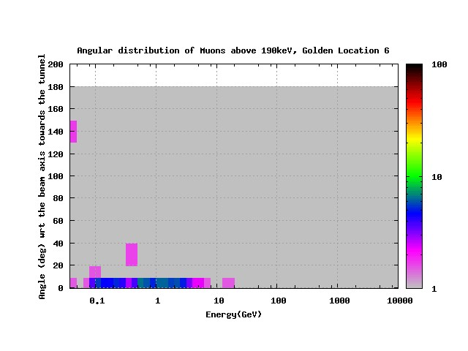
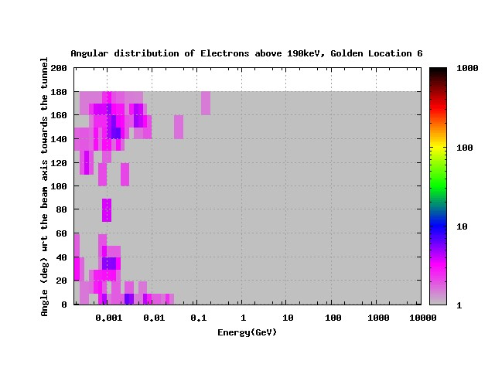
Golden Location 6 Background sources
Golden Location 6 Background source
Angle vs Energy (for m above Cherenkov thresh)
Background sources:
electrons and positrons coming from secondary interactions & multiple scattering from both sides.
muons coming straight from the IP
high energy gammas that could produce delta rays in the material.
Fake signal
(Very small)
Lab polar angle φ (rad)
Particles/cm²/sec/dΩ/dE
Expected PP contribution coming on the opposite site
of the signal
(very small angles)
Angle vs Energy (for e above Cherenkov thresh)
Energy (GeV)
Fake signal
Lab polar angle φ (rad)
Particles/cm²/sec/dΩ/dE
Expected PP contribution coming on the opposite site
of the signal
Energy (GeV)

Slide 24
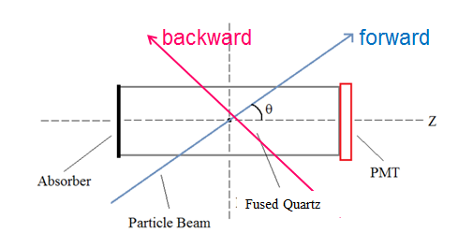
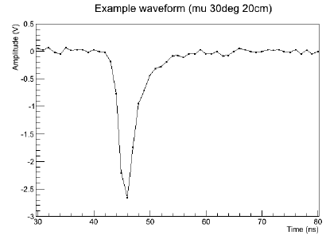
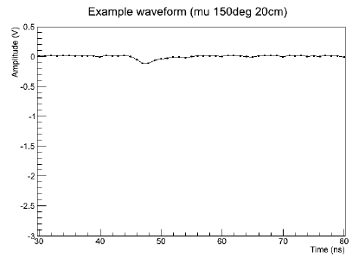
Principle of Detection: Directionality
DIRECTIONALITY: property of the detector to distinguish between particles coming from different directions => suppress background signal while selecting particles parallel and consistent with the direction of the incoming beam.
Tested fused quartz Cherenkov radiators during test beam (July 2012).
Amplitude [V]
forward
backward
Amplitude [V]
Time [ns]
Time [ns]

Slide 25
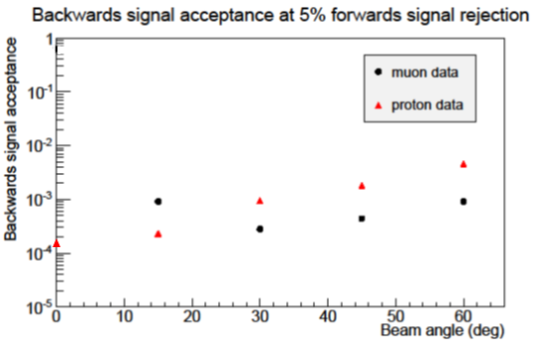
Principle of Detection: Directionality
Goal: suppression of the background signal 1 over 1000.
✓
Proven directionality functionality of the tested fused quartz Cherenkov radiator during test beam (July 2012).
By setting a discrimination voltage such that 95% of the forward signal is accepted, the backward signal acceptance is O(10⁻³). That means that only 1 out of the 1000 backward moving particles (coming from the pp) would be confused as a MIB particle.
With a small loss of the signal (5%) the backward acceptance less than 0.1% is achievable
Comparable results for muons and protons.

Slide 26
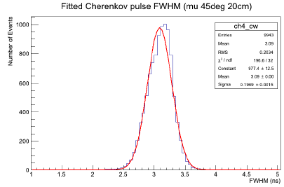
Principle of Detection: Timing
TIMING: To benefit from the placement at the golden location the signal needs to be faster than 10ns.
Goal:
rapid signal propagation <10ns
✓
Proven fast timing distribution of the signal = 3.1ns FWHM.
(July 2012 test beam).
Fast timing distribution 3.1ns FWHM
R2059 PMT
FWHM [ns]

Slide 27
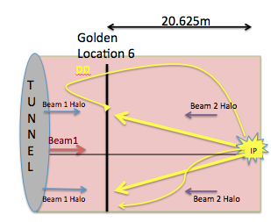
The fake signal component
FAKE SIGNAL is the signal that is moving at the same direction of the MIB signal but comes from pp-products.
Directionality cannot be used to suppress this background component.

Slide 28
The fake signal component
FAKE SIGNAL is the signal that is moving at the same direction of the MIB signal but comes from pp-products.
Directionality cannot be used to suppress this background component.
MIB signal rate:
0.4 particles/cm²/sec

Slide 29
The fake signal component
FAKE SIGNAL is the signal that is moving at the same direction of the MIB signal but comes from pp-products. Dominated by low energy e- e+.
Directionality cannot be used to suppress this background component.
FAKE signal rate:
45 particles/cm²/sec
MIB signal rate:
0.4 particles/cm²/sec

Slide 30
The fake signal component
FAKE SIGNAL is the signal that is moving at the same direction of the MIB signal but comes from pp-products. Dominated by low energy e- e+.
Directionality cannot be used to suppress this background component.
Fake signal 100 times more than MIB signal.
FAKE signal rate:
45 particles/cm²/sec
MIB signal rate:
0.4 particles/cm²/sec

Slide 31
The fake signal component
FAKE SIGNAL is the signal that is moving at the same direction of the MIB signal but comes from pp-products. Dominated by low energy e- e+.
Directionality cannot be used to suppress this background component.
Fake signal 100 times more than MIB signal.
FAKE signal rate:
45 particles/cm²/sec
Goal:
Suppress the fake signal to 1%.
MIB signal rate:
0.4 particles/cm²/sec

Slide 32
The fake signal component Particle characteristics
Goal:
Suppress the fake signal to 1%.
FAKE SIGNAL DOMINATED BY LOW ENERGY e-+.
Energy spectrum of e-+ from pp collisions
Most of e-+ arriving at GL6 at the same direction with the signal (red spots) have energy less than 100MeV.
dN/dE [cm⁻² sec⁻¹ GeV⁻¹]
Energy [GeV]

Slide 33
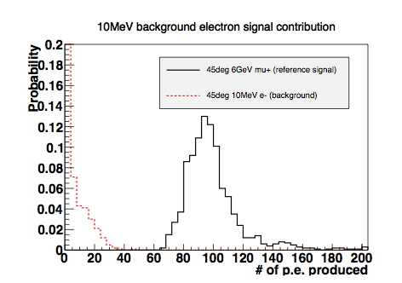
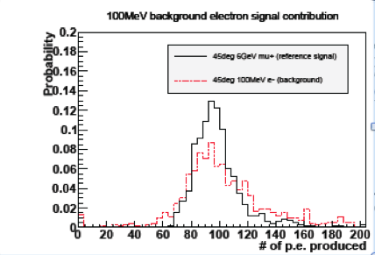
Suppression of the fake signal component- Shielding
Goal:
Suppress the fake signal to 1%.
Shielding of 1cm Al suppresses the signal that the 10MeV e-+ would produce below the threshold, but doesn’t affect the 100MeV signal.
Geant4
M.Ambrose
Geant4
M.Ambrose

Slide 34
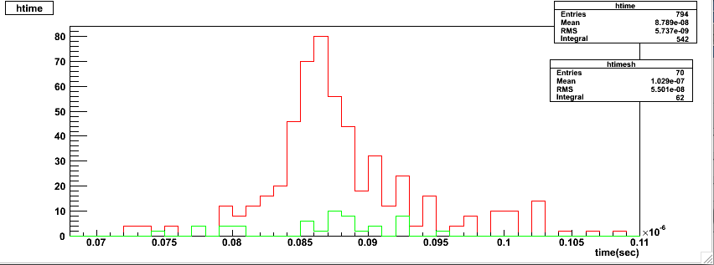
Suppression of the fake signal component- Timing
Goal:
Suppress the fake signal to 1%.
Distribution of the time of arrival of the 794 e-+
During this time interval contribution of pp is expected.
Distribution of the time of arrival of the 70 e-+ with energy >10MeV
✓
Based on timing combined with shielding of 1cm Al, suppression 99% of the fake signal component succeeded.
FLUKA
10ns
Time(sec)
Criteria | Relative number of e-+ arriving at the same direction with MIB | Percentage
Cherenkov threshold | 794 | 100%
Passing the shielding material | 70 | 8%
Outside a 10ns time interval | 8 | 1%

Slide 35
Suppression of the fake signal component- gamma rays
HIGH ENERGY γ are capable of creating delta rays with energy sufficient to produce Cherenkov radiation in the detector.
Energy spectrum of γ from pp collisions
Goal:
Suppress the HE gammas.
Most of γ arriving at GL6 have energy less than 100MeV.
Energy[GeV]

Slide 36
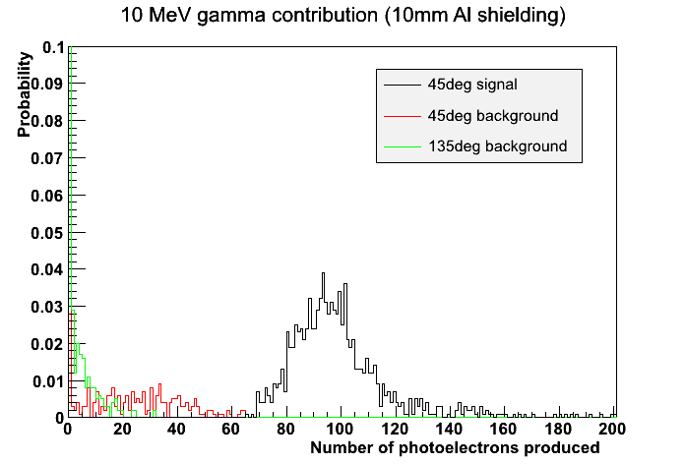
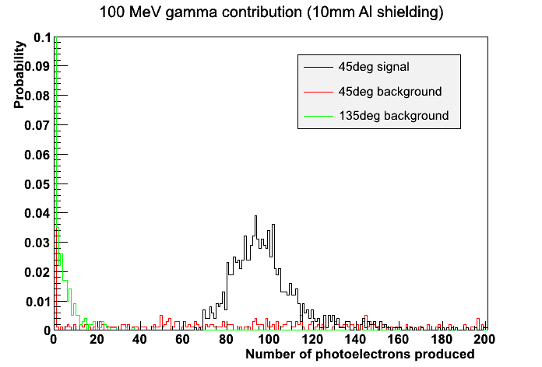
Suppression of the fake signal component- gamma rays
Goal:
Suppress the HE gammas.
✓
Shielding of 1cm Al suppresses the signal that the HE gammas would produce under the threshold.
Geant4
M.Ambrose
Geant4
M.Ambrose

Slide 37
Detector Motivation &Feasibility Summary
Golden location 6
Good environmental conditions
Free space
MIB flux rate close to 1hit/cm²/sec.
Need to suppress background signal coming from the opposite side (pp-products) to 1 over 1000.
✔ directionality
Need to suppress background signal coming from the same side to 1 over 100.
timing and shielding for low energy e-+.
Need to suppress high energy gammas.
✔ shielding.

Slide 38
Design Parameters
Cherenkov radiator
Material choice
Geometry
Length
Radius
Surface tolerance and roughness
Optical coupling
Photomultiplier choice
Characteristics and Features
Performance

Slide 39
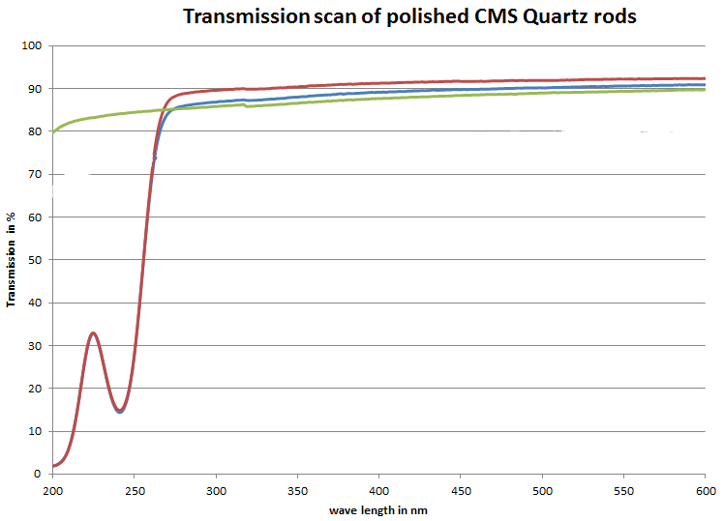
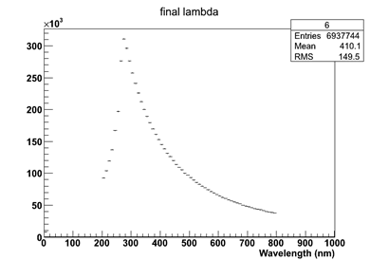
Design: Material Choice
Directionality of quartz proven during test beams.
Transmission in UV area
Transmission in %
Expected wavelength for 0 deg
450nm
Wavelength(nm)
Geant4
M.Ambrose
HSQ300 (=HSQ330, not certified %impurities)
HSQ330 (certified %impurities)
Suprasil (synthetic quartz)
Wavelength(nm)

Slide 40
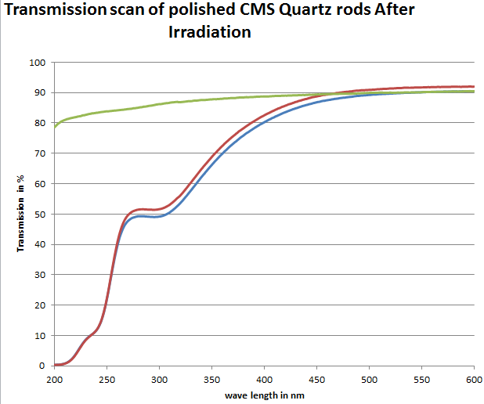
Design: Material Choice
Irradiation of 3cm long samples with a source = Co⁶⁰ γ rays (E~1MeV), for the expected 1kGy dose at GL6.
Transmission in %
AFTER 1kGy
Degradation of the transmission coefficient for λ<450nm for the HSQ.
No loss for Suprasil but more expensive.
450nm
Wavelength(nm)
HSQ300 (=HSQ330, not certified %impurities)
HSQ330 (certified %impurities)
Suprasil (synthetic quartz)

Slide 41
Design: Length
The longer the bar, the more photons produced by the crossing particle.
Defining roughly a directionality metric as the mean number of photoelectrons at the PMT for a forward particle over respective number for a backward particle.
Example: [#ph.e. at PMT for 5deg]/[#ph.e. at PMT for 175deg]
Directionality
Geant4

Slide 42
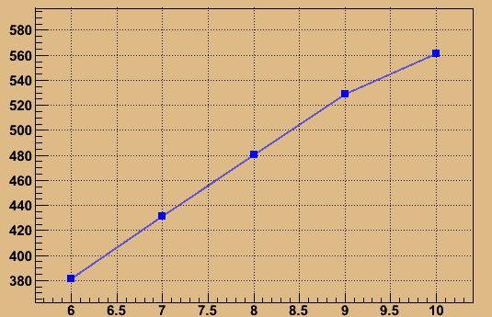
Design: Length
The longer the bar, the more photons produced by the crossing particle.
Defining roughly a directionality metric as the mean number of photoelectrons at the PMT for a forward particle over respective number for a backward particle.
Example: [#ph.e. at PMT for 5deg]/[#ph.e. at PMT for 175deg]
Directionality
0deg
[#ph.e. at PMT]
Geant4
Length[cm]
Geant4
Directionality(left) for 0deg (blue top line) is decreasing as the length decreases but not much as the absolute number of ph.e. at the PMT for 0deg.

Slide 43
Design: Length
The longer the bar, the more photons produced by the crossing particle
=> Can set a higher discriminator threshold to:
Suppress more the backward signal to less than 0.1%
Decrease the effect of the signal produced at the PMT window and not in the bar.

Slide 44
Design: Length
The longer the bar, the more photons produced by the crossing particle
=> Can set a higher discriminator threshold to:
Suppress more the backward signal to less than 0.1%
Decrease the effect of the signal produced at the PMT window and not in the bar.
The longer the bar the more exposed to pp.
Muons from MIB are very angular (0-15deg) while PP is spread in angles.
PP
MIB
0deg
PP

Slide 45
Design: Length
The longer the bar, the more photons produced by the crossing particle
=> Can set a higher discriminator threshold to:
Suppress more the backward signal to less than 0.1%
Decrease the effect of the signal produced at the PMT window and not in the bar.
The longer the bar the more exposed to pp.
Muons from MIB are very angular (0-15deg) while PP is spread in angles.
=> Orientation in the cavern such that the acceptance of MIB increases.
MIB particles would “see” the projection of the bar.
PP
PP
MIB
MIB
0deg
φ deg
PP
PP

Slide 46
Design: Length
Work in progress:
Geant4 simulations to estimate the expected number of ph.e. at the PMT (for the both PMT cases) based on the
Entry point
Radius, if front/back face
Z, if side of the bar
Entering angle
Create a LUT based on the above results f(r,θ,z)
Find the optimal orientation for the input files from FLUKA.

Slide 47
Design: Radius
Radius depends on
The acceptance
The larger radius the more sensitive to MIB.
The PMT choice
If the R2059 PMT is chosen (cathode d=4.6cm), and the bar has d=4.5cm, then the whole exiting area of the bar shall be covered by the cathode.
If the R7600U-M4 is chosen (cathode 1.8cmx1.8cm), and the bar has radius larger than the PMT, then a large portion of the photon yield is lost at the outer radius

Slide 48
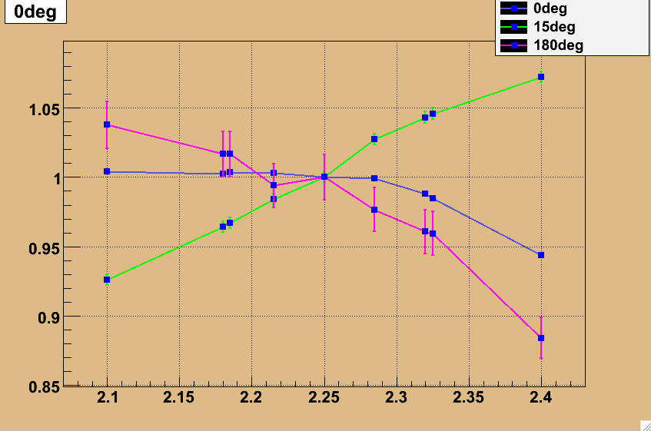
Design: Surface properties
TOLERANCE
Manufactures provide a tolerance of +-1.5mm in diameter.
Geant4 simulations show that tolerance should affect the number of ph.e. no more than 5%.
ROUGHNESS
Roughness of the PMT window is not exceptional
No extra polishing other than the default one will be asked, for the moment.
TOLERANCE
Geant4
R
+-5%
+-0.075cm
Radius[cm]

Slide 49
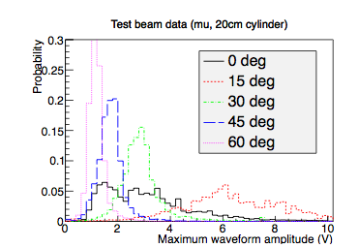
Design: Optical Coupling
From July 2012 test beam data where the PMT were stuck to the bar without any optical material, there was a low angle behavior due to the refraction in air caused by airgap.
Proof of the need of an optical material to couple the PMT with the bar.
Options:
optical glue
silicon gel disk.
Low angle behavior verified with Geant4 simulations by M.Ambrose.

Slide 50
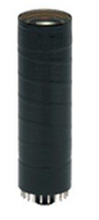
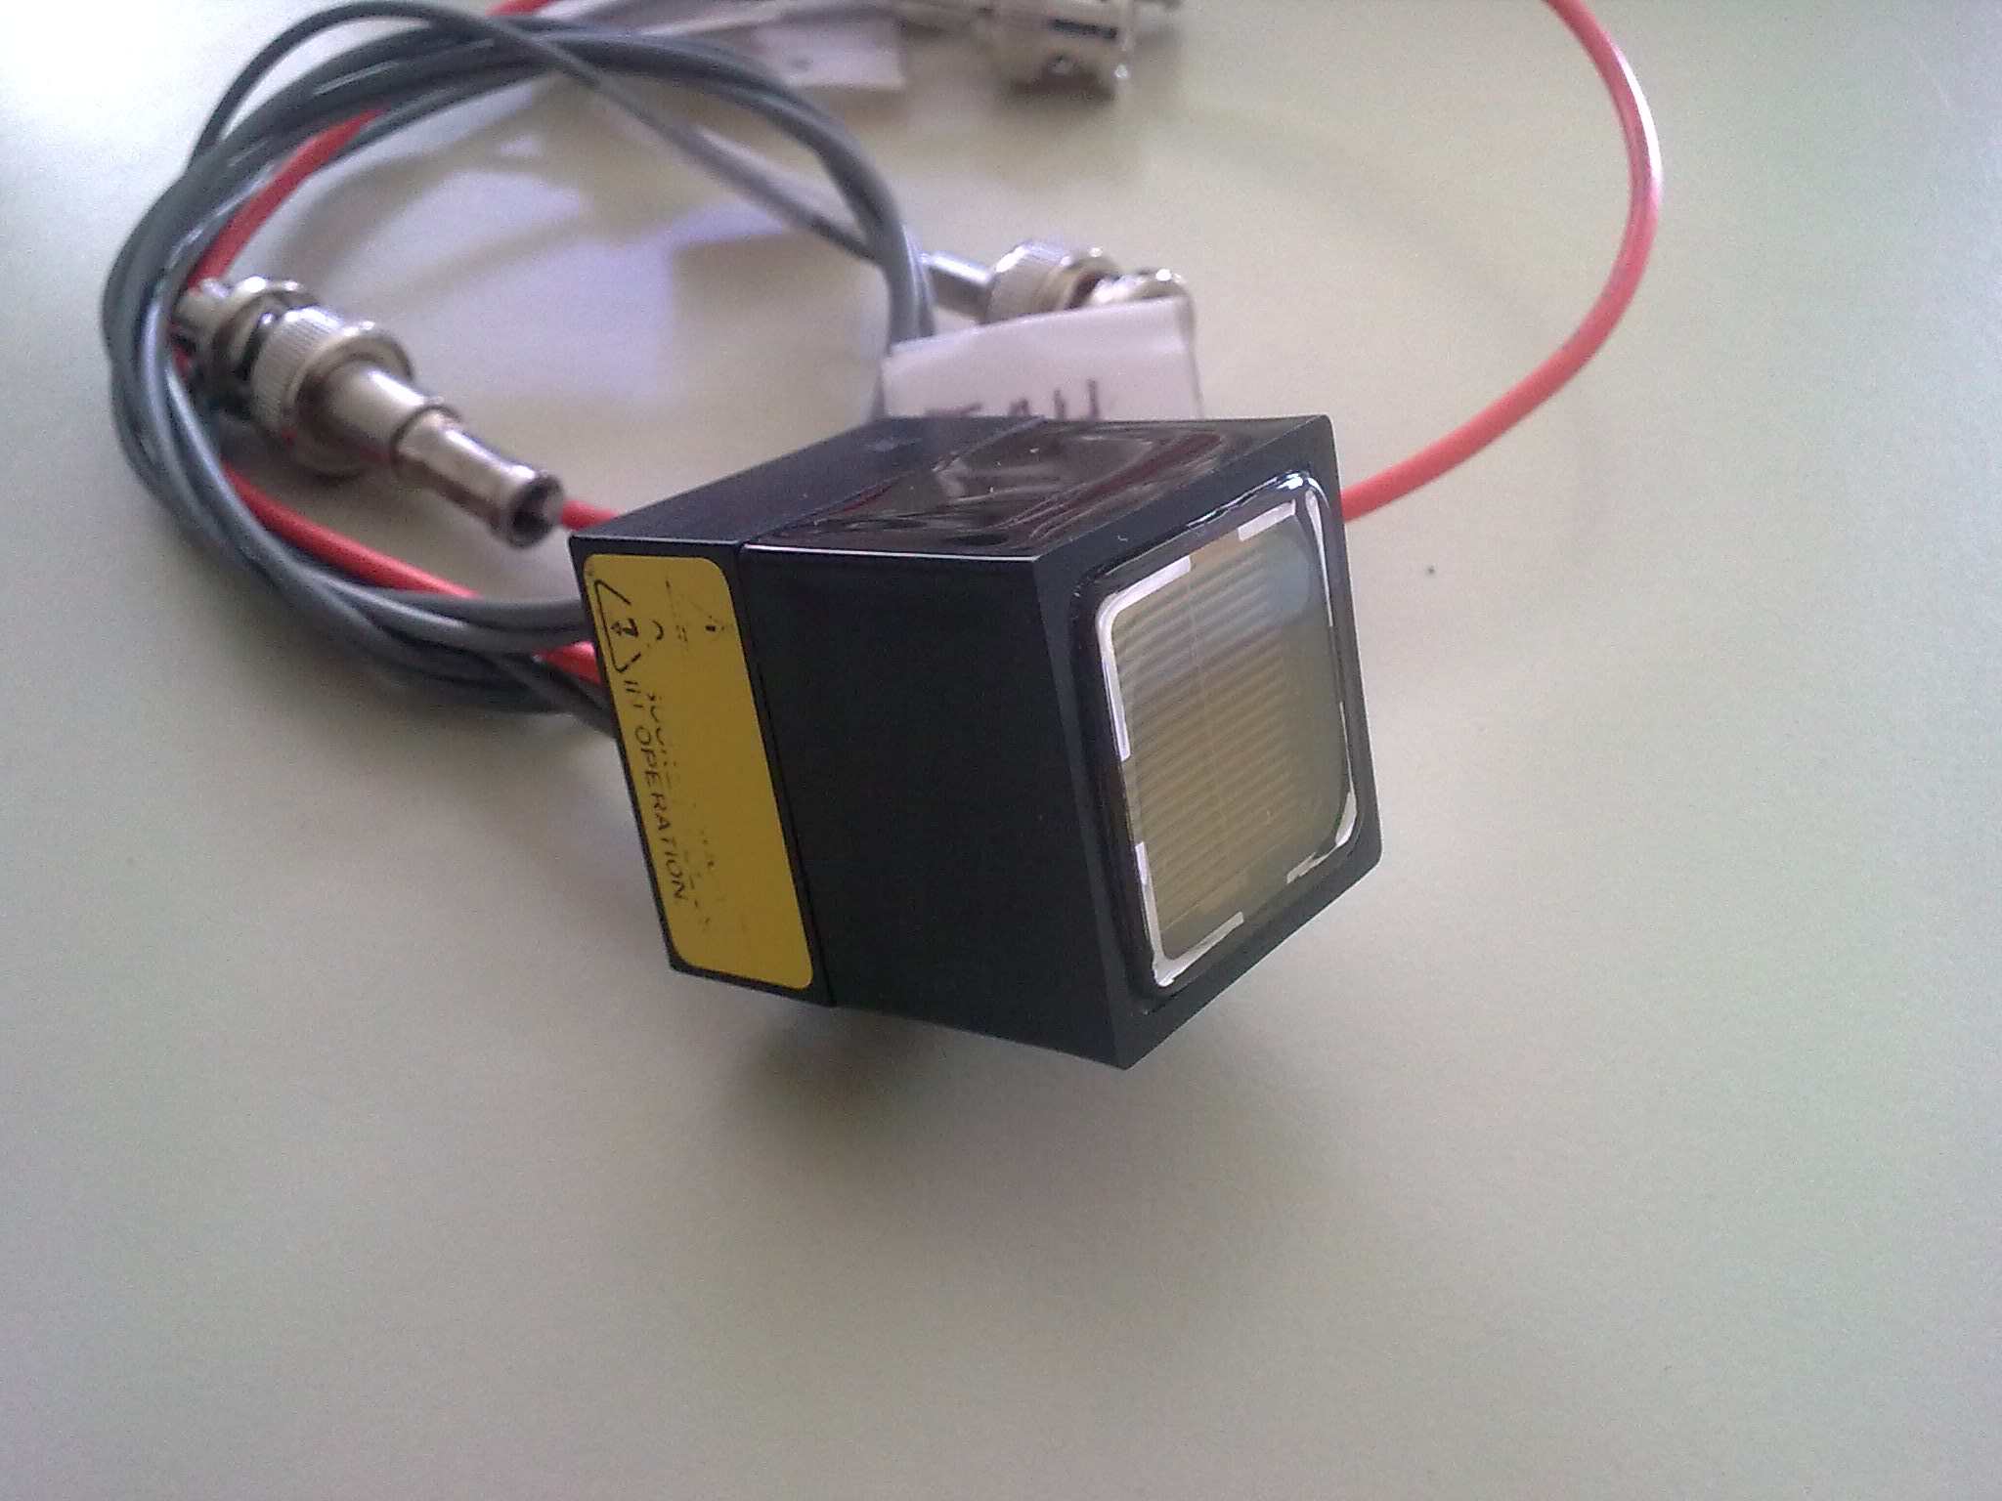
Design: Photomultipliers-Characteristics
Hamamatsu R7600-M4
Hamamatsu R2059
Due to fake hits in the R2059 window started considering R7600-M4 (also used as an upgrade in HF for R7525 )
 | R2059 | R7600-M4
Spectral response | 160 to 650nm | 300 to 650nm
Effective area | d= 46mm | Side= 1.8 x 1.8cm²
 | Area= 16.6cm² | Area=3.24cm²
Rise time | 1.3ns | 1.2ns
#channels | 1 | 2x2
Photocathode shape | circular | square
Window thickness | 1mm-8mm | 0.6mm
Window shape | planoconcave | plane

Slide 51
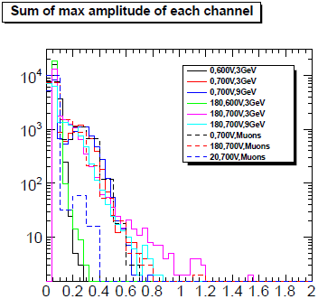
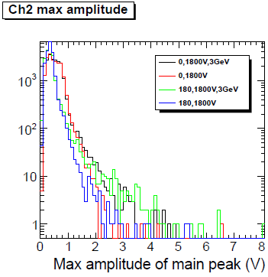
Design: Photomultipliers- Fake hits
From December 2012 test beam, below the signals for 0deg and 180deg signal contribution produced in the PMT windows (no bar measurements).
Both photomultipliers give fake hits.
R7600-M4
R2059
Confirmed also from Geant4 simulations.
Sum of max amplitude of each channel(V)

Slide 52
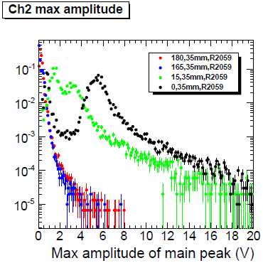
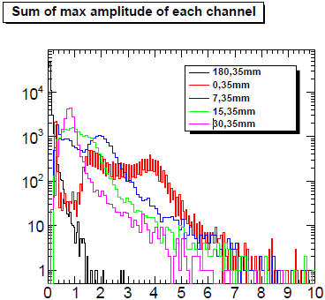
Design: Photomultipliers- Output signal
Maximum amplitude plots for several case from December test beam.
Test beam data still under study.
Lower amplitude fake signal but also real signal for R7600M4 compared to R2059.
Longer bar to set higher threshold.
R7600M4
R2059
Sum of max amplitude of each channel(V)

Slide 53
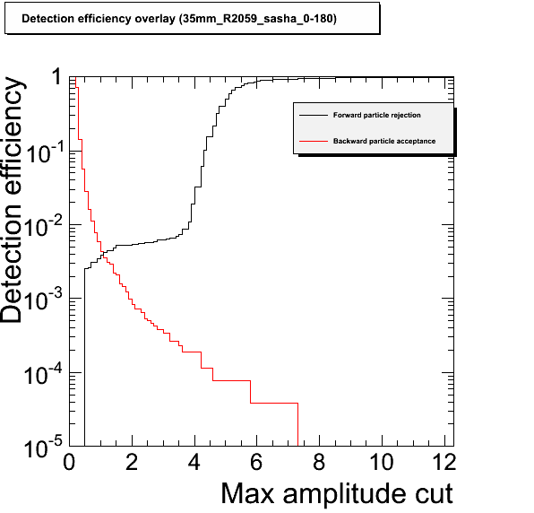
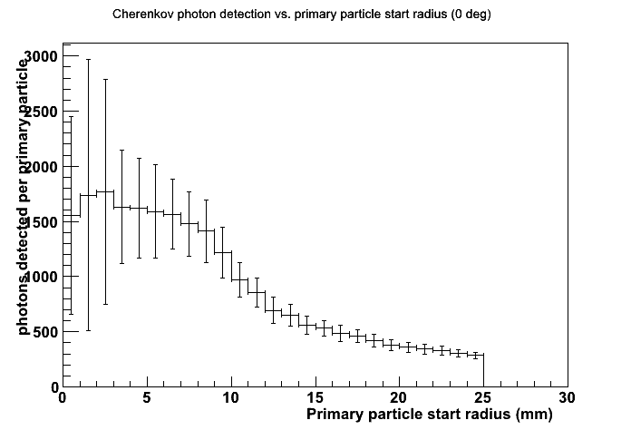
Design: Photomultipliers- Performance with large R bar
From simulations HFPMT seems to lose a lot of photon rate for particles that enter in the outer radius of the bar (r=2.5cm).
Detection efficiency plot for the R2059 PMT, only for particles that went for sure through the r=1.75cm bar (smaller trigger acceptance).
R7600M4
R2059
Dec.test beam data
Geant4
M.Ambrose
R2059
Discrimination Voltage | 1.6V | 4.2V
Backward Acceptance | 0.16% | 0.02%
Forward Acceptance | 99.5% | 94%

Slide 54
Design: Photomultipliers- Choice
RATE
Photocathode area: R2059 (16.6cm²) >> R7600 (3.24cm²)
Radial acceptance: R2059
FAKE HITS
Window thickness: R7600 (0.6mm) << R2059 (up to 8mm)
Both windows contribute (according to test beam and for R2059 confirmed by Geant4).
R7600 provides the feature to reject based on the 4 channels signal => future upgrade option.
A longer bar could compensate the high rate of fake hits in R2059 since it provides the benefit to set a higher threshold.

Slide 55
Design: Summary
The baseline is a 4.5cm diameter, 10cm long bar with R2059 and an optical medium for the coupling.
OPEN QUESTIONS
R2059 VS HFPMT
HFPMT, If we consider an upgrade where the feature of rejecting the fake hits could be used.
HFPMT, if test beam data prove that has good enough directionality.
HFPMT, if for big radius bar and different orientation the acceptance increases sufficiently.
Radiation hardness of the material
Suprasil shows no loss in the UV area but is more expensive.
Optical material for coupling.

Slide 56
Plans.
Use full set of test beam data to decide on the efficiencies of the PMTs.
Apply the FLUKA output results (expected fluxes) to the LUT for the response for the two PMTs and compare.
Finalize the choices for the quartz:
Radius and length depends also on the choice of the PMT and vice versa.
FLUKA activation for Golden Location 6.
Use the rates from FLUKA to decide optimal orientation in the cavern .
Estimate the systematics in Geant4.
Check radiation hardness of optical materials.
Start constructing a prototype.
Test prototype in November.
S
P
R
I
N
G
SUMMER
FALL

Slide 57
Thank you!

Slide 58
BACK-UP slides

Slide 59
MIB-FLUKA

Slide 60
Angle VS Energy MIB
BGE
BΗ
BGΙ

Slide 61
Ekin Vs time MIB
There is a high energy tail that it is produced along the LSS (before the TCTs) but with very few entries.

Slide 62
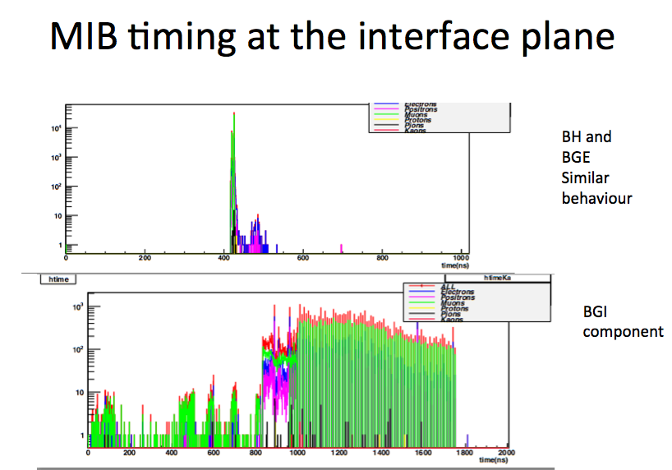
MIB time- components and particle species. Mostly e-+ and mu.

Slide 63
WHERE THE MIB MUONS ARE BORN? Beam halo at TCTs
Most of the arriving particles were born ~450-500ns before -> ~150m away -> TCTs

Slide 64
Pp-products, timing FLUKA

Slide 65
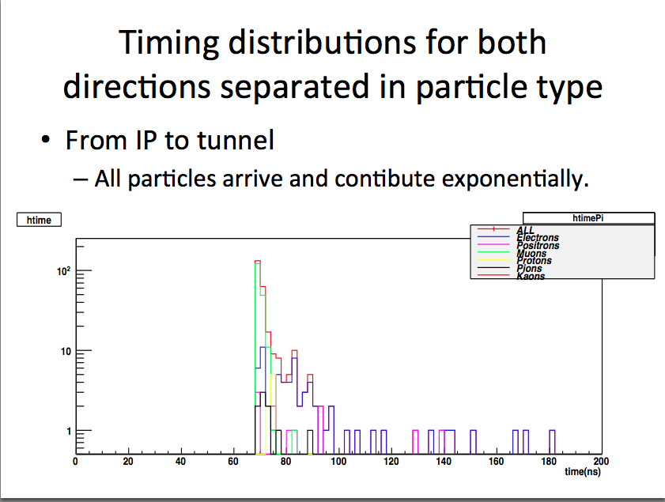
TIMING for pp products from IP to tunnel-particle species

Slide 66
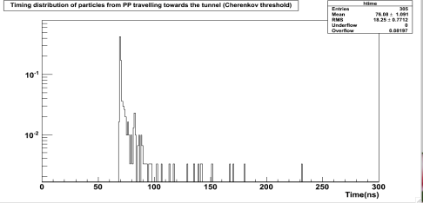
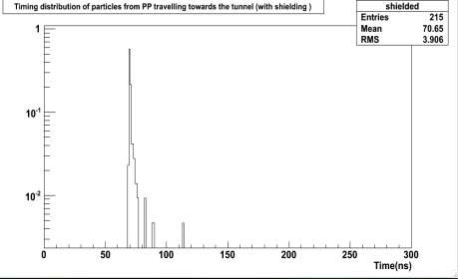
TIMING for pp products from IP to tunnel- shielding & rms
Above Cherenkov Threshold
305 entries,
Rms 18ns
With Shielding (e-+>10MeV)
Shielding and timing are also helping at rejecting most of the background coming from the opposite side of the signal.
215 entries,
rms 3.8ns

Slide 67
TIMING for pp products fron tunnel to IP (fake signal)
PP collision products arriving at the same direciton of the signal (fake signal) sharply in time .
This will allow us to get rid of the fake signal with gating in time.

Slide 68
TEST BEAM SETUP

Slide 69
Test beam setup
Scint.tile
Small
Scint.
beam
Scint.tile

Slide 70
Test beam setup
Scint.tile
Small
Scint.
beam
Scint.tile

Slide 71
RESPONSE FUNCTION

Slide 72
RESPONSE function with R2059 PMT entering from the side of the bar

Slide 73
RESPONSE function with R2059 PMT entering at the front at different radius

Slide 74
RESPONSE function with R2059 PMT entering at the front at different radius

