Slide 1
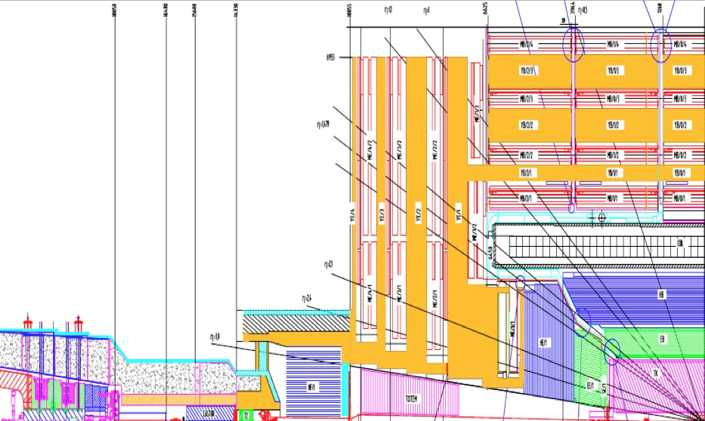
Workshop on CMS Beam Conditions, Radiation Monitoring and Luminosity Systems. Summary & Decisions
➔ LHC
➔ CMS TC
➔ CMS RC
➔ CMS POGs
1st Workshop towards a Common Project !
TLD’s, dosimetry
Radiation
Simulation
MediPix
BHM
Halo Counters
HF RADMON
BCM2L
Abort
BPTX
<-----
HF
Lumi
BCM1L
Abort
BCM1F
Bkd/Lumi
PLT
Lumi
VDM
Scans

Slide 2
BCM Abort Systems
Now two redundant systems.
BCM1L must be rebuilt due to cabling/fixtures/plt
Rebuild as closely as possible to existing version remove dependency on BCM1F (HV / LV boards)
BCM2L Should be rebuilt to move tunnel cards into USC that is good for maintenance
Ensure that at least one system is 100% functional on day -1 of next run
Lay infrastructure for moving BCM2L, prepare all components, but reinstall as 2012 setup pending verification of new BCM1L
Switch to new system during a short stop (Can we do everything without access to the castor table – probably – patch panel level)

Slide 3
Diamonds
Testing underway, but probably we will RIE/re-metalize most (all?) BCM diamonds if tests demonstrate the ability to go to higher HV
Money required for BCM1F & PLT
Choose best poly diamonds for the BCM1&2 Inner locations.
Split mask for new BCMF being metalized this week, tests asap.
Critical decision point approaching: Will we have 24 satisfactory sCVD in time?
5+3 new diamonds in hand
15 diamonds on order CERN (check DESY on order?)
8 (6) “existing BCM1F”
@ the moment we have no contingency for sensor failure
3 months for order
Early June 2013 latest time to launch another order if necessary
Test beam requirements and schedule must be incorporated in planning

Slide 4
BCMF
Baseline for BKGD is first bunch in each bunch train, which has lowest albedo contamination
Backend Priority:
1)MGD/LUT, 2)RHU, 3)Digitizer
Discriminator decision
June 2013
(in order to have contingency to order CD950 if needed)
Cool laser to reduce temperature effects
Cold test in the lab (-10 to 0) of lasers
Split diamonds for lower occupancies
Simulation predicting *6 rates compared to 2012/cm^2! Time/effort to develop de-convolution algorithms essential
Red-light not currently in installation plan…
Zeuthen tests in lab; PLT high rate test beam PSI
cShape design finalised Sep 2013, red light decision needed before August for mechanical; must check CMS integration schedule for fiber pulling for laser or use spare fiber?
Understand polarisation in lab for software correction.

Slide 5
BPTX
Scope crashes were an issue in 2012
p-Pb separate beam “cogging” needs to be addressed. (bptx1,2, orbit 1,2 inputs)
12 bit digitizer, candidate for bunch currents (and potentially other BPTX measurements)
Decision on priority of bunch current measurement required.
Double check firmware / sampling for pulse integration
Decision on bunch current June 2013
Revisit BPTX algorithms in context of clients and manpower

Slide 6
Luminosity Requirements
W/Z Cross section set ultimate offline accuracy goals of ~2%
LHC: 5% absolute online (preferred)
Physics candles important for tracking relative changes, but VDM calibration from first principles remains the fundamental calibration
No reduction in the rate of identifying new factors affecting in the VDM analysis!
Analyses such as pp total inelastic require offline bbb luminosity
LHC: 10% relative bunch-by-bunch online (preferred) or at least corrections into the logging data base, 24 hrs later
Should include “afterglow” corrections
DPG pileup tracking / trigger understanding b-b-b

Slide 7
Luminosity: Systems
HF
Frontend rebuild! New Afterglow correction technique very promising (must be redone with HF PMT), New Pileup analysis required. Algorithms: Occupancy and E_{T} sum
Request beam with single colliding bunch
Request beam with steps in pileup before 2015 VDM scan
PLT
The only dedicated CMS luminometer! Castor prototype was absolutely vital. Can polarization be mastered in time for a full diamond installation (red-light)? Can cooled silicon be prepared in time? Installation review end of May; Date?. Systematic error estimate on lumi essential, rate & time stability.
BCM
Polarization is also an issue, but regional problem averages and time response of frontend is faster
Addition Gain, speed, saturation… should increase efficiency compared to 2012, Polarization Effects less due to 1kV HV; Pileup helped by granularity, #channels … LHC rate goes up too
Minimal goal of backup to HF online is certainly achievable. VDM to Hi-Lumi absolute scaling remains problematic

Slide 8
Luminosity: Calibration and Usage
Many VDM issues and data samples still to be analyzed
Institutionalize responsibility
Additional effort NOW would be very valuable to close some loopholes before the summer
Final number for lumi 2012 end May 2013!
VDM has to be studied for each luminometer, though tools and systematics and corrections to beam effects in common
lumiCalc/DB. 2 solid years of work to prepare

Slide 9
lumiDAQ
Common for all BRIL systems
Histogrammer (phase locked to common lumi nibbles)
Detector specific combiner
Storage manager and Publisher
HFLumiDAQ is first implementer
RHU – we have a proposal to validate that requires TCDS distribution of nibble and section boundaries.
RHU board production to be launched in the summer
Modifications to hardware input/output frozen @ this time
Any changes to hardware must be communicated soon
LHC vs CMS Clock to be considered
Don’t forget Halo Monitors!

Slide 10
brilDQM
Needs to be developed + real time monitoring
Learn from existing DQM
Difference for lumiDAQ
LS-by-LS data
Follow up meeting required

Slide 11
Integration Geant4 CMSSW
Detectors to be integrated into CMSSW
This work should continue
Dedicated meeting on this subject needed
Synergies BCM1F/PLT

Slide 12
Halo Monitor
Excellent design to suppress background from pp at > 10^3 level!
This will be a big improvement to beam background monitoring
Fast time response
Radiation Hard
Basic design is fixed
PMT choice to be finalised in next days
Readout VME or HF?

Slide 13
Radiation Simulation
Build up of manpower
Systematizing the simulation process
Enabling and comparing FLUKA/MARS according to application and collaborator skills

Slide 14
Other Systems
Medipix
Install cables for power over Ethernet for 8 detectors per quarter
Readout setup in BRM Lab in summer 2013 using old readout board/chip
Allows us to learn about system, calibrate with source to learn about sensors
Final readout board/chip
2014
HF Radmon
Not reported here but plan to move readout to our S1 racks and to include in lumiDAQ/DQM

Slide 15
Test Beams
Must validate new BCML, BCMF, PLT, BHM ready-to-install system designs.
Must calibrate BCML before reinstallation
Linearity up to abort thresholds

Slide 16
Thank You!
Yet again the retreat to Zeuthen has proven to be a valuable opportunity to review, regroup and plan for the future
Special thanks to Martina, Maria, Jessica and Wolfgang !

